Slide 1
VTP: VDIF Transport Protocol
Chris Phillips, Alan Whitney, Mamoru Sekido & Mark Kettenis
November 2011

Slide 2
VTP Team
Chris Phillips, CSIRO (chair)
Alan Whitney, MIT Haystack
Mark Kettenis, JIVE
Mamoru Sekido, Kashima Space Research Center
http://www.vlbi.org/vdif
See poster by Whitney

Slide 3
VDIF: VLBI Data Interchange Format
VDIF is intended as a VLBI data interchange format usable for both real-time e-VLBI and non-real time data file formats
Essentially any time based data – e.g. Pulsar baseband data
Frame based format with each frame self-identifying and time tagged
Supports multi-bit data as well as multiple channels in one frame or multiple parallel streams of 1 or more channels
Format ratified at eVLBI2009 in Madrid

Slide 4
VDIF Frame Format
Each Data Frame 32 byte header followed by data array of user specified length
Up to one second in length
Number of Data Frames/second must be an integer
Data Frame may NOT span a second boundary
Data Frame length must be a multiple of 8 bytes

Slide 5
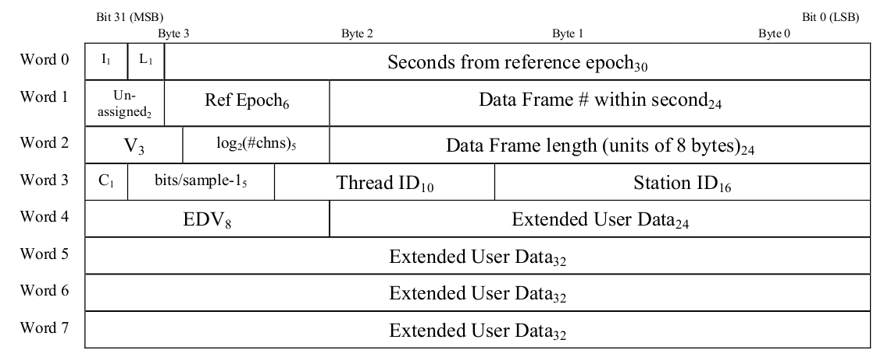
VDIF Frame Format
Frame Header contains
Time in seconds, frame number within second
# channels & bits. “Complex” flag
Station ID, Thread ID, Frame length

Slide 6
VDIF Extensions
Extension versions can be registered to extend VDIF
E.g. Current proposed extension to accommodate non-standard sampling rates

Slide 7
VTP
VDIF just describes format of data – not how to pass if from one place to another.
VTP defines how VDIF frames are sent over commodity networks.
Not relevant to proprietary data connections etc
VTP source generates VDIF data
E.g. samplers – DBBC, RDBE, Mark6 sending pre-recorded data
VTP sink receives VDIF data
E.g. Mark5C, correlator interface

Slide 8
Direct Connection
DAS
Recorder

Slide 9
Simple switched
DAS
Switch
Recorder

Slide 10
Multiple Recorders
Recorder
DAS
Switch
Recorder

Slide 11
Multiple DAS
DAS
Switch
Recorder
DAS

Slide 12
Remote Recording
DAS
Router
Recorder

Slide 13
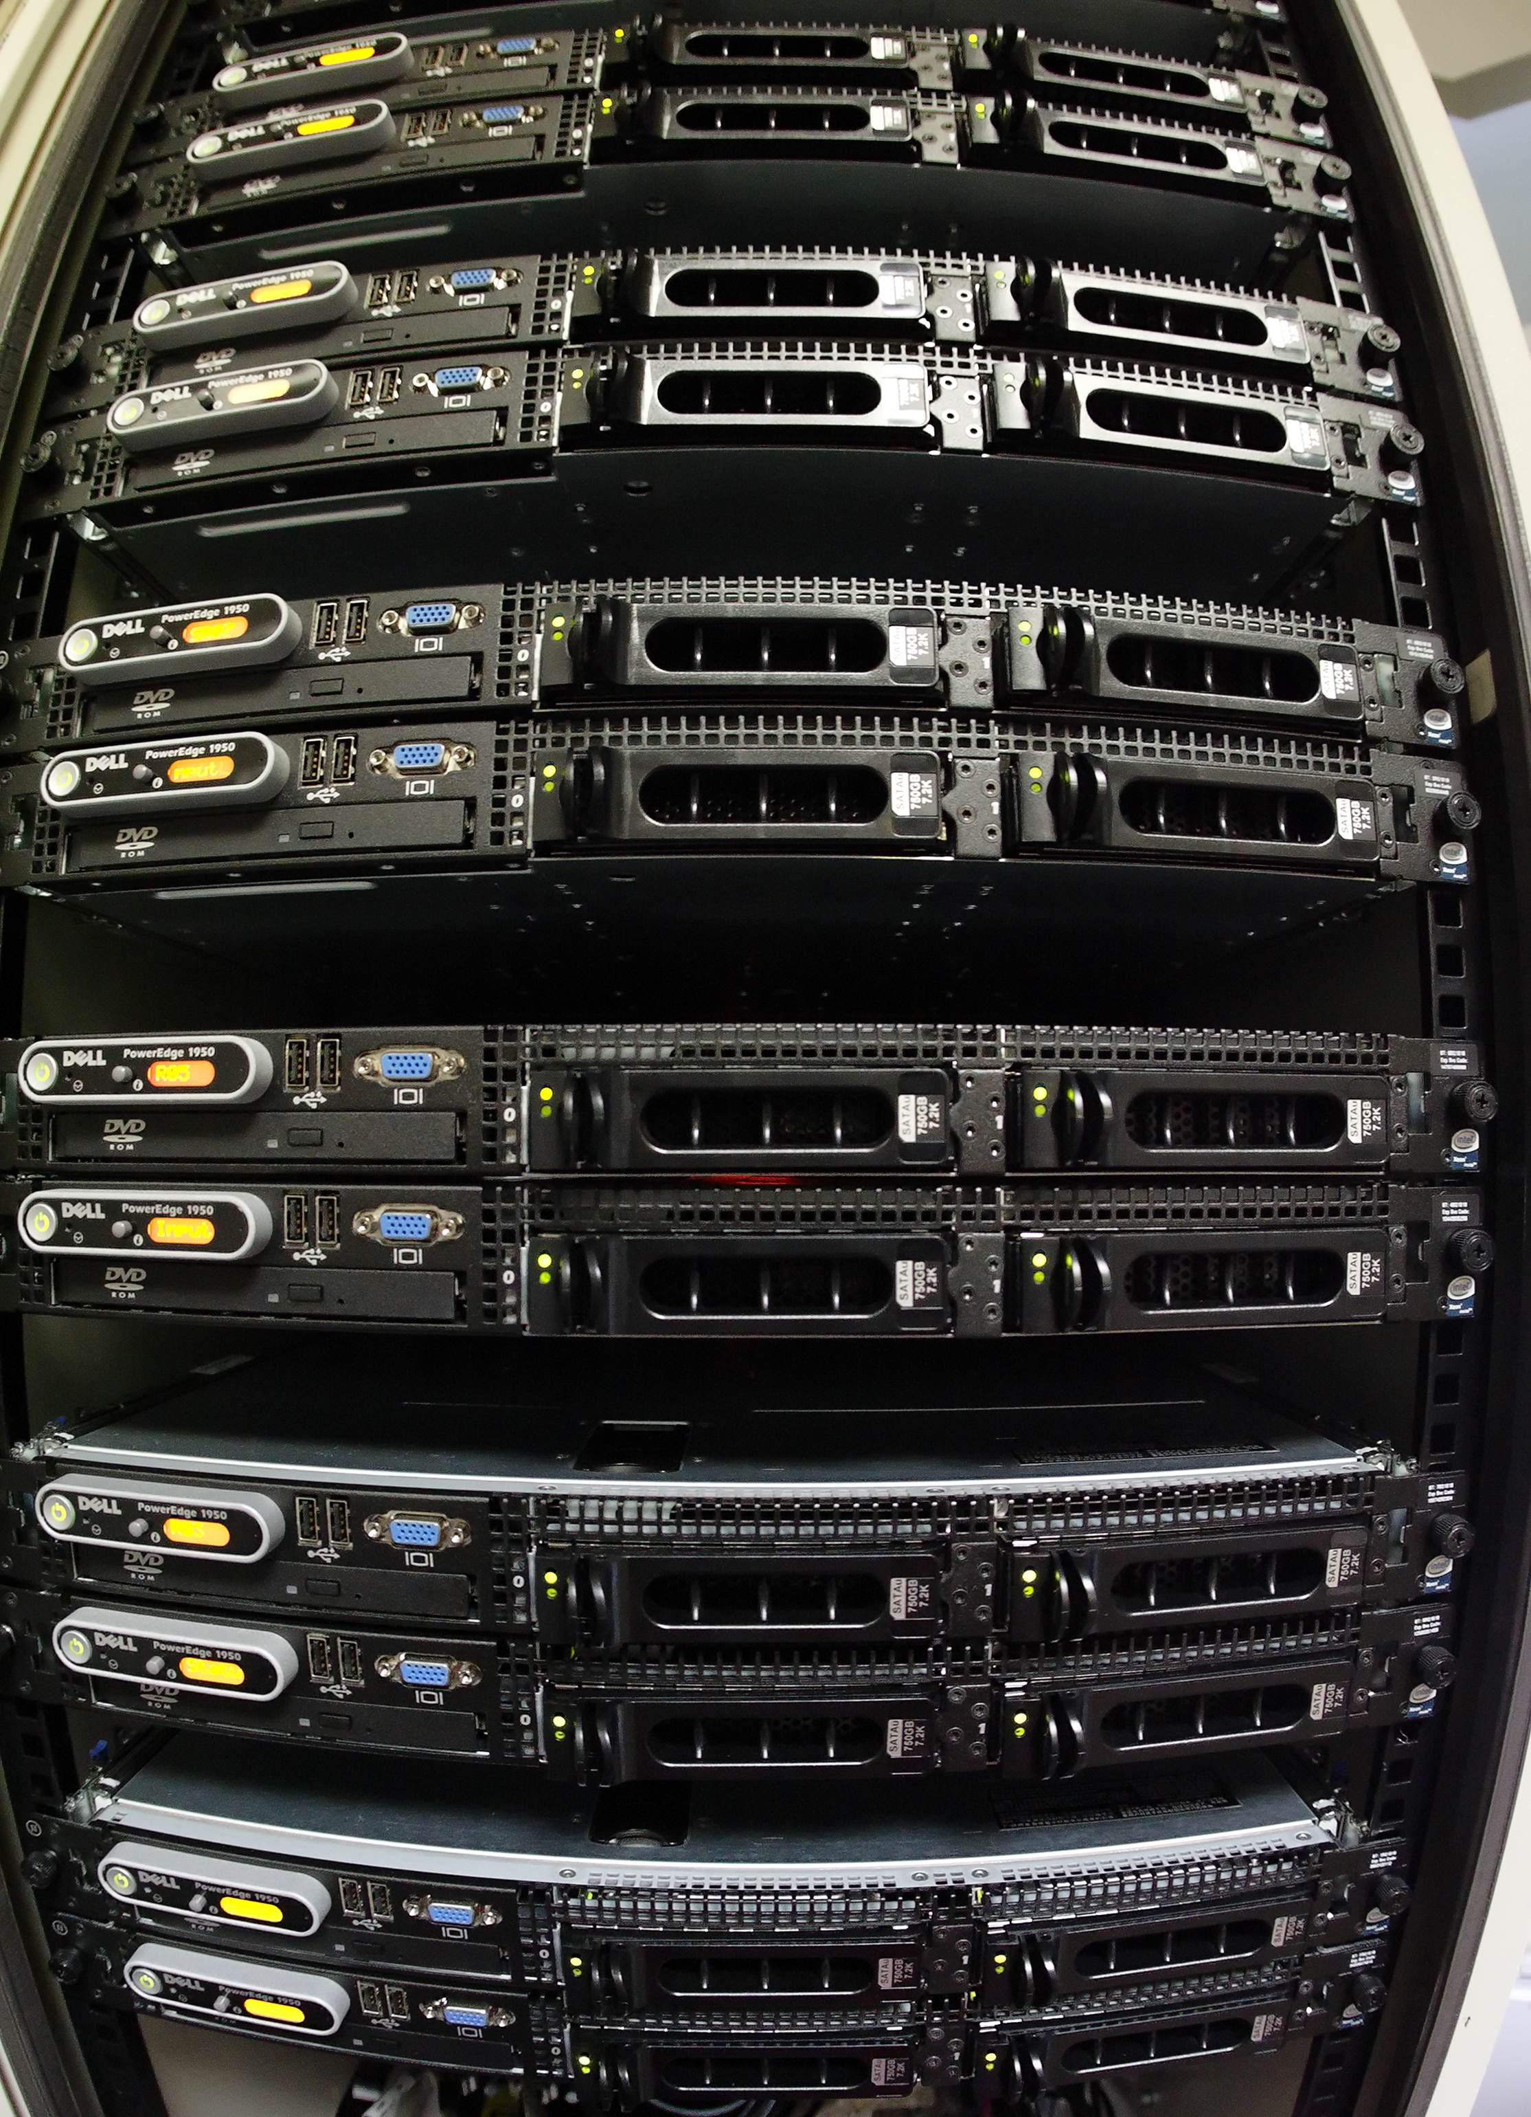
eVLBI
DAS
Router

Slide 14
VTP/TCP
TCP supports connection oriented “reliable” stream
Bytes guaranteed to arrive in-order
No further formatting is required. VDIF frames are sent directly down wire to receiver
Same approach for any other reliable/connection oriented protocol

Slide 15
VTP/UDP
UDP does not guarantee delivery of packets or in-order arrival
VDIF header contains enough detail to resemble frame order, but cannot distinguish packets dropped on network from packets never sent
VDIF supports burst mode transmission
Preface each VDIF frame with unsigned 64 bit sequence number
Sequence Number
VDIF
Frame

Slide 16
VTP/UDP continued
One VDIF frame per UDP datagram
Strongly encourage single UDP datagram per underlying layer (e.g. don’t fragment over multiple Ethernet frames)
Each network stream to use unique sequence numbers
Each stream uses unique port number at sink
Possible multiple threads per stream

Slide 17
Raw Ethernet
Raw Ethernet (ie Ethernet frames without embedded UDP/IP headers possible
Same basic concept as VTP/UDP
When using multiple streams to a single sink need to use source MAC address to distinguish streams
Implies one stream per source

Slide 18
Packet Flooding
Single direction UDP flows have the habit of flooding networks
Receiver MAC address/physical port gets forgotten by switch
Requires receiver to send occasional packet
Sink to send ACK packet with receiver statistics
~once per second
Eliminates network flood problems and allows sink to modify behavior with high packet loss

Slide 19
ACK Packet Structure
struct vtp_ack {
uint32_t sec;
uint32_t nsec;
uint64_t seqno;
uint64_t received;
uint64_t reordered;
};

Slide 20
Next Step?
Request comments from community for the next few weeks
Committee will produce final specification by the end of the year

Slide 21
Thank you
Astronomy and Space Science
Chris Phillips
e-VLBI Project Scientist
Phone: 02 93724608
Email: Chris.Phillips@csiro.au
Web: www.atnf.csiro.au
Contact Us
Phone: 1300 363 400 or +61 3 9545 2176
Email: enquiries@csiro.au Web: www.csiro.au

