Slide 1
Imaging Sgr A* from space Freek Roelofs Heino Falcke, Christiaan Brinkerink, Monika Moscibrodzka, Leonid Gurvits, Marc Klein-Wolt, Remo Tilanus, Manuel Martin-Neira, Volodymyr Kudriashov, Michael Kramer, Luciano Rezzolla 14-05-2018

Slide 2
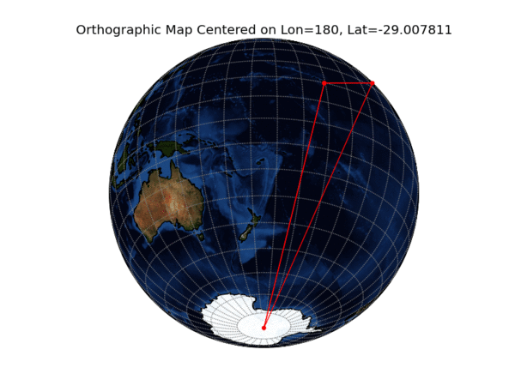
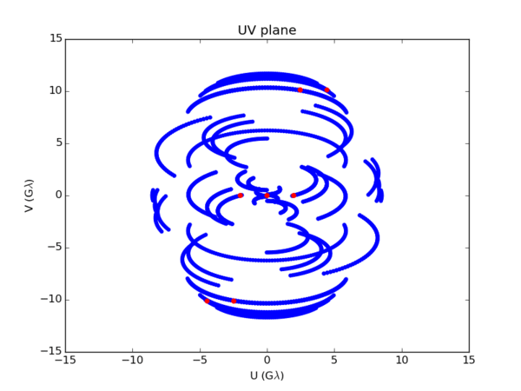
EHT image quality
Limited by array resolution, sparse uv-coverage, atmosphere, interstellar scattering, source variability
Visibilities should be averaged, normalized, and smoothed to mitigate variability
Shiokawa (2013)
Laura Vertatschitsch
Observing 1 day Averaging 8 days + Normalization + Smoothing
Lu, Roelofs et al. (2016)

Slide 3
Space VLBI: new concept
Idea developed in collaboration with ESTEC (M. Martin-Neira)
Two satellites at slightly different orbital radii, observing at high frequencies up to ~690 GHz
Satellites send data and correlate on the fly
Positions determined by GNSS satellites, fringe fitting in post-processing on ground
May be suitable for Medium-class ESA mission
Collaboration with ESA to assess engineering challenges (V. Kudriashov, M. Martin-Neira)

Slide 4
Space VLBI: high uv-coverage

Slide 5
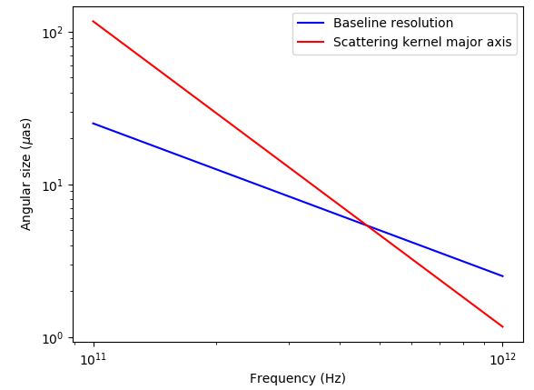
Moving towards higher frequencies (690 GHz)
Increased angular resolution (up to 4 μas, EHT resolution 22 μas)
Emission originating close to the black hole: GR effects dominate
Only small interstellar scattering effects
Not possible from Earth due to water vapor in atmosphere
Bower et al. (2006)

Slide 6
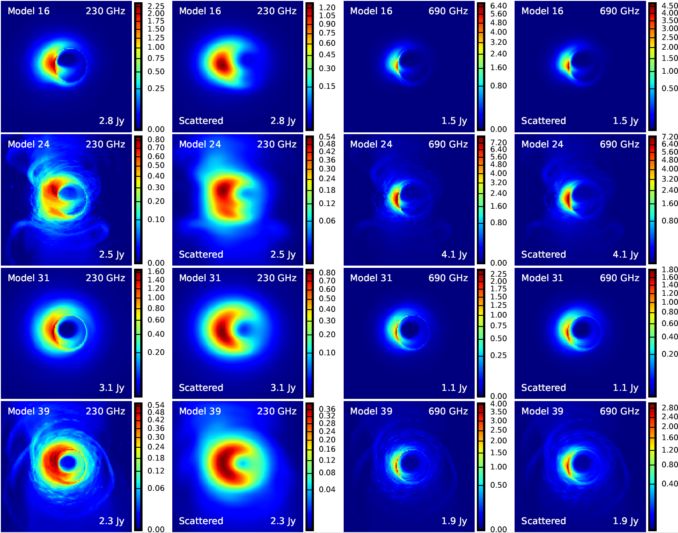
Sgr A* models, 230 and 690 GHz (Moscibrodzka+ 2014)
i=60 deg, disk emission
i=60 deg, jet + disk emission
i=30 deg, disk emission
i=30 deg, jet + disk emission

Slide 7
Noise parameters
Noise from parameters estimated at ESTEC

Slide 8
SNR of simulated visibilities (scattered models)
Noise from parameters estimated at ESTEC
SNR can be improved by gridding uv-plane and integrating for multiple iterations (months) of the spiral

Slide 9
Gridding and averaging visibilities
SNR maps with varying integration time and dish diameter

Slide 10
FFT of gridded visibilities

Slide 11
Reconstructions for different models
EHT
230 GHz
EHI
230 GHz
EHI
690 GHz

Slide 12
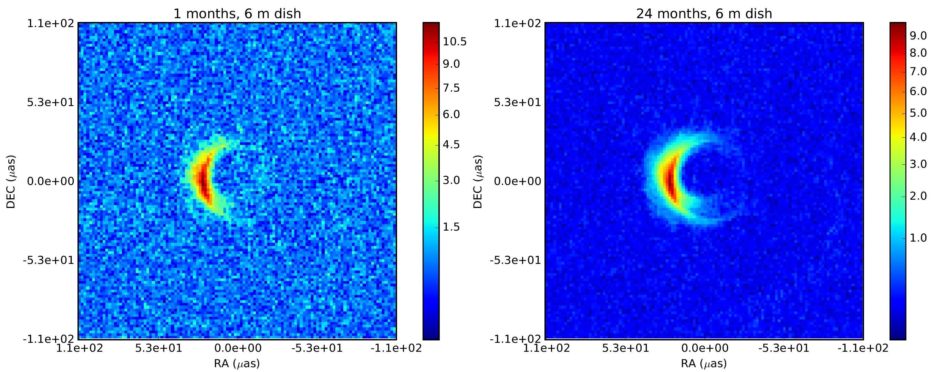
Source and scattering variability
Observed GRMHD movie with changing scattering screen

Slide 13
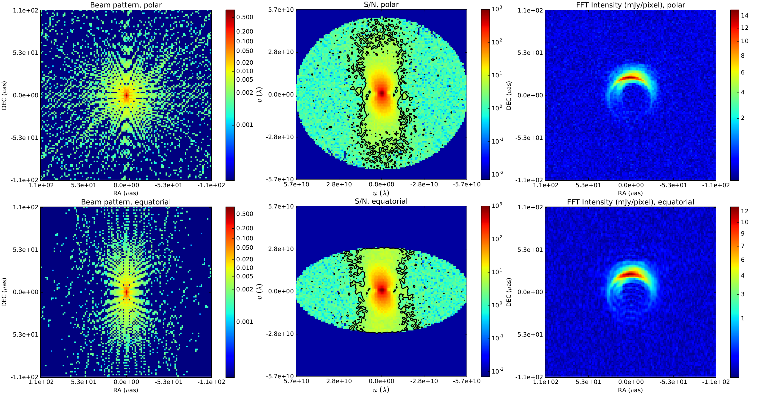
Effect of declination
Beam pattern, SNR, and FFT for polar and equatorial orbits, given the -29 deg declination of Sgr A*

Slide 14
Conclusions
Two-element space VLBI is interesting due to
High uv-coverage
High frequencies
Long baselines
With uv-gridding and long integration, high SNR measurements can be obtained
An image with remarkably high resolution and fidelity (much higher than with ground telescopes) can be reconstructed
More investigations should be done into feasibility of orbit determination, clock stability, and reducing noise
Technical concept and engineering studies: papers in prep. by M. Martin-Neira et al. and V. Kudriashov et al.
Simulation paper submitted to A&A

Slide 15
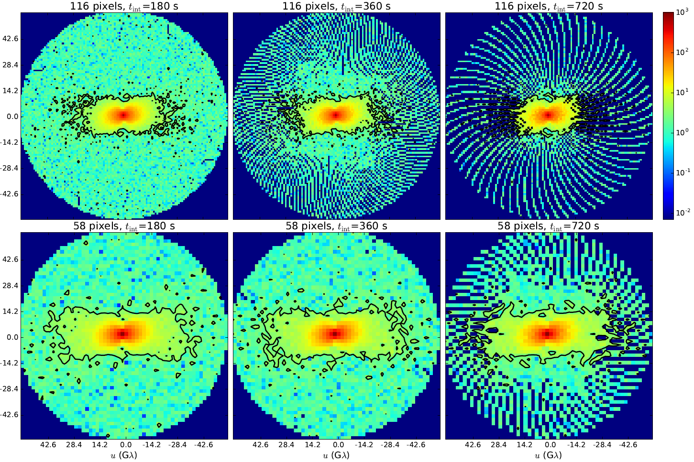
Varying integration time and grid cell size

Slide 16
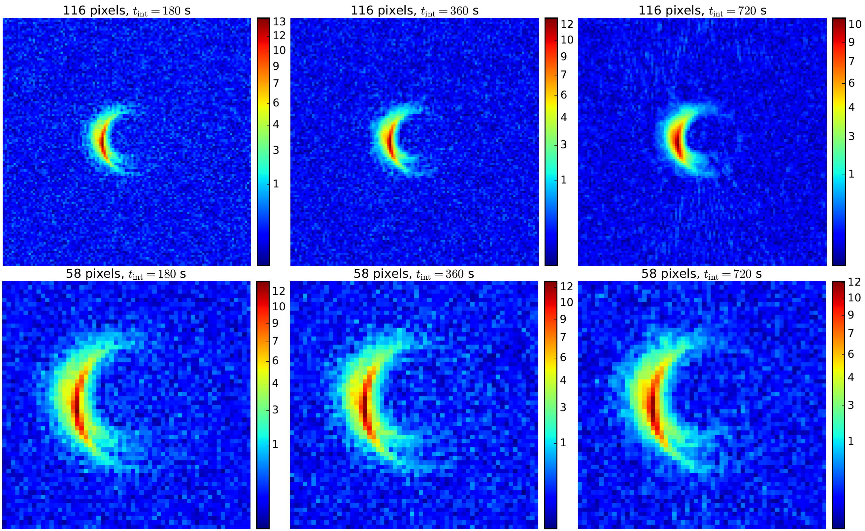
Varying integration time and grid cell size

