Slide 1
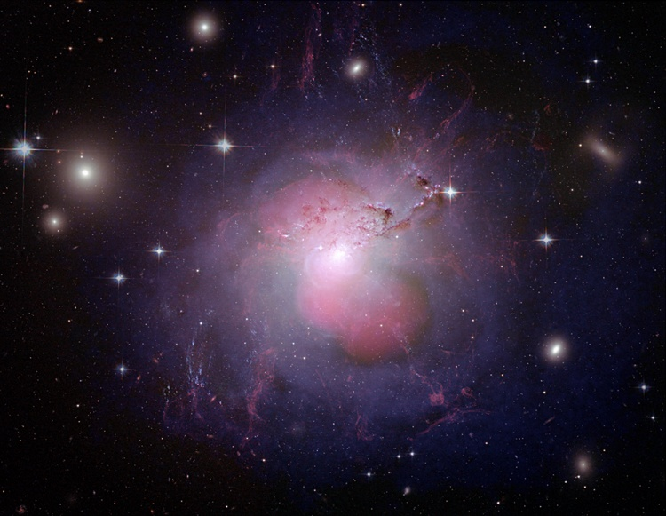

The AGN activity of NGC1275 and the ubiquity of AGN in cool core clusters
Alastair Edge
Durham University

Slide 2
….or……
The rise and fall
(and rise again) of NGC1275!
Alastair Edge
Durham University

Slide 3
Apologies for Absence
I would like to thank the organisers for allowing me to give my talk by proxy (and also my proxy for giving it!).
I was really looking forward to being with you all to discuss the most interesting source in the Universe but personal commitments mean I can’t.

Slide 4
NGC1275 – lessons from history
NGC1275 holds an important position as being an archetypal object in a number of different astronomical “special interest groups”!
Brightest Cluster Galaxy in a cool core cluster
Gamma-ray detected radio galaxy
BLLac/AGN hybrid
Target to search for Dark Matter annihilation in

Slide 5
NGC1275 – lessons from history
As such it is worth reviewing the full span of our observations of it to understand its evolution since 1960.
Any variation on this timescale relates to the accretion on to the central black hole and/or the impact on the jet on parsec scales.
Starting with the GHz radio regime…..

Slide 6
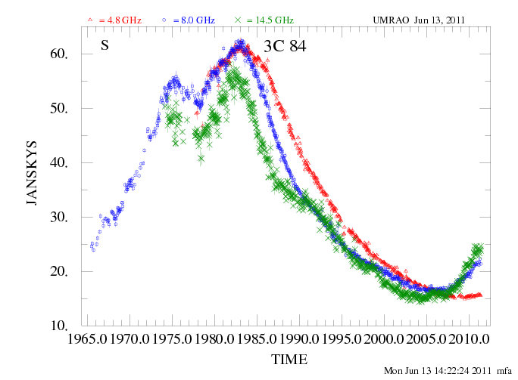
UMRAO Michigan radio monitoring (thanks to Margo and Hugh Aller)

Slide 7
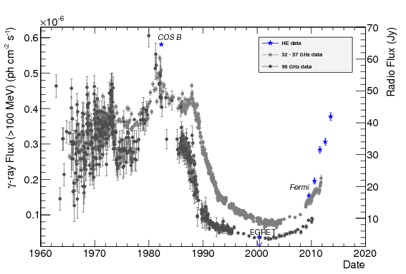
High Frequency radio variability Dutson et al 2014

Slide 8
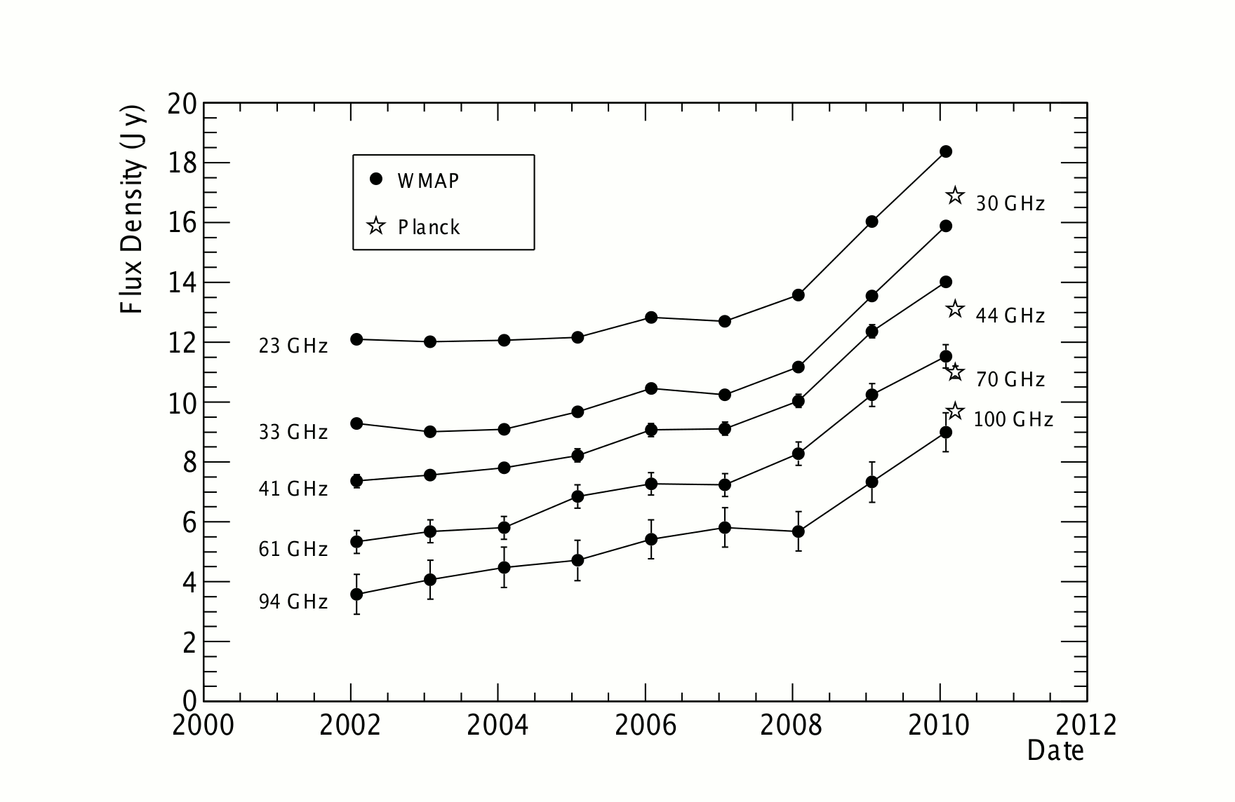
NGC1275 as seen by CMB satellites Dutson et al 2014

Slide 9
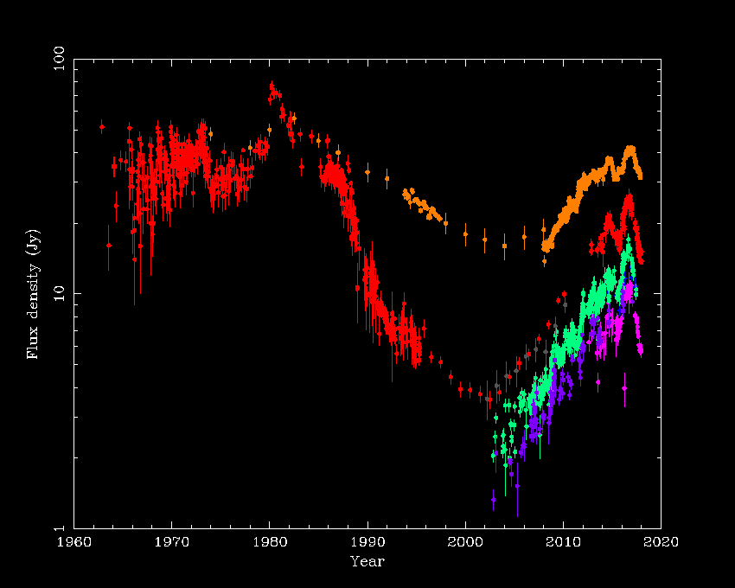
High Frequency radio variability – over 60 years!
UMRAO + OVRO 15GHz
90GHz
230GHZ
350GHz

Slide 10
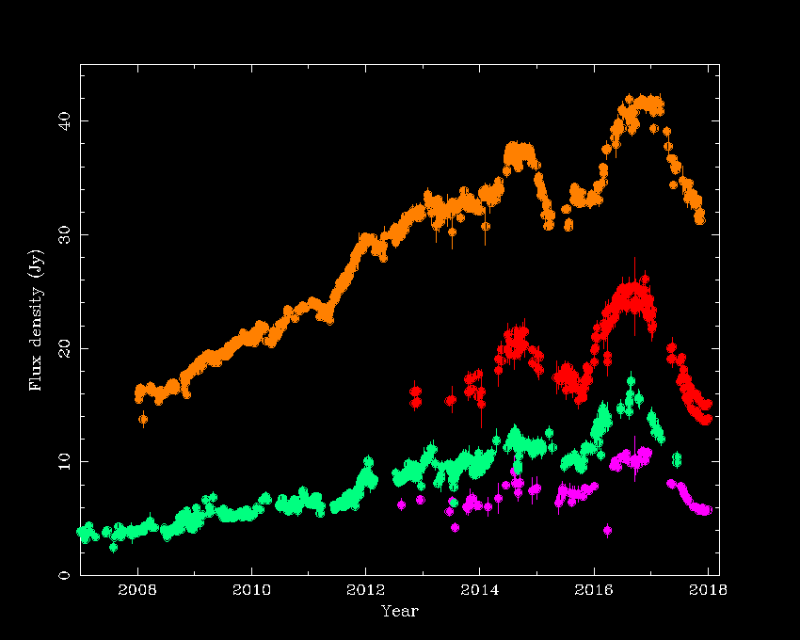
High Frequency radio variability – Fermi operational
OVRO 15GHz
ALMA 91GHz
ALMA 103GHz
SMA 230GHZ
ALMA 343GHz

Slide 11
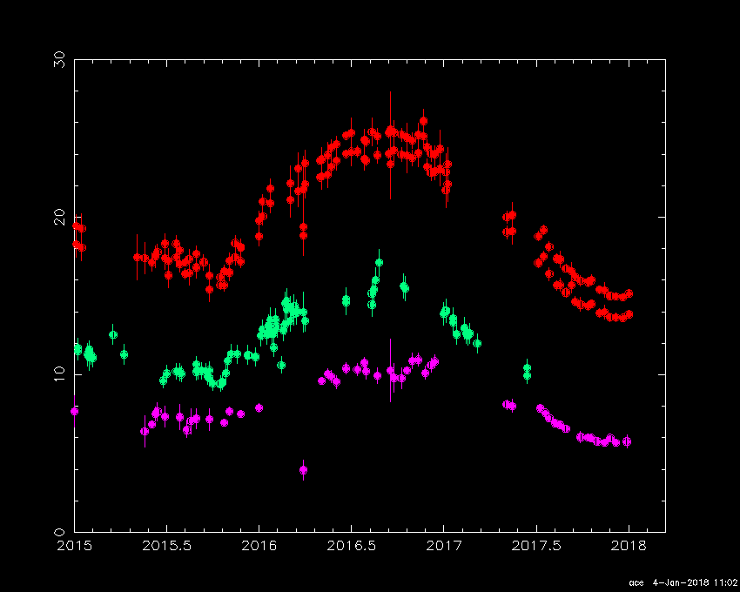
High Frequency radio variability – most recent ALMA and SMA
ALMA 91GHz
ALMA 103GHz
SMA 230GHZ
ALMA 343GHz

Slide 12
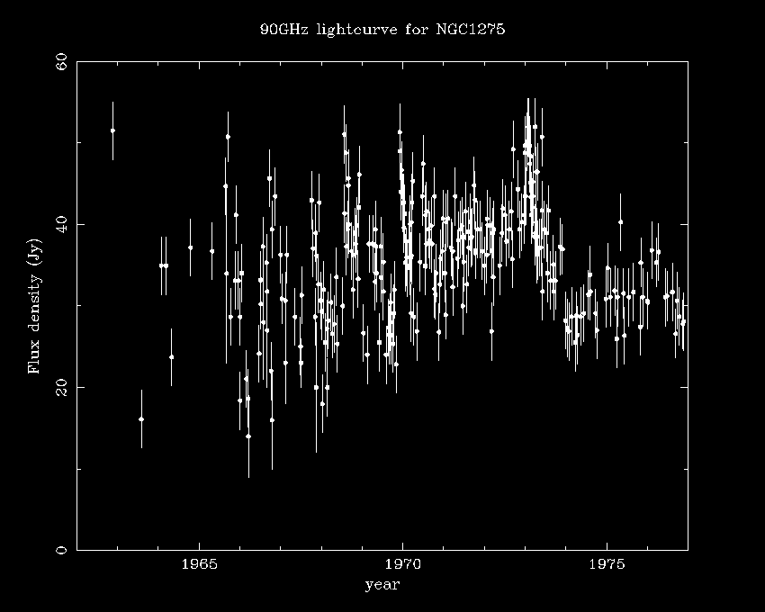
High Frequency radio variability - Early 3mm data
Dutson et al 2014
Similar Oscillations!

Slide 13
History Repeating! – a two year outburst cycle?
ALMA 91GHz
ALMA 103GHz
SMA 230GHZ
ALMA 343GHz

Slide 14
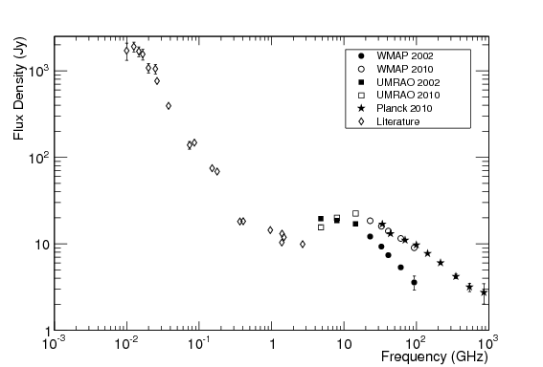
Full radio spectrum Dutson et al 2014
1982 peak fluxes
Current fluxes
2002 Low state
2010 rising state

Slide 15
NGC1275 as a BCG archetype?
The Brightest Cluster Galaxies (BCGs) in cool core clusters are similar to NGC1275 in that they also exhibit extended optical emission line nebulae, cold molecular gas reservoirs, recent star formation and a powerful radio source.
How similar are the radio properties?
Let’s first consider a single frequency radio power….

Slide 16
1.4GHz Radio luminosity function of BCGs with and without lines
from combined X-ray sample of >750clusters (BCS/eBCS/REFLEX)
Almost 100% detection rate = UBIQUITY
With Optical Lines
i.e. Cool Core
NGC1275 is in the
upper quartile of radio
power in the sample
NGC1275
Without Optical Lines
i.e. non-Cool Core
Hogan et al (2015a)

Slide 17
Is NGC1275 unusual in its radio SED?... NO!
from Hogan et al (2015a)

Slide 18
How do you interpret such strange spectra?!
“Core”
“Steep”

Slide 19
Cool cores have a large variety of core to steep component fluxes
Core vs extended emission for line emitting BCGs
from Hogan et al (2015a)
NGC1275
CORE
Core >> Steep
Core = Steep
Hydra A
Activity now!
Her A
Steep >> Core
STEEP
Activity averaged over many 10’s Myrs

Slide 20
Whereas non-cool cores don’t! Relatively few BCGs in these systems have a core
Core vs extended emission for non-line emitting BCGs
from Hogan et al (2015)

Slide 21
The radio cores in cool core clusters are >100 times more powerful
10GHz Radio luminosity function of cores with and without lines
NGC1275 in upper 10%
of sample in core power
in lowest observed state
NGC1275 in upper 5%
in highest observed state
With Optical Lines
Without Optical Lines
Hogan et al (2015a)

Slide 22
1GHz Radio luminosity function of steeper spectrum emission with and without lines
NGC1275 is close to median of
sample in extended power
With Optical Lines
Without Optical Lines
Hogan et al (2015a)

Slide 23
Also core components vary!
Few BCG sources other than NGC1275 have been monitored to allow us to search for longer term variability consistent with the >30 year cycle of NGC1275.
However, the OVRO 40m has been monitoring a sample of 16 BCGs with a core brighter than 100mJy (as well as NGC1275) for the past 6-10 years (Hogan et al 2015b).

Slide 24
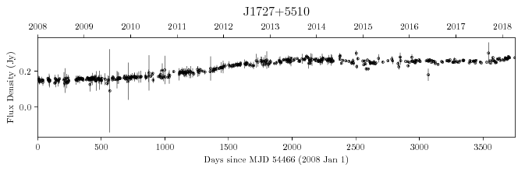
OVRO 40m 15GHz monitoring of the BCG in A2270 (J1727+5510)
Hogan et al (2015b)
16 other sources monitored: two varied by factor 2, three more by >+/-30%,
five between 20% and 30%, seven <20%, i.e.~half sample vary more than 20%
Decade long monitoring at >10GHz is vital to study this issue!
A role for ALMA, KVA, NOEMA and ngVLA in the SKA era!

Slide 25
Compare them to NGC1275 UMRAO lightcurve!
Only period in which a
factor of two increase
would be found
i.e. ~10% of sampled period
6 years
Whereas most others vary by ~20-30%

Slide 26
NGC1275 in its wider context
So from a large parent sample of >750 X-ray selected clusters we can identify many sources with the same characteristics as NGC1275 in terms of radio activity on month to Myr timescales from their core variation to their radio lobe properties!
The MIR, optical, X-ray and gamma-ray properties of their AGN are similar too.

Slide 27
What is in store in the near future?
The radio/sub-mm emission we see appears to lag the optical and gamma-ray variability we observe by at least a year.
We have been monitoring NGC1275 in BVRI using a robotic 0.5m telescope on La Palma since 2015 to test this.
Watch this space!

Slide 28
Conclusions
NGC1275 started brightening when I was born.
It reached maximum brightness as I started my astronomical career.
I hope it will reach maximum brightness again before I retire…..!

