Slide 1
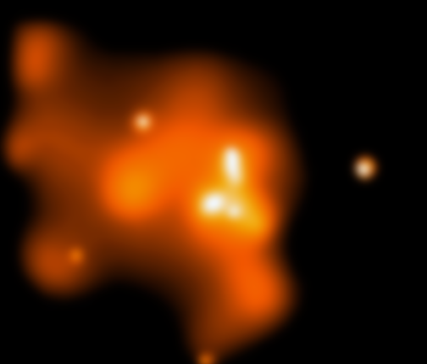
AGN Feedback in an Isolated Elliptical Galaxy
—elaborating the AGN physics
Feng Yuan
Shanghai Astronomical Observatory, CAS
Collaborated with:
D. Yoon, Y. Li, Z. Gan, F. Guo (SHAO)
L. Ho (KIAA-PKU)
J. P. Ostriker (Columbia University)
L. Ciotti (University of Bologna)
R. Narayan (CfA)
A. Sadowski (MIT)
D. Bu (SHAO)
X. Bai (CfA/Tsinghua)

Slide 2
Outline
Brief introduction to AGN feedback
Accretion physics
  Two accretion modes: cold & hot
  Wind & radiation in the two modes
Numerical study of AGN feedback
Results: lightcurve; duty-cycle; star formation; BH growth

Slide 3
What is AGN feedback?
Mechanical & Radiative feedback
Key issues for feedback:
How to determine the mass
accretion rate of BH ?
For a given Mdot, what are
the outputs from AGN?
wind
radiation
Jet
Gas fueling
AGN
Bondi radius
ISM

Slide 4
Previous works & our motivations
Often focus on large scale: ~100pc to several tens kpc; (Di Matteo et al. 2005; Springel et al. 2005; Debuhr et al. 2010, 2011; Johansson et al. 2009; Li et al. 2015; Illustris…)
  only resolve galactic length and timescale
  Model for feedback physics:
    Mdot estimated
    Subgrid; parameterized; outputs not properly described
Our goals:
  Resolve the accretion (Bondi) and galaxy scales
  Adopt the most updated sub-grid AGN physics
  Calculate the interaction between wind & radiation with ISM

Slide 5
Two accretion modes: cold & hot
Pringle 1981, ARA&A; Yuan & Narayan 2014, ARA&A
Super-Eddington accretion (slim disk)
(Abramowicz et al. 1989; Sadowski et al. 2014; Jiang et al. 2014)
TDEs, ULXs, SS433
SEAF
0
Standard thin accretion disk
(Shakura-Sunyaev 1976;
Pringle 1981, ARA&A)
Typical QSOs, Seyferts; XRBs in thermal soft state
SSD
-2
-2.5
LHAF
Hot Accretion: ADAF & RIAF
(Narayan & Yi 94; Yuan 2001;
Yuan & Narayan 2014, ARA&A)
LLAGN, BL Lac objects, Sgr A*, M87
XRBs in hard & quiescent states
ADAF

Slide 6
Cold accretion mode (I)
Shakura & Sunyaev 1976, A&A; Pringle 1981, ARA&A
Correspond to quasar (cold) feedback mode
Cool: ~10⁶ K, Geometrically thin & Optically thick
Outputs: strong wind & radiation, but no jet (?)
Radiative efficiency
  standard thin disk: ~0.1
  Super-Eddington: ~0.1 (?)

Slide 7
Cold accretion mode (II): wind
Shakura & Sunyaev 1976, A&A; Pringle 1981, ARA&A; Gofford et al. 2015
Many observations: BAL quasar, UFO, warm observer…
Wind production mechanisms:
  thermal+magnetic+radiation (line force)
Wind properties: mass flux & velocity (from observations, e.g., Gofford et al. 2015)

Slide 8
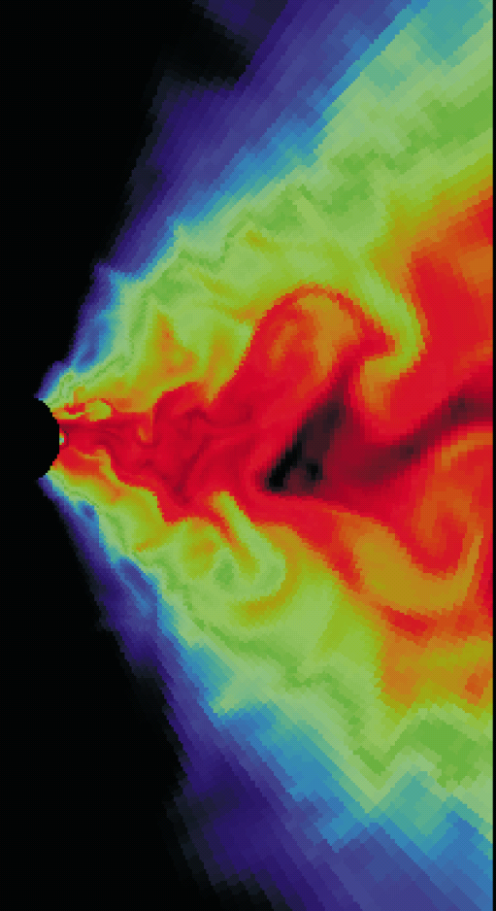
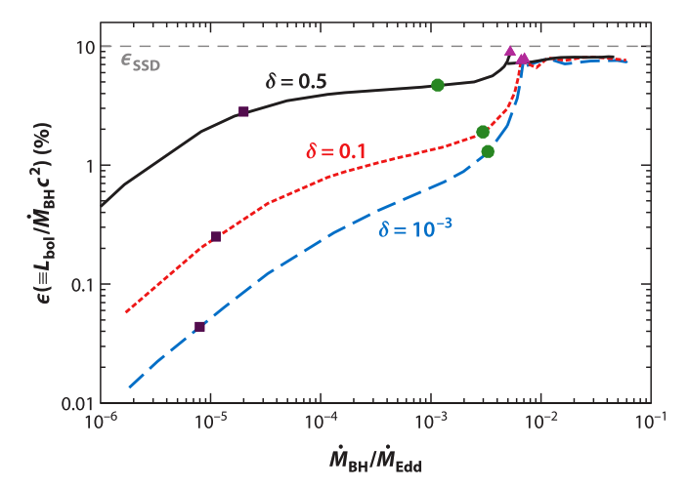
Hot accretion flow (I)
Yuan & Narayan 2014, ARA&A
Correspond to kinetic (radio/jet) (hot) feedback mode
Hot, geometrically thick; Optically thin; Spectrum: complicated
Outputs: radiation, wind & jet
Radiative efficiency
  A function of Mdot →
Xie & Yuan 2012

Slide 9
Hot accretion flow (II): wind
----Defu Bu’s talk in Friday afternoon
Observational evidences:
  Hard state of black hole X-ray binaries (Homan et al. 2016)
  Sgr A* (Wang et al. 2013, Science)
  LLAGN (Cheung et al. 2016, Nature)
  Radio galaxy (Tombesi et al. 2010, 2014)
    Blue-shifted iron absorption lines
    Winds co-exist with jets
But wind properties still poorly constrained
Theoretical studies:
  Yuan et al. (2012): show the existence of wind
    Confirms the assumption of ADIOS
  Yuan et al. (2015): wind properties (based on 3D GRMHD simulation data)
    Mass flux; velocity; angular distribution..

Slide 10
Special wind — disk-jet — jet sheath??
Yuan et al. 2015; Yuan & Narayan 2014,ARA&A
disk-jet
BZ jet
Angular distribution of wind
Angular distribution of wind speed
Disk-jet
  Originate from disk (not BH); present even for a=0
  Gas-rich (not Poynting flux)
  v~0.2-0.4 c
  Accelerated by gradient of toroidal magnetic field; so not BZ nor BP, but Lynden-Bell (1996) mechanism
  Just outside of BZ jet --- sheath?
wind

Slide 11
Momentum/energy fluxes of wind/radiation in cold/hot accretion(feedback) modes

Slide 12
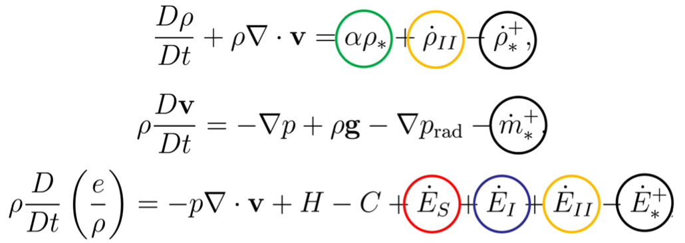
Hydrodynamical Equations
Stellar mass loss from dying stars
Gas depletion of star formation
Feedback of Type II supernovae
Feedback of Type Ia supernovae
Thermalization due to stellar
dispersive motion
Physics included in the model:

Slide 13
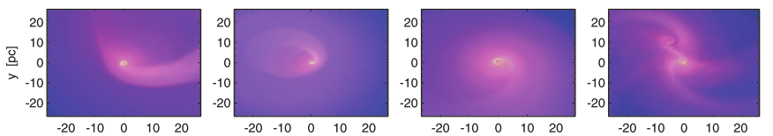
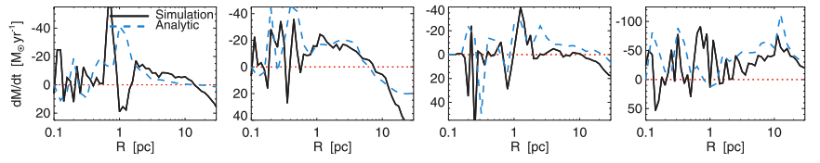
Angular Momentum Transport
Yoon et al. 2018
Magneto-rotational Instability (MRI; Stone+99,01)
Gravitational Instability (Gammie 01)
Anisotropic Gravitational Torque (Hopkins+10,11)
  This is what we adopt
  We use alpha description to mimic it

Slide 14
Galaxy Model
We focus on the cosmological evolution of an isolated elliptical galaxy.
Gas source
only stellar mass loss during their cosmological evolution
BH
Stars
Dark Matter
Gravity
Super massive black hole
Stellar population
Dark matter halo
But no gravity from interstellar medium
Li&Bryan2012

Slide 15
Contribution of SN Ia to energy
Ciotti, Ostriker et al. 2009
Massive stars (SNe II) died before the simulation starts due to their short lifetime.
But SNe Ia can be triggered by accretion or merger events of neutron stars/white dwarfs,
Each SN Ia releases energy in an order of 10^51 erg !

Slide 16
Star Formation
We estimate SFR using the standard Schmidt-Kennicut prescription:
We also consider SNe II among the newly formed stars.

Slide 17

Radiative Heating & Cooling
Sazonov et al. 2005
Net energy change rate per unit volume:
$$\dot{M}\dot{=n^{2 }(S^{1}+ S^{2}+ S^{3}})$$
Bremsstrahlung cooling
Compton heating/cooling
photoionization heating, line and recombination cooling

Slide 18
Compton temperature T_{c}
Compton heating ~ (Tc – TISM)
Definition of Tc
In cold (radiative/quasar) mode (Sazonov et al. 2004):
Tc ~ 10⁷ K
In hot (kinetic/radio) mode (Xie, Yuan & Ho 2017):
(This is because the SED of LLAGN is different from luminous AGNs: more hard photons)
Tc ~ 10⁸ K

Slide 19
Setup of Numerical Simulation
Yuan et al. 2018; Yoon et al. 2018
ZEUS-MP code: 2D + hydro + radiation
From 2.5 pc (~0.1 Bondi radius) to 250 kpc
Evolve for cosmological time (~12 Gyr)
Mdot self-consistently determined
two accretion/feedback modes discriminated according to Mdot
Inject wind & radiation from inner boundary & calculate their int. with ISM

Slide 20
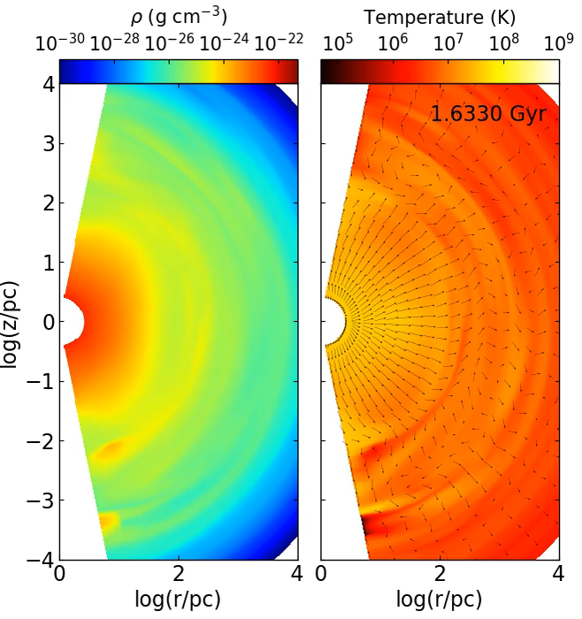

Slide 21
Light curve of AGN (I)
Yuan et al. 2018
Most of time, AGN stays in LLAGN phase
Wind rather than radiation controls Mdot & BH growth
  Why?

Slide 22
Lightcurve of AGN (II): effect of AGN physics
Gan et al. 2014
Difference between two models: Wind strength
Typical L differs by 2 orders of magnitude
Lifetime of AGN: 10^5 yr (vs. 10^7 yr), consistent with observations (e.g., Keel et al. 2012; Schawinski et al. 2015)

Slide 23
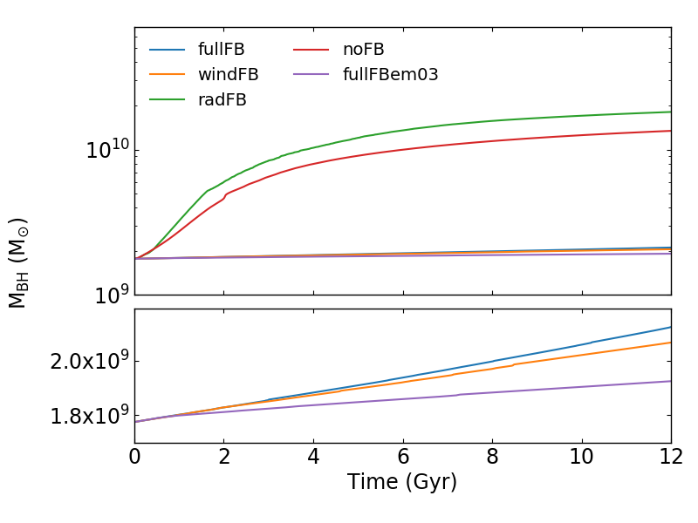
Growth of black hole mass
Yuan et al. 2018
AGN feedback (mainly by wind) regulates BH mass growth.

Slide 24
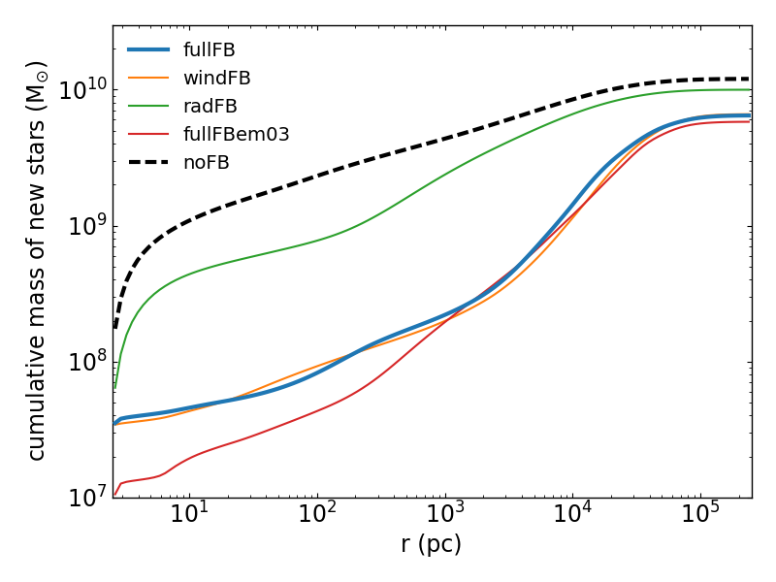
Star formation
— suppressed or enhanced?
Wind feedback is dominant
Wind can reach & suppress SF up to 20 kpc , consistent with observation (e.g., Liu et al. 2013)
But beyond ~20 kpc, SF is enhanced
consistent with observation (e.g., Cresci et al. 2015)
AGN wind
Radiative heating

Slide 25
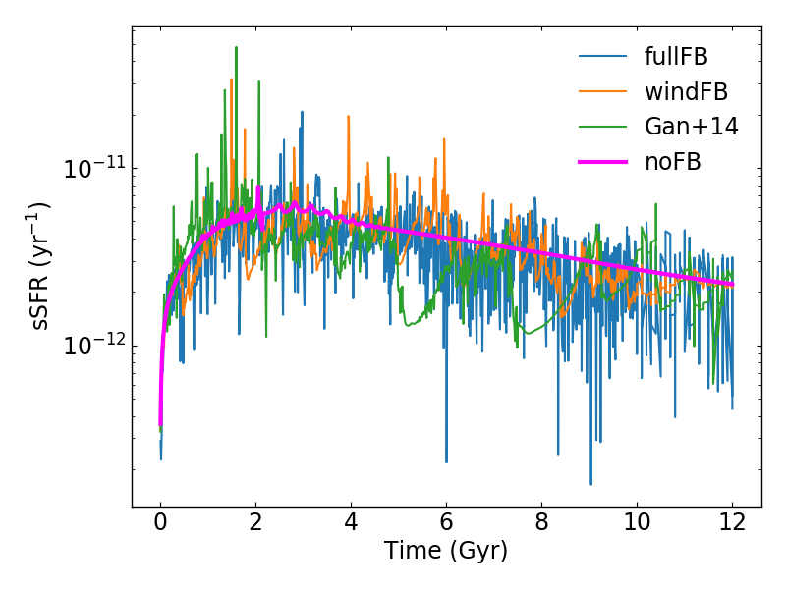
Specific Star Formation Rate
Negative or positive effect on SFR?
Difficult to answer, depending on
location and time！

Slide 26
AGN duty-cycle
Percentage of the total simulation time spent above an Eddington ratio; consistent with observations
Percentage of the total energy emitted
above an Eddington ratio
NOT consistent with observations: why?

Slide 27
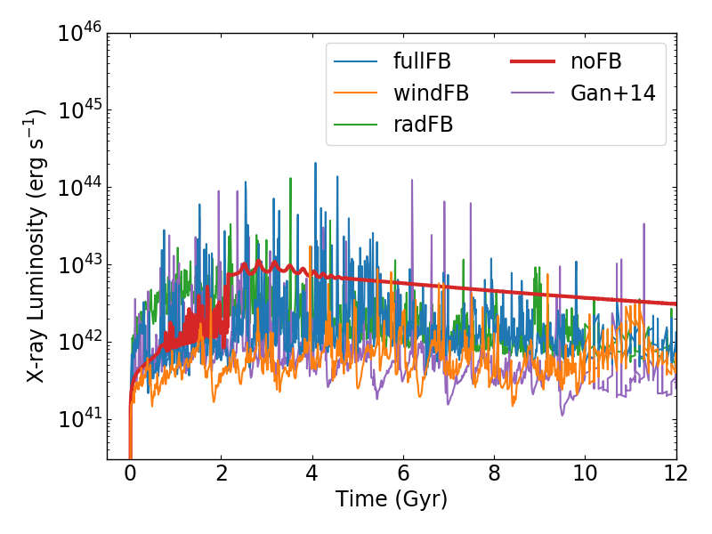
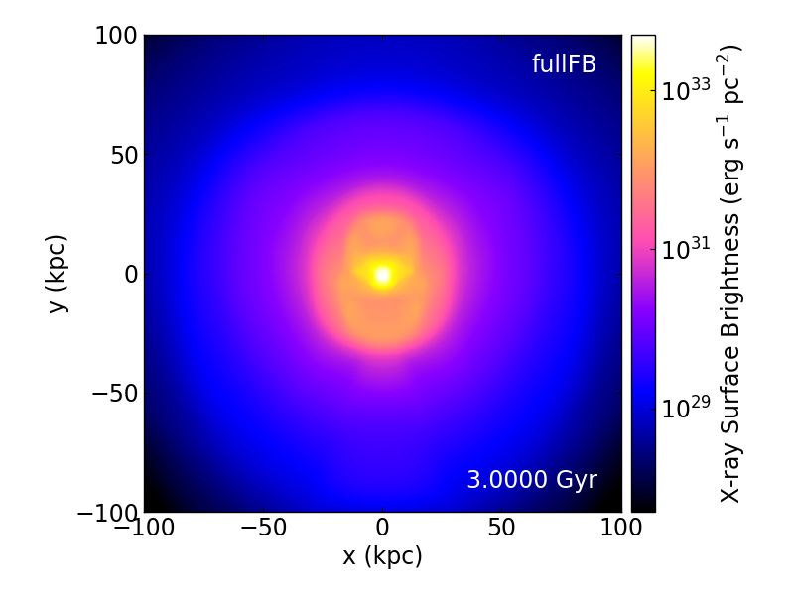
X-ray Luminosity & Surface Brightness
X-ray cavity can be produced by
AGN wind even if the jet is absent!

Slide 28
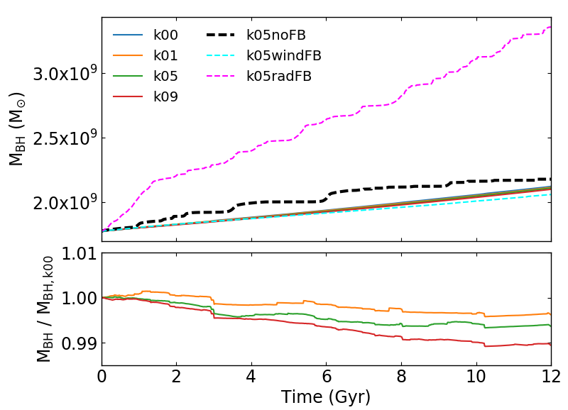
BH Mass Growth w/ Galactic Rotation
Notes:
I updated the figure.

Slide 29
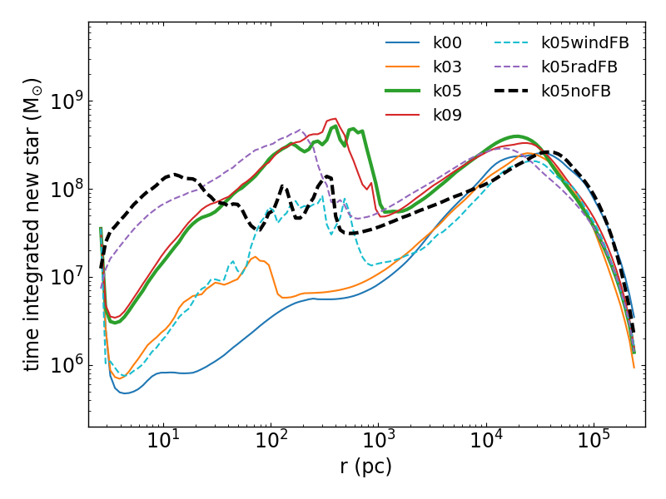
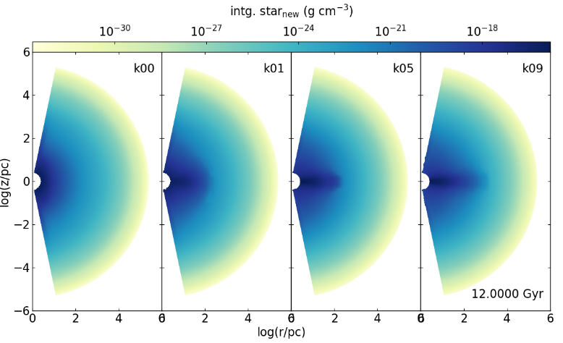
Newly born stars as a function of galaxy rotation
Faster the host galaxy rotates,
more stars forms at the central region of the galaxy
(mostly at the mid-plane disk).
Notes:
I updated the figure.

Slide 30
Summary
AGN feedback considered by 2D HD simulation; Bondi radius resolved
Physical processes like SNe, SF, int. between radiation & wind with ISM considered
Exact AGN physics adopted:
  two accretion/feedback modes: cold & hot
  Correct description of radiation & wind in each mode
Light curve, BH growth, AGN Duty-cycle, star formation, surface brightness
Comparison with other works indicates the importance of exact AGN physics

Slide 31
END

