Slide 1


Jets and outflows in AGN: a radio and an X-ray view
Francesca Panessa
Notes:
Jets and outflows in AGN: a radio and X-ray view
From recent results, a sizable fraction of AGN shows outflowing material in the X-ray (and UV) spectra. These observational facts show that the existence of outflows is becoming a widespread feature of AGN over an ample range of frequencies. The connection between X-ray-detected winds and their radio counterparts is a crucial element in pinning down the accretion-ejection mechanism, as it has been recently proposed that in radio-quiet quasars, the radio emission could be a by-product of the outflow activity.
However, the origin of the weak and confined radio emission in the majority of AGN is still under debate. I will present a characterization of the radio emission at high resolution of nearby AGN together with cases of co-existence of jets and winds in AGN and their radio/X-ray connection.
Session:
Jets and outflows (high angular resolution radio observations)
Emission from other low-luminosity AGN

Slide 2


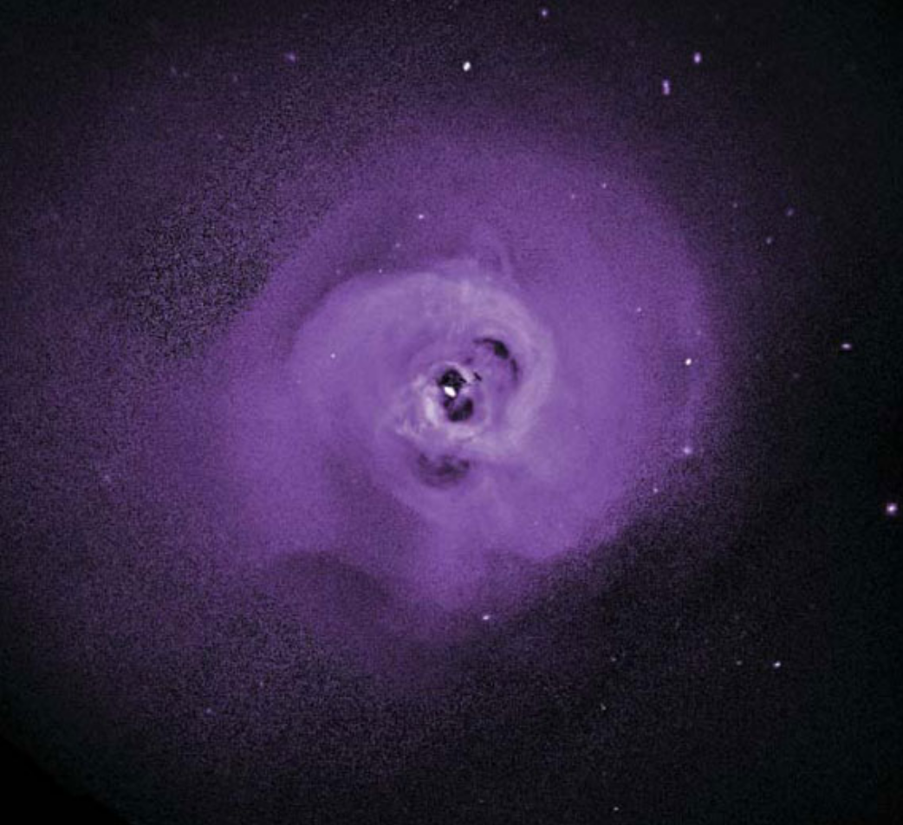


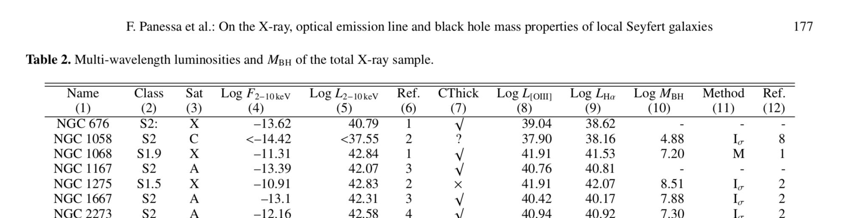


Slide 3
Jets and outflows in AGN: a radio and an X-ray view

Slide 4
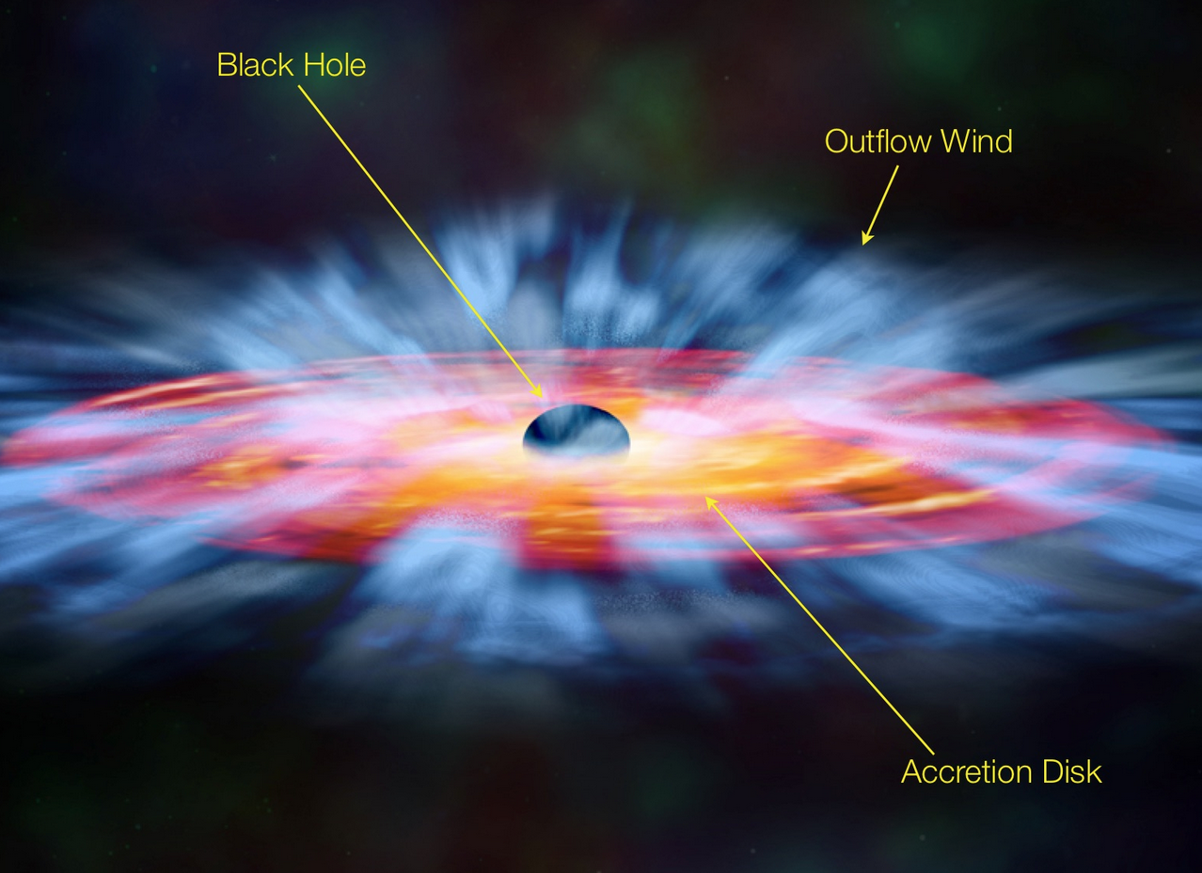

MULTI-FREQUENCY
MULTI SCALE
WINDS

Slide 5
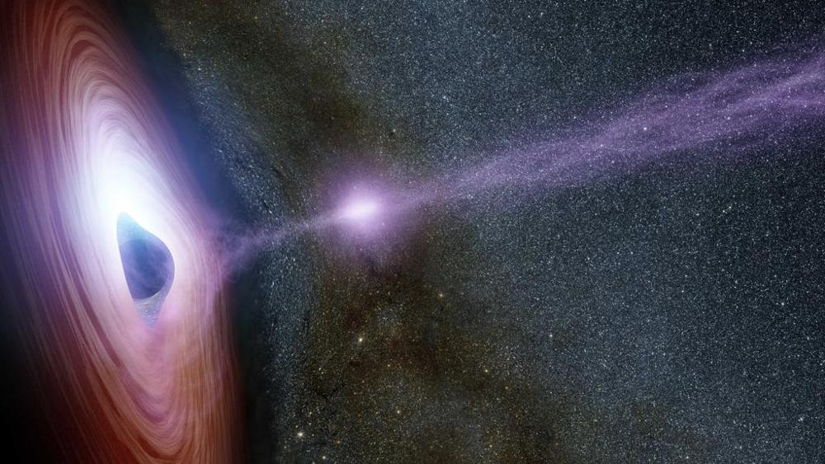
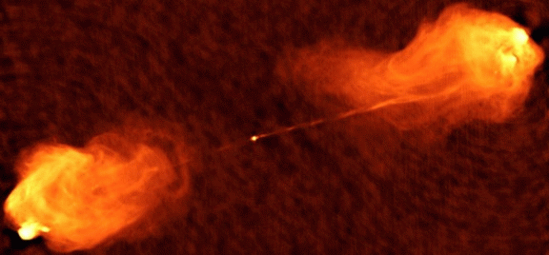
MULTI-FREQUENCY
MULTI SCALE
JETS

Slide 6
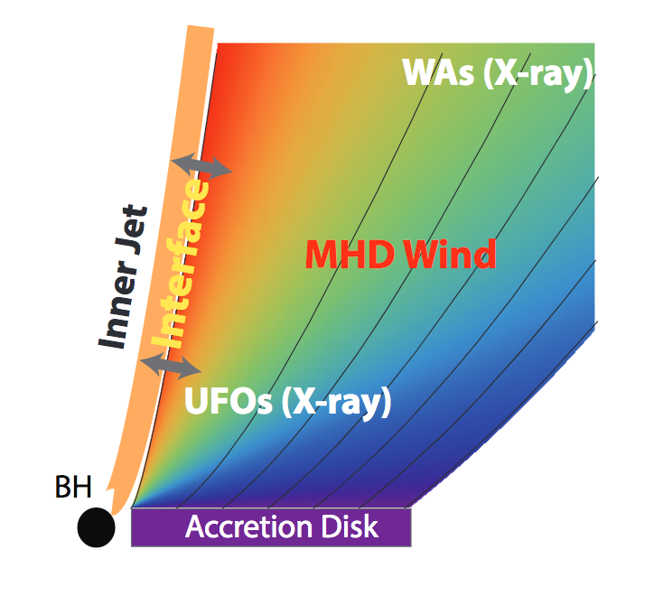
JETS and WINDS interplay
How are jets and winds formed?
Are they a phase of the AGN life?
Is the jet and the wind connected to the accretion flow and how?
Does the disk wind collimate the jet?
How is the jet and wind feedback acting in galaxies?
Magneto-hydrodynamic models
(Tchekhovskoy et al. 2011, Fukumura et al. 2014)
Notes:
A schematic description
of stratified MHD-driven wind structure manifesting WAs and UFOs (
not to scale) with
column distribution (similar to Fig. 8 in K12 and Fig. 5 in T12c). The arrow
s indicate a
mutual interaction between inner relativistic jets and the MHD winds
at their interface.

Slide 7
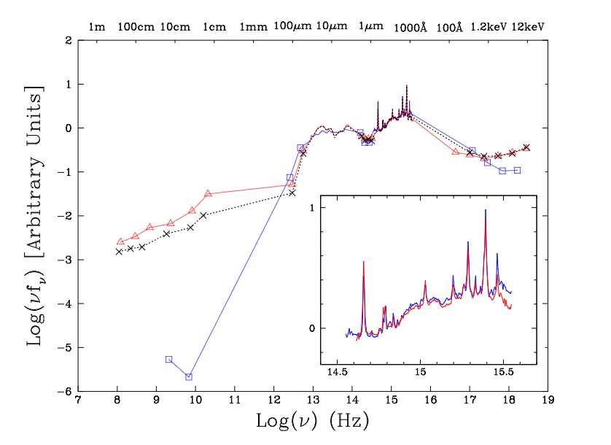
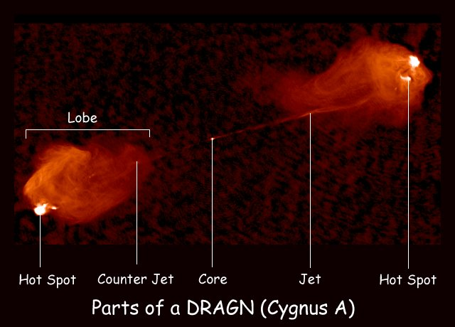
Radio Loud
Radio Weak
Shang et al. 2011

Slide 8
RADIO WEAK AGN

Slide 9
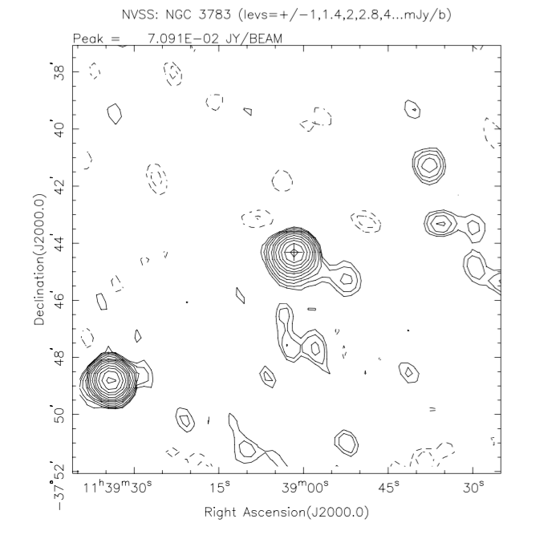
RADIO EMISSION from OUTFLOWS IN RADIO WEAK
Is this thermal or non thermal? Jet or outflow?
Giroletti & Panessa 2009, Bontempi et al. 2012, Panessa & Giroletti 2013, Chiaraluce, et al. in prep

Slide 10
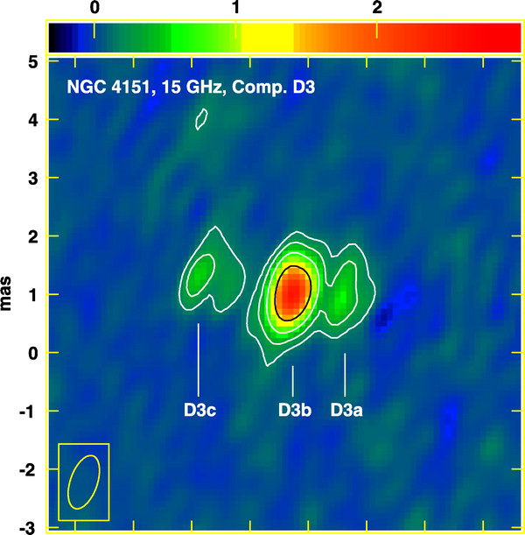
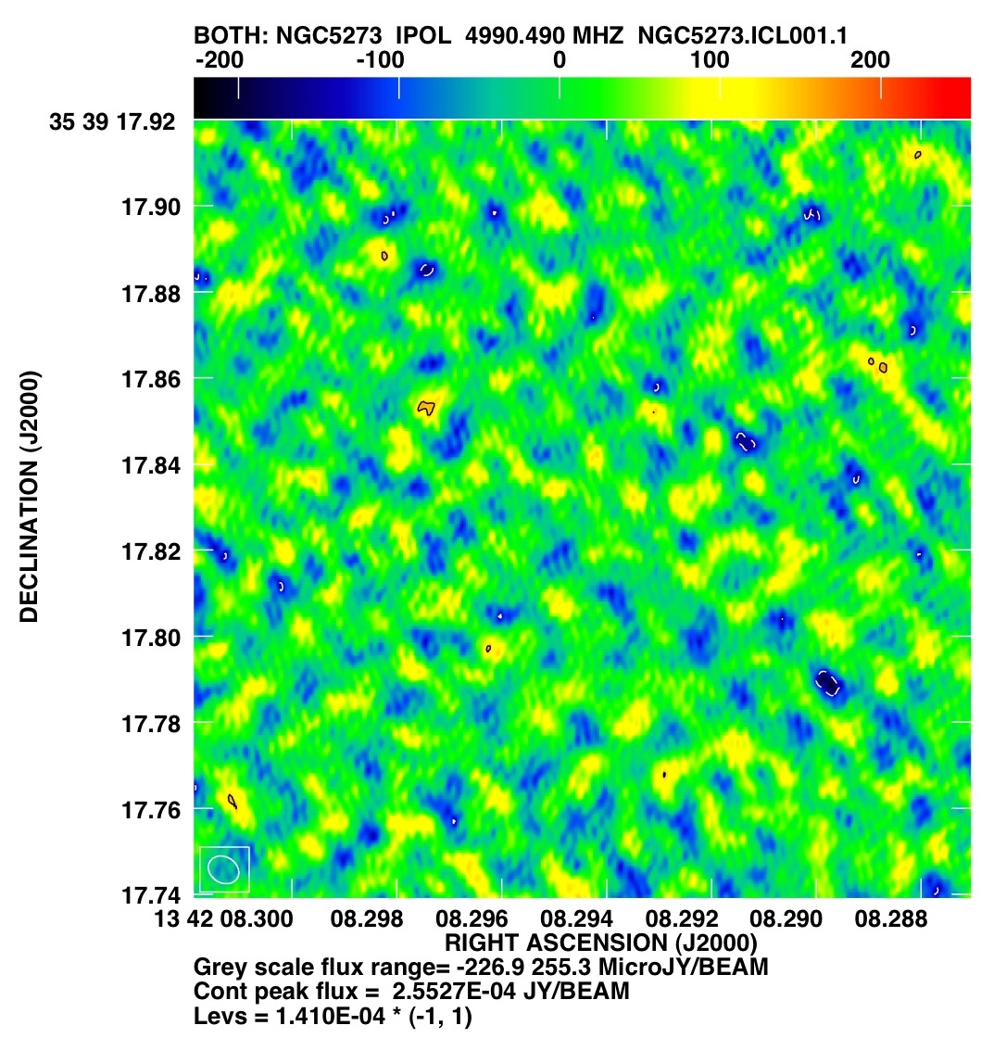
THE DOMINANT AGN POPULATION: RADIO FAINT
ORIGIN of the FAINT RADIO emission:
Synchrotron emission from a jet:
  Mostly sub-relativistic and weak jets
Free-free emission from a molecular torus or corona
ADAF + jet
Magnetic reconnection from a corona
  Possible outflows
non detection!

Slide 11
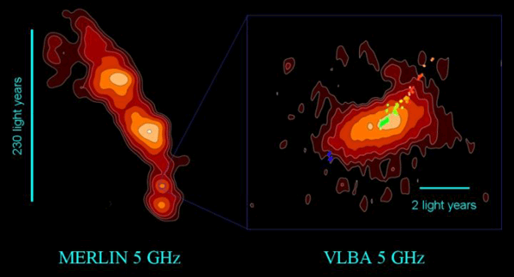
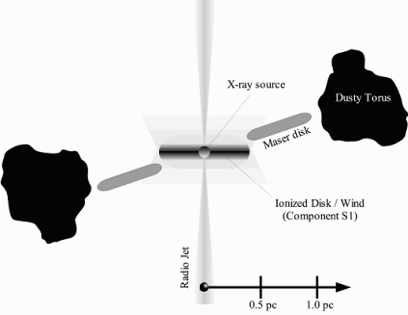
NGC 1068
Gallimore et al. 2004
MERLIN emission: low power jet
VLBA emission: free-free emission from the hot X-ray corona – wind from molecular wind?

Slide 12
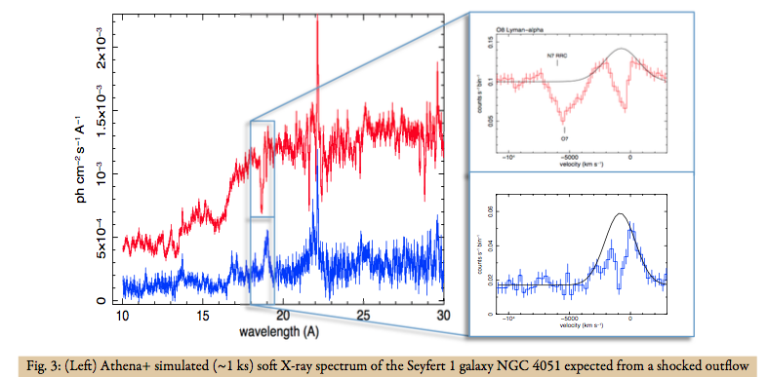
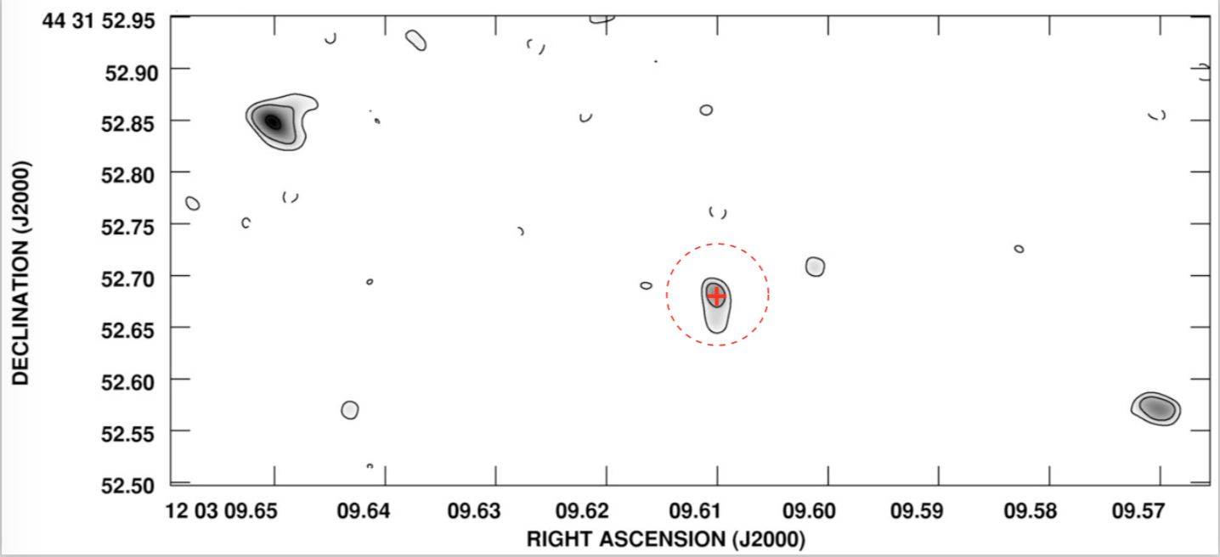
NGC 4051
post-shock region of radius ∼0.3 pc (Pounds and Vaughan 2011)
Giroletti & Panessa 2009
Radio linear size < 0.31 pc

Slide 13
RADIO LOUD AGN

Slide 14
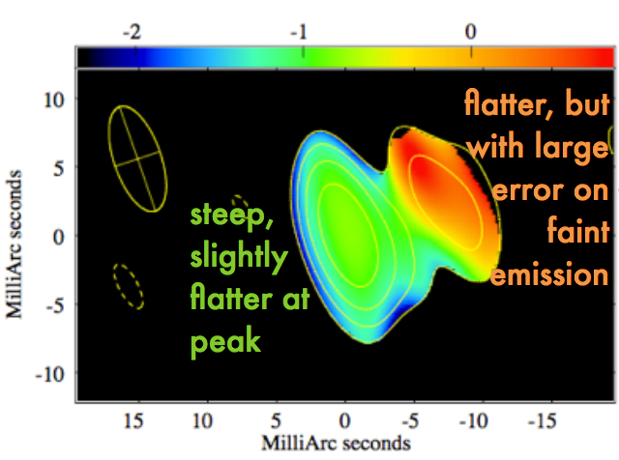
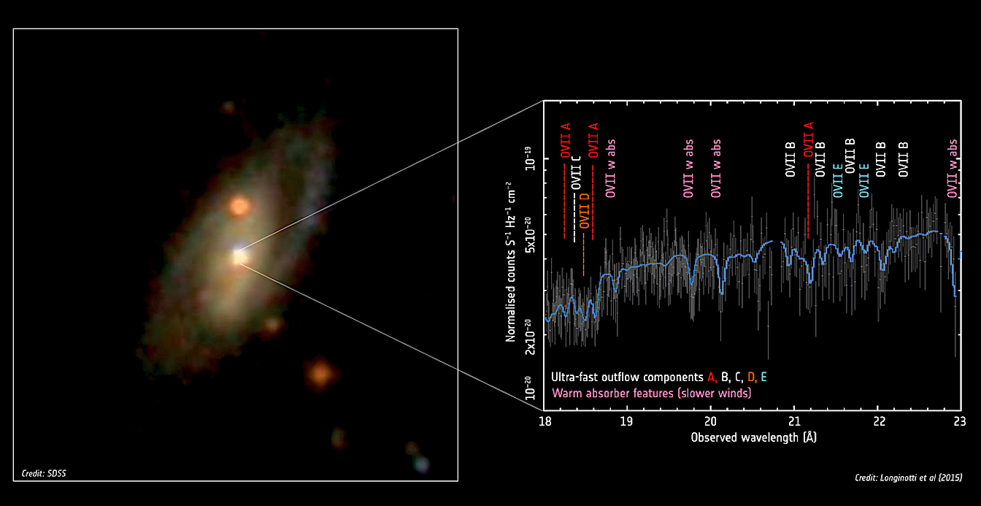
JET AND OUTFLOW COEXISTENCE
→ Ultra fast outflows in 27% of 26 Radio-Loud AGN sample (Tombesi et al. 2014)
IRAS 17020+4544
Longinotti et al. 2015
Giroletti et al. 2017
VLBA Observations in 2000 and 2014
Compact bright core plus a secondary fainter component at 1.2’
Steep spectral index indicates synchrotron spectrum (magnetic fields)
Elongated jetted structure /outflow at ~10 pc scale moving at v ~ 0.1c
→ Possible connection with X-ray outflow?

Slide 15
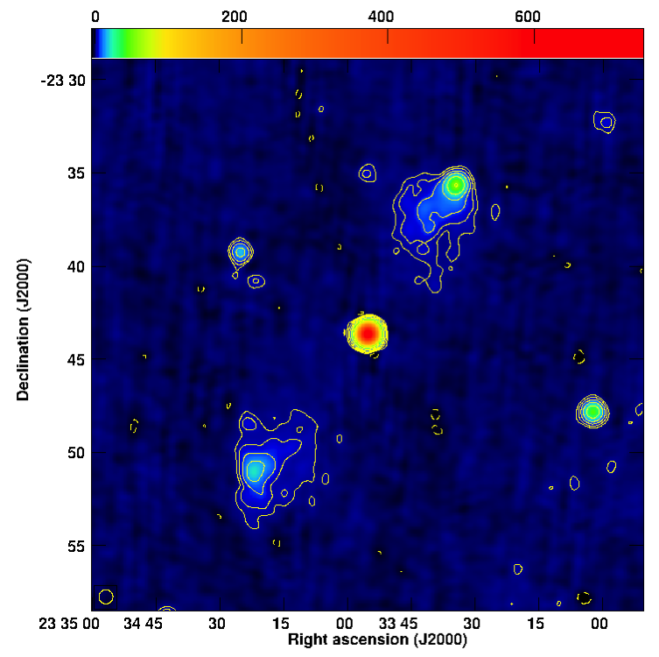
THE REACTIVATING NUCLEUS OF PBC J2333.9-2343
from giant radio galaxy to blazar!
→ small angle!
Hernandez-Garcia et al. 2017
→ X-rays produced by the jet

Slide 16
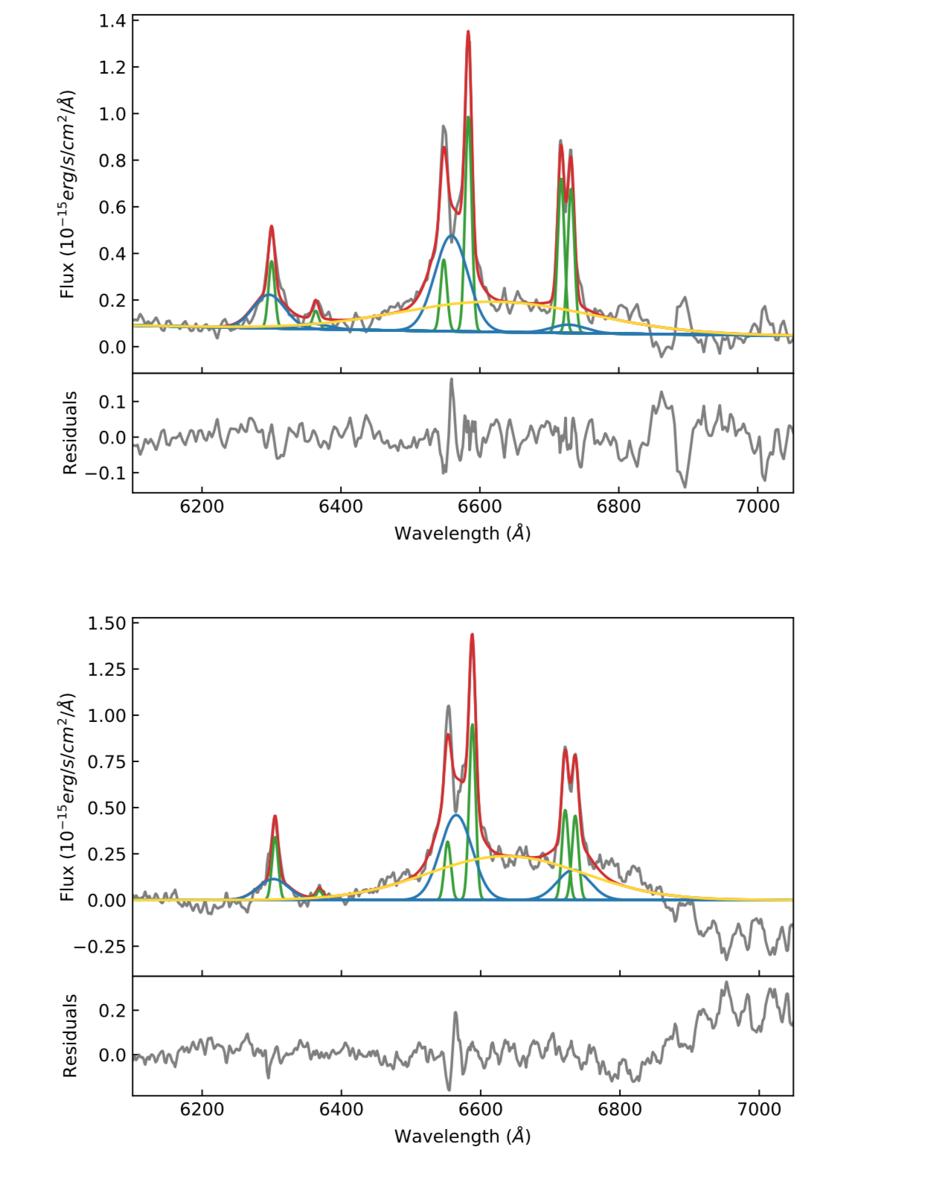
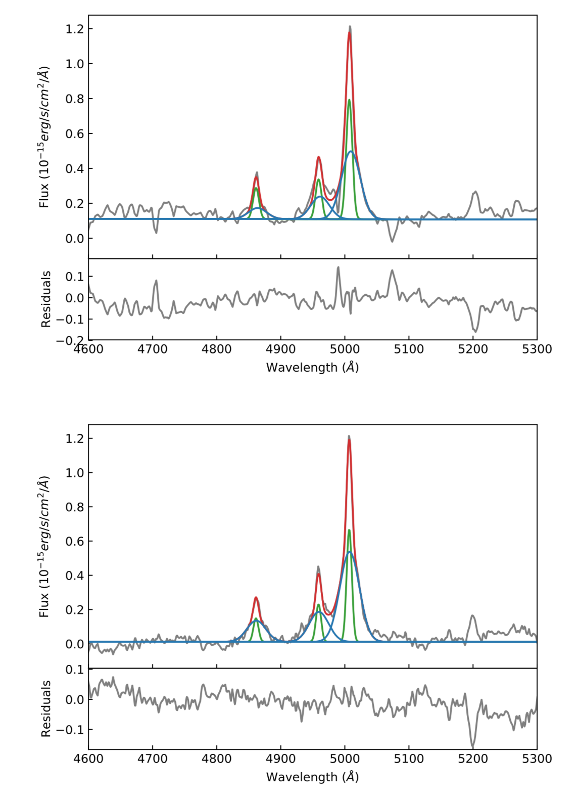
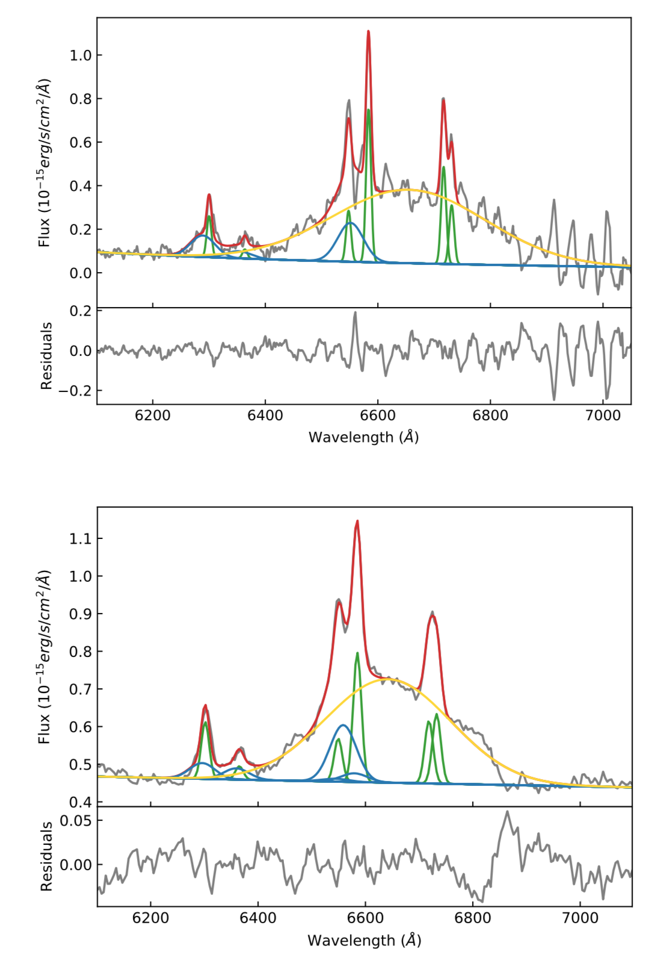
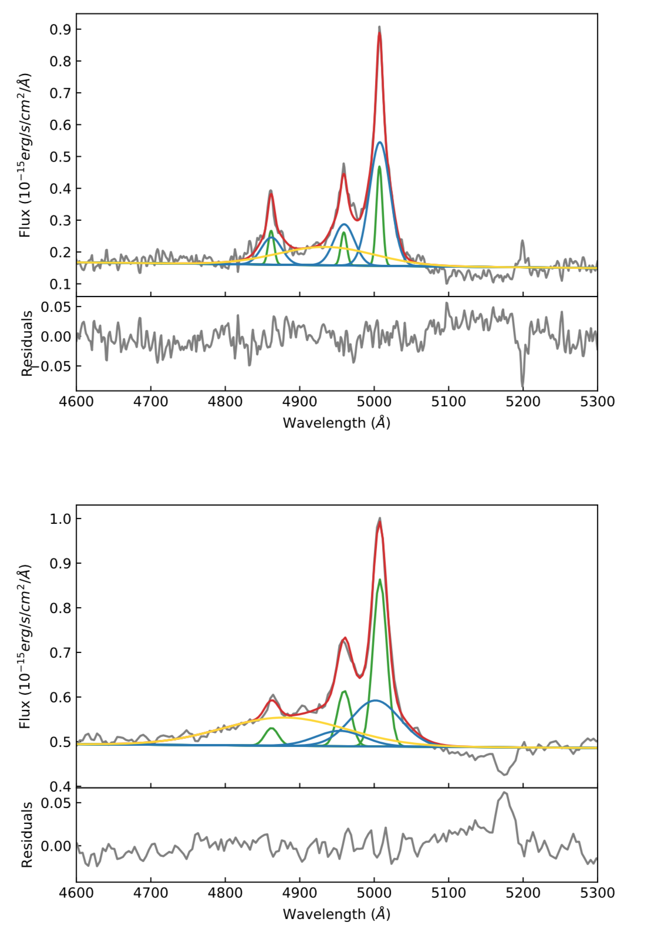
NLR
BLR
Outflow
Total
Variations in the broad lines
2009
SPM, Mexico
2015
2016
NTT, Chile
2016
Hernández-García et al. (submitted)

Slide 17
NLR
BLR
Outflow
Total
Brodened component in all narrow lines
→ Large scale (NLR) outflow!
…2 sigma variability
Hernández-García et al. (submitted)

Slide 18
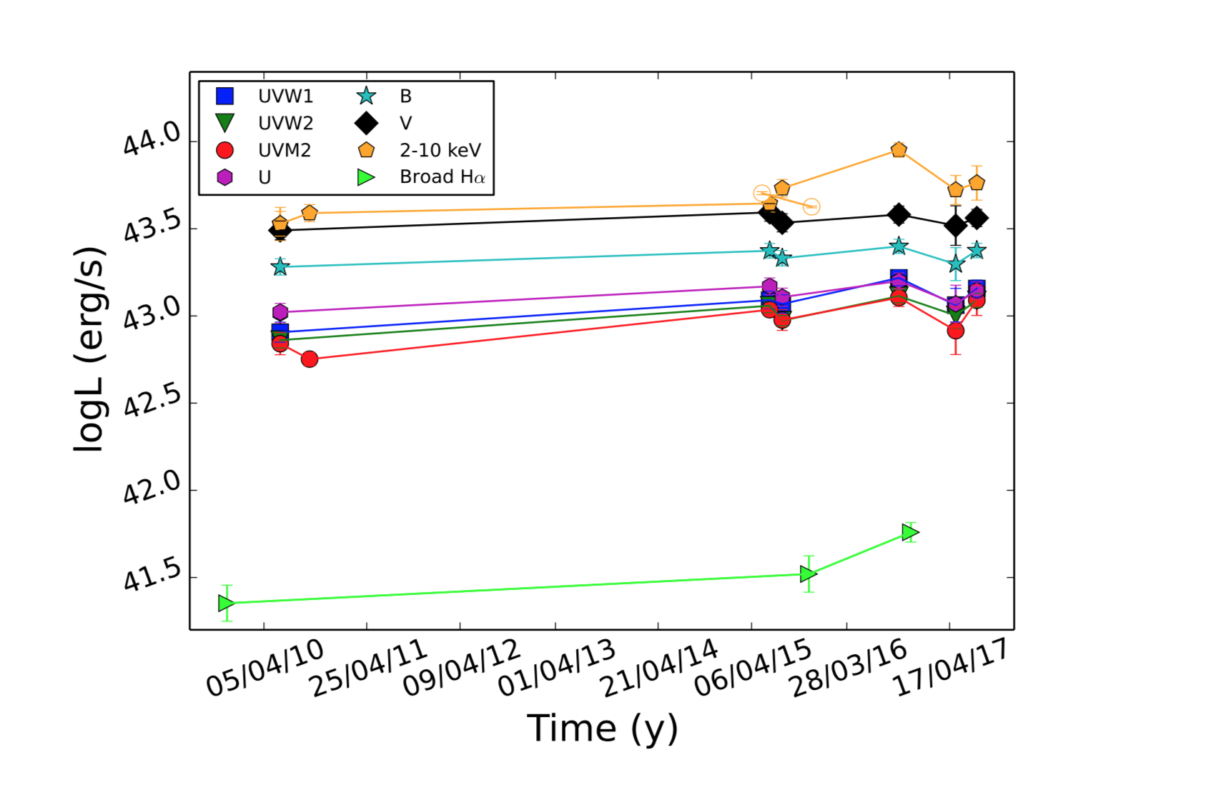
NLR
BLR
Outflow
Total
…that follow variations in X-rays and opt-UV continuum
Hernández-García et al. (submitted)

Slide 19
JET and CLOUDs in the blazar-candidate PBC J2333.9-2343
Change in the BLR: variability in the optical broad components → Jet powering the ionization of the AGN
First time of a wind in a blazar?
Hernandez-Garcia et al. 2017, 2018

Slide 20


Shang et al. 2011

Slide 21
Thank you!

Slide 22
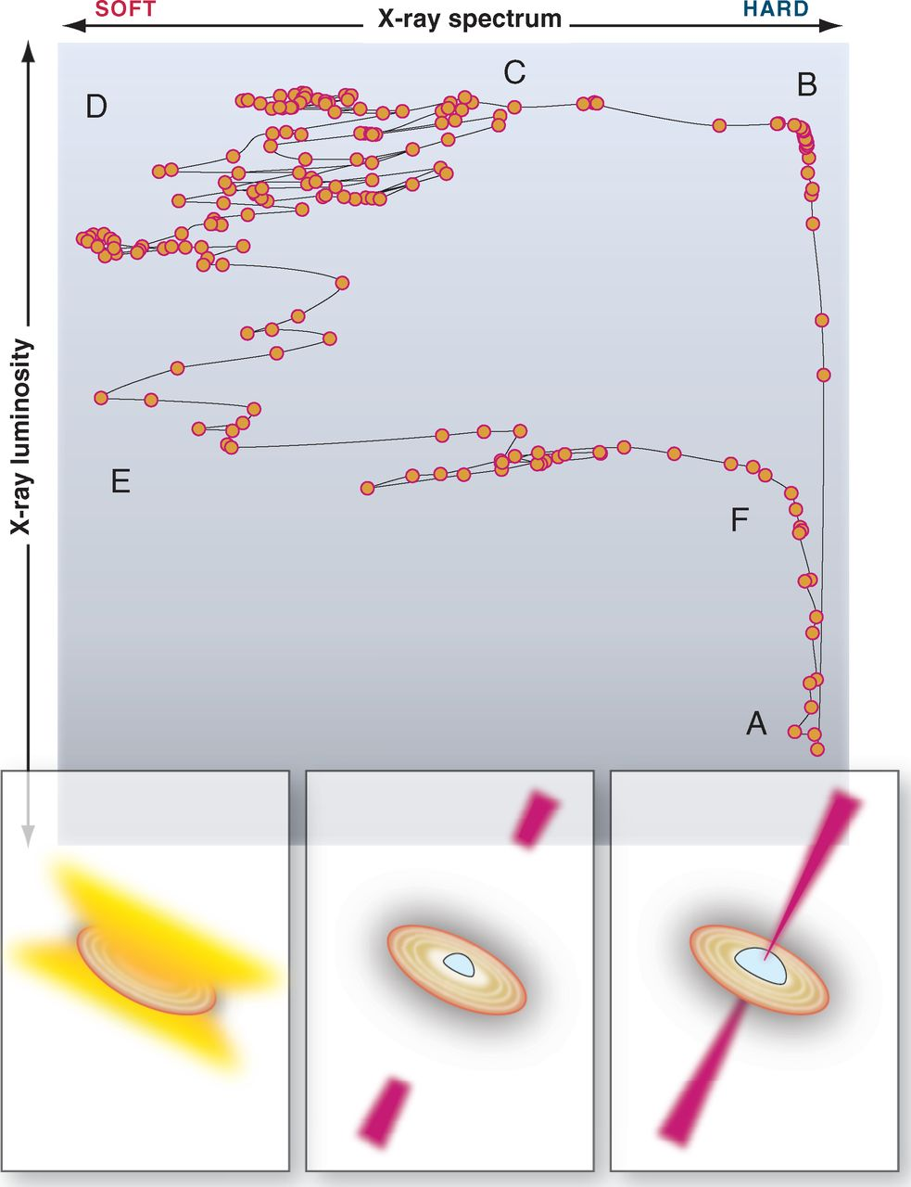
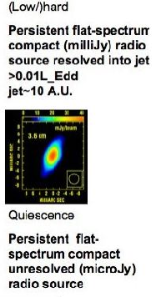
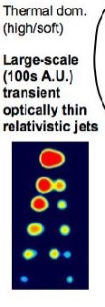
X-RAY BINARIES in OUTBURST (weeks time scales)
Fender & Belloni 2012

Slide 23
SUMMARY
RQ AGN: X-Ray - UV winds in AGN → What to expect in radio emission of AGN?
Radio survey of RQ → some consistent with outflow emission → need of better characterization and theoretical models
Winds in RL →50% Tombesi
IRAS case (a mildly RL AGN)
PBC (a blazar!)

Slide 24
VLBI Observations of Radio Quiet Nuclei
Discriminate between jet synchrontron, SSA, ADAF, free-free emission?
Physical constraints:
Compactness of the source (ADAF < 10⁴ R_{S})
Brightness temperature limits (high T_{B} --> non thermal emission)
Spectral indices (steep, flat or inverted --> Synch, ADAF or SSA)
Motions (relativistic/sub-relativistic)

