Slide 1
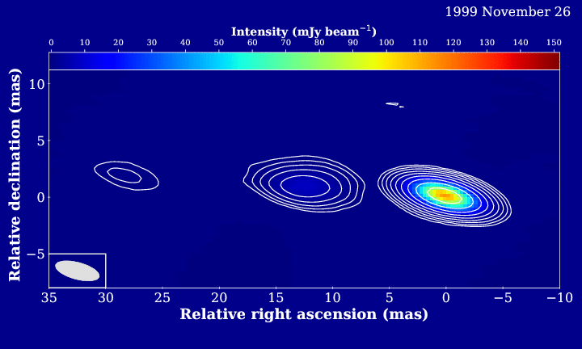
A jet proper motion study in the early Universe
Krisztina Perger
Perger+ 2018, MNRAS, 477, 1065

