Slide 1
AAVS0 & AAVS0.5:
System Design and Test Plan
Nima Razavi-Ghods
Eloy de Lera Acedo
Andrew Faulkner
Jan Geralt bij de Vaate
Laurens Bakker
Peter Hall
Adrian Sutinjo
Mark Waterson

Slide 2
Overview
AAVS0 (& AAVS0.5): System Architecture
  Objectives
  System design
  Test RF front-end developments (Pre-ADU)
  UniBoard digital back-end requirements
  Receiver housing options
  Control software development
Test Plan (Cambridge, Medicina and Murchison)
  Testing already carried out on AAVS0 (Cambridge)
  Intermediate testing without a full receiver
  Extended testing with a full receiver (AAVS0.5)
  A plan for the future…

Slide 3
Objectives (AAVS0 & 0.5)
Deploy a 16 element dual-polarised low frequency AA (SKALA) with a full receiver at Lords Bridge (Cambridge) and then at the Murchison Site, WA
Continue from AAVS0 by testing the Antenna + LNA in a potential low RFI SKA environment and prototype technologies suitable for future AA-low developments
As well as performing coupling and pattern measurements, there should be an aim to measure system temperature as well as assess beamformer and correlator platforms.
Gain understanding of practical aspects of deployment at site.
Understand some of the impact on “Calibration and Science”
Our aim is therefore a potential “Testing Platform” for AAVS1
Notes:
Not just a photo op

Slide 4
AAVS0 & 0.5: System Architecture
To work in both low and high RFI environment

Slide 5
Active SKALA Specifications
Parameters | Frequency | Typical | Units
Antenna Directivity | 70 MHz 100 MHz 300 MHz 450 MHz | 7.5 8 7.4 7.6 | dBi
LNA module Gain (noise matched) | 70 MHz 100 MHz 300 MHz 450 MHz | 37 40 43 40 | dB
LNA module Noise Figure (noise matched) | 70 MHz 100 MHz 300 MHz 450 MHz | 1.18 0.51 0.47 0.44 | dB
LNA module supple current (per board) | - | 155 | mA
LNA module power dissipation (per board) | - | 750 | mW
LNA module input IP2 | 70-450 MHz | -23 (worst case) | dBm
LNA module input IP3 | 70-450 MHz | -18 (worst case) | dBm
Notes:
Power, noise, IP3 all to improved

Slide 6
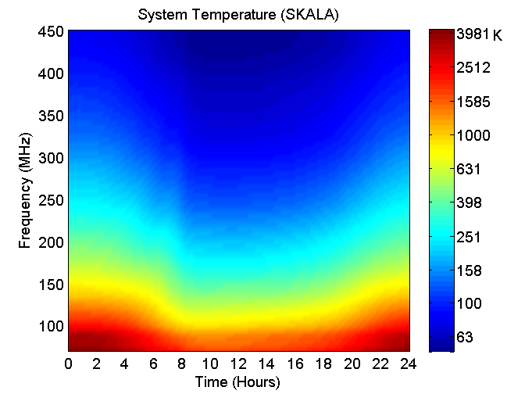
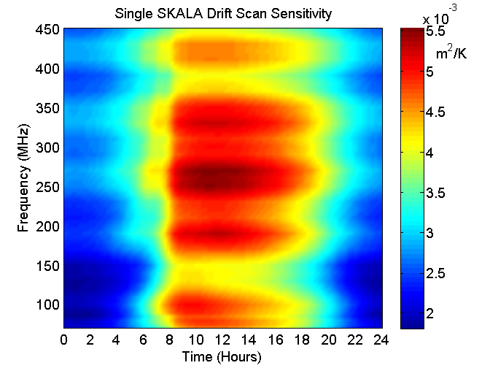
Our Environment (SKALA)
Using the Active SKALA element at the Murchison site
Notes:
Example

Slide 7
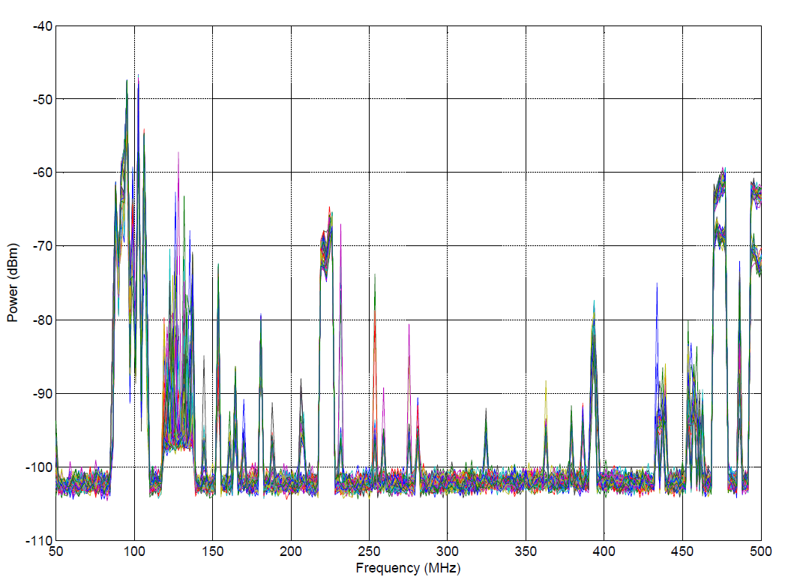
The worst case RFI (Cambridge)

Slide 8
Front-end (Pre-ADU)
PWR < 3W per pol
Notes:
Should be suitable for both a high and low RFI environment

Slide 9
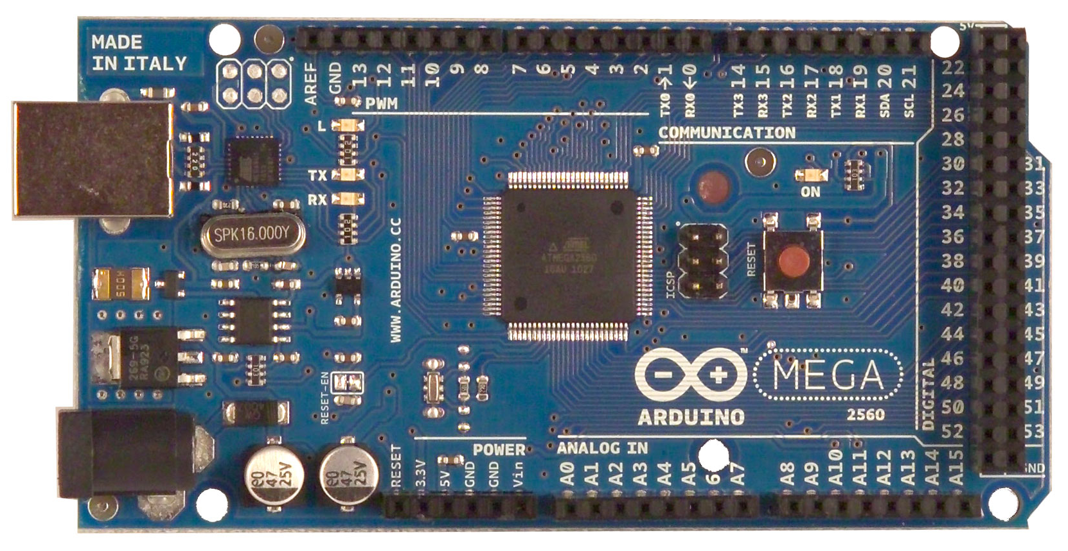
Arduino for Front-end Control

Slide 10
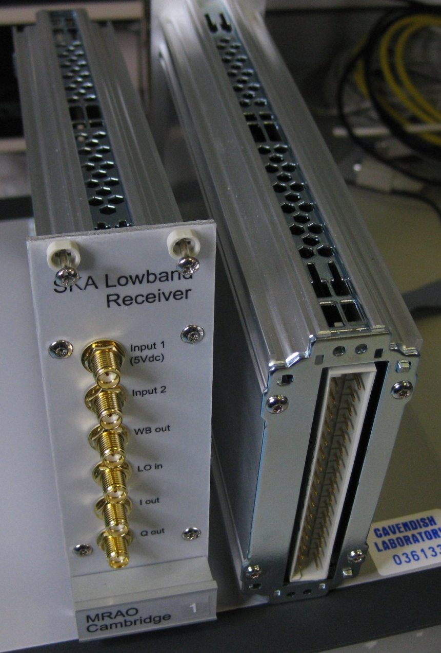
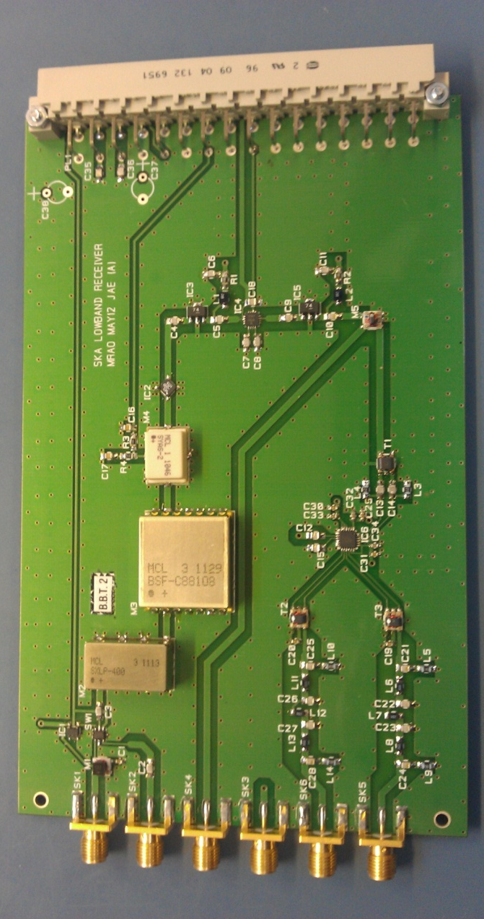
Previous Design (AAVS0)…
Notes:
See report

Slide 11
UniBoard Digital Back-end
The aim is to use half of the standard UniBoard sub-rack as a beamformer & correlator backend.
In full mode the UniBoard hardware can produce 384 sub-bands x 42 beams (39 bits) through its 10 GbE interfaces.
Through its 1GbE interface (assuming 80% efficiency of UDP), it can produce 50 MHz of beam data which assuming 1GSamples/s clock corresponds to 100 sub-bands (split between frequency bands and FoV in anyway desired).

Slide 12
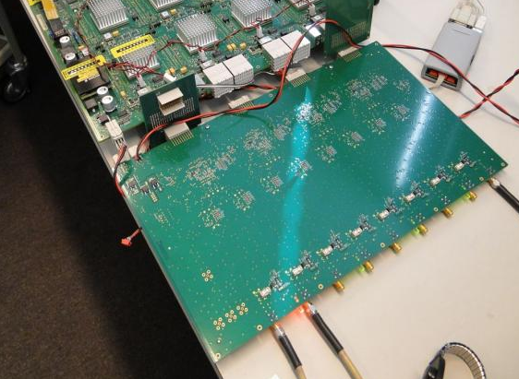
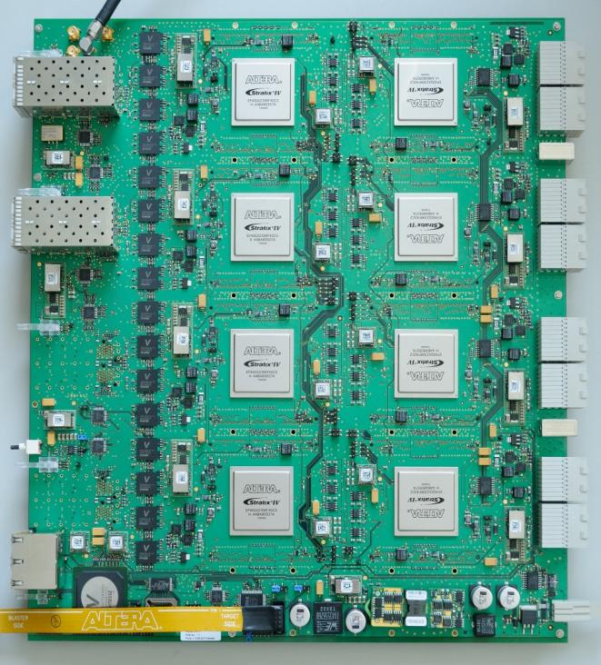
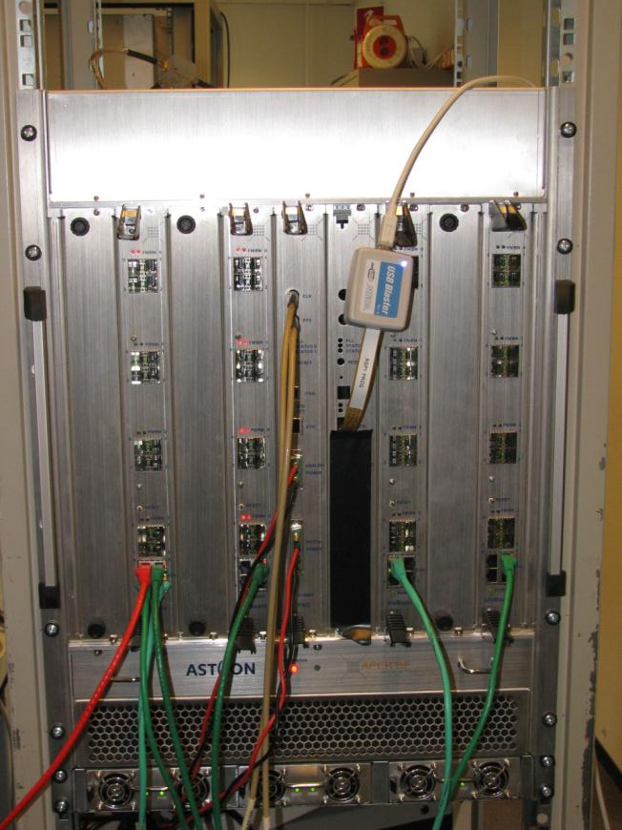
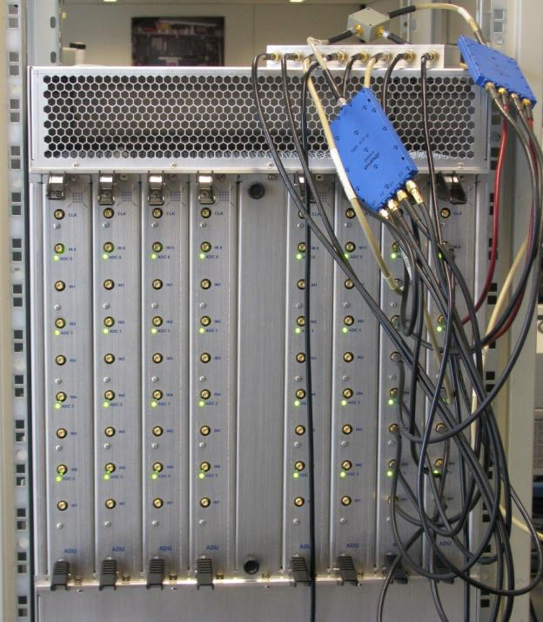
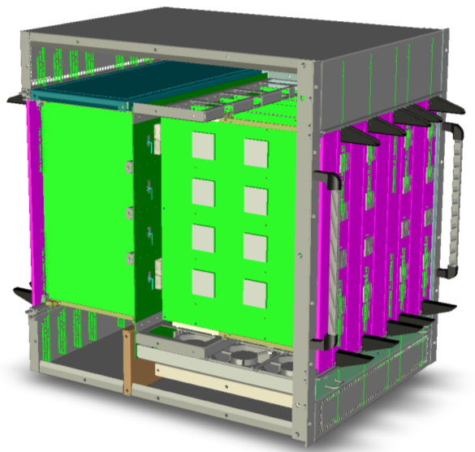
UniBoard
ADC
Interface

Slide 13
Adapting UniBoard to AA-low
The ADU hardware needs to be changed to include new filters and a PLL clock at 1 GHz instead of 800 MHz.
The firmware (VHDL) needs to be adapted for this new sampling frequency and this requires development time.
There are no “top” level python scripts as of yet which set the weights for a sub-band and specific antenna. This requires time in dealing with coefficient register mapping but does not present a major challenge.
There are many python scripts already available which can be used with little or no changes for controlling UniBoard hardware (e.g. quick power spectrum, temperature and other utility functions) .
There is no “triggered weight update” mechanism but this does not present a significant challenge.
Data capture is also a viable option for offline correlations.

Slide 14
Receiver Housing Options
Option 1 (recommended): A screened room in a container within 30-40m of the array (typical price: £20k for a 2.5m x 2.5m x 2.5m 100dB screened room)
Option 2: Use high spec RF over fibre devices to transmit 32 signals over single mode fibre. A small MWA receiver container (19 inch, 15U) can be used to house Pre-ADU cards and RFoF links. Links with very high dynamic range from OpticalZonu (Z450) cost ~£800 a link. A USB to fibre module is also required here (for Arduino control).

Slide 15
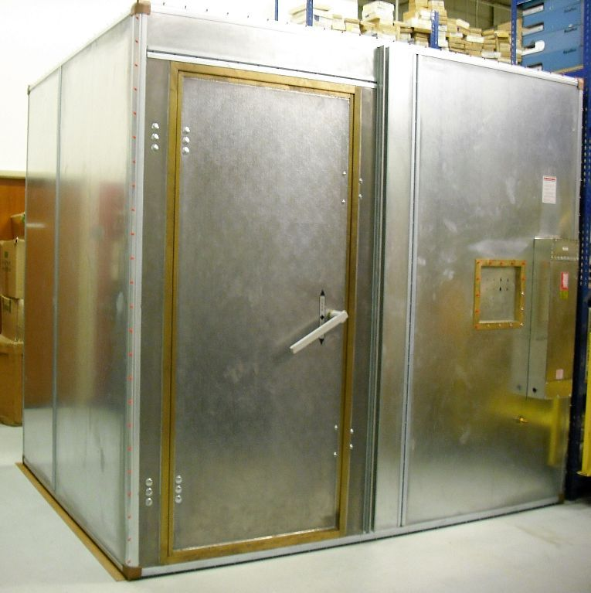
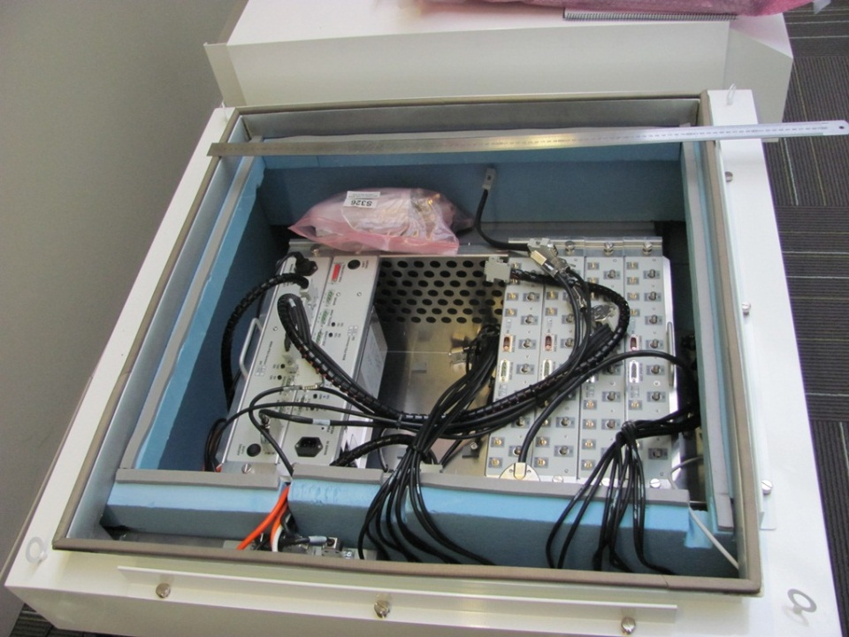
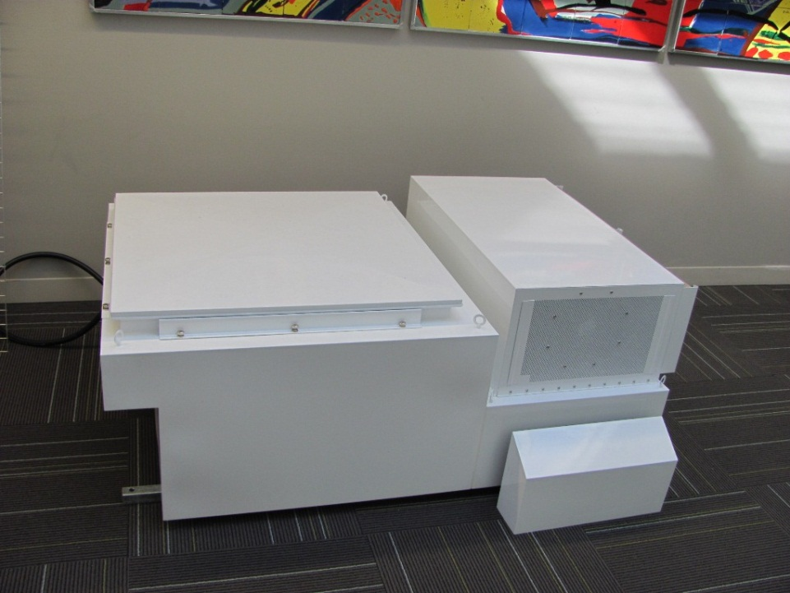
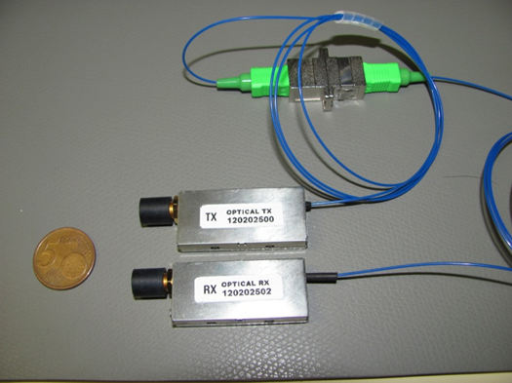
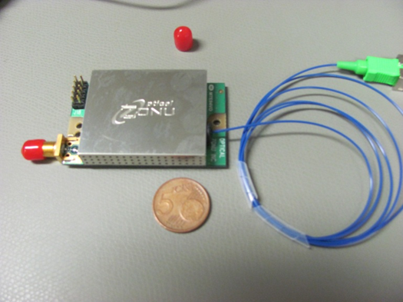
Receiver Housing

Slide 16
Control Software: What should it do?
Control of the Front-end (Pre-ADU): Set gain, filter switch, phase switch
Communicate with mid to high level python scripts which control UniBoard
Set observing mode: Stationary beams, tracking beams and testing mode
Use and test simple calibration routines and upload complex weights accordingly
Monitor power spectrum, system temperature and other utility functions including physical temperature

Slide 17
Test Plan…

Slide 18
AAVS0 Testing so far
Impedance and Coupling measurements (Cambridge, ASTRON, Stellenbosch)
Pattern measurements (Cambridge, QinetiQ)
Near-field pattern measurements (Cambridge, Université catholique de Louvain)
LNA measurements: Gain, NF, IP3 (Cambridge, NPL, ASTRON)
4 reports available on these measurements

Slide 19
AAV0 Testing to do soon
Further near-field measurements and comparison with simulations (Cambridge, Université catholique de Louvain)
Far-field pattern measurements (Paardefontein)
Far-field pattern measurements using 2-element correlator (Cambridge)

Slide 20
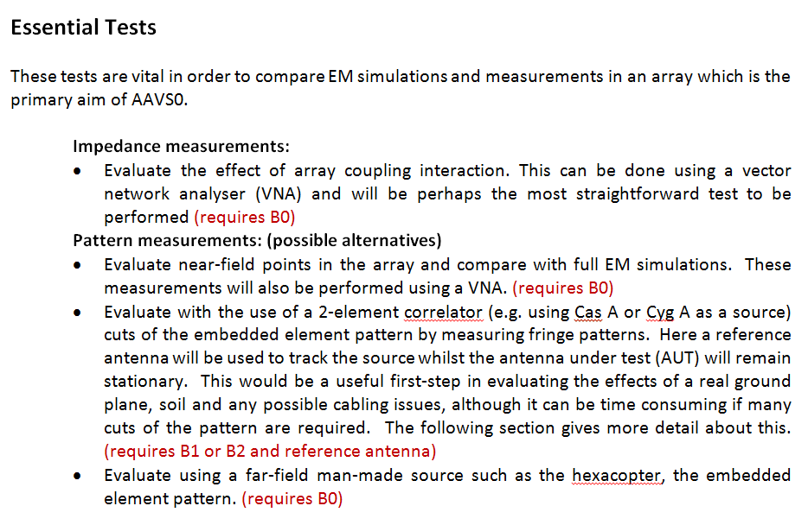
Original Test Plan:

Slide 21
2-element correlator measurements

Slide 22
2-element correlator update
Alt-Az mount: mechanical design 90% completed. Limit switches and weather proofing to do.
Control software - completed
Feed box 1 and 2 - completed
Front-end boards in a rack – completed
Roach correlator - completed

Slide 23
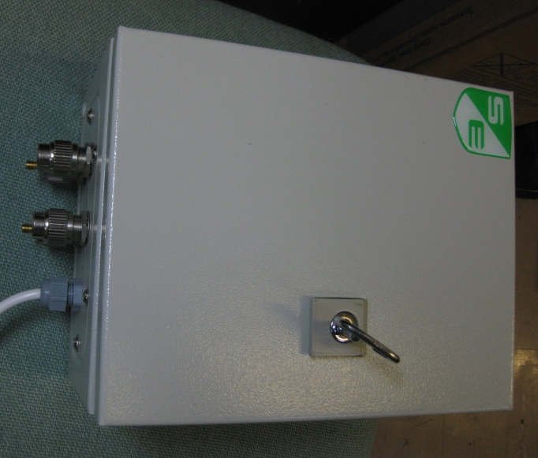
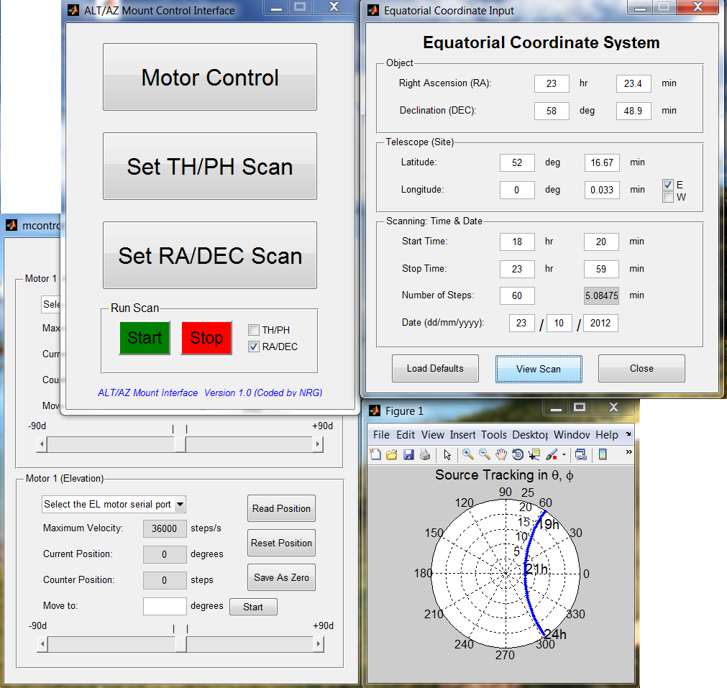
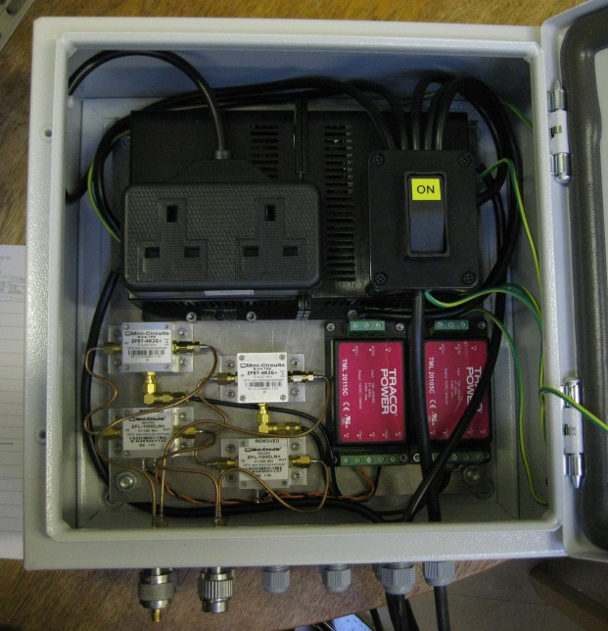
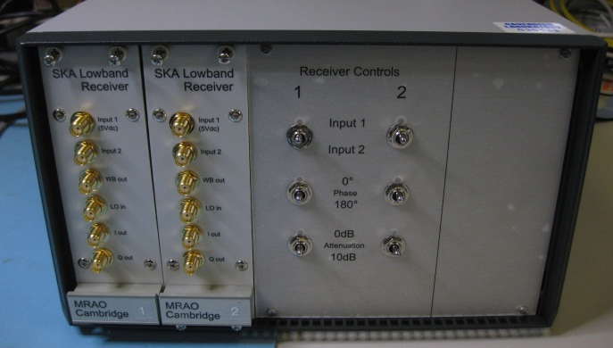
2-element correlator update

Slide 24
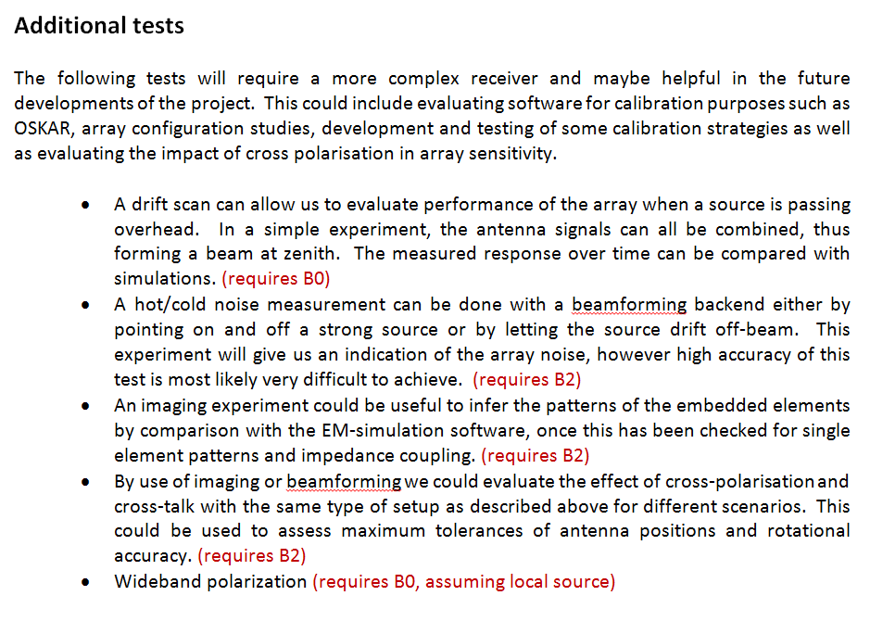
Next level testing

Slide 25
A plan for the future (by July 2012)
Complete testing of AAVS0 in all aspects previously described and fully characterise the Antenna + LNA.
Validate measurements against simulations
Continue intermediate testing using strong northern sources to measure antenna pattern
Develop front-end boards and test in Cambridge
Employ a UniBoard back-end and test in Cambridge
Develop Control software

Slide 26
Thank you.

