Slide 1
AA System configuration options 23 October 2012

Slide 2
System level considerations from Perth 2011:
Science requirements finalisation
Technical implementation
Software development
Configuration
Deployment & Environmental
Cost & Power – an issue throughout….
Operational model – SKA system decision
Upgrade path to SKA₂
These are still all true…!

Slide 3
Specification & scientific requirements
DRM2 stable and will be until SRR
Derive specifications from CoDR’s and SoWG report
There is pressure from scientists – there always will be!
We need to derive and agree element and sub-system specifications with OSKAO.
Part of the Stage 1 PEP work

Slide 4
AA-low outline specification (current)
Not an official spec, yet…
Currently 50*180m stations
Required for imaging and matching science
Maybe will be still smaller stations
Parameter | SKA1 | SKA2 | Comments
Type of array | Single element | Single element | Sparse array using a single wide-band element
No. of elements /station | 1750 | 11,000
No. of elements total | 500,000 | 3,000,000 | Approximately
Approx. Size of elements | 1x1x2 m | 1x1x2 m | Must be small enough for the pitch
No. of polarisations | 2 | 2 | Each element has two receiver chains
Diameter of station | 80m | 180m
Number of stations | 280 | 280 | Anticipated number SKA Stations
Element communication | Analogue fibre | Analogue fibre | Requires copper for power
Layout | pseudo-random | pseudo-random | The most flexible design is as individual elements.
Frequency range | 70-450 MHz | 70-450 MHz | May be down to 50MHz
Digitisation rate | 1 - 2GS/s | 1 - 2GS/s | There is no frequency conversion, covers full frequency range with guard bands
Digitisation depth | 6 or 8-bit | 6 or 8-bit | Required for RFI environment at these frequencies
Max instantaneous bandwidth | 400 MHz | 400 MHz | Covers operating band of array
Output data rate /station | 140Gb/s | 8Tb/s | Organised as 4+4bit complex data
Data rate into correlator | 40Tb/s | 2.2Pb/s | Peta = 10¹⁵

Slide 5
Possible AA station design: Copper analogue signal transport
Cooling
2-Pol
Elements
...
Copper
Element Digitisation
Fibre
Station Processing
RFI shielded
Element Digitisation
RFI Shielded
Tile Digitisation
Station
Beams
Tile Digitisation
...
Element Data
......
Control &
Monitor’g
C & M
...
......
......
System
clock
...
Clock
2x 500MHz
Analogue
+ power
To
Correlator
&
Services
Element Digitisation
Front-end
...
Power Distribution
Power
Grid

Slide 6
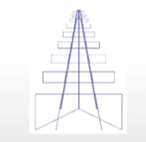
Possible AA station design: Analogue fibre signal transport…
Element power distribution
Analogue
Fibre
SKA₁ 1,750
Elements
AA-low
Digitisation & Station Processing
RFI shielded
Station
Beams
AA-low Station
Control &
Monitoring
Needs some successful
optical development!
......
…....
......
SKA₂ 11,000
Elements
......
System
clock
Single or dual fibres
Correlator
&
Services
Element power distribution
Element
Cooling
Power
Grid
500MHz LO
Data
Pol 1 & 2
Mixer
+
e/o
Pol 2
Pol 1
500MHz
f
Elements:
50-450MHz
LNA, filter, gain
Power
conditioning
Power over
copper

Slide 7
SKA₁ AA-low Station Processing
2 x 70-450MHz
16Gb/s
per element
Spectral filters
1st Beamforming
o/e
140Gb/s
RF over Fibre
from
Elements
o/e
o/e
…
Station beamforming
o/e
3 x 56Gb/s
Infiniband
1750
Elements
ADCs
2GS/s
6-8 bit
e/o
Data to
Central
Processing
System
…
Spectral filters
1st Beamforming
o/e
RF over Fibre
from
Elements
o/e
o/e
…
o/e
RFI shield

Slide 8
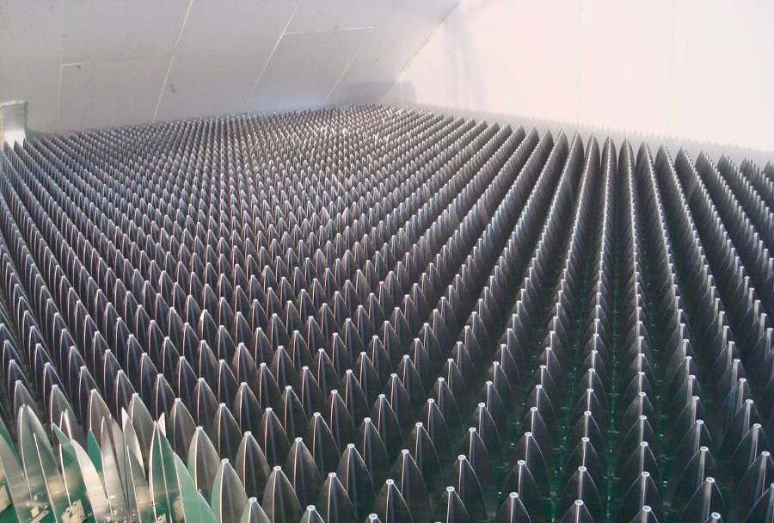
What is the AA Power challenge…?
….an awful lot of “stuff”!

Slide 9
AA-low SKA₁ Station power
Total AA-low station power ~10kW 3MW tot
Processing and digitisation
Technology | FPGA (TMAC/s) | Board (TMAC/s) | # per station* | Power/Board, inc ADC (W) | Total
UNIBOARD 1 | 0.5 | 4 | 200 | 400 | 80kW
UNIBOARD 2 | ~4.0 | 32 | 25 | 500 | 12.5kW
SKA1 processing | 10 est. | 80 | 10 | 700 | 7kW
*allowance made for inefficiency
Processing requirement
Analogue and Comms Power
Spectral filter:
Polyphase filter into 1024 channels 10⁵ MACs
PFF rate at 1GS/s 10⁶ /s
Processing rate per element 2*10¹¹ MAC/s
Total spectral filter proc. (1750 el.) 3.5*10¹⁴ = 350TMAC/s
Beamforming:
Each element 40GS/s (>160Gb/s): 8*10¹⁰ MAC/s
Total processing/station (1750 el.): 1.4*10¹⁴ = 140TMACs
Total station processing: ~500TMAC/s
Element power
LNA 50mW 100mW
Gain chain and mux 50mW 100mW
Optical Transmission 100mw 150mW
Total Element power 350mW
All elements <1000W
Communications etc. power
Transmission 3*56Gb/s 100W
Internal comms 30*56Gb/s 300W
Misc. 1000W
Total Station 2.5kW

Slide 10
Some AA choices to be made….
Station/core physical layout
Number of stations/Size of stations
Single-Dual element
Element type
Element spacing – Nyquist freq.
Analogue transport/ADC location
Processing flexibility (e.g. freq/time)
1st stage processing technology
Digital interconnect
Later processing technology
Output data transport

Slide 11
Some AA choices to be made….
Station/core physical layout
Number of stations/Size of stations
Single-Dual element
Element type
Element spacing – Nyquist freq.
Analogue transport/ADC location
Processing flexibility (e.g. freq/time)
1st stage processing technology
Digital interconnect
Later processing technology
Output data transport
Antenna layout:
Random, golden …
Apodised array
Core handling, resized arrays

Slide 12
Some AA choices to be made….
Station/core physical layout
Number of stations/Size of stations
Single-Dual element
Element type
Element spacing – Nyquist freq.
Analogue transport/ADC location
Processing flexibility (e.g. freq/time)
1st stage processing technology
Digital interconnect
Later processing technology
Output data transport
Total number of elements ~ constant for given SKA sensitivity.
Number+size of stations linked, determined by science and post processing requirements.
Core could (should…) be dynamically sized arrays.

Slide 13
Some AA choices to be made….
Station/core physical layout
Number of stations/Size of stations
Single-Dual element
Element type
Element spacing – Nyquist freq.
Analogue transport/ADC location
Processing flexibility (e.g. freq/time)
1st stage processing technology
Digital interconnect
Later processing technology
Output data transport
An important decision!
Need to balance (at least):
Performance over the frequency range
Cost, power, required performance
Calibration questions
Political issues: land usage, co-usage of processing etc.

Slide 14
Some AA choices to be made….
Station/core physical layout
Number of stations/Size of stations
Single-Dual element
Element type
Element spacing – Nyquist freq.
Analogue transport/ADC location
Processing flexibility (e.g. freq/time)
1st stage processing technology
Digital interconnect
Later processing technology
Output data transport
Depends on single-dual decision.
Then best performing, lowest cost, durable etc..

Slide 15
Some AA choices to be made….
Station/core physical layout
Number of stations/Size of stations
Single-Dual element
Element type
Element spacing – Nyquist freq.
Analogue transport/ADC location
Processing flexibility (e.g. freq/time)
1st stage processing technology
Digital interconnect
Later processing technology
Output data transport
Principally a performance over freq range/configuration question.
Part of physical layout choice
Requires element to be capable of relevant min spacing and ability to have large spacings.

Slide 16
Some AA choices to be made….
Station/core physical layout
Number of stations/Size of stations
Single-Dual element
Element type
Element spacing – Nyquist freq.
Analogue transport/ADC location
Processing flexibility (e.g. freq/time)
1st stage processing technology
Digital interconnect
Later processing technology
Output data transport
As discussed… This is a major impact on the system design:
Long range means all processing can be in one bunker
Short range requires distributed digitising/processing
ADC at antenna tricky for RFI, clock distribution, comms bandwidth, upgradeability.

Slide 17
Some AA choices to be made….
Station/core physical layout
Number of stations/Size of stations
Single-Dual element
Element type
Element spacing – Nyquist freq.
Analogue transport/ADC location
Processing flexibility (e.g. freq/time)
1st stage processing technology
Digital interconnect
Later processing technology
Output data transport
The level of programmability of the processing needs careful consideration.
Time domain (pulsars/transients) frequency domain, calibration issues, new algorithms, RFI, local storage of history etc…

Slide 18
Some AA choices to be made….
Station/core physical layout
Number of stations/Size of stations
Single-Dual element
Element type
Element spacing – Nyquist freq.
Analogue transport/ADC location
Processing flexibility (e.g. freq/time)
1st stage processing technology
Digital interconnect
Later processing technology
Output data transport
Initial processing is the heavy user of FLOPs/MACs – should be simple, but is it?
Technology choice is a major impact on cost, power, development time, NRE etc…

Slide 19
Some AA choices to be made….
Station/core physical layout
Number of stations/Size of stations
Single-Dual element
Element type
Element spacing – Nyquist freq.
Analogue transport/ADC location
Processing flexibility (e.g. freq/time)
1st stage processing technology
Digital interconnect
Later processing technology
Output data transport
Within the bunker there is a lot of data movement. Almost inevitably fibre based, but:
Switches?
Protocol?
Interconnect system?

Slide 20
Some AA choices to be made….
Station/core physical layout
Number of stations/Size of stations
Single-Dual element
Element type
Element spacing – Nyquist freq.
Analogue transport/ADC location
Processing flexibility (e.g. freq/time)
1st stage processing technology
Digital interconnect
Later processing technology
Output data transport
More complex processing capability after first stages. Implementation can be easier with processors if possible, maybe FPGAs or even the same as the 1st stage processors

Slide 21
Some AA choices to be made….
Station/core physical layout
Number of stations/Size of stations
Single-Dual element
Element type
Element spacing – Nyquist freq.
Analogue transport/ADC location
Processing flexibility (e.g. freq/time)
1st stage processing technology
Digital interconnect
Later processing technology
Output data transport
A major interface to the rest of the SKA!
To be agreed with correlator design.
But details need decisions:
Data rate
Protocol
Format of data – frequency division?
Etc.

Slide 22
Sub-system selection 23 October 2012

Slide 23
Basis for sub-system selection
Follow the System Engineering process…
Agree with OSKAO
Needs to meet the requirements and be the lowest cost system implementation.
Uses an “allocated” specifications incl max. cost, for the sub-system, derived from SKA system specifications
Costing relates to the whole system cost, it will include all aspects of cost.
Need to eliminate unsuccessful designs as soon as possible to save development time and cost.
This is not complicated in concept:
No requirement to compare and contrast many diverse performance specifications
Costing is the main determinant if the sub-system has the required performance
Will need to be verified by demonstration or simulations

Slide 24
Basic questions on a Sub-system
Can it meet the SKA technical specification?
Allocated specification
Technically ready for SKA Phase 1
Can it be delivered in time for SKA Phase 1
Does it deliver the lowest system cost?
When built into the overall SKA design
Includes: Capital, development, NRE, deployment Plus apportionment of Operational costs e.g. 5years
Allocated specifications need to be written and agreed
Requires a model for the impact on the overall system cost e.g. if the amount of processing varies etc.
System engineering provides the information for the element/sub-system engineering team to concentrate on

Slide 26
Associated questions
The AAs-s should be of sufficient technical maturity to be assessed and expected to be at Technical Readiness Level [8] in time for SKA scheduled deployment.
Can an SKA system design using the AAs-s deliver the relevant SKA science case(s) by meeting the SKA technical specification?
Will the SKA system design using the sub deliver the lowest overall cost?
Does the AAs-s provide a substantial (50%) performance benefit over the cheapest AAs-s selection within a small cost premium (5%) of the lowest overall cost solution?

Slide 27
Physical array design
Element data link: copper/fibre
analogue/digital
Element power: phantom/direct Solar??
Dispersed digitisation?: part of comms decision
Cabling: surface/buried
Groundplane: continuous/by element
Placement precision: What can calibration handle?
Rotational precision: “ “ “

