Slide 1


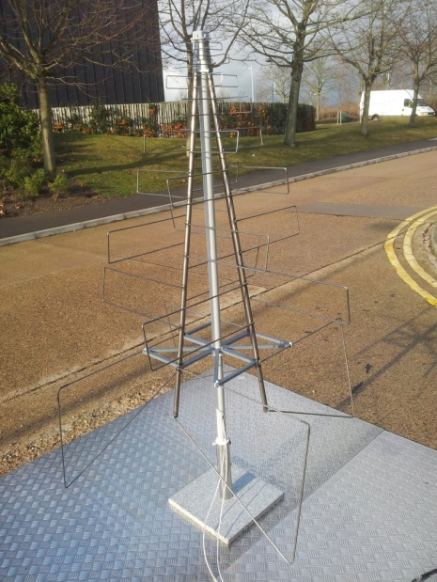
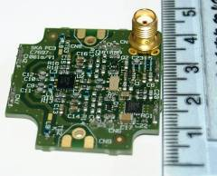
Update on Measurements and Simulations at Cambridge:
SKALA element + LNA
Eloy de Lera Acedo
Nima Razavi Ghods
Cavendish Laboratory
University of Cambridge
Cambridge, UK.

Slide 2
Overview
Design and Simulations
Measurements
  Impedance and coupling (AAVS0 array)
  Pattern
  LNA
Future work and conclusions
  SKALA with integrated ground plane
  Cross-polarization

Slide 3
Design
Dual-polarization from (50) 70-450 (600) MHz
Element gain ~ 7dB
Receiver noise < 35 K above 100 MHz
Receiver gain > 36 dB (2 stages)

Slide 4

Design and Simulations
The antenna was designed using CST
The simulations of the element were confirmed using HFSS
The MoM/MBF specialized code (UCL/UCAM) was used to verify the behaviour at array level (SKA stations)
  Mutual coupling analysis (averages out for random configurations)
  Low order models for calibration
  Objective of the measurement campaign with single elements and the AAVS0 array: Confirm that these simulations are correct. We design the SKA with simulations!

Slide 5
EM characterization of SKA arrays
  Mutual coupling effects randomize out in quasi-random configurations.**
*Gonzalez-Ovejero, D., De Lera Acedo, E., Razavi-Ghods, N., and Craeye, C. (2009)
*Gonzalez-Ovejero, D., De Lera Acedo, E., Razavi-Ghods, N., Garcia, E., and Craeye, C. (2011)

Slide 6
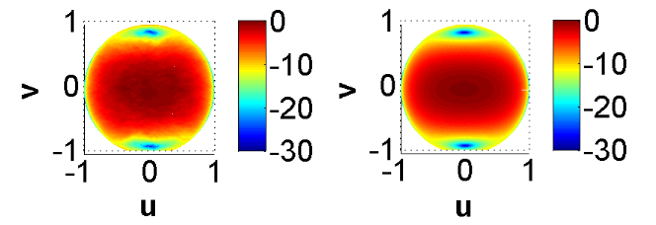
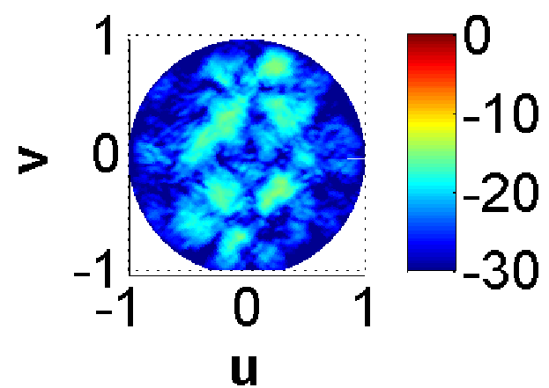
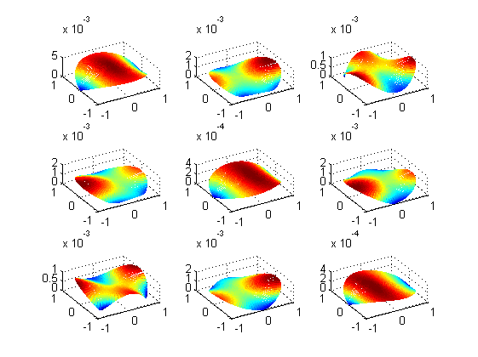
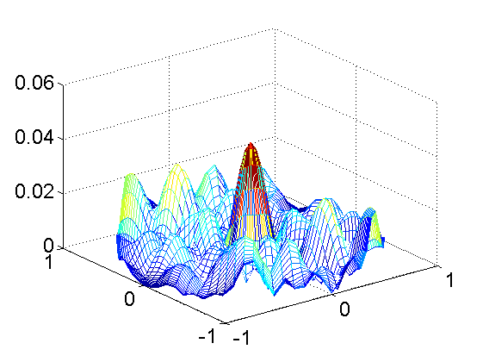
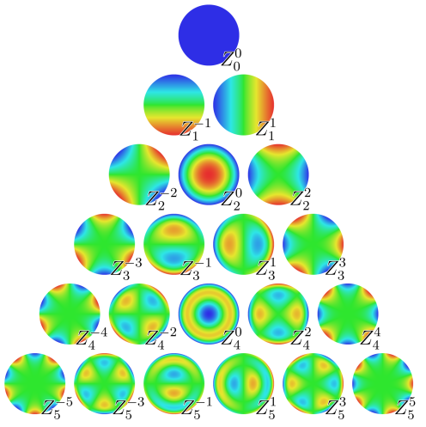
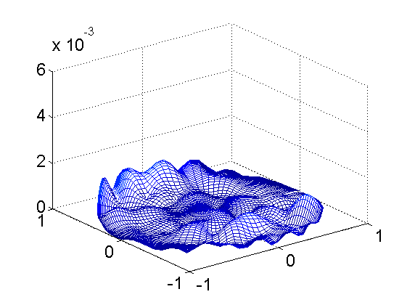
EM characterization of SKA arrays
  Accurate EM simulations can be useful for the telescope calibration.**
+
=
Q=3
*De Lera Acedo, E., Razavi-Ghods, N., Gonzalez-Ovejero, D., Sarkis, R., and Craeye, C. (2011)
**Craeye, C., Gonzalez-Ovejero, D., Razavi-Ghods, N., and de Lera Acedo, E. (2012)

Slide 7
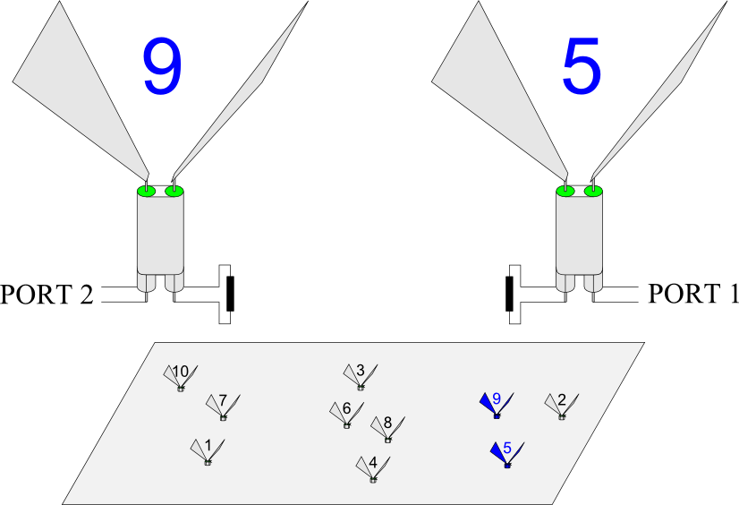
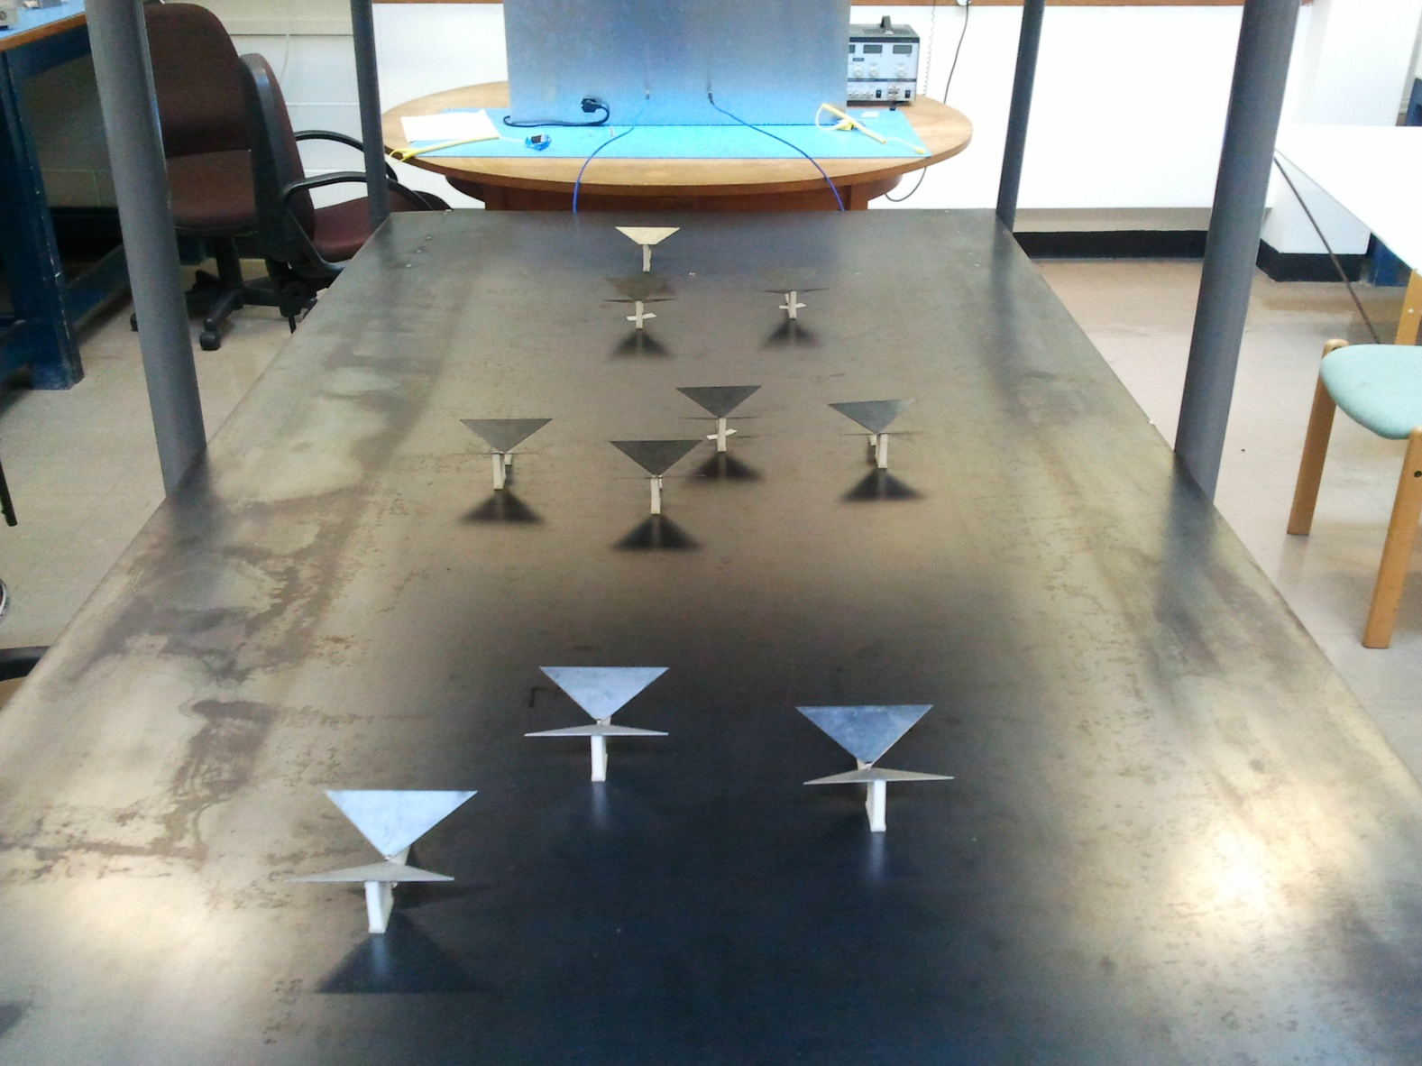
EM characterization of SKA arrays
  The method has been tested before.*
→Measurements
→Simulations MoM
→Simulations MBF
*Raucy, C., De Lera Acedo, E., Craeye, C., Gonzalez-Ovejero, D., and Razavi-Ghods, N. (2012)

Slide 8
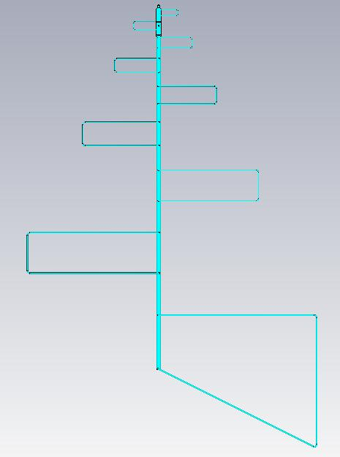
EM characterization of SKA arrays:
Antenna model in simulations
CST
MoM
spine

Slide 9
Design and Simulations
  Important for a SKA antenna element (embedded in a station)
Effective aperture
Pattern
Noise
(sky, ground, LNA)
Antenna
impedance
Calibratability
Cross-polarization
LNA noise & gain
Sensitivity
Linearity, stability, ripple
LNA intermodulation
Element’s footprint
Cost (including deployment and durability)
Power consumption
LNA power consumption
Materials, construction, assembly, maintenance, etc.
Material properties

Slide 10
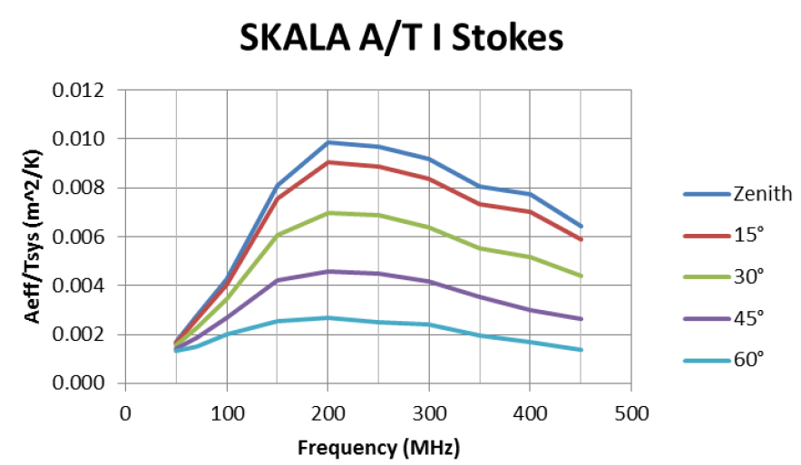
Design and Simulations
  Sensitivity (“Antenna Standardization report”: Shantanu Padhi, Ver: 2.0, 1 August 2012)
~1,300 m^2/K for 500,000 elements

Slide 11
Measurements
  We can measure most of what we can simulate
Effective aperture
Pattern
Noise
(sky, ground, LNA)
Antenna
impedance
Calibratability
Cross-polarization
LNA noise & gain
Sensitivity
Linearity, stability, ripple
LNA intermodulation
Element’s footprint
Cost (including deployment and durability)
Power consumption
LNA power consumption
Materials, construction, assembly, maintenance, etc.
Material properties
  *See more about future measurements in Nima’s talk (test plan)

Slide 12
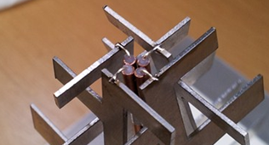
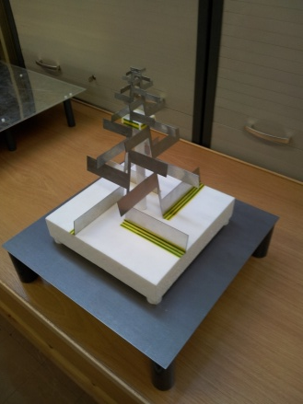
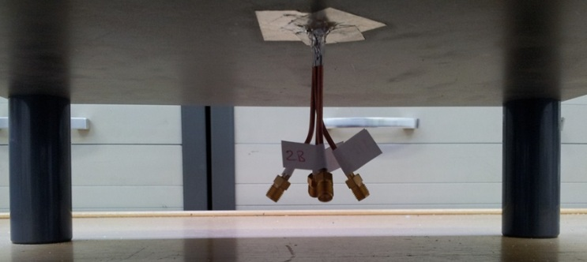
Measurements: Impedance and coupling tests
  Scaled prototype
Zdiff
+
-
1
2
VNA

Slide 13
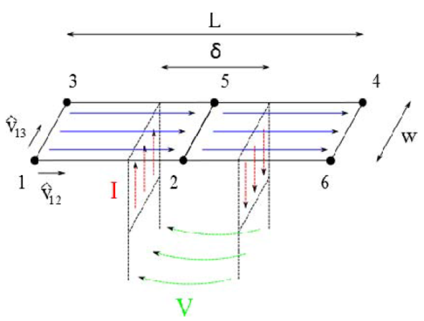
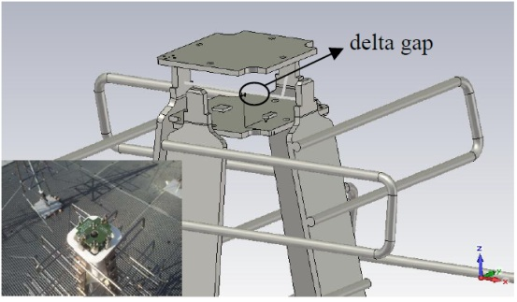
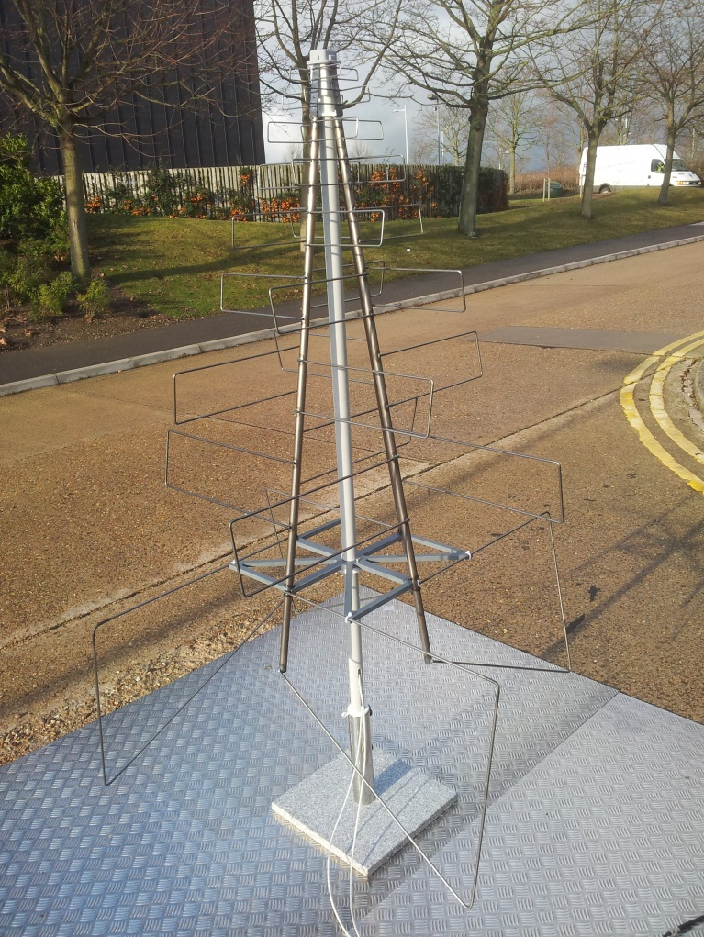
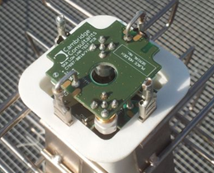
Measurements: Impedance and coupling tests
MoM
  SKALA element
CST
Test board

Slide 14
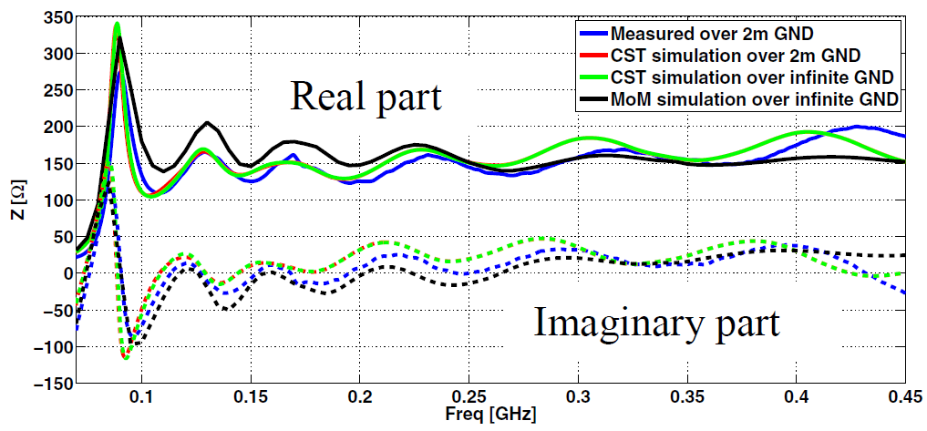
Measurements: Impedance and coupling tests
SKALA element

Slide 15
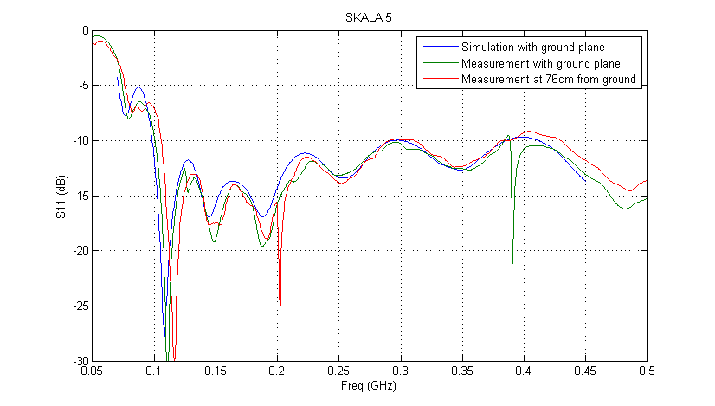

Measurements: Impedance and coupling tests
*B. Fiorelli

Slide 16
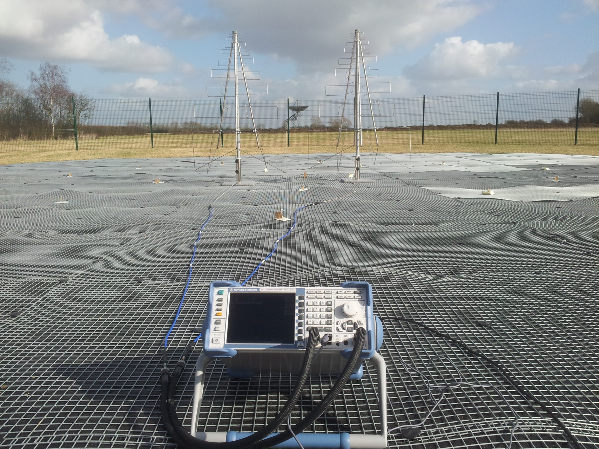
Measurements: Impedance and coupling tests
  AAVS0 array
2 SKALA elements 1.5 m apart

Slide 17
Measurements: Impedance and coupling tests
TOP VIEW
1.5 m

Slide 18

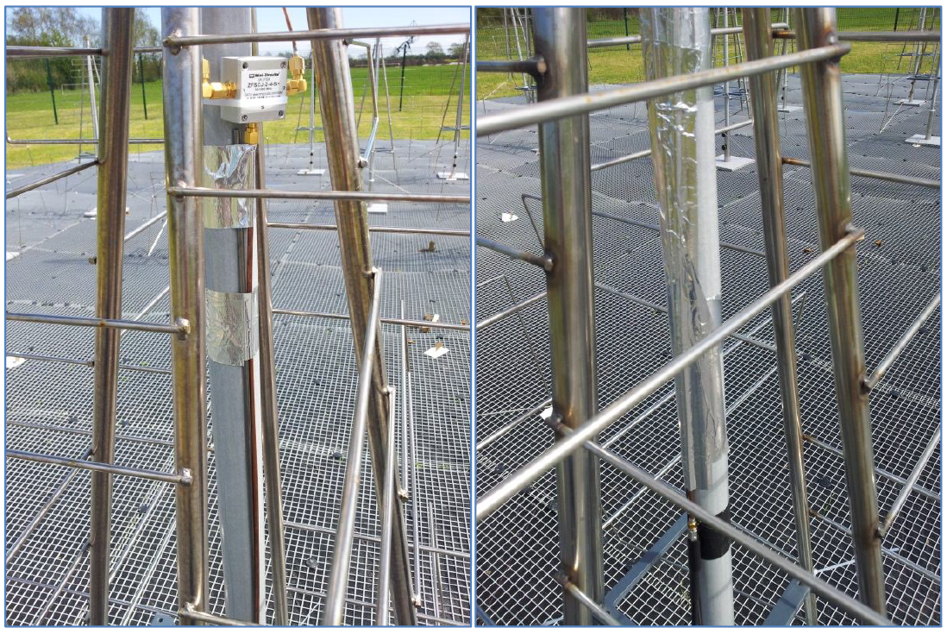
Measurements: Impedance and coupling tests
  Common-mode currents (with Howard Reader – April 2012)

Slide 19
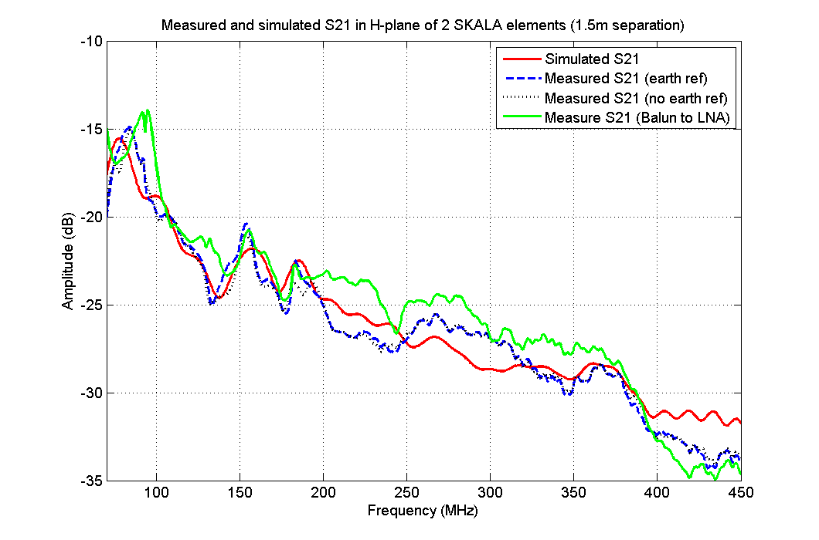
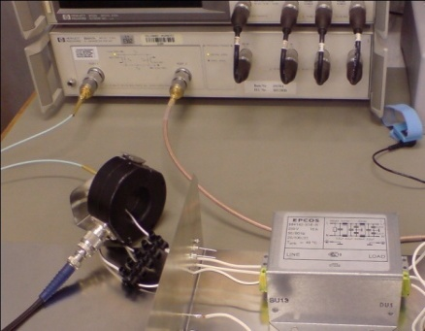
Measurements: Impedance and coupling tests

Slide 20
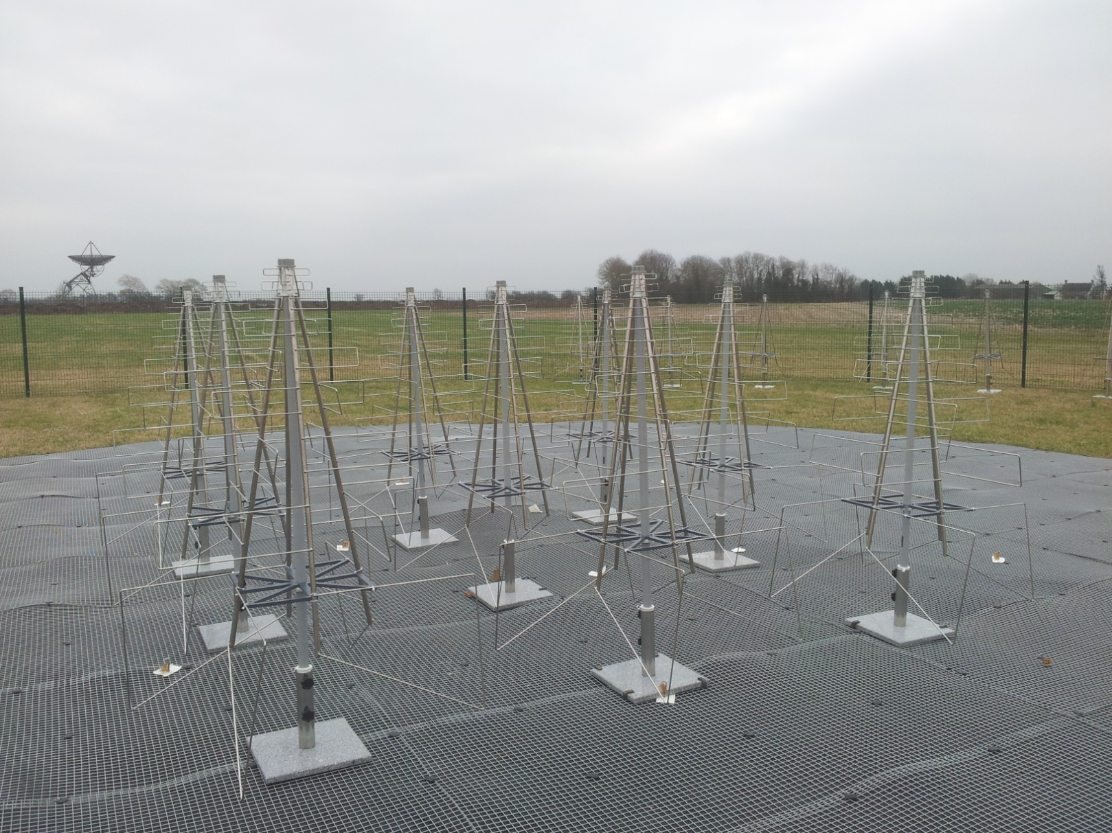
Measurements: Impedance and coupling tests

Slide 21
Measurements: Impedance and coupling tests

Slide 22
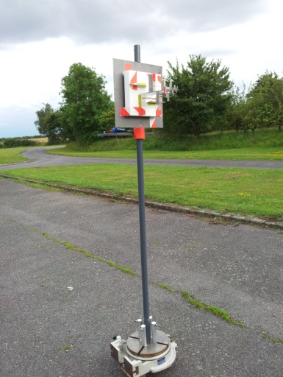
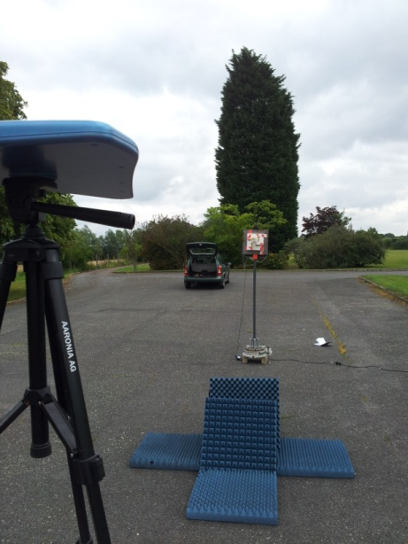
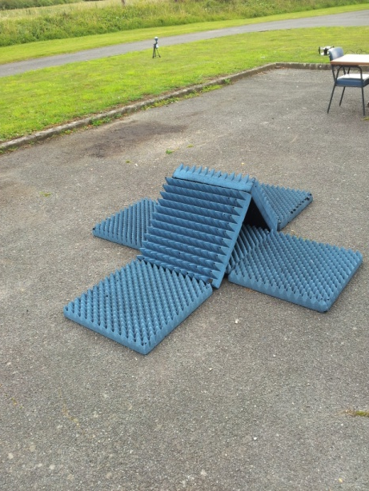
Measurements: Pattern
  Scaled prototype:
    Direct line of sight range (main reflected ray absorbed).
    Using Spectrum analyser, signal generator and power combiner.
    At Lords Bridge. Easy, quick and great results.

Slide 23
Measurements: Pattern

Slide 24

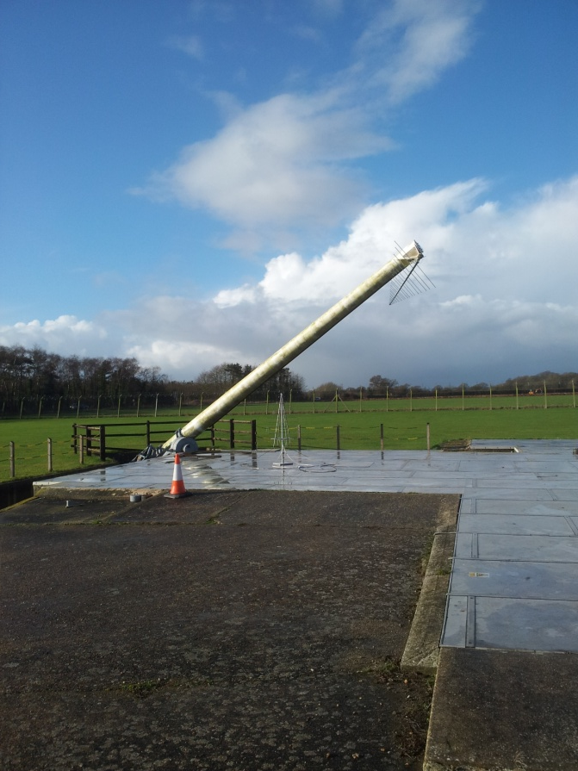
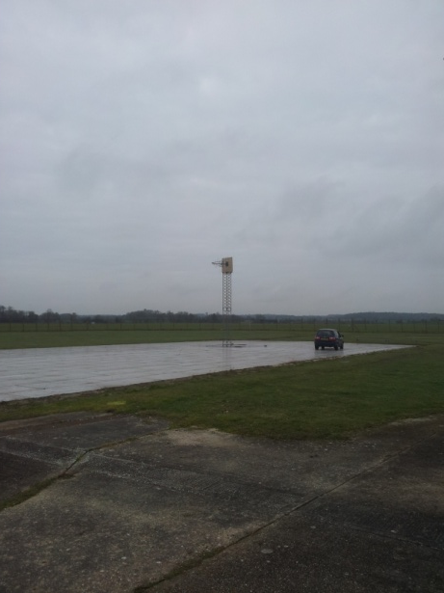
Measurements: Pattern
  SKALA element (at QinetiQ)
    Arch above antenna (near field).
    Ground refection range.

Slide 25
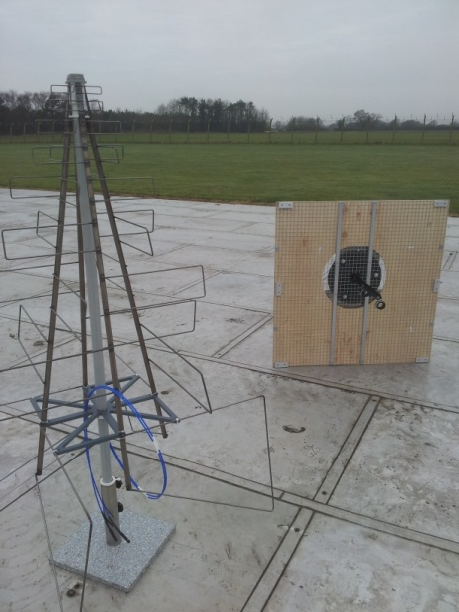
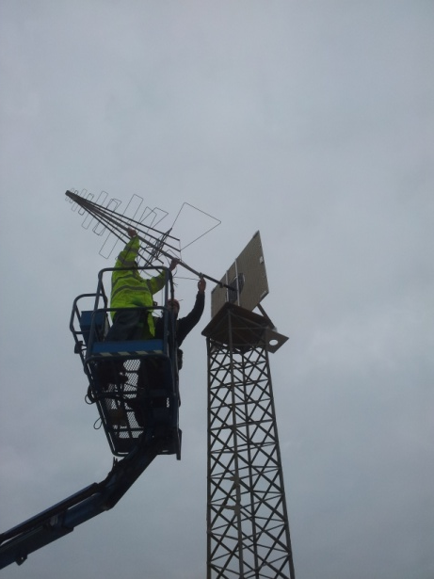
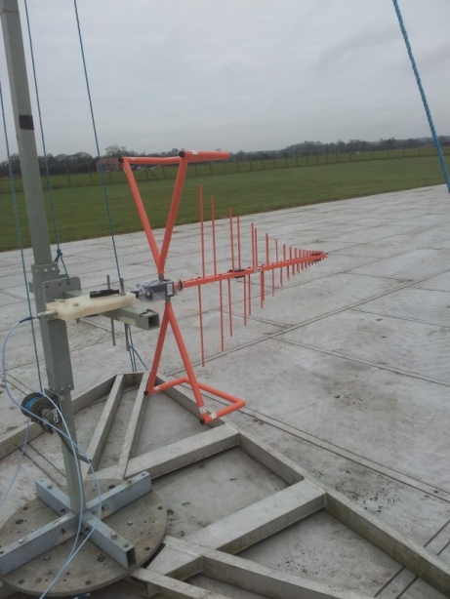
Measurements: Pattern

Slide 26
Measurements: Pattern
70 MHz | 200 MHz
300 MHz | 450 MHz
E-plane cut

Slide 27
Measurements: Pattern
200 MHz
300 MHz | 450 MHz
H-plane cut

Slide 28

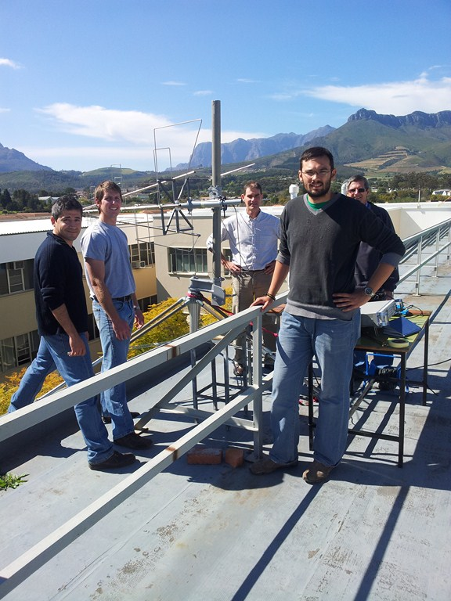

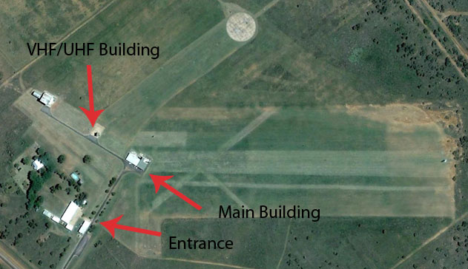
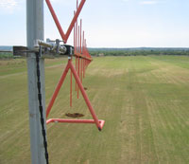
Measurements: Pattern
  SKALA element (with Howard Reader)
    At Stellenbosch University.
    Ground refection range.
www.paardefontein.co.za

Slide 29
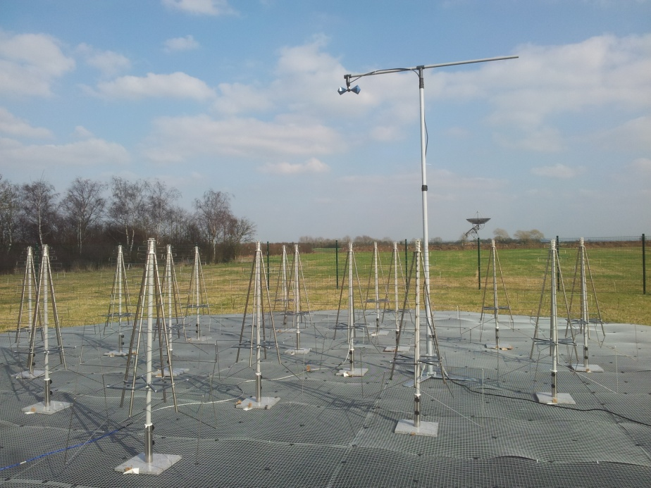
Measurements: Pattern
  Near field pattern measurement (AAVS0)

Slide 30
Measurements: LNA
  Concept
LNA1
COAX
LNA2

Slide 31

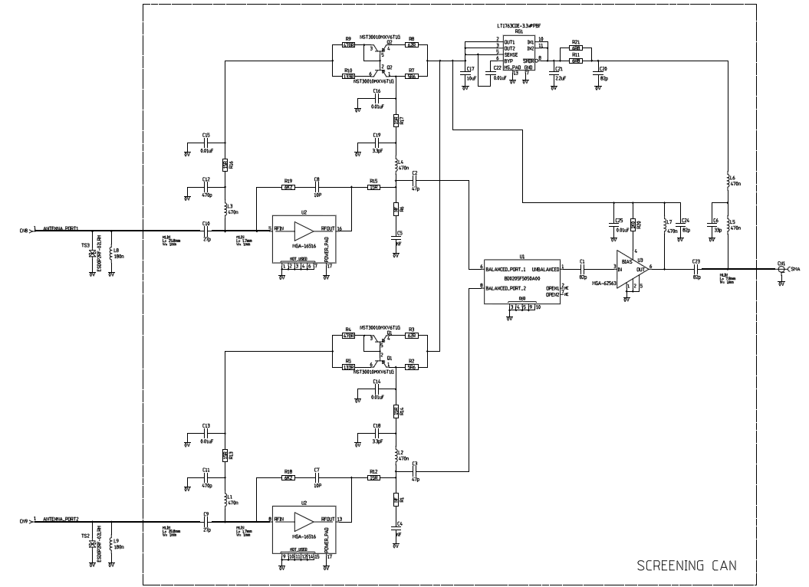
LNA
  Design
Transformer
2nd stage
amplifier
AVAGO
MGA-16516

Slide 32
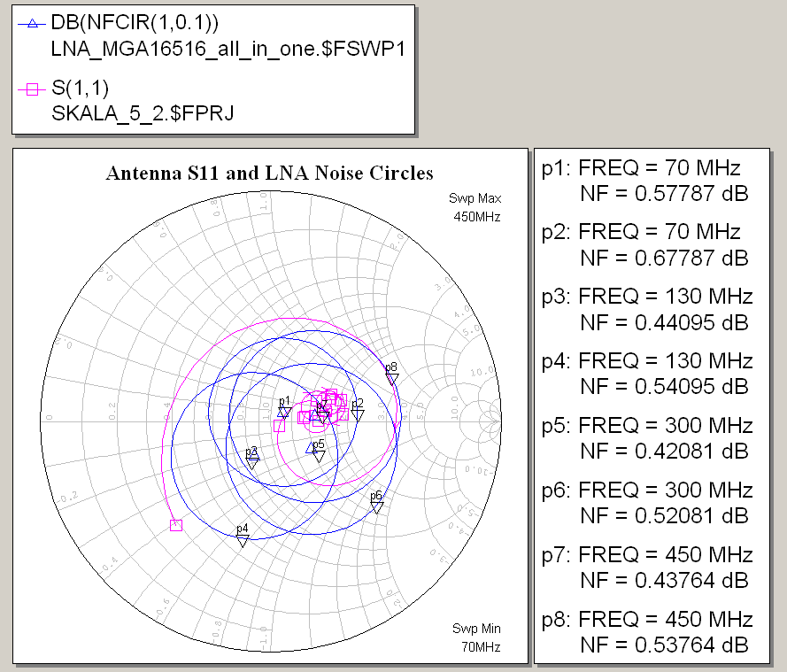
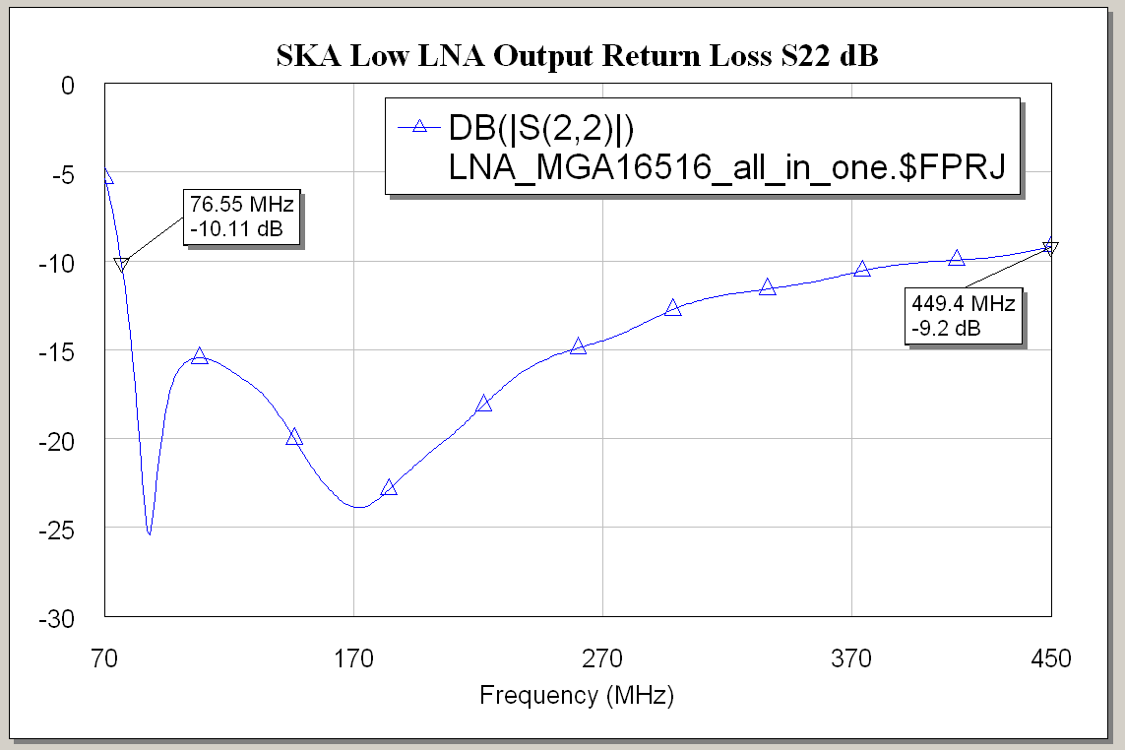
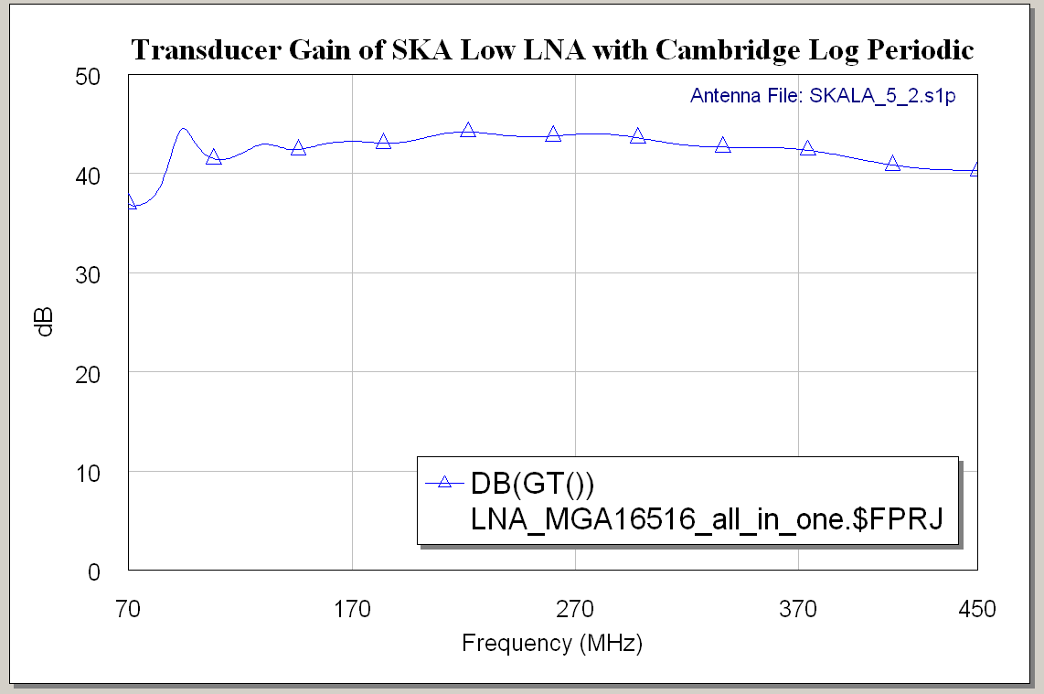
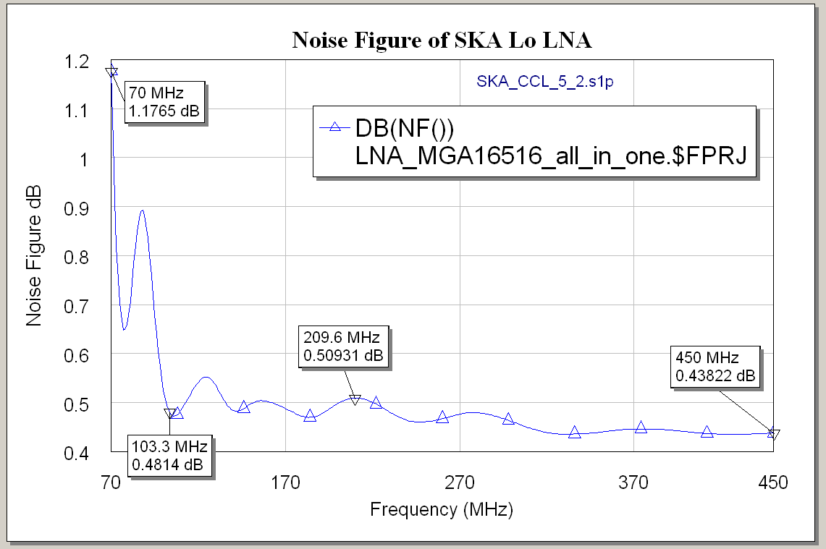
LNA
  Simulations

Slide 33
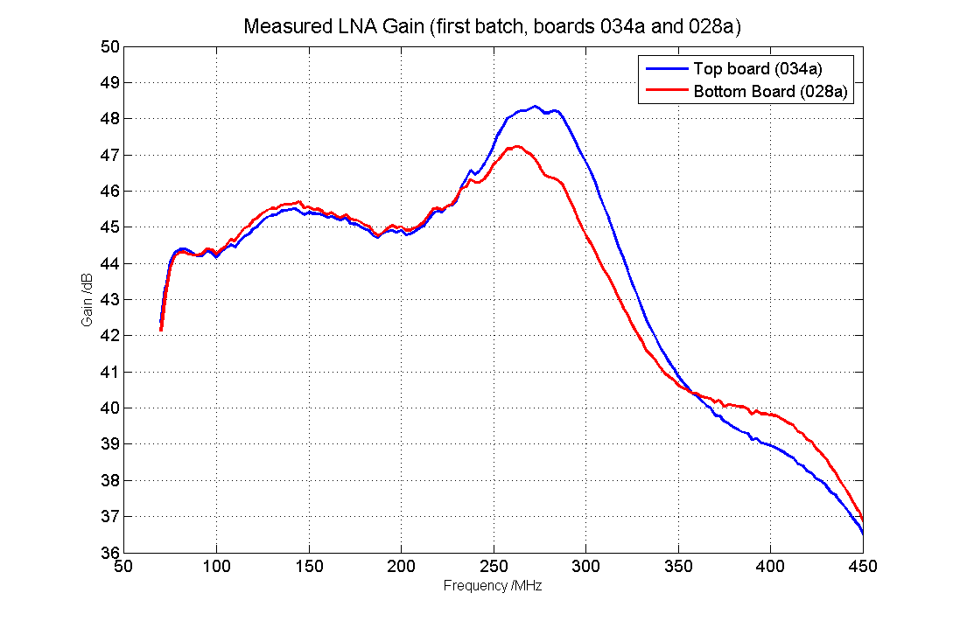
Measurements: LNA
  Gain

Slide 34
Measurements: LNA
  Hot/cold measurement with 150 Ω load.
    Liquid Nitrogen (77 K)
    Room temperature (290 K)
    Filtering

Slide 35

Measurements: LNA
  1st stage amplifier with Agilent noise analyser in reverberation chamber.

Slide 36
Measurements: LNA
  Noise tuner and noise parameter measurement in reverberation chamber at ASTRON.

Slide 37
Measurements: LNA
  Intermodulation
    Not great expectations (by design):
      OIP2: 17 dBm
      OIP3: 19 dBm
  Others:
    Tests on single transistors.
    Connection to antenna and noise measurement in reverberation chamber.
    RFI monitoring.

Slide 38
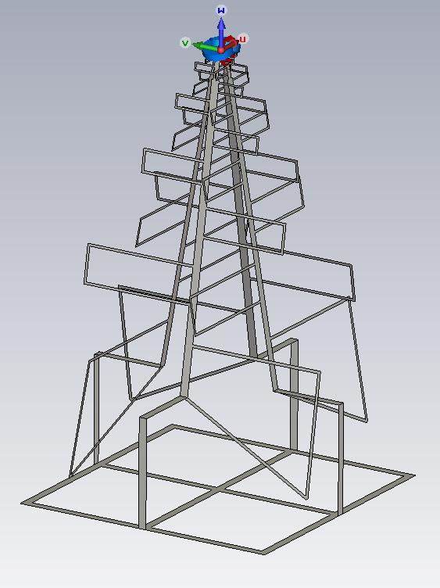
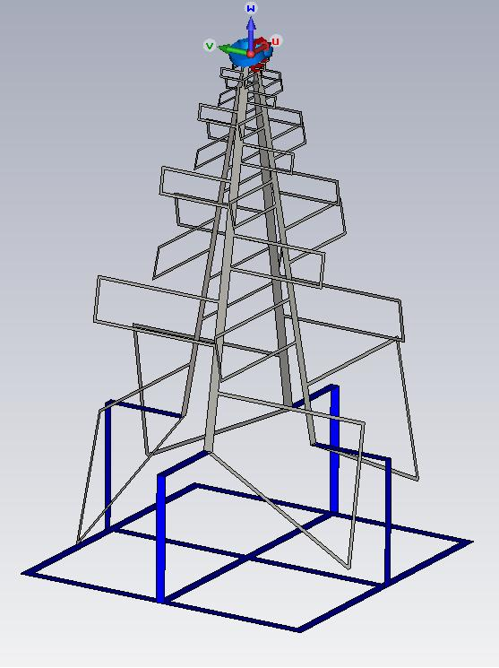
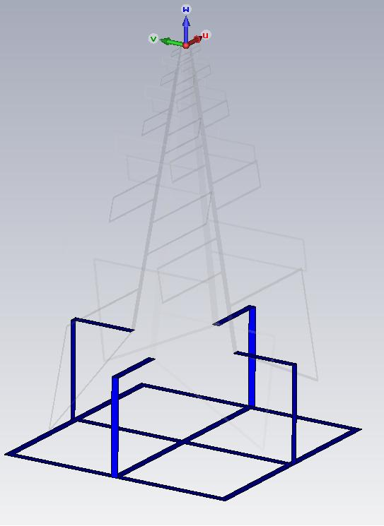
Future work and conclusions
  SKALA with integrated ground plane

Slide 39
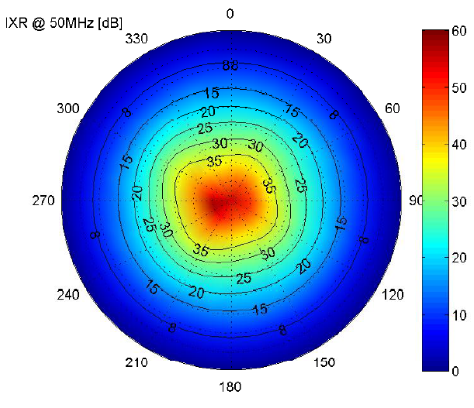
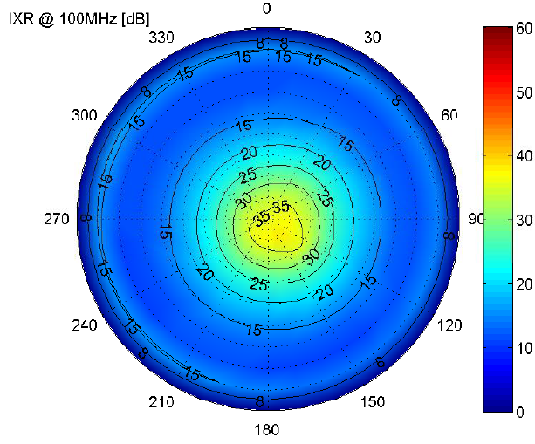
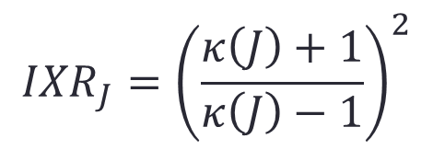



Future work and conclusions
  Cross-polarization (“IXR SKALA with GP vs Vivaldi V2 with Soil C”, 08/10/2012 – B. Fiorelli)
$$\left[\begin{matrix}V_{1} \\ V_{2}\end{matrix}\right]=\left[\begin{matrix}J_{11} & J_{12} \\ J_{21} & J_{22}\end{matrix}\right]\left[\begin{matrix}E_{t} \\ E_{p}\end{matrix}\right]$$

Slide 40
Future work and conclusions
  Most measurements already done.
  The performance is looking like the simulations said.
    Element
    LNA
  More measurements to be done, using a back-end (see Nima’s talk).
  More development coming.
    Even cheaper element, long lasting materials, integrated ground plane.
    Lower power consumption for LNA, better IP2/3.

Slide 41




Lord’s Bridge Observatory
SKALA-AAVS0

Slide 42

Thank you! Any questions?

