Slide 1
AAVS 0.5: An Overview
Peter Hall
ICRAR/Curtin, Bologna, October 22, 2012

Slide 2
What is AAVS 0.5?
16-element LPDA array (70-450 MHz) located at the Murchison Radioastronomy Observatory
Specifically, within the site designated for the MWA precursor
Similar to one (of several) AAVS 0 arrays
Dependent on MWA infrastructure and site legal agreements
Constituted as an MWA extension, via MWA user instrument policy
P J Hall as Principal Investigator
Known as “test and evaluation tile” to the MWA
Physical access via MWA site visits
One-off opportunity
Limited resources, very limited site access, limited lifetime (~18 months)

Slide 3
AAVS partners and motivation
Self-funded partners: ICRAR, ASTRON, UCamb
Test results freely available beyond partnership
Opportunities to incorporate some systems and ideas from other parties
Motivation
Enhance MWA practical contribution and profile as an SKA precursor
Enhance MWA calibration and science, where possible
Meet ICRAR project plan for MRO small array
Begin transfer of MWA practical site expertise to ICRAR SKA-low team
Needed for AAVS 1 and beyond
Provide an MRO test platform for AAVS (0 or 1) electronic systems, where possible
Information and optimization on actual RFI-quiet SKA-low site
Highlight EMC challenge early
Provide an MRO test platform for infrastructure and physical systems, where possible
Feed to AAVS 1 design, along with info from various AAVS 0 systems

Slide 4
What AAVS 0.5 is not
Not formally an SKA-related system
All SKA activities require a new, and comprehensive, site licence at the MRO (and in RSA)
Not formally part of SKA system engineering process
Does not feature in WBS
Has no preferential bearing on SRR etc, beyond current (multiple) AAVS 0 inputs
Reflects no position on preferred final form of SKA-low, e.g.
Choice of antenna
Choice of 1 or 2-band implementation
Choice of final frequency range
Not part of WBS → currently not part of AADC Consortium activities
(but platform and results available to AADCC, where possible)
Could be part of updated WBS (?)
Have to enter via pathfinder links, not SKA verification
Have to be formally undertaken by 3 original partners, to meet MWA and MRO agreements
Probably better to keep wider inputs informal

Slide 5
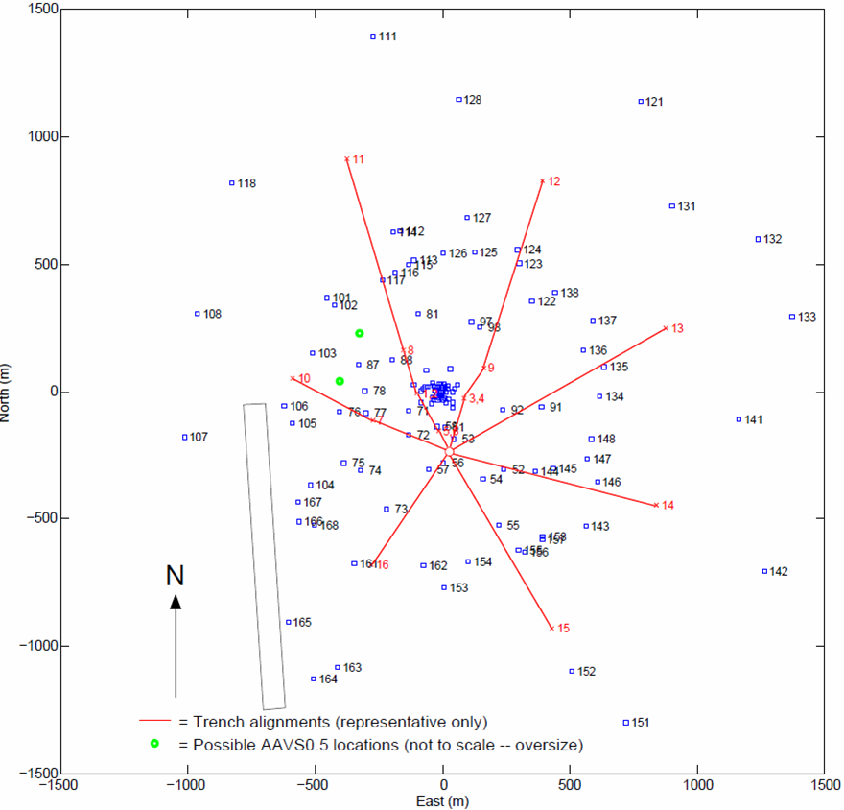
AAVS 0.5 location within MWA
Is it a big tile or small station?
Depends if you come from the MWA or SKA perspective
Leads to some system physical arrangement issues

Slide 6
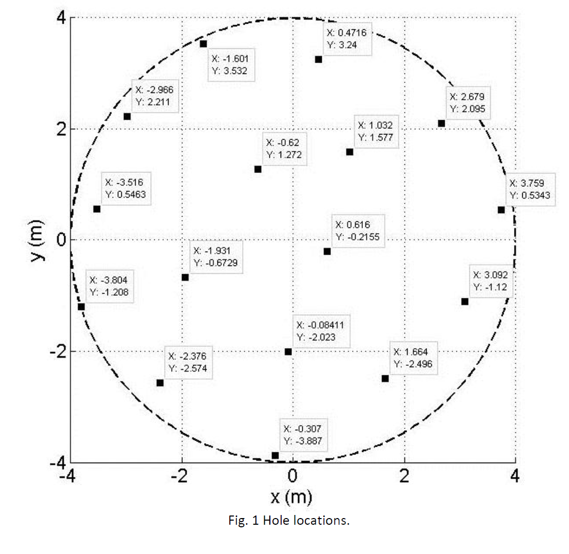
Initial configuration
16 antennas,
8 m dia. station
(5 deg HPBW 450 MHz)
2 remote mountings, each ~30 m from centre
(correlation reference)

Slide 7
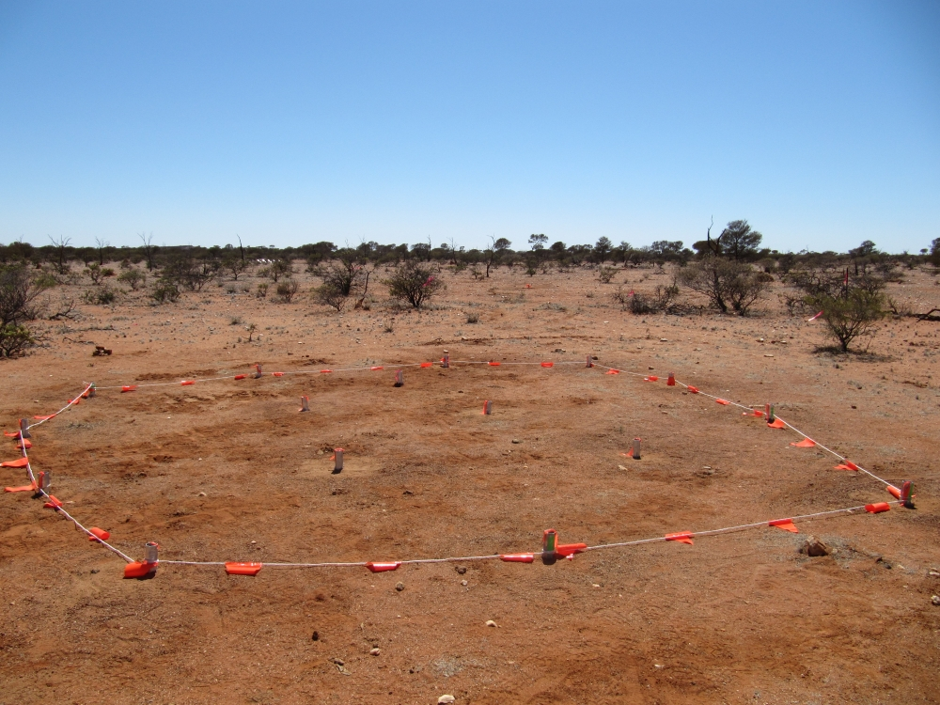
Site as of 18 October, 2012
Holes 0.6 m deep,
0.12 m dia
Bedrock ~0.2 m deep
~6 mins to drill 1 hole
2 deg vertical tolerance ‘easy’
Courtesy Adrian Sutinjo and Jon Tickner

Slide 8
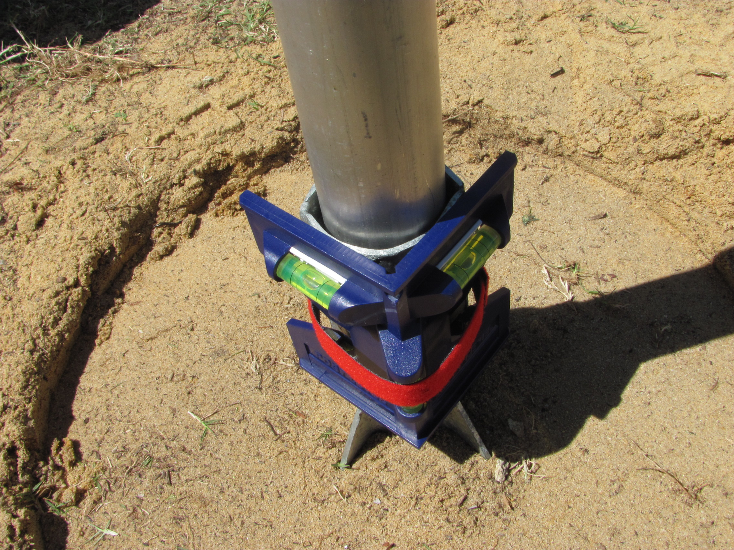
AAVS 0.5 mounting

Slide 9
Approximate schedule
Stage 1 – November 2012
Mechanical installation of antennas and ground mesh
MWA Geraldton workshop inc. SKA-low session Dec. 1, 2012
Stage 2 – May 2013
Simple electronics and data-taking installation
First performance tests via e.g. Galactic transit observations
Maybe: station tied-array correlation with reference antenna
Stage 3 – December 2013
DSP installed
Intra-station correlation
MWA cross-correlation
Stage 4 – June 2014
Final characterizations and MWA joint science
AAVS 0.5 removal, if required by MWA and/or MRO site manager

Slide 10
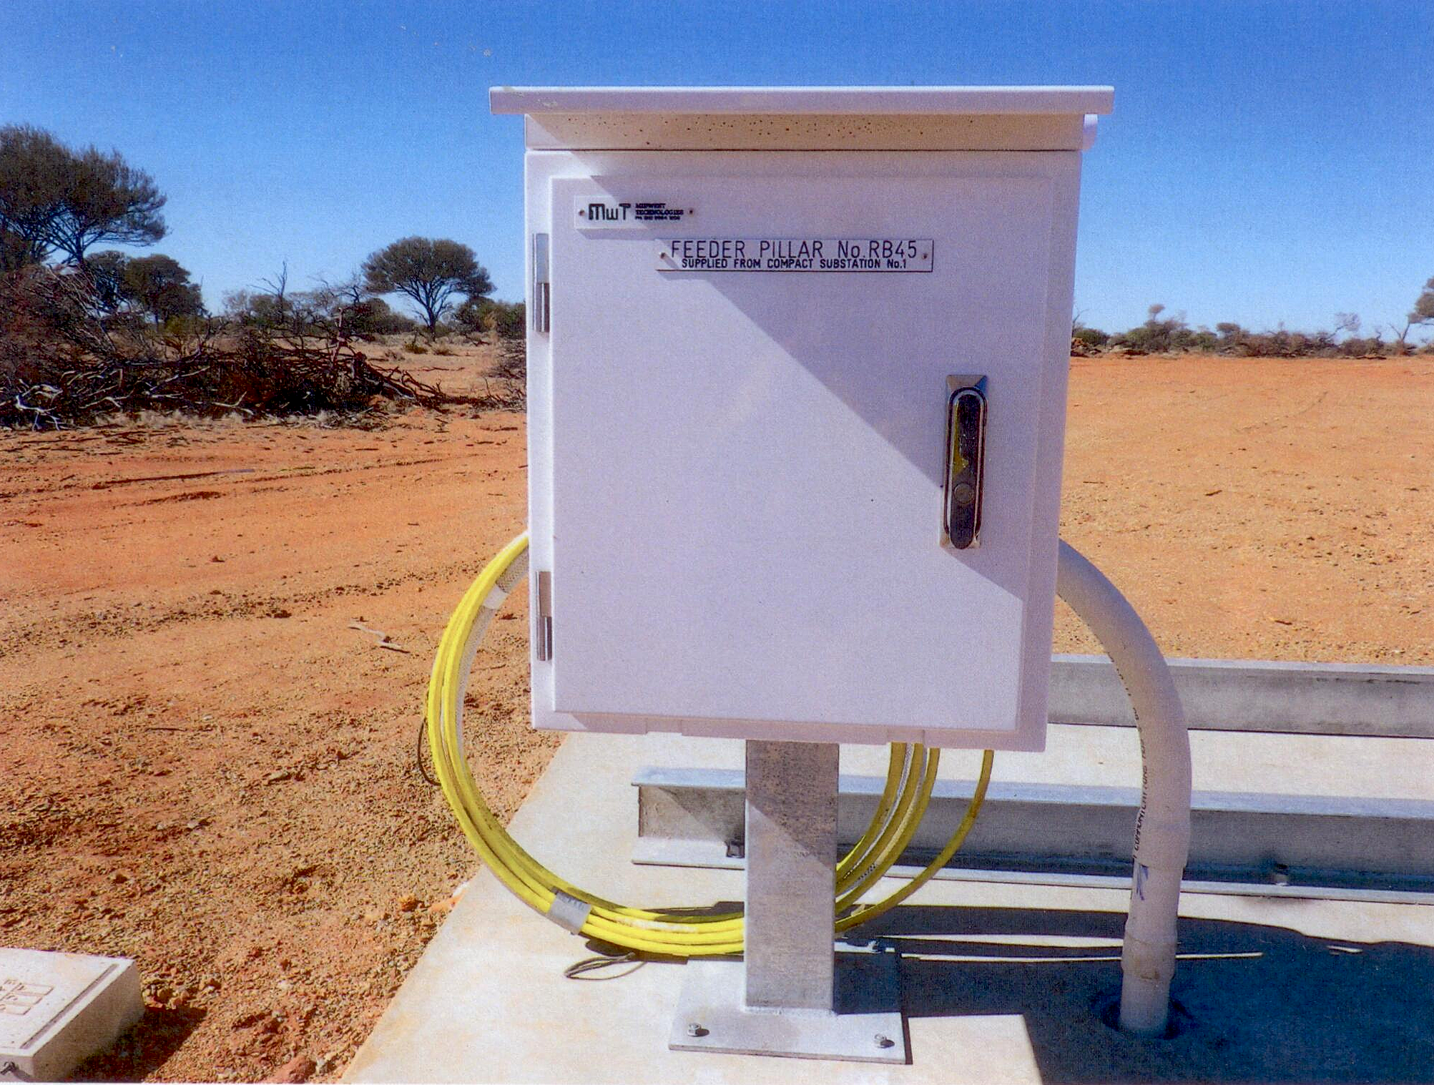
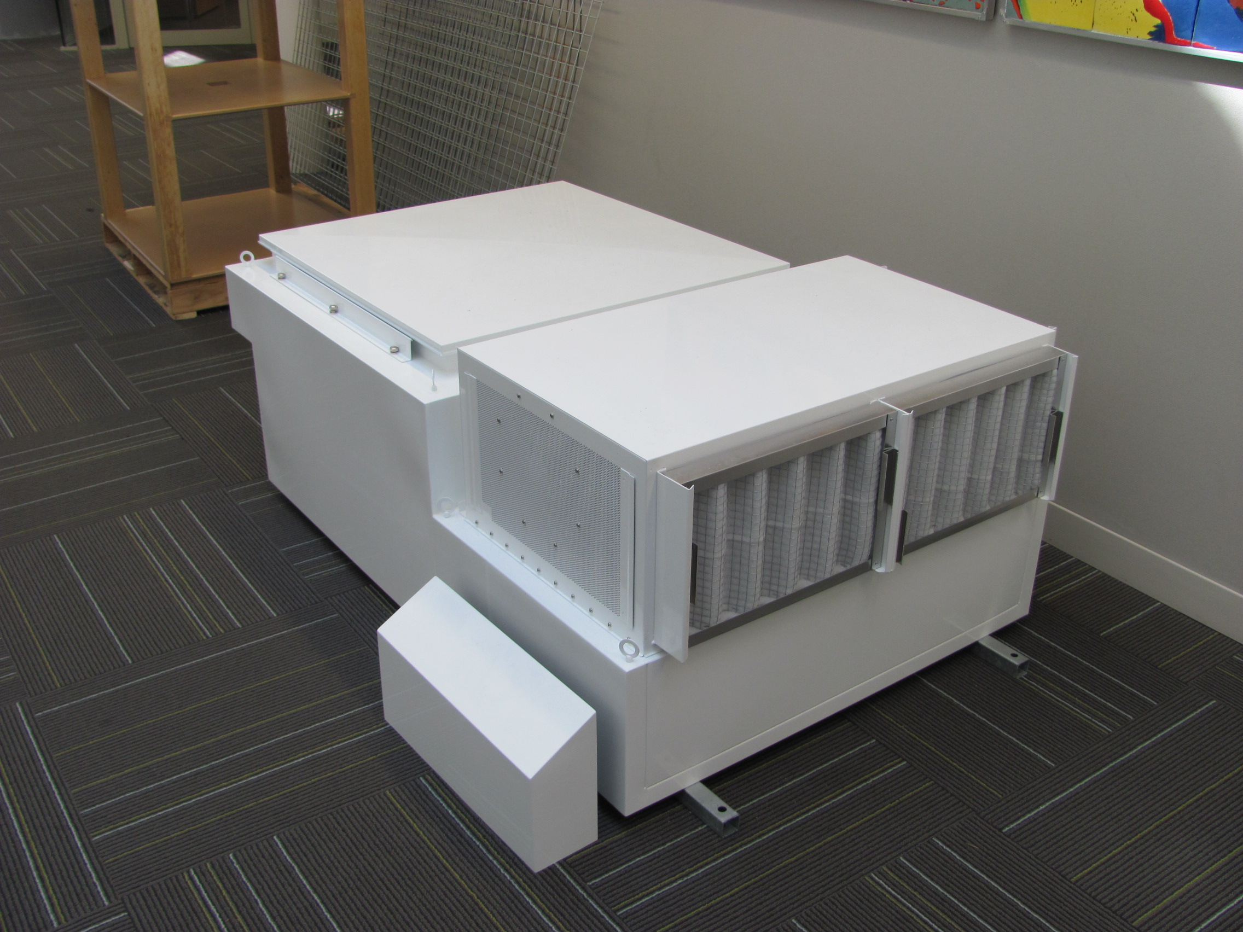
MWA infrastructure
“Spare” infrastructure when MWA de-scoped to 128T
Power, fibre most relevant for AAVS 0.5
AAVS 0.5 station electronics ~ 1 MWA “receiver” (digitizer)
Power limit of ~ 1.5 kW at “receiver” pad
Fibre connectivity to MWA hut → ASKAP/MWA screened building → to Perth → anywhere
MWA has dedicated 10 Gb/s link to Perth
Partly, or (sometimes) wholly, available to AAVS 0.5
Much more data capacity available at “modest” cost
There is one spare MWA receiver enclosure available if required (EMC certified)

Slide 11
Conclusion
AAVS 0.5 is a useful augmentation of other AAVS 0 systems
Provides MRO-specific information for all AAVS 0 systems
Feeds unique information to AAVS 1 design efforts
AAVS 0.5 offers MWA the opportunity to make large contributions to SKA-low, via the defined pathfinder WBS
AAVS 0.5 could be of considerable benefit to MWA
Well-modelled LPDAs are an excellent reference against which to characterize MWA beamformed bow-tie dipoles
AAVS 0.5 “long-ish” baseline could be useful in bootstrapping 128T MWA ionosphere calibration
AAVS 0.5 is small, but useful astronomy characterization is possible, e.g.
Galactic Centre transits within 2 deg of zenith; Vela pulsar polarimetry; ....
Correlation of AAVS 0.5 “station” beam with reference antenna (or MWA) essential
Intra-station AAVS 0.5 correlation invaluable in verifying e.m. and other design tools
AAVS 0.5 is formally outside AADCC but it has highlighted the urgency of drafting SKAO – MRO agreements for AAVS1 and beyond
Probably needs to be done in stages, or delay will be intractable
May need AADCC and SKAO to accelerate some WBS tasks (to inform MRO managers)

