Slide 1

LNA implementation
Federico Perini
AA-low Technical Progress Meeting
Medicina, 22-23 September 2012

Slide 2
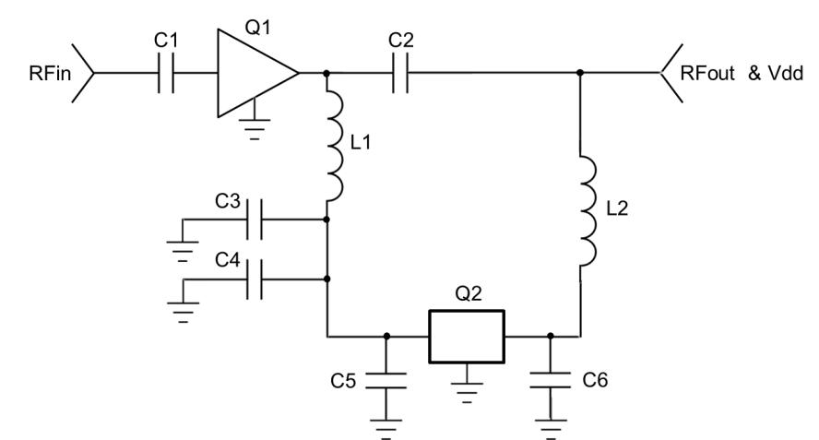

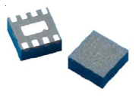
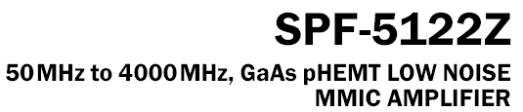

50Ohm AAlo LNA
C1 | Murata, 150pF, 0603, GRM1885C1H151JA01
C2 | Murata, 150pF, 0603, GRM1885C1H151JA01
C3 | Murata, 150pF, 0603, GRM1885C1H151JA01
C4 | Murata, 100nF, 0603, GRM188R71H104KA93
C5 | AVX, 4.7uF, Case B, TAJB475K010RNJ
C6 | AVX, 1uF, Case B, TAJB105K035RNJ
L1 | Coilcraft, 1.2uF, 1008LS-122XJLB
L2 | Minicircuits, RF choke, ADCH-80A
Q1 | RFMD, MMIC Amplifier, SPF-5122Z
Q2 | National Semiconductors, LDO regulator, LP2950
3V, 60mA (included LDO)

Slide 3
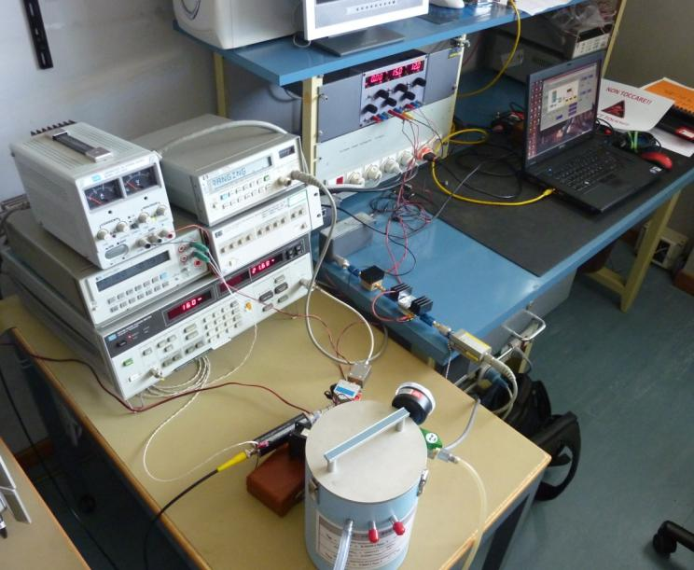
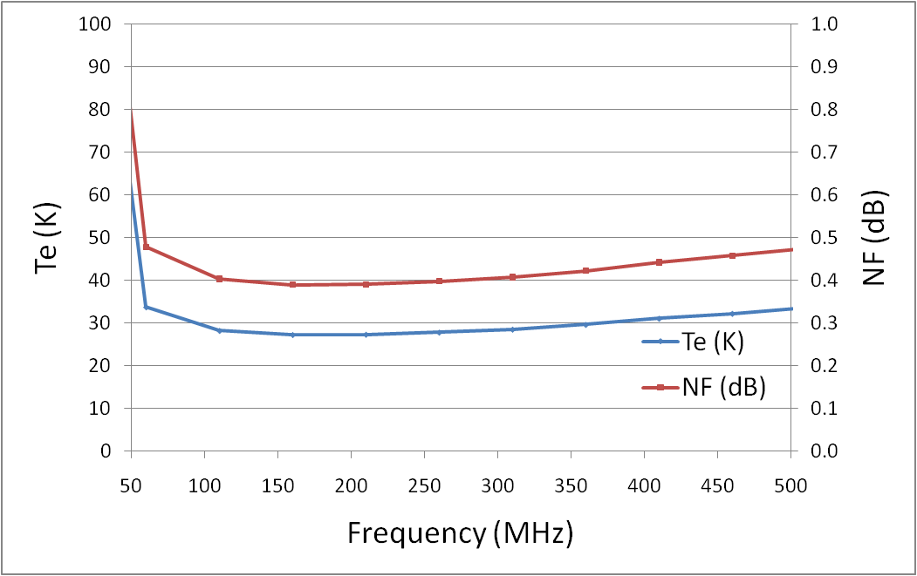
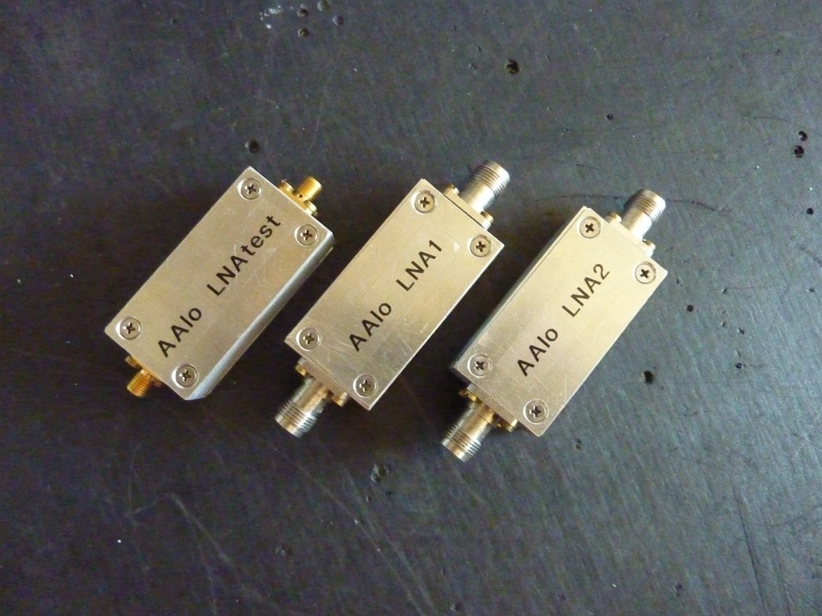
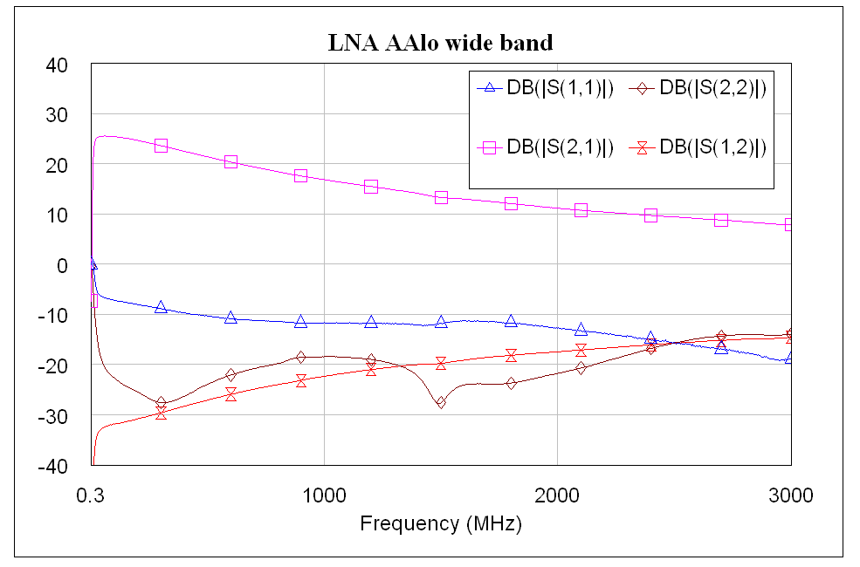
LNA for Vivaldi (August 2011)
2 samples shipped to Perth for (active) antenna pattern measurement on mast
1 LNA for measurement and test (presented in Perth September 2011)

Slide 4
LNA Datasheet (March 2012)

Slide 5
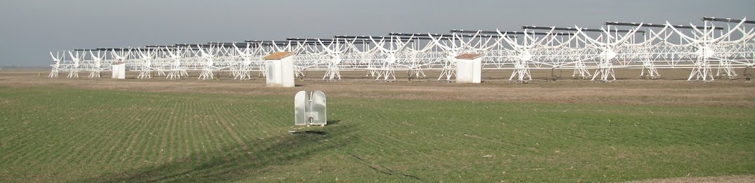
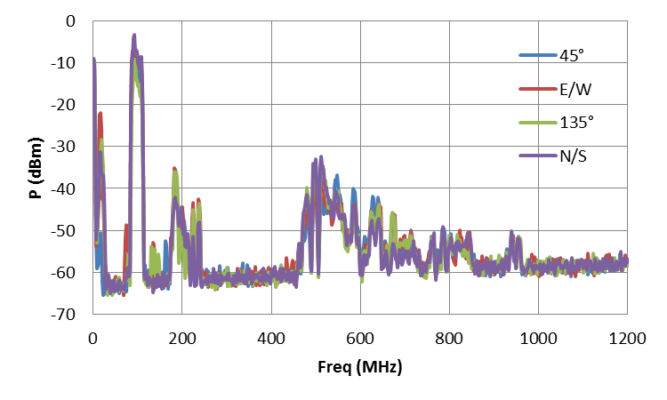
LNA with RFI (Medicina, May 2012)
RFI measurements performed with both SA and Power Meter
 | 45° | E/W | 135° | N/S
P (dBm) | -0.8 | -4.4 | -10.6 | -2.2
15dB below the P1dB (@FM, 3V)

Slide 6
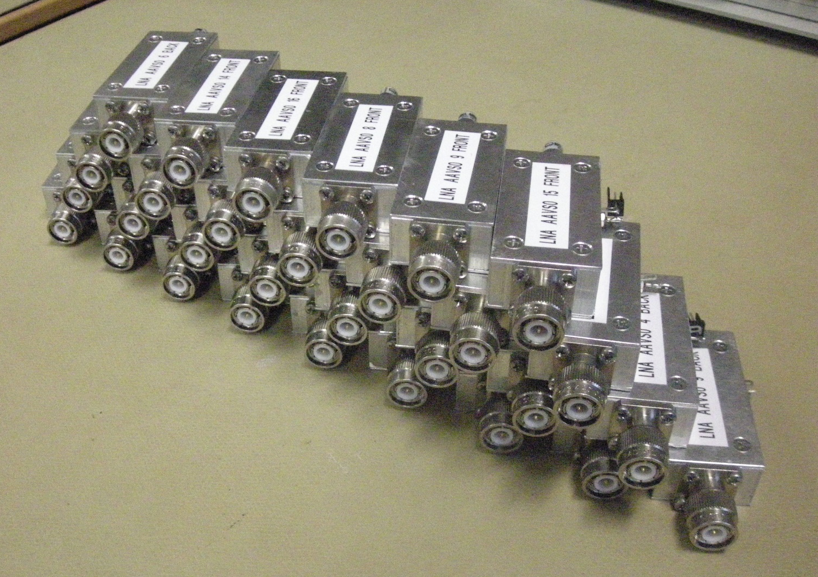
LNA for AAVS0 (June 2012)
32 LNA assembled and tested for (active) embedded pattern measurement and/or mutual coupling

Slide 7
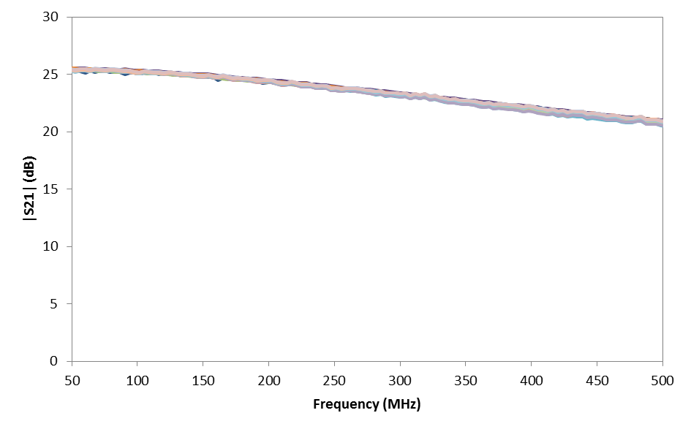
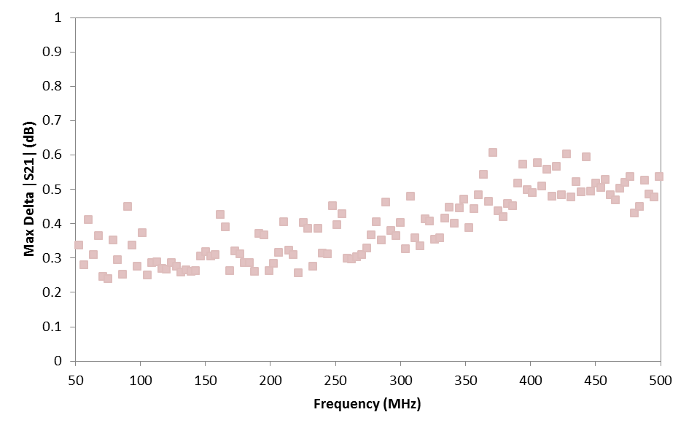
LNA for AAVS0 (July 2012)

Slide 8
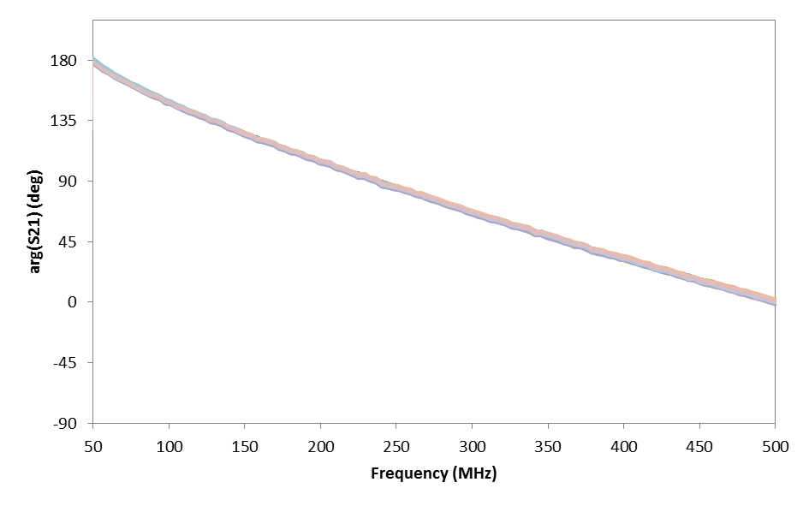
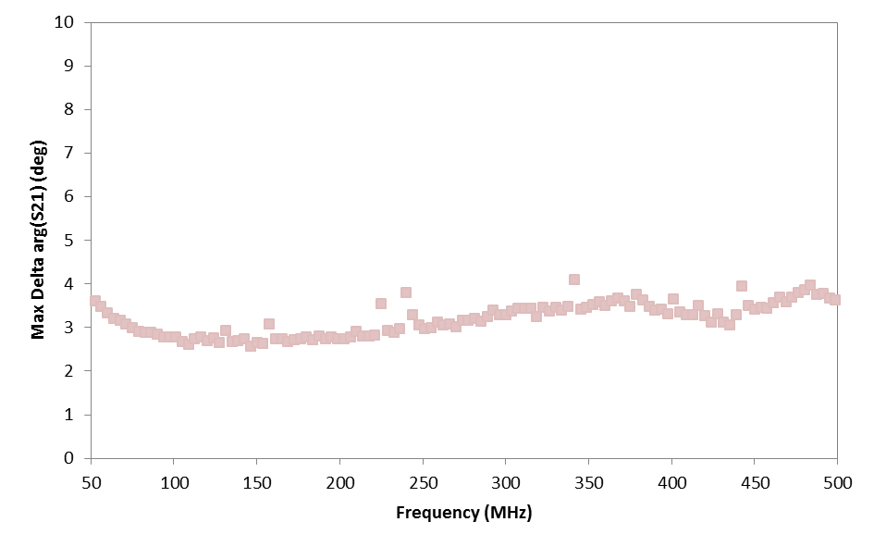
LNA for AAVS0 (July 2012)

Slide 9
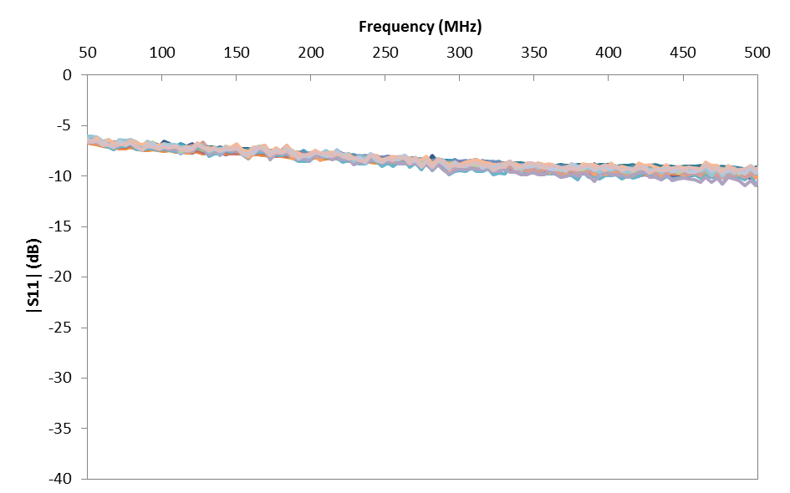
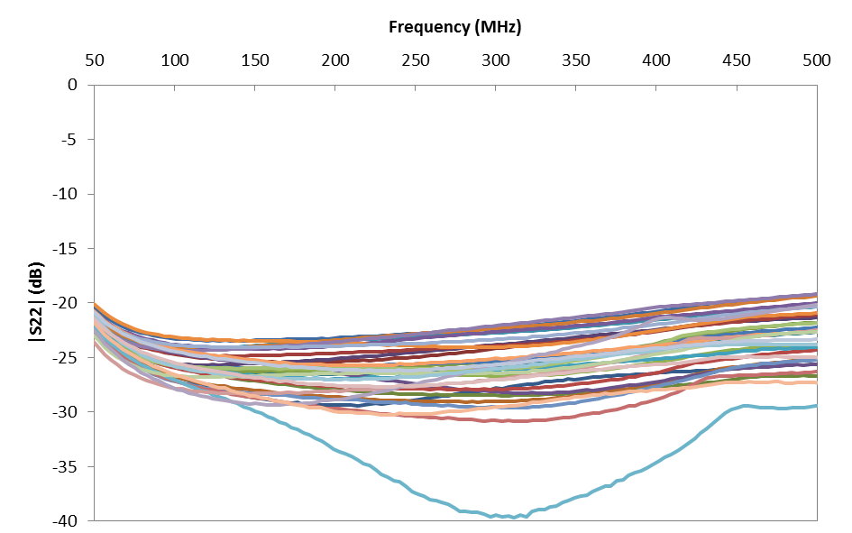
LNA for AAVS0 (July 2012)

Slide 10
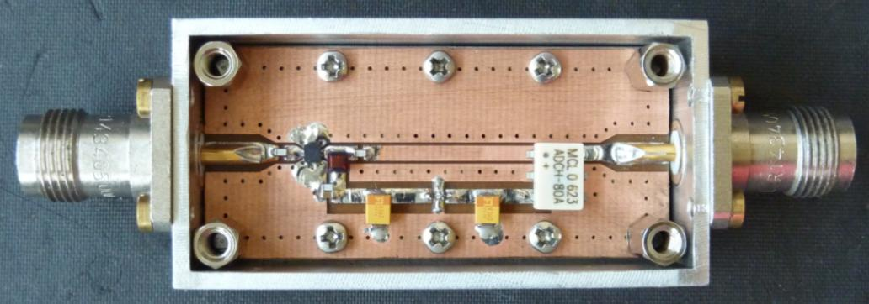
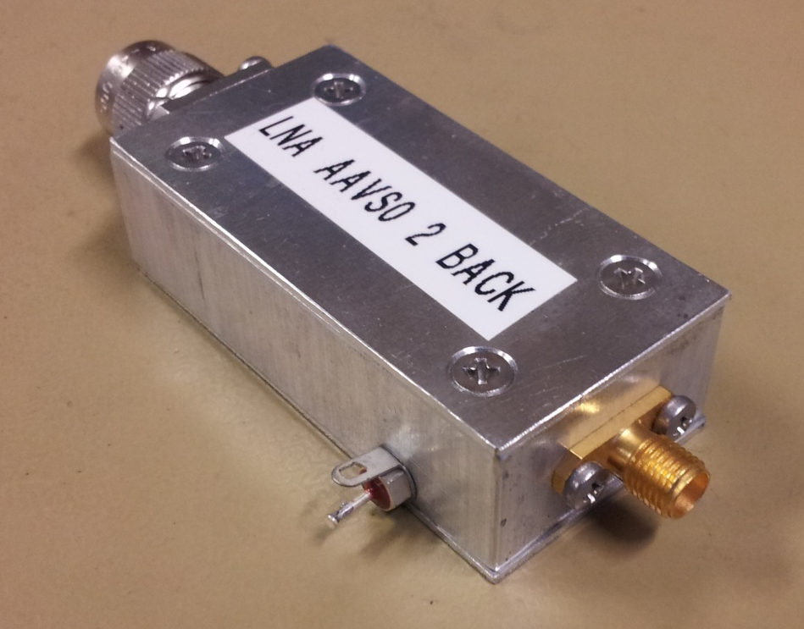
AAVS0 LNA housing

Slide 11

Conclusion
LNA for both single antenna and AAVS0 array measurements produced and delivered on time
For AAVS1 (∼500 pieces):
  Integration of 2 (and 3?) stage
  Integration of O-TX?
  LNA replication on PCB (FR4)
  Avoid the connectors?
  Different housing?
For AAVS2 (min 7K pieces)
  Custom MMIC?
  Avoid the connectors!
  Different housing!
  Integration of O-TX?

Slide 12
Thanks!

Slide 13
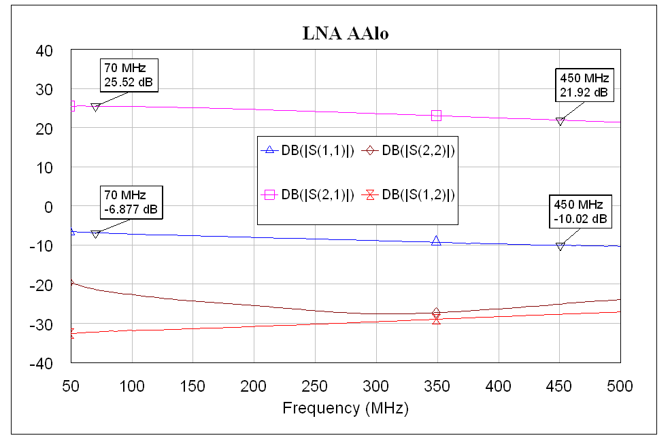
LNA: S-parameters (1)
Meas. notes: Equipment: HP8753C with HP85047 test set
Full 2 port Calibration, LNA Bias from port 2 of the VNA

Slide 14
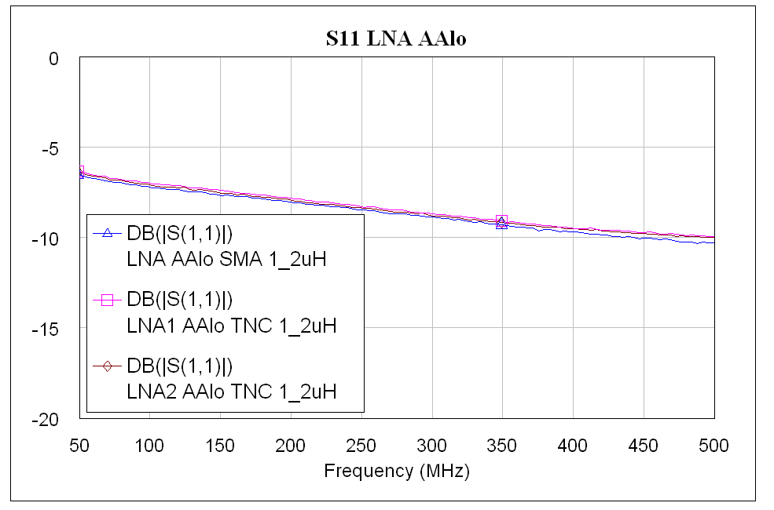
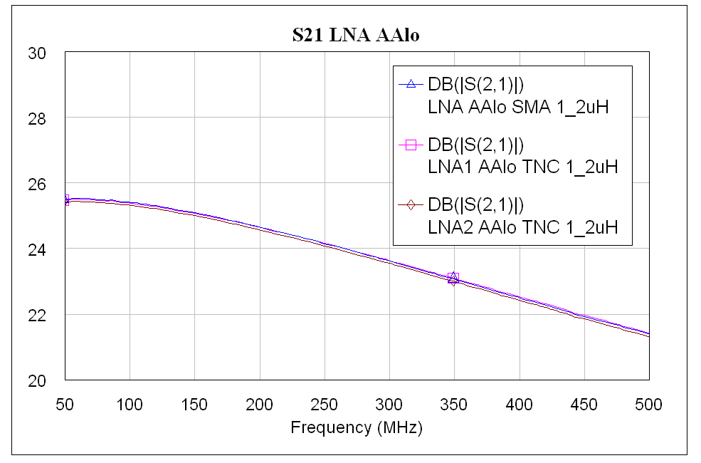
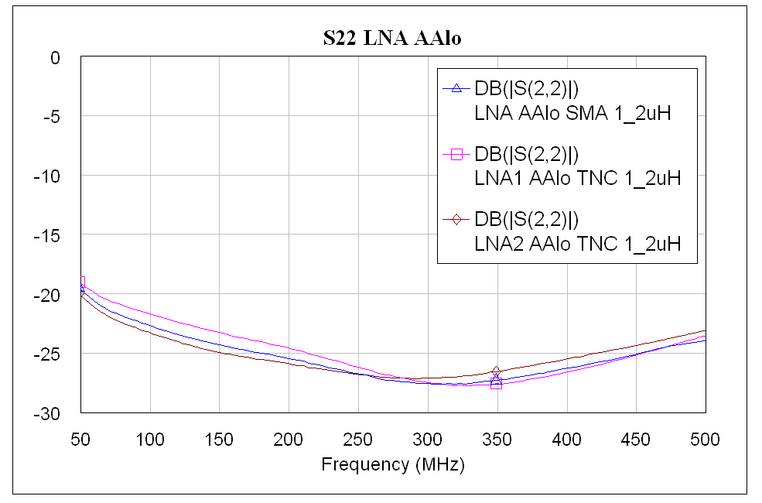
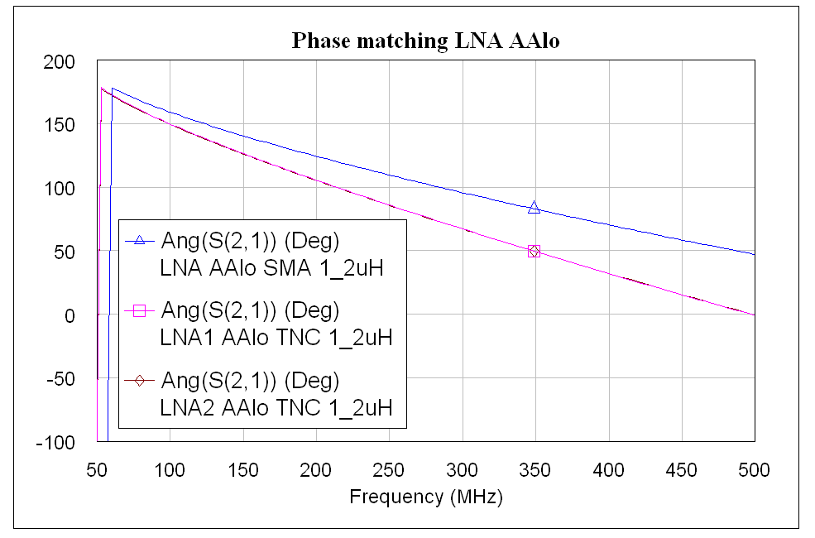
LNA: S-parameters (2)

Slide 15
LNA: Noise measurements
Hot/Cold Load by Maury
Best accuracy (+/- 3.5K vs +/-12K)
Noise Source (re)calibration (ENR)
More ENR points
(i.e. standard ENR table: 0.01, 0.1, 1, … GHz)
Meas. notes: Hot/Cold Maury, Bias=3V , Tamb=297.4K
deducted switch with post processing
( reference plane = IN Connector)

Slide 16
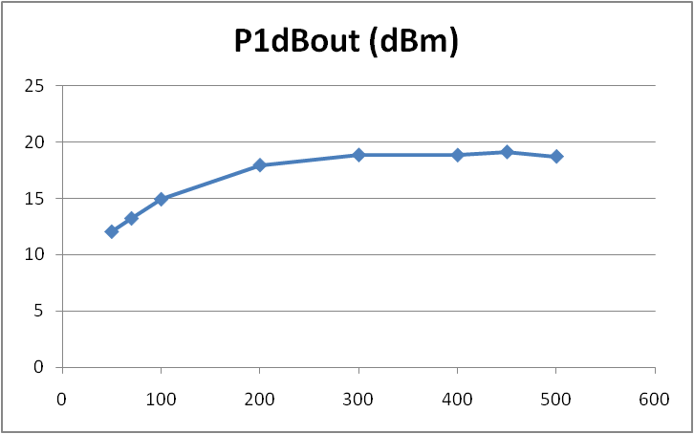
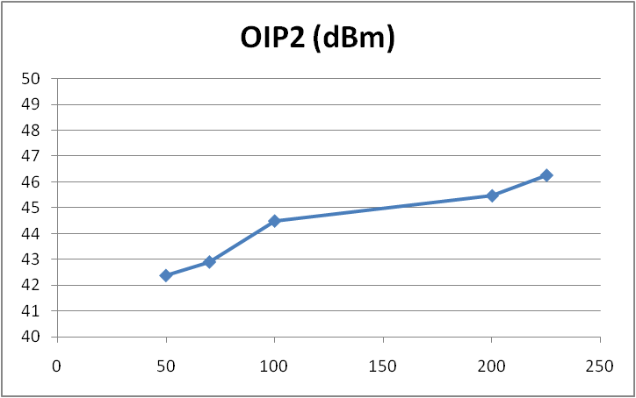
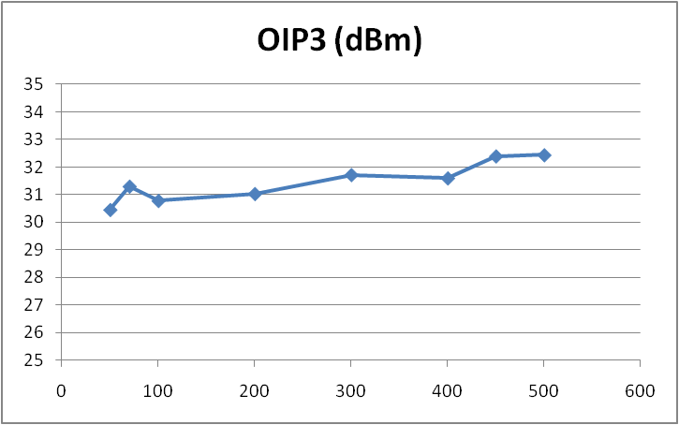
LNA: Dynamic measurements
All measurements at: 3V, 58mA
→ 174mW
2-3 dB IP3 improvement at 5V, 90mA
→ 450mW!!

