Slide 1



Measurements on Vivaldi v2 for AAVS0, design considerations
G. Virone, A. Olivieri, A. Tibaldi, Z. Farooqui
O.A. Peverini, G. Addamo, R. Tascone
M. Piras°, A. Lingua°, A. Cina°, P. Maschio°, H. Bendea°
°DIATI, Politecnico di Torino
F. Perini*, M. Schiaffino*, J. Monari*, G. Bianchi *, S. Montebugnoli*
*Istituto di Radio Astronomia
Istituto Nazionale di Astro Fisica

Slide 2
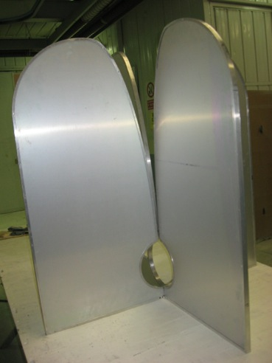
Vivaldi v2
- Unbalanced 50 Ohm excitation
Low cross pol on the principal axes
No ground plane required
Small size
Metal-only
Optical Self-powered element

Slide 3
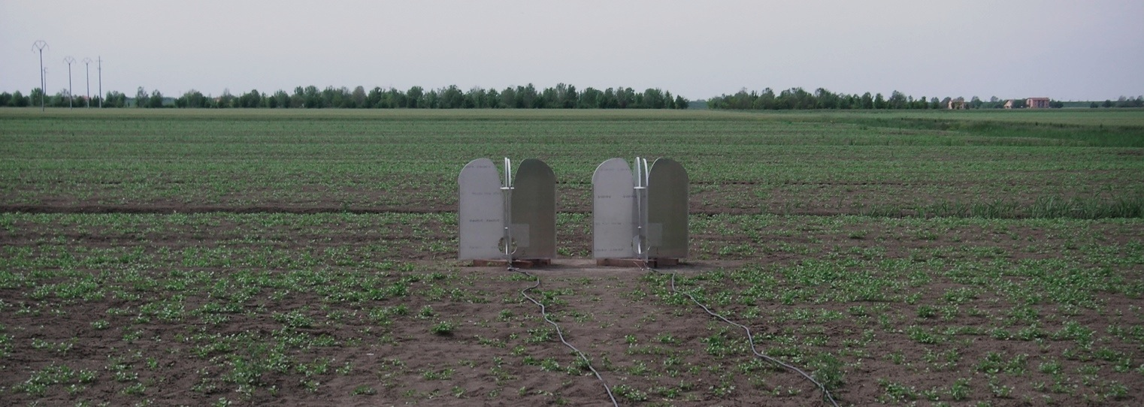
AAVS0 Results – mutual coupling
Medicina, May 9th 2012
Spacing 1.5 m

Slide 4
AAVS0 Results – mutual coupling
Medicina, May 9th 2012

Slide 5
AAVS0 Results – mutual cross coupling
Spacing 1.5 m

Slide 6
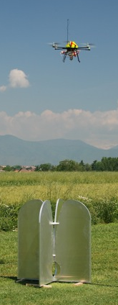
AAVS0 Far-field Measurements
Embedded Element Pattern measurement in the operative conditions

Slide 7
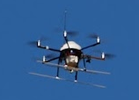
Planar Scan Strategy
Height=60 m
AUT

Slide 8
Single Antenna Pattern @ 75 MHz
E-plane
H-plane
Problems with TX instability
TX spurious radiation
Compass Accuracy

Slide 9
Single Antenna Pattern @ 150 MHz
E-plane
H-plane

Slide 10
Single Antenna Pattern @ 300 MHz
E-plane
H-plane

Slide 11
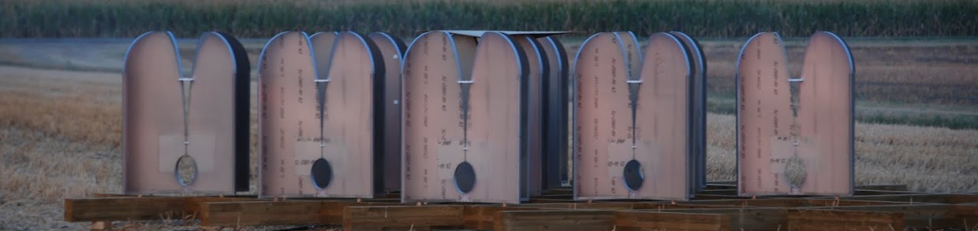
E-plane @ 450 MHz
Single antenna
3 x 3 Array (1.5 m spacing)

Slide 12
H-plane @ 450 MHz
Single antenna
3 x 3 Array (1.5 m spacing)
We also measured the honeycomb version

Slide 13
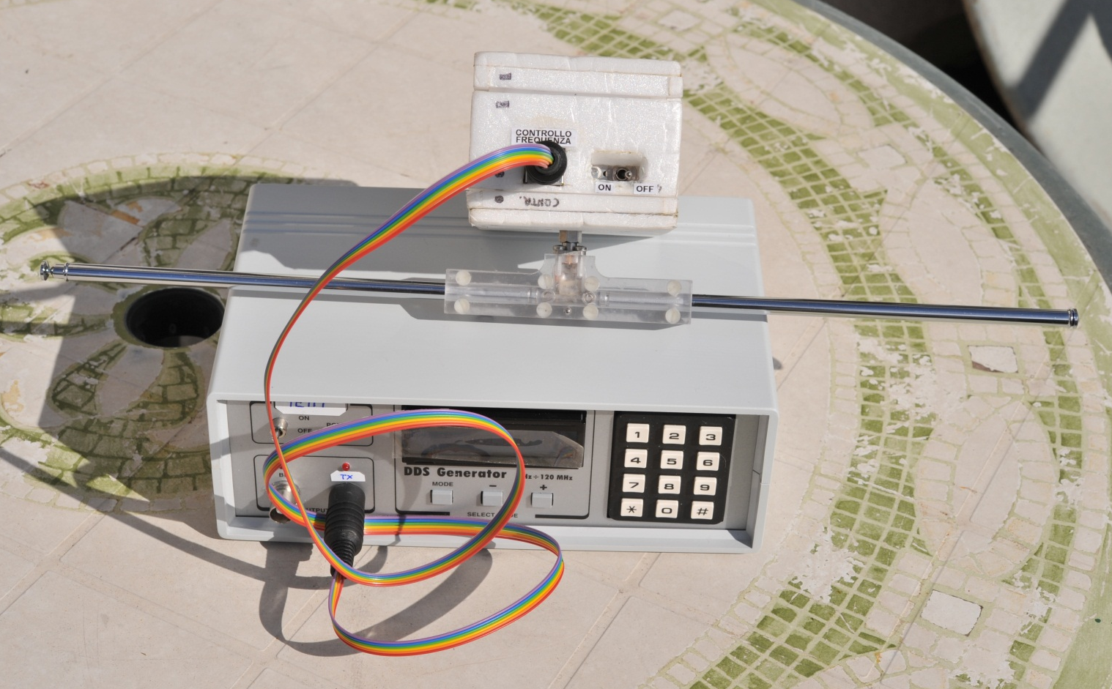
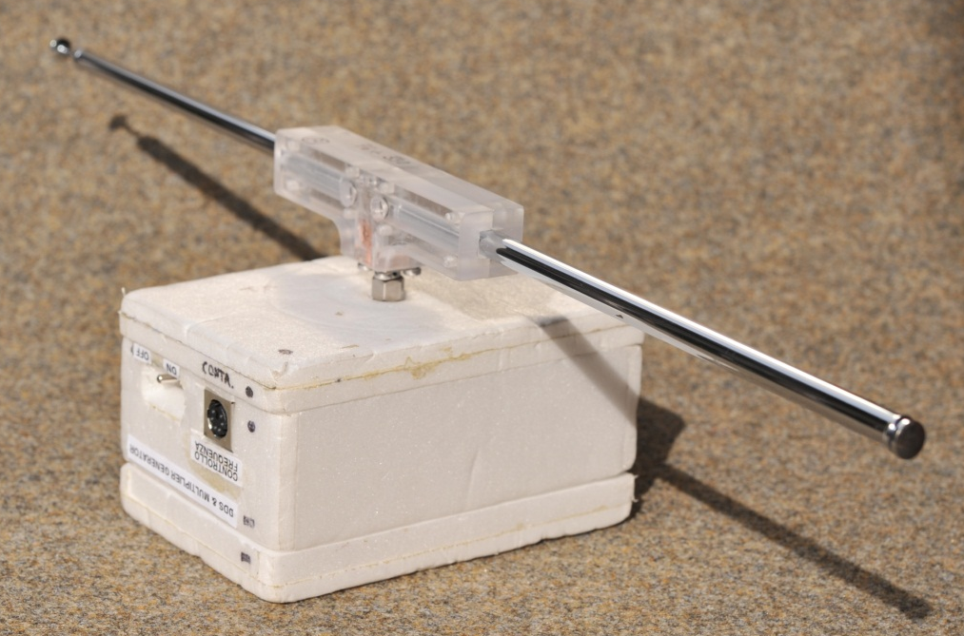
New TX Unit for hexacopter
DDS Generator
4x Multiplier
External Programming
Good Symmetry

Slide 14
Design activity
Parametric Analyses
  Width
  Length
  Aperture
  Inner Profile
  Outer Profile
Optimization runs (gradient, genetic)
Width (mm)
Length (mm)

Slide 15
Better matching

Slide 16
Better symmetry of E- and H-planes

Slide 17
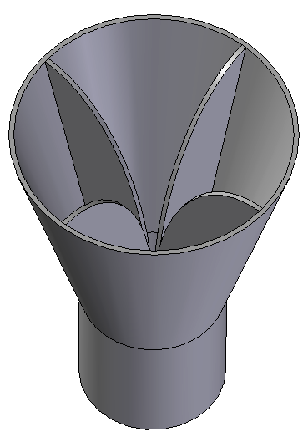

No back lobe reduction
Vivaldi: the Back lobe reduction requires a narrower beam
SOLUTIONS
Open Boundary TEM Horn
Quad Ridge Horn
Possible Gridded version

Slide 18
QR Horn A_{eff}/T_{sys}
Tant_{Gnd} = 11 K @ 450 MHz
Theta=0°
Theta=30°
Theta=45°

Slide 19
Conclusion
AAVS0 goals have been reached in schedule
  Experimental results confirmed the computed data of the Dual-Pol Vivaldi v2
    Mutual Coupling
    Embedded element pattern
Vivaldi optimization
  Better matching
  High flexibility on main lobe shaping
  Improvement of the back lobe is in progress

