Slide 1

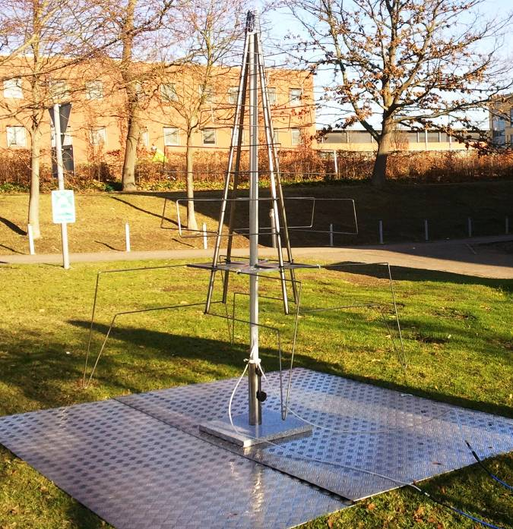
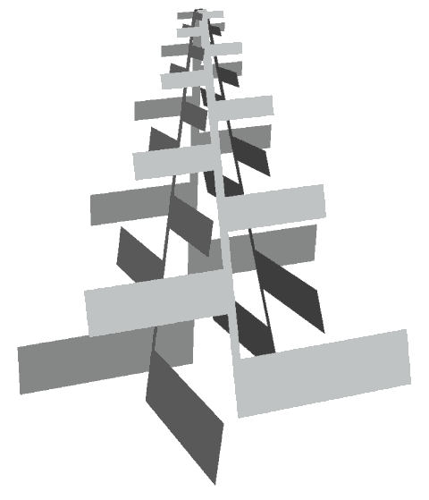
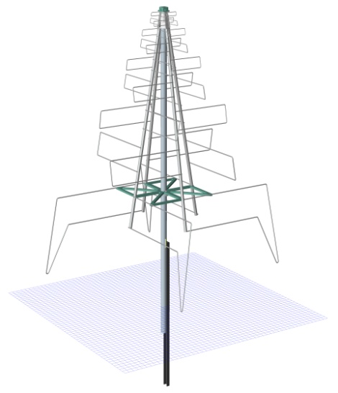
AA-low LPD Antenna:
Design for High Volume Manufacture
Paste an
image over the
circle and use ‘Send
Backward’ tool 3 times
OR delete the picture
frame and the white
square if no image
is required.
AAVP2011 Workshop, 14 December - Dwingeloo
Richard Williams

Slide 2

AA-low LPD Antenna:
Design for High Volume Manufacture
Update
Paste an
image over the
circle and use ‘Send
Backward’ tool 3 times
OR delete the picture
frame and the white
square if no image
is required.
AA-low Progress meeting, 23 October - Medicina
Richard Williams updated by Andrew Faulkner

Slide 3
Agenda:
AA-low requirements for low cost manufacture
1
1
The AA-Low LPD example – Element section
2
The AA-Low LPD example – Complete Design
1
3
The next steps
4
1
Summary and conclusions
5

Slide 4
AA-low manufacturing requirements
AA-low requirements for low cost manufacture
Low unit cost when made in large quantity (€75 target)
Universally manufacturable
  No special processes, Can be made anywhere
Finally assembly on-site
  Avoid the cost of transporting a large assembly
Finally assembly quick and simple
  Un-skilled labour, remote location, few facilities
Environmentally robust with a long in-field life
Low (zero) maintenance – Line replaceable unit
No compromise in EM performance from the original design

Slide 5
Agenda:
AA-low requirements for low cost manufacture
1
1
The AA-Low LPD example – Element section
2
The AA-Low LPD example – Complete Design
1
3
The next steps
4
1
Summary and conclusions
5

Slide 6
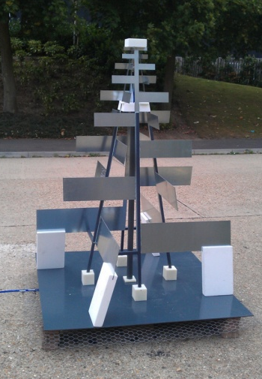
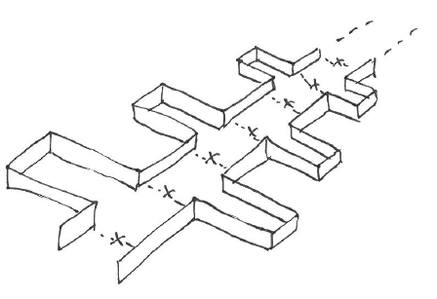
How can the LP element shape be made with the least material and operations ?
The AA-Low LPD example – Element section
Starting point
Must keep parameters:
Overall dimensions
Outline of the element sections
Angle of the pyramid
Spacing of element sections ?
Height above the ground ?
Orientation
Cut & fold flaps
from ½ size sheet
(so less waste material)
Push ‘staples’ of round tube into a square tube
(like standard TV aerial)
integrity & durability of electrical connections ?
Use middle of each panel to make next one (like a Russian Doll), and crimp into a channel as a spine
Fold 2 flat strips and spot weld (or rivet)
at the overlapping sections to form spine

Slide 7
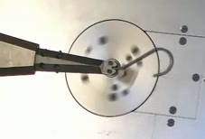
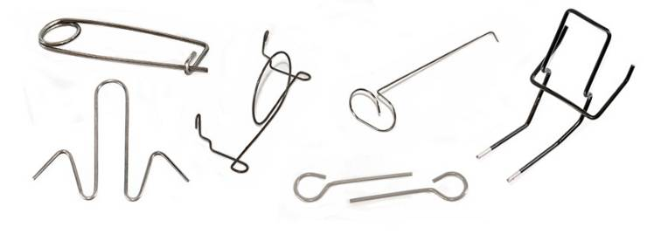
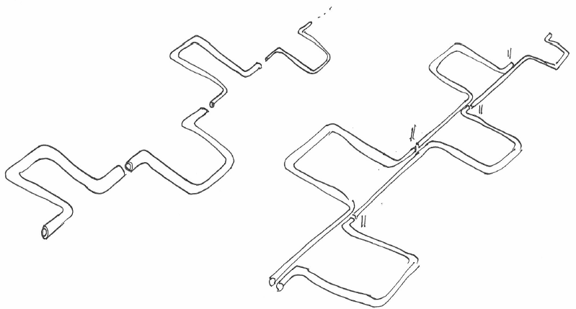
“Wire” is cheap, stiff and can be formed in bending machines
The AA-Low LPD example – Element section
LP element shape could even be made from a single piece of wire, with spot or tack welds applied in a jig, after the forming
We presume these gaps
are not OK ?
If we split the top end, can add features to connect to the PCB ?
Possible design variants :
- single piece of wire with different bending pattern and straight spine
- top end divided to provide feed into LNA, just before the top loop ?
- solid wire eg. Ø6 mm, or small tube; made from aluminium or steel ?
Form ‘top-hats’ from tube or wire
(of same or different cross-sections ?)
Pairs of bends can be made in single operations, but extra joints are needed.

Slide 8
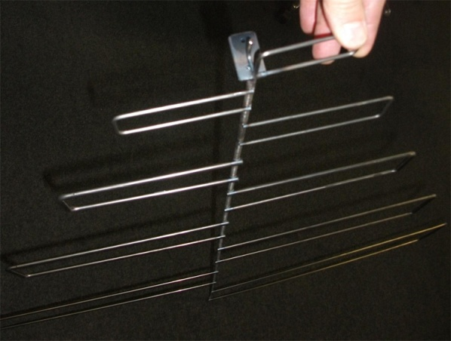
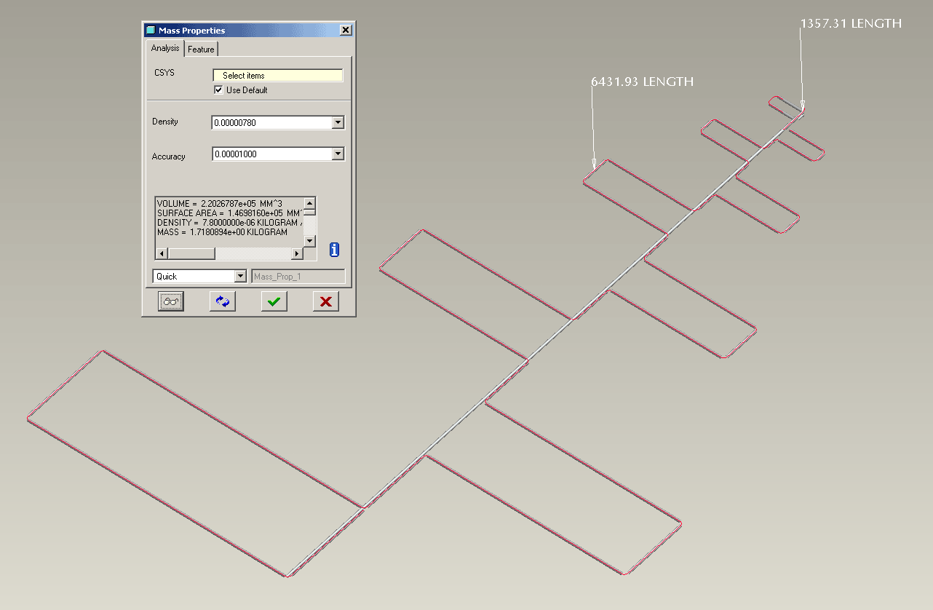
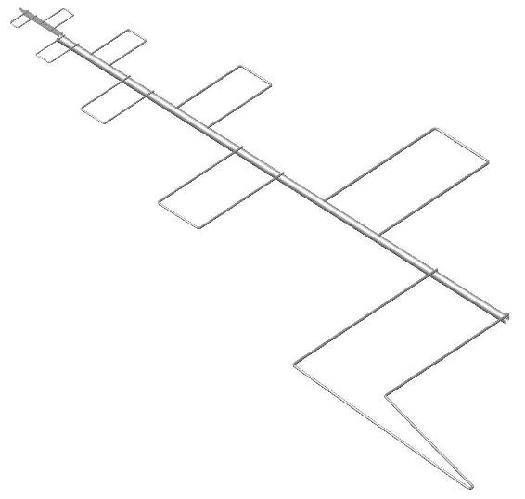
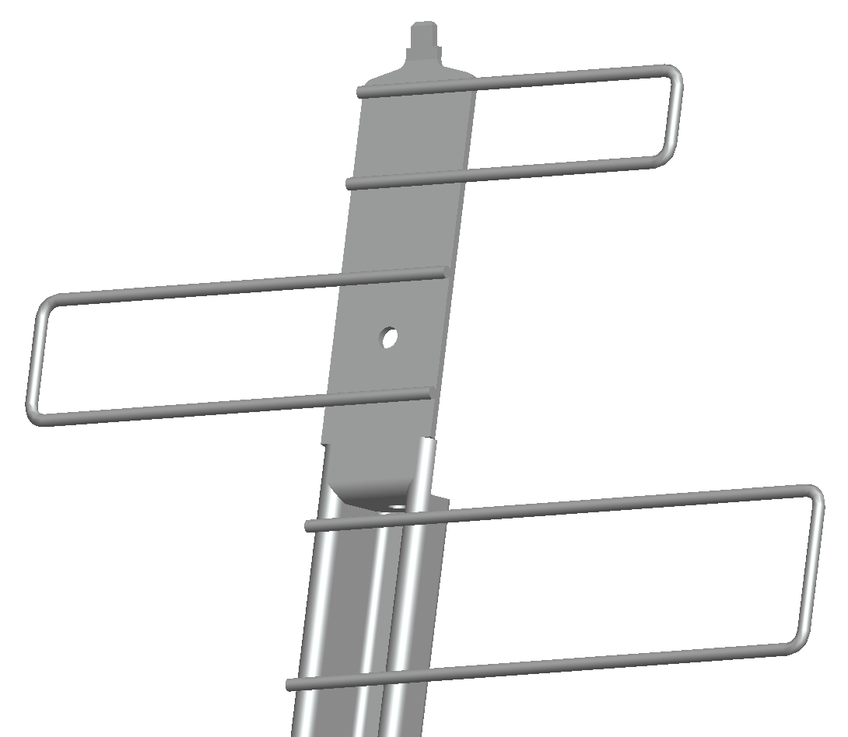
Analyse in CAD: If the antenna is made from Ø6.0mm wire, it would use ~7.8 m (~1.7 kg Steel, or ~0.6 kg Alu’), and a surface area of 0.147 m² (to plate and/or paint)
The AA-Low LPD example – Element section
32 x 90° bends
15-20 welds
+ end forms…
Manufactured a first version - not stiff enough on the central spine
Then with feedback from the manufacturer
Tube for central spine
Decreasing wire diameter 6, 5, 4, 3mm for arms
Flat section at top for connection tabs and fixing point

Slide 9

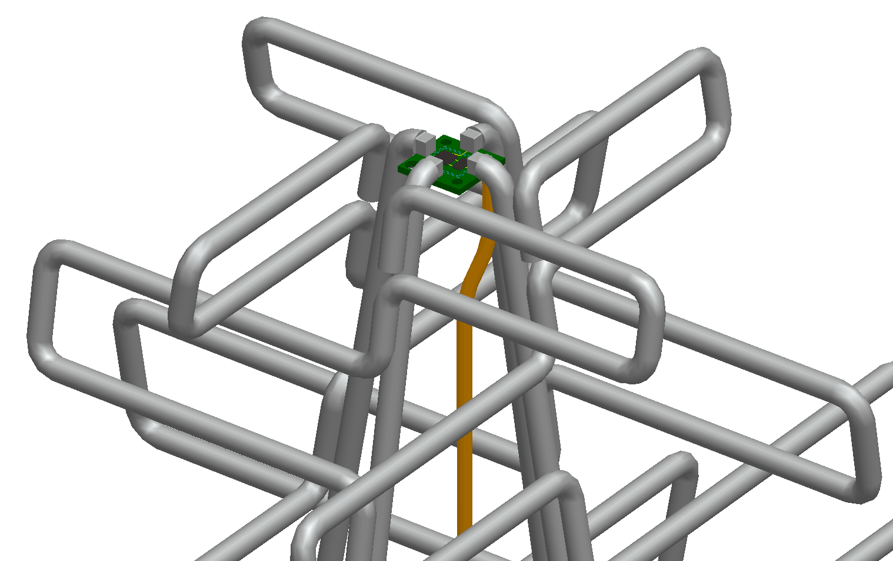
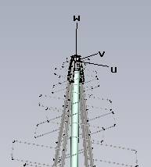
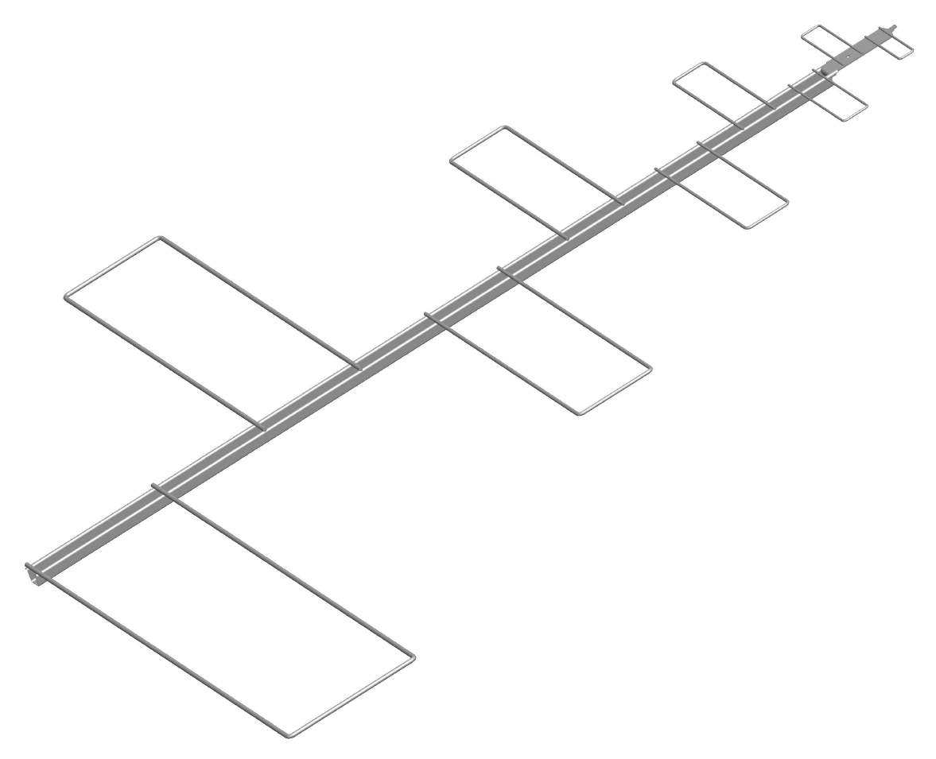
Design and manufacturing iteration – Exploration of design solutions
The AA-Low LPD example – Element section
Simulation results
Important feedback and discussion of the trade-offs
Manufactured sample
3D Mechanical CAD
Fabrication drawing
Simplified 3D shape for simulation

Slide 10
Agenda:
AA-low requirements for low cost manufacture
1
1
The AA-Low LPD example – Element section
2
The AA-Low LPD example – Complete Design
1
3
The next steps
4
1
Summary and conclusions
5

Slide 11
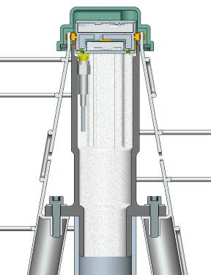
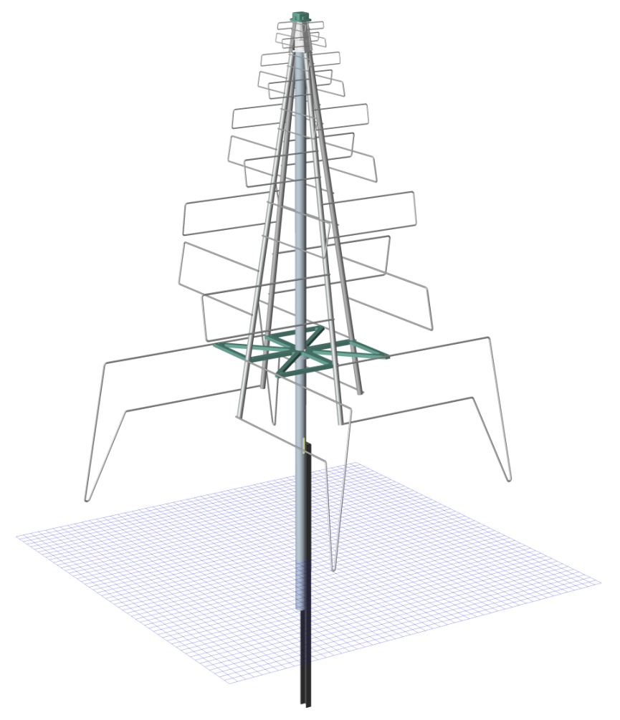

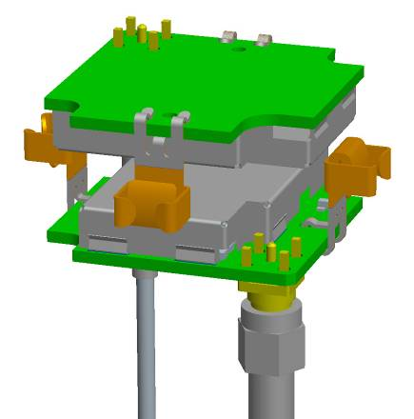
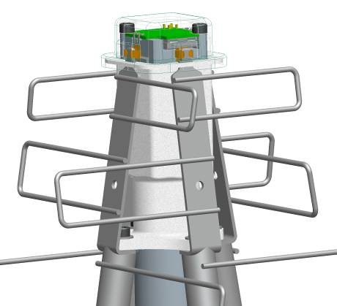
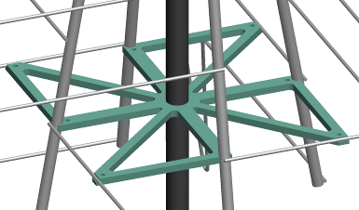
Bringing together the complete design – the other main components
The AA-Low LPD example – Complete Design
The complete design and its main parts
  Element section supports
  LNA PCB
  Antenna feed to LNA
  PCB support and
  Enclosure

Slide 12
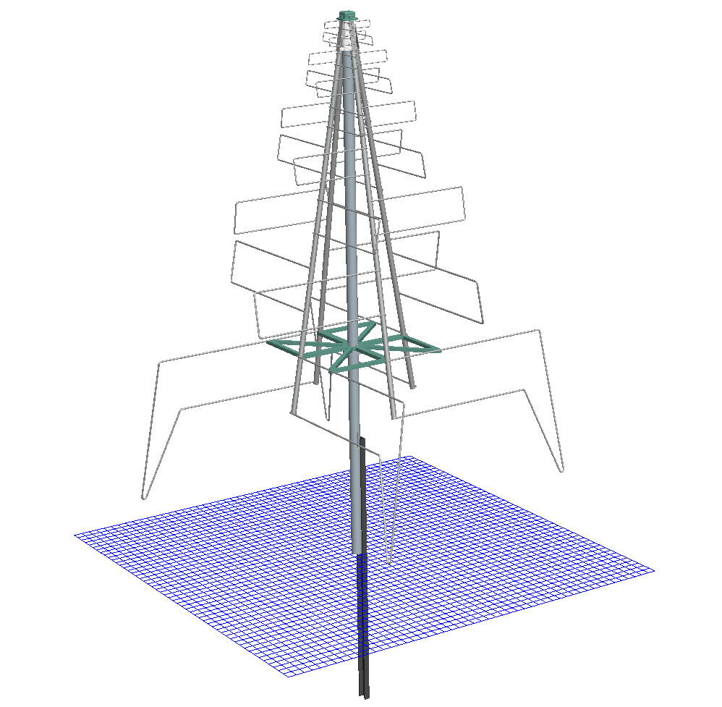
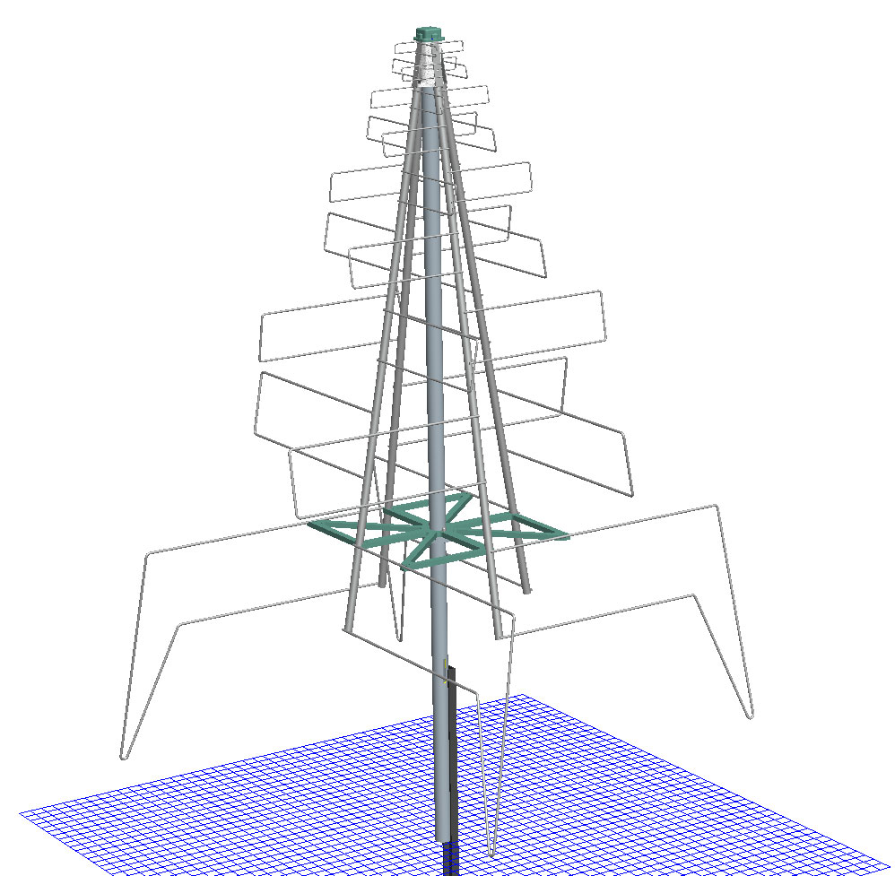
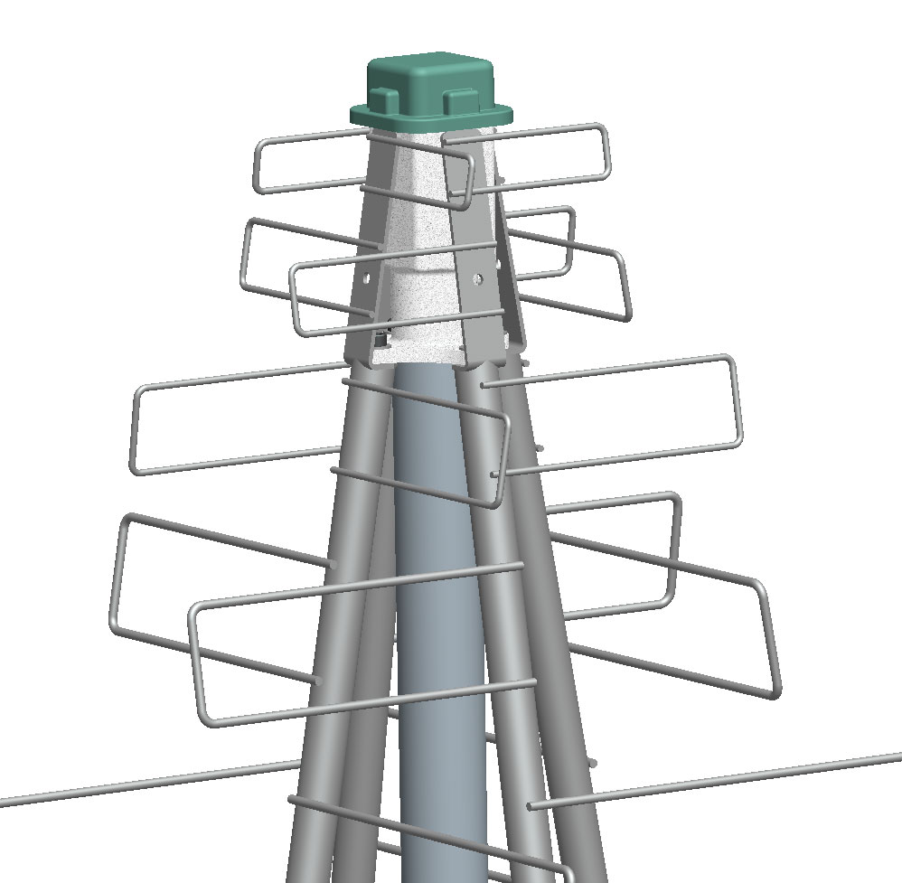
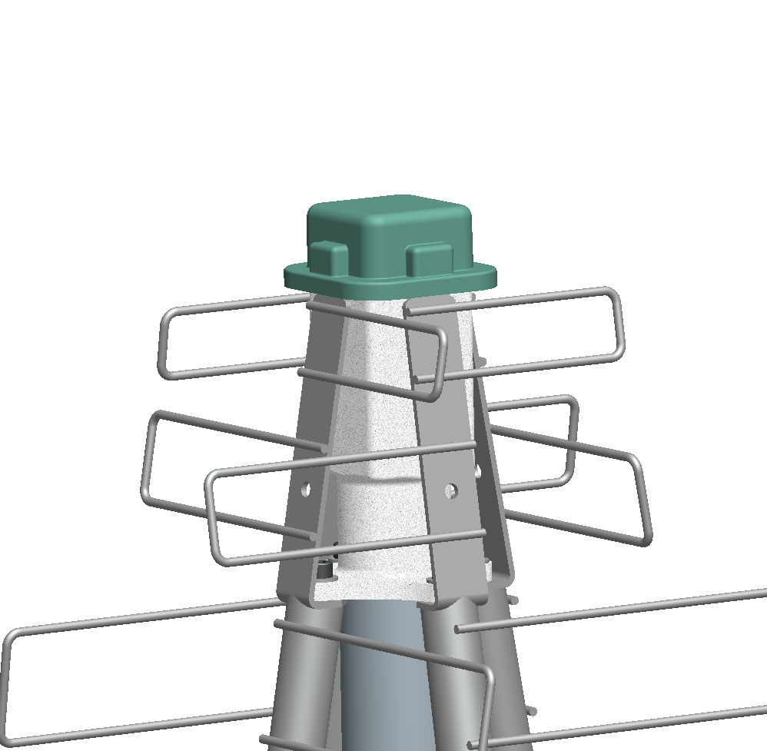
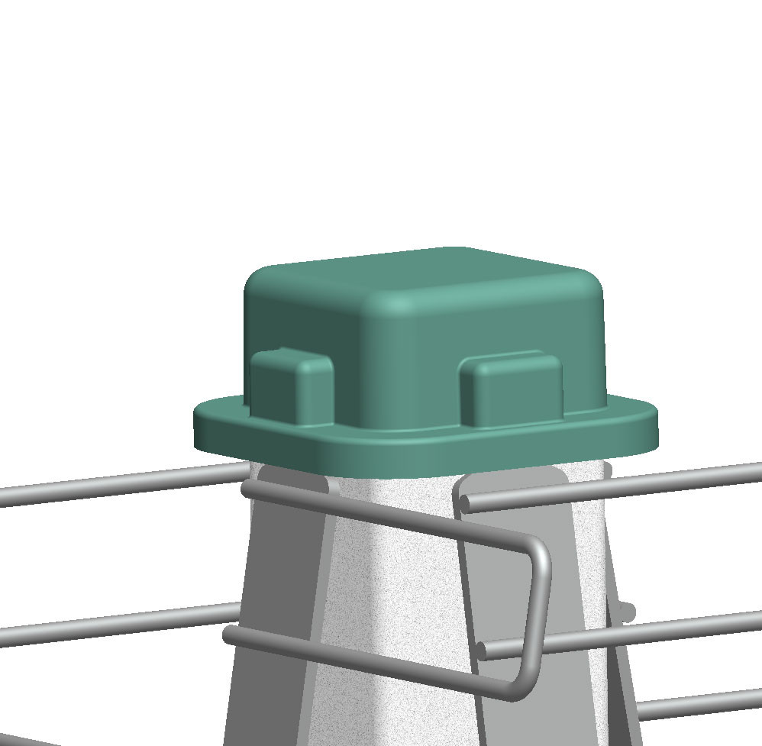
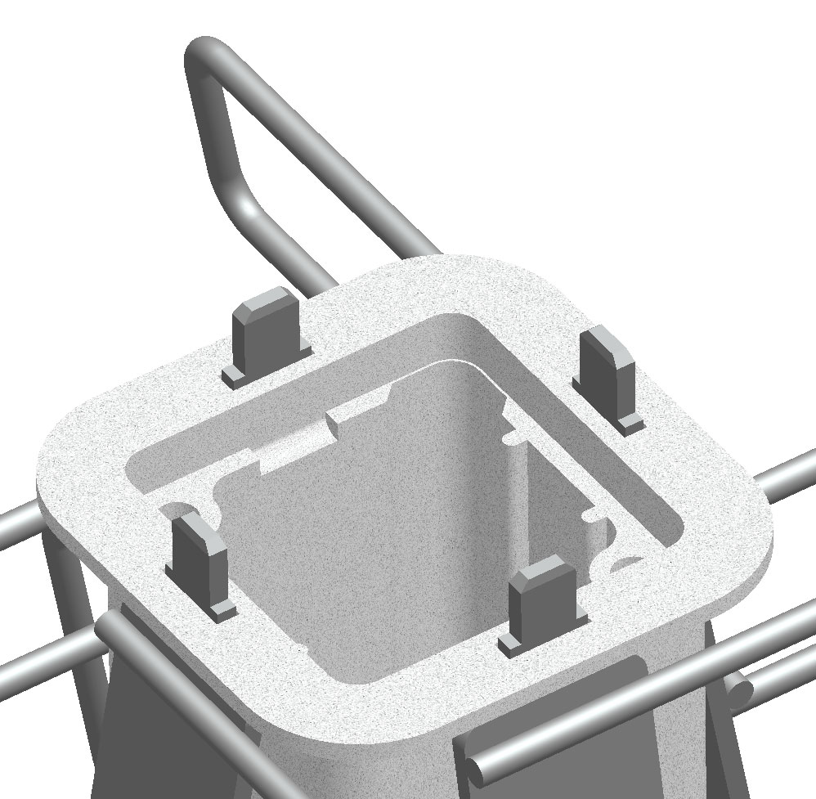
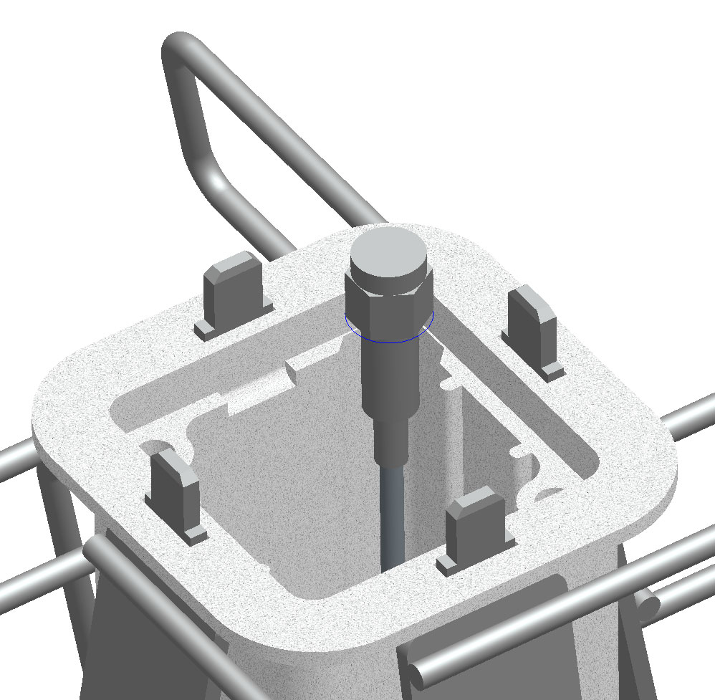
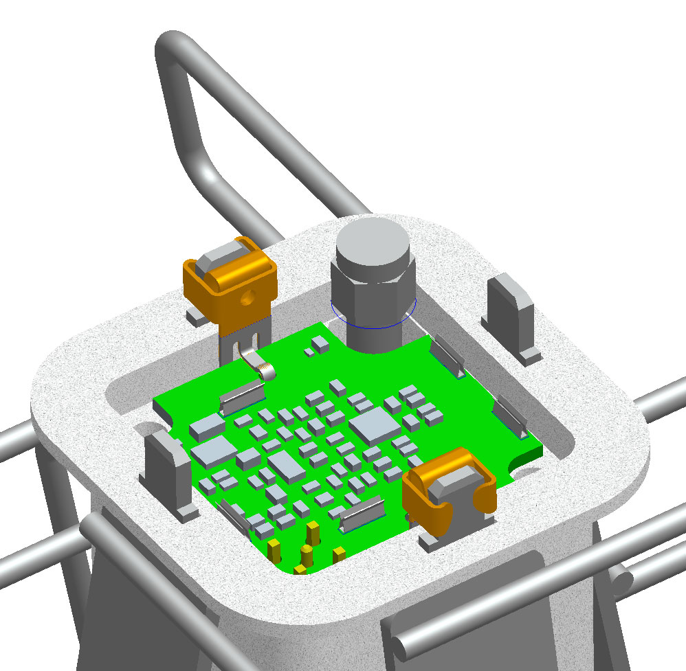
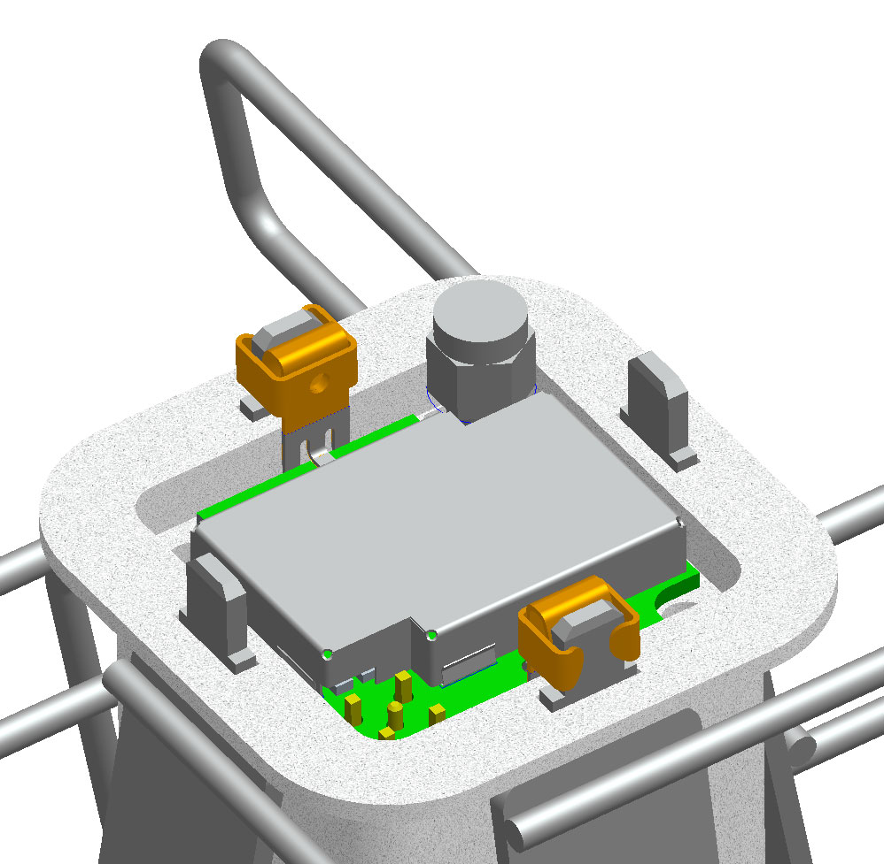
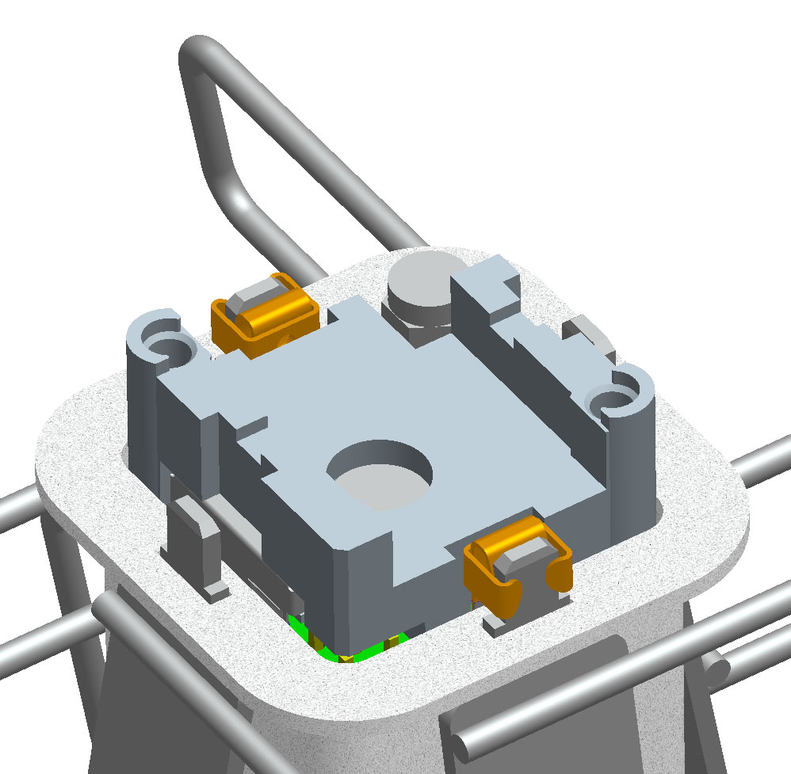
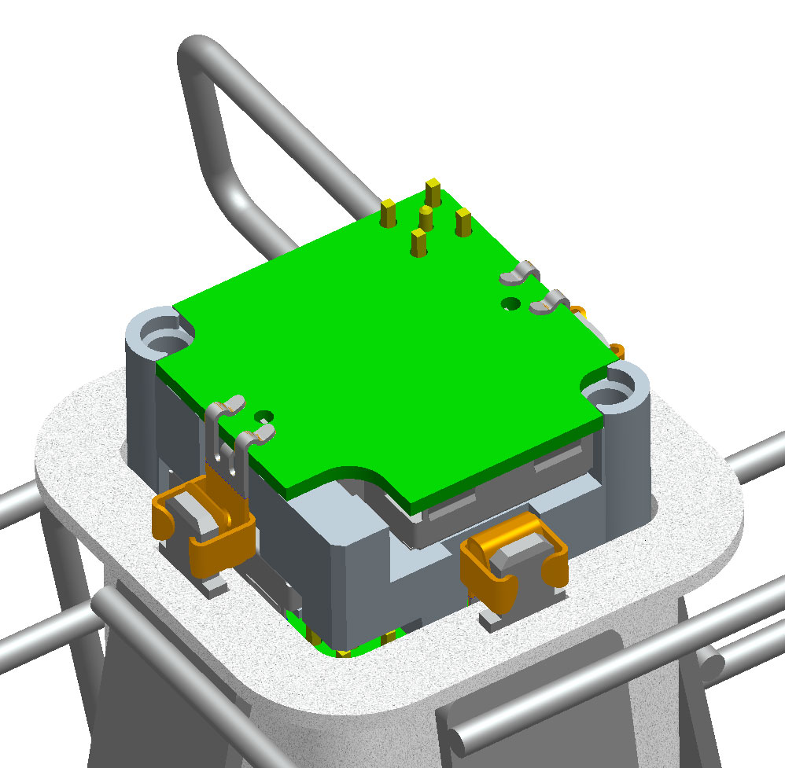
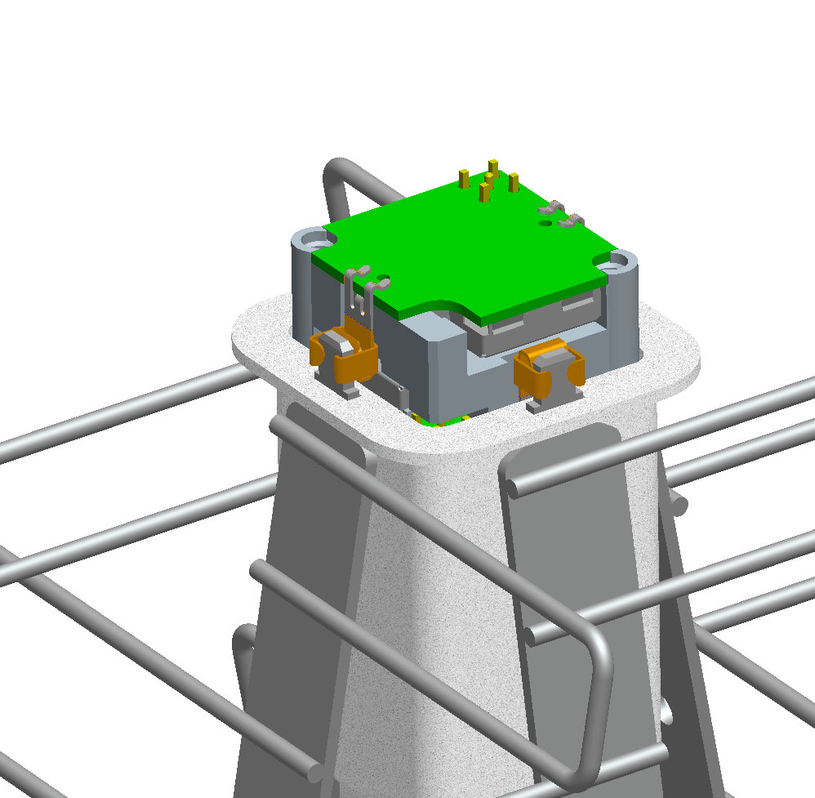
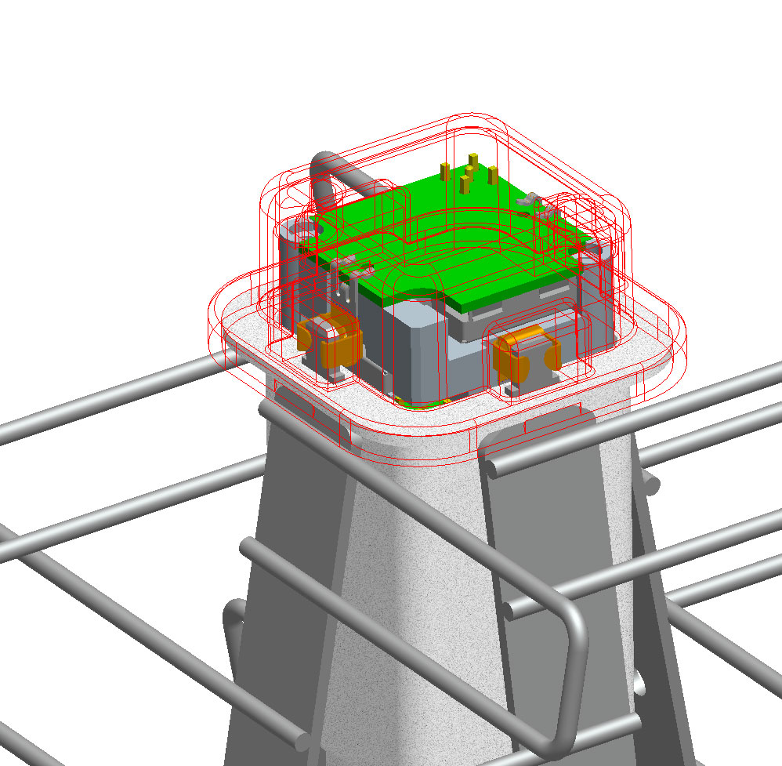
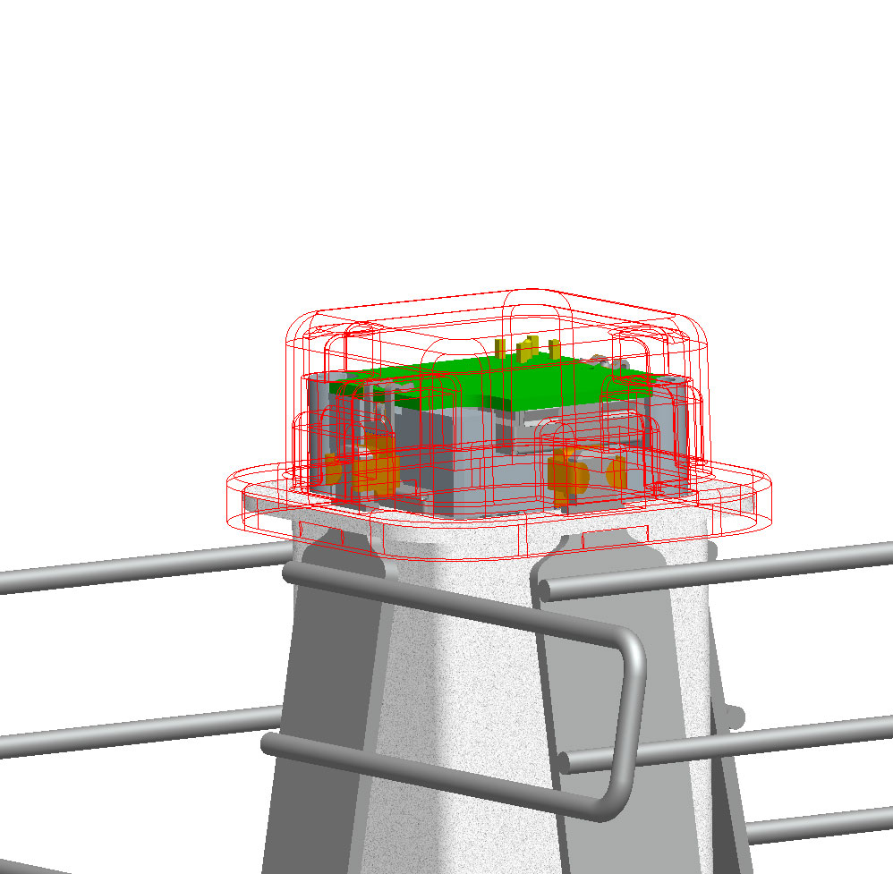
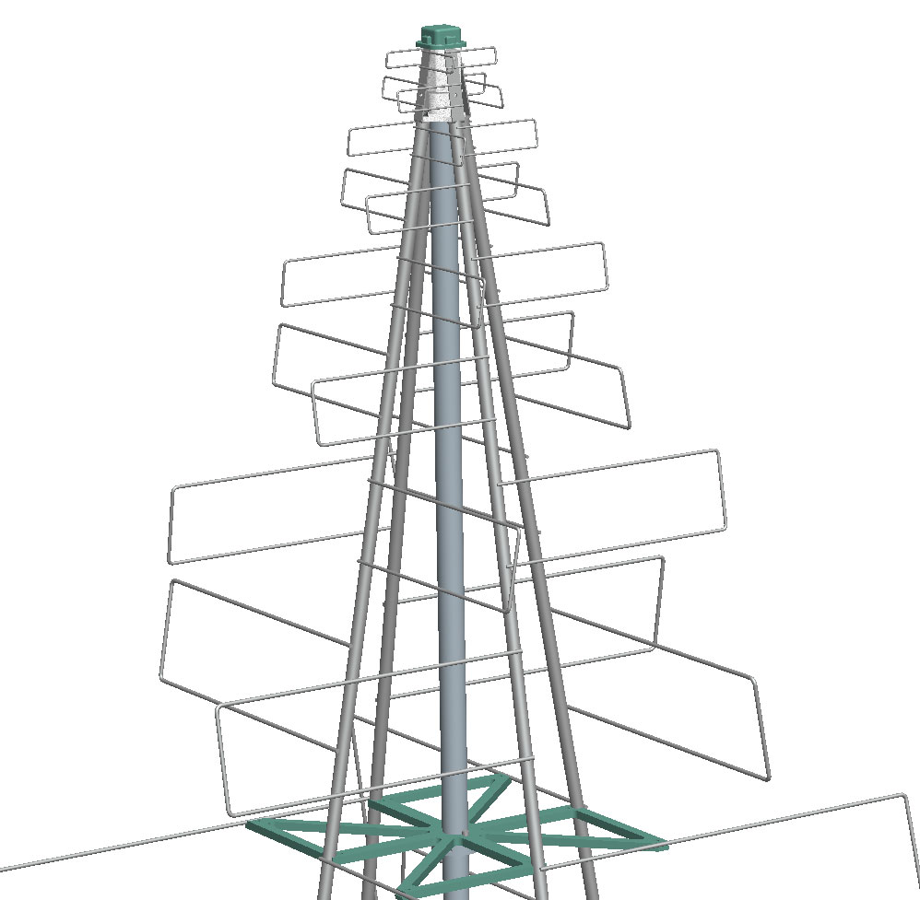
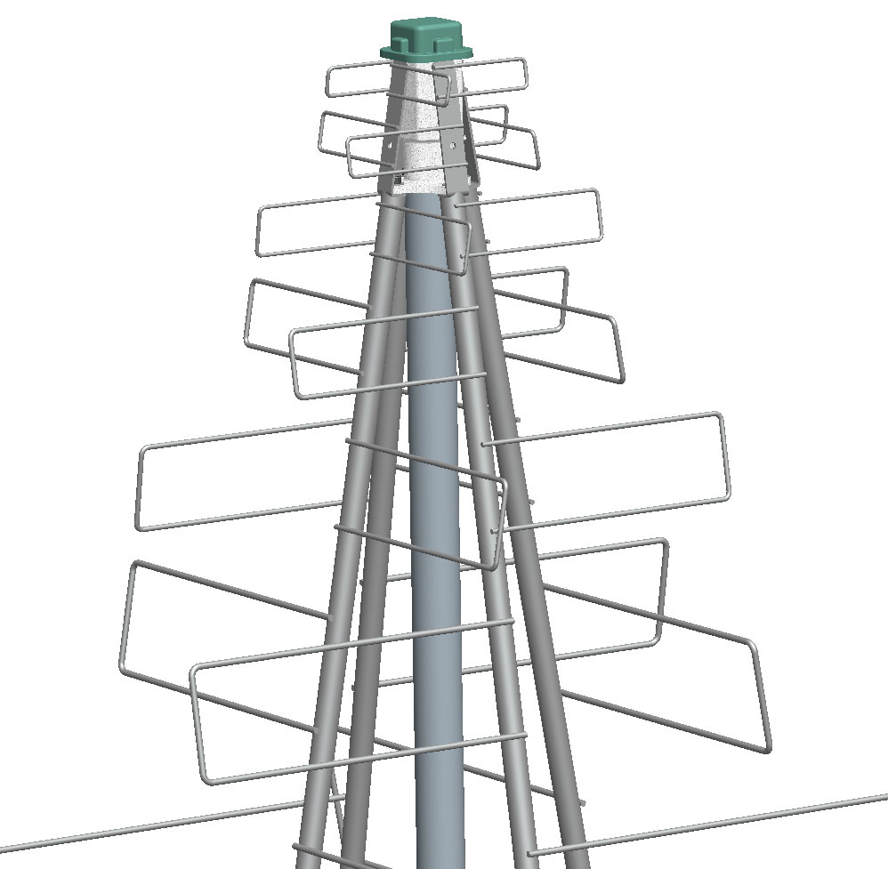
Proposal for construction of internal parts :
The AA-Low LPD example – Complete Design

Slide 13
Transport and Assembly
The AA-Low LPD example – Complete Design
Options for transportation
  Full assembly at factory and ship complete elements
  Single source but ship as a kit of parts (flat packing etc.)
  Multiple (geographically diverse) sources and bring together on site
On-site Assembly
  Either a one or a two stage process - the concept enables either option
    Assemble and test near to final location then transport and fix to the ground
    Assemble and test at final location
  Low skill and only simple assembly tools required
    Fixing bolts, Cable connection, Alignment, Basic electrical test (pass/fail)
    For alignment clamp to a ground stake and adjust for rotation and height

Slide 14
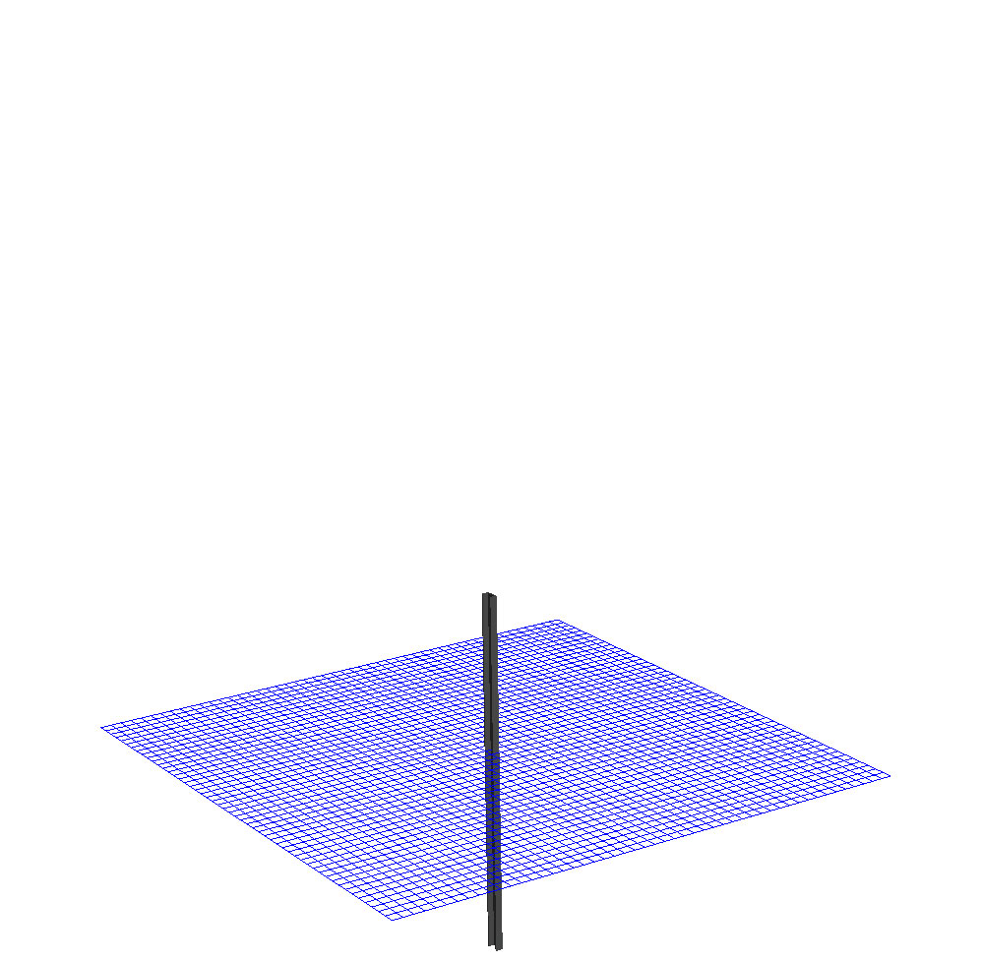
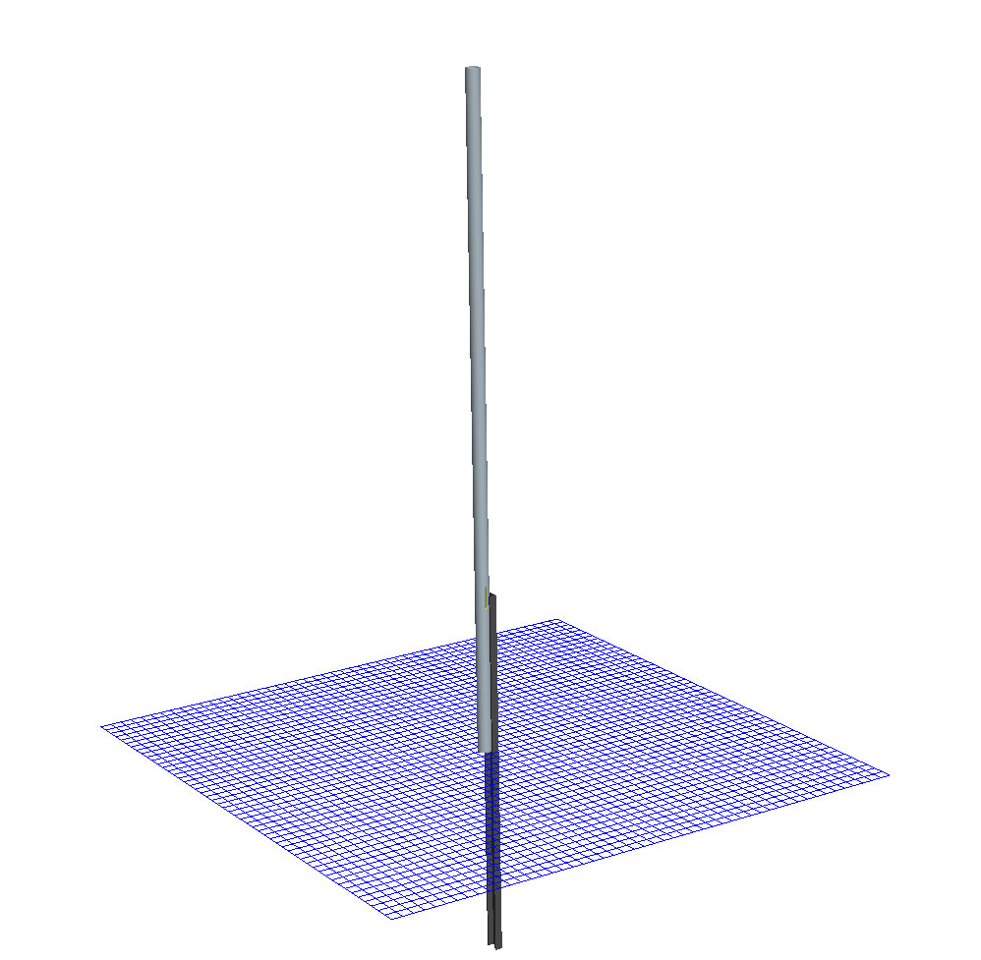
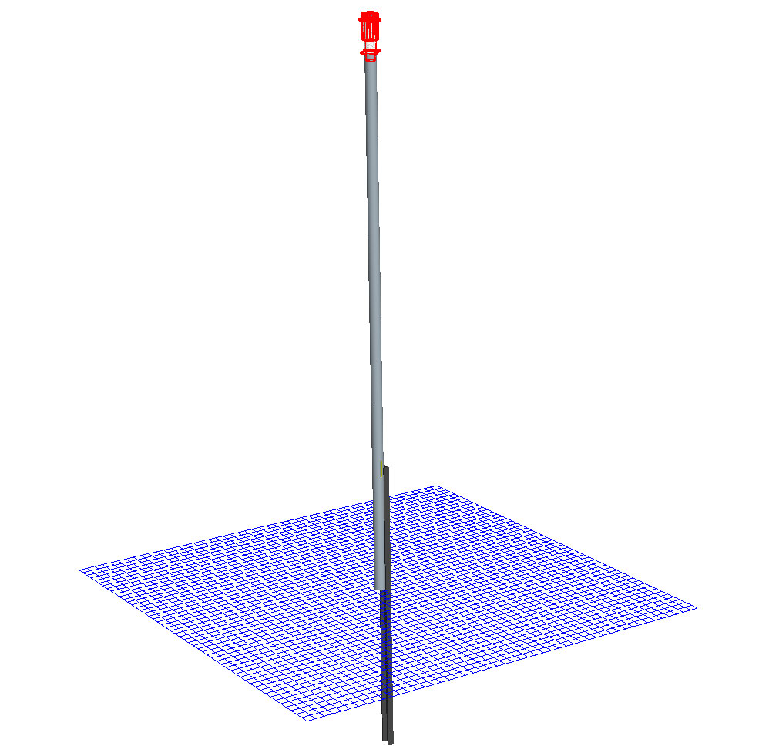
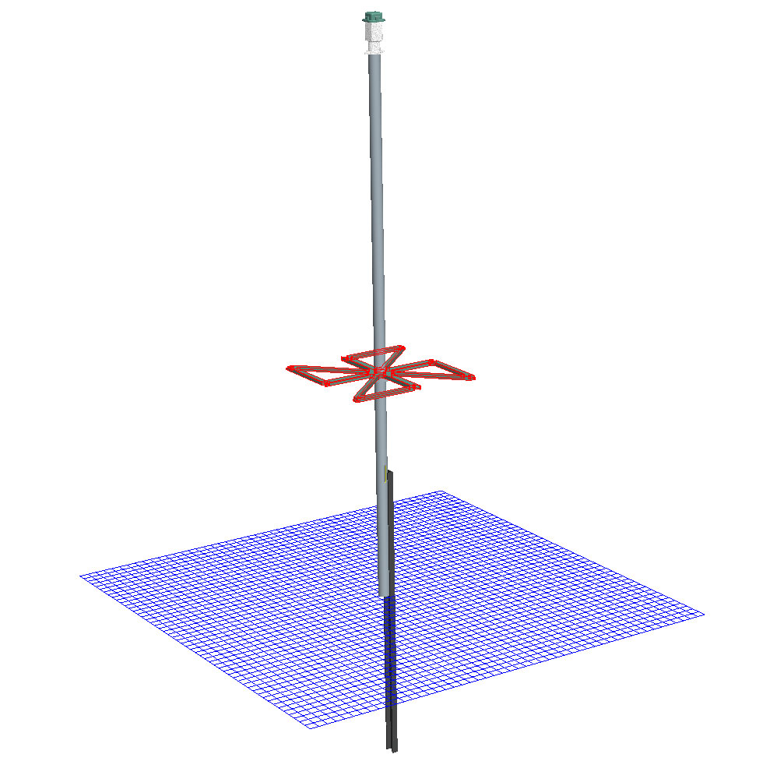
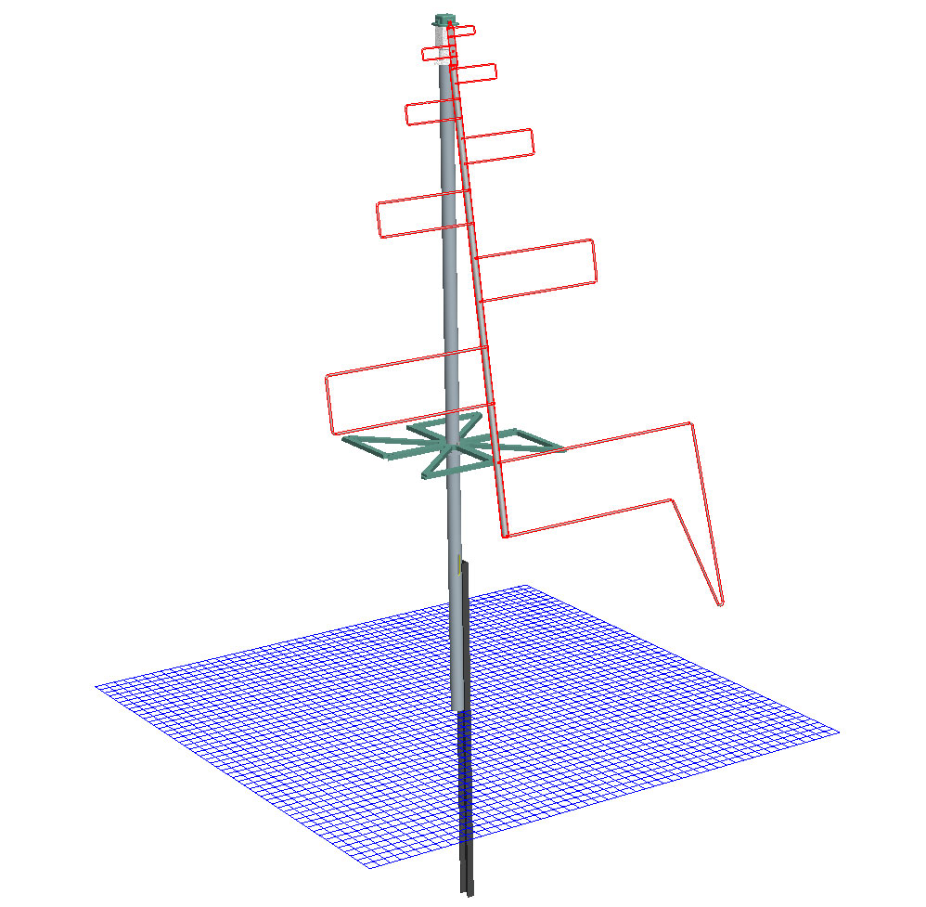
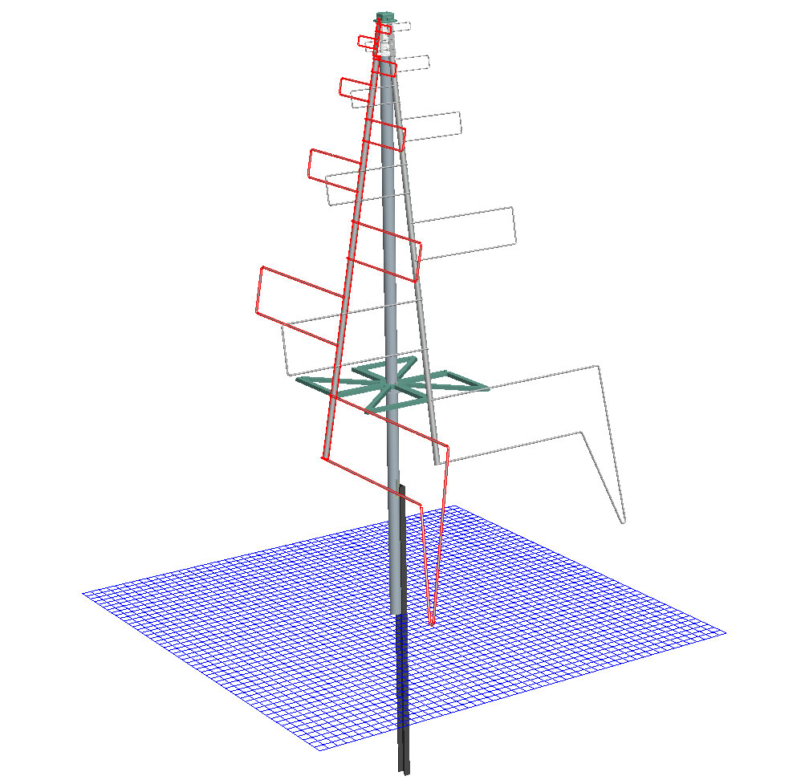
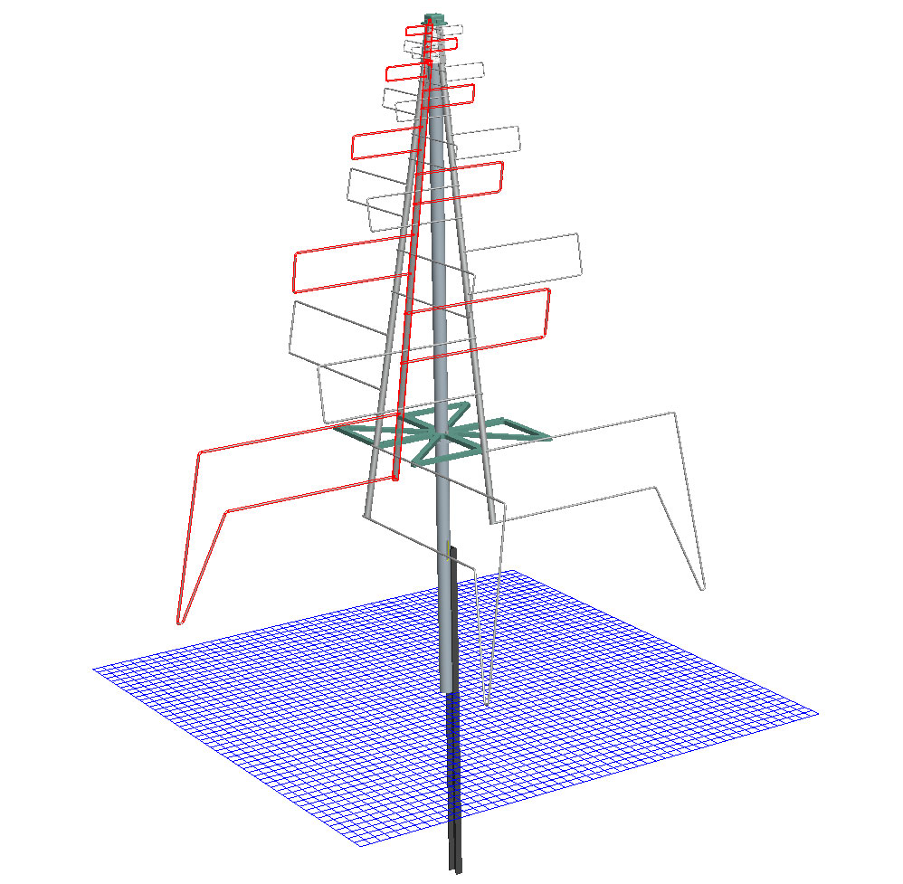
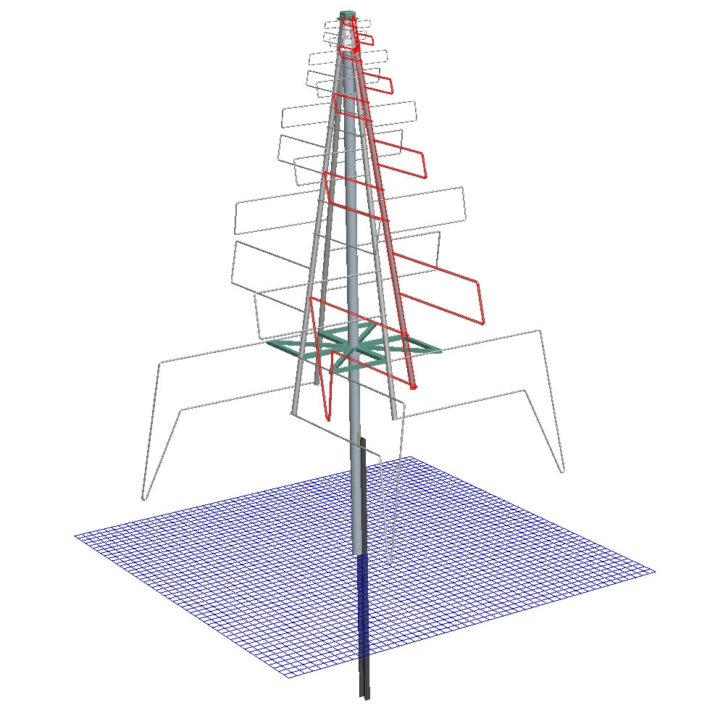
On site assembly and field installation :
The AA-Low LPD example – Complete Design

Slide 15
Agenda:
AA-low requirements for low cost manufacture
1
1
The AA-Low LPD example – Element section
2
The AA-Low LPD example – Complete Design
1
3
4
1
The next steps
Summary and conclusions
1
5

Slide 16
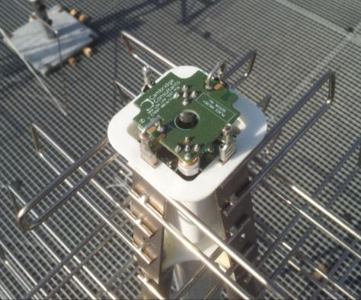
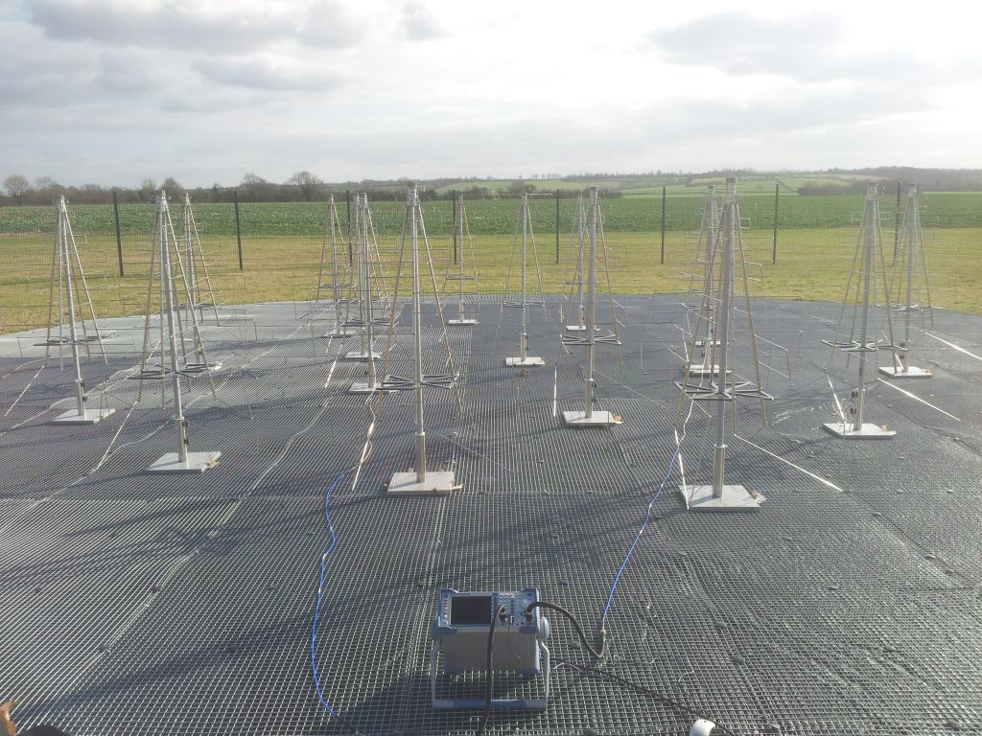
The Concept is successful – it WORKS!
The next steps
Building two arrays, performing a lot of testing, installing, new ideas
The design is fundamentally good – low cost, easy to build
Learning:
  Detailed performance
  Installation issues
  Better ways of building
  Integration: ground plane etc.
  Material issues etc. etc

Slide 17
The Concept is successful – it WORKS!
So, starting new evolution, as soon as funding is available (few months)…
The next steps
Ensure meets specification for: frequency range, element spacing, polarisation etc.
Improve design: lower cost, design life, integrated ground plane etc.
Enhance deployment: faster assembly, easier alignment, reduced fixings
Material selection: uv tolerance, environmental performance, better coatings
Electronic design: lower noise LNA, lower power, ESD tolerance etc.
System design: fibre communications, power distribution
Reduce cost further: apply volume manufacturing techniques and methodology
SKALA is the basis of a superb, low cost AA-low element

Slide 18
Agenda:
AA-low requirements for low cost manufacture
1
1
The AA-Low LPD example – Element section
2
The AA-Low LPD example – Complete Design
1
3
The next steps
4
1
Summary and conclusions
1
5

Slide 19


Conclusions
Summary and conclusions
A design has been produced which:
  is suitable for low cost manufacture
  provides good EM performance
    Including the antenna feed and LNA
  can be evolved as the overall AA-low is developed
The benefits of close collaboration between academic and industrial design teams have been demonstrated:
  Design optimisation
  Close alignment and a shared understanding
  Speed and efficiency of working

Slide 21
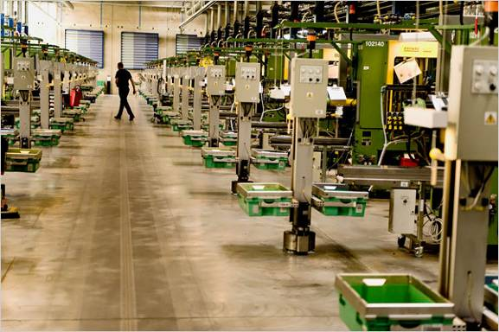
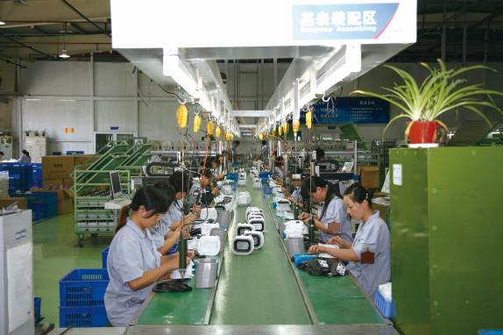
Drivers for low cost Design for Manufacture
AA-low requirements for low cost manufacture
Some general principles (but be prepared to compromise)
  Minimise parts count
  Minimise material usage
  Low cost materials
  Component and assembly tolerances consistent with materials and manufacturing processes
  Standard/conventional production techniques
    Wide range of manufacture and assembly options
    Choice of supplier
    Levels of automation (depending on region)
  Design for manual assembly: minimise operations
  Automation of production test

Slide 22
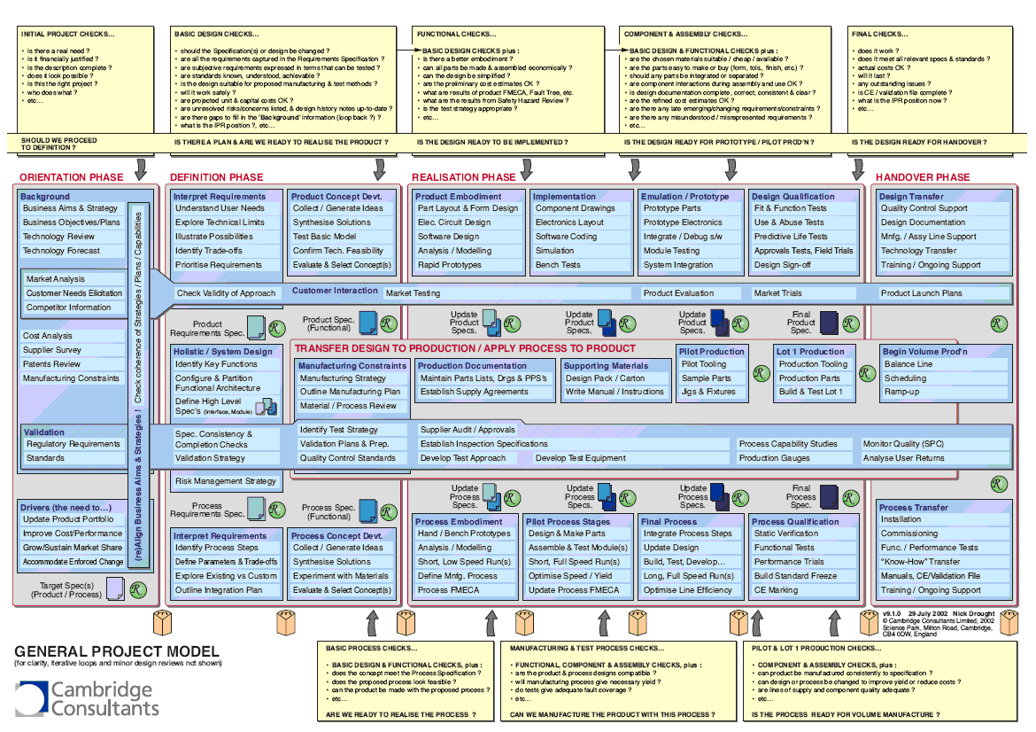
The manufacturing design should not limit choices at this stage in the programme
AA-low requirements for low cost manufacture
Recognise where we are in the programme
  From a manufacturing perspective we are at the concept stage
Need to keep flexible as we are still in the early stage of the development
  Choice or materials and finishes
    Trade unit cost with lifetime and performance degradation
  Arrangements for powering and the signal feed are to be defined
    Flexibility in the design and space requirements for the electronics
  Keep options open to explore manufacturing choices
    Location, Capability, Multiple sources

Slide 23
The element has been designed for a target cost of 75 Euros in high volume
The AA-Low LPD example – Complete Design
Here is how this cost target breaks down for the LPD production design concept
  Metal Element Sections (per 4 off) 24 Euro
  LNA, Connectors and Pole cable (for 2 channels) 14 Euro
  Central Tube 8 Euro
  Plastic Mouldings (4 components) 8 Euro
  Ground Stake 5 Euro
  Ground Plane 1.5m x 1.5m, 10 cm galvanised mesh 6 Euro
  TOTAL 65 Euro
  Transport, fixings, final assembly and test 10 Euro
Note:
  These costs are indicative and will change based on the final specification, design and manufacturing choices. Significant areas of uncertainty include:
    The choice of materials and finishes for the element sections, and other mechanical components, to achieve the required lifetime in the chosen location.
    The functionality of the electronics in the antenna. The concept is based on “simple” two stage amplifier built using standard components.
    The locations and suppliers chosen for manufacture, assembly and installation.

Slide 24
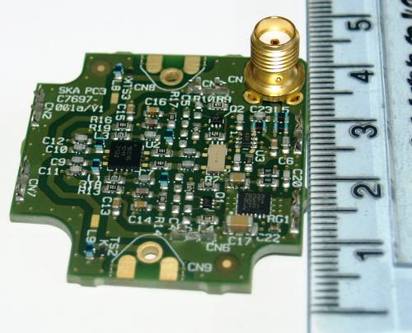

Next steps
Summary and conclusions
Testing
  As a single element
    With an LNA
    “Bare metal” with a matched antenna feed connection
  In a small array – 16 elements
Developing the element design
  For the environmental conditions and required lifetime
    Mechanical robustness, corrosion, material ageing
  Evolve the electronic system design and incorporate into the element
    What will be the functionality of the element electronics in the production array?
  Refine the design for low cost volume manufacture

Slide 25

Contact details:
Cambridge Consultants Ltd Cambridge Consultants Inc
Science Park, Milton Road 101 Main Street
Cambridge, CB4 0DW Cambridge MA 02142
England USA
Tel: +44(0)1223 420024 Tel: +1 617 532 4700
Fax: +44(0)1223 423373 Fax: +1 617 532 4747
Registered No. 1036298 England
info@CambridgeConsultants.com
www.CambridgeConsultants.com
Cambridge Consultants is part of the Altran group, the
European leader in Innovation Consulting. www.Altran.com
Commercially Confidential This Presentation contains ideas and information which are proprietary to Cambridge Consultants Limited and/or Cambridge Consultants Inc: it is given to you in confidence. You are authorised to open and view any electronic copy we send you of this document within your organisation and to print a single copy. Otherwise the material may not in whole or in part be copied, stored electronically or communicated to third parties without the prior written agreement of Cambridge Consultants Limited and/or Cambridge Consultants Inc.
© 2011 Cambridge Consultants Ltd, Cambridge Consultants Inc. All rights reserved.

