Slide 1
RF over fibre
Federico Perini
AA-low Technical Progress Meeting
Medicina, 22-23 September 2012

Slide 2
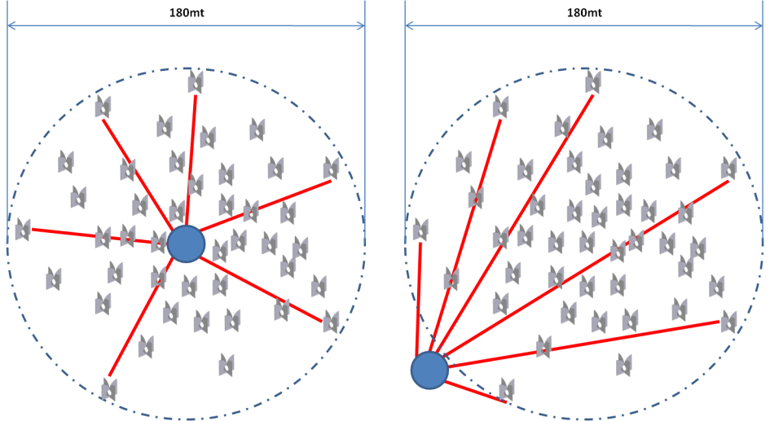
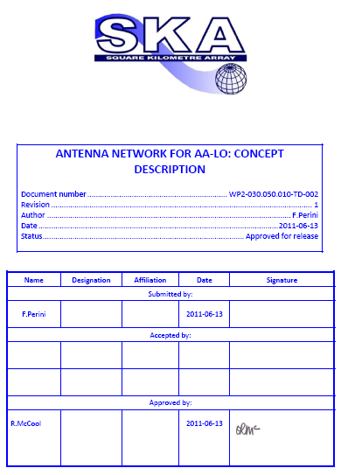
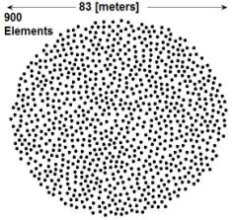
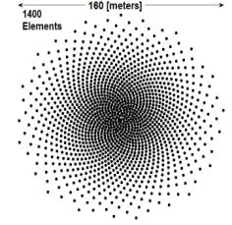
RoF concept
STaN CoDR Jodrell Bank
28th‐30th June 2011

Slide 3
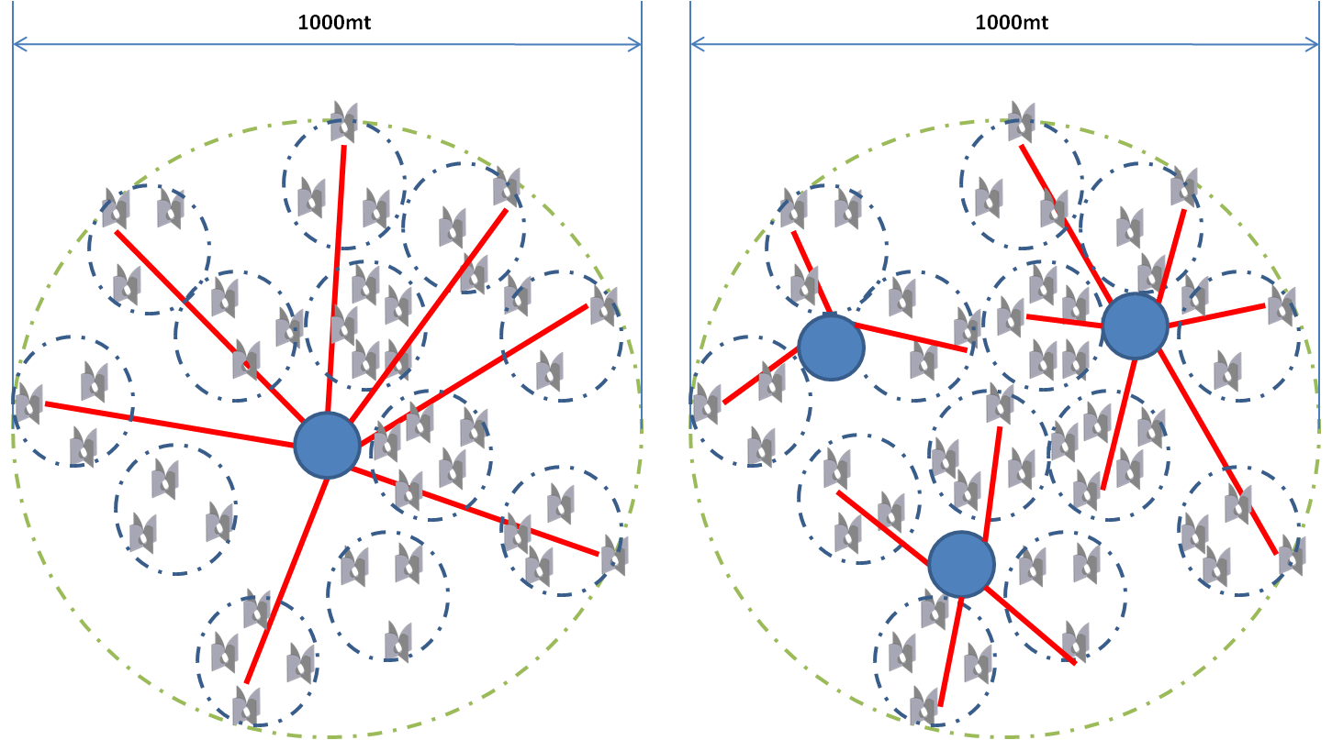
RoF concept
200-500m link length

Slide 4
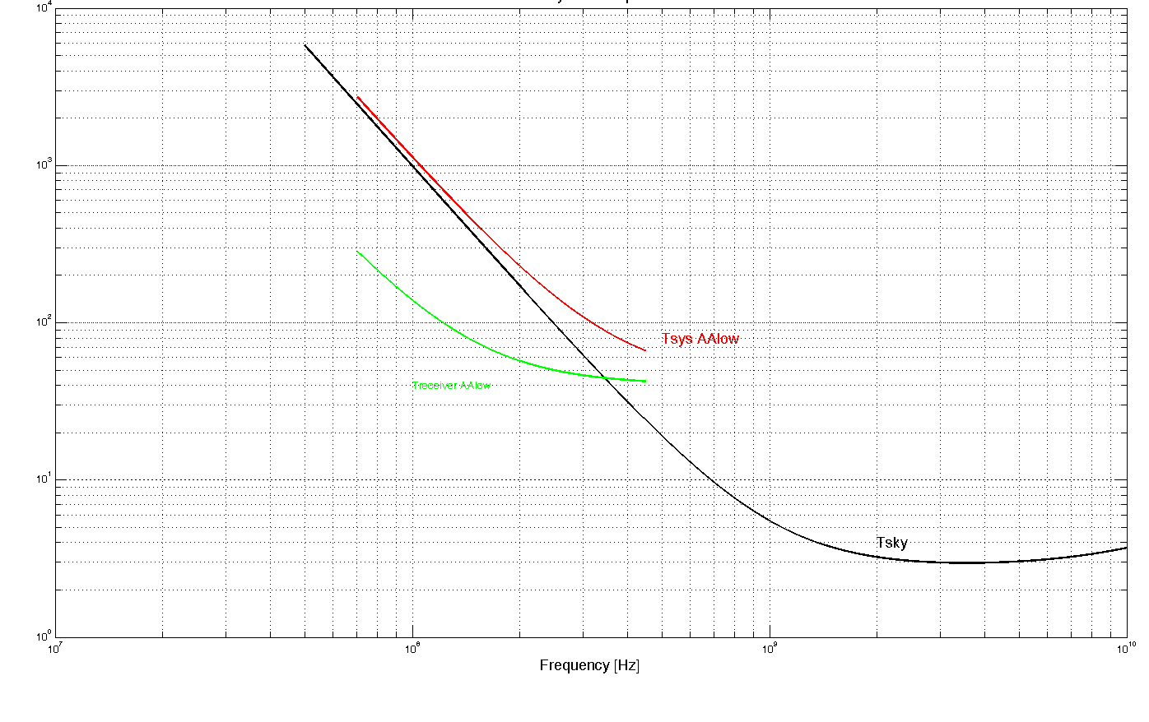
Signal Transportation & RX chain
∼ -100dBm Input Power
(noise at the antenna level) → 70dB min Gain
Tsys AAlo
Trec AAlo
Tsky
Antenna
LNA
RF Amp
Copper
or
RoF link
RF Amp
ADC
Receiver
SFDR_{RXchain}=(OIP3-G+KT-NF)=(35-71+174-0.5)= =91.7dB/Hz^{2/3}

Slide 5
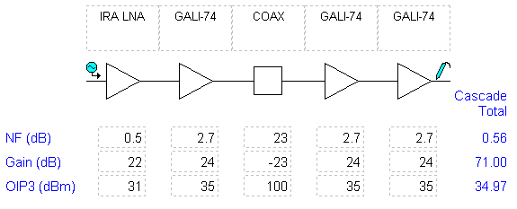
Copper link
LOFAR Coax Cable (75Ohm/TV)
Freq | Att. | Attenuation vs Length[dB]
[MHz] | [dB/m] | 50m | 100m | 200m | 500m
50 | 0.041 | 2.05 | 4.1 | 8.2 | 20.5
100 | 0.056 | 2.8 | 5.6 | 11.2 | 28
200 | 0.082 | 4.1 | 8.2 | 16.4 | 41
400 | 0.118 | 5.9 | 11.8 | 23.6 | 59
2-PAD Twisted Cable (CAT-7)
Freq | Att. | Attenuation vs Length[dB]
[MHz] | [dB/m] | 50m | 100m | 200m | 500m
500 | 0.45 | 22.5 | 45 | 90 | 225
SFDR_{RXchain}=91.6dB/Hz^{2/3}

Slide 6
Copper link
HDF400 Coax Cable (50Ohm/WiFi)
Freq | Att. | Attenuation vs Length[dB]
[MHz] | [dB/m] | 50m | 100m | 200m | 500m
50 | 0.029 | 1.45 | 2.9 | 5.8 | 14.5
150 | 0.050 | 2.5 | 5 | 10 | 25
220 | 0.061 | 3.05 | 6.1 | 12.2 | 30.5
450 | 0.089 | 4.45 | 8.9 | 17.8 | 44.5
SFDR_{RXchain}=91.6dB/Hz^{2/3}

Slide 7
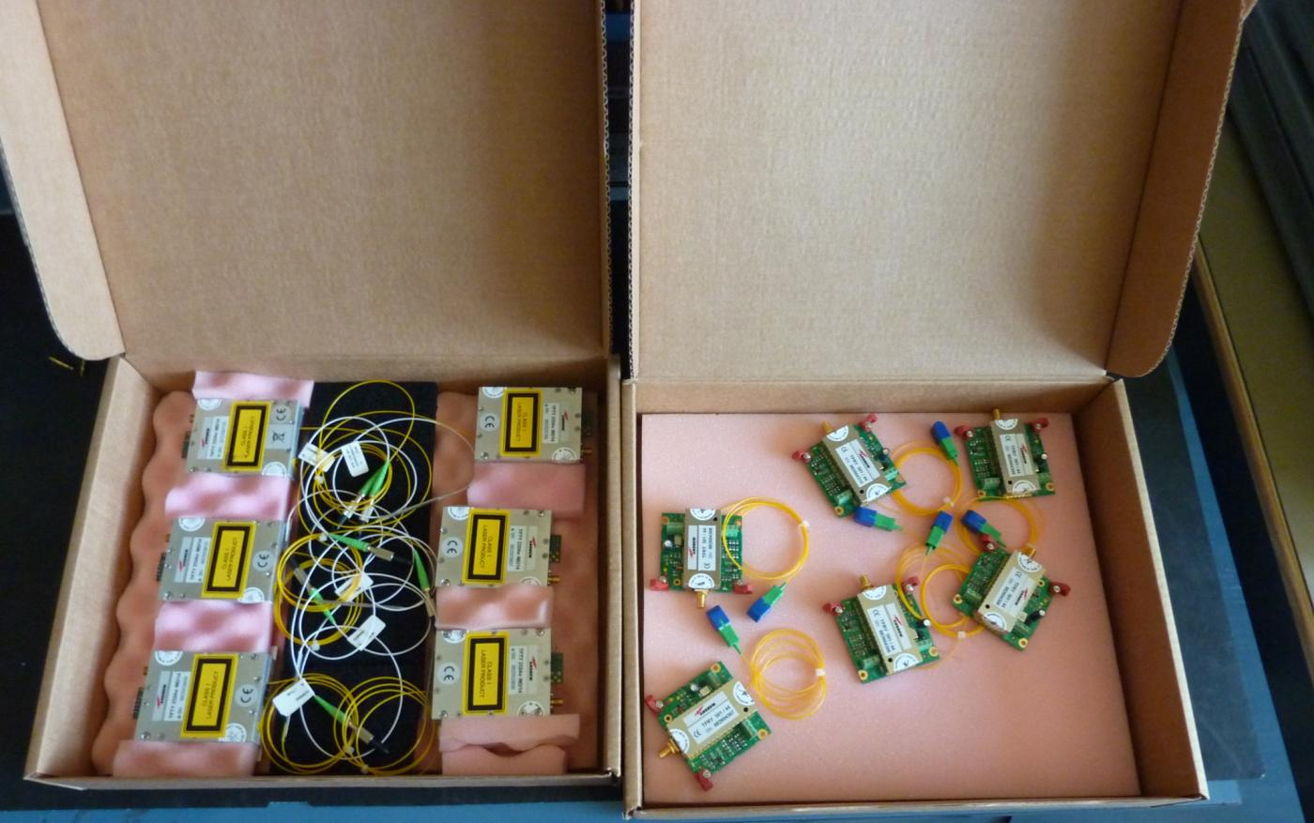
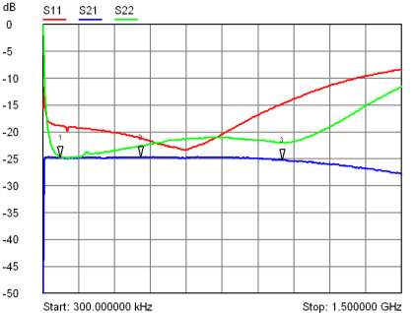
RoF link (BEST-2)
Gain (dB) | -25
Gain Flatness (dB) | +/-0.75
IRL (dB) | >15
ORL (dB) | >20
IIP3 (dBm) | +33
NF (dB) | 36
SFDR (dB/Hz^{2/3}) | 120
1.3um DFB SLT4260
from Sumitomo

Slide 8
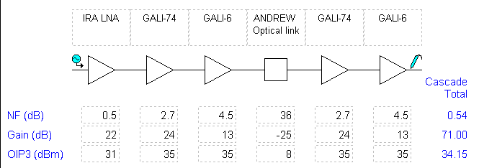
RoF link (BEST-2)
SFDR_{RXchain} = 91dB/Hz^{2/3}

Slide 9
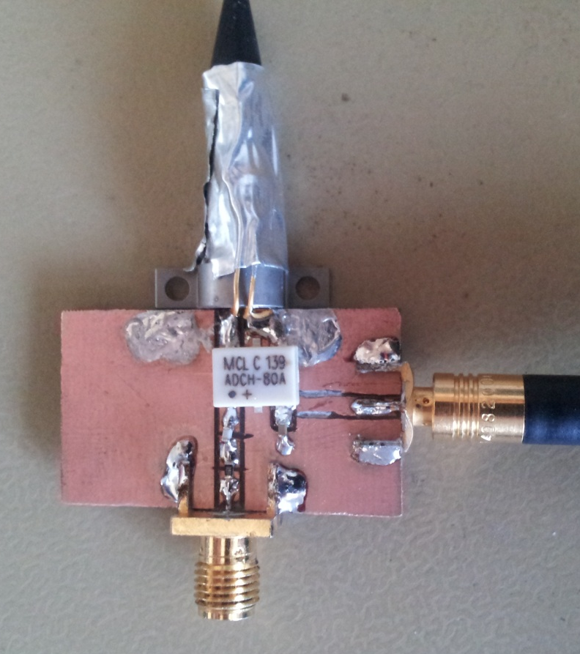
Cost reduction?
1.3um DFB SLT4260
from Sumitomo
RF choke
SMB for DC power
(to Laser Driver)
Passive
Matching Network
PCB fixture
SMA RFin

Slide 10
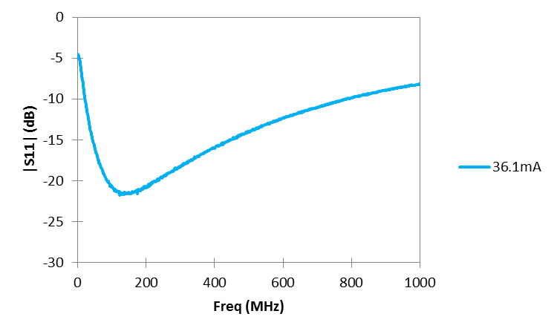
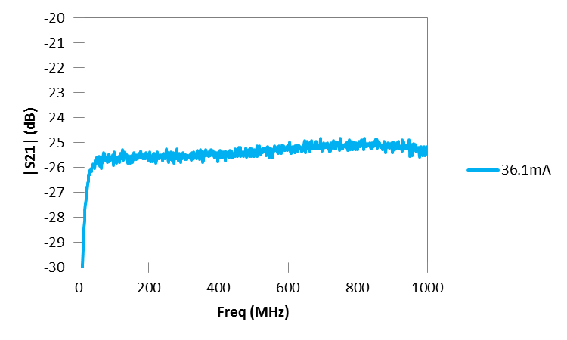
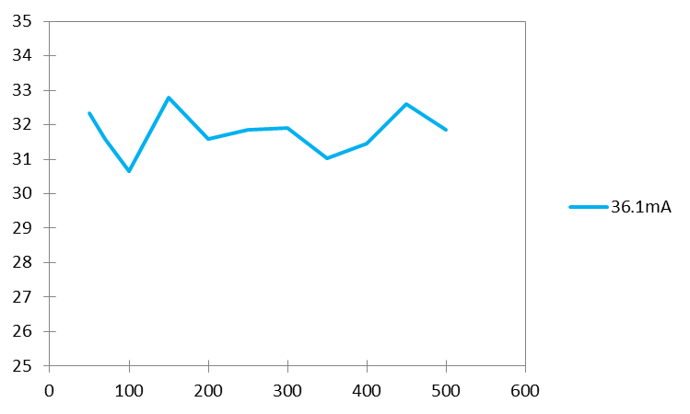
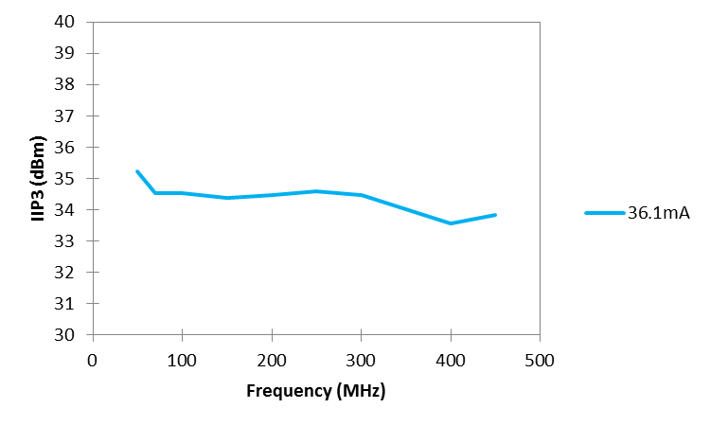
Cost reduction?
SFDR_{DFB_Link} = 118dB/Hz^{2/3}

Slide 11
Not only cost…
Vcc (V) | If (mA) | P (mW)
6 | 3 | 18
 | 5 | 30
 | 10 | 60
 | 15 | 90
 | 20 | 120
 | 25 | 150
 | 30 | 180
 | 35 | 210
 | 50 | 300

Slide 12
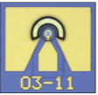
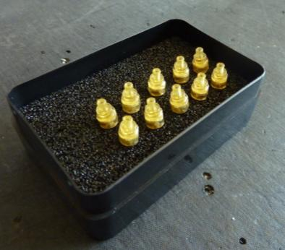
VCSEL, VCSEL, VCSEL…
Through the collaboration with CNR – IEIIT (Turin):
1.25, 2.5, 4.5 and 10Gbps COTS devices:

Slide 13
Measurement path
P1dB
L-I
Curve
NF
IP3
S
SFDR
Passive
Match
Laser
PD
Passive
Match
RFin
RFout
Optical
fibre

Slide 14
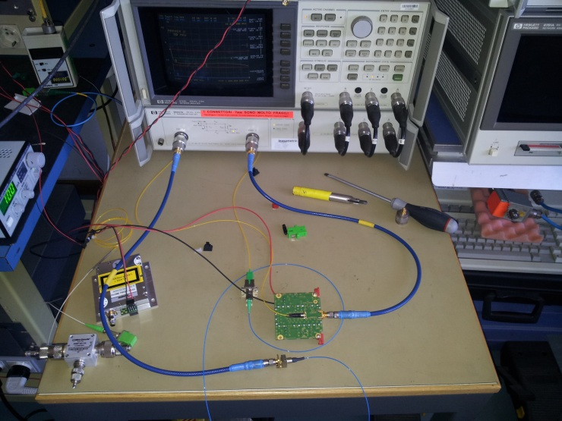
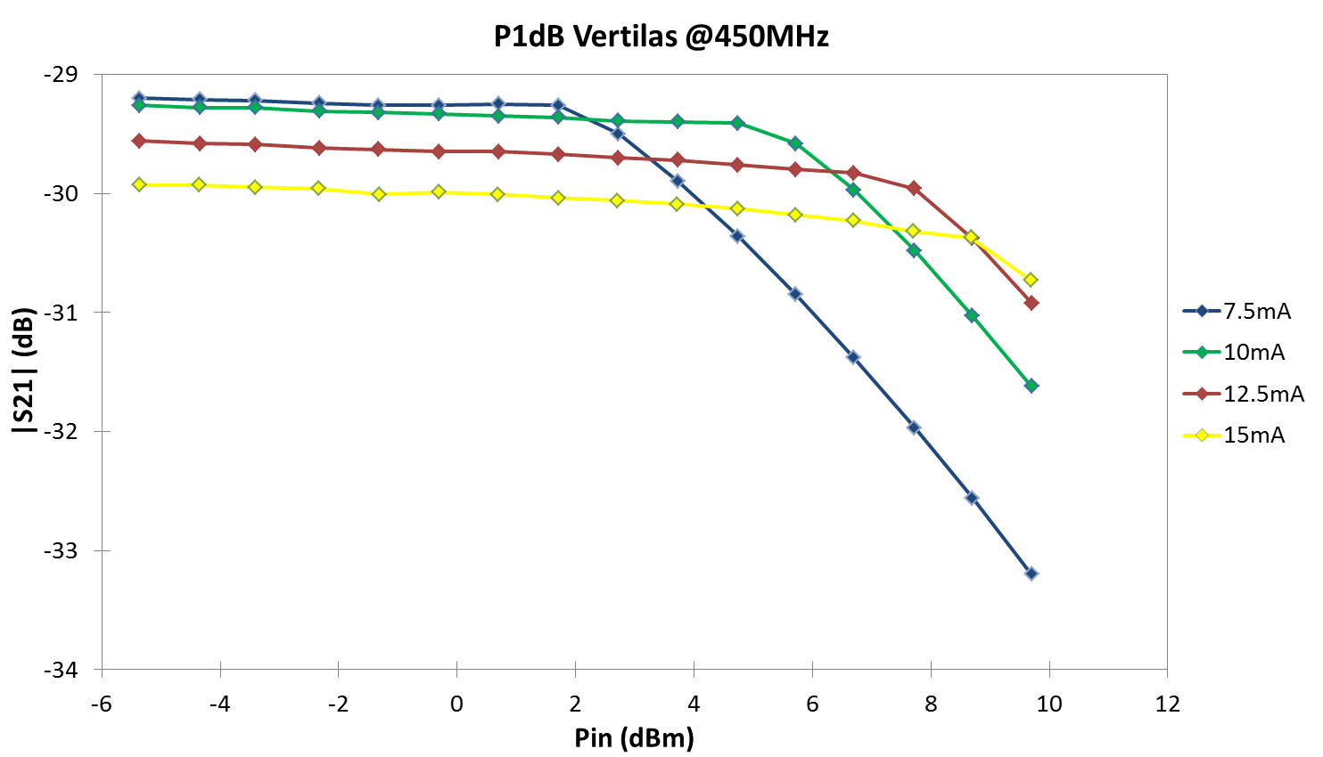
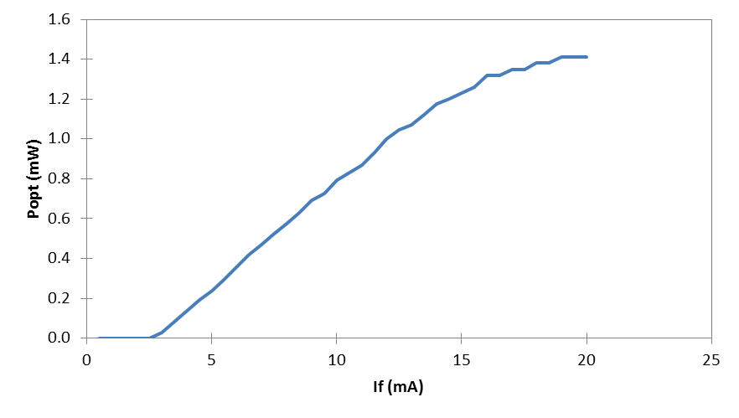
VERTILAS 1300nm

Slide 15
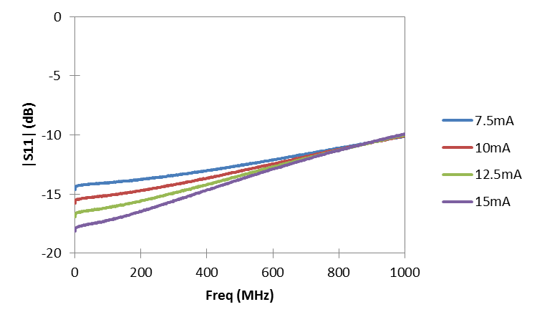
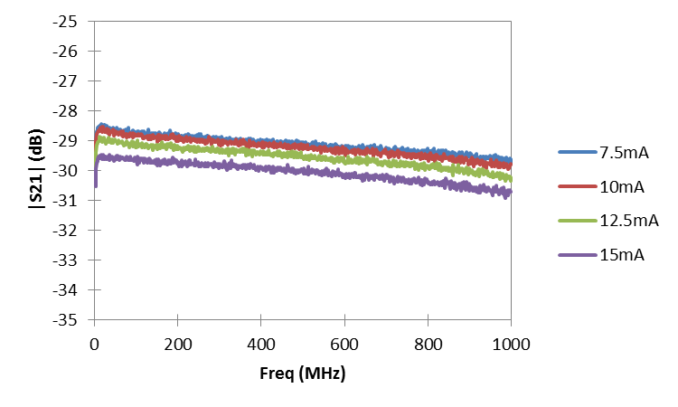
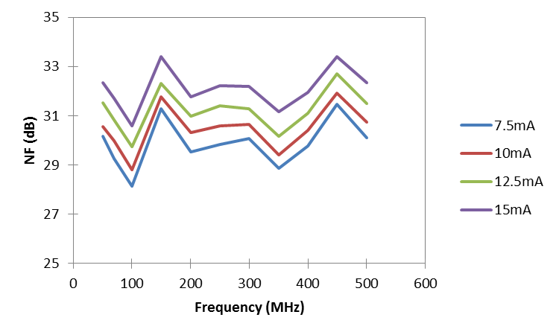
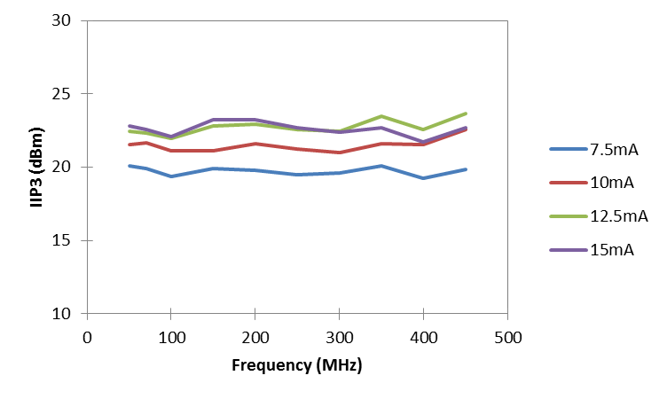
VERTILAS 1300nm
SFDR_{Vertilas_Link} = 110dB/Hz^{2/3}

Slide 16
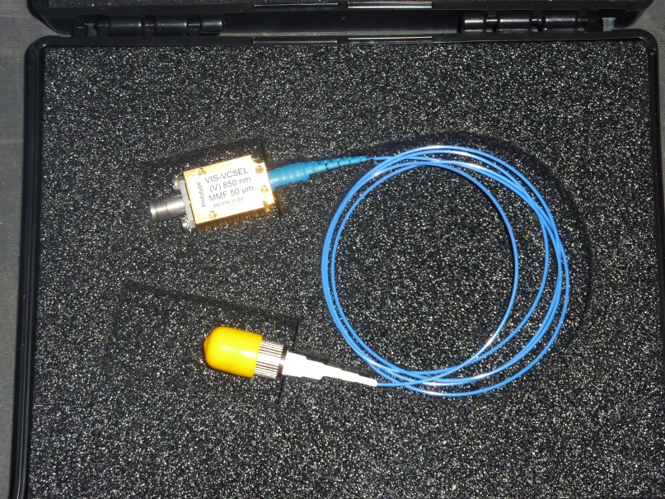
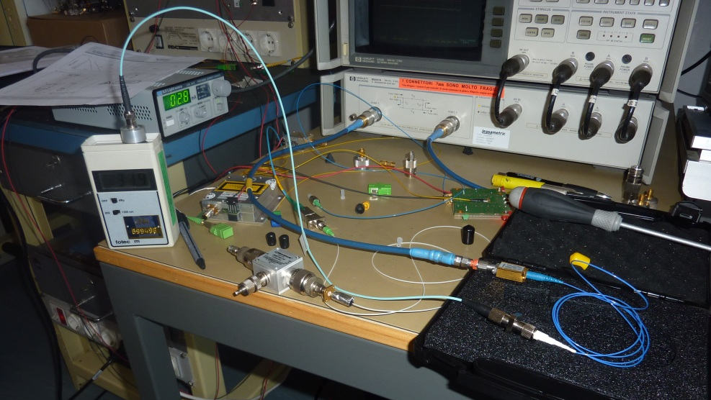
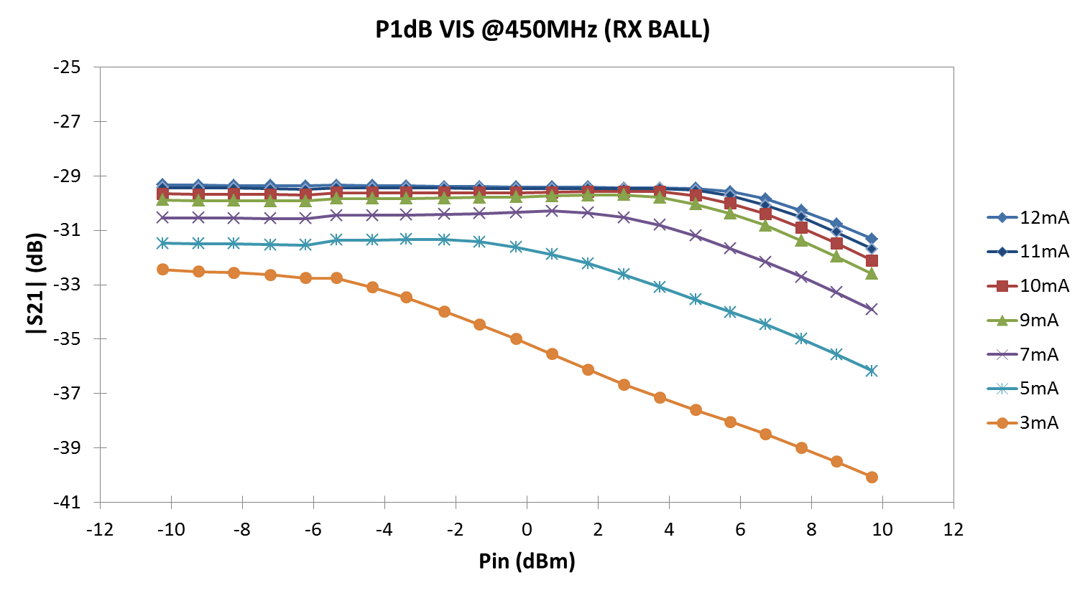
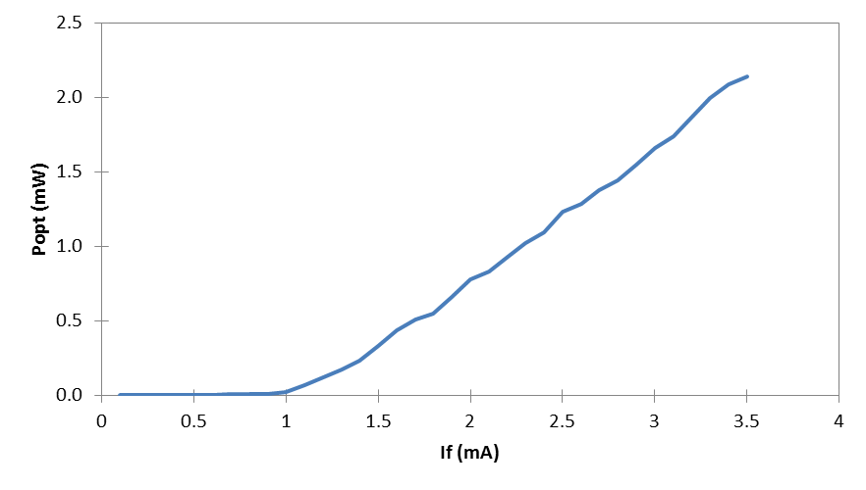
VIS 850nm

Slide 17
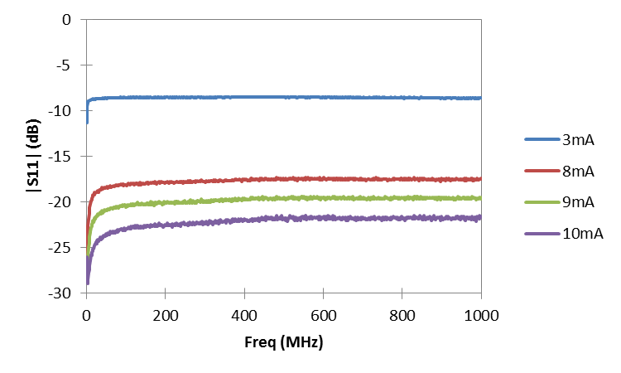
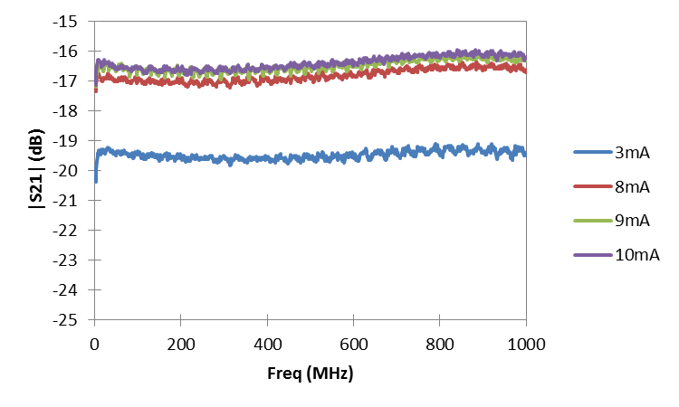
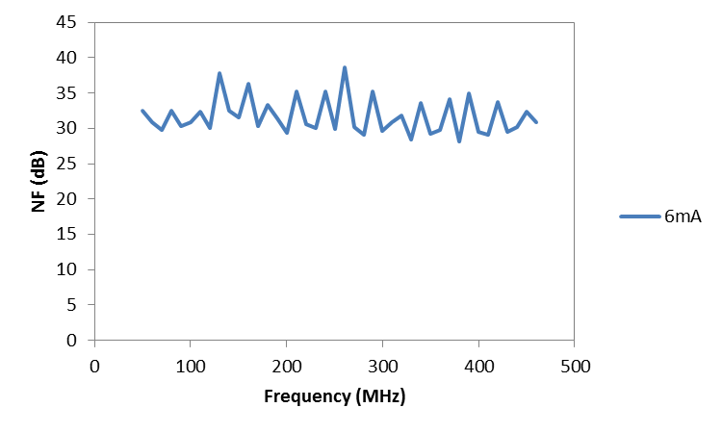
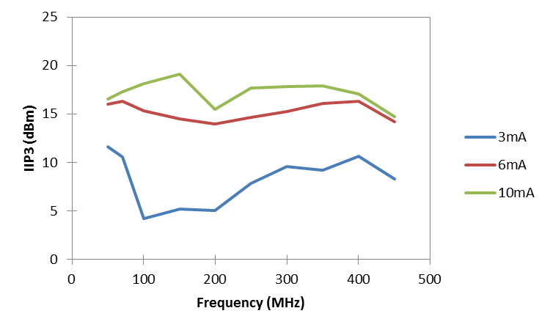
VIS 850nm
NO OPTOISOLATOR?

Slide 18
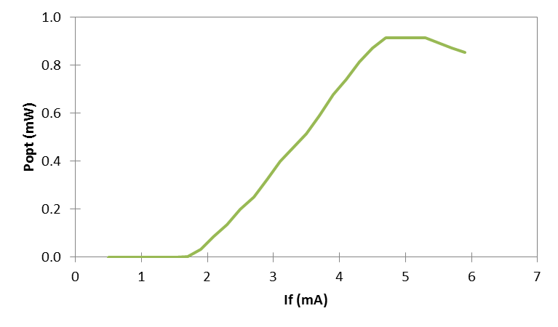
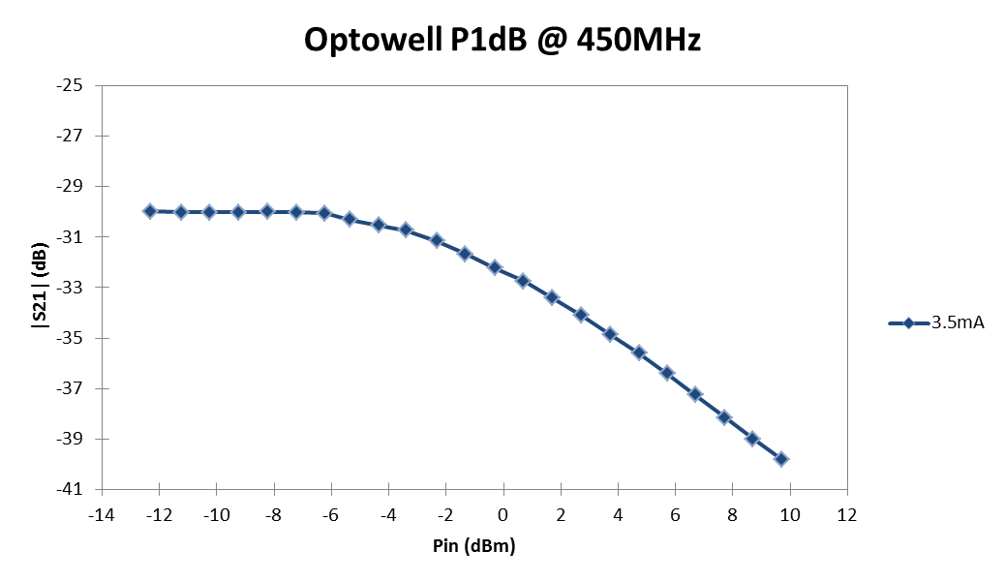
Optowell 850nm

Slide 19
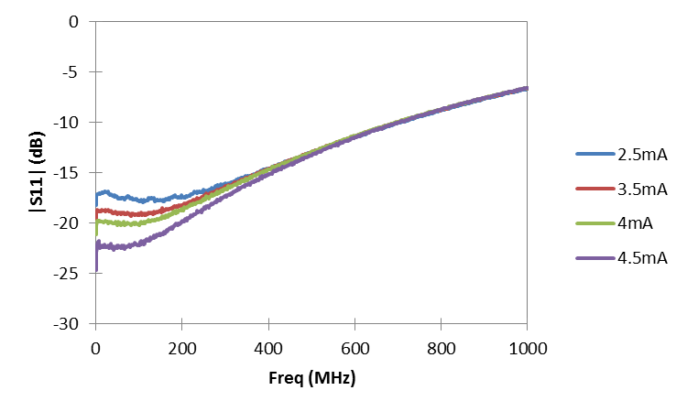
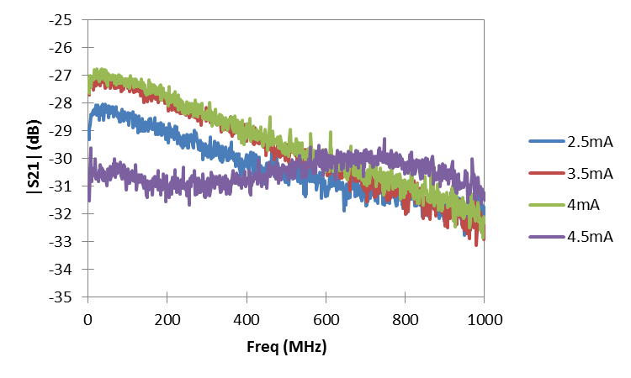
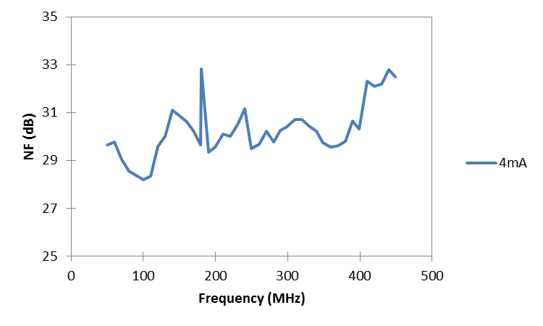
Optowell 850nm
NO OPTOISOLATOR?

Slide 20
VCSEL characterisation
Good experience gained in devices characterization
Link with UNIBO open (see next slides)
Found first suitable device (Vertilas)?
Instrumentation for 1300nm devices quite good
Lack of instrumentation and accessories for 850nm devices
new photodetector acquired
new optical power meter acquired
optoisolator under evaluation

Slide 21
Current and future work
A lot of VCSEL still to be tested
Searching of low cost DFB should goes in parallel
Passive
Match
Laser
PD
Passive
Match
RFin
RFout
Optical
fibre
TIA
Laser driver

Slide 22
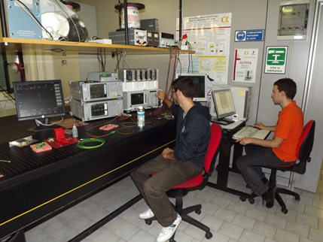
Optics Laboratory of DEI – UniBO Radio over Fiber research activities
Responsible: Prof. Giovanni Tartarini
More than 10 years of experience in the
Radio over Fiber technology.
Active collaboration with R&D sector of private companies
Participation to National and European Research Projects
Integration of Wide Band Services (InSeBaLa, Italy, 2004-2006)
Architectures for Flexible Photonic Home and Access Networks
(ALPHA, EU FP7, 2008-2011)
Department of Electrical, Electronic and Information Enginnering (DEI) “Guglielmo Marconi”

Slide 23
Optics Laboratory of DEI – UniBO Radio over Fiber research activities
Theoretical Analysis and Modelling
Locally developed software (MATLAB® , Simulink®, ….)
Commercial tools (OptSim®, Comsol Multiphysics,…)
Experimental investigations
Automated measurement benches (LabVIEW®)
State-of-the-art equipment, which include:
Three-port Vector Network Analyzer (10 MHz-9 GHz)
Optical Spectrum Analyzer (600 - 1750 nm, 62.5/125 input, Res. 70 pm)
Vector Signal Analyzer (9 kHz-6 GHz, Analysis band 31.25 MHz)
Vector signal generator (9 kHz-6 GHz, Modulation band 120 MHz)
Laser driver (200/500mA source current range)
Department of Electrical, Electronic and Information Enginnering (DEI) “Guglielmo Marconi”

Slide 24
List of Journal papers on the topic
D. Visani, M. N. Petersen, F. Sorci, P. Faccin, G. Tartarini,
“In-building Wireless Distribution in legacy Multimode Fiber with an improved RoMMF system,”
IEEE Microwave and Wireless Components Letters, article in press, 2012
G. Alcaro, D. Visani, L. Tarlazzi, P. Faccin, G. Tartarini,
“Distortion Mechanisms Originating from Modal Noise in Radio over Multimode Fiber Links,”
IEEE Transactions on Microwave Theory and Techniques, vol. 60, no. 1, pp. 185-194, Jan. 2012.
D. Visani, G. Tartarini, P. Faccin, L. Tarlazzi,
“Cost-effective radio over fiber system for multi service wireless signal,”
Optics Communications, vol. 284, no. 12, pp. 2751-2754, June 2011.
M. N. Petersen, G. Tartarini, D. Visani, P. Faccin, L. Tarlazzi,
“Influence of transmitter chirp and receiver imperfections on RF gain in short-range ROMMF systems,”
Microwave and Optical Technology Letters, vol. 53, no. 4, pp. 822-824, Apr. 2011.
D. Visani, G. Tartarini, M. N. Petersen, L. Tarlazzi, P. Faccin,
“Link Design Rules for Cost-Effective Short-Range Radio Over Multimode Fiber Systems,”
IEEE Transactions on Microwave Theory and Techniques, vol. 58, no. 11, pp. 3144-3153, Nov. 2010.
D. Visani, G. Tartarini, M. N. Petersen, P. Faccin, L. Tarlazzi,
“Effects of laser frequency chirp on modal noise in short-range radio over multimode fiber links,”
OSA Applied Optics, vol. 49, no. 6, pp. 1032-1040, Feb. 2010.
D. Visani, G. Tartarini, L. Tarlazzi, P. Faccin,
“Transmission of UMTS and WIMAX Signals Over Cost-Effective Radio Over Fiber Systems,”
IEEE Microwave and Wireless Components Letters, vol. 19, no. 12, pp. 831-833, Dec. 2009.
G.Tartarini, A.Lena, D. Passaro, L. Rosa, S. Selleri, P. Faccin, E. Fabbri.
“Harmonic and Intermodulation Distortion Modeling in IM-DD Multi-Band Radio over Fiber Links exploiting Injection Locked Lasers” .
Optical and Quantum Electronics vol. 38, pp. 869 - 876., 2006
G. Tartarini, P. Faccin,
“Efficient characterization of harmonic and intermodulation distortion effects in dispersive radio over fiber systems with direct laser modulation,”
Microwave and Optical Technology Letters, vol. 46, pp. 114 – 117, 2005.

Slide 25
List of Conference Papers on the topic
D. Visani, F. Sorci, P. Faccin, G. Tartarini,
“Comeback of Fabry-Perot RoMMF Transmitters for Improve LTE Signal Distribution”,
IEEE International Topical Meeting on Microwave Photonics (MWP) 2012 , Norwijk, The Netherlands, paper Th5.5, 11-14 Sep. 2012.
G. Alcaro, D. Visani, G. Tartarini, L. Tarlazzi, P. Faccin,
“Controlling the impact of Modal Noise on Harmonic and Intermodulation distortions in Radio over Multimode Fiber links,”
36th European Conference and Exhibition on Optical Communication (ECOC) 2010 , Torino, Italy, paper We.7.B.5, 19-23 Sep. 2010.
D. Visani, G. Tartarini, M. N. Petersen, L. Tarlazzi, P. Faccin,
“Reducing Modal Noise in Short-Range Radio over Multimode Fibre Links,”
OSA Optical Fiber Communication Conference (OFC) 2010 , San Diego, CA, USA, paper JWA56, 21-15 Mar. 2010.
D. Visani, G. Tartarini, L. Tarlazzi, P. Faccin,
“Accurate and efficient transmission evaluation of wireless signals on radio over fiber links,”
IEEE International Topical Meeting on Microwave Photonics (MWP) 2009, Valencia, Spain, paper Th4.17, 14-16 Sep. 2009.
L. Rosa, D. Passaro, S. Selleri, G. Tartarini, P. Faccin, E.M. Fabbri,
“Simulation and Measurement of Intermodulation Induced by Chirp-Dispersion Interaction in Radio-over-Fiber Systems”
IASTED International Conference on Antennas, Radar and Wave Propagation ARP 2007. Montreal, Canada. May 30 - June 1, 2007
L. Rosa, S. Selleri, G. Tartarini, E. M. Fabbri, P. Faccin,
“Intermodulation Distortion Modelling in IM-DD Multi-Band Radio over Fibre Links”.
International Topical Meeting on Microwave Photonics (MWP 2006). Grenoble (F). 3-6 October 2006.
S. Selleri, L. Rosa, G. Tartarini, P. Faccin, E. Fabbri,
“Distortion Performance Prediction in Multi-band Radio over Fiber Systems Exploiting Direct Laser Modulation”
European Microwave Week 2006. Manchester (U.K.). 10-15 September 2006.
A. Faniuolo, G. Tartarini, P. Bassi, P. Faccin, A. Casini,
“Effects of directly modulated laser chirp on the performances of radio over fiber systems”
IEEE International Topical Meeting on Microwave Photonics (MWP) 2003 , Budapest, Hungary, pp. 283-286, 2003.

Slide 26
Thanks!

Slide 27
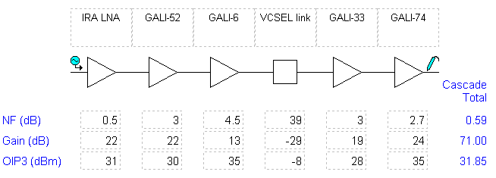
RoF link based on VCSEL
RF Transmission Over Multimode Fibers Using VCSELs - Comparing Standard and High-Bandwidth Multimode Fibers.
C. Carlsson , A. Larsson, A. Apling.
IEEE Journal of Lightwave Technology, 2004.
SFDR (dB/Hz^{2/3}) | 104
Gain (dB) | -29
NF (dB) | 39
OIP3 (dBm) | -8
SFDR_{RXchain} = 90dB/Hz^{2/3}
(SFDR_{Link(VCSEL)}=104dB/Hz^{2/3})
500m link on MMF
SFDR_{RXchain DFB} = 91dB/Hz^{2/3}
SFDR_{RXchain Copper} =91.6dB/Hz^{2/3}

Slide 28
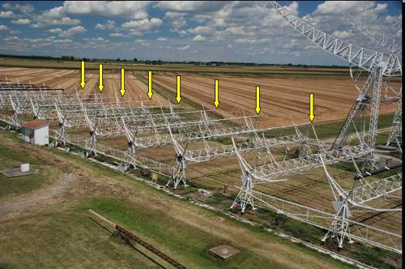
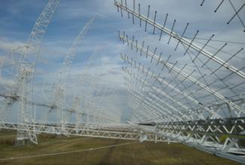
Current and future work
VCSEL links for AAVS0
Comparison of VCSEL/MMF&SMF with DFB/SMF using:
-BEST2: 32 elem. 2D, A_{c}=1400m²
-BEST3-lo: 16 elem. 1D, A_{c}=800m²

