Slide 1

Receiver work
          Presented by Monari Jader
          INAF-IRA
          Radiotelescopio Croce del Nord
          Email : j.monari@ira. inaf.it
          AA-low Technical Progress Meeting
          Medicina, 22-23 September 2012

Slide 2
Foreword……..
The receiver design is on hold
in order to achieve the AAVS0 goals

Slide 3
Distributed Receiver Architecture
(* Monari et al. Medicina 2012)
From Antenna (30? 70-450MHz)
To Back End
LNA
Front End
(FE+OTX)
Link
Receiver
(ORX+RX)
Outputs 30-450MHz

Slide 4
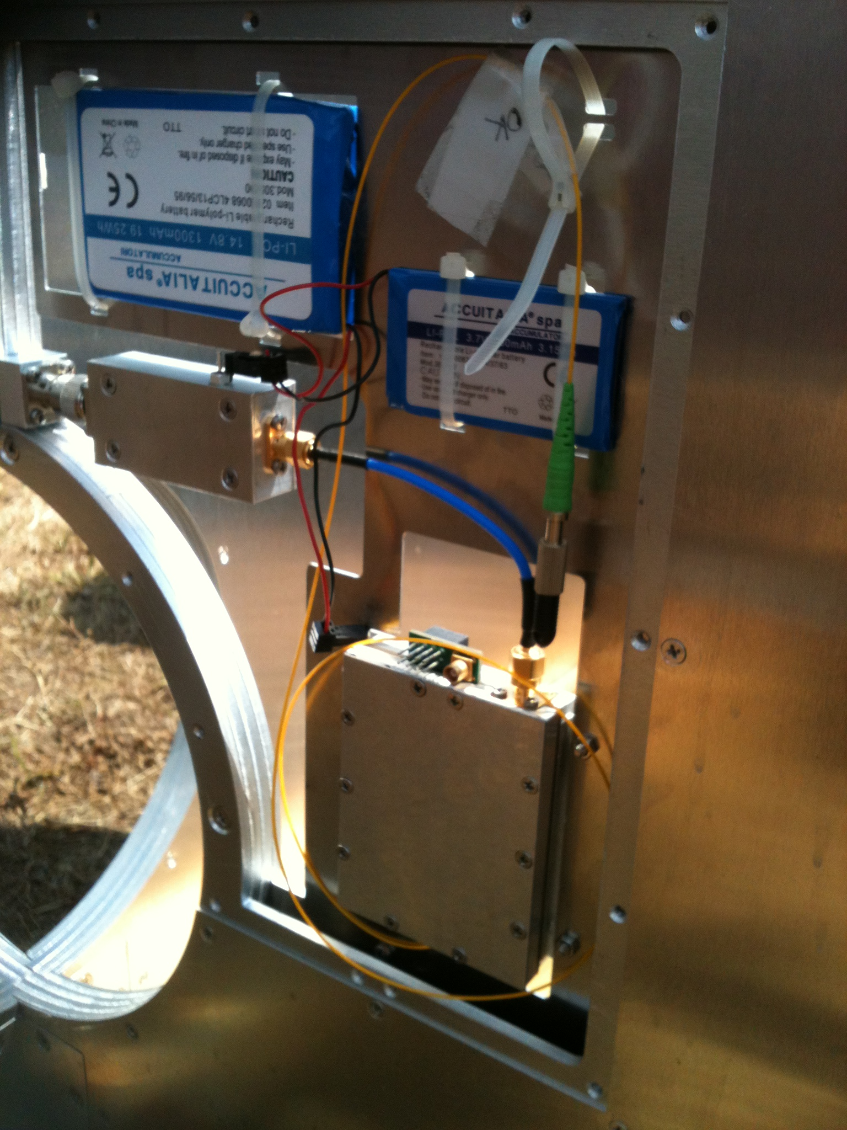
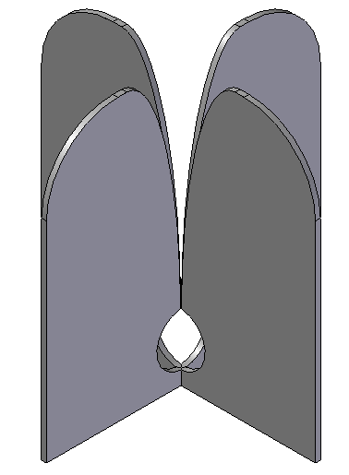
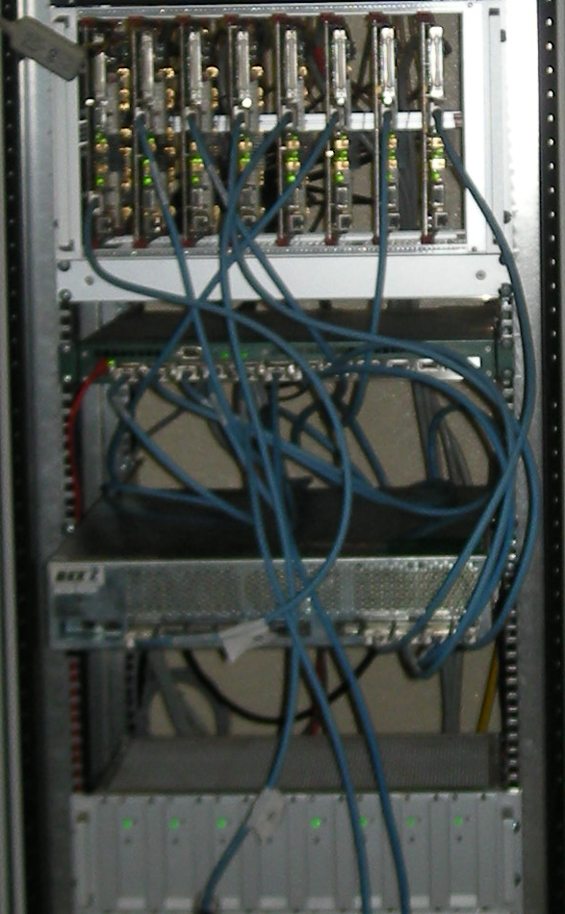
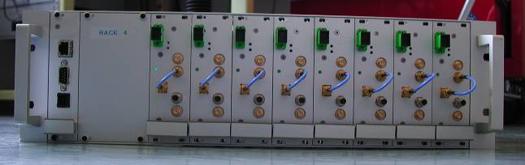
RECEIVERS ROOM
Receiver
(RX)
LNA
LNA
400mt Optical fiber
Receiver
(RX)
Front End
+OPT TX
Front End
+OPT TX
BACK END

Slide 5
Receiver Specifications

Slide 6
Receiver’s Blocks
ADL5387
Q
WB output 70-450MHz
NB outputs 0-16MHz
OPTICAL RX
MNC SBTCJ-1W
MNC GALI 52
A-INFO JXWBLB-S-BP-50-450
OPTICAL TX
OPTICAL RX
MNC SBTCJ-1W
MNC GALI 6
MNC
SBTC 2-10
MNC GALI 6
Equalizer
I
MNC TCBT-14+
Equalizer
Pre-whitening
MNC ADC-10-1R
0
0
LO
HMC960-10
π
π
FM STOP
MNC ZX75BS-88108-S+
TV STOP
MNC BSF-C174223+
MNC GALI 52
COARSE
HMC800LP3
FINE
HMC472LP4
A-INFO JXWBLB-S-BP-50-450
HMC849
COARSE
HMC800LP3
FINE
HMC472LP4
HMC849
A-INFO JXWBLB-S-BP-50-450
WB RECEIVER
Pre-whitening
MNC GALI 84
WB output 70-450MHz
FRONT END
UNIVERSAL RECEIVER
A-INFO JXWBLB-S-BP-50-450
MNC GALI 84

Slide 7
Pre-whitening block

Slide 8
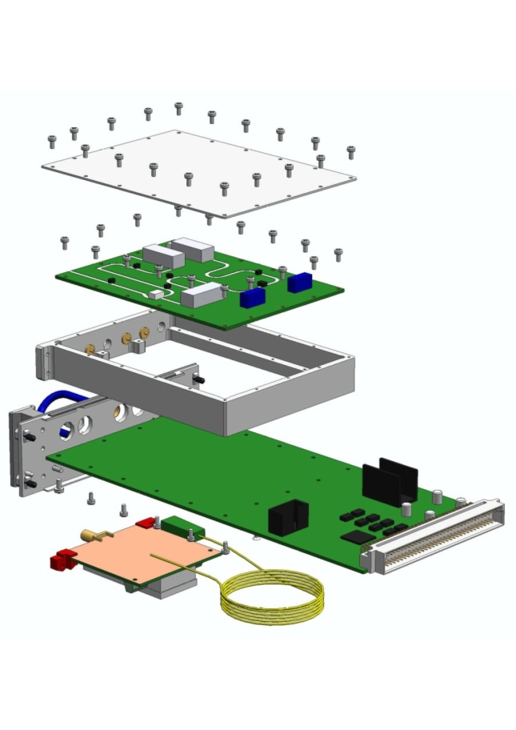
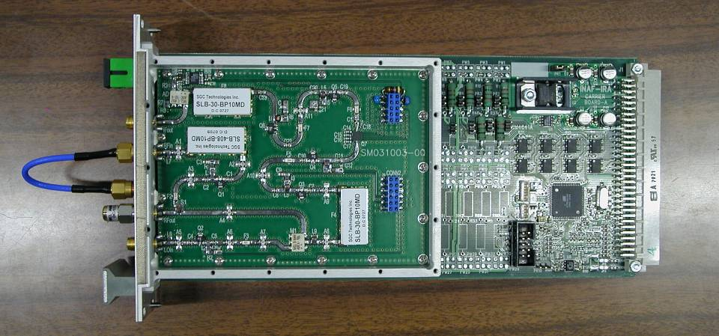
Carrier Board

Slide 9
Communication

Slide 10
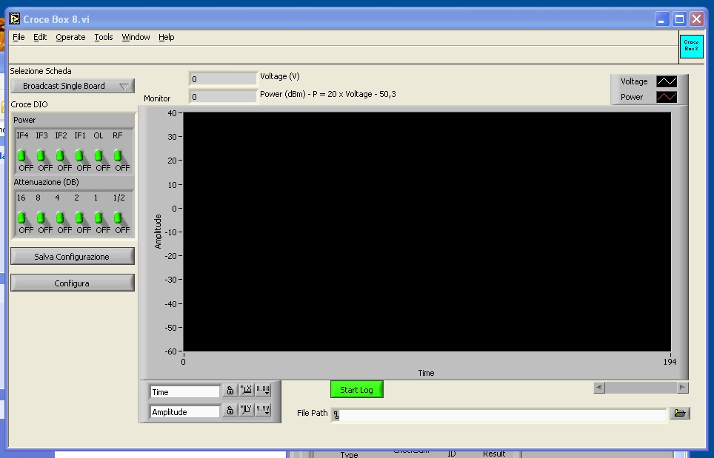
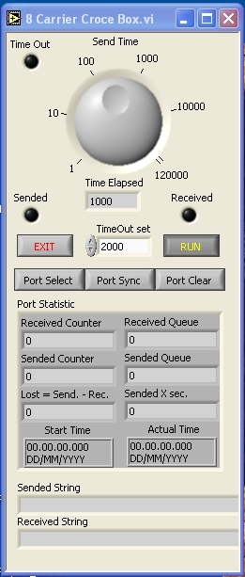
Control Software

Slide 11
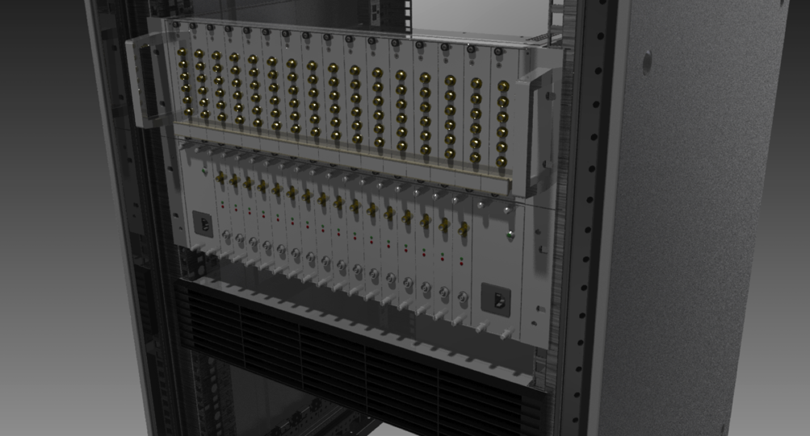
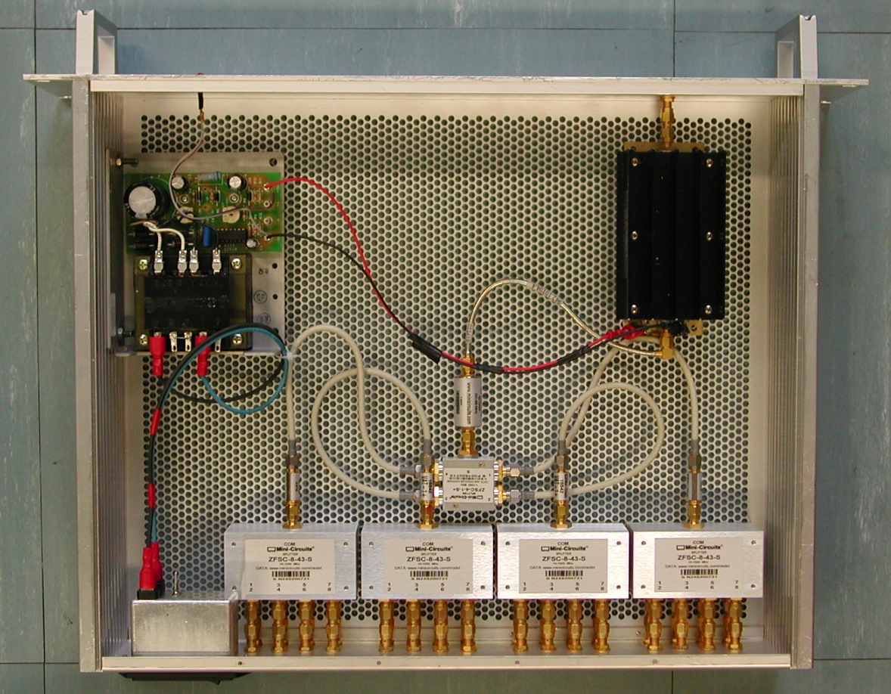
Mechanics Assembly

Slide 12
Costs for 16 receiving systems
Based on Carrier + VCSELs

