Slide 1

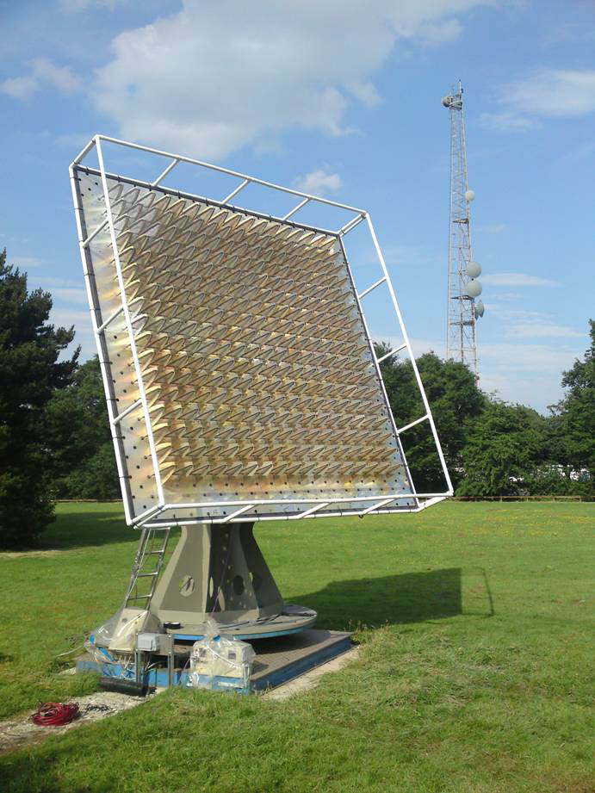
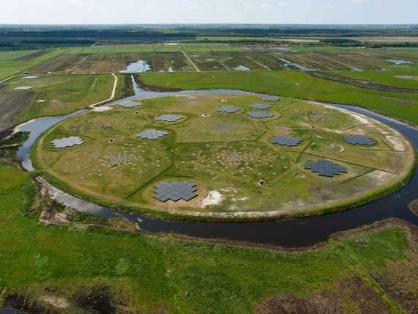
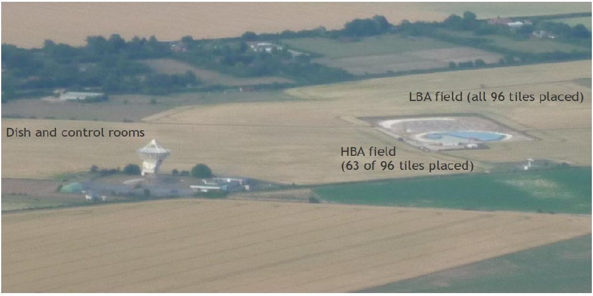
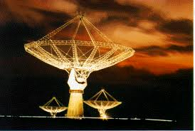
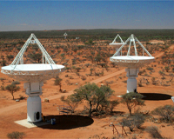
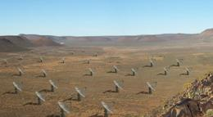
Single vs Dual Band Considerations
Kristian Zarb Adami
Danny Price
M E Jones
& the AADC
Instruments:
Notes:
Business of observing hydrogen in our universe

Slide 2

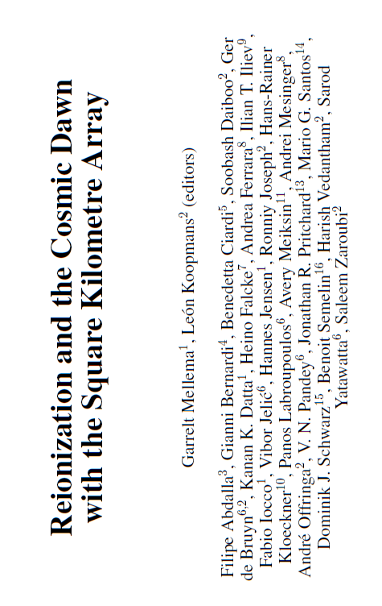
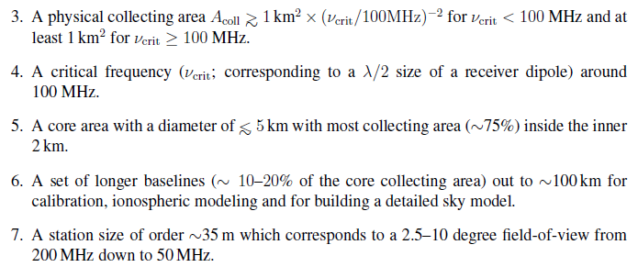
The new shopping list

Slide 3
DRM Current Requirements
 | Frequency (MHz) | Sky Coverage (deg²) | Survey speed (m²K⁻¹) | Relevant FoM
EoR | 70-200 | 25 | 2060 - 10400 | Extended
EoR - 21-cm forest | 70-200 | 20,000 | 1300 | Extended?
HI Absorption | 200-450 | 10,000 | 10⁶m⁴K⁻² deg² | Point source
Pulsar surveys | 300-450 | 20,000 | 500 | Pulsar
Continuum deep-field | 300-3000 | 10 | 10000 | Point source
Intensity mapping | 200-1420 |  |  | Extended

Slide 4










Important to...
Distinguish between Point Source Sensitivity:
And Brightness Sensitivity:

Slide 5
Comparing
Point Source Sensitivity Survey Speed
with Temperature Sensitivity Survey Speed
Increasing the collecting area Ae while keeping f constant will increase the PFoM, but will not increase the BFoM.
Increasing the filling factor f while keeping the collecting area A_{e} constant will increase the BFoM, but not the PFoM (so long as the source remains resolved).

Slide 6
A 3x3 gridded array with spacing d. In the regime where the collecting areas of individual antennas do not overlap, the overall collecting area is the sum of all individual collecting areas.

Slide 7
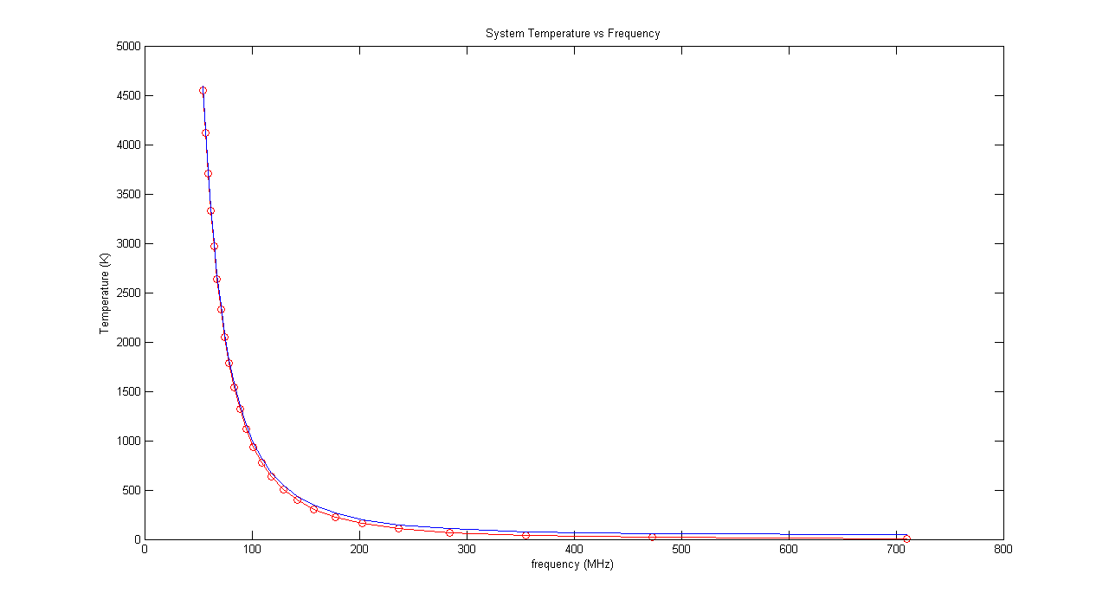


T_{sys} vs frequency

Slide 8
Comparison of brightness sensitivity between single (dashed) and dual (continuous) band implementations for SKA-low. An antenna gain of 9dBi has been used.

Slide 9
Ratio of brightness sensitivity survey speed between the dual and single band implementations. At 200MHz, the single implementation is sparse while the dual band is fully filled; at about 320MHz, the dual band becomes sparse also, and the ratio becomes constant. An antenna gain of 9dBi has been used.

Slide 10
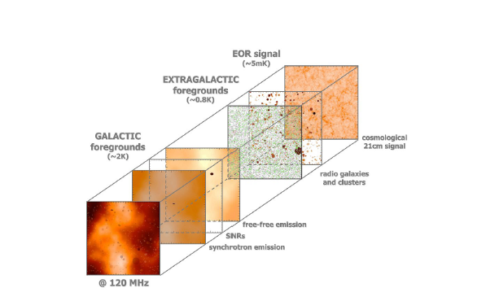
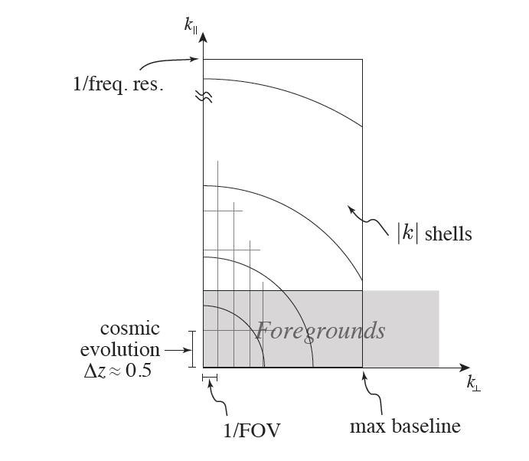
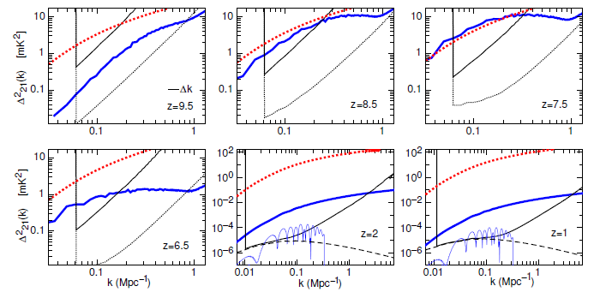
Epoch of Re-ionisation

Slide 11
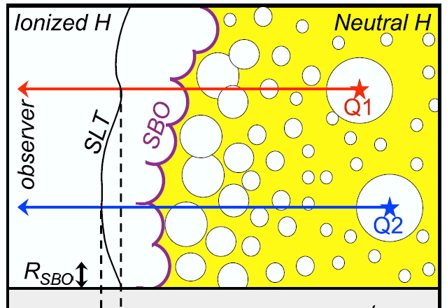
However...
The Science Case between 200-450MHz seems rather weak except for (Wyithe and Loeb): “ Our novel result implies that future radio experiments should be tuned to a characteristic angular scale of ∼ 0.5◦ and have a minimum frequency band-width of ∼ 8 MHz for an optimal detection of 21cm flux fluctuations near the end of reionization.”

Slide 12
Next Steps...
Progress the Single vs Dual Considerations Document with realisitc OSKAR-2 dynamic range simulations
Feedback into the DRM process requirements for Brightness Sensitivity and Brightness Sensitivity Survey metrics
Discuss in detail the 50MHz requirements and produce an engineering response to the Cosmic Dawn/EOR Paper
Discuss in detail the 200-450MHz science requirements and the requirements for Intensity Mapping Experiments at these frequencies

Slide 13
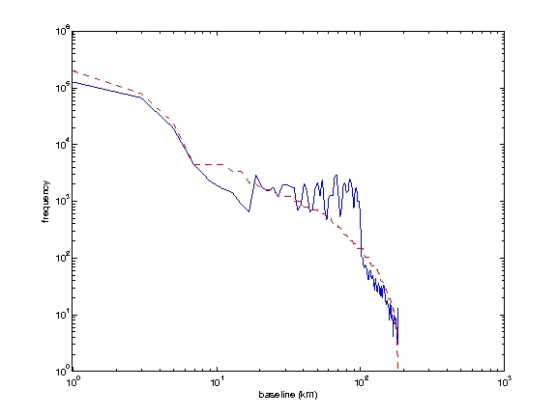
Fitness Functions
Correlation with Ideal Baseline Histogram (user defined)

Slide 14
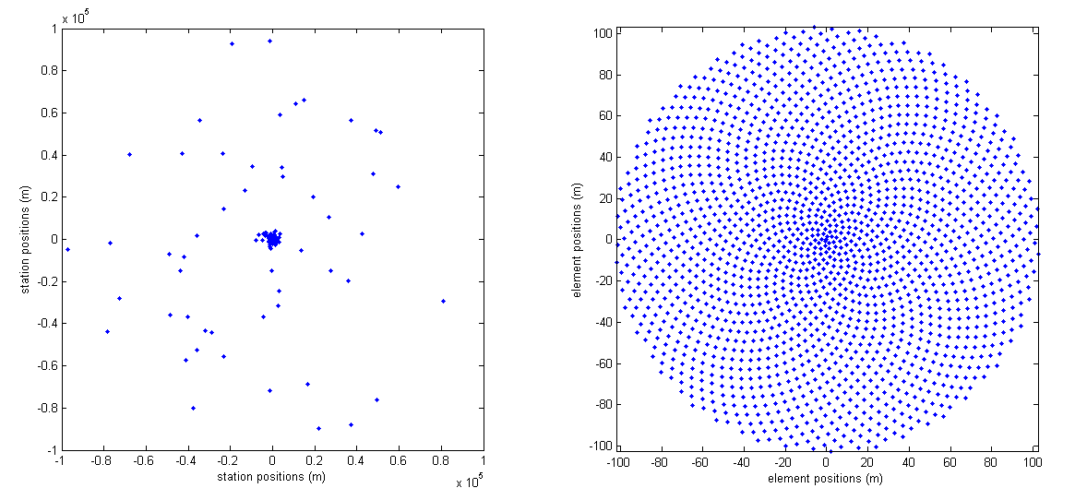
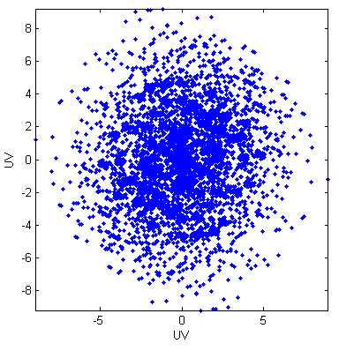
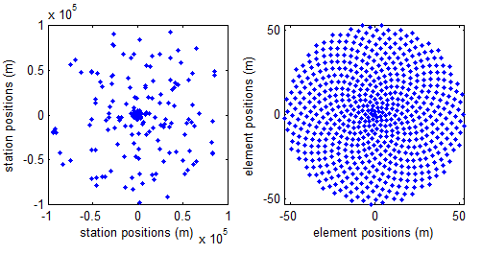
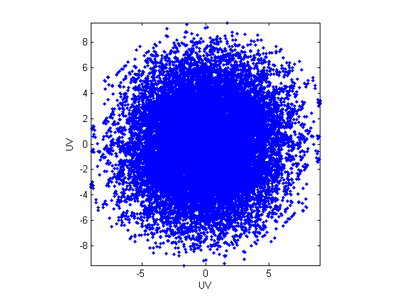
Typical Chromosomes (golden ratio elements in stations)

Slide 15
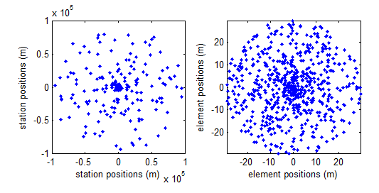
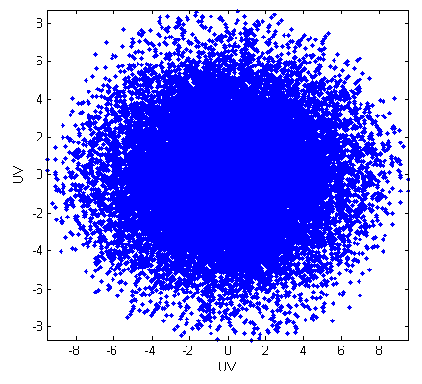
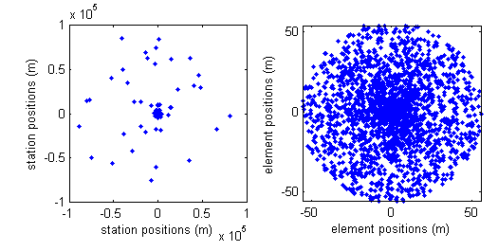
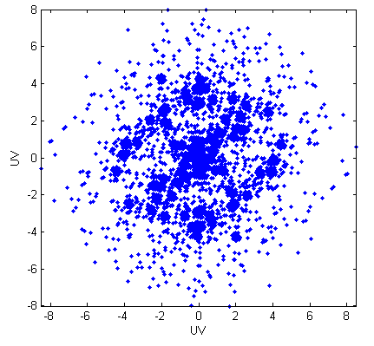
Typical Chromosomes (random elements in stations)

Slide 16
Antenna Design

