Slide 1

INAF Status Report
          Presented by Monari Jader
          INAF-IRA
          Radiotelescopio Croce del Nord
          Email : j.monari@ira. inaf.it
          AA-low Technical Progress Meeting
          Medicina, 22-23 September 2012

Slide 2







Italian Organization for AAVP
IRA-INAF Medicina
Stelio Montebugnoli
Jader Monari, Federico Perini, Germano Bianchi, Marco Schiaffino, Giovanni Naldi, Andrea Mattana
Giovanni Tartarini,
Davide Visani
Giuseppe Virone, Pierluigi Debernardi, Augusto Oliveri
UNIBO
IEIIT Turin
COSPAL
Andrea Lingua, Marco Piras,
Paolo Maschio, Horea Bendea,
Alberto Cima
POLITO
SGUINZI

Slide 3
Where we started the studies…....
Face up the AAlo architecture problems:
  Reduce Costs
  Reduce Complexity
  Increase Reliability
  Increase Maintainability
Study the crucials parts
  Antennas
  Minimizing the cabling from Front End to Receiver/Digital Acquistion System
  ........ perhaps it is worth putting a single sensor to save money......
  Very Scalable System
  Modular System
  Easy to replicate all parts
  Design for deployment

Slide 4
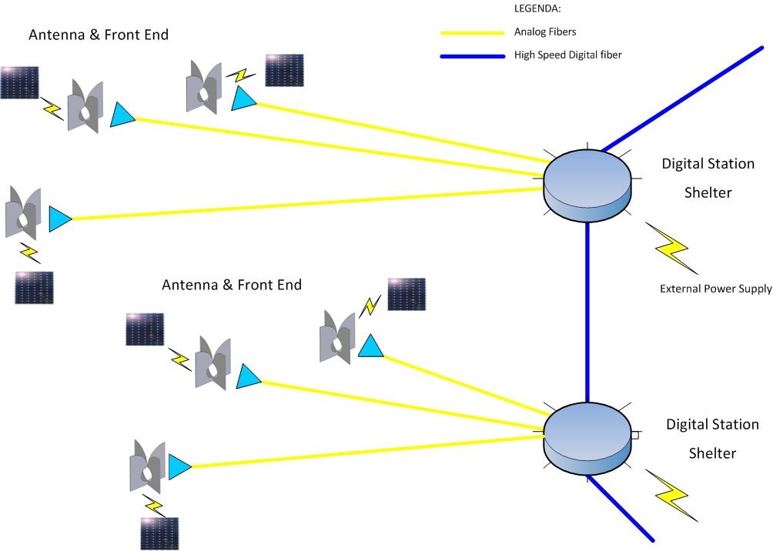
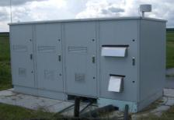
Aperture Array Architecture
(* Monari et al. Cambridge 2010)
Notes:
Whre we strated the studies….
Face up the AAlo architecture problems:
Reduce Costs
Reduce Complexity
Increase Reliability
Increase Maintainability
Very Scalable System
Modular System
Easy to replicate all parts
Design for deployment
Study the crucials parts
Antennas
Minimizing the cabling from Front End to Receiver/Digital Acquistion System
........ perhaps it is worth putting a single sensor to save money......

Slide 5
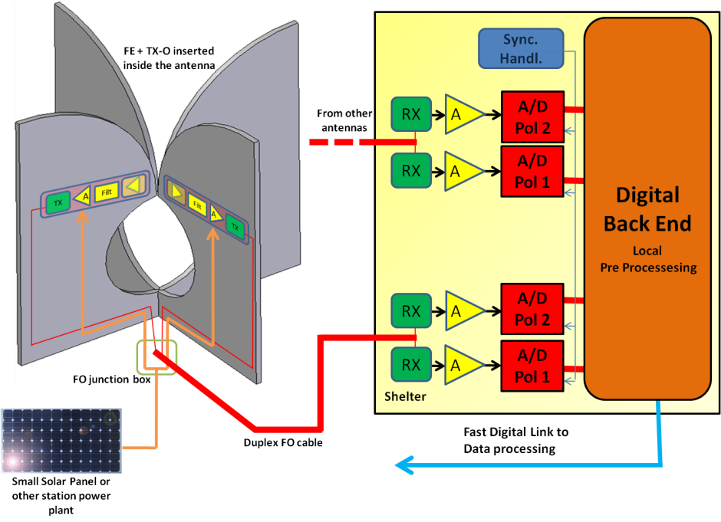
First Draft: Concept Description
(* Perini et al. Jodrell Bank 2011)
Notes:
Antenna and Front End: LNA+ post amplifiers +Analogue Optical Transmitter supplied with solar panel.
500m fibre optic
Digital Station: Analogue Optical RXs, Power amplifications, ADCs, Digital boards inside a shielded shelter. In order to reduce the digital electronic, an analogue beamformer could be considered.
Self powered FE+ Optical Link
Galvanic isolation between FE and DS, more stable amplitude&phase Vs temperature so easy to deploy it (not necessary to bury the FO), RFI immunity, no DC power losses on the cable, no Gain disequalization.

Slide 6
Goals and deliverables

Slide 7
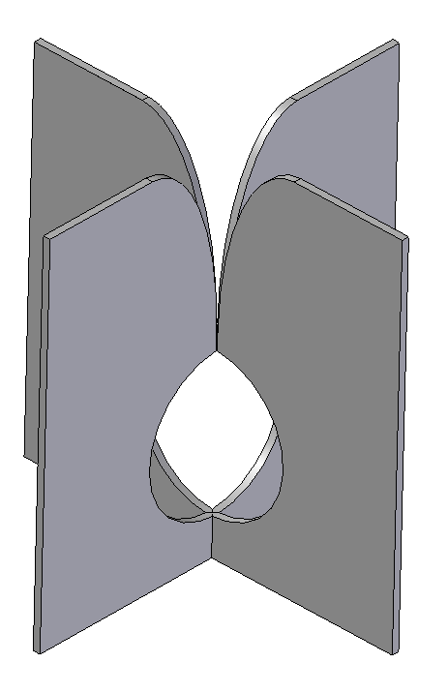
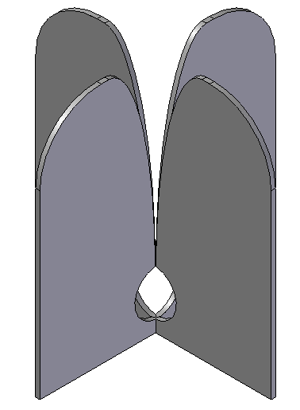
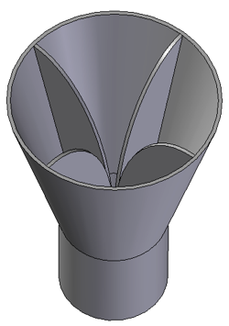
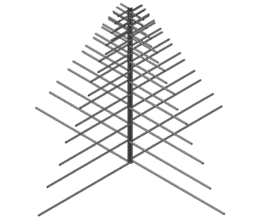
Dual-Pol Log-periodic | Dual-Pol Vivaldi version 1 | Dual-Pol Vivaldi version 2 | Quad-Ridge Horn
Pro Well-known design Simple manufacturing Low-cost | Pro Good reflection coefficient (50 Ohm) High isolation between polarizations | Pro Acceptable refl. Coeff. (50 Ohm) High isolation between polarizations Lower back lobe Higher directivity at 45° | Pro Very High directivity in the required sky coverage Very Low back lobe High isolation between polarizations
Cons - Very Poor Isolation between polarizations | Cons High back lobe Low directivity at 45° | Cons -Refl. Coeff is -4 dB at 120 MHz | Cons Only suitable for split band solution More complex manufacturing
All the configurations are metal-only and do not require a ground plane

Slide 8
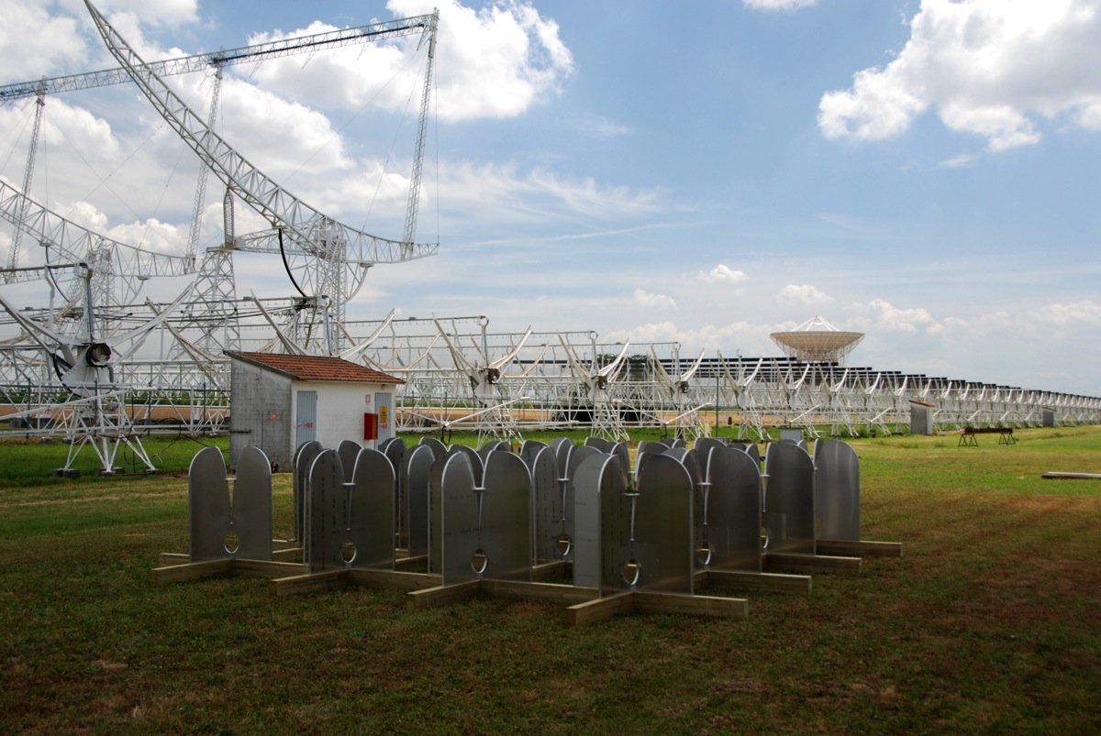
AAVS0 16 Vivaldi array on field

Slide 9
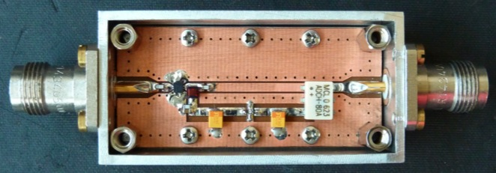
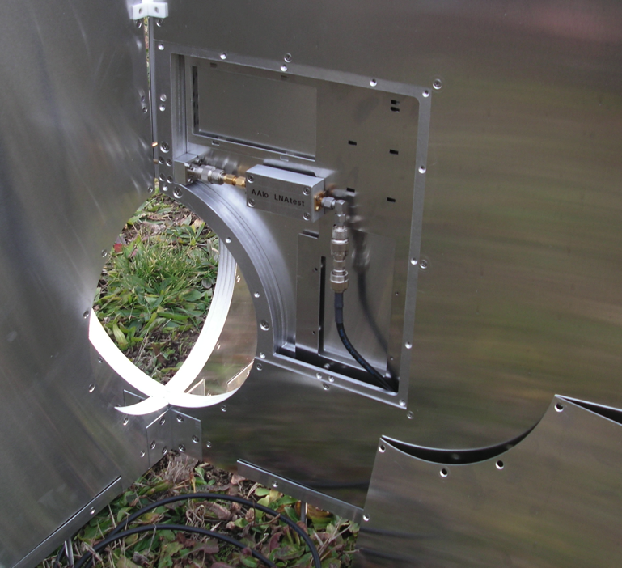
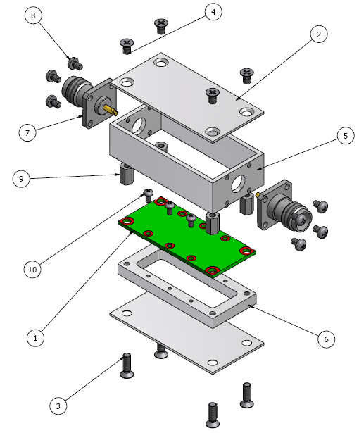
LNA for Vivaldi
Notes:
TNC connectors, 50Ohm I&O
Vmin=3V, I=60mA (180mW)
Bias through output coax cable or feed through
30K Tnoise Gain 20dB

Slide 10
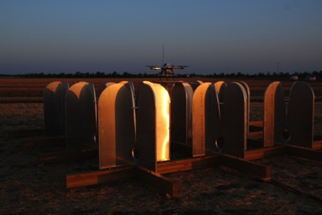
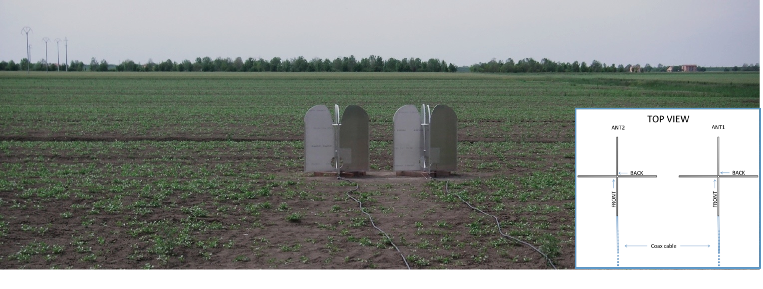
Measures task
Single isolated antenna
“S” parameters →reflection and cross-coupling (amplitude & phase)
Pattern E-H plane, cross-coupling (only amplitude) @75, 150, 300 and 450MHz
Two adjacent Antenna
Cross-coupling (second only 50Ohm matched) amplitude & phase
Mutual cross-coupling in E-H plane (amplitude & phase)
3X3 Array (passive load)
Pattern E-H plane, cross-coupling (only amplitude) @75, 150, 300 and 450MHz

Slide 11

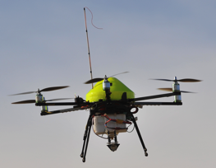
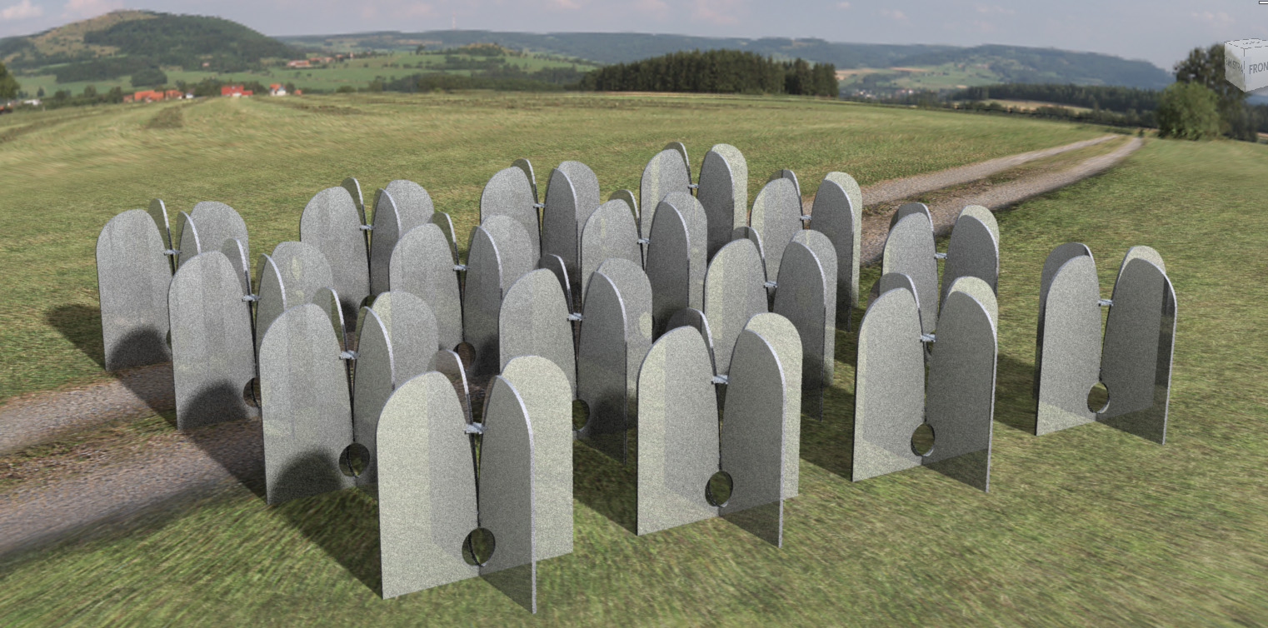

Slide 12

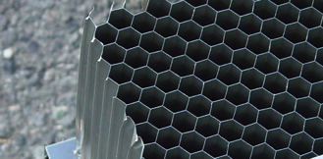
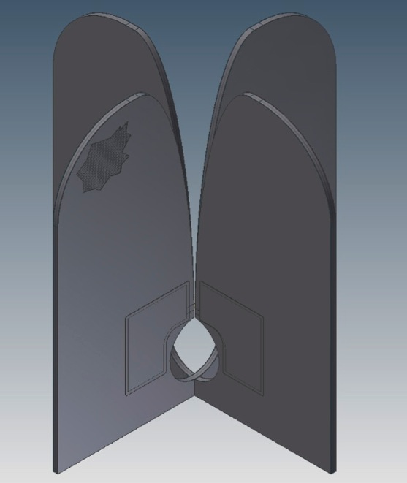
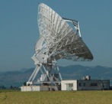



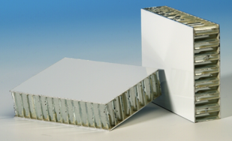
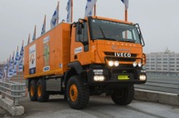

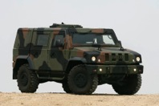
Low cost Manufacturing
AAVS1 goal
COSPAL areas
SGUINZI areas
Target Cost
200€ x antenna
(AAVS1 oriented)
Notes:
IVECO LINCE and Overland

Slide 13
Low cost Manufacturing
AAVS2 goals

Slide 14
Distributed Receiver Architecture
(* Monari et al. Medicina 2012)
ADL5387
Q
WB output 70-450MHz
NB outputs 0-16MHz
OPTICAL RX
MNC SBTCJ-1W
MNC GALI 52
A-INFO JXWBLB-S-BP-50-450
OPTICAL TX
OPTICAL RX
MNC SBTCJ-1W
MNC GALI 6
MNC
SBTC 2-10
MNC GALI 6
Equalizer
I
MNC TCBT-14+
Equalizer
Pre-whitening
MNC ADC-10-1R
0
0
LO
HMC960-10
π
π
FM STOP
MNC ZX75BS-88108-S+
TV STOP
MNC BSF-C174223+
MNC GALI 52
COARSE
HMC800LP3
FINE
HMC472LP4
A-INFO JXWBLB-S-BP-50-450
HMC849
COARSE
HMC800LP3
FINE
HMC472LP4
HMC849
A-INFO JXWBLB-S-BP-50-450
WB RECEIVER
Pre-whitening
MNC GALI 84
WB output 70-450MHz
FRONT END
UNIVERSAL RECEIVER
A-INFO JXWBLB-S-BP-50-450
MNC GALI 84

Slide 15
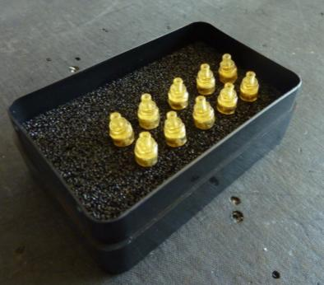

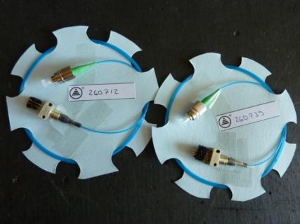


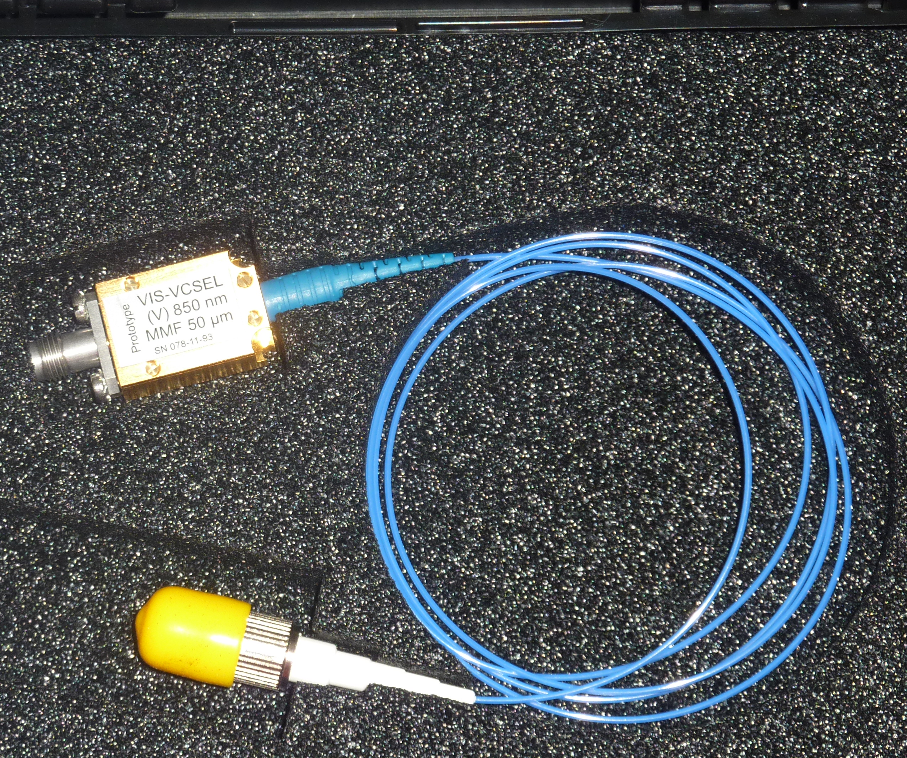
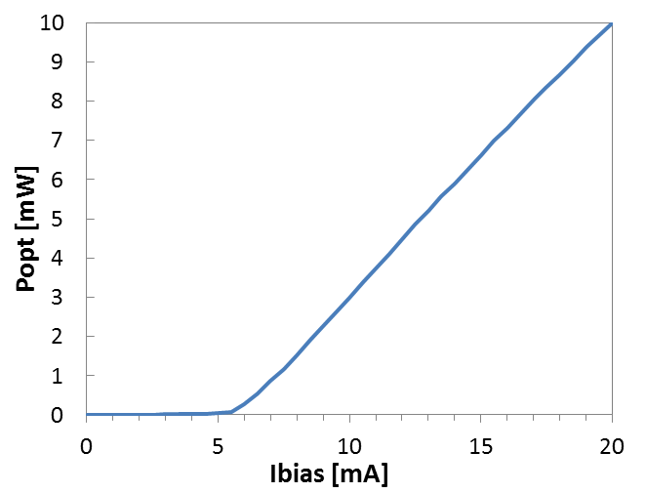
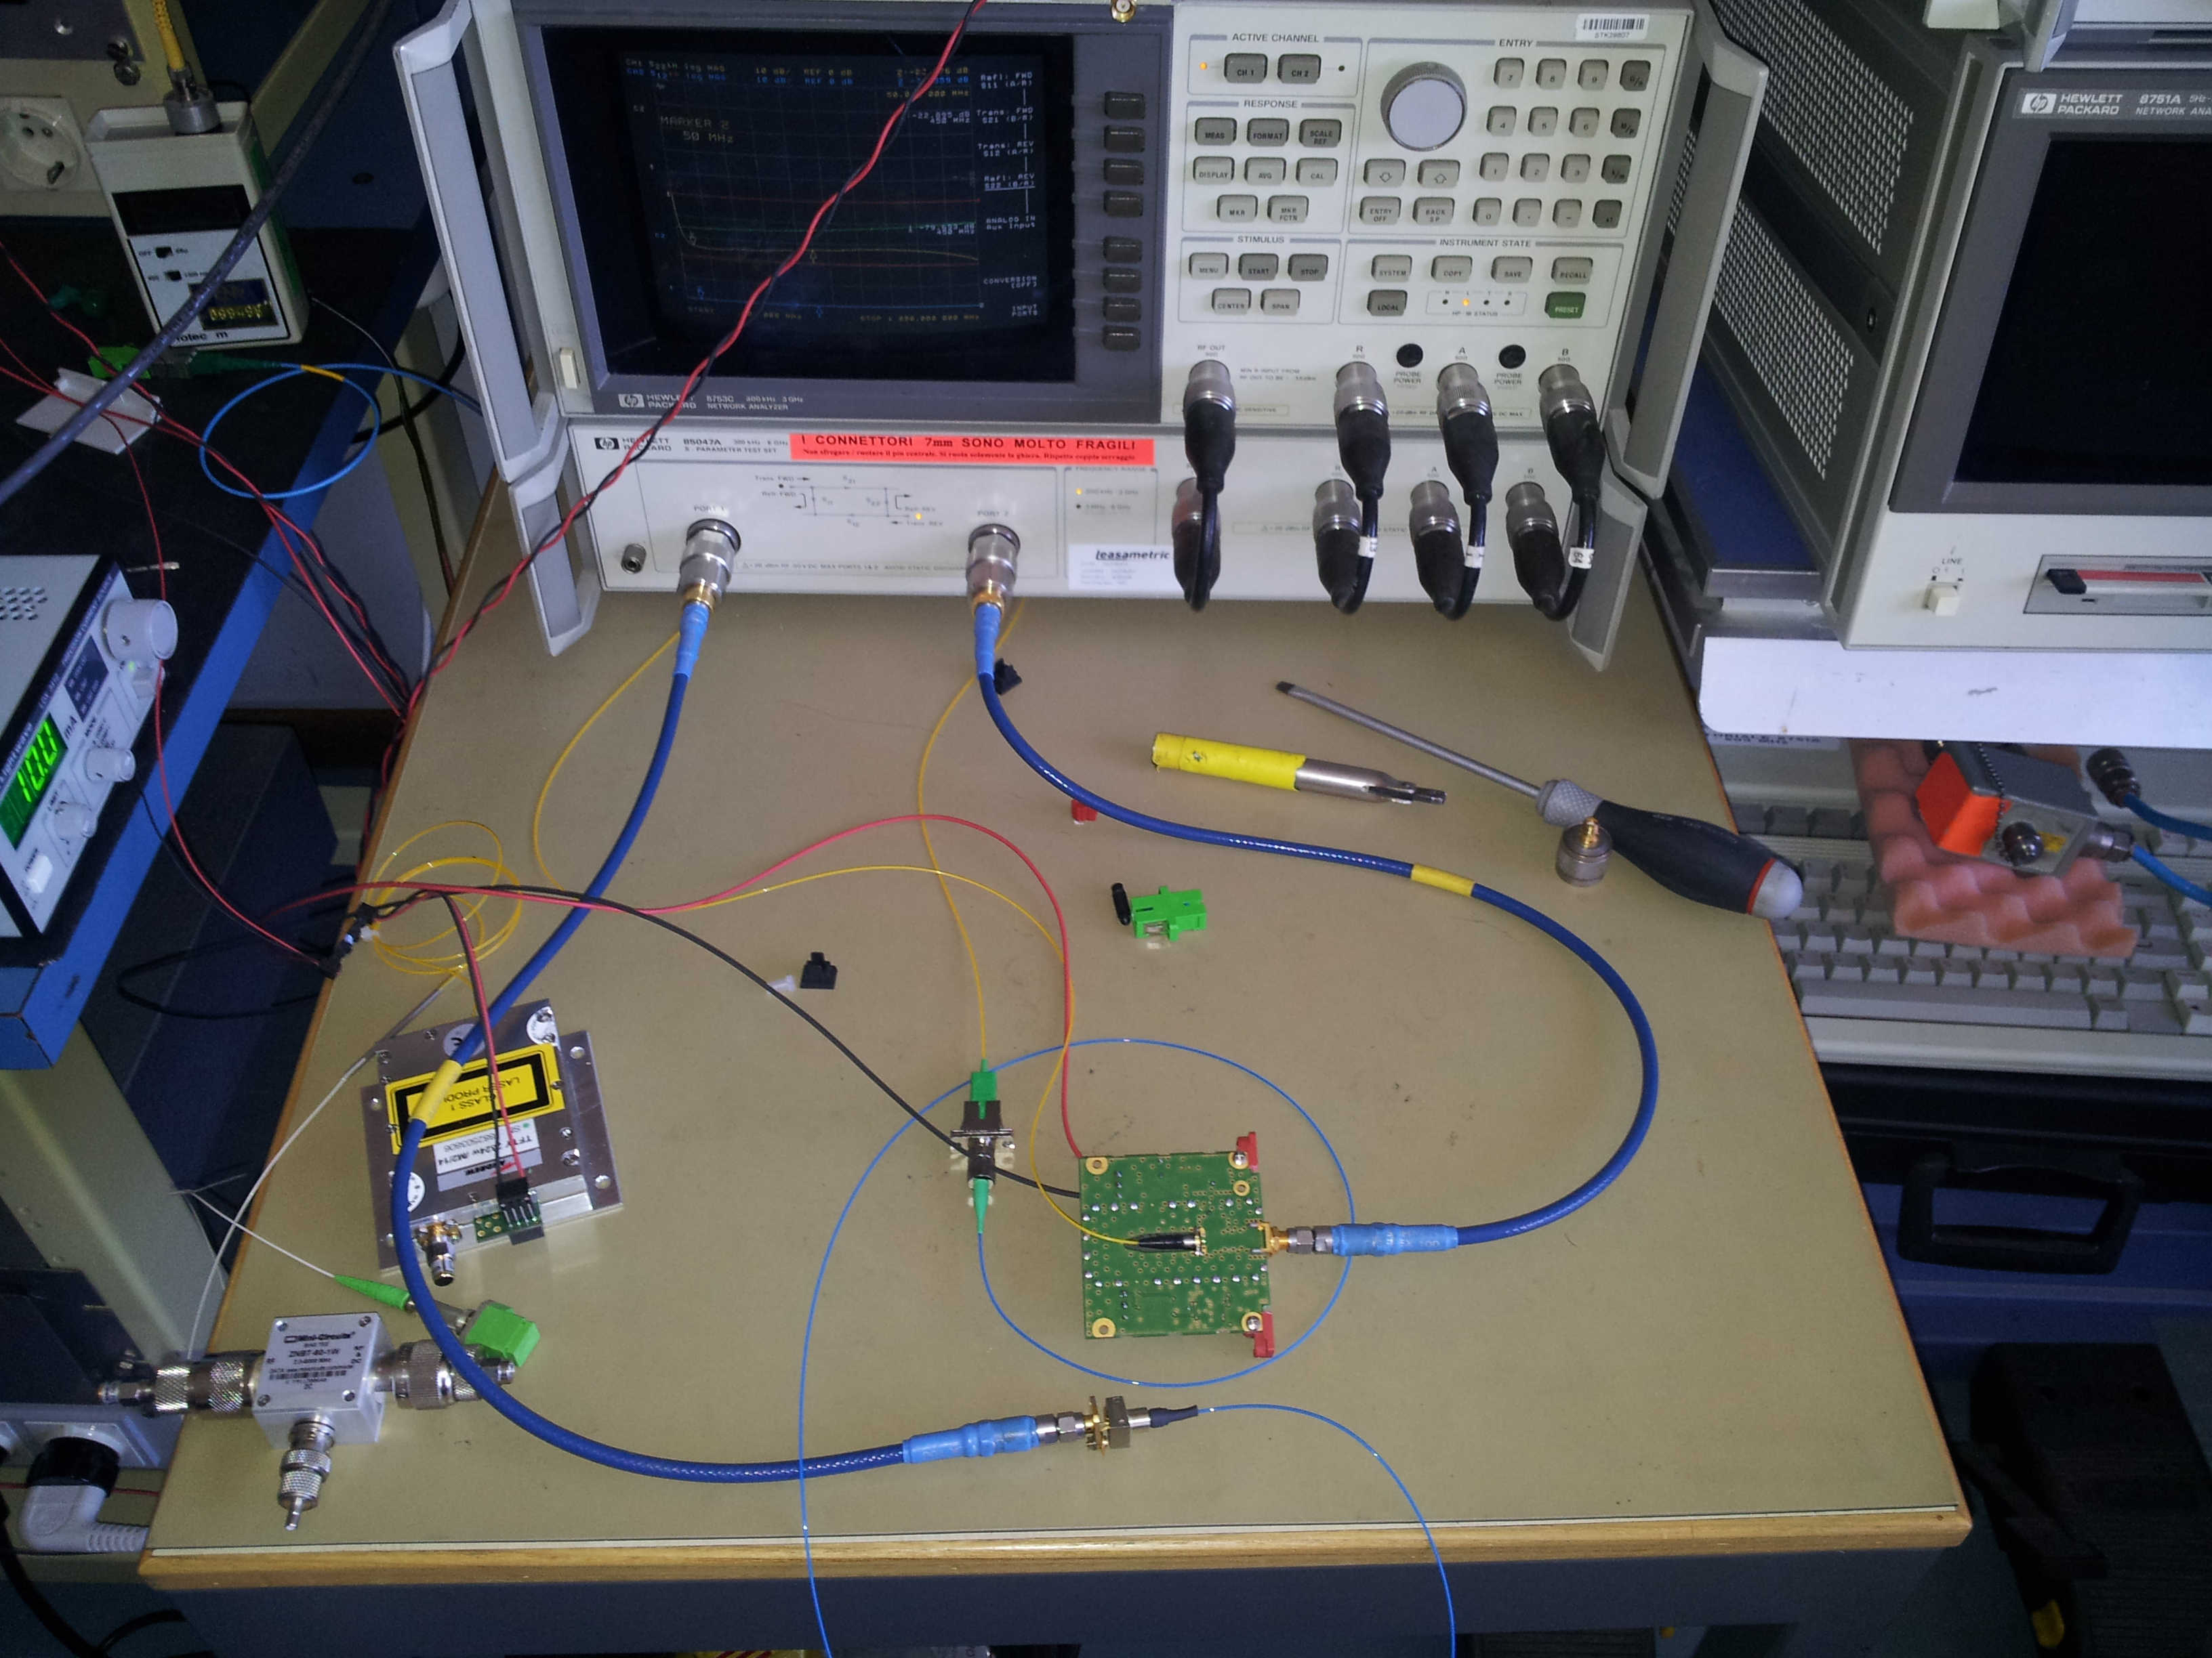
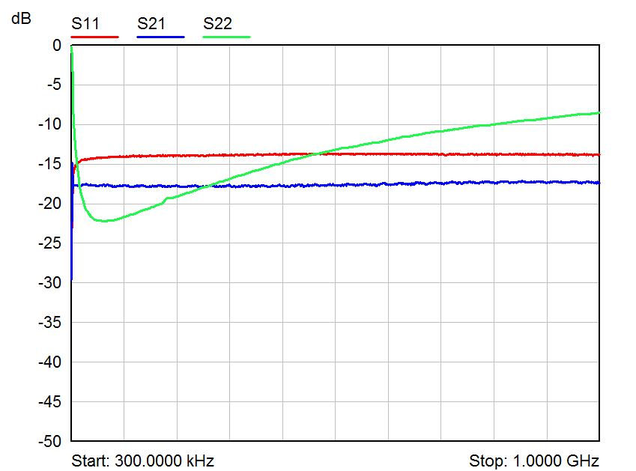

VCSELs link
Measurement of VCSEL devices started this summer
New collaboration with DEI-UNIBO recently set up
Collaboration with IEIIT still running to get more devices from other company/spin off,…

Slide 16
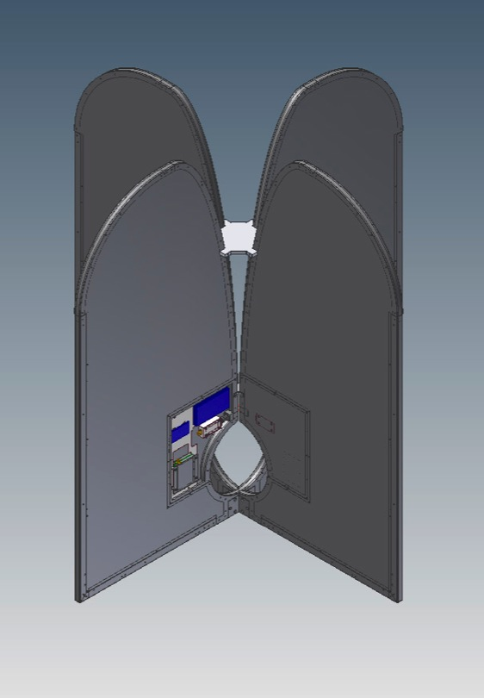
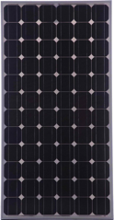
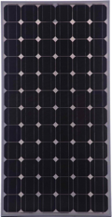
Optical Self Powered Vivaldi
- Galvanic isolation between FE and DS
more stable amplitude&phase Vs temperature
RFI immunity (self-shielded)
no Gain disequalization
no Power Distribution → no DC power losses
easy-deployable (no buried FO)
We have 0.15 m² maximum
available area per arm.
BATTERY
That area could be sufficient,
but we need more investigation
and tests on the field.
Front End
Thin film (amorphous silicon )

Slide 17
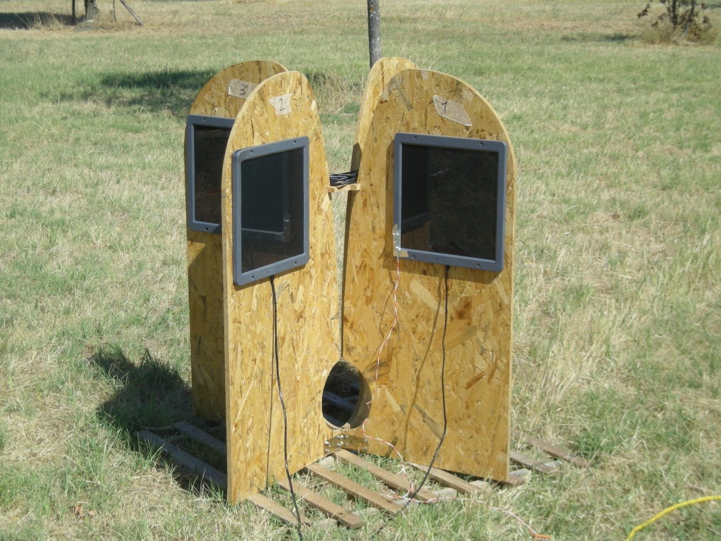
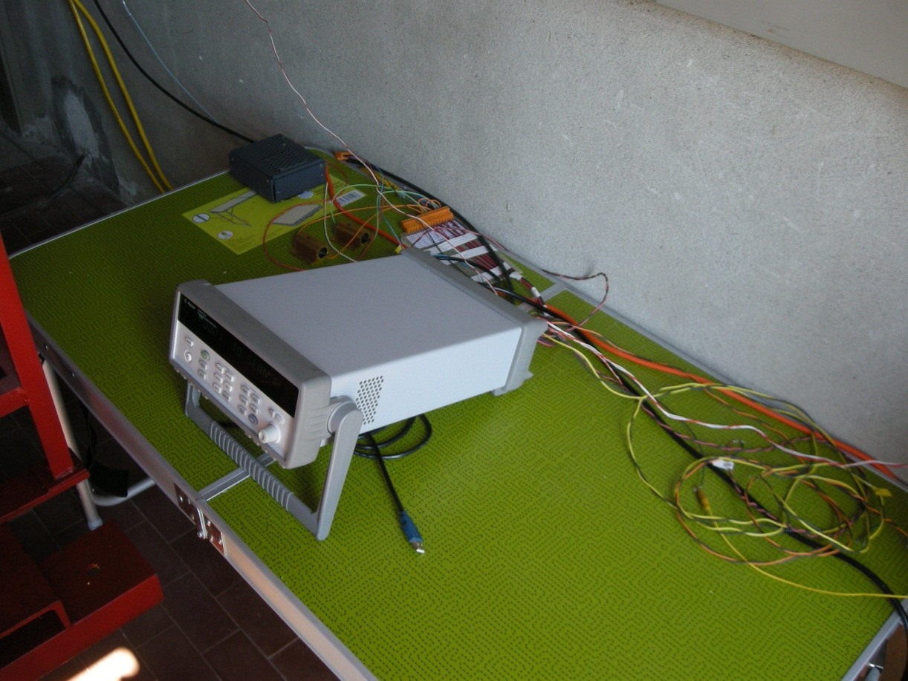
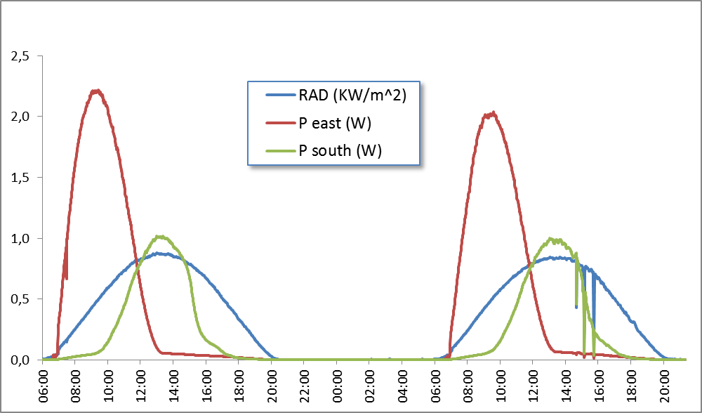
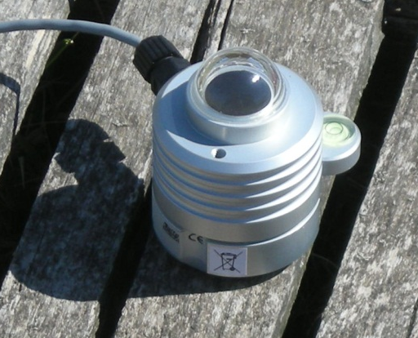
Solar panels
Summer measurement campaign
Amorphous solar panels on the wood Vivaldi
Data Logger
Power generated by the
solar panel oriented to East
Power generated by the
solar panel oriented to South
Solar radiation
Pyranometer
7th August
8th August

Slide 18
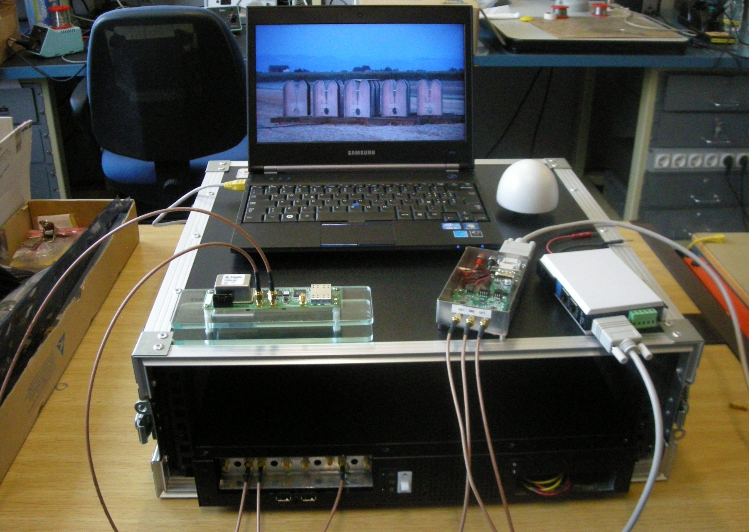
Portable Roach
NFS Server
GPS
antenna
Trimble Disciplined 10 MHz
Clock Board & PPS
Valon Dual Clock Synth
RS232-Ethernet adapter
ROACH board

Slide 19
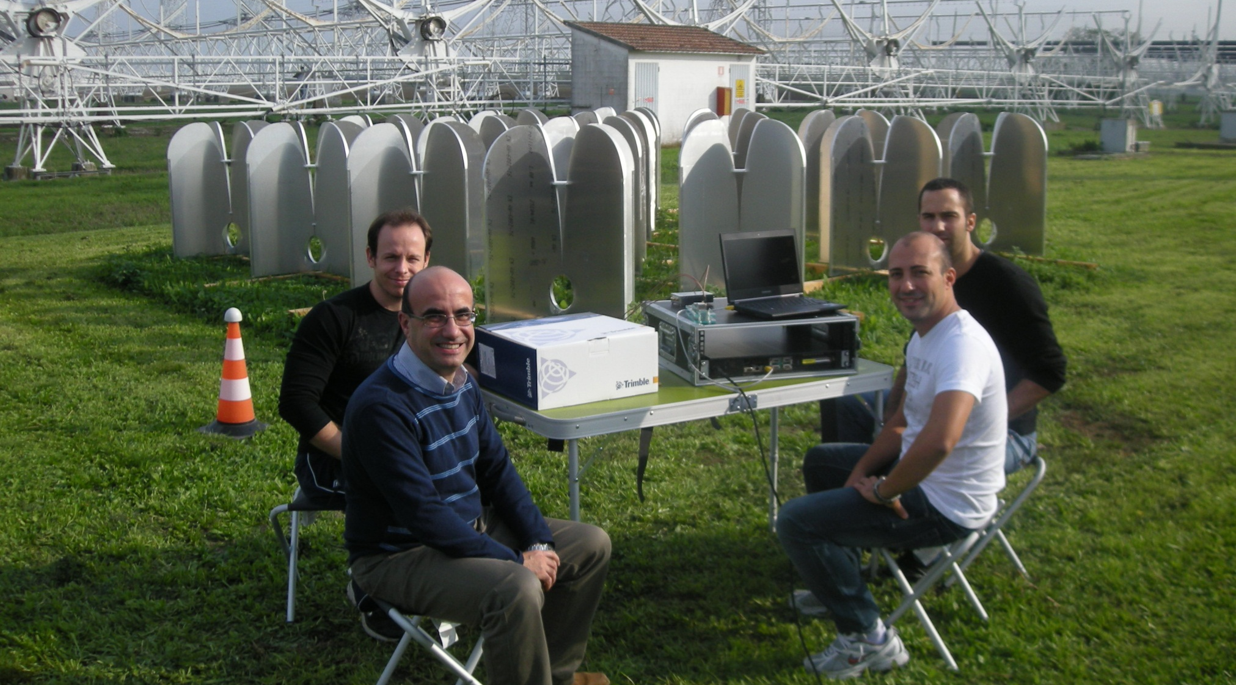
Testing a 450MHz bandwidth
2x 2pol. FX Correlator

Slide 20
Summary of the work done
since 2010
The Vivaldi antenna + LNA meets the original specs of AAlow
AAVS0 goals and deliverables has been achieved in time
Pre-industrial Vivaldi for AAVS1 system ready for production now and low cost solutions for AAVS2 are on going and very promising
VCSELs link, self power element and low cost receiver is under investigation
21 documents has been issued to demonstrate architecture, designs and measures of the work done by INAF team

