Slide 1
Beamformer implementations
(Mike Jones, Kris Zarb Adami, David Sinclair, Chris Shenton)
Starting with ‘top level’ considerations for now, ie
Not, which FPGA board shall we use, rather
What is the structure of the beamformer (as function of AA specs)
What are the ideal properties of the processing nodes and interconnects to implement this
What existing/possible hardware is available to implement this for prototyping (incl AAVS1,2)
What is the most efficient (NRE cost, construction, power) solution for Phase 1

Slide 2
Assumptions:
Partial rather than heirarchical beamforming, ie no well-formed tile beams.
Advantages:
  Better station beam quality (eg Dulwich et al, Limelette conference 2009)
  More flexible (arbitrary station beam pointing directions)
  Easy beams/bandwidth tradeoff
Disadvantages
  Doesn’t reduce data rate like heirarchical beamformer
  Can increase data rate through first part of beamformer, depending on N_{tile} vs N_{beam}
Separate out antenna processor
  Always have to do channelization per antenna
  ADC -> digital signal tranport interface – may as well have channelisation in same chip
  Allows flexibility of placement of ADC

Slide 3
The aperture illumination problem
Partial beamform
Heirarchical (Tiled) beamform
φ
A

Slide 5
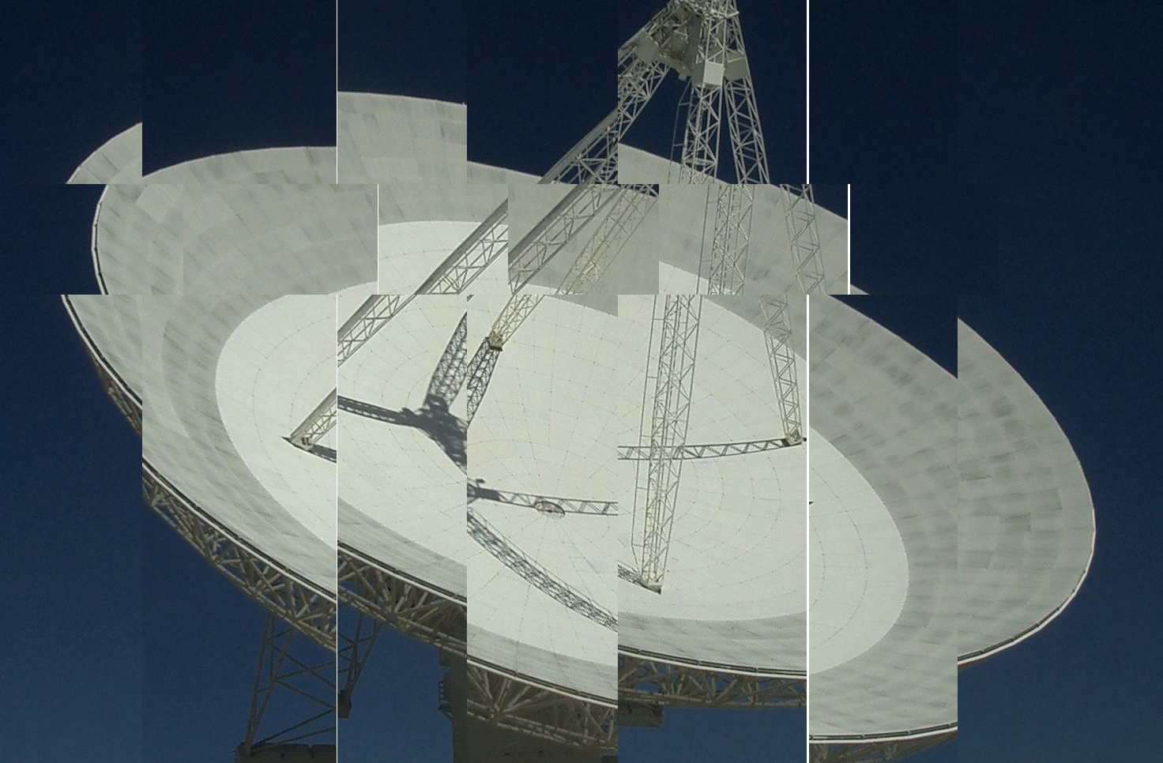
Would you buy this dish?

Slide 6
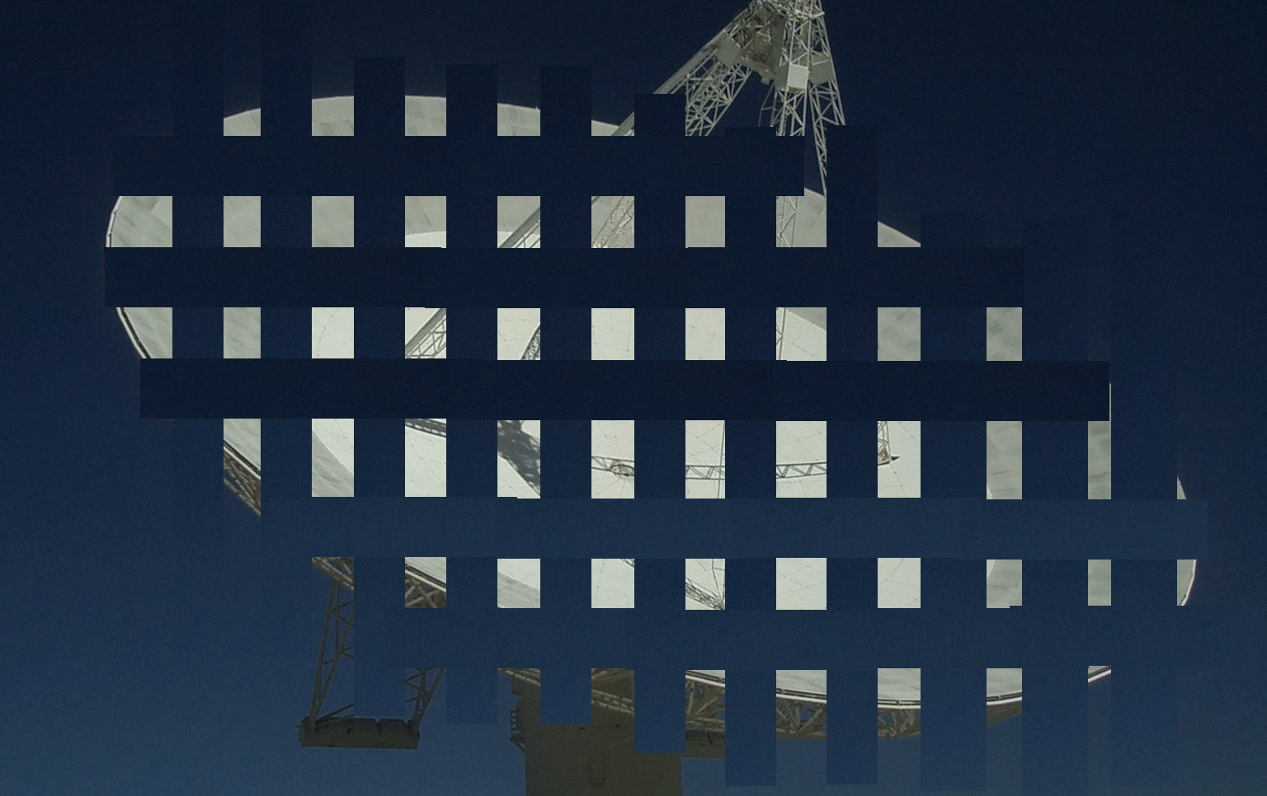
(or this one…?)

Slide 7
Antenna processor
Digital out (antenna to bunker or local rack)
ADC
Channelize
Data format and physical interface
Analogue in
(local to antenna or RFoF)
ADC
Channelize
Clock
Timing data in
Can be developed as block (almost) independently of architecture
Processing load ‘only’ ~500 GMAC/s – smallish chip compared to beamformer
SKA.TEL.LFAA.RCV.DNA, SKA.TEL.LFAA.RCV.DCH, SKA.TEL.LFAA.SP.FB

Slide 8
Beamformer node
In partial beamformer, only one level of coefficient multiplication
Everything else is just adders!
Implement b = M.v in blocks – each block is a ‘tile’
Ideal implementation (simplest connections) is node with N_{in} = no elements in tile, N_{out} = no of beams (average over bandwidth)
Multiplier node
M.v
Coefficient matrix in
+
Adder node

Slide 9
Multiplier node properties
Roughly equal worry is processing and I/O
Amount of each is large and depends strongly on station properties – no of elements and no of beams.
Internal switching needs to assemble data vectors flexibly from input antenna streams – this is only flexibility you need!
Assuming each antenna data stream = 1 GS/s 4+4 bits = 8 Gb/s encoded on a 13 Gb/s serial interface
If nbeams = 300 , Nant(tile) = 100
  Node needs 400 x 13 Gb/s interfaces and 300 x 100 x 1G = 30 TMAC/s
If nbeams = 35 (possible with dual-band array)
  Node needs 135 x 6 Gb/s interfaces and 35 x 100 x 0.5G = 1.7 TMACS

Slide 10
Adder node
All coefficients applied in multiplier node
Adders ‘just’ add…
Ideally structured so input BW proportional to N_{tiles}, output BW proportional to N_{beams}
Eg in 300-beams, 100-tiles, 1GS/s:
  Needs 400 13 Gb/s interfaces, 77 TADD/s (assuming binary adder tree – not the most efficient)
35-beams, 100-tiles, 0.5 GS/s:
  Needs 135 6 Gb/s interfaces, 4.5 TADD/s

Slide 11
Current implementations
 | Roach II | Uniboard | Virtex 7 | 300-beam single multiplier | 35-beam dual multiplier | 300-beam single adder | 35-beam dual adder
I/O lines | 8 x 13 Gb/s | 12 x 13 Gb/s | 96 x 13 Gb/s | 400 x 13 Gb/s | 135 x 6 Gb/s | 400 x 13 Gb/s | 135 x 6 Gb/s
TMAC/s | 1 | 4 | 1.7 | 30 | 1.7 | 77 | 4.5

Slide 12
Current tasks
Antenna processor:
Looking at filter bank specs and algorithms (SKA.TEL.LFAA.SP.FB T1-6)
Physical configuration of antenna processor in the near-antenna case (SKA.TEL.LFAA.RCV.DNA T1, T4, T9)
Beamformer:
Developing parametric model of beamformer dependent on station/array parameters (SKA.TEL.LFAA.SP T4)
Investigate partition of processing architectures for different available technologies (SKA.TEL.LFAA.SP T5)
  Study realisation of beamforming architectures (SKA.TEL.LFAA.SP.ARC T2)
  Simulate beamformer using implementation-agnostic tools (SKA.TEL.LFAA.SP.DBF T4)

