Slide 1
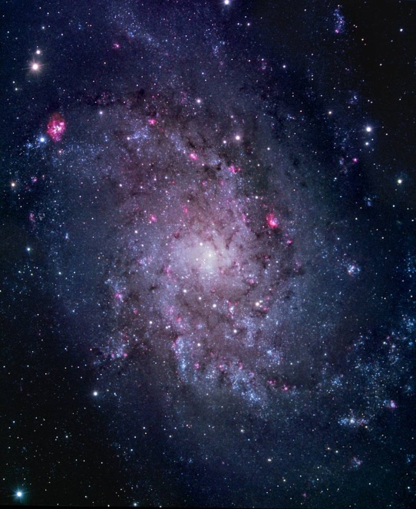
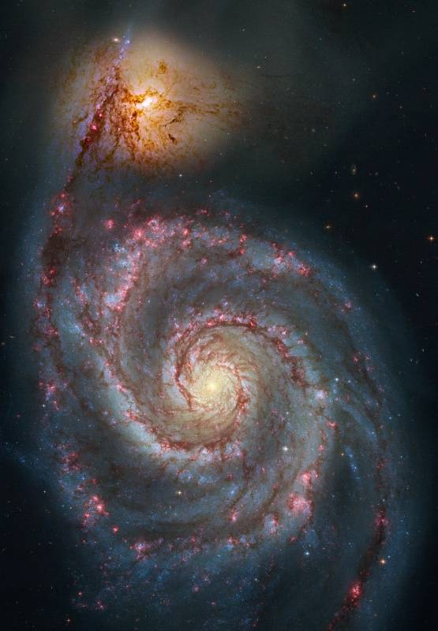
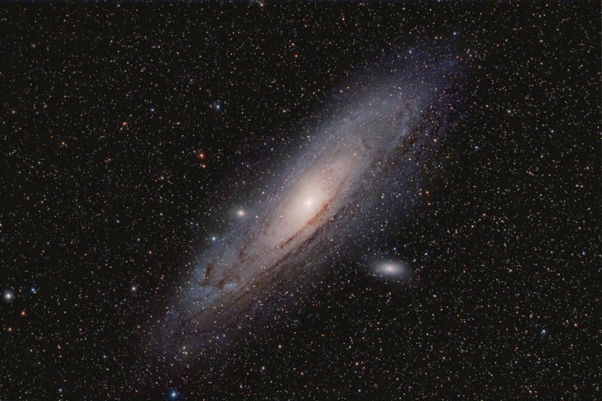
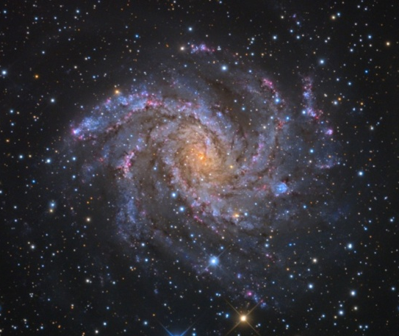
Radio-IR Correlation:
What Do We Learn in Nearby Galaxies?
Fatemeh Tabatabaei
Instituto de Astrofísica de Canarias
Max Planck Institut für Astronomie

Slide 2
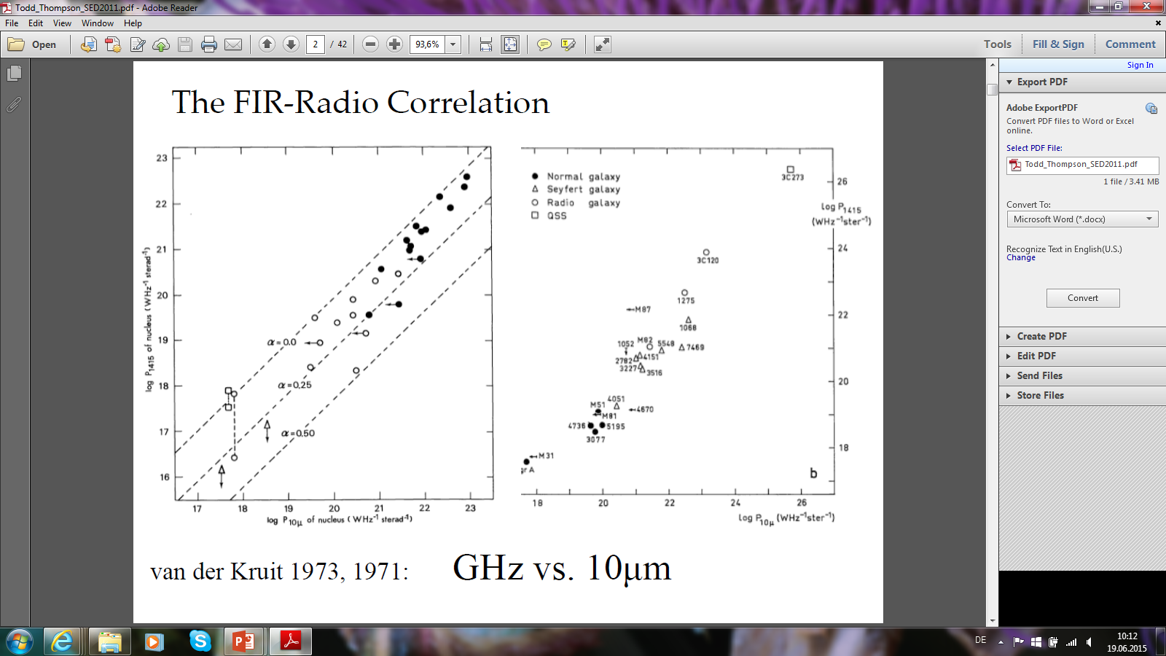
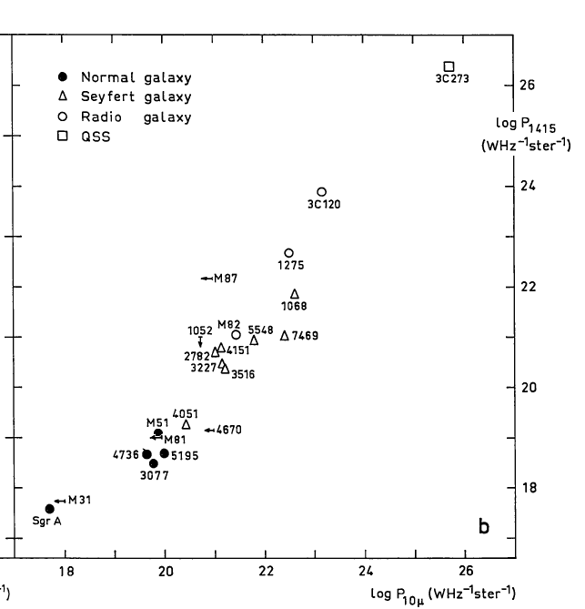
Radio-IR Correlation: First Detections
20cm Radio vs. 10µm IR
van der Kruit (1971, 1973)
Notes:
A historical note:
for the first time for sample of galaxies, explanations,
importance: sfr estimation, scaling & calibration studies at hihg z..
necessity in studying nearby galaxies to understand dependence on the ISM like SFR, gas density, magnetic field, turbulence, and so on..
studies in galaxies, M33, M31, LMC, M51, SINGS
what we had shown in M33 and now what we have for both M33 and M31

Slide 3
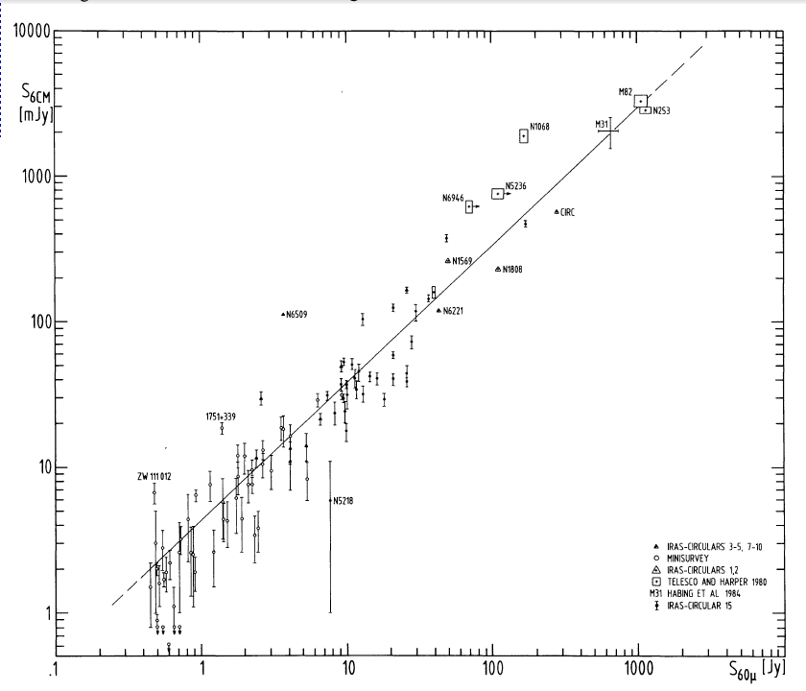
Radio-IR Correlation: First Detections (IRAS)
6cm Radio vs. 60µm FIR
de Jong, Klein et al. (1985)
Notes:
A historical note:
for the first time for sample of galaxies, explanations,
importance: sfr estimation, scaling & calibration studies at hihg z..
necessity in studying nearby galaxies to understand dependence on the ISM like SFR, gas density, magnetic field, turbulence, and so on..
studies in galaxies, M33, M31, LMC, M51, SINGS
what we had shown in M33 and now what we have for both M33 and M31

Slide 4
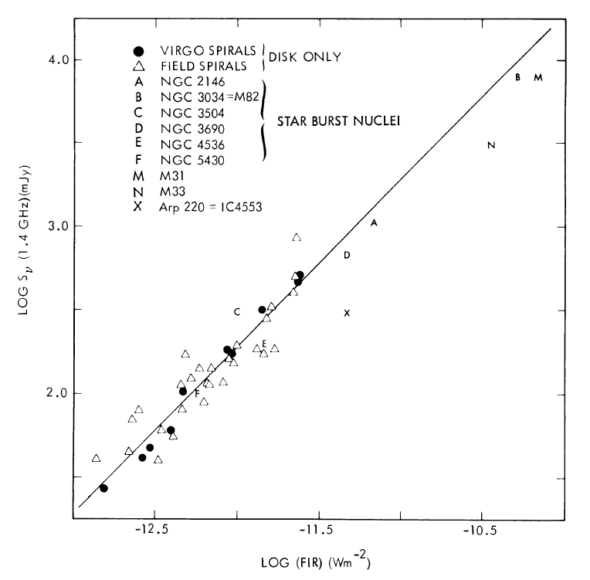
Radio-IR Correlation: First Detections (IRAS)
20cm Radio vs. FIR (60, 100µm)
Helou et al. (1985)
Notes:
A historical note:
for the first time for sample of galaxies, explanations,
importance: sfr estimation, scaling & calibration studies at hihg z..
necessity in studying nearby galaxies to understand dependence on the ISM like SFR, gas density, magnetic field, turbulence, and so on..
studies in galaxies, M33, M31, LMC, M51, SINGS
what we had shown in M33 and now what we have for both M33 and M31

Slide 5
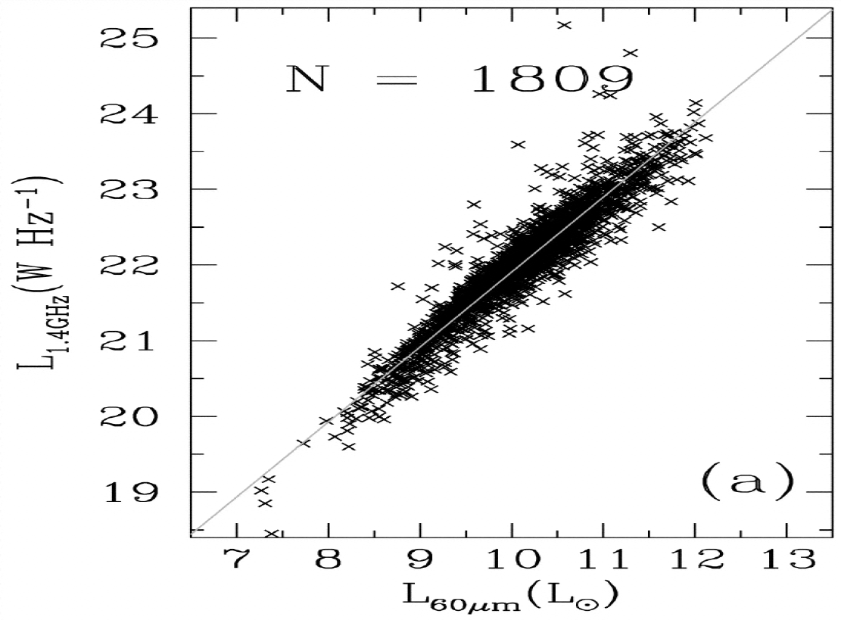
Radio-IR Correlation: Large Surveys
A linear correlation over 4 orders of Mag.
20 cm Radio
IRAS 2Jy Sample
Yun et al. (2001)
Notes:
A historical note:
for the first time for sample of galaxies, explanations,
importance: sfr estimation, scaling & calibration studies at hihg z..
necessity in studying nearby galaxies to understand dependence on the ISM like SFR, gas density, magnetic field, turbulence, and so on..
studies in galaxies, M33, M31, LMC, M51, SINGS
what we had shown in M33 and now what we have for both M33 and M31

Slide 6
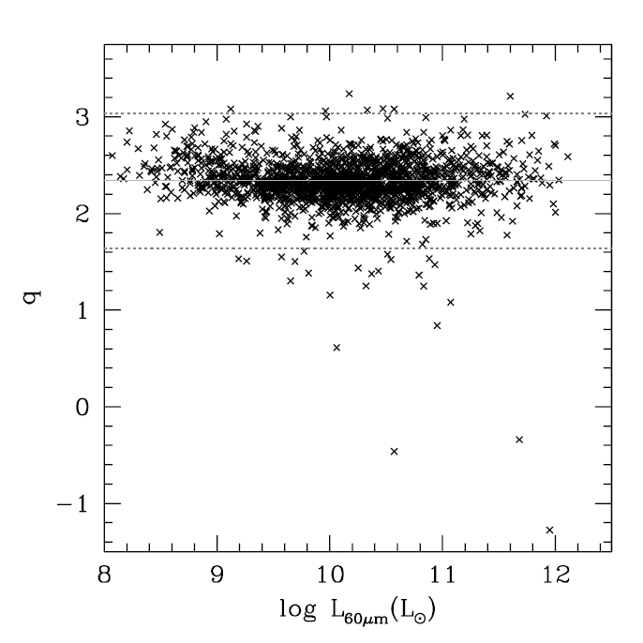
Radio-IR Correlation: Large Surveys
q~ FIR/20cm ratio vs. 60µm
FIR Bright,
Radio Dim
FIR Dim,
Radio Bright
Yun et al. (2001)
Notes:
A historical note:
for the first time for sample of galaxies, explanations,
importance: sfr estimation, scaling & calibration studies at hihg z..
necessity in studying nearby galaxies to understand dependence on the ISM like SFR, gas density, magnetic field, turbulence, and so on..
studies in galaxies, M33, M31, LMC, M51, SINGS
what we had shown in M33 and now what we have for both M33 and M31

Slide 7
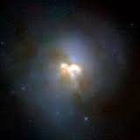
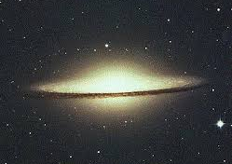
Radio-IR Correlation: Large Surveys
q~ FIR/20cm ratio vs. 60µm
IR Bright,
Radio Dim
Also holds on Kpc scales in Galaxies (e.g. Beck & Golla 1988)
IR Dim,
Radio Bright
Yun et al. (2001)
Notes:
A historical note:
for the first time for sample of galaxies, explanations,
importance: sfr estimation, scaling & calibration studies at hihg z..
necessity in studying nearby galaxies to understand dependence on the ISM like SFR, gas density, magnetic field, turbulence, and so on..
studies in galaxies, M33, M31, LMC, M51, SINGS
what we had shown in M33 and now what we have for both M33 and M31

Slide 8
Extreme Cases
IR Bright, Radio Dim (high q):
Galactic Center (Croker et al. 2011)
Early type galaxies with SF (Bureau et al. 2011)
Rare bursty SF galaxies (Roussel et al. 2006)
Radio Bright, IR Dim (low q):
Radio galaxies
Some AGNs (e.g. Sanders & Mirable 1985, Prieto talk)
SMGs (Murphy et al. 2009, Michalowski et al. 2010)
Notes:
A historical note:
for the first time for sample of galaxies, explanations,
importance: sfr estimation, scaling & calibration studies at hihg z..
necessity in studying nearby galaxies to understand dependence on the ISM like SFR, gas density, magnetic field, turbulence, and so on..
studies in galaxies, M33, M31, LMC, M51, SINGS
what we had shown in M33 and now what we have for both M33 and M31

Slide 9
Surprising Cases
Invariant with redshift (Basu talk, Magnelli talk)
Same in dwarfs and normal galaxies (Klein+1991, Heesen talk )
Notes:
A historical note:
for the first time for sample of galaxies, explanations,
importance: sfr estimation, scaling & calibration studies at hihg z..
necessity in studying nearby galaxies to understand dependence on the ISM like SFR, gas density, magnetic field, turbulence, and so on..
studies in galaxies, M33, M31, LMC, M51, SINGS
what we had shown in M33 and now what we have for both M33 and M31

Slide 10
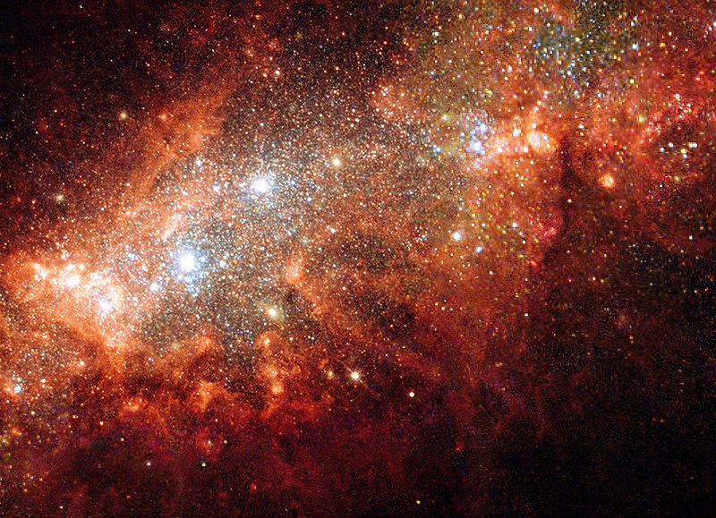
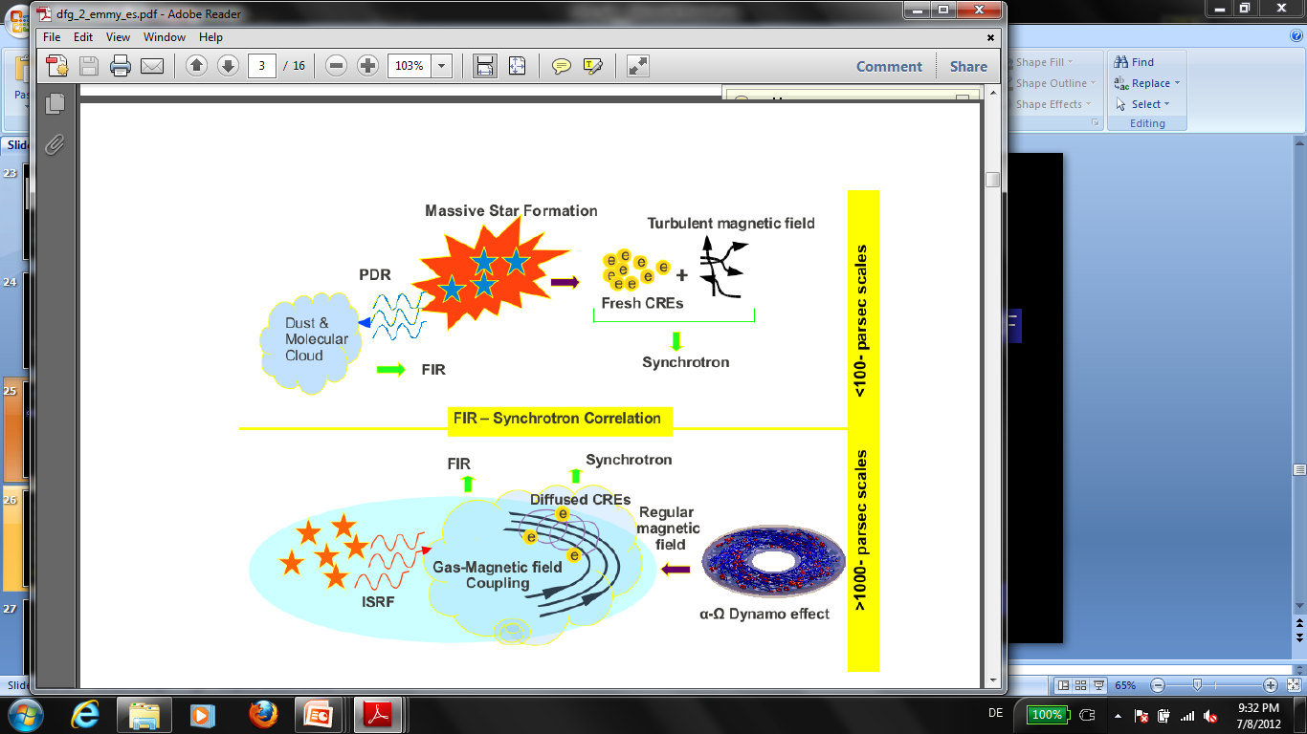
Linearity of Correlation: Massive Star Formation
Young massive star formation as common source
Classical View
Starburst in Arp 210
Notes:
A historical note: if SFE~N(CRe) and warm dust is a better tracer of SF then a better synchrotron-warm dust than synchrotron-cold dust expected? What is the role of magnetic field?
for the first time for sample of galaxies, explanations,
importance: sfr estimation, scaling & calibration studies at hihg z..
necessity in studying nearby galaxies to understand dependence on the ISM like SFR, gas density, magnetic field, turbulence, and so on..
studies in galaxies, M33, M31, LMC, M51, SINGS
what we had shown in M33 and now what we have for both M33 and M31

Slide 11
Linearity of Correlation: Massive Star Formation
Young massive star formation as common source
Optically thick models:
CRs cannot escape, UV photons are all absorbed,
Synchrotron & IC dominates (Völk 1989, Lisenfeld et al. 1996)
Optically thin models :
Constant FIR/radio ratio,
magnetic field-gas coupling (Helou & Bicay 1993)
Notes:
A historical note: if SFE~N(CRe) and warm dust is a better tracer of SF then a better synchrotron-warm dust than synchrotron-cold dust expected? What is the role of magnetic field?
for the first time for sample of galaxies, explanations,
importance: sfr estimation, scaling & calibration studies at hihg z..
necessity in studying nearby galaxies to understand dependence on the ISM like SFR, gas density, magnetic field, turbulence, and so on..
studies in galaxies, M33, M31, LMC, M51, SINGS
what we had shown in M33 and now what we have for both M33 and M31

Slide 12
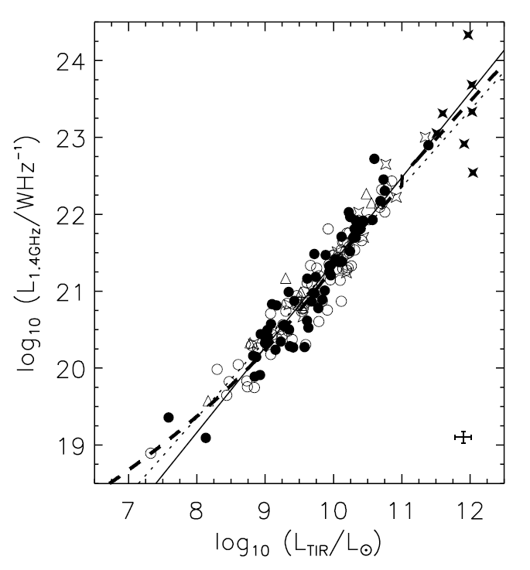
Linearity of Correlation: Conspiracy
Radio and IR do not trace all SF in dwarfs, yet a good correlation
→ conspiracy
Bell (2003)
Notes:
A historical note:
for the first time for sample of galaxies, explanations,
importance: sfr estimation, scaling & calibration studies at hihg z..
necessity in studying nearby galaxies to understand dependence on the ISM like SFR, gas density, magnetic field, turbulence, and so on..
studies in galaxies, M33, M31, LMC, M51, SINGS
what we had shown in M33 and now what we have for both M33 and M31

Slide 13
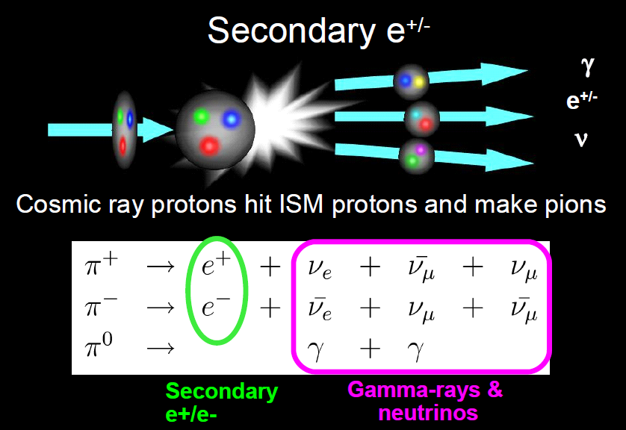
Linearity of Correlation: Conspiracy
In Starbursts primary CREs from SF loose their energy to
ionization & Bremsstrahlung → not visible in radio
The linearity is caused by secondary electrons/positrons produced in dense gas
Lacki et al. (2010)
Notes:
A historical note:
for the first time for sample of galaxies, explanations,
importance: sfr estimation, scaling & calibration studies at hihg z..
necessity in studying nearby galaxies to understand dependence on the ISM like SFR, gas density, magnetic field, turbulence, and so on..
studies in galaxies, M33, M31, LMC, M51, SINGS
what we had shown in M33 and now what we have for both M33 and M31

Slide 14
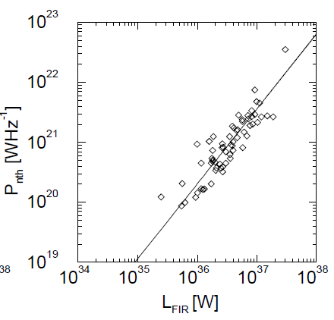
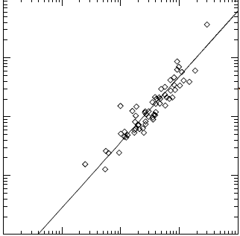
Nonthermal Radio-IR Correlation: Nonlinear
In galaxy samples (e.g. Shapely-Ames sample)
Kennicutt-Schmidt law
+
Magnetic field-gas coupling
→ Nonlinear correlation
Niklas et al. (1991), Niklas & Beck (1998)

Slide 15
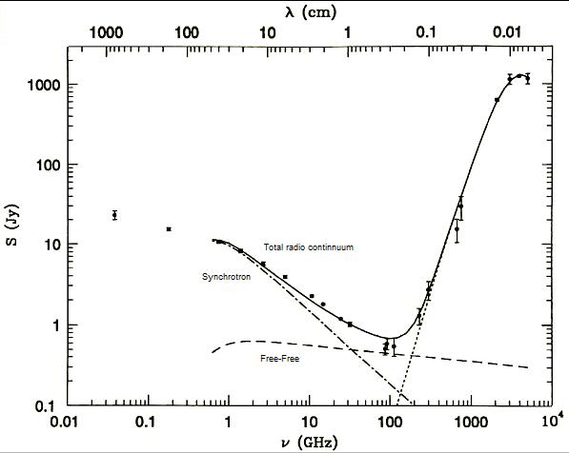
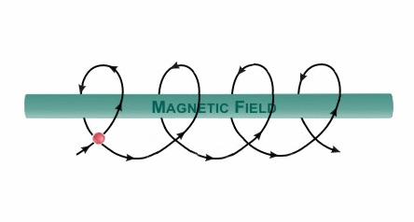

Physics of Radio-IR Correlation
Radiation Field + Dust →IR
CREs + Magnetic Field → Nonthermal (Synchrotron)
Ionized gas → Thermal (free-free)
IR continuum
Radio continuum
M82, Condon (1992)

Slide 16
Physics of Radio-IR: Resolved Studies
Questions:
Connection of cold dust to massive SF?
Connection of magnetic fields to dust, gas ?
Effects of cosmic-ray propagation?
Dependencies on other ISM properties: radiation field?
Does the correlation hold on small scales ?
Requires detailed studies within nearby galaxies including:
- Reliable separation of the synchrotron radio emission
- Cold/warm dust differentiation
- Structural characteristics of IR and radio emission,….
Notes:
A historical note: if SFE~N(CRe) and warm dust is a better tracer of SF then a better synchrotron-warm dust than synchrotron-cold dust expected? What is the role of magnetic field?
for the first time for sample of galaxies, explanations,
importance: sfr estimation, scaling & calibration studies at hihg z..
necessity in studying nearby galaxies to understand dependence on the ISM like SFR, gas density, magnetic field, turbulence, and so on..
studies in galaxies, M33, M31, LMC, M51, SINGS
what we had shown in M33 and now what we have for both M33 and M31

Slide 17
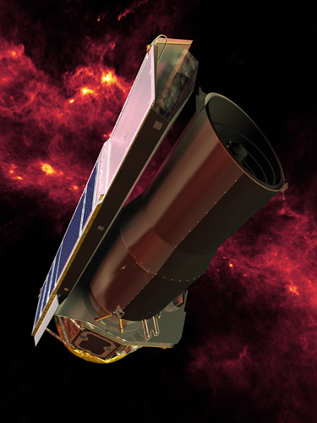
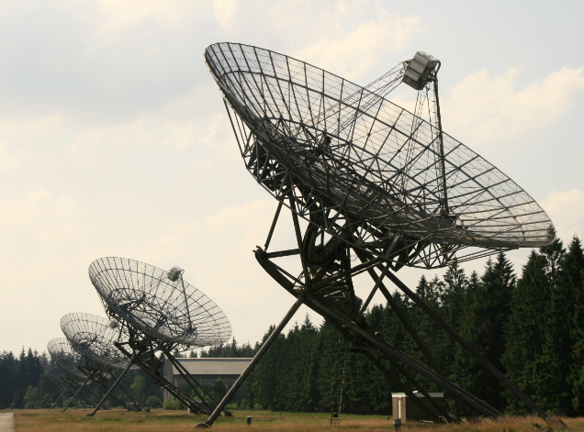
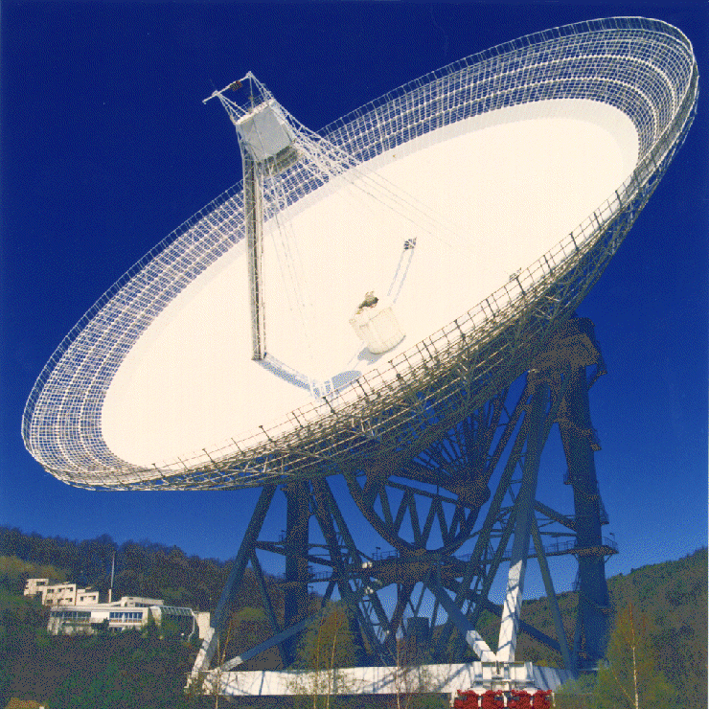
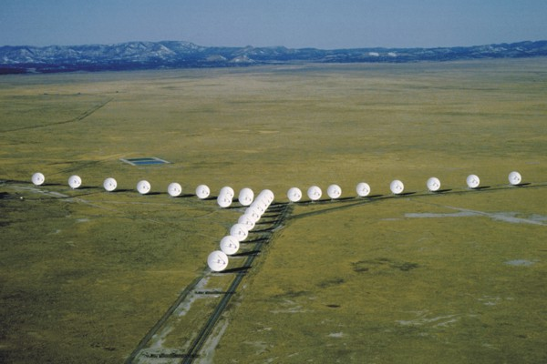
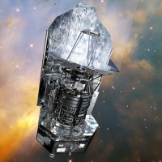
Nearby Galaxies as Benchmarks for High-z
Ideal laboratories to study a galaxy as a whole
(high resolution + no distance ambiguity)
Effelsberg 100-m
WSRT
Spitzer
Herschel
Karl Jansky VLA
Notes:
A historical note: if SFE~N(CRe) and warm dust is a better tracer of SF then a better synchrotron-warm dust than synchrotron-cold dust expected? What is the role of magnetic field?
for the first time for sample of galaxies, explanations,
importance: sfr estimation, scaling & calibration studies at hihg z..
necessity in studying nearby galaxies to understand dependence on the ISM like SFR, gas density, magnetic field, turbulence, and so on..
studies in galaxies, M33, M31, LMC, M51, SINGS
what we had shown in M33 and now what we have for both M33 and M31

Slide 18
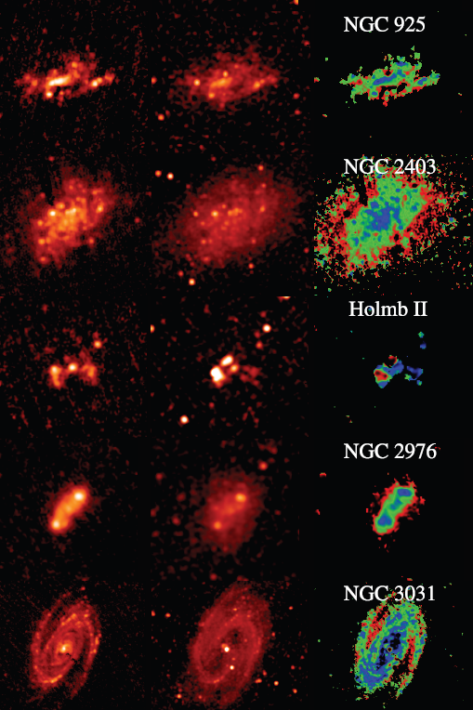
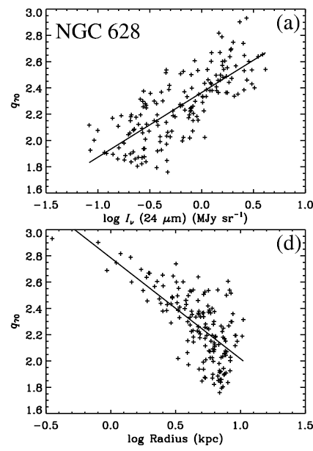
Local Radio-IR Correlation
Correlation varies inside galaxies
70µm 20cm q
red (radio bright),
blue (FIR bright)
range:
-0.75 to +0.75 dex
Murphy et al. (2008)
SINGS sample

Slide 19
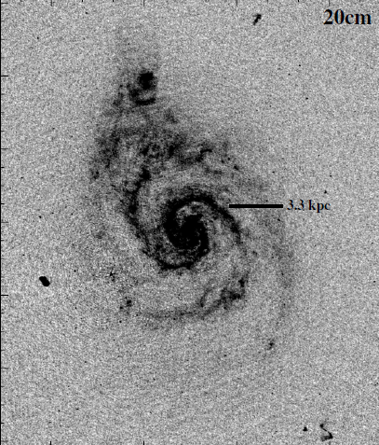
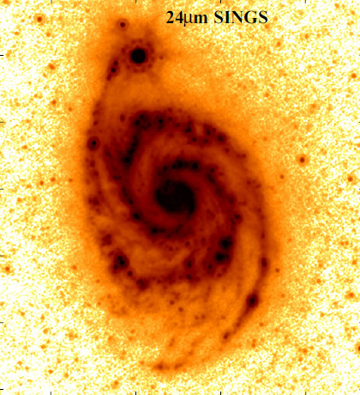
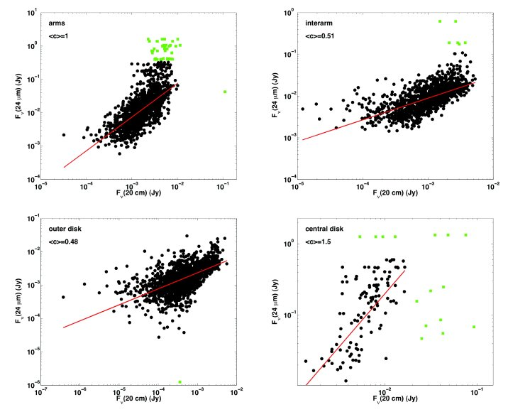
Local Radio-IR Correlation
Correlation varies inside galaxies
arms
inter arm
outer disk
center
Dumas et al. (2011)

Slide 20
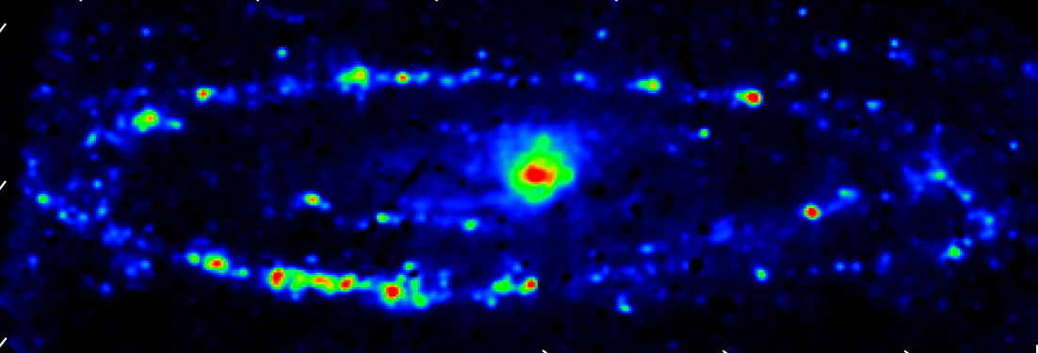
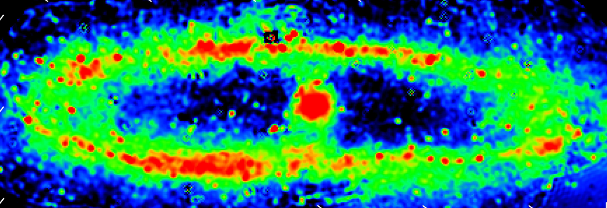
Thermal & Nonthermal Separation
TRT Separation Technique: Synchrotron spectral index varies in the disk
as CREs experience various energy losses
Free-free
Synchrotron
→ Synchrotron is a SF tracer
Synchrotron emission:
extended, yet strong near SF regions
→ enhanced turbulent B/fresh CREs?
Tabatabaei et al. (2007, 2013a)

Slide 21
Local Radio-IR Correlation
Radial decrease mainly due to the nonthermal component
Tabatabaei (+2013a, IR10)

Slide 22
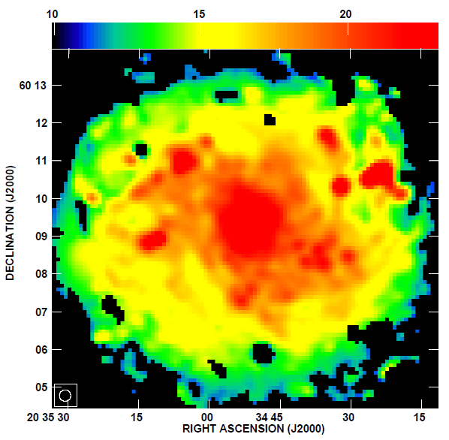
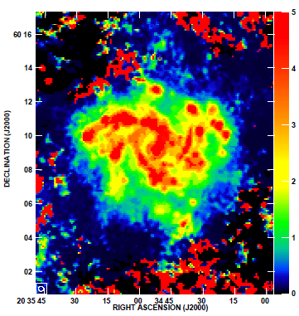
A detailed Study in NGC6946
Magnetic field strength
Radiation field energy density
Aniano et al. (2012)

Slide 23
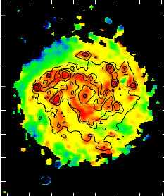
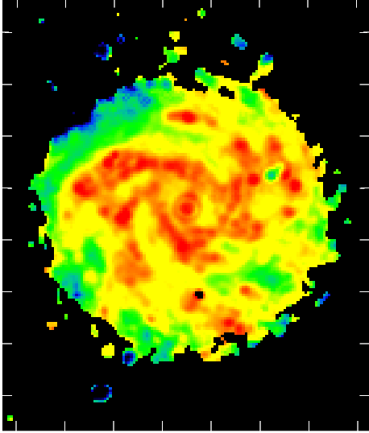
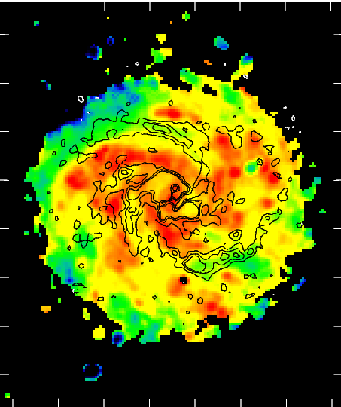
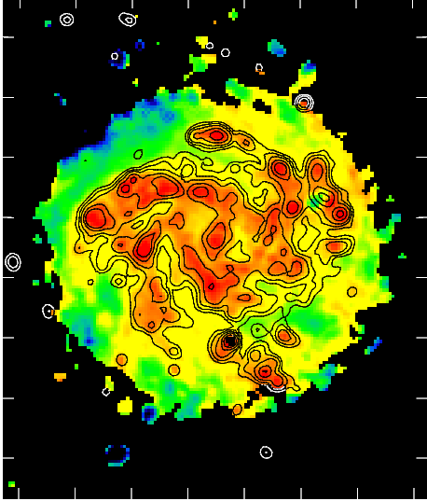
Variation of FIR/Sync ratio (q)
Contours:
Turbulent B
Contours:
Massive SF
Contours:
Ordered B
In SF regions: FIR bright, nonlinear correlation
In ISRF regions (dust heated by older stars):
the correlation exists and even linear!
Tabatabaei, Schinnerer + (2013)

Slide 24
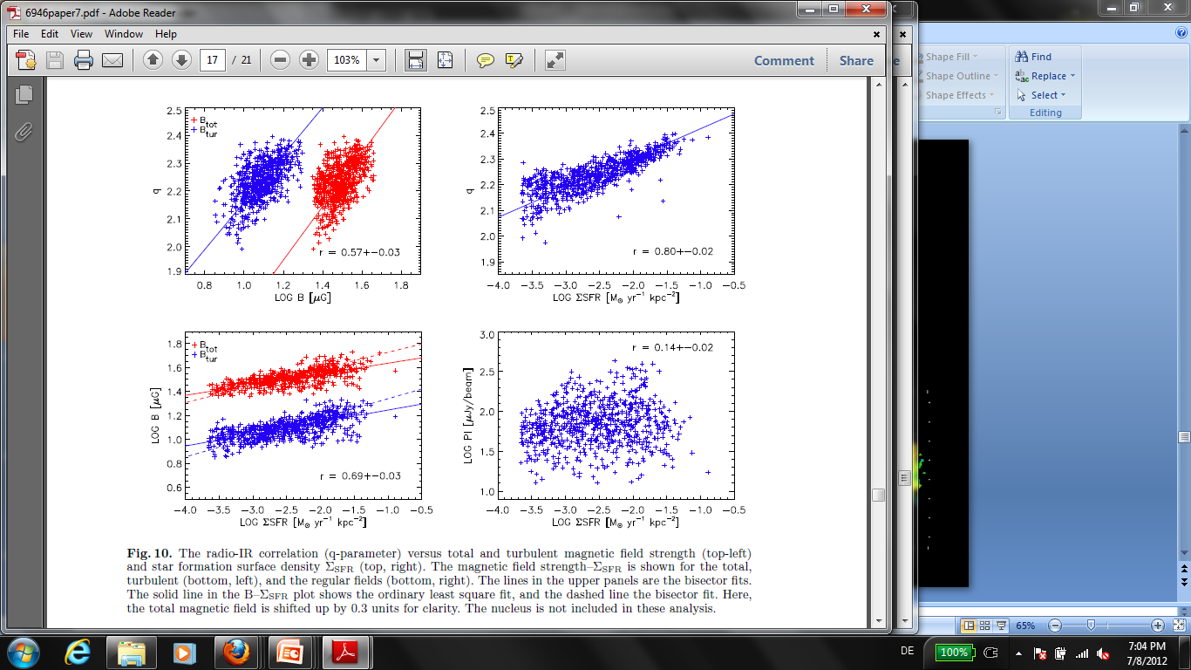
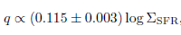
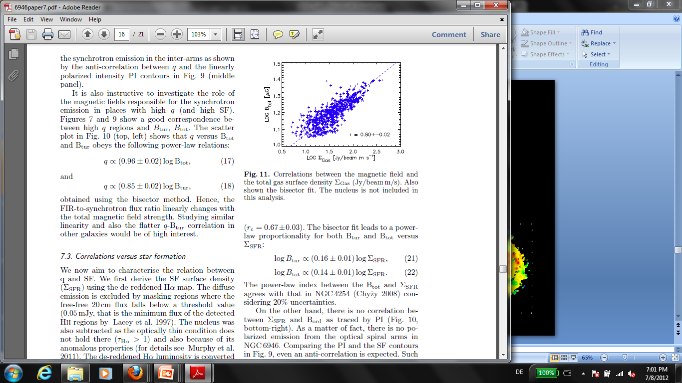
q: Highly Sensitive to Magnetic Field Strength (B)
With SFR:
Strong correlation for a shallow sub-linear relation
Corr.coef.=
Turbulent B
Total B
With magnetic fields:
~ a linear relation
Corr.coef.=
Tabatabaei, Schinnerer + (2013)

Slide 25
Magnetic Field-Gas Coupling
The synchrotron-FIR correlation can be well explained by
B/CRE - gas coupling→ importance of the molecular connection (Murgia+2005, Schinnerer+2013, Paladino talk)
Prediction:
No correlation where no balance
between hydrostatic gas, B, CRE pressure exists, e.g. on small scales (due to diffusion of CREs)
Tabatabaei, Schinnerer + (2013)
Notes:
A static
pressure equilibrium could then be achieved when
the components of the interstellar medium have
been relaxed on larger scales

Slide 26
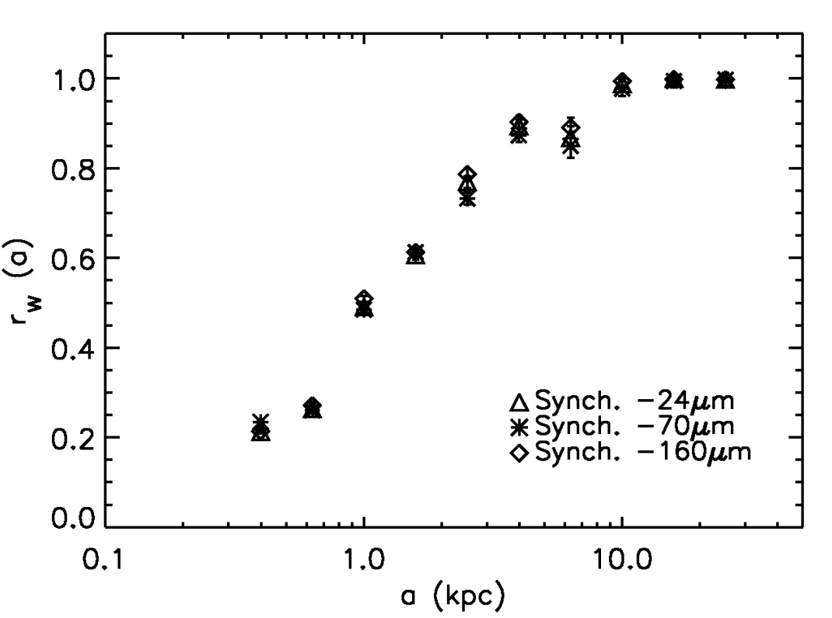
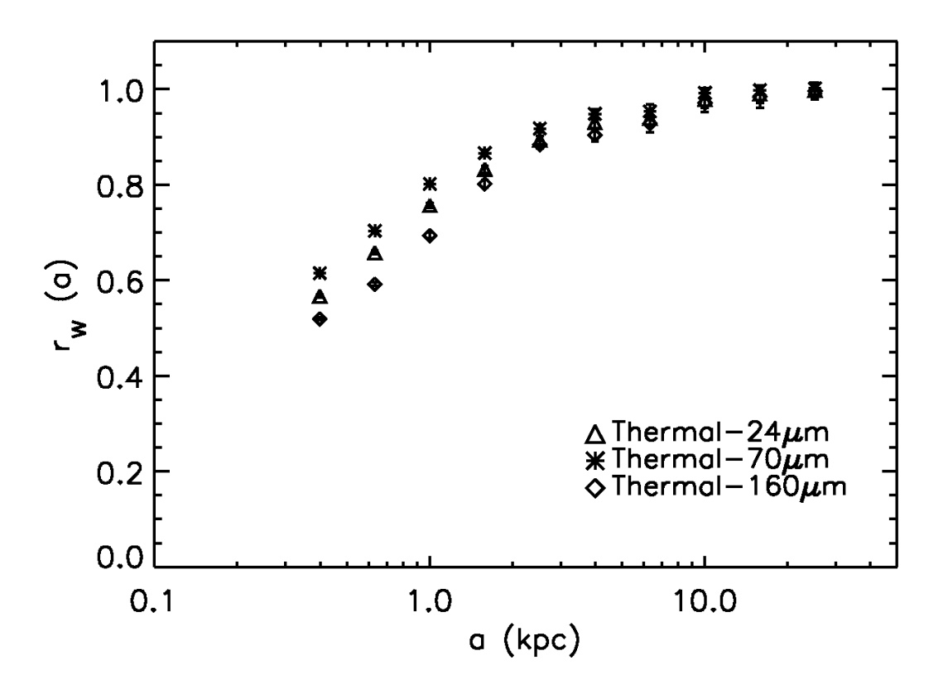
Scale-by-scale Correlation in M31
Synchrotron -IR correlation
Thermal -IR correlation
Thermal-IR are correlated everywhere.
Synchrotron-IR breaks down for a<1kpc.
Tabatabaei, Berkhuijsen + (2013)

Slide 27
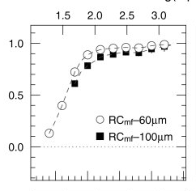
Break on ≤ Sub-kpc scales
Our own Galaxy:
various observations, no correlation
e.g. in Orion (Boulanger & Perault 1988)
Log(d/pc)
Nearby galaxies:
-The LMC (Hughes et al. 2006)
-M51 (Dumas et al. 2011)
-NGC6946 (Tabatabaei +2013a)
-M33, M31 (Tabatabaei +2013b)
Correlation coefficient
RC-60μm
RC-100μm
The smallest scale of the correlation is not the same in different galaxies!!
Hughes et al. 2006

Slide 28
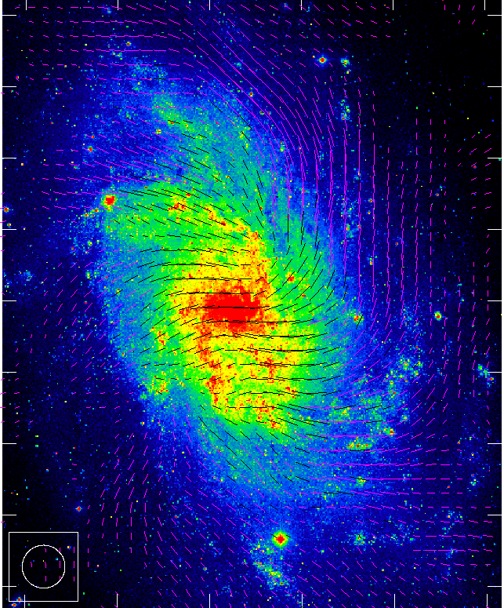
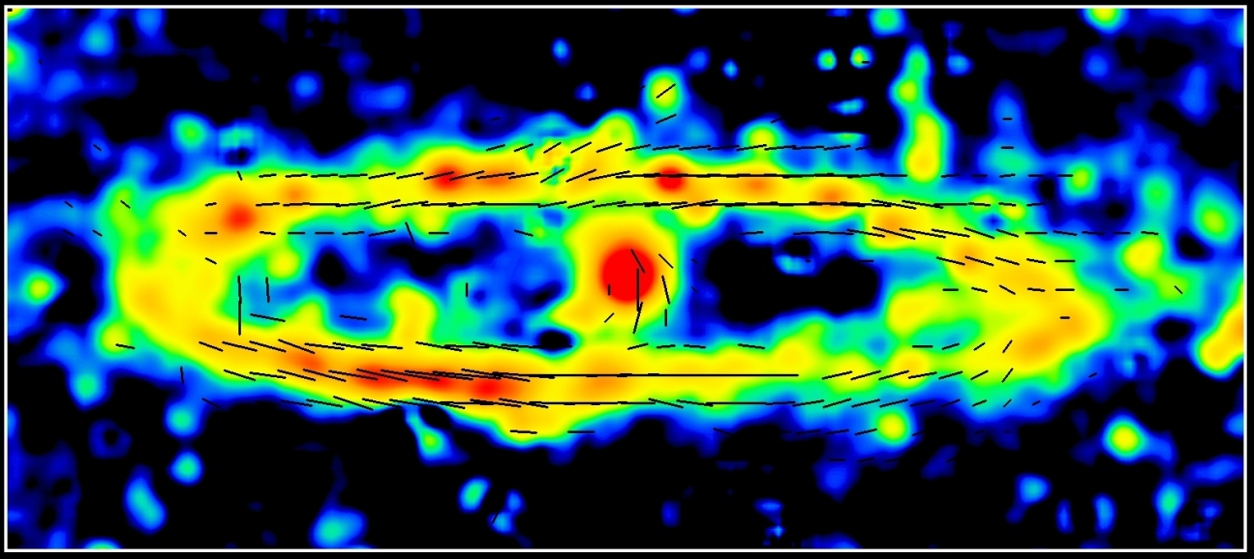
Magnetic Fields & CREs
B–vectors on optical image
Total radio emission and B–vectors
Fletcher et al. 2004
In M31:
Total B ≈ 7 µG, regular B ≈ 5 µG
Axisymmetric regular field in the ring
Turbulent B
Tabatabaei et al. 2008
Theoretical expectation:
In M33:
Total B ≈ 6.5 µG, regular B ≈ 2.5 µG
Strong turbulent fields in SF regions
Spiral field pattern, no correlation with arms
(e.g. Breitschwerdt et al. 2002)

Slide 29
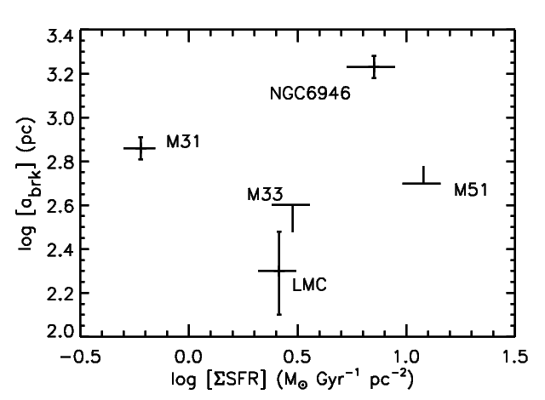
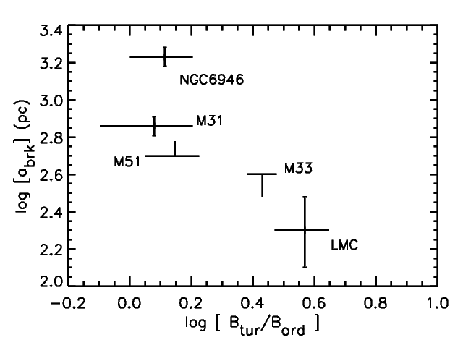
Radio-IR Correlation: Smallest Scale
Star formation?
or magnetic fields/CRE propagation?
→Static pressure equlibrium maintans on larger scales in galaxies with larger field regularity
Smallest scale
The smallest scale of the correlation depends on regularity of B
→ smallest scale ~ mean free path of CREs
Tabatabaei, Berkhuijsen + (2013)

Slide 30
Origin of Radio-IR correlation

Slide 31
Origin of Radio-IR correlation
UV
Coupled with gas
FIR

Slide 32
Origin of Radio-IR Correlation per Scale
UV
Coupled with gas
Coupled with gas
FIR

Slide 33
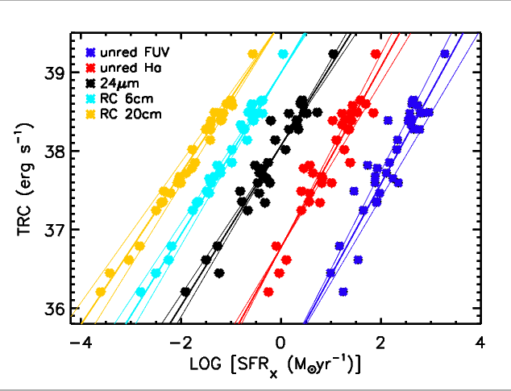
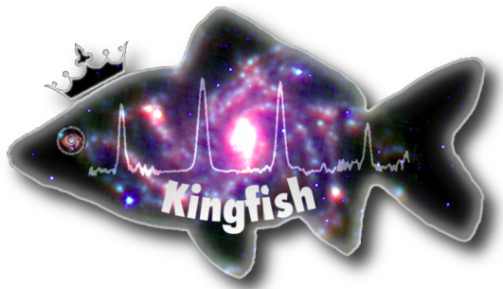
Radio-IR Correlation: from Local to Global
Although, the radio-IR could also hold in non-SF regions locally,
it is still a tracer of SF globally,
as the integrated fluxes are weighted toward them
→ Conspiracy dissected!
The global radio flux is about lineraly correlated with not only IR but also other SFR tracers in the KINGFISH sample (in prep.)
Amplification of magnetic fields in SF could lead to a non-linear correlation globally and locally (Heesen et al. 2013)

Slide 34
Summary
Resolved studies are important to understand the PHYSICS BEHIND THE RADIO-IR CORRELATION in galaxies.
The correlation changes inside galaxies depending on the environment.
First observational evidence for the importance of the magnetic fields in controlling the radio-IR correlation was obtained.
The correlation holds every where, even in non-SF regions, unless there is no coupling between equipartition B and gas.
The correlation could break on small scales due to the diffusion of CREs and the magnetic field regularity.
Globally radio, IR, and their correlation trace SF,
but the correlation is physically caused by
a fine balance between
gas density/magnetic fields/CREs in the ISM.

Slide 36

Magnetic Field - SFR Dependency
The turbulent B is correlated with SFR.
Amplification of torbulent B by SF:
Total B - SFR:
Tabatabaei et al. 2013
The ordered B & SFR are independent and partly anti-correlated.
→In agreement with Chyẑy (2008)

Slide 37

Break on ≤ Sub-kpc Scales
Our own Galaxy: various observations,
e.g. no correlation in Orion (Boulanger & Perault 1988)
Nearby galaxies→ Structural analysis (wavelet decomposition)
Example: evolution of 70μm emission with scale in M33
0.6 kpc 1.1 kpc 1.4 kpc 1.9 kpc 2.5 kpc 4.5 kpc

Slide 38

Wavelet Decompositions
Example: resolving radio & FIR differences on the smallest scale in M31
20cm Synchrotron
20cm Free-free
160 μm FIR

Slide 39

Star formation or CRE propagation?
Higher SFR per area →
Stronger turbulent field→
Smaller diffusion length →
CREs are found on small scales → Stronger Radio-FIR on small scales
Oversimplification !
Propagation of CREs not only depends on the turbulent B but also on the ordered B which is influenced by other phenomena rather than SF (rotation, density waves, shear / compression..)

Slide 40


Implication for Global Radio-FIR Correlation
RC-FIR is still a tracer of SF globally, as integrated fluxes are weighted toward them → Conspiracy dissected!
Example: Global properties of radio & IR emission in KINGFISH Galaxies (in prep.)

Slide 41


EVLA Survey of Magnetized ISM in M33
PI: Tabatabaei
50-pc resolution survey → scale of giant molecular clouds :
Unbiased sample of star forming regions
Unbiased sample of super nova remnants (+ X ray XMM), environmental effects (metallicity..)
Formation of clouds : Turbulence or magnetic fields ?
Energy balance vs. spatial scale and galactic structure?
Herschel -160μm (12“) : Kramer+ 2010
IRAM-CO observations (12“):Braine+2010

Slide 42

Radio-FIR Correlation with SKA
High- ʋ: spining dust?
Low-ʋ: flattening of spectrum?
Mid- ʋ: synchrotron spectral index?
All : total energy emitted in RC?
http://www.skatelescope.org/.

Slide 43

Bolometric RC : Total Radio Continuum (TRC)

Slide 44
Radio Continuum Observations with 100-m Effelsberg (2010-2013)
PI: Eva Schinnerer
~35 KINGFISH galaxies
- Mapping mode at 3.6, 6, and 20cm
-Cross-scan mode at 6cm

Slide 45

M31 (Hoernes et al. 1996) LMC (Hughes et al. 2006)

Slide 46
Nearby Galaxies as Benchmarks for High-z
Ideal laboratories to study a galaxy as a whole
(high resolution + no distance ambiguity)
M33, M31 & M51
Notes:
A historical note: if SFE~N(CRe) and warm dust is a better tracer of SF then a better synchrotron-warm dust than synchrotron-cold dust expected? What is the role of magnetic field?
for the first time for sample of galaxies, explanations,
importance: sfr estimation, scaling & calibration studies at hihg z..
necessity in studying nearby galaxies to understand dependence on the ISM like SFR, gas density, magnetic field, turbulence, and so on..
studies in galaxies, M33, M31, LMC, M51, SINGS
what we had shown in M33 and now what we have for both M33 and M31

Slide 48



What does shape the extended synchrotron emission?
20cm Synchrotron Emission
3.5cm Linearly Polarized Emission
Tabatabaei et al. 2008
Extended synchrotron emission follows the polarized emission or → ordered magnetic field

Slide 49


Weaker correlation between ordered B and short-wavelength synchrotron emission?
3.5cm Synchrotron Emission
3.5cm Linearly Polarized Emission
Synchrotron emission traces higher energy CREs close to their birthpalce at shorter wavelengths

Slide 50


Magnetic Field - SFR Dependency in a Virgo-cluster Galaxy:
Effect of Environment
NGC4254: similar to NGC6946 in B & SF
Chyẑy (2008)
Turbulent B - SFR:
Shear, compression of the turbulent field due to tidal forces, ram pressure:
→ anisotropic turbulent field ~ordered field
→ steepening of the B_tur-SFR relation
Total B - SFR:

Slide 51

Thermal & Nonthermal Separation in Nearby Galaxies
TRT Separation Technique:
Synchrotron spectral index varies in the disk
as CREs experience various energy losses
(Tabatabaei et al. 2007& 2013)
Free-free
Synchrotron
- Synchrotron emission: north/south assymetry→ interaction feedback?
-Thermal emission: SF regions & Diffuse ionized gas

Slide 52


NGC6946: Symphony of ‘Magnetic Arms‘ and Giant HII Regions
20cm Synchrotron Emission
Hα image with 6cm PI-contours
Beck et al. 1996, 2007
The magnetic arms are filld with bright-extended synchrotron emission.
→ Intense synchrotron energy loss along the magnetic arms
Tabatabaei et al. 2013

Slide 53


NGC6946: How the CRE Energy Index Varies?
α_sync
Tabatabaei et al. 2013
Mean sync. spectral index ~0.8
Steep spectrum along the magnetic arms
Flat sync. spectrum in giant SF
Energy loss of CREs propagating away from SF

Slide 54

NGC6946: Magnetic Field Strength
Total B (I_sync, α_sync)
Turbulent B (I_sync - PI/0.75, α_sync)
Tabatabaei, Schinnerer et al. 2013

