Slide 1
The survey for new AGN candidates
within the field
of Fermi unassociated gamma-ray sources
Yamaguchi Univ.
Yoshitaka FUJINAGA
K. Ninuma, A. Kimura, K. Fujisawa, K. Akutagawa, K. Sugiyama, K. Motogi (Yamaguchi Univ.) T. Oyama, S. Kono, S. Sawada-Sato (NAOJ), S. Mizuno (AES), Y. Fukuzaki, R. Kawabata (GSI), S. Takemura (Gifu Unive)
EATING VLBI 2014 @ Bologna

Slide 2
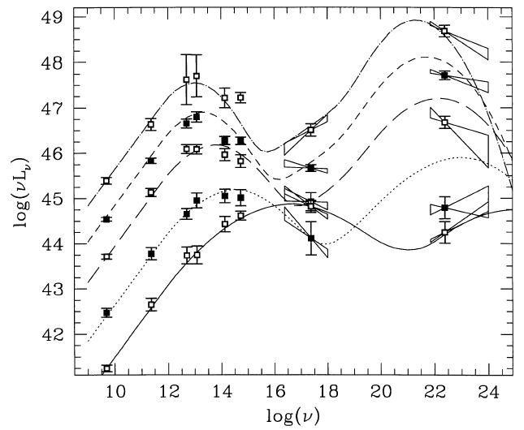
Introduction
Blazar ・・・
active galactic nucleus ( AGN ) with relativistic jets pointing almost along the line of sight.
< Blazar’s SED >
FSRQ
Anti-correlation between and
⇛ Blazar Sequence( Fossati et al. 1998 )
LBL
IBL
This characteristic was discovered
among bright blazars at radio
HBL
Is this characteristic seen among all blazars ??
Fig. Blazar Sequence ( Fossati et al. 1998 )
It is necessary to inspect that with taking account of faint blazars !!
We are going to increase the number of faint blazars
by using higher sensitivity VLBI system !
EATING VLBI 2014 @ Bologna

Slide 3
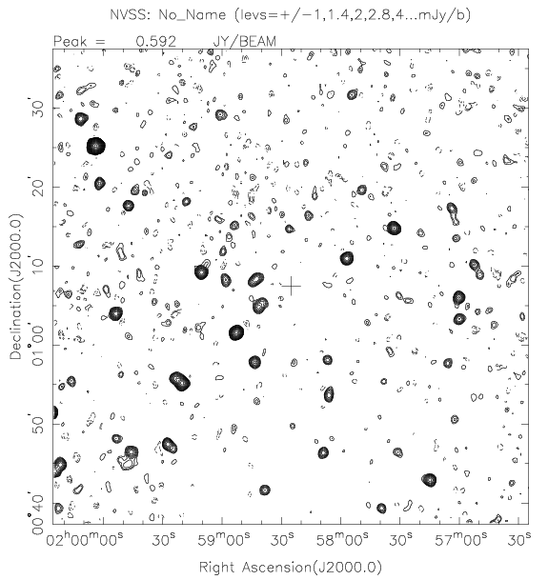
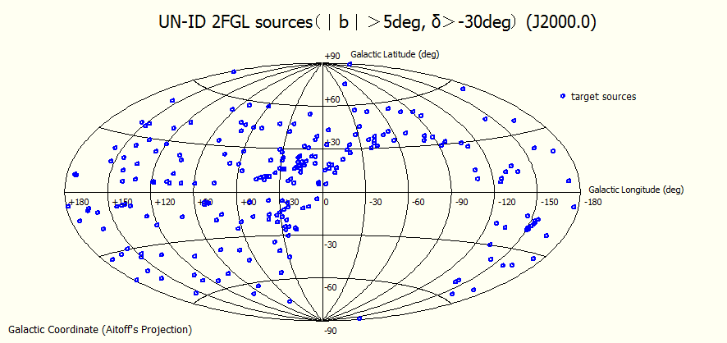
Source selection
～ γ-ray sample sources ～
< Fermi 2nd catalog ( Nolan et al. 2012 )>
1873 γ-ray sources
1298 sources ・・・ associated
806 sources are ‘blazar’ !!
575 sources ・・・ unassociated
< γ-ray sources selection criteria >
Galactic latitude |b| > 5°
Declination δ > -30°
575 → 231 γ-ray sources
< Radio sample sources >
Used catalog :
NVSS
FIRST
Fig. The distribution of our γ-ray samples
(Condon et al. 1998)
(Becker et al. 1995)
→ we obtained 1211 radio sources.
EATING VLBI 2014 @ Bologna

Slide 4
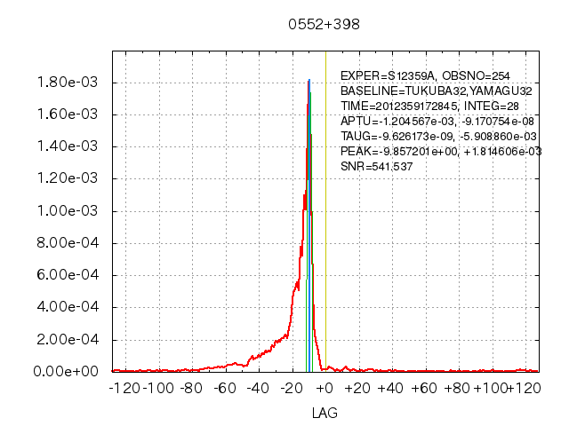
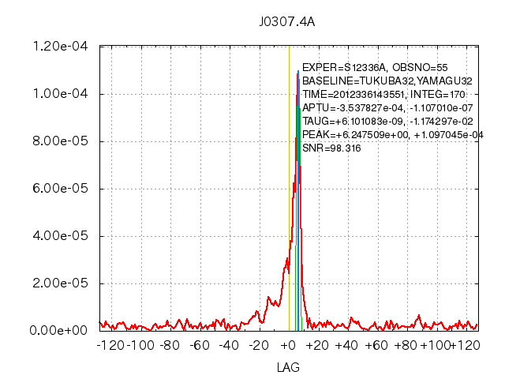
Observation
～ Observation system ～
Optical-fiber-linked real-time VLBI system
< Optical-fiber-linked real-time VLBI system >
Recording speed
2048Mbps(previous : 128Mbps)
Real-time correlated processing
16 times Band width !!
→ 4 times higher sensitivity !!
Immediate results !!
< Our observation’s spec >
Angular resolution : 9.2 mas @8.4GHz ( Yamaguchi-Tsukuba : 804km )
Noise level : ～2 mJy ( on source time : 3 minutes )
SNR (signal to noise ratio) is over 6 → Detection!!
We completed 845 sources out of 1211 samples.
EATING VLBI 2014 @ Bologna

Slide 5
Results
～ Detection sources ～
We detected 29 sources !!
brightness temperatures of detected sources exceed 10 to 6 K at least!!
→
This result show detected sources are possible AGN candidates due to such high brightness temperature.
EATING VLBI 2014 @ Bologna

Slide 6
Results
～ Counterparts to detected sources ～
VLBI observation has high positional accuracy.
With using radio coordinate,
we searched for counterparts at other wavelength.
< Used catalog >
2MASS
WISE
SDSS
In this presentation,
we focus on WISE counterpart.
WISE counterpart : 22 sources
EATING VLBI 2014 @ Bologna

Slide 7
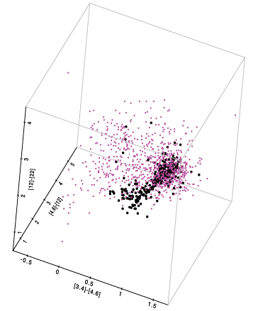
Discussion
We discriminated blazars from detected sources
using the method described in Massaro et al.(2012)
They classified blazars based on
WISE Gamma-ray Strip ( WGS )
and
parameter ‘s’.
< WISE Gamma-ray Strip ( WGS ) >
A characteristic distribution of blazars with γ-ray emission in WISE color – color space.
We discriminated blazars
based on their method.
Massaro et al. (2013)
( For detail of this method, please see their report. )
EATING VLBI 2014 @ Bologna

Slide 8
Discussion
< Our results >
We applied the method described
by Massaro et al (2013) to 14 sources.
threshold ：
Nine sources are possible blazars ！！
EATING VLBI 2014 @ Bologna

Slide 9
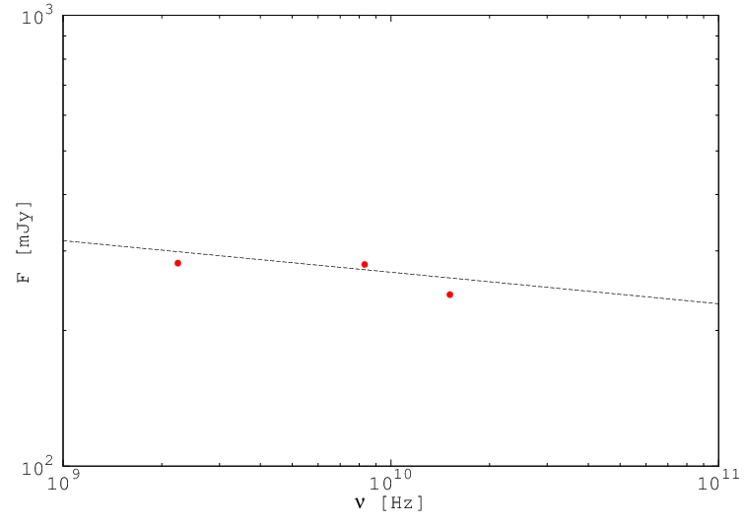
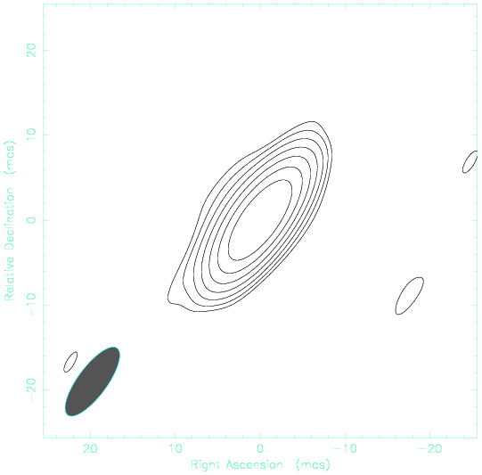
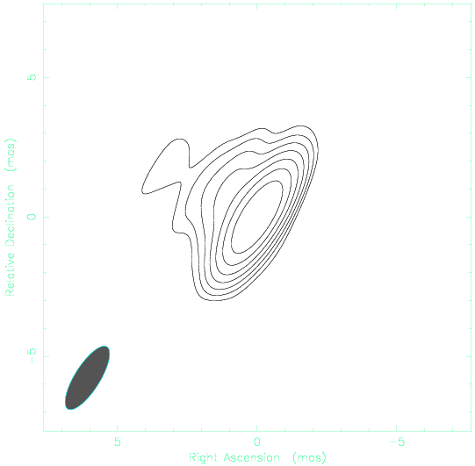
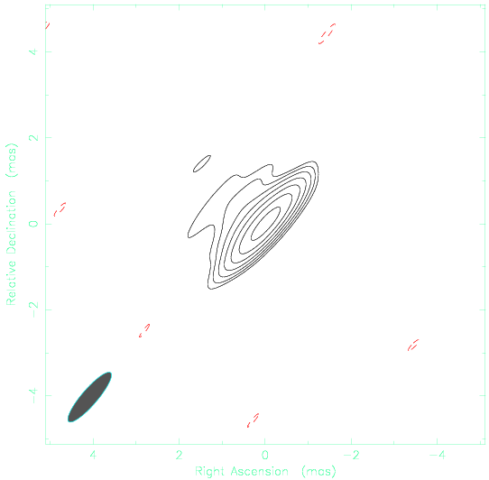
Discussion
< Results of VLBA Observation >
We estimated the spectral indices of detected sources with using the results of multi-band observations by VLBA.
～ J0307+4915 ～
※Convolved beam size of
5 [mas] × 5 [mas]
Beam size [mas] × [mas] :
9.7 × 3.4 2.6 × 0.9 1.5 × 0.37
Spectral index α:
NVSS J030727+491510 : α=0.07
( Typical blazar : α<0.3;
“ACTIVE GALACTIC NUCLEI”Krolik et al. )
Peak flux : 0.272[Jy/beam]
Beam size : 9.7 × 3.4 [mas]
Image rms : 2 [mJy]
Peak flux : 0.249[Jy/beam]
Beam size : 2.6 × 0.9 [mas]
Image rms : 2 [mJy]
Peak flux : 0.204[Jy/beam]
Beam size : 1.5 × 0.37 [mas]
Image rms : 2 [mJy]
Jet component in the northeast direction.
EATING VLBI 2014 @ Bologna

Slide 10
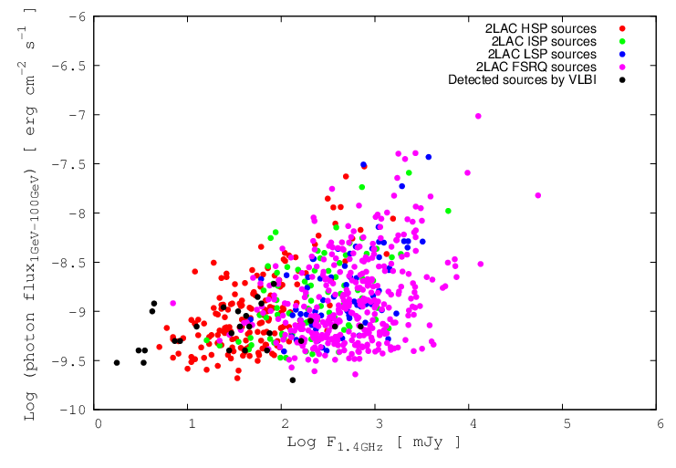
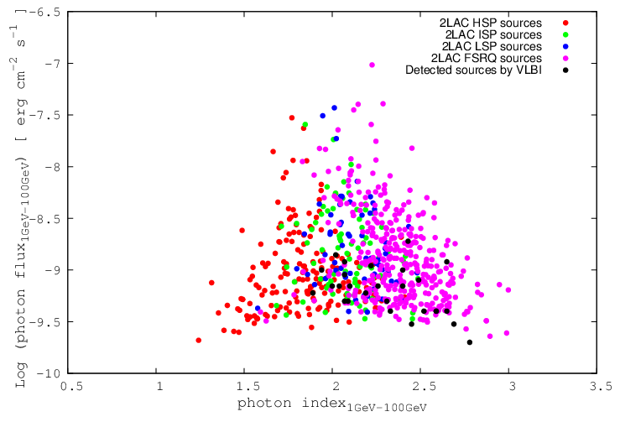
Discussion
< Correlation diagram>
Radio flux at 1.4GHz
– 1 GeV – 100 GeV Photon flux
1 GeV – 100 GeV Photon index–
1 GeV – 100 GeV Photon flux
→ the region of detected sources are
similar to that of HSP BL Lacs
→ the region of detected sources are
similar to that of FSRQ
EATING VLBI 2014 @ Bologna

Slide 11
Conclusion
Search for new faint blazars with γ-ray emission
e-VLBI observation for radio sources within the positional error of unassociated γ-ray sources in Fermi 2nd catalog
29 radio sources with high brightness temperature
Nine detected sources are possible blazars
( by Massaro way )
J0307+4915(detected source) is possible blazar
( from the viewpoint of spectral index )
Different trend from known blazars
( from correlation diagrams )
EATING VLBI 2014 @ Bologna

