Slide 1
The OCTAVE-DAS and correlator system for VERA, JVN, Japanese e-VLBI(OCTAVE) and KJJVC
Tomoaki Oyama¹,
Yusuke Kohno¹, Syunsaku Suzuki¹, Masahiro Kanaguchi¹, Takashi Nishikawa¹, Moritaka Kimura, Noriyuki Kawaguchi², OCTAE-team members
National Astronomical Observatory of Japan¹,
Shanghai Astronomical Observatory²,
Notes:
My name is Tomoaki Oyama, I am from NAOJ. I will talk about a , These are collaborators.

Slide 2
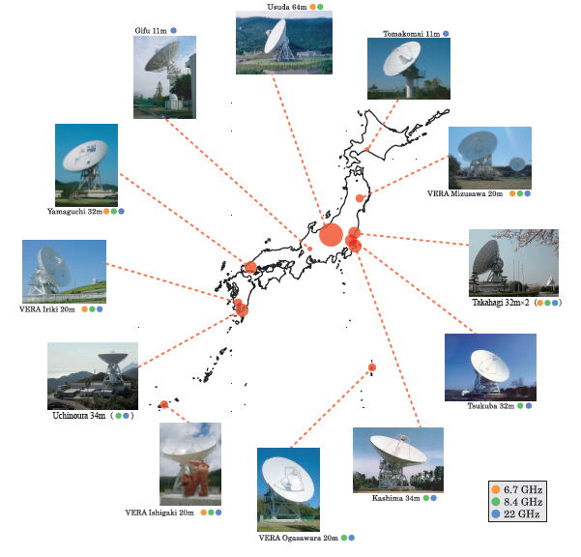
OCTAVE: e-VLBI array （Optically ConnecTed Array for Vlbi Exploration） Subarray of JVN(Japanese VLBI Network)
Connected
not operated
(Fiber is connected)
not connected
Brief history of e-VLBI at NAOJ
1998～ ：Nobeyama45m-Usda64m
(real-time fringe detected
ATM, 256Mbps)
2004 ： usuda64m, tukuba32m, gifu11m (2Gbps, ATM-IP)
2005 ：Kashima34m, Yamaguchi32m,
Nobeyama 45m(2Gbps)
2008 ：several stations with10GbE
2011 ： all connected station using 10GbE
NRO 45m
Gifu 11m
Tomoakomai 11m
USUDA 64m
Mizusawa 20m
Yamaguchi 32m
IRIKI 20m
Hitachi 32m
T
Uchinoura 34m
Takahagi 32m
Kashima34m
Ishigaki 20m
３
OGASAWARA 20m
Notes:
This slide shows the OCTAVE array, OCTAVE is an abbreviation for “ Optically,,,,,, “ , and subarray of JVN
Blue lines statons, Optical fiber is connected, and yelloo line , fiber is conneceted , but not opperated, red lines, optical fiber is not connected.
This is a brief history of e-VLBI at NAOG, We got a first real time fringe between 45 and 64, and 2004, usuda, tukuba, giifu stations ,

Slide 3
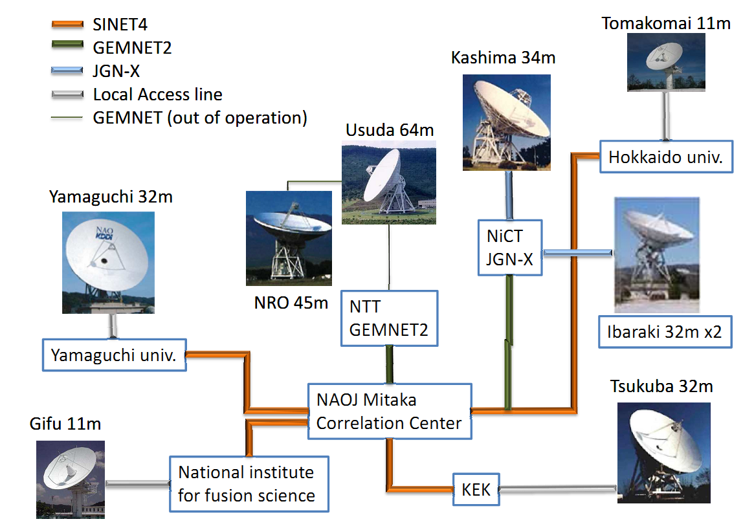
Communication lines
lines Supplied by an academic network (SINET4/NII) and a test bed network(JGN-X/NICT) with 10GbE
Usuda and NRO are offline now
SINET5 with 40 GbE in new future
Local Disk Recording system were installed into non connected or at a slow bit rate station by 2013 (VERA, Usuda, NRO45m, Ibaraki and Tomakomai(for slow rate)) . Old system wsa replaced at all JVN stations .
(Hagiwara-san talked)
Network configuration (Plan)
Notes:
This slide shows a communication lines.

Slide 4
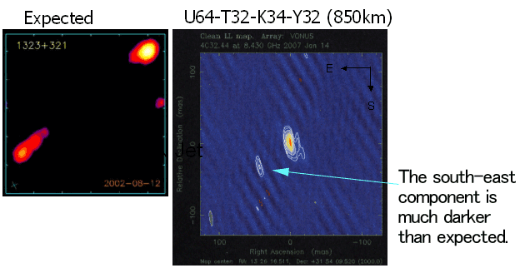
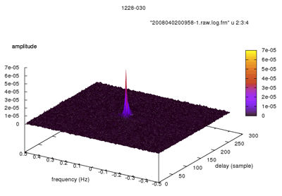
e-VLBI Observations
Image of 4C32.44
4/2007
X-band, BW512 MHz, 4stations
Real time correlator(OCTACOR)
Fringe detection survey of Parsec-Scale Nonthermal Jets in Radio-Loud Broad Absorption Line Quasars,
Doi et al., 2009
Fringe detection survey of Fermi/LAT Un-associated Gamma-ray Sources, Niinuma et al.,2013, Fujinaga et al. submitted
Science Obs. proposals are selected and operated by JVN-Consortium
Notes:
These are exmples of e-vlbi observations. We got a first image of e-vlbi observations in 2007
We carried out fringe detection survey of parsec-snon and Fermi Lat unassociated gammna –ar , Many target sources could be detected, and these results were published.
And Now, scienc observation

Slide 5
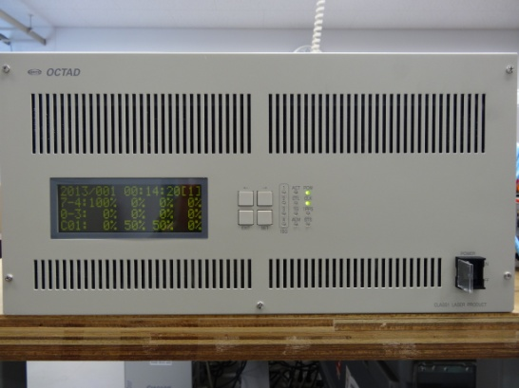
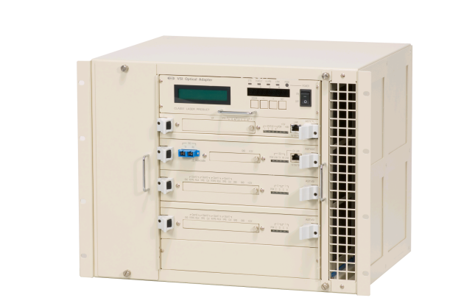
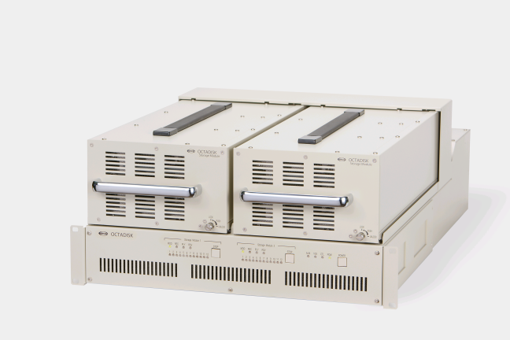
Octave family
We have developed several instruments
for OCTAVE. We call them Octave family.
Octave series.
OCTAD : OCTAve A/D Converter
16(max) Gsps high speed RF(~30GHz) direct A/D Converter
OCTAVIA1,2 : OCTAve VSI Adapter
VSI-H ⇔ 10GbE (VDIF) converter
OCTADISK : OCTAve DISK drive
Disk recorder for VDIF (10GbE)
OCTADISK2(VSREC=VDIF Software RECorder)
Commercial PC with 10 GbE-card and Raid Box
OCTACOR : OCTAve CORrelator
Gbit realtime Hardware correlator (VSI-H)
OCTACOR2 : OCTAve CORrelator2
Software correlator system (10GbE, VDIF)
Many non-OCTAVE family instruments are also used in
the array, such as ASD1000/3000, K5(NICT), Mark5B(Haystack).
Notes:
From next slide, I introduce these instruments detaildly

Slide 6
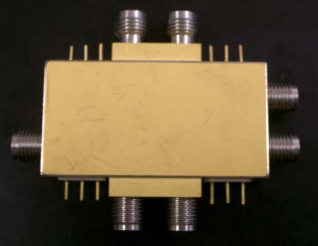
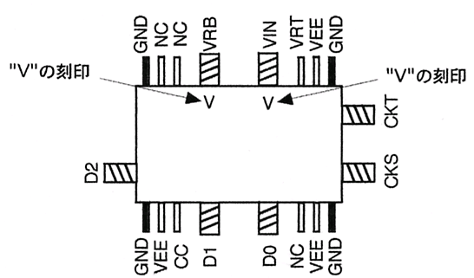
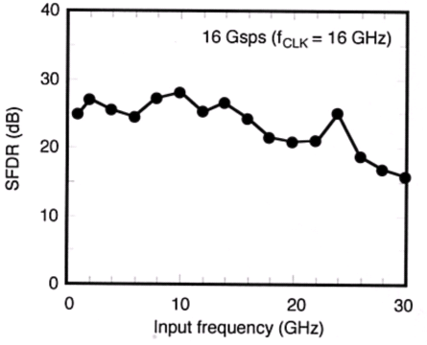
OCTAD : OCTAve A/D Converter (High speed sampler : RF(~30 GHz) Direct Sampling)
A/D Chip
NTT Photonics/NEL/NAOJ
InP HBT ADC（～30GHz）
or
Hittait microwave（～20GHz）
DBBC(Digital BaseBand Converter)
Two FPGA(Virtex7)
Firm : SuperH by Renesas
We do not need Down converter and
base band converter using this simple system
Notes:
This slide shows a introduction of OCTAD, Two A/D chips are available , one is manufacutured by Input frequency is within 30 GHz, Second available chip is developed by Hittait microwave
DBBC is composed of twe fpga and firm

Slide 7
Block Diagram(OCTAD)
VDIF Formatter
RF input 1
ADC1
10GbE MAC/PHY
RF input 2
ADC2
ADC3
RF input 3
ADC2
RF input 4
ADC4
ADC2
Signal processing(DBBC) FPGA
Notes:
This slide shows a block diagram of OCTAD , octad has four rf input channel , and 4 adc chips, signal processing is implemented with fpga,,
Next vdif formatter, and OCTAD ;has 4 10GbE output ports. Total output rate is 32 Gbps

Slide 8
Specification of OCTAD
Input channel | 4 Ch
Input frequency | ～20 GHz(Hittaite) or ～30 GH(NEL)
Sampling Frequency | 16 GHz(Hittaite), 8 GHz(NEL)
Sampling bit | 3 bit
Output port | 10 GbE X 4, 32Gbps(max rate)
Transfer protocol | UDP、VDIF
DBBC | Out bit | Channels of out put
4096 Msps | 2 or 3 | 2, 4
2048 Msps | 2 or 3 | 2, 4, 8
1024 Msps | 2 or 3 | 2, 4, 8, 16
256,128,64,32,16 Msps | 2 or 3 | 2, 4, 8, 16, 32
OCTD has several DBBC modes to be comformable to VGOS(VLBI2010) and present VLBI system.
Notes:
This slide show a specification of OCTAD, , transfer protocol is udb and vdif, OCTD has several DBBC modes to be comformable to

Slide 9
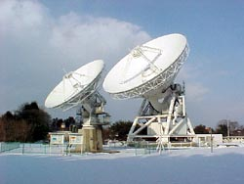
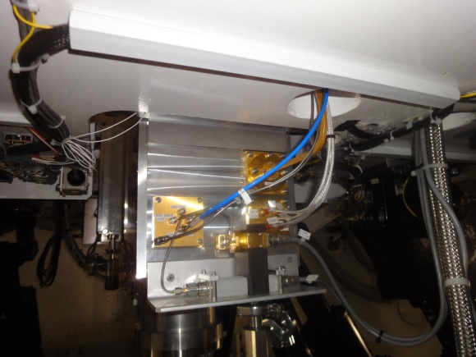
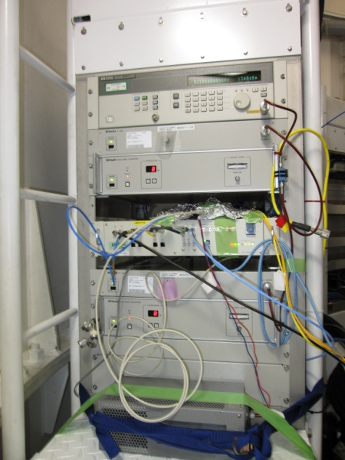
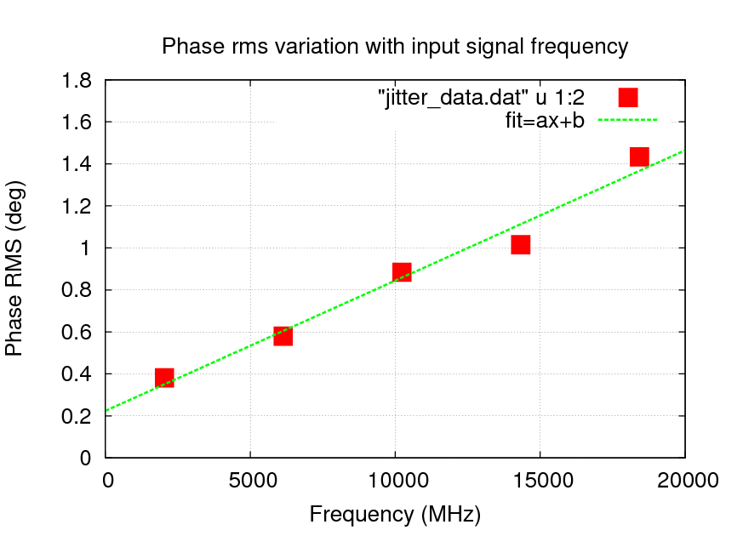
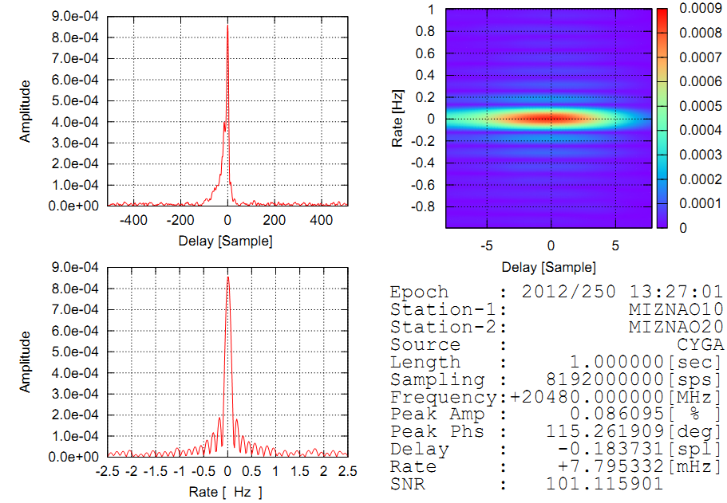
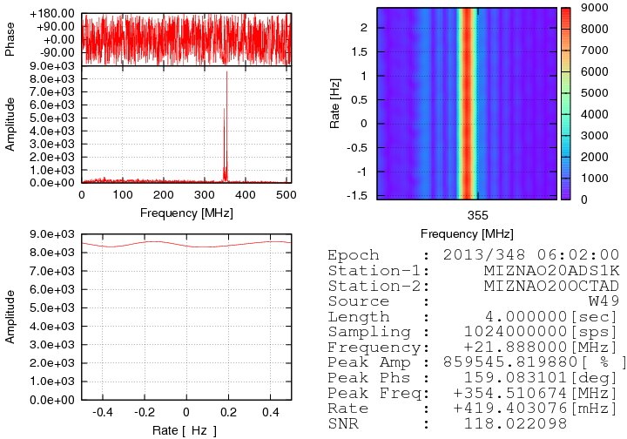
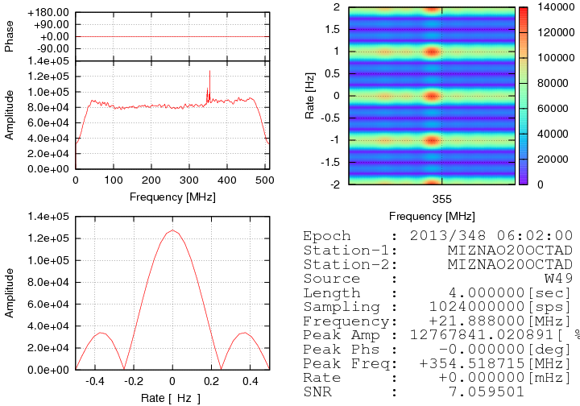
Evaluation of OCTAD
Lab. test of sampling jitter
0.17 psec (Lc<1% @43GHz)
Zero baseline fringe test observation
9/2012
Mizusawa 10m x 20m BL=60m
16Gbps x 2 OCTAD
Jitter 0.17psec
Lc <1%
RX output 20-24GHz
OCTAD(A/D) input 20-24GHz
0.17psec
A/D output using 10GbE
Optical fiber, VDIF format
Sampling jitter
Fringe of CygA (4GHz band width)
Software recorder
VSREC(OCTADISK2)
9
XS of W49 (512MHz BW)
AS of W49 (512MHz BW)
Notes:
This slide shows a evaluation of octad., Firstly this is a result of lab. Test of sampling jitter, sampilng jitter is 0.17 psec, so it is no problem to use iit for interferometr.
Secondlly, we carried out zero baseline fringe test observations on Sep 2012, between Mizusawa 10m and 20m telescope, baseline length is 60 cm, this is a observing setup ,, rx output 20-24 directly input to sampler, and output with opticl fiver to software recorder,. We could get fringe of cyga ,and w49, an this is a autopower spectrum of w49, bandwidth is 512MHz.. So now, we continue to evaluate it.

Slide 10
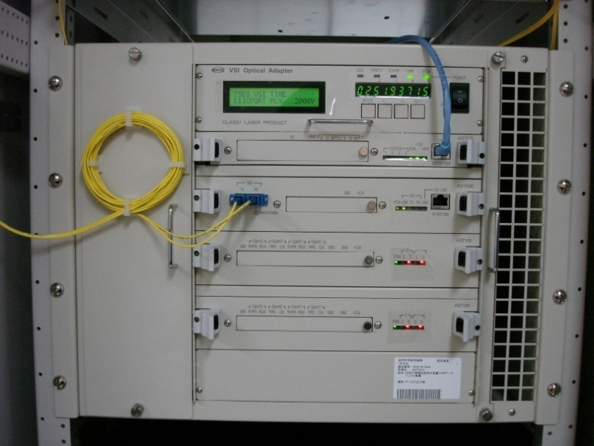
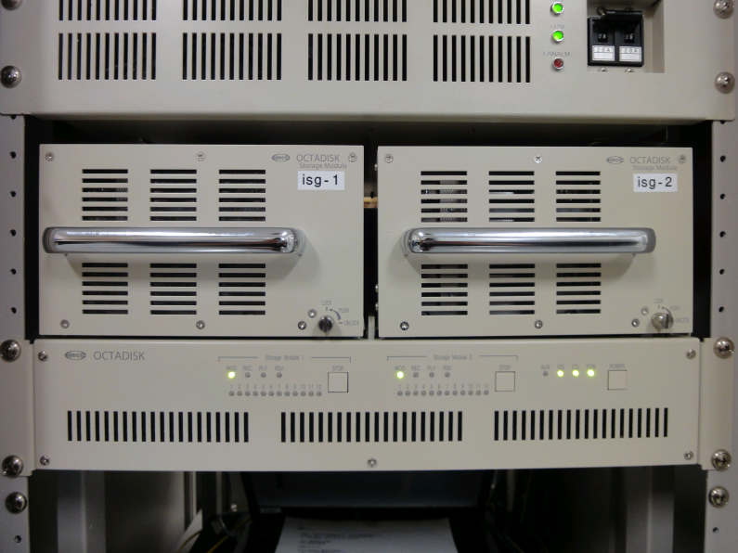
VSI-Adapter (OCTAVIA1,2) Disk recorder (OCTADISK)
OCTAVIA(Octave-VSI-Adapter)
( VSI-H⇔10 GbE Converter, bi-directional）
4 VSI I/O ports (1 or 2 Gbps)
One 10 GbE I/O port (VDIF Format)
VBR Function for the traffic jam for e-VLBI
Multicast
Originally developed and operated for Korea Japan Joint vlbi correlator , 2007～
OCTADISK（Octave-disk-drive）
Implemented on FPGA
One 10 GbE I/O port（VDIF Format）
Recording and playing rate is 4(cont) + 0.5(maser) Gbps, totally 4 streams
12 hard disk drive per 1 module
Originally developed and operated for Korea Japan Joint vlbi correlator , 2007～
Notes:
This slide shows a specification of OCTAVIA and OCTADISK. OCTAVIA is a converter between vsi-h and 10gbe, ,enabling multicast protocor, for recording and dsp simultaneously. OCTAVIA is used for old VSI-H system.

Slide 11
OCTADISK2p（Octave-disk-drive 2）
OCTADISK2p(Software recording system)
VSREC(Software) + Commercial PC customized by requirement
Customized PC (ex, for OCTAD, >8 Gbps recording )
CPU: Core i 7 3.2 GHz
Memory: 24 Gbyte
Raid : Areca ARC-1882-ix-24
Raid box : STARDOM ST8-U5X2(SAS)
10 GbE card : Neterion X3110SR
Cent OS 5.6
VSREC(Recording software)
Code: Standard C
Input : UDP, TCP/IP, (VDIF)
Output : Linux standard format (xfs, ext4)
>8 Gbps recording @1 pc+ 1 or2 raid box(8 HDD)
Have playing function to OCTAVIA for KJJVC
Installed at VERA, NRO45, 3/2012
Current status of OCTADISK2
OCTAVIA to OCTADISK2(PC) using this software
Raid | HDD | ARC-1882 ix
Raid 0 | 8 disks | 10.201 Gbps
Raid 6 | 8 disks | 4.337 Gbps
Raid 0 | 8 disks | 10.447 Gbps
Completely COTS system
(include shipping media and raidbox)
Notes:
OCTADISK2 is a completely cots system, include raid box and shipping mdia.. It is important and convinent, in case of 1Gbps recording, we can use usb-hdd, 2gps , we can use small commersially raid box, , 8gpbs, commercially thise raid box . If we use commercially medi, we can connect it directly to correlation server, we do not need special disk pack, and playing machine.
so we do not have palying instrument, Raid box coud be directly connected to correlation server with digichain

Slide 12
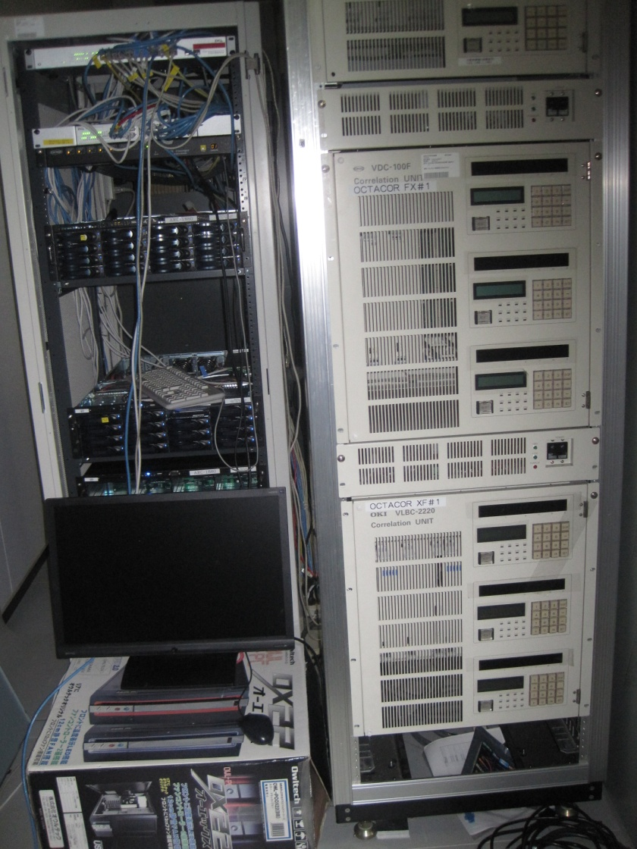
Correlators for OCTAVE and JVN
Real time correlator(OCTACOR) for e-VLBI
FPGA correlator
FX and XF type
2Gbps/station
5 stations
Installed and operated at Tokyo-Mitaka-correlation center from 2001
Post processing Correlator(OCTACOR2)
Software correlator
Engine(GICO3) by NICT and NAOJ
Integration and post-processing software developed by NAOJ
Speed of processing@Core I 4.6 GHz , 6 corel 1024Mbps for 4 stations with 2Gbps data, 2k
We use 8 PCs to correlate 8Gbps 4stations data.
Correlation time is same as observing time.
Soft Correlators Hard Correlators
Notes:
This slide shows specifications of correlators. We have two correlators for octave and JVN, First correlator

Slide 13
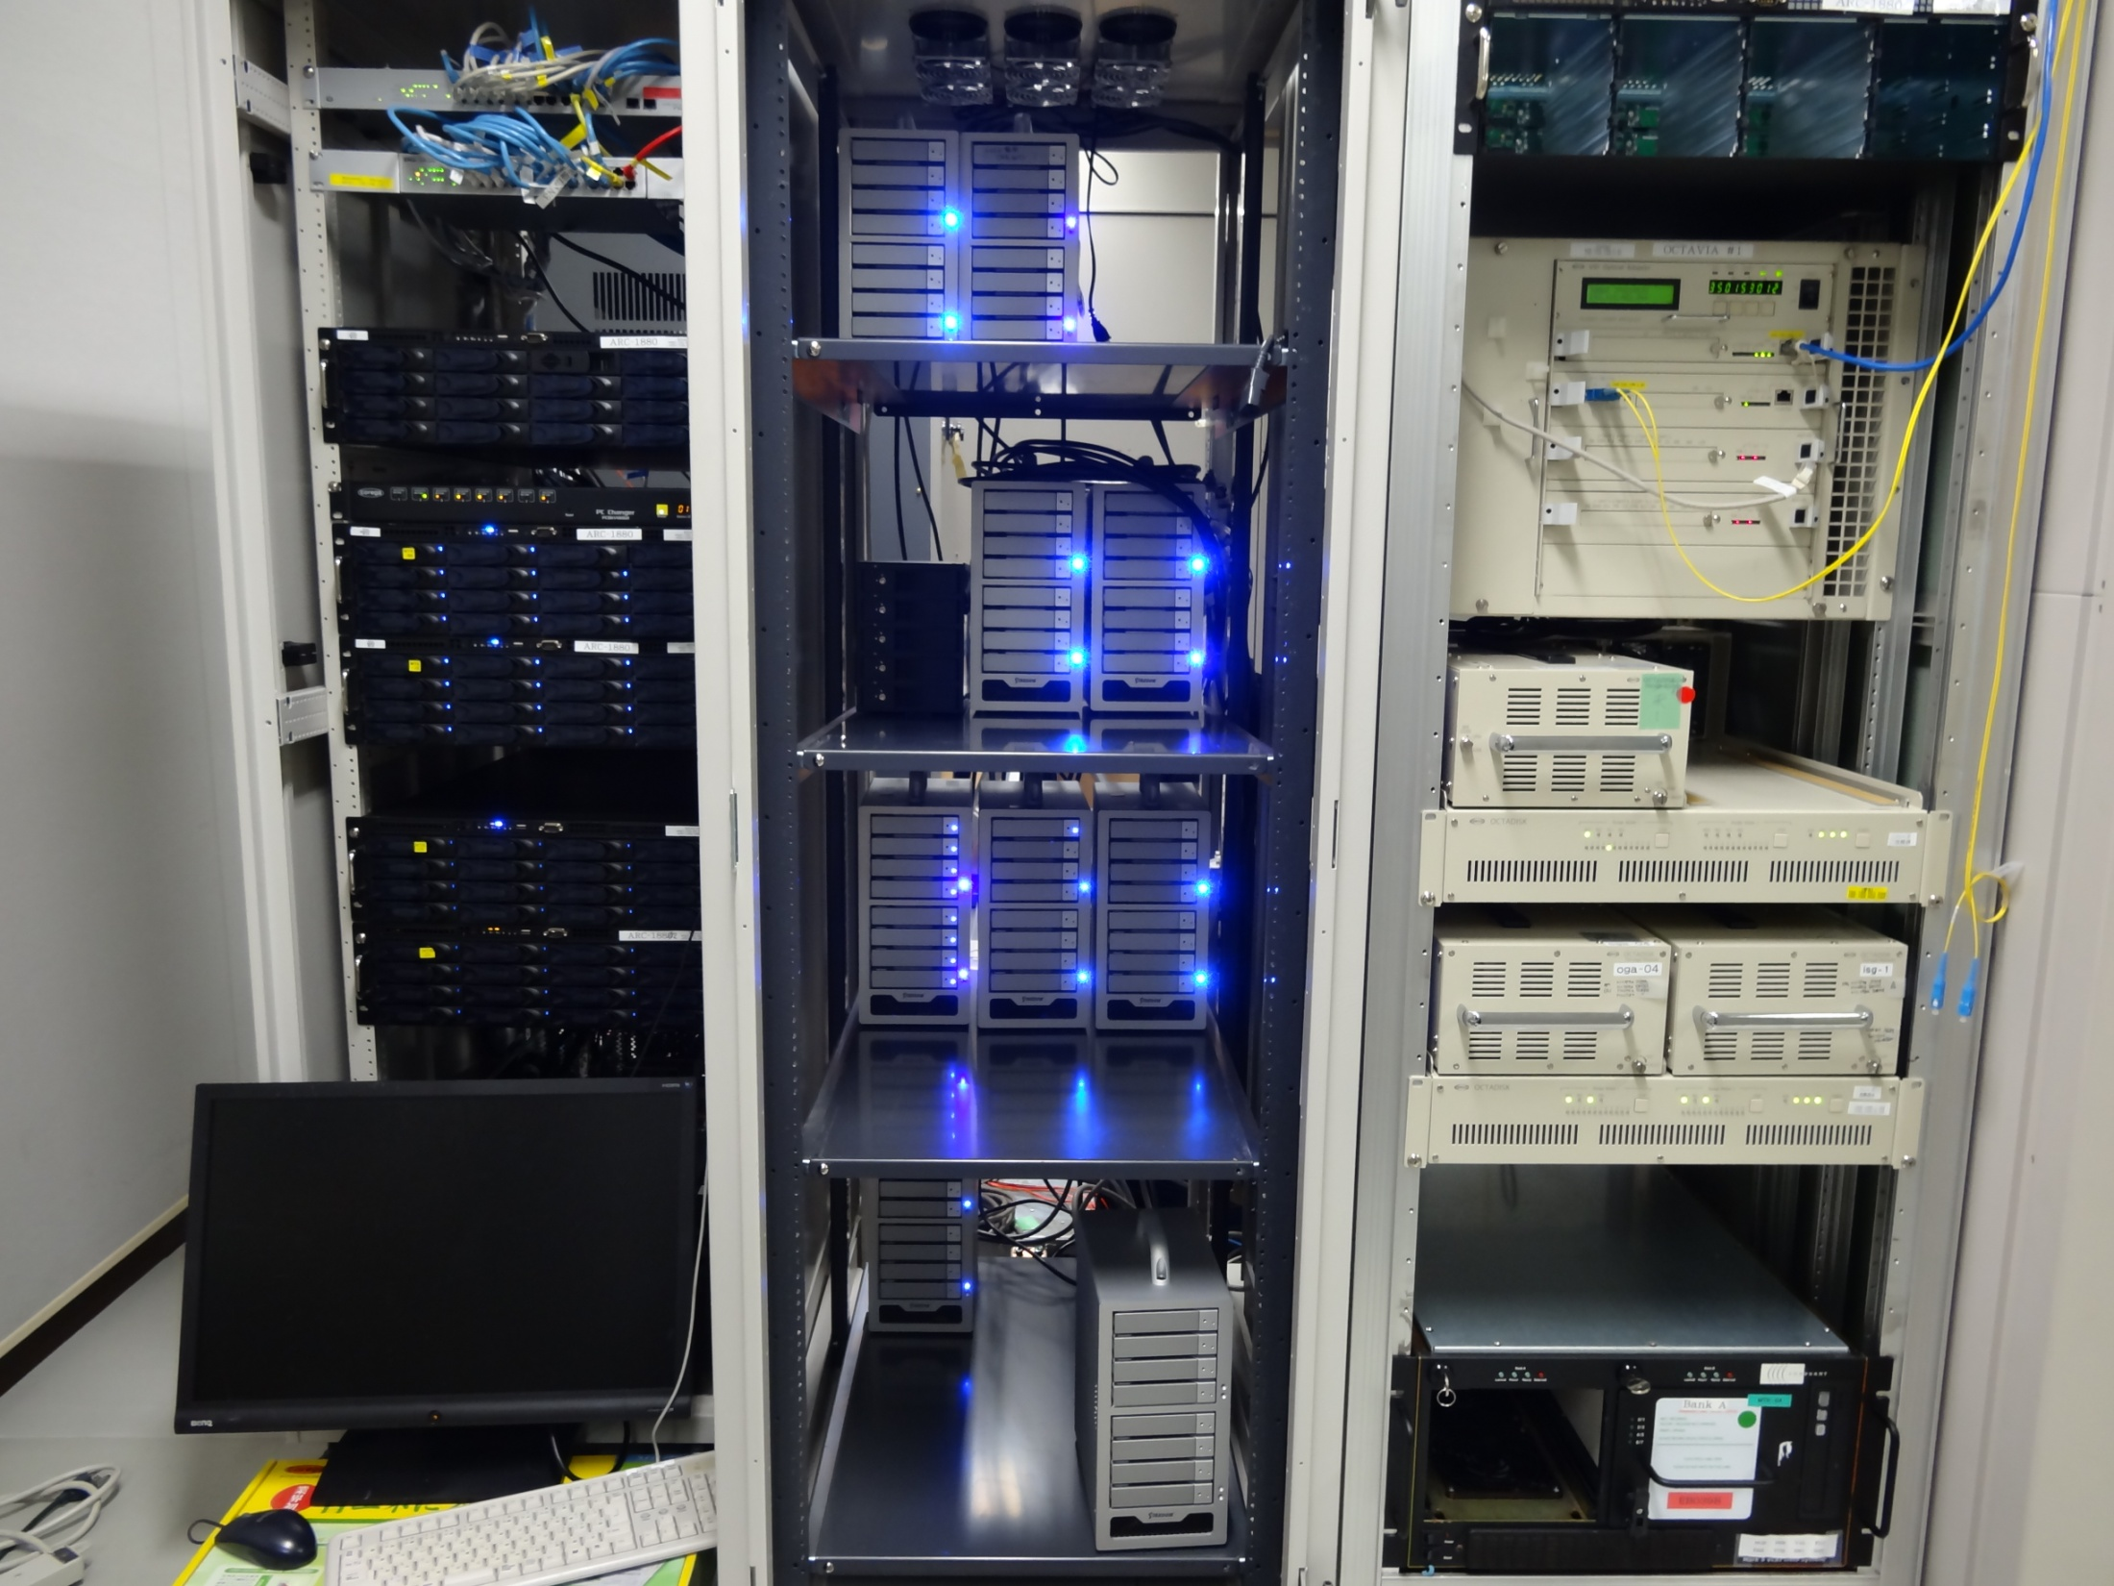
Notes:
This slide shows one block of correlation center

Slide 14
VLBI Calibrator survey for VERA using wide band (8Gbps) system
Purpose：
Evaluation of new system
Calibrator survey for VERA
Data： Jan 8/2013.(6:00~18:00)
Band：K
target：VCS X band（petrov et al.,2012）
30°<DEC<55°, total 193 target sources
Freq:
DIR2K ：21.459-21.971GHz , BW=256MHz
WIDE-BAND：21.459-23.507GHz, BW=2048GHz
Recorder:(Simultaneous recording )
・DIR2K 1Gbps
・OCTADISK 2Gbps + OCTADISK2(VSREC)6 Gbps
total：8 Gbps (512 MHz X 4 ch )
DIR2K 256MHz
WIDE-BAND 2GHz
Results
1, 176/193 sources were detected between
MIZ-IRK baseline using OCTAVE-DAS (8Gbps).
2, SNRs were increased to 3-3.6 times
higher than present observing system.
Discussion
1, The number of Candidates
- VCS( -30 to 90 ) : 3228
- Average number of VCS sources within
2 degree circle : 1.35 (3228 / 2383)
- Sufficiency rate is
113 % in case of Tsys 140K, 8 Gbps
43 % in case of Tsys 140K,1 Gbps
15 % in case of Tsys 600K, 1 Gbps
- In case of Tsys 400K, 8 Gbps recording,
there is at least one vlbi calibrator source within 2 degree circle.
 | Detection rate(1Gbps) | Detection rate(8Gbps) | Increasing rate(numbers) | Increasing rate(SNR)
MIZ-IRK（Tsys 140K） | 43%（83/193） | 92%（176/193） | 2.12 | 3.21
IRK-OGA | 34%（66/193） | 87%（167/193） | 2.53 | 3.60
IRK-ISG（Tsys 600K） | 15%（28/193） | 74%（142/193） | 5.07 | 3.01
 | X band(VCS) | C,S band | Total | Candidate/ need number
-30<DEC<90 | 2193 | 1035 | 3228 | 135% （3228/2383）
Tsys140K、1Gbps =43% | 943(2193X0.43） | 194 | 1137 | 48% （1137/2383）
Tsys600K、1Gbps =15% | 329 | 91 | 420 | 18% （420/2383）
Tsys140K、8Gbps = 92% | 2018 | 665 | 2683 | 113% （2683/2383）
Tsys600K、8Gbps = 74% | 1623 | 347 | 1969 | 83％ （1969/2383）
Notes:
This is a first results of wide band test observations. We carried out vlbi calibrator surveys for vera using wide band system on Jan 2013. The initial catalog is vcs,, and the survey region is small, , total 193 target sources were observed.
This is a result of presetn 1Gbps tape syste, Another one is a result of wide-bband systen. As you can see that, the number of detections were incleased to 5 times, and snr were increased to 3-3/6 times hihger than present system
This figure shows a expectation of the number of sources which could be detecttd iwithin 2 degree circle, if we observe toward whole sky under same condition.. In case of TsysSo, it is important for VERA

Slide 15
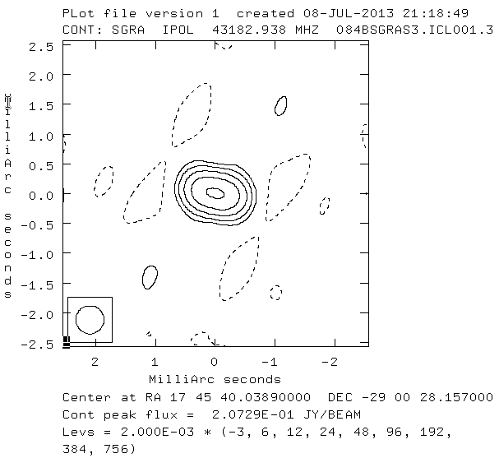
Broad band (8Gbps) scientific observations for VERA
Date : 3/2013/
Antenna : VERA (4 stations)
Band : Q-band(43GHz)
Target : Sgr A*
Recorder: OCTADISK2(VSREC)
Recording rate: 8 Gbps(512MHz X 4)
Correlator: OCTACOR2
(software correlator)
First image of 8 Gbps obs
SgrA*
Notes:
This is a second exmple of broad band obs, we could get a first image using broad band system, minimum baselein of vera is 700km, so is too long for vlbi observation of sgra*,
It was difficult to observe sgra* at only vera, but broad band system enable us to get fringe between all bselines, so we could get clear image., it is important for vera aiming to reveal dynaics of milkyway.
Second exmple is very broad band scentific observatioins , The nominal recorder of VERA is Dir2000 taperecorder rrecording rate is 1Gbps, we replaced tape with disksytem, so
Sensitivity is higher , so we can get clear Sgra* image though minimum baseline is 700 kim is too long for VLBI observations of Sgr A* , It is important for VERA aiming to reveal the dynanics of Milkyway

Slide 16
A history of fringe test observation btw other systems and OCTA system
Mark5B ：Mark5B format > Cutting header is needed for our soft correlator
First fringe test
btw SMA and SMTO for submm VLBI on Oct 2010.
Second fringe test
btw KVN and VERA for KJJVC evaluation on Jan 2011.
Third
Btw CVN and VERA leaded by Hachisuka, hagiwara and china-team in 2012
Fourth
Btw Italy and VERA leaded by Hagiwara-san and Italy-team,
Could get first fringe btw SRT and NOTO on Sep 2014 using OCTA software correlator! We will try again btw Italy and Japan (hagiwara-san talk)
Mark5C : VDIF >
First
Tidbinbila and VERA leaded by Hagiwara-san and Horiuchi-san in 2014
Others
EAVN test leaded by Hagiwara-san , tiger-team
Btw LBA and VERA leaded by Sugiyama-san , and LBA team
Notes:
This slide shows a history of fringe test observations btw other systems and octa system. In case of Mark5B, cutting header is needed for our software correletor, we conducted first fringe test observations btw SMA and SMTO for submm vlbi at oct 2010, at 2009 and 2010, our EHT-J team leaded by honnma-san, participated EHT with ASTE, and Hada-san, nagai-san were also member , and we went to Chili to setup observing system.
And after eht observations , we tried to correlate the data. So we could get fringet btw sma and smto , but it is unfortunatley not to get friinge btw ASTE. However, we could get much knowledge of Mark5B and other digital equipment.
Seond fringe test observations were carried out btw kvn and vera, because of 1st test, we could get fringe easilly. , their, fourth, , we could getn first fringe btw srt and not on sep 2014, so we could understand each system..
Because of using vdif format, we could get fringet easily.

Slide 17
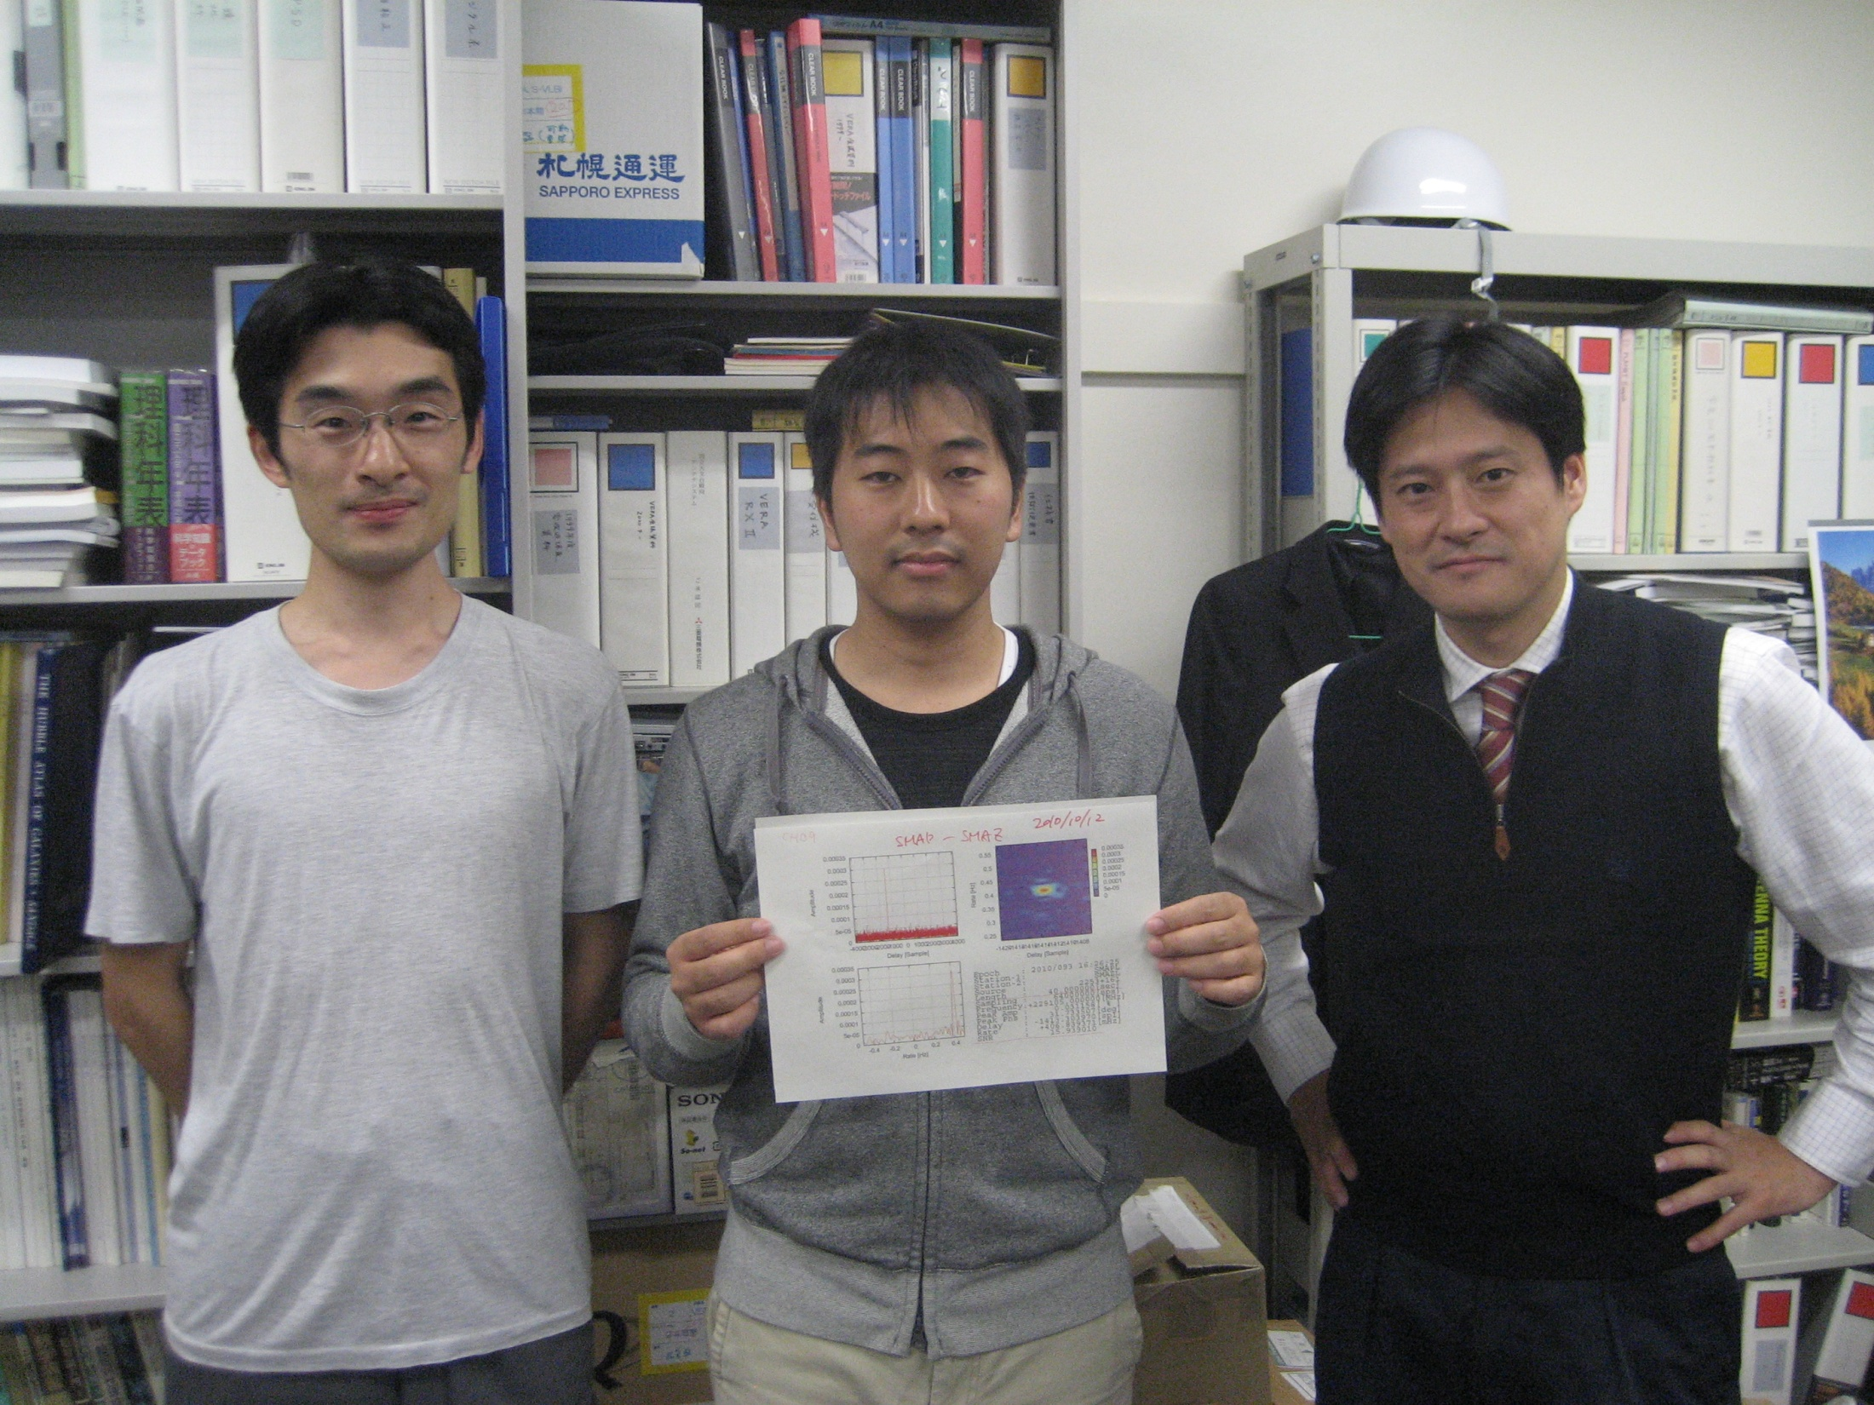
Fringe btw SMA and SMTO at 230GHz
On Oct 2010

Slide 18
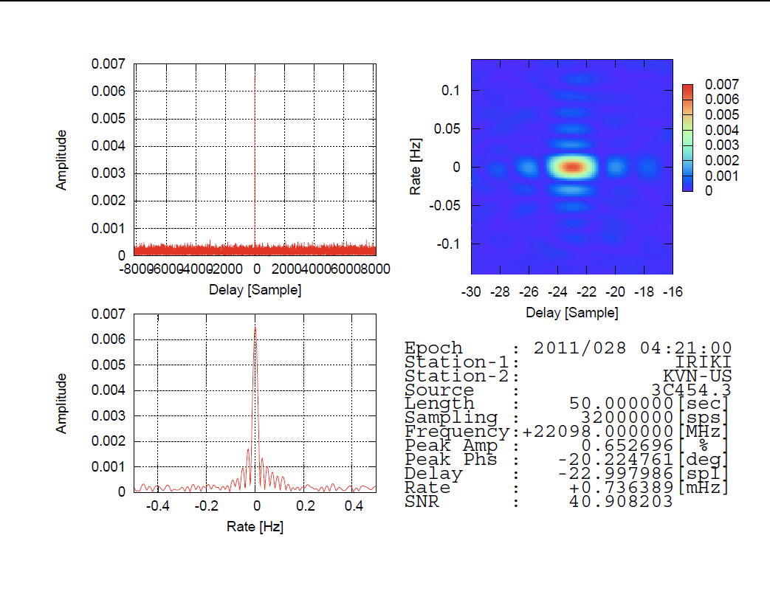
Fringe btw Iriki and Ulsan @2011 Jan

Slide 19
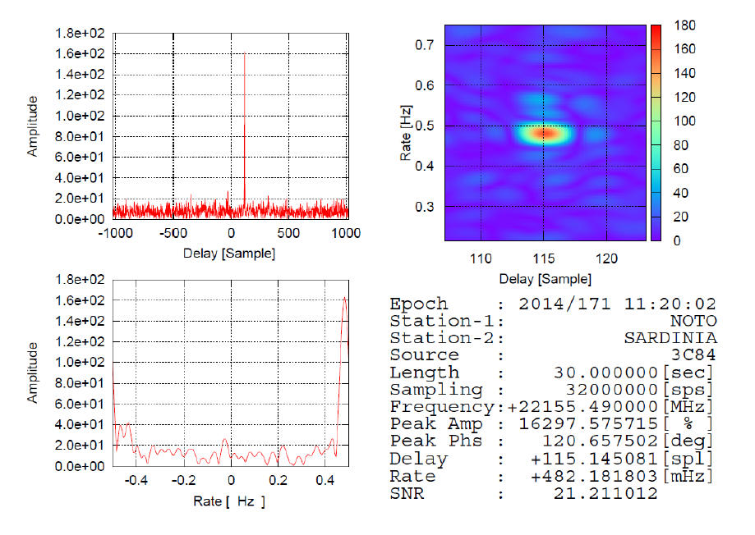
Fringe btw NOTO and SRT on Sep 2014

Slide 20
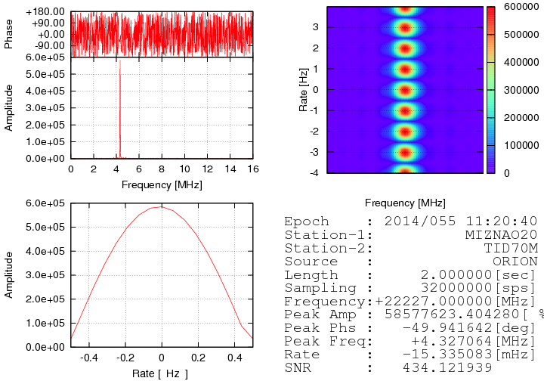
Fringe test observation between VERA-IRKI 20m and Tidbinbilla 70m
2014/2/23 Orion-KL
Date : 2014/2/23
Antenna : Tidbinbilla 70m
VERA-IRK 20m
Target : Orion-KL
Recorder: OCTADISK2@VERA
Mark5C@Tidbinbilla
Recording rate: 1Gbps
Correlator: OCTACOR2
(software correlator)
Because of using the VDIF format ,
so it is easy to correlate the date from different recorders.
VERA IRIKI 20m-Tidbinbilla 70m
Notes:
This is a exmple of using octav-das system and other system. This test observation were conducted by hagiwara-san and horiuchi-san@Tidbinbilla.

Slide 21
Summary
Everything has been prepared!
Try to do fringe check and scientific observations btw Italy, Korea, Japan and world (hagiwara-san talked)
Effort of conducting vlbi observations are very important for making real good community, because various field astronomers and engineers need to setup, discuss, analyze, re-setup,re-discuss and re-analyze, like as KaVA.
(Japanese adage “同じ釜の飯を喰う” ＝ eating same food (even bad taste, burnt, good taste, )

