Slide 1
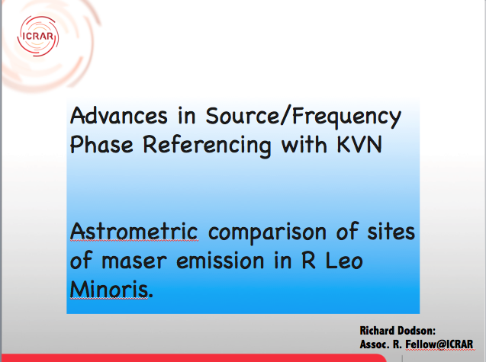
KVN
Advances in Source/Frequency Phase Referencing with KVN
Astrometric comparison of sites of maser emission in R Leo Minoris.
Richard Dodson:
Brain Pool Fellow@KASI

Slide 2

KVN observations of R Leo Min.
Largely covered in paper on R Leo Minoris, where we observed R LMi in H2O and SiO v=1,2 J=1-0 with 4C39.25 as phase reference calibrator. Dodson et al, AJ, 2014, in press
Summary:
SiO and H2O masers around AGB stars
What Astrometry of these will tell us
Difficulties of Astrometry at high frequencies
Review the Source Frequency Phase Ref. Method
Stress differences for SFPR between line and cont.
R LMi astrometric images in H2O and SiO
KVN

Slide 3
SiO masers around AGB Stars
SiO masers have high excitation energy, so form close to star
Pumping mechanism a matter of vigorous debate.
Radiative (Bujarrabal 1994).
SiO masers are pumped by 8 µm stellar radiation.
Requires: a thin shell emitting region and/or radialstrong accelerations
Explains: SiO rings (tangential amplif.)
Linear Pol
Correlation of SiO and IR fluxes
KVN

Slide 4
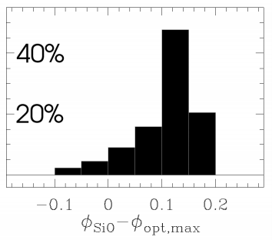
SiO masers around AGB Stars
SiO masers have high excitation energy, so form close to star
Pumping mechanism a matter of vigorous debate.
Collisional (Humphreys et al. 2002). SiOmasers are pumped by collisions with H2, and shocksinduced by the stellar pulsation.
Explains: SiO rings (tangential amplif.)
Linear Pol
Requires: very high (100km/s) propagation speeds
to achieve the SiO/Optical Phases
KVN

Slide 5


A rant about astrometric comparisons
If you compare two images without astrometric registration you are speculating ...
You have not proved anything
You might be right -- but equally you might be wrong
KVN

Slide 6


A rant about astrometric comparisons
If you compare two images without astrometric registration you are speculating ...
You have not proved anything
You might be right -- but equally you might be wrong
(Also true for cont. images)
So .. how do we do it correctly?
Phase Referencing
KVN

Slide 7
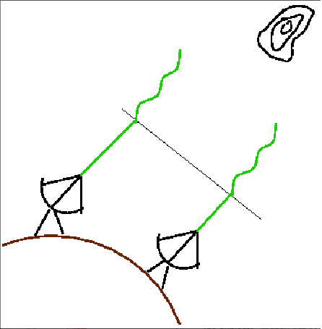
Phase Referencing
The default calibration in VLBI is Self Calibration
Calibrate the data using the large N inputs
to solve for the small M variables.
Requires: Strong Signals
Delivers: High dynamic range image, but position information lost
The alternative is Phase Referencing
Calibrate the data using the (selfcalibration) solutions from a nearby known source.
Ideal for: Weak sources and provides Astrometry
Conditions:
* Nearby strong point source
* 1.6GHz < ν < 43GHz
IONO TROPO
But Phase referencing at 43GHz is very hard
KVN
Notes:
Quick Intro to PR. If needed
PR has provided a huge increase in the useability of VLBI

Slide 8
Alternative Tropospheric Calibration for mm-VLBI
Conventional Phase referencing to a calibrator source
(requirements difficult to meet)
fast
43
43 GHz
Different
source
Multi-frequency: phase ref. to a lower frequency
Observe at lower band (e.g. 21.5 GHz)
Apply to higher band (e.g. 43 GHz)
fast
Same source
KVN
Notes:
But mm-VLBI phase referencing is really hard.
You have to switch very fast (and so) your calibrator needs to be very close. And they are not so many which are bright enough.
To my knowledge only 86GHz PR is P&R 2000 on the 1308+32 pair.
But for any source there is a source at 0 deg sep. So why not use the low freq to calibrate the high freq and switch rapidly between the freq?

Slide 9
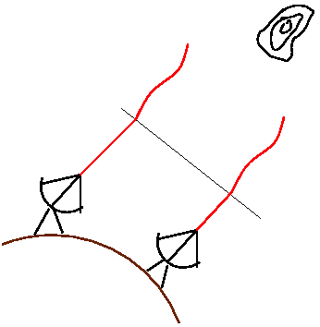
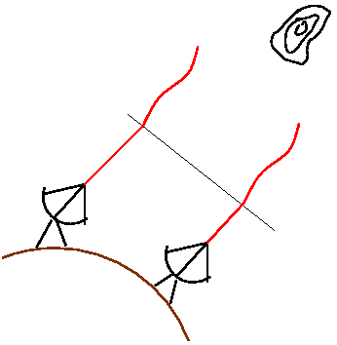
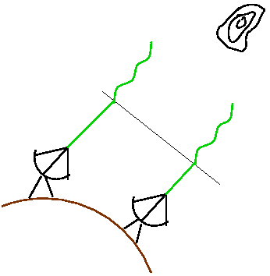
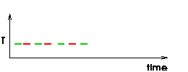
Basics of new method:
SOURCE/FREQ. phase referencing
Target
fast
slow
slow
X
X
φ_{Α} = φ _{A,GEO} + φ_{A,TRO} + φ_{A,ION} + φ_{A,STR +} 2πn_{A}
High:
φ_{Α} = φ _{A,GEO} + φ_{A,TRO} + φ_{A,ION} + φ_{A,STR +} 2πn_{A}
Low:
R∗φ_{Α} = R∗ (φ _{A,GEO} + φ_{A,TRO} + φ_{A,ION} + φ_{A,STR} + 2πn_{A})
High:
R = ν / ν
φ_{A,TRO} - R * φ_{A,TRO} = 0, Atmosphere errors cancel
φ_{A,XYZ} - R * φ_{A,XYZ} = 0, Antenna errors cancel
φ_{A,ION} - R * φ_{A,ION} = (R-1/R) ∗ φ_{A,ION}
…
slow
slow
φ_{Α}−R∗φ_{Α} = (φ_{Α,STR} + 2πν/c (D . θ_{A,shift})) + ΙΟΝ + ΙΝST
KVN
Frequency Phase Transfer
Notes:
Step 1 Freq Phase Transfer:
Phase in VLBI visibilities (high freq green) are made of multiple contributions:
Geometric, Tropospheric, Ionospheric, Instrumental, Structual + N2pi:
Some of these are fast some are slow:
The low freq (red) situation is the same: If we scale the low by the ratio: non-dispersive go to zero. Ionosp made LARGER (but start small): So phase residuals are Structure, Core shift and slow changing Iono and Inst.

Slide 10
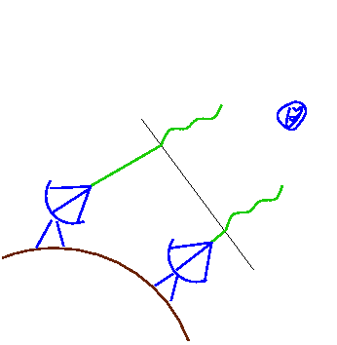
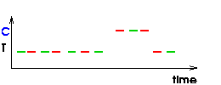
Basics of new method:
SOURCE/FREQ. phase referencing
KVN
Introduce a Second Source B
φ_{Β}−R∗φ_{Β} = 2πν/c (D . θ_{B,shift}) + ION + INST
Same as for A
Source/freq. referenced Visibility phase:
φ_{A,STR} + 2πν/c ∗ D (θ_{A,shift} - θ_{B,shift})
KVN
Notes:
Rather than SelfCalibrating. We can introduce a second source. With same proceedure we end up with residuals with Core-shift (Structure) and Iono and Inst.
Alternating between A and B allows us to separate out structure and combined core-shift.

Slide 11
Important points
“Perfect” Tropospheric calibration
→ increased coherence time (for weak sources)
Extends Phase Referencing to the Highest Frequencies
Calibrator can be much further away
Frequency agility crucial: VLBA (switching);
Much better to sim. observe than switch
as for KVN (& potentially others)
Direct Astrometric measurement, even
at the highest frequencies > 43 GHz
BUT assumed integer ratio between frequencies
KVN
Notes:
Summary points
Long Coherence Times = Sensitive obs.
PR at > 43GHz
Robust

Slide 12
SFPR for Masers lines:
Maser lines rarely have integer freq. ratios
(v=x, J=1-0 & J=2-1, etc do
but not H2O to SiO)
R∗φ_{Α} = R∗ (φ _{A,GEO} + φ_{A,TRO} + φ_{A,ION} + φ_{A,STR +} 2πn_{A})
If R not integer then R*2πn_{A} introduces phase jumps
Makes the astrometric calibration impossible.
(but phase stabilisation still works)
Unless n_{A} is carefully tracked
KVN

Slide 13
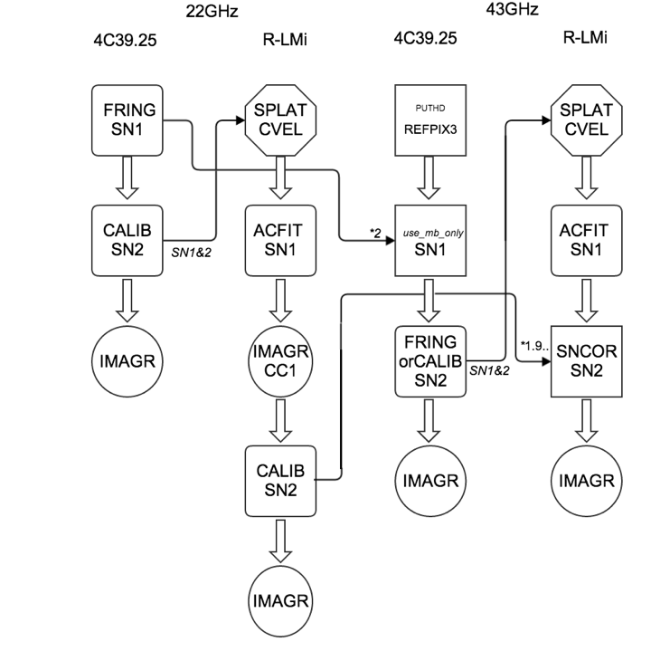













SFPR for Masers lines:
We have developed an approach which will
keep Δn_{A} zero
One (just) has to ensure that there are no phase ambiguities, that is the:
Antenna positions are good
Source positions are good
Una Selva Obscura
Don’t Panic
*1.9
We can do it
Geodesy
Line SFPR
Normal
phase referencing
FRING
Normal
Calibration
Normal
SFPR
line
SFPR
KVN
Notes:
Phase Referenced images from the KVN, referenced between 22 and 43 GHz (both SiO transitions)
redone with new (<5cm) positions

Slide 14
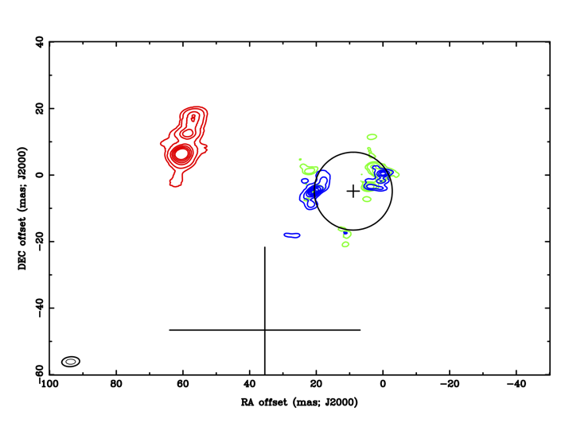



Astrometric comparison of maser emission in R Leo Minoris.
Transfer H20 maser
corrections to SiO data with scaling factors
VLBI Position
(with 1𝜎 PR errors)
SiO maser phase referenced to H2O maser.
Errors between:
SiO v=1 & 2 ~35μas
SiO & H2O ~ 2mas
Centre of SiO ~ 5mas
v=1 & 2: 1mas
Sep. H2O/SiO: 70mas
Ring Size: 20mas
Hipparcos Position
(with 1𝜎 PM errors)
KVN
Notes:
Resuits from AJ paper

Slide 15
Conclusions:
the Source Frequency Phase Ref. Method for line
sources is now understood.
Successful astrometric alignment of images
of H2O and v=1 & 2 SiO masers in R LMi with KVN
Absolute astrometric alignment to improve R LMi
proper motion measurement
Pumping model predictions for SiO in KVN bands can
be checked.
Astrometrical aligned images between H2O and SiO
H2O and CH3OH can be formed.
KVN

Slide 16
Multi-frequency Phase Referencing (MFPR):
KVN has capability to observe at 4 frequencies
Can we solve for all the atmospheric contributions?
  3 unknowns, 4 frequencies – should be possible
VLBA also has wide frequency range
  Can we fast-frequency switch in mm-band & add slow-frequency switch in cm-band to do this?
  Measure static ionospheric contributions; new
    version of geodetic blocks?
KVN

Slide 17
Can we go further?
Multi-Freq phase referencing
Freq 1 (22GHz) φ_{Α} = φ _{A,GEO} + φ_{A,TRO} + φ_{A,ION} + φ_{A,STR +} 2πn_{A}
Freq 2 (43GHz) φ_{Α} = φ _{A,GEO} + φ_{A,TRO} + φ_{A,ION} + φ_{A,STR +} 2πn_{A}
Freq 3 (86GHz) φ_{Α} = φ _{A,GEO} + φ_{A,TRO} + φ_{A,ION} + φ_{A,STR +} 2πn_{A}
Freq 4 (129GHz) φ_{Α} = φ _{A,GEO} + φ_{A,TRO} + φ_{A,ION} + φ_{A,STR +} 2πn_{A}
FPT₁₂ =(2-1/2)*φ_{A,ION}
Assuming Inst. Cal done
& no structure phase
FPT₁₃ =(4-1/4)*φ_{A,ION}
FPT₂₃ =(2-1/2)*φ_{A,ION}
FPT₂₃ =(2-1/2)*(φ_{A,ION} /2)
FPT₂₄ =(3-1/3) *φ_{A,ION}
FPT₂₄ =(3-1/3) *(φ_{A,ION} /2)
KVN

Slide 18
Can we go further?
Multi-Freq phase referencing
Freq 1 (22GHz) φ_{Α} = φ _{A,GEO} + φ_{A,TRO} + φ_{A,ION} + φ_{A,STR +} 2πn_{A}
Freq 2 (43GHz) φ_{Α} = φ _{A,GEO} + φ_{A,TRO} + φ_{A,ION} + φ_{A,STR +} 2πn_{A}
Freq 3 (86GHz) φ_{Α} = φ _{A,GEO} + φ_{A,TRO} + φ_{A,ION} + φ_{A,STR +} 2πn_{A}
Freq 4 (129GHz) φ_{Α} = φ _{A,GEO} + φ_{A,TRO} + φ_{A,ION} + φ_{A,STR +} 2πn_{A}
Expected Ratios:
FPT₁₂ =(2-1/2)*φ_{A,ION}
Ref Target | FPT₁₂ | FPT₁₃ | FPT₂₃ | FPT₂₄
FPT₁₃ | 2.5 | 1 | - | -
FPT₂₃ | 0.5 | 0.8 | 1 | -
FPT₂₄ | 0.9 | 0.7 | 1.8 | 1
FPT₁₃ =(4-1/4)*φ_{A,ION}
FPT₂₃ =(2-1/2)*(φ_{A,ION} /2)
FPT₂₄ =(3-1/3) *(φ_{A,ION} /2)
KVN

Slide 19
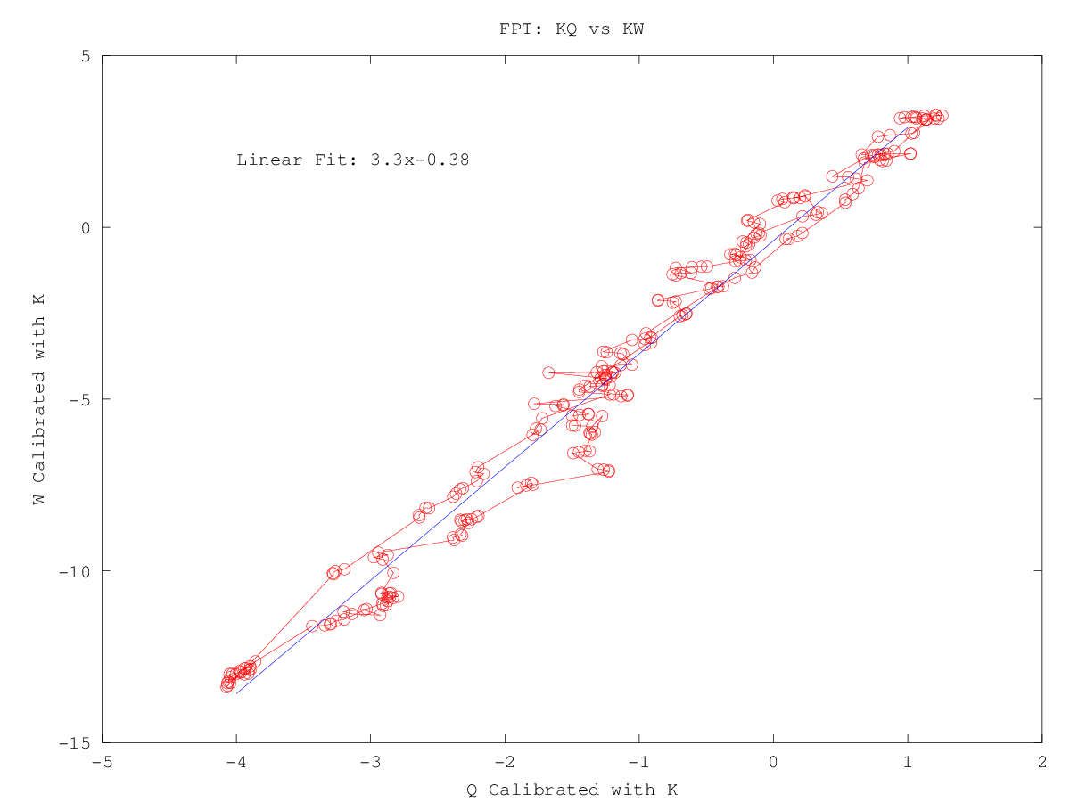
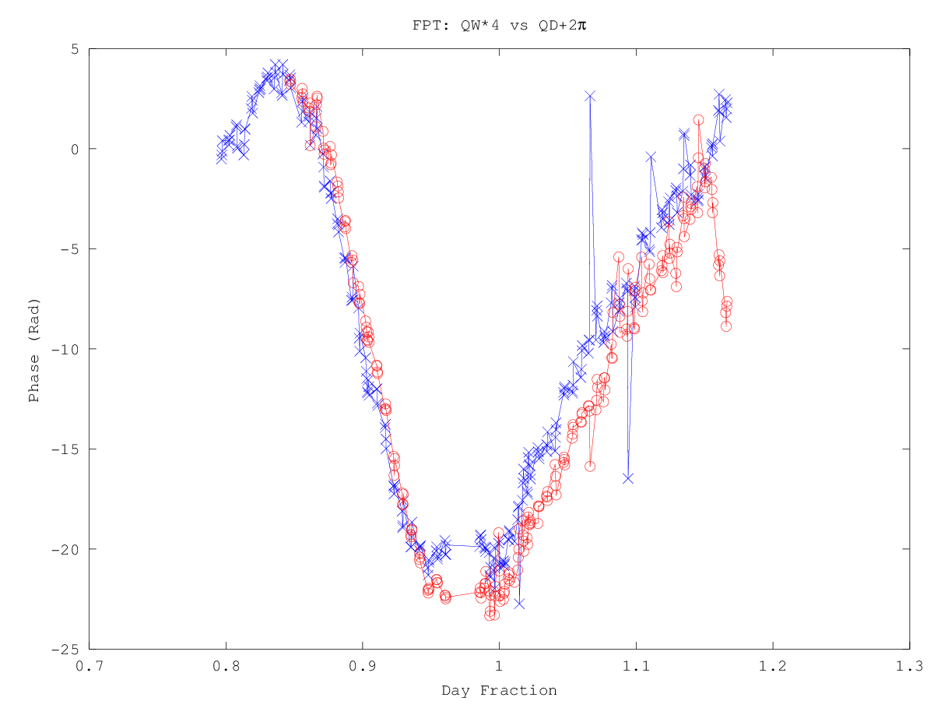
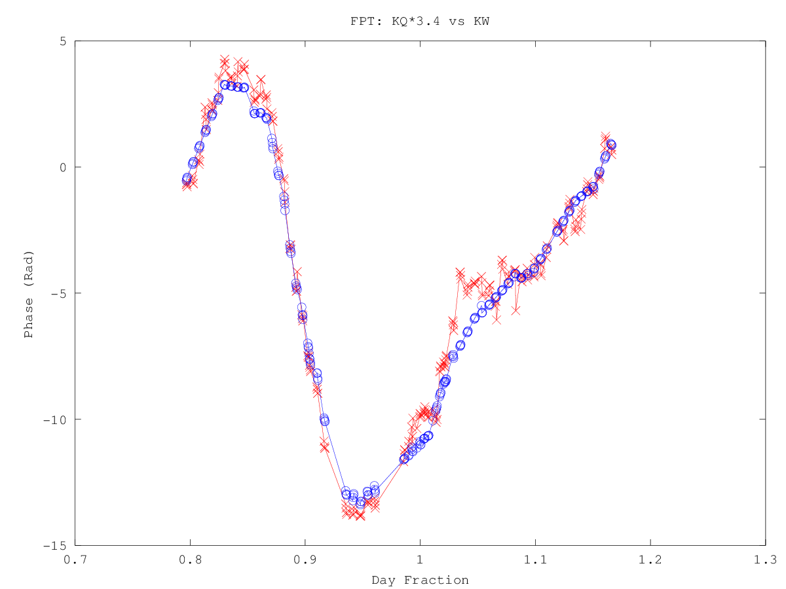
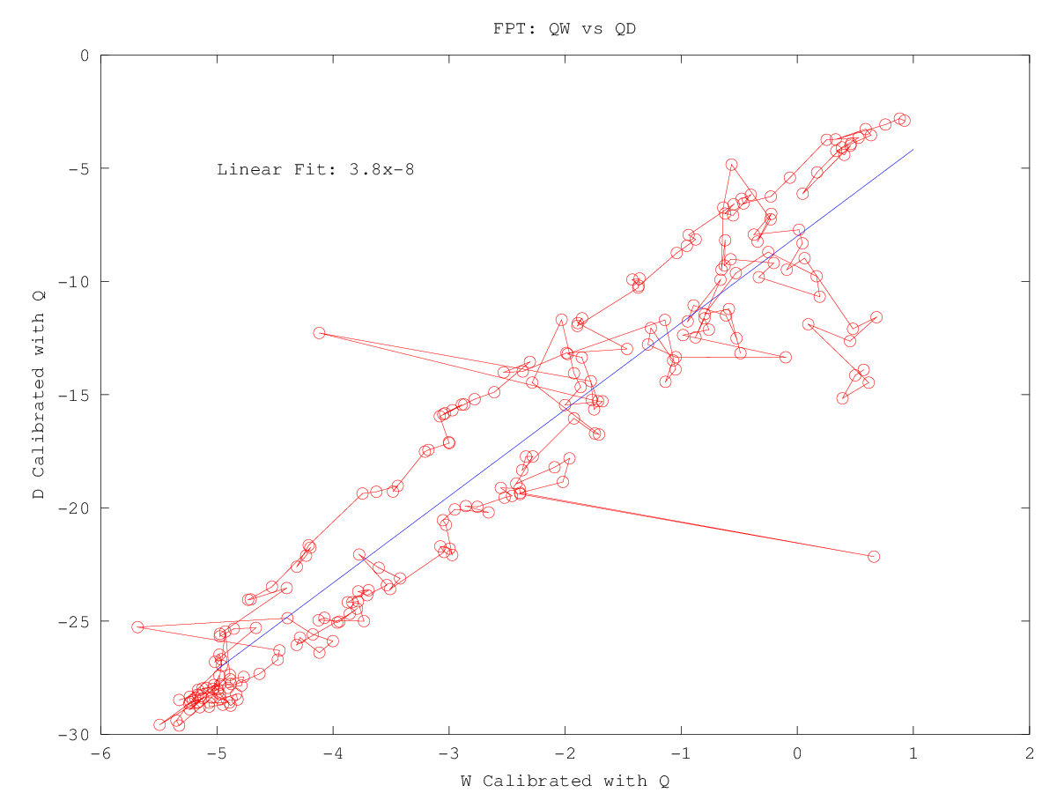
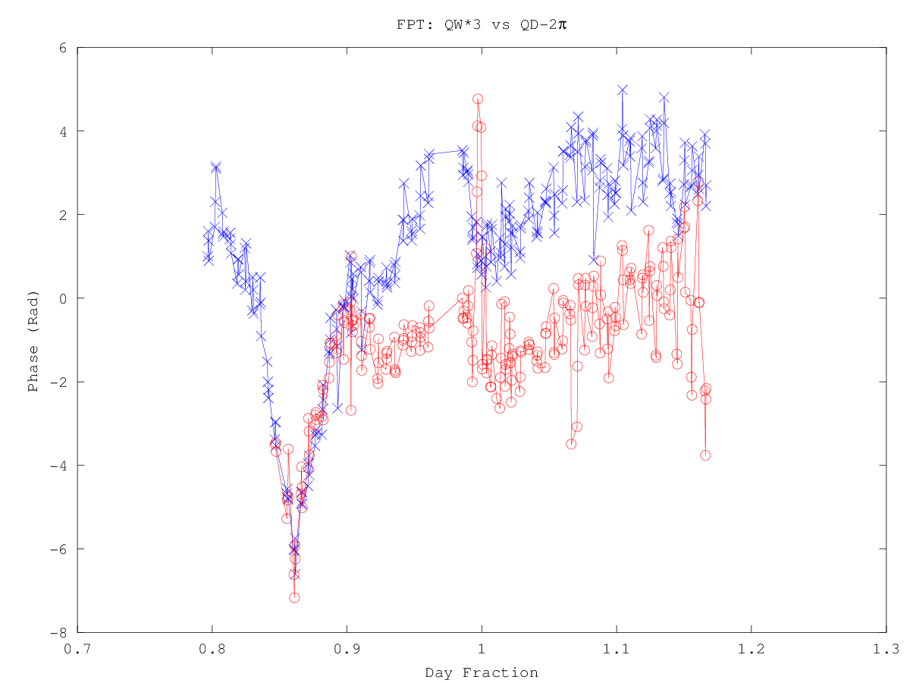
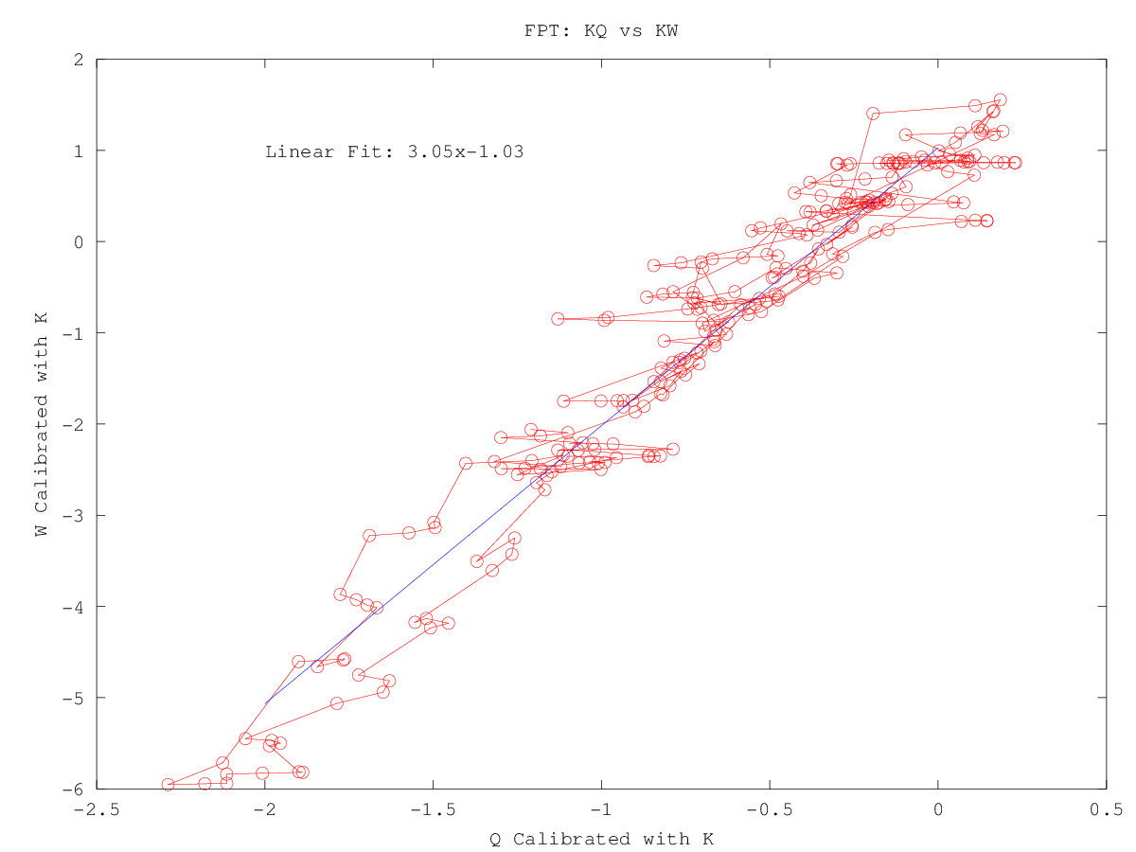
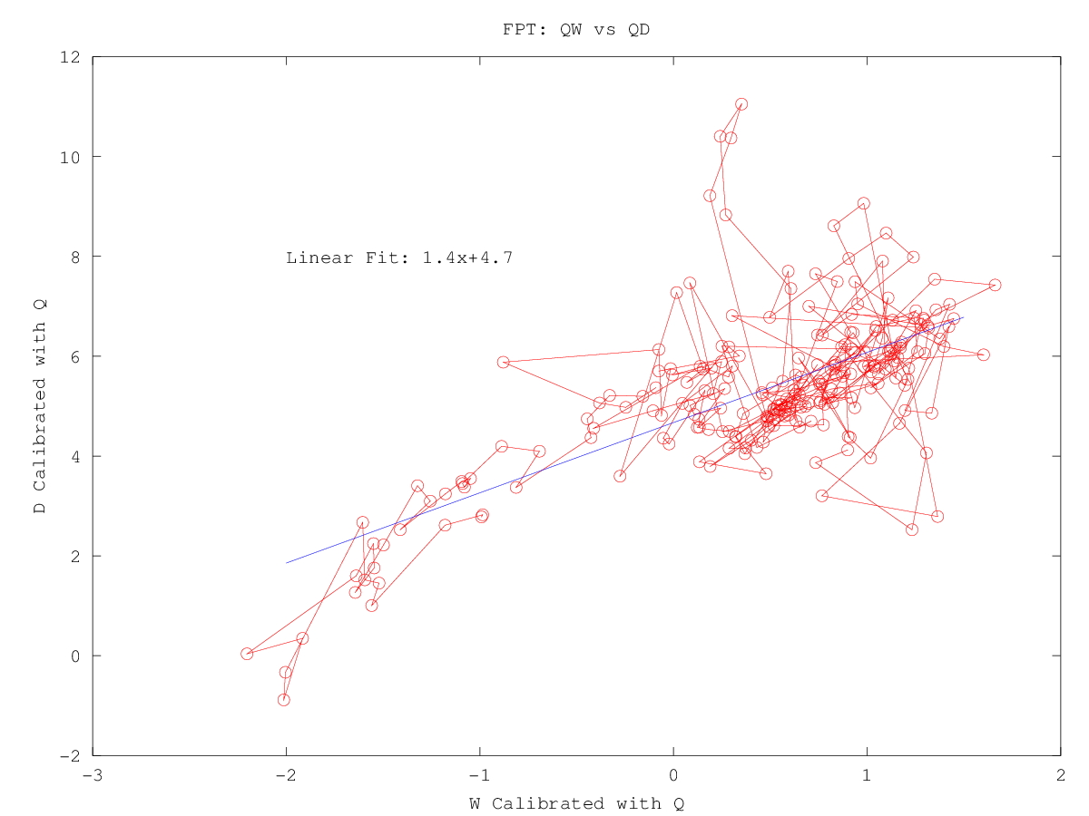
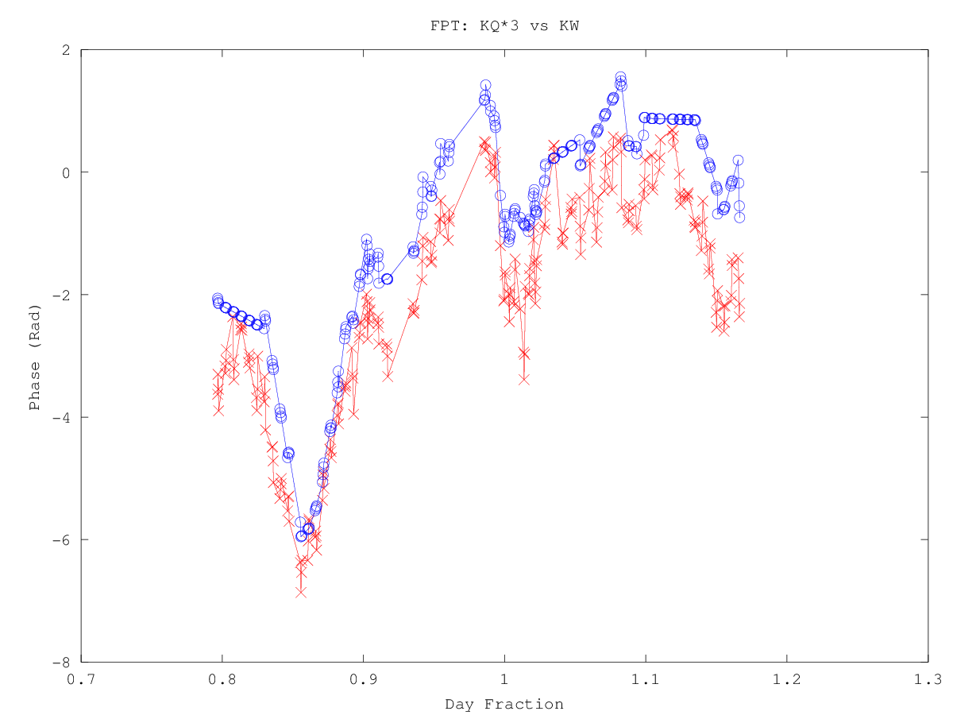
Can we go further?
Multi-Freq phase referencing
KVN

Slide 20
Can we go further?
Multi-Freq phase referencing
Expected Ratios:
Found Ratios:
Ref Target | FPT₁₂ | FPT₁₃ | FPT₂₃ | FPT₂₄
FPT₁₃ | 2.5 | 1 | - | -
FPT₂₃ | 0.5 | 0.8 | 1 | -
FPT₂₄ | 0.9 | 0.7 | 1.8 | 1
Ref Target | FPT₁₂ | FPT₁₃ | FPT₂₃ | FPT₂₄
FPT₁₃ | 3-3.3 | 1 | - | -
FPT₂₃ | 2-1 | ~1-2 | 1 | -
FPT₂₄ | ? | ~2-3 | 1.4-3.8 | 1
KVN

Slide 21
Non-Conclusions:
the Multi-Frequency Phase Ref. Method needs more work before it is understood.
Looks like that these are not ionospheric residuals
  In which case our approach will not succeed.
Could these be instrumental residuals?
  If so perhaps these can be measured independently and removed, revealing the expected behaviour?
KVN

