Slide 1
Super-resolution imaging with Sparse Modeling
Mareki Honma (NAOJ)
Kazu Akiyama(U. Tokyo)
Makoto Uemura (Hiroshima U.)
Shiro Ikeda (Institute of Statistical Mathematics)

Slide 2
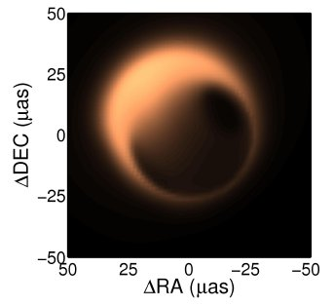
Motivation
For BH study, we need high resolution.
Higher is better.
(the main motivation for going to mm/sub-mm)
If there is an imaging technique to obtain resolution better than the beam size (Θ～λ/D), this would significantly boost the imaging capability of EHT.
Super-resolution technique is equivalent to building a larger array !!

Slide 3
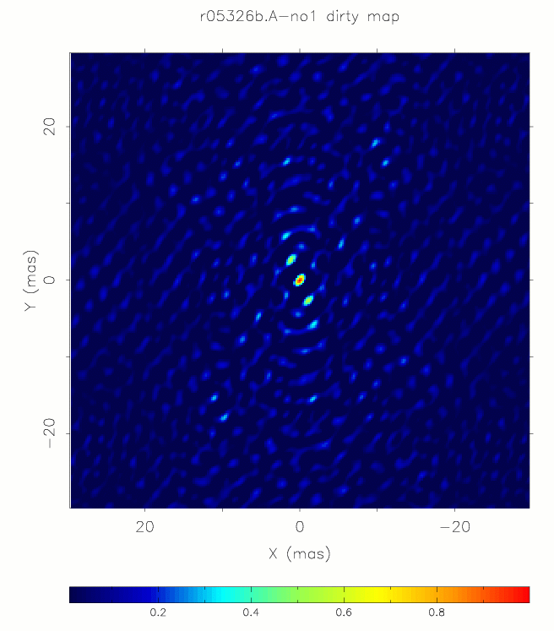
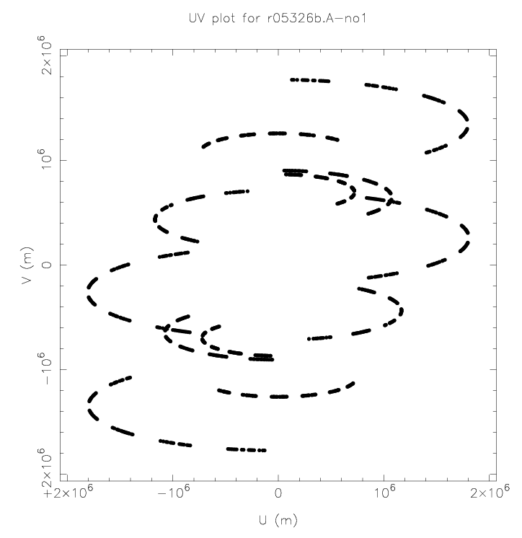
Interferometry imaging
Discrete Fourier transform of 2-D grid data
Limited (u, v) coverage needs 0 padding of grids
As a result, there will be finite-size beam and side lobes
beam size Θ ～ λ / B (λ：wavelength, B：baseline length)
Image I (x,y)
Visibility S(u,v)
N² points
2-D FT

Slide 4
Standard imaging: FFT with 0-filling
V₁ I₁
V₂ I₂
V₃ = x I₃
… …
V_{M} …
0 …
0 I_{N}
A
Observed data
0-fill
0-filling is done to equalize the number of equations and solutions

Slide 5
Imaging with sparse modeling
V₁ I₁
V₂ I₂
V₃ = x I₃
… …
V_{M} …
…
I_{N}
A
Observed data
(with l1-norm penalty)
Sparse modeling can solve such an under-determined problem, only if the solution is sparse.
i.e., select most sparse solution among infinite number of possible solutions
Free from side-lobes, free from the synthesized beam (in theory)

Slide 6
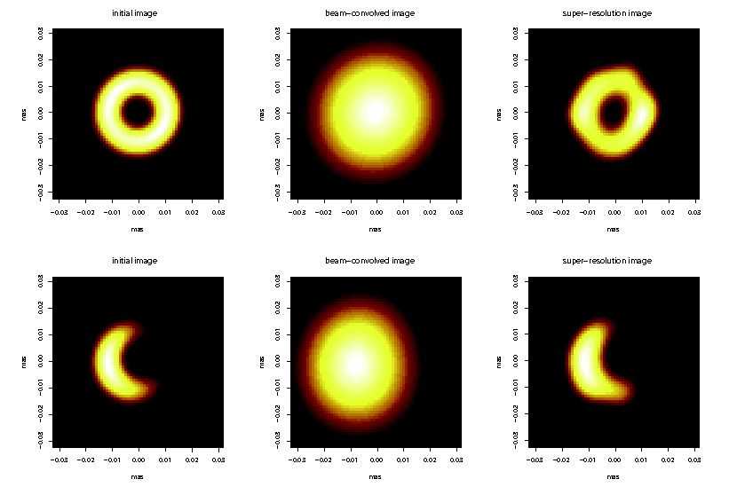
Simulation
Simulated 6-station EHT observations of M87 (with noise)
Initial model Standard image Sparse modeling
Honma et al.(2014), PASJ in press, arXiv 1407.2422

Slide 7
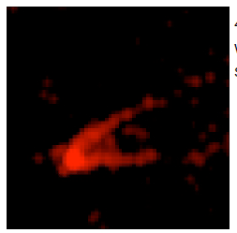
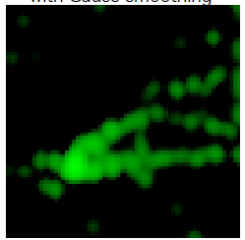
Application to real data: M87
Not EHT, but VLBA at 22G/43G (Hada et al.11)
Preliminary
Results !
Standard imaging
(Hada + 2011)
Sparse modeling
43GHz 4x4 mas
Sparse modeling
24GHz 4x4 mas
Jet’s limb structure is clearly seen toward the core.
Counter-jet is also resolved !

Slide 8
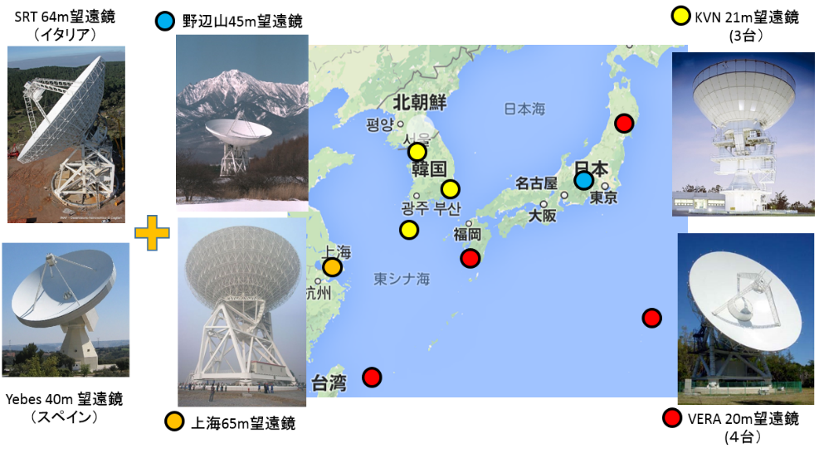
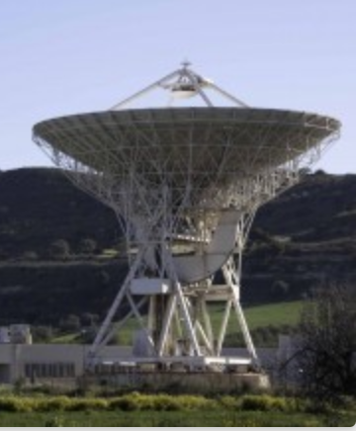
Concluding remarks
Introduction of sparse modeling allow us to obtain super-resolution images and to boost imaging capability
Application to the M87 data seems that the technique is promising, and hopefully make significant contribution to understand the event-horizon-scale structure in the AGNs.
Great if we can apply this to high-sensitive data such as EATING VLBI
SRT
Noto
Yebes

