Slide 1
Meeting summary
Mareki Honma (NAOJ)
On behalf of EATING VLBI collaboration

Slide 2
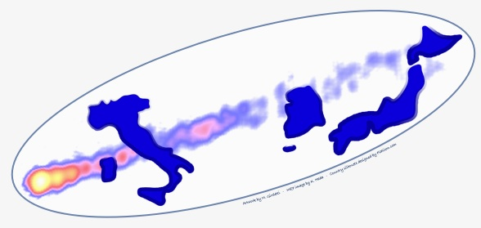
Session 1 - National reviews
Giroletti VLBI in Italy
Hagiwara VLBI in Japan and East Asia
Sohn VLBI in Korea
Three countries are all active in VLBI.
Particularly great is the inauguration of SRT and start of Italian VLBI !

Slide 3
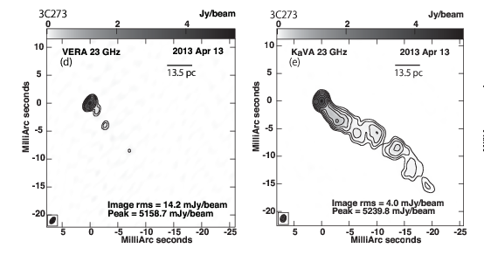
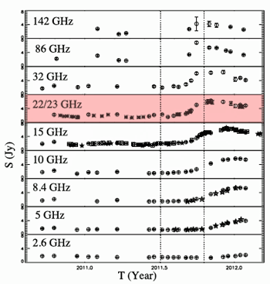
Session 2 - Results from ongoing collaboration (first part)
Hada M87
Niinuma KaVA Imaging
Kino KaVA AGN Key Science
Orienti 1510-08, 3C454.3
Sasada Photopolarimetry of Blazar bursts
VERA
KaVA

Slide 4
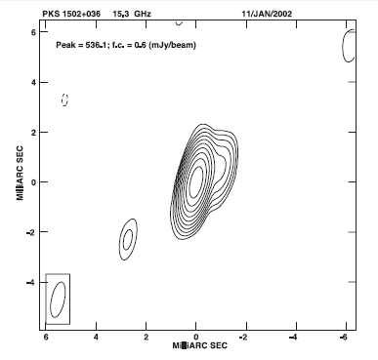
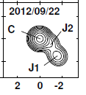
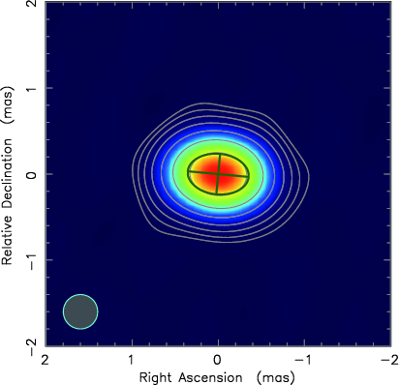
Session 4 - Results from ongoing collaboration (second part)
D'Ammando Narrow Line Seyfert 1s
Koyama new component in Mrk 501
Sawada-Satoh VERA/GENJI monitor of OJ 287
Zhao KaVA Sgr A*

Slide 5
Findings/Lessons
AGNs are exciting targets for EATING VLBI
Imaging matters
combination of I-J-K arrays should be promising
need to look at the source at multi-scale (core-to-jet)
Monitoring matters
Having our own array/telescope is important !
More information is certainly better
multi-λ observations (radio-IR-opt-X-Gamma)
Polarization also seems the key for understanding jets

Slide 6
Session 3 - Presentations from junior researchers
Casadio 3C120 jet monitor (MOJAVE)
Chida 3C84 (VERA/GENJI)
Fujinaga survey of unidentified Fermi sources
Kim AGN jets with KVN and KaVA
Lico Markarian 421 broadband campaign
Nakahara M84 nucleus with VERA
Sakai Sgr D proper motion

Slide 7
Findings/Lessons
We have excellent students,
and so bright future !
Let’s encourage them, and support them !!
and make them work hard(er) !!!

Slide 8
Session 5 - Joint observations: status and plans
Jung Multi-Frequency AGN obs. with KVN
Orfei Multifeed systems for VLBI from 18 to 100GHz
Stagni Italian VLBI network
Oyama DAS and Correlator System in Japan
Hagiwara Planning Italy-Japan observations

Slide 9
Findings/Lessons
Fringes detected with Italian VLBI: Excellent !
Fringes from EATING VLBI: soon to come !!
All of I/J/K also work on the multi-frequency capability
Better to collaborate coherently !
Also important is the science case discussion

Slide 10
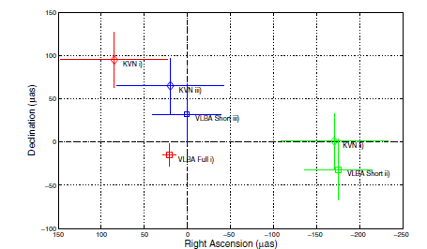
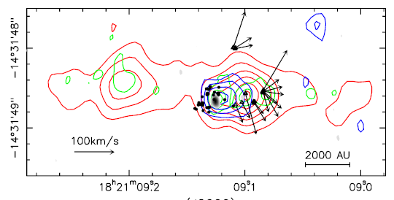
Session 6 - Science results of mutual interests
Rioja Astrometric Continuum Obs. with KVN
Dodson Spectral-line Source-frequency Phase Referencing
Mantovani Faint blazars for KVN/KaVA obs.
Hirota Star-forming regions with VERA and beyond
Moscadelli Outflow in high-mass protostars

Slide 11
Findings/Lessons
Broader science cases with EATING VLBI
Source-frequency phase-referencing
new technique for AGN and maser astrometry
Multi-λ study
blazars, AGB stars, SFR masers, and more

Slide 12

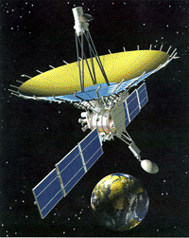


Session 7 - Towards the future
Giovannini SKA
Gómez AGN jets/magnetic fields with RadioAstron
Nagai Kpc-scale Jet Emission with ALMA
Casasola AGN fueling with ALMA
Honma Super-resolution imaging

Slide 13
Findings/Lessons
A lot of synergies between EATING VLBI and other on-going/future projects:
ALMA, EHT
RadioAstron
SKA
and more

Slide 14
Progress since the last meeting
Number of talks
31 in 2012 -> 35 in 2014
Participating countries
Italia, Japan, Korea -> I, J, K + Spain, Germany, Australia
Important milestones done since 2012
Italia inauguration of SRT
start of test obs. of Italian VLBI
Korea Multi-freq. fringes including 129G!
K and J Start of regular KaVA operation

Slide 15
Progress since the last meeting
Real outputs through collaboration (published after the last meeting)
Blasi+(2013)
Orienti+ (2013)
D’ammando+ (2013)
Foschini+(2012)
Hada+ (2012, 2013a, 2013b, 2014)
Kino+(2013)
Nagai+ (2013, 2014)
c.f. collaborative papers between 2010-2012
Bontempi+(2012), Lico+(2012), Giroletti+(2011,12),
Suzuki+(12), Nagai+(12)

Slide 16
Prospect for next meeting
Next one probably in 2016 (Question: where ?)
With more milestones
First fringe from EATING VLBI
First map from EATING VLBI
More activity from younger generation, with new PhDs like Rocco, Kazunori, …
And, more results from all the collaborators !!
Next meeting should be very exciting one !

Slide 17
Thank you !
Keep collaboration, Keep EATING !
喰

