Slide 1


Status of MKSP
LOFAR Observations
Andreas Horneffer

Slide 2
Contents
Where we are
  Old observations
  Cycle-0 observations
Open Issues
  My list of Milestones
Cycle-0 and Cycle-1 Observations

Slide 3
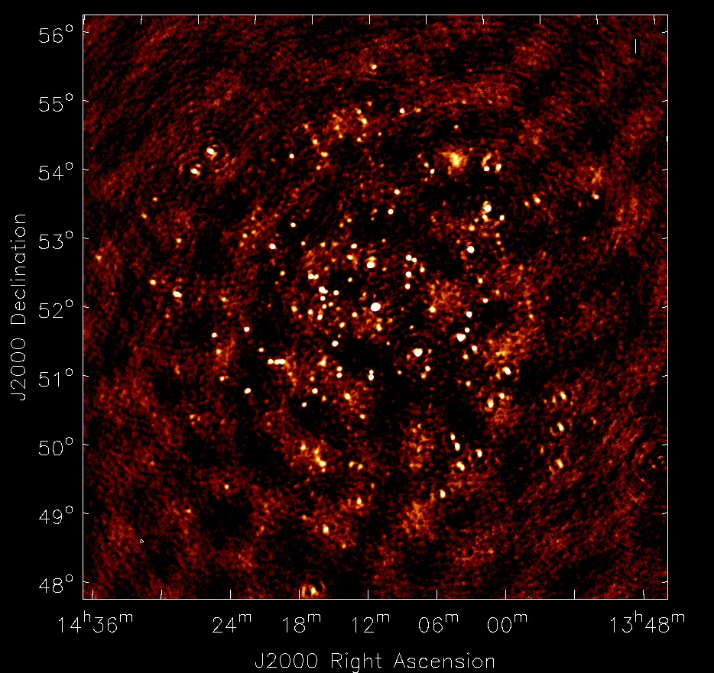
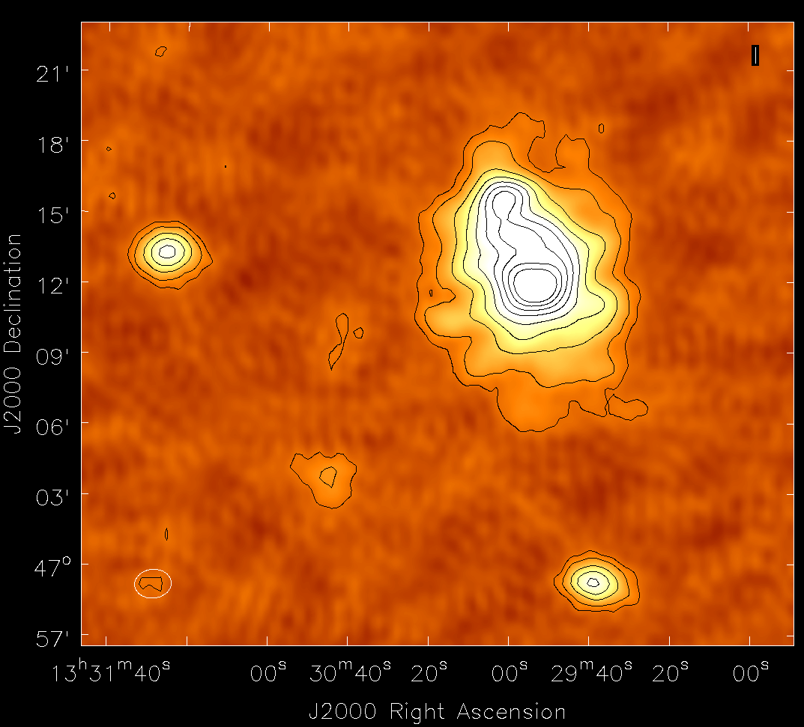
M51
Early Image
3C295 field
M51 closeup
M101
M51 with 3C295 as calibrator
Observed to test calibration interpolation and study M51
D. Mulcahy

Slide 4
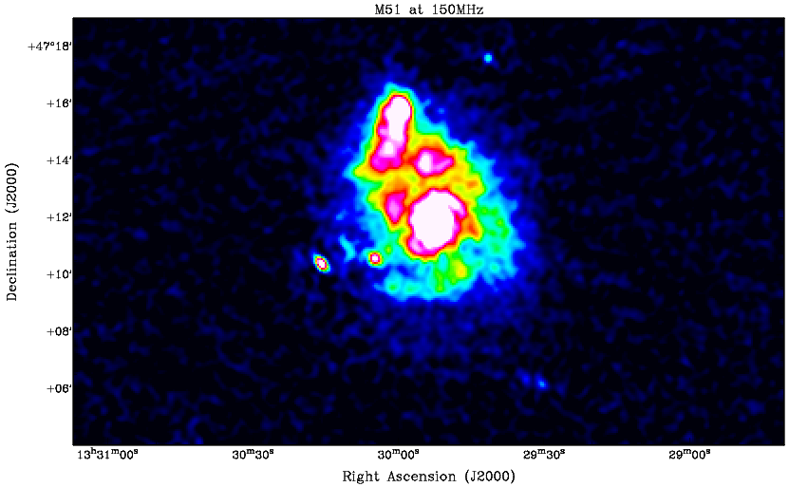
M51
Better Image
After ca. 9 months of work
D. Mulcahy

Slide 5
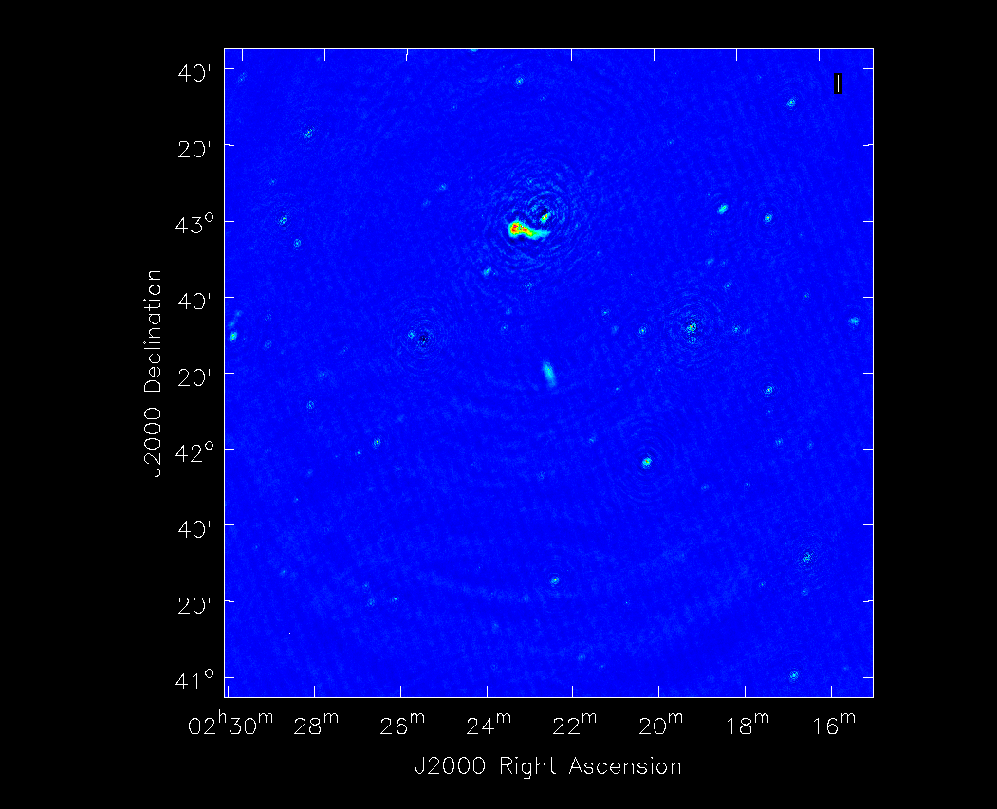
NGC891
1 subband, basic calibration
selfcal-bias source held for a real transient

Slide 6
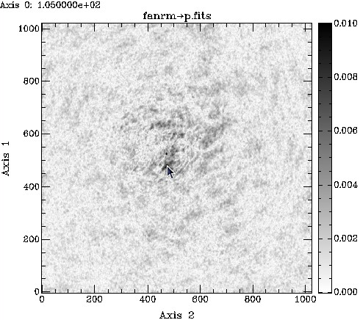
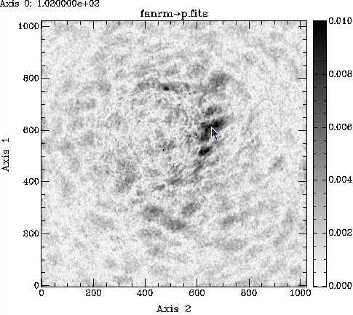
Fan Region
FD = -5 rad/m/m
FD = -2 rad/m/m
M. Haverkorn, M. Iacobelli

Slide 7
Double Double B1835+620
M. Orru

Slide 8
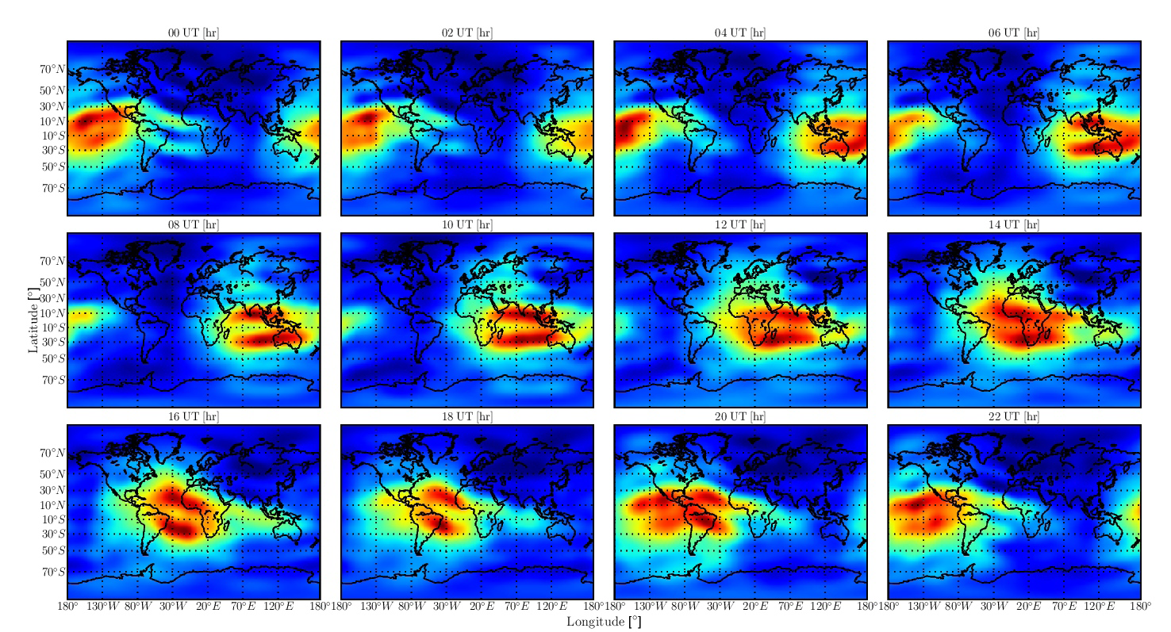
Ionospheric Faraday Rotation
The Ionosphere introduces Faraday rotation
This adds an unknown to RM measurements
Ionospheric changes during a multi-hour observation rotates the position angle of polarization
  This needs to be corrected before integration.

Slide 9
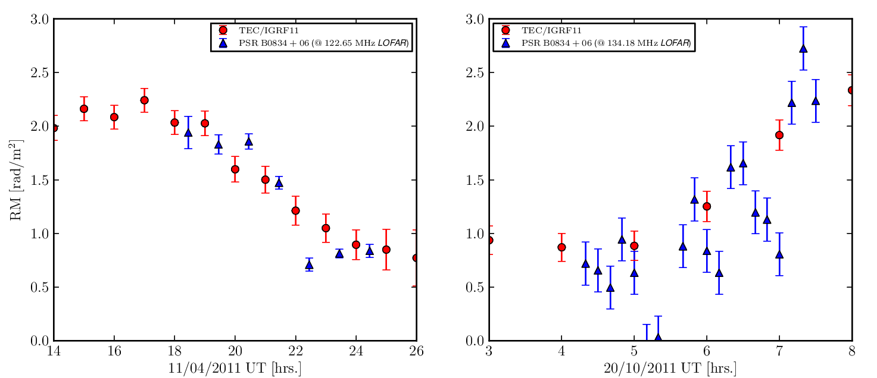
Prediction of Ionospheric RM from GPS data
C. Sobey and C. Sotomayor
Comparison of Ionospheric RM prediction (red) and pulsar data (blue).
Ionospheric RM prediction can be included in BBS

Slide 10
IC342
C. van Eck
Cycle-0 regular observation data
1 Subband, basic calibration

Slide 11
Open Issues
List of Milestones:
Normal Imaging
Long integrations of polarization
  Multi-hour observations
RM Cubes with absolute FD
  Multi-Epoch observations
High Resolution in FD
Low instrumental Polarization
High angular resolution

Slide 12
Milestone 0: Normal Imaging
Need to calibrate data:
  Station clocks
  Ionospheric delay
  Station gains (incl. dipole gains)
Selfcal needs good model of the sky to work
  Have a good sky model from e.g. MSSS
  Transfer solutions from a second beam on a calibrator.
  Be careful when using e.g. gsm.py skymodel!
Demixing, sagecal, BBS must not corrupt polarization information.
Still several Features missing in the software

Slide 13
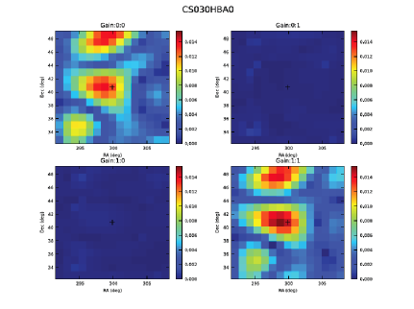
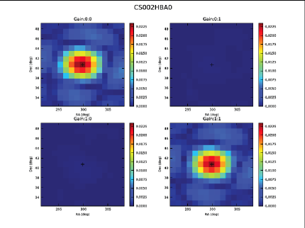
5ns Problem Solved
LOFAR had a major hardware issue last year
  “5 ns” issue
This has been solved with new hardware

Slide 14
Milestone 1:
Long Integrations
Needs Conversion between visibilities and Stokes parameters done correctly
  correct beam model
  -> test it with pulsar and all sky data
Needs the ability to correct for changes in the ionospheric RM
  calibrate on pulsars or with GPS based corrections
  -> GPS based corrections alone are not good enough.

Slide 15
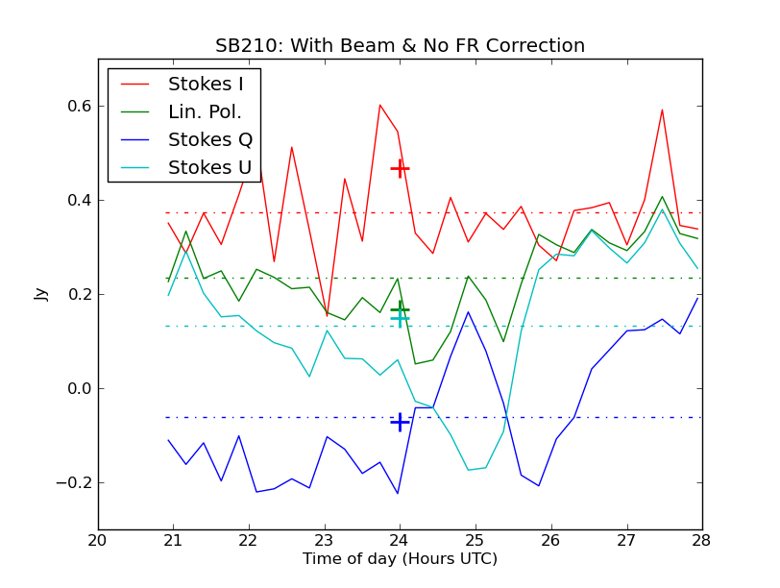
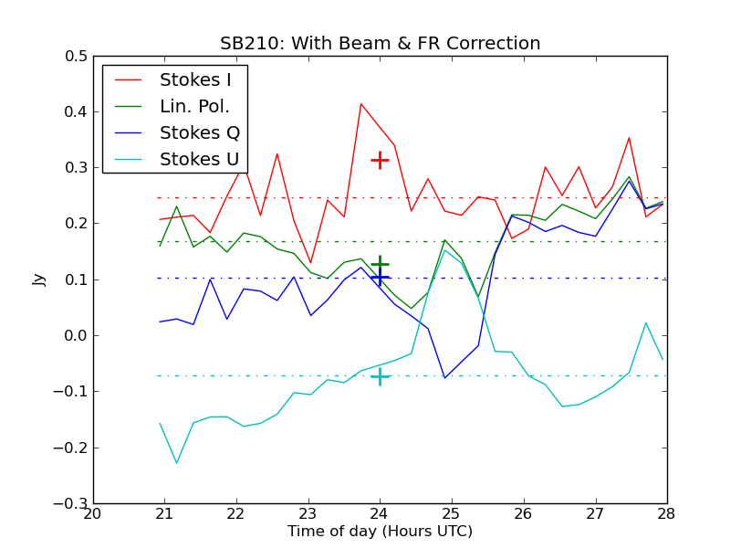
Ionospheric RM Correction

Slide 16
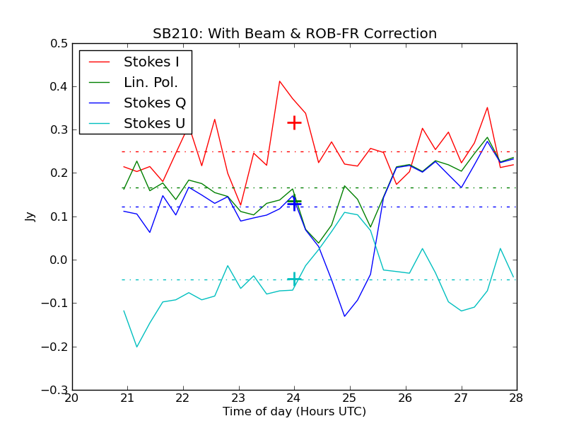
Ionospheric RM Correction

Slide 17
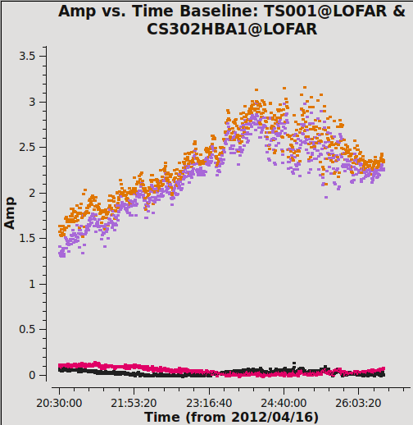
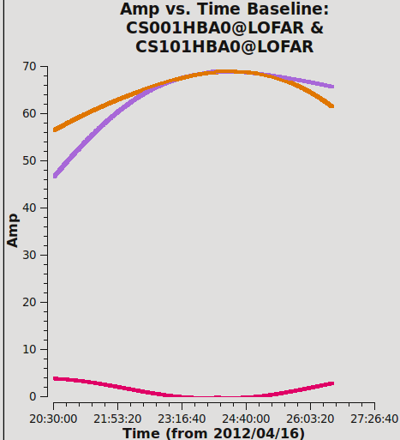
Beam Model Test
3C295 Data
Left: data Right: simulation
The LOFAR beam model is needed for two steps:
  to compute the station beam, e.g. for calibration transfer or source subtraction
  to convert from Stokes parameters to visibilities or vice versa

Slide 18
Milestone 2:
RM Cubes with absolute FD
Needed for multi-epoch observations
Needs at least one calibrator with known absolute RM
  Get it from studies of measured RM and e.g. ionospheric RM from GPS
  Connect the position angle of a source (a blazar?) to higher frequencies.
  “Assign” a RM to a calibrator and use it as reference
Propagate absolute RM to all calibrators

Slide 19
Milestone 3:
High Resolution in FD
Needs wide frequency coverage
-> 8-bite mode works!
Multi-epoch observations for HBA low and high?
Use the low-band?
  Probably not…

Slide 20
Milestone 4:
Low Instrumental Polarization
Good understanding of the instrument
For the time being: flag out parts at RM ≈ 0

Slide 21
Milestone 5:
High Angular Resolution
Needs us able to deal with long baselines.
Made a start at the long-baseline BW
Rely on the long baseline working group for the time being.

Slide 22
LOFAR Cycle 0
Regular Cycle 0 observations started December 2012
Originally planned till end of August 2013
Extended till 14. November 2013
  (To implement and test the new correlator.)
The nearby galaxies proposal got granted:
  112 hours observing time
  213 hours computing time
We asked for more time due to the extension

Slide 23
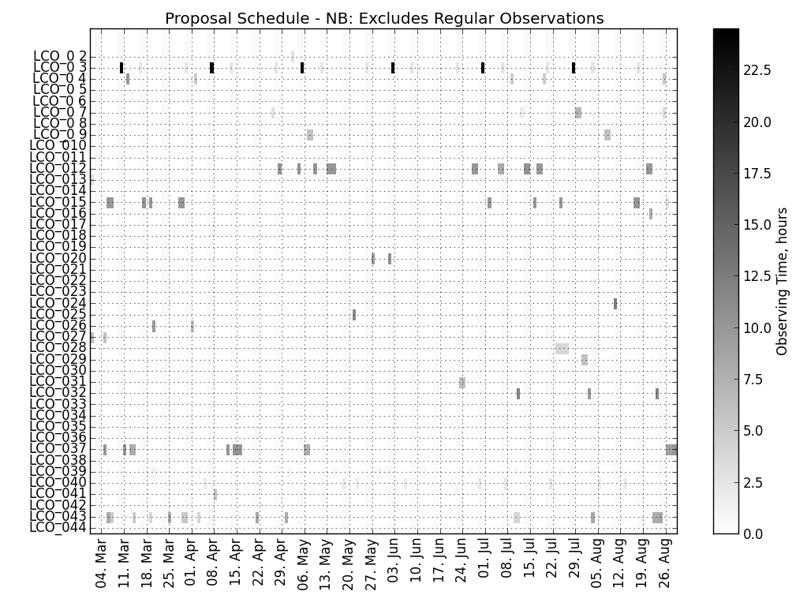
LC0 Scheduling
March - August

Slide 24
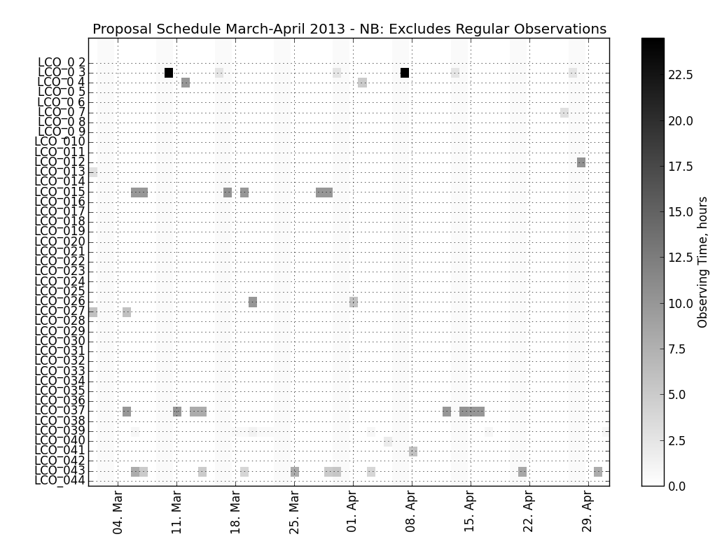
LC0 Scheduling
March – April

Slide 25
MKSP Clycle-0:
Nearby Galaxies

Slide 26
Cycle-0 Processing/Analysis
Quite a bit of the MKSP Cycle-0 data is currently only archived, but not looked at.
The problems are manpower and processing capabilities
  Processing (data storage) at CEP-1 only guaranteed for 4 weeks.
  Processing at other places (e.g. Bonn Juelich) possible but cumbersome.
For new observations: include manpower and processing in your plans from the beginning.

Slide 27
LOFAR Cycle 1
Next observing cycle for LOFAR
Planned to run for 6 months
Call for Proposals planned for end of May
Deadline: end of August
Start of observations: 15. November

Slide 28
Summary
LOFAR is reliably taking science data
  Still a lot of manual work but getting better
Data quality has improved
Still many features missing in the software.
Calibration quality is continuously improving
  Quick image with basic calibration can be made by the RO
  Good (state of the art) images take about 9-12 months dedicated work
There is new data available
Polarization calibration needs still more work, but I’m still confident that we’ll manage it with time.

Slide 29
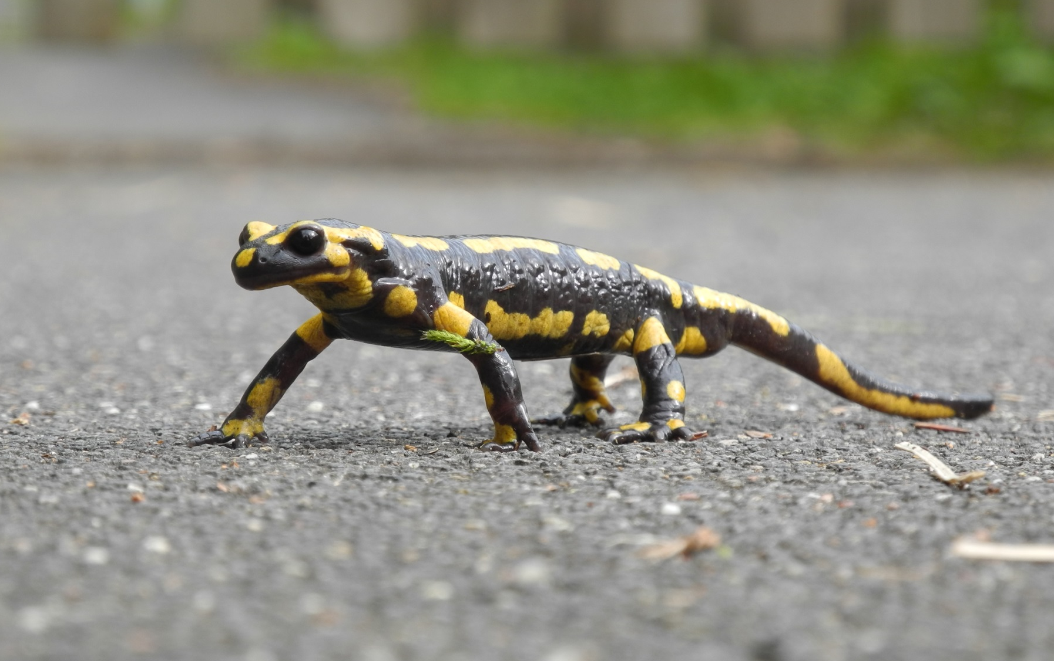
Questions?

Slide 30
Discussion:
What new observations are needed?
Science goals?
Who is going to do the work?
  Does she/he have the time and experience?
Where is the processing going to be done?
  Even just moving around the data takes time!
LOFAR in three lines:
  Total power is possible now.
  Low noise and/or high resolution is a lot of work.
  Polarization is even more work.

