Slide 1


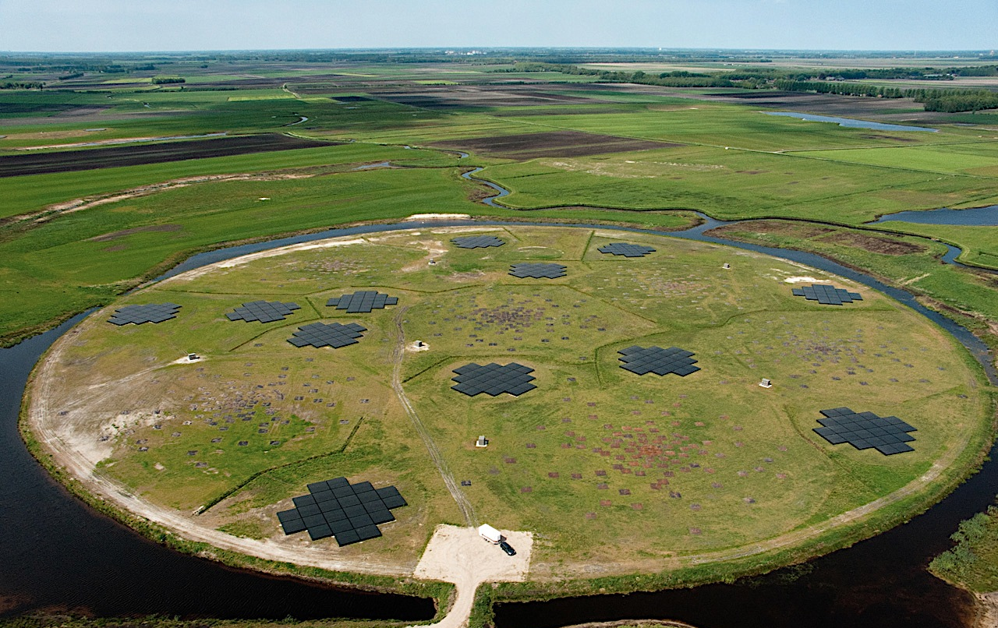
Galactic (polarized) emission
Vibor Jelić*
*on behalf of the LOFAR-EoR team

Slide 2
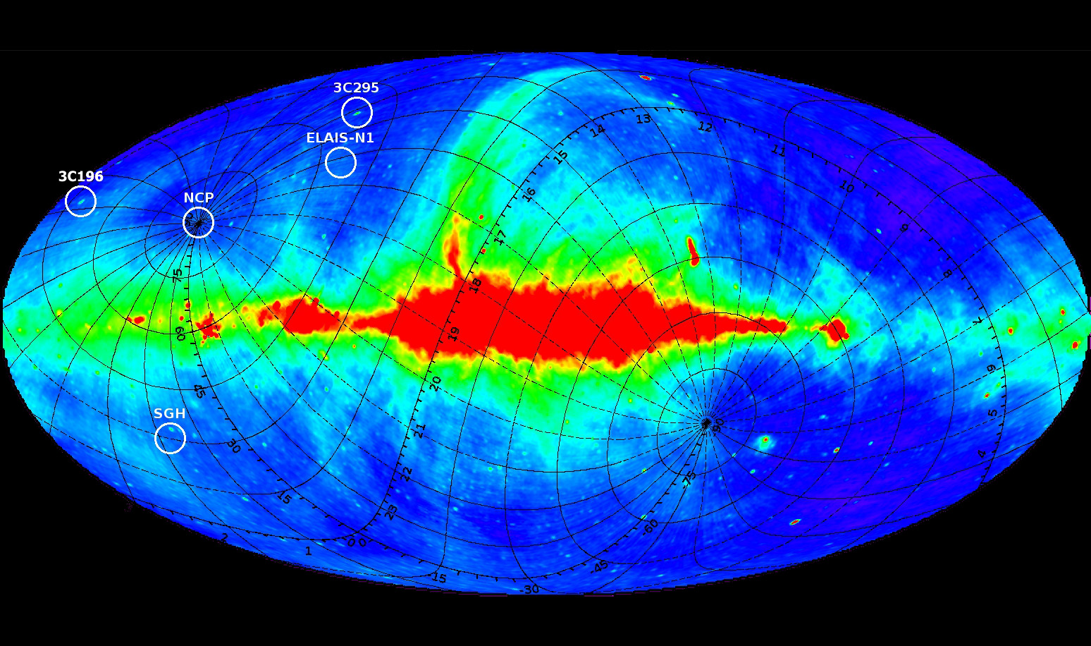
LOFAR-EoR observations
LOFAR-EoR observations

Slide 3
LOFAR-EoR experiment: Elais N1 field
European Large Area ISO Survey – North 1 field
RA 16h14m00s Dec +54:30:00
motivation: one of the Subaru fields, observed at many wavelengths,
synergy with the LOFAR-survey KSP
no bright sources (< 5 Jy)
  LOFAR – HBA observation @ 138 – 185 MHz
    July 2012, 7h, 244 sb, CR+RS stations (55)
  WSRT @ 350 MHz
  direction independent calibration using BBS
  Ionospheric Faraday rotaion correction
  corrected for direction and time dependent LOFAR beam (AWimager)

Slide 4
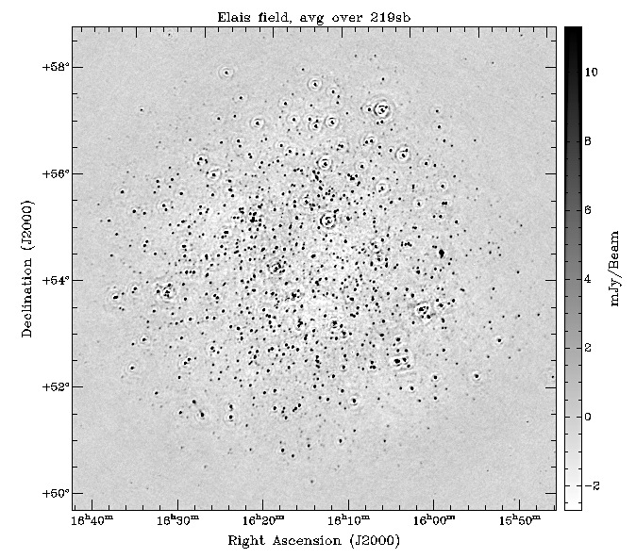
LOFAR-EoR experiment: Elais N1 field
Noise
0.22 mJy/beam
(48MHz bandwidth)

Slide 5
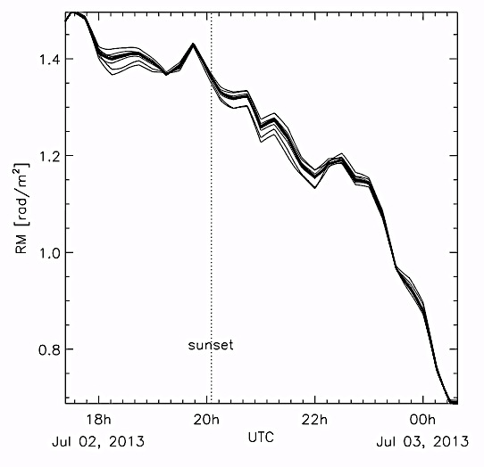
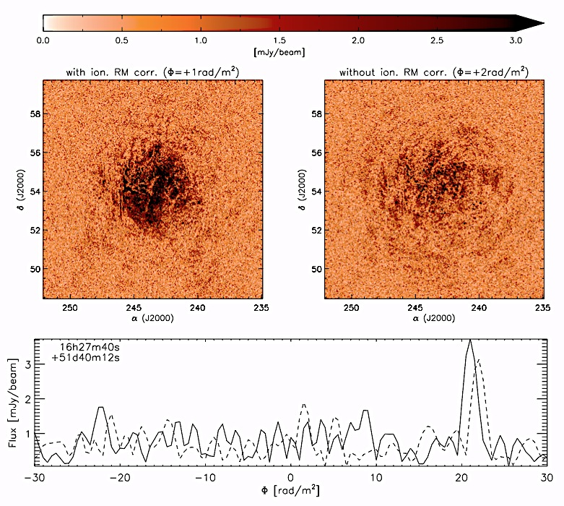
Elais N1 field: ionospheric RM correction
M. Mevius

Slide 6
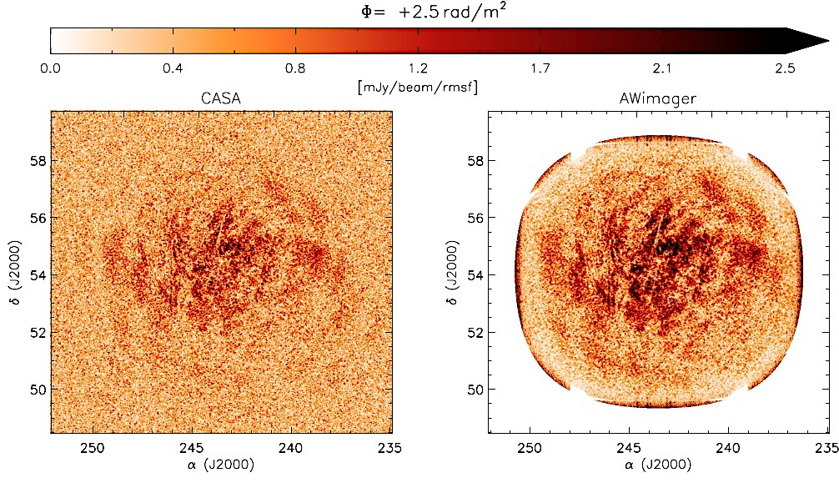
Elais N1 field: beam corrections

Slide 7
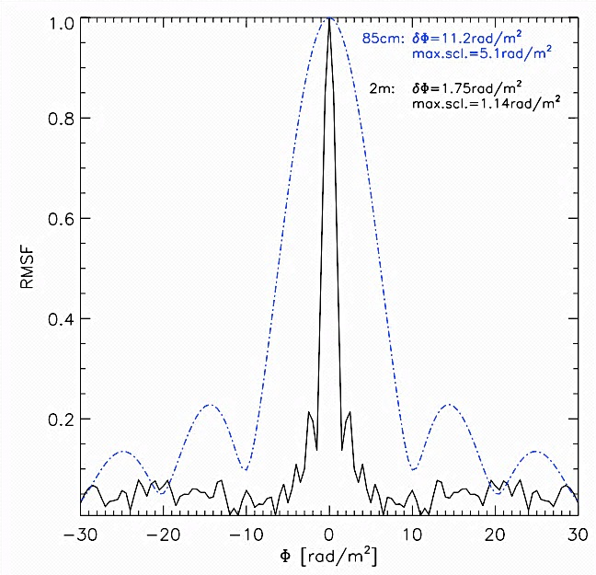
Elais N1 field: beam corrections

Slide 8
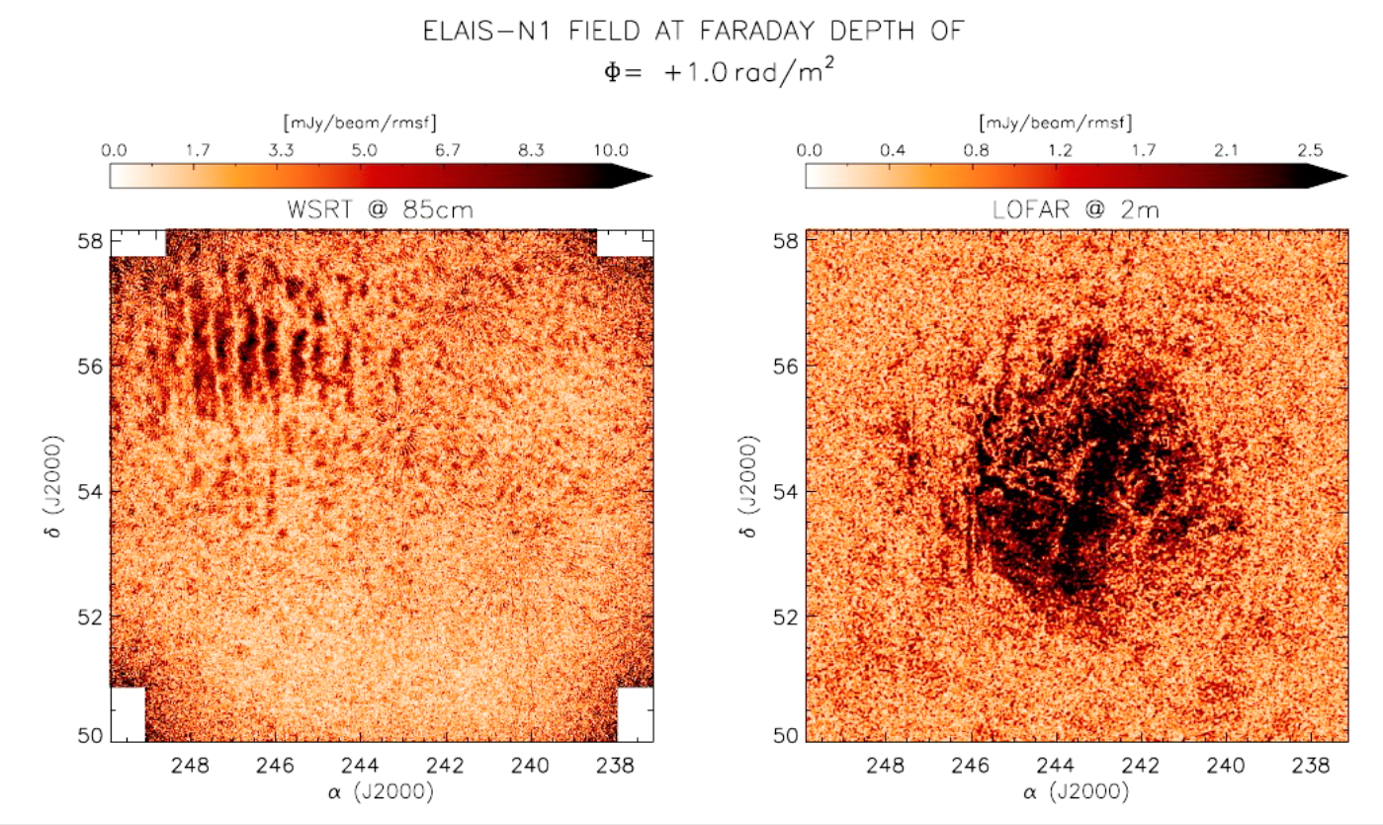
LOFAR-EoR experiment: Elais N1 field

Slide 9
LOFAR-EoR experiment: NCP field
30 x 30 deg
0.8 microJy/beam
(62MHz bandwidth)
S. Yatawatta

Slide 10
LOFAR-EoR experiment: NCP field
8 x 8 deg
0.8 microJy/beam
(62MHz bandwidth)
S. Yatawatta

Slide 11
Summary & Conclusions
GALACTIC POLARIZED EMISSION
full polarization calibration
correct for FR in the ionosphere
apply array and tile beam corrections
make a low resolution images (~3 arcmin resolution)
  with a uniform uv coverage, apply both inner and outer uv taper
apply RM synthesis
ELAIS-N1 field
Galactic polarized emission of a few Kelvin
noise in RM cubes ~ 0.2 mJy

