Slide 1


LOFAR STATUS UPDATE
R. F. Pizzo
on behalf of LOFAR Science Support
Sant’Antioco, May 13th 2013

Slide 2

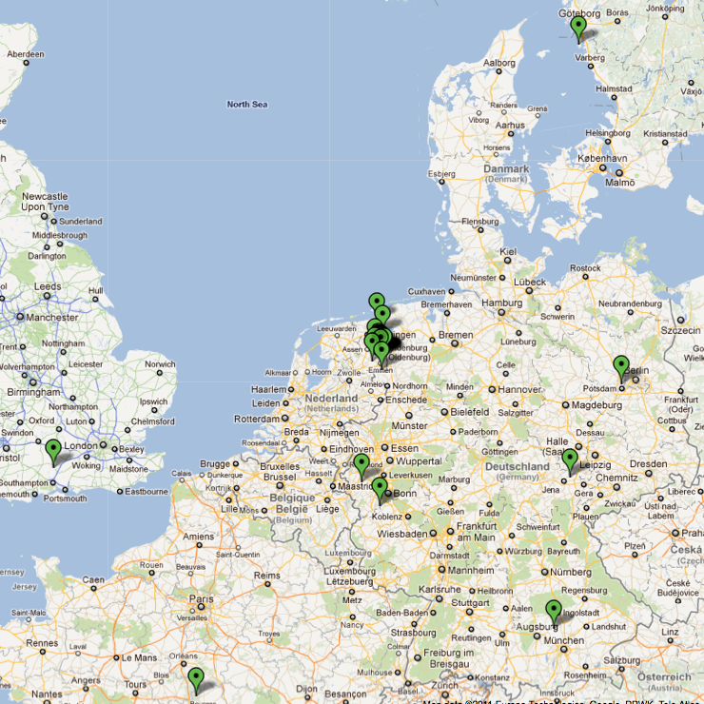

THE PROPOSALS
ARRAY STATUS
43 operational stations
  24 core + 13 remote in NL
  8 international stations online
  Remaining 3 NL stations in 2013
  New stations in Poland & Germany
IBM BlueGene/P supercomputer
  Operating nominally (uptime of 99%)
  Bandwidth to CEP2 upgraded to 80 Gbit/s
  COBALT correlator port underway
Post-processing cluster
  CEP2 stable, CEP1 software upgraded
  All development work moved to CEP1
  CEP3 upgrade plan under discussion

Slide 3
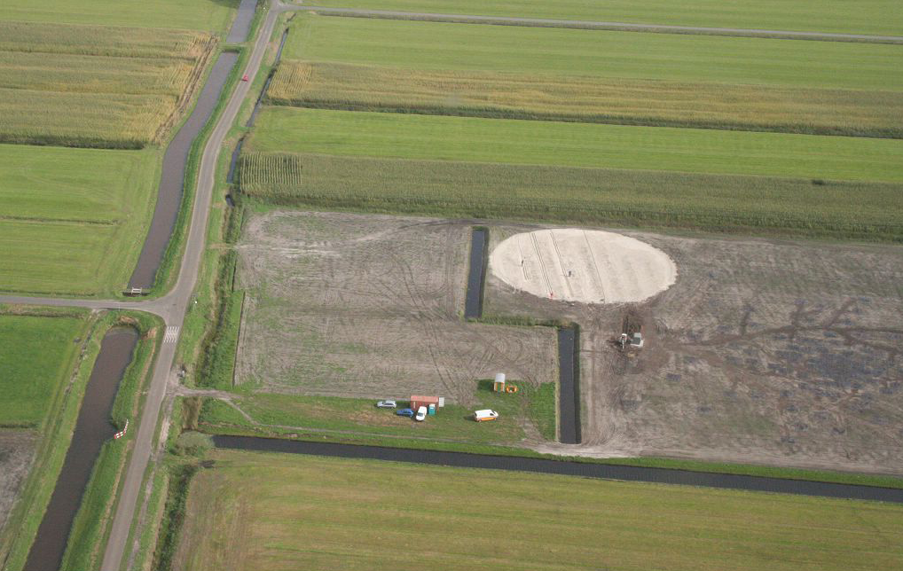
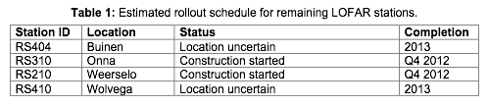
THE PROPOSALS
ROLLOUT OF FINAL NL STATIONS
RS 310 (Zuidveen/ Onna)
Three remaining NL remote stations being rolled out
RS310 complete
RS210 connection available mid-May
RS404 location uncertain due to archaeological sites nearby
RS410 delayed due to building permit issues
Courtesy of M. Gerbers & N. Ebbendorf
complete
complete

Slide 4
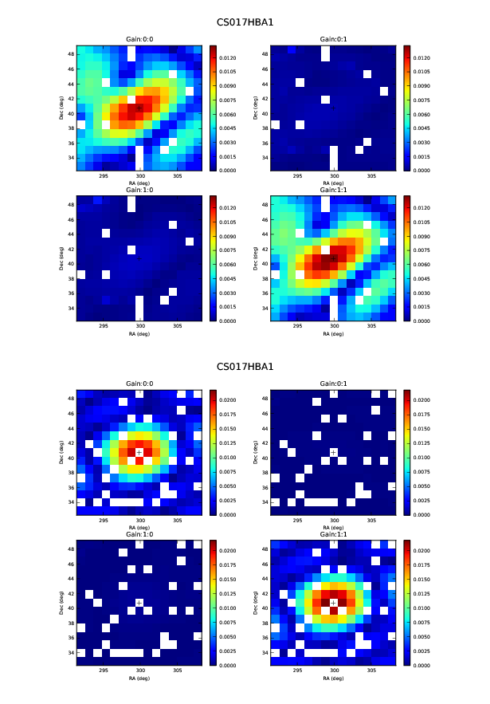
THE PROPOSALS
INSTALLATION OF SYNCOPTIC BOARDS
Mid-September 2012
Mid-November 2012
Courtesy of W. Frieswijk
Issue identified early 2012
Caused out-of-focus, mispointed beams, loss of sensitivity
Prototype Syncoptic board tested in May, rolled out to all NL stations by October
Second batch of boards ordered for remaining International stations

Slide 5
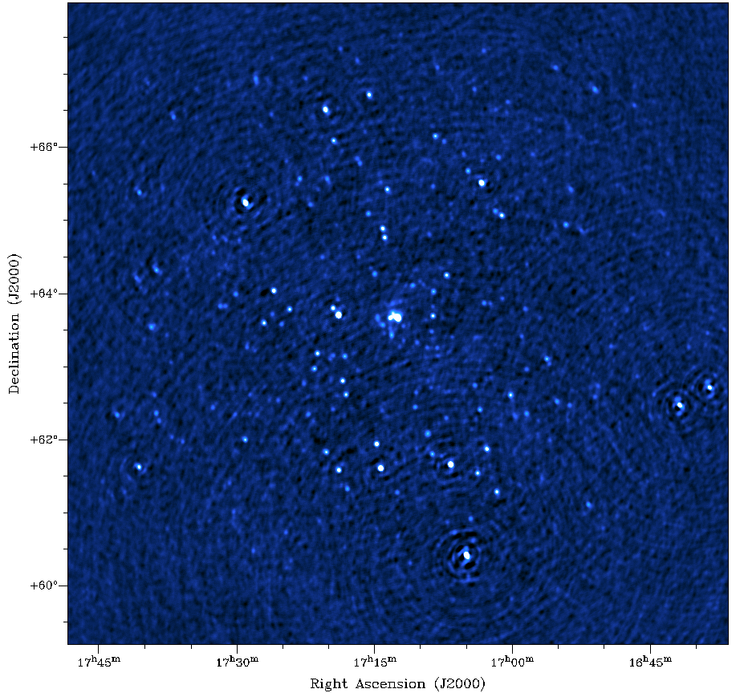
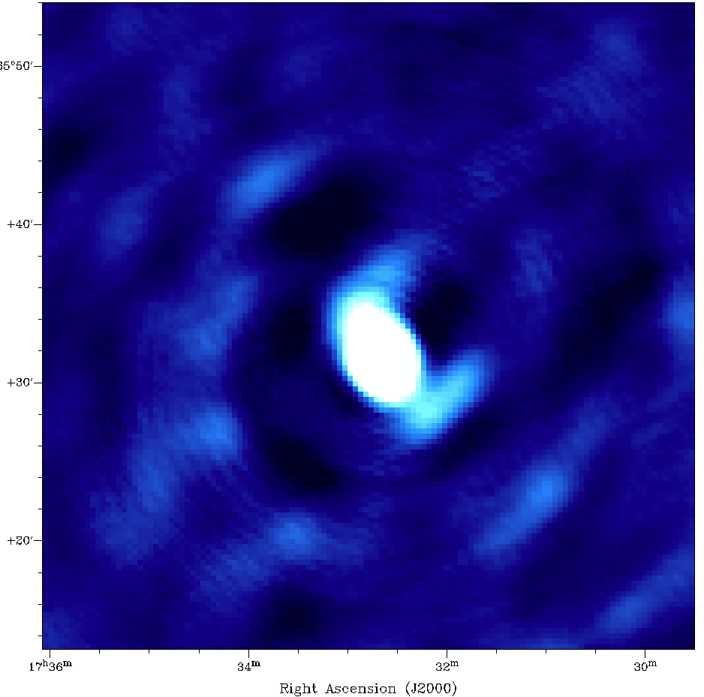
THE PROPOSALS
ABELL 2255 HBA: 2011
A2255: 2011
CS only

Slide 6
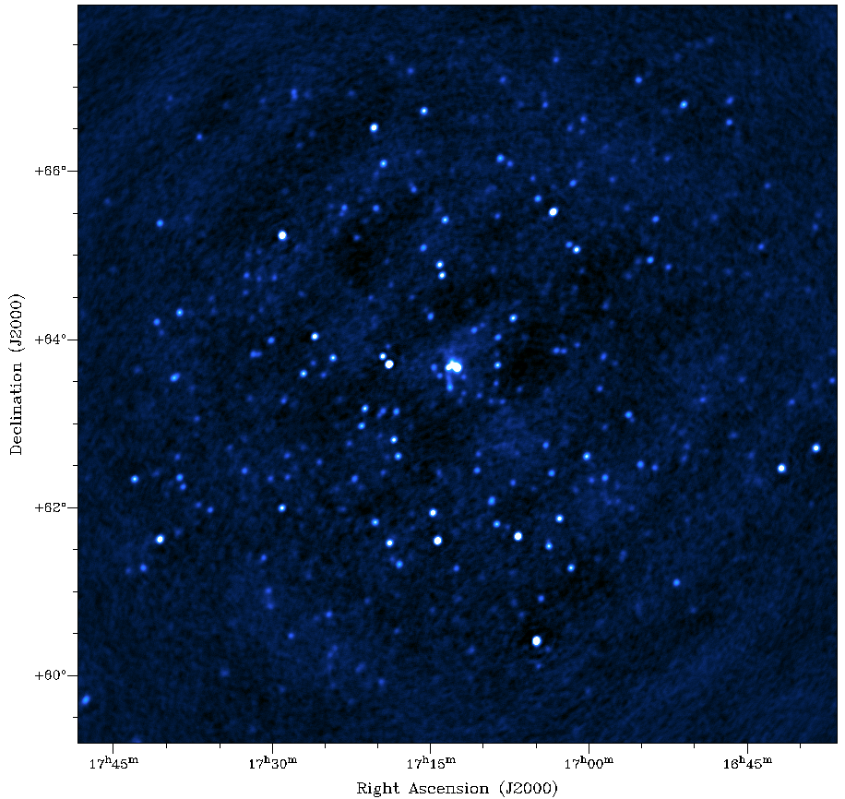
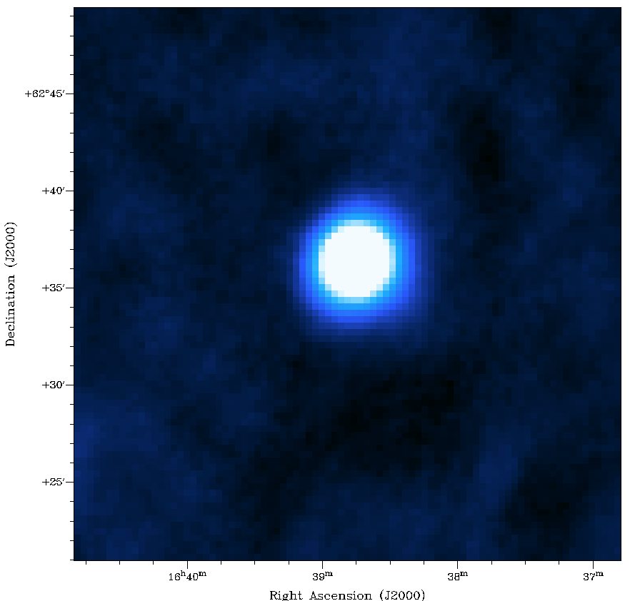
THE PROPOSALS
ABELL 2255 HBA: 2013
A2255: 2013
A2255: 2011
CS only
Noise improved by a factor of ~2

Slide 7
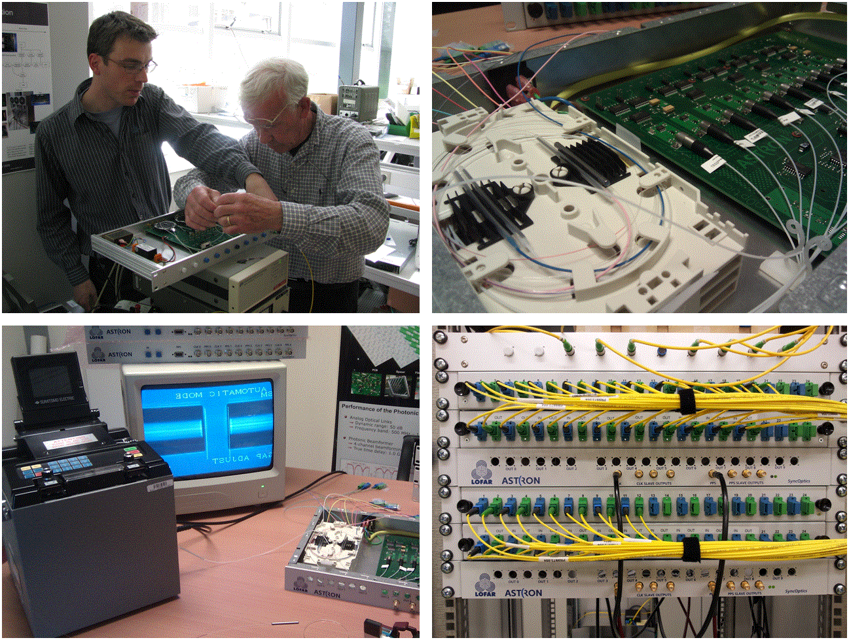
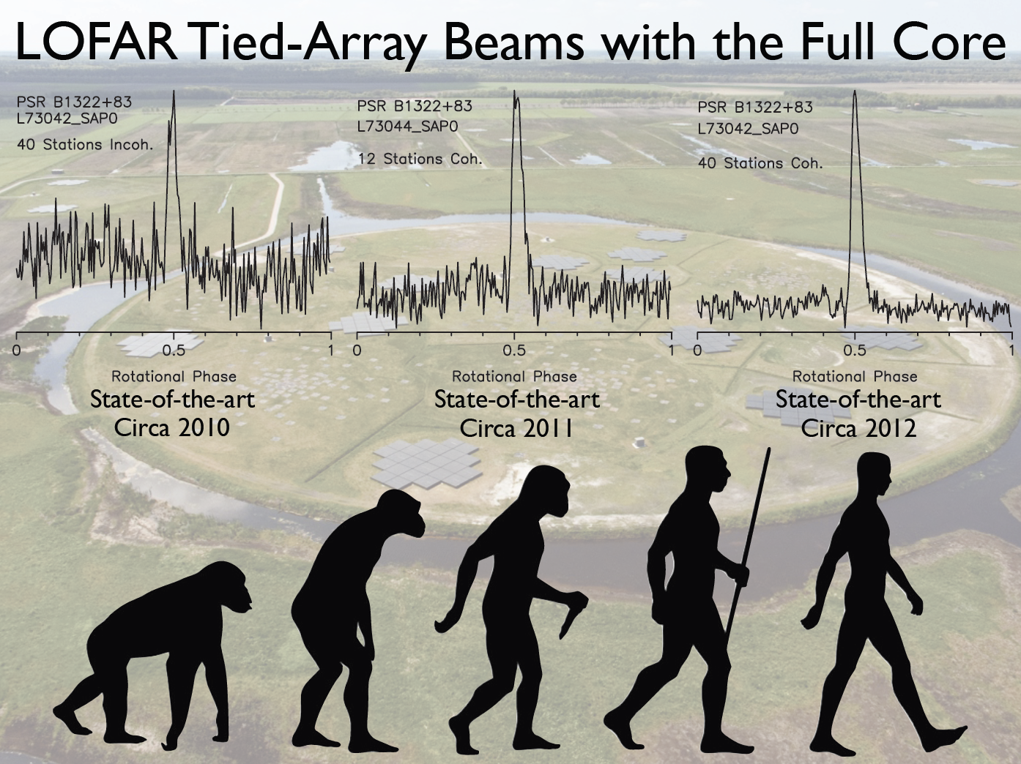
THE PROPOSALS
SINGLE CORE CLOCK DISTRIBUTION
Courtesy of J. Hessels
Central clock at Concentrator Node
All CS now use a single clock -> improved S/N for coherent TABs

Slide 8
THE PROPOSALS
LOFAR VERSION 1.0: USED in CYCLE 0 OPERATIONS
Standard Imaging Observations
  LBA and HBA MSSS-like imaging observations
  Automated execution of Standard Imaging Pipeline (SIP)
  Specification, planning, and management of observations
Beam-formed Observations
  Tied array mode observing with up to 127 pencil beams
  Four tied-array modes: complex voltages, coherent stokes, incoherent stokes, fly's eye
  BG/P processing and kickoff of post-processing pipeline
  Specification, planning, and management of observations
Initial Long Term Archive (LTA)
  Ingest of imaging data products (visibilities and images)
  Ingest of raw beam-formed data products
  Search and retrieve functionality for LTA data products

Slide 9
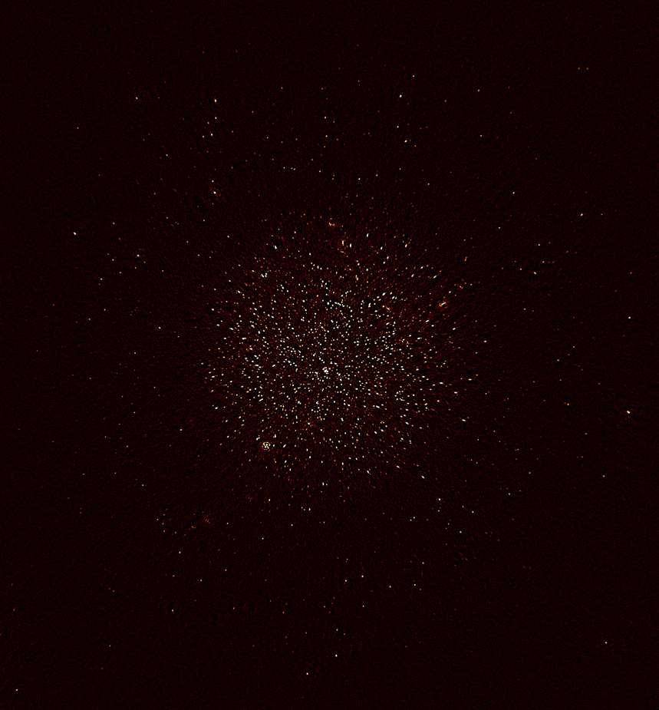
THE PROPOSALS
POST-1.0 DEVELOPMENTS
8-bit mode observing
  Updates to station firmware (8,4-bit)
  Updates to various parts of the system to allow it
Standard Imaging Pipeline
  Updates to beam model
  Direction dependent corrections
  Initial source finding and GSM integration
Long Baseline Imaging
  Superterp baseline addition in NDPPP
  Fringe fitting preprocessing (developed by LB working group)
NCP Field
30º x 30º
96 MHz bandwidth
FWHM = 2 arcmin
100 μϑψ noise

Slide 10
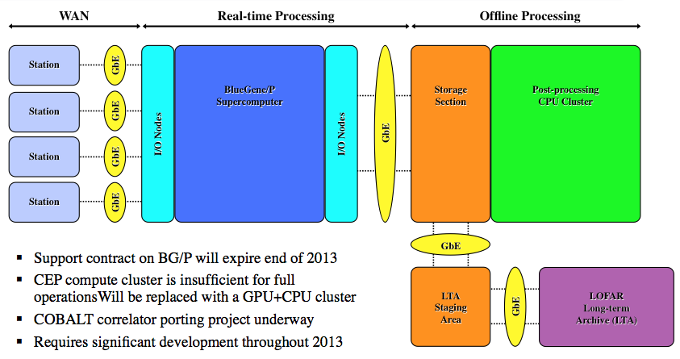
THE PROPOSALS
CENTRAL PROCESSING UPGRADE
COBALT

Slide 11
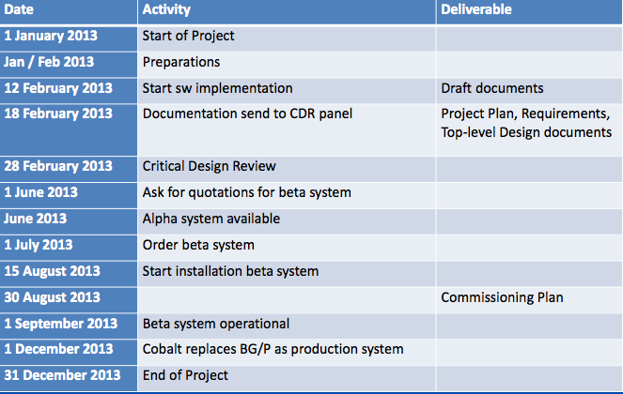
THE PROPOSALS
COBALT PROJECT TIMELINE
Project Leader: Ronald Nijboer

Slide 12
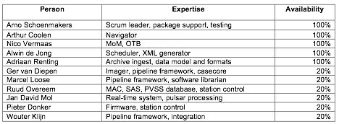
THE PROPOSALS
NEW DEVELOPMENTS
Development priorities for 2013:
  COBALT replacement of BG/P
  Support and improve current operational system
  Speed up and improve functionality of LTA
  Investigation of requirements for responsive telescope
  Improvements in performance and flexibility of the imaging pipeline
Limited new functionality in Cycle 1

Slide 13
THE PROPOSALS
STABILITY AND PERFORMANCE
Overall stability is good:
  Observations stable
  Pipelines stable
    swapping
    Specifications errors
Issues:
  Because of too many processes (ObservationControl) active on the MCU, system
  hanged (experienced twice already)
  Communication problems between various parts of the system – feedback not
  reliable and incomplete metadata -> significant delays with ingestion
  System slow and unstable when handling demanding projects (e.g. LC0_003: ~
  1000 pipelines associated with 192 runs performed in 24 hours)
  Observations involving International stations: first minute heavy flagging – under
  investigation

Slide 14
THE PROPOSALS
LTA STATUS I
Archiving of raw and processed data is progressing:
  Speeding up the ingest of small data products
    Target: keep up with overall observing program
      Requires average ingest duration of 2 seconds
      Improvements:
        Multithreading Astro-Wise side of ingest
        Avoid parsing redundant metadata
        Moved MoM side of ingest to server in LOFAR domain
      Result: Small file ingests now take on average 1.7 seconds
  New issue causing ingest to fail: non-unique data products ID’s in MoM (under investigation)
  Improving the ingest status overviews

Slide 15
THE PROPOSALS
LTA STATUS II
Data suffering from incomplete metadata will not be ingested. They will be transferred to an LTA location (Bit Bucket), where they will remain available for download for the users
A fix to repair incomplete metadata is currently being worked on
DO NOT COPY DATA FROM CEP2 WITHOUT
SCIENCE SUPPORT APPROVAL
Processed LC0 data transferred also to CEP1 (staging areas) if further manual processing on CEP was requested in proposal – max lifetime on CEP1 = 4 weeks
STAGING AREAS ARE UNRELIABLE – MAKE YOUR OWN BACK-UP OF YOUR DATA

Slide 16
THE PROPOSALS
EFFICIENCY DURING THE QUARTER OF CYCLE 0
EFFICIENCY DURING THE FIRST TRIMESTER
Cycle 0 was planned to end on August 31st 2013
During the first operational semester: 50% on sky time
Efficiency increased significantly during the first trimester of the Cycle
December 2012 – mostly EoR and Pulsar (LC0_019, 034)

Slide 17
THE PROPOSALS
STATUS OF ACTIVE PROJECTS
STATUS OF ACTIVE PROJECTS
29 active projects
6 projects completed
Large projects (EoR, Pulsar) in very good shape

Slide 18
THE PROPOSALS
WHERE WE STAND AND WHAT IS COMING
WHERE WE STAND AND WHAT IS COMING
On track with an end of the Cycle on August 31st 2013
But note that severe delays will be caused by COBALT implementation
Cycle 0 extended till 14 November 2013
1272 hours observed so far

Slide 19
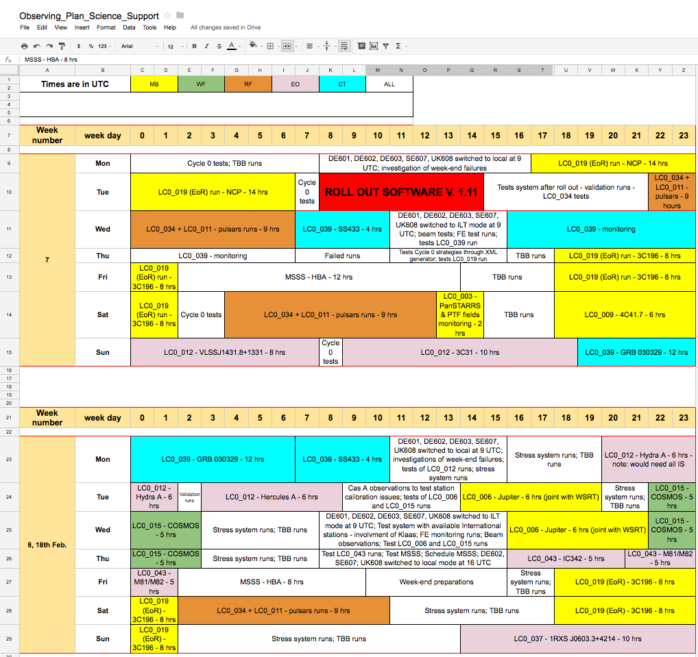
THE PROPOSALS
OBSERVING SCHEDULE: COMING TWO MONTHS
OBSERVING SCHEDULE: WEEKLY VIEW
Color code is your support scientist
https://www.astron.nl/radio-observatory/lofar/cycle-0-schedule/cycle-0-schedule

Slide 20
OUR EXPERIENCE
Expert users request ad hoc observing/processing strategies:
Only when doable, we can accommodate
It shows that more flexibility is requested in the system – material for new development
Commissioning activities are very important:
LSM allows users to present their results and question their findings
Busy days give commissioners the possibility to elaborate on the most appropriate reduction strategy for the various fields. Moreover, they need to be used to give feedback to RO. Your attendance is crucial!
YOUR FEEDBACK IS CRUCIAL, AS IT HELPS US TO IMPROVE OUR SUPPORT AND PROCEDURES

Slide 21
THE PROPOSALS
IMPORTANT NOTES
IMPORTANT NOTES
Cycle 0 extended till November 14 2013
Together with Cycle 0, also commissioning and MSSS took place during the last 3 months
50 hours of successful commissioning runs + ~ 40 hours of successful MSSS LBA observations
More recently: MSSS HBA
  Observations for MSSS at a rate of 16 hours per week – completion expected middle 2013

Slide 22
THE PROPOSALS
IMPORTANT NOTES
CYCLE 1
Cycle 1 will start on November 15 2013:
The intention is to advance COBALT hardware installation from September 2013 as early as June 2013; this will mitigate the risks of delays for COBALT – it will require reshuffling of Cycle 0 schedule and will start a period of testing in parallel with operations
MSSS LBA should be completed and a few fields re-observed
Flexibility and automatization of the system is being worked on. Roll out of such features will be accompanied by initial drop in production efficiency
June | Formal call issued
Early September 2013 | Proposal deadline
End of October 2013 | PC meeting
15 November 2013 | Cycle 1 starts
15 May 2014 | Cycle 2 starts

Slide 23
THANK YOU

