Slide 1
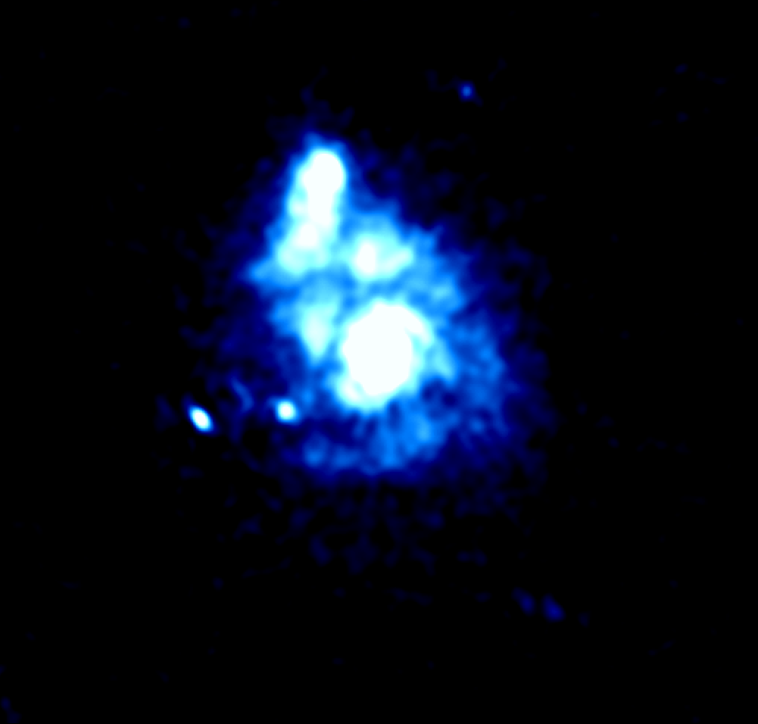
Observations of Nearby Spiral Galaxies with LOFAR HBA
David Mulcahy
Rainer Beck, Andreas Horneffer
DFG Research Group 1254

Slide 2
Outline of Talk
Observations of M51 with LOFAR HBA and Data Reduction
Initial Results
Observations of NGC891 and preliminary images
Future plans and summary

Slide 3
Dual Observation of M51 and 3C295 with LOFAR HBA
Observation was taken last year in April to observe M51 and 3C295 in dual beam mode.
Observation was a 6 hour night-time observation when M51 was at high elevation to ensure greater sensitivity.
Full Dutch Array was used in this observation

Slide 4
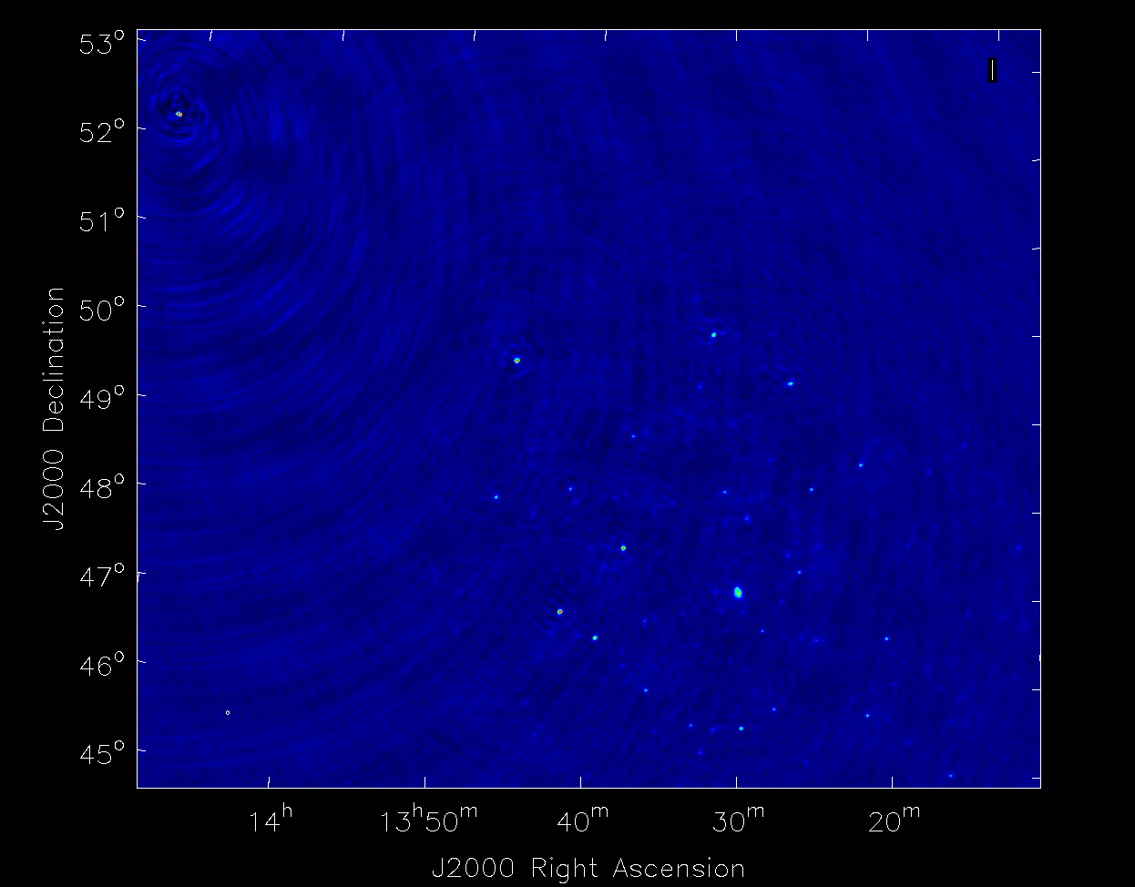

Slide 5
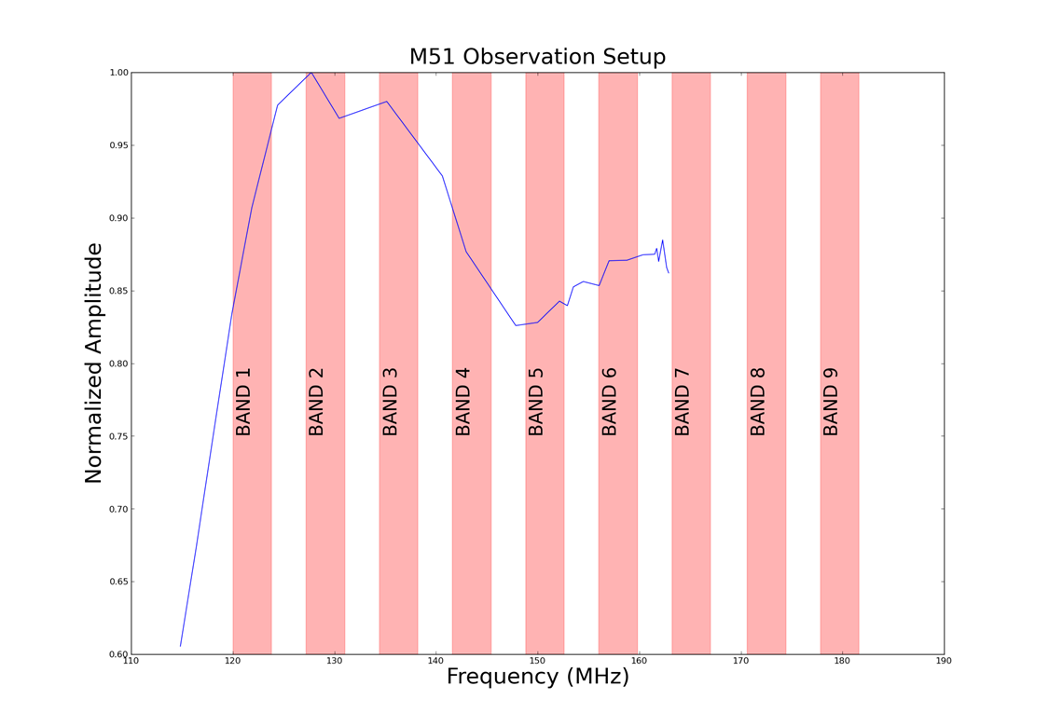
Observation of 3C295 & M51 with LOFAR-HBA
9 blocks of 20 subbands (of 200KHz) spread evenly from 120 to 181MHz (36 MHz in total)
54 subbands on calibrator.

Slide 6
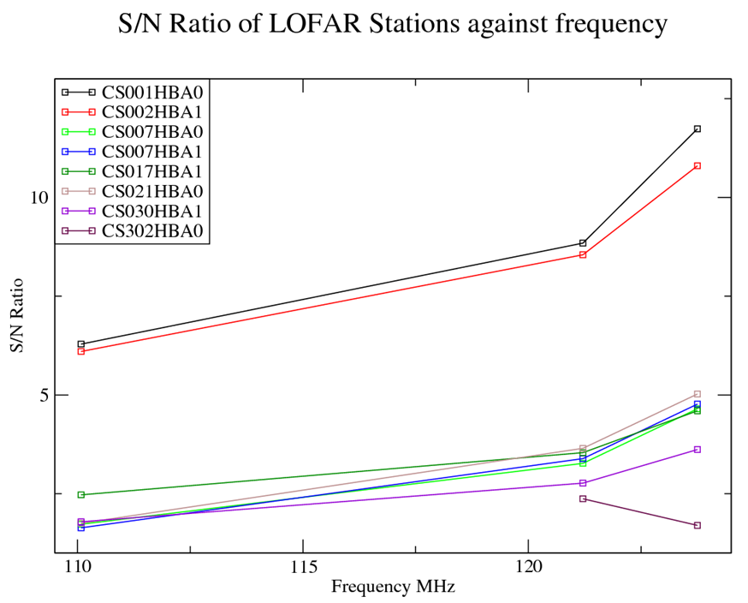
Data Inspection
Due to DAB 5, heavy RFI present at approx 180MHz, lost 10 subbands.
In addition to normal RI flagging, several stations had to be entirely
flagged due a 5 ns delay in RSP boards.
Could be identified by comparing the signal to noise of stations at low frequencies.

Slide 7
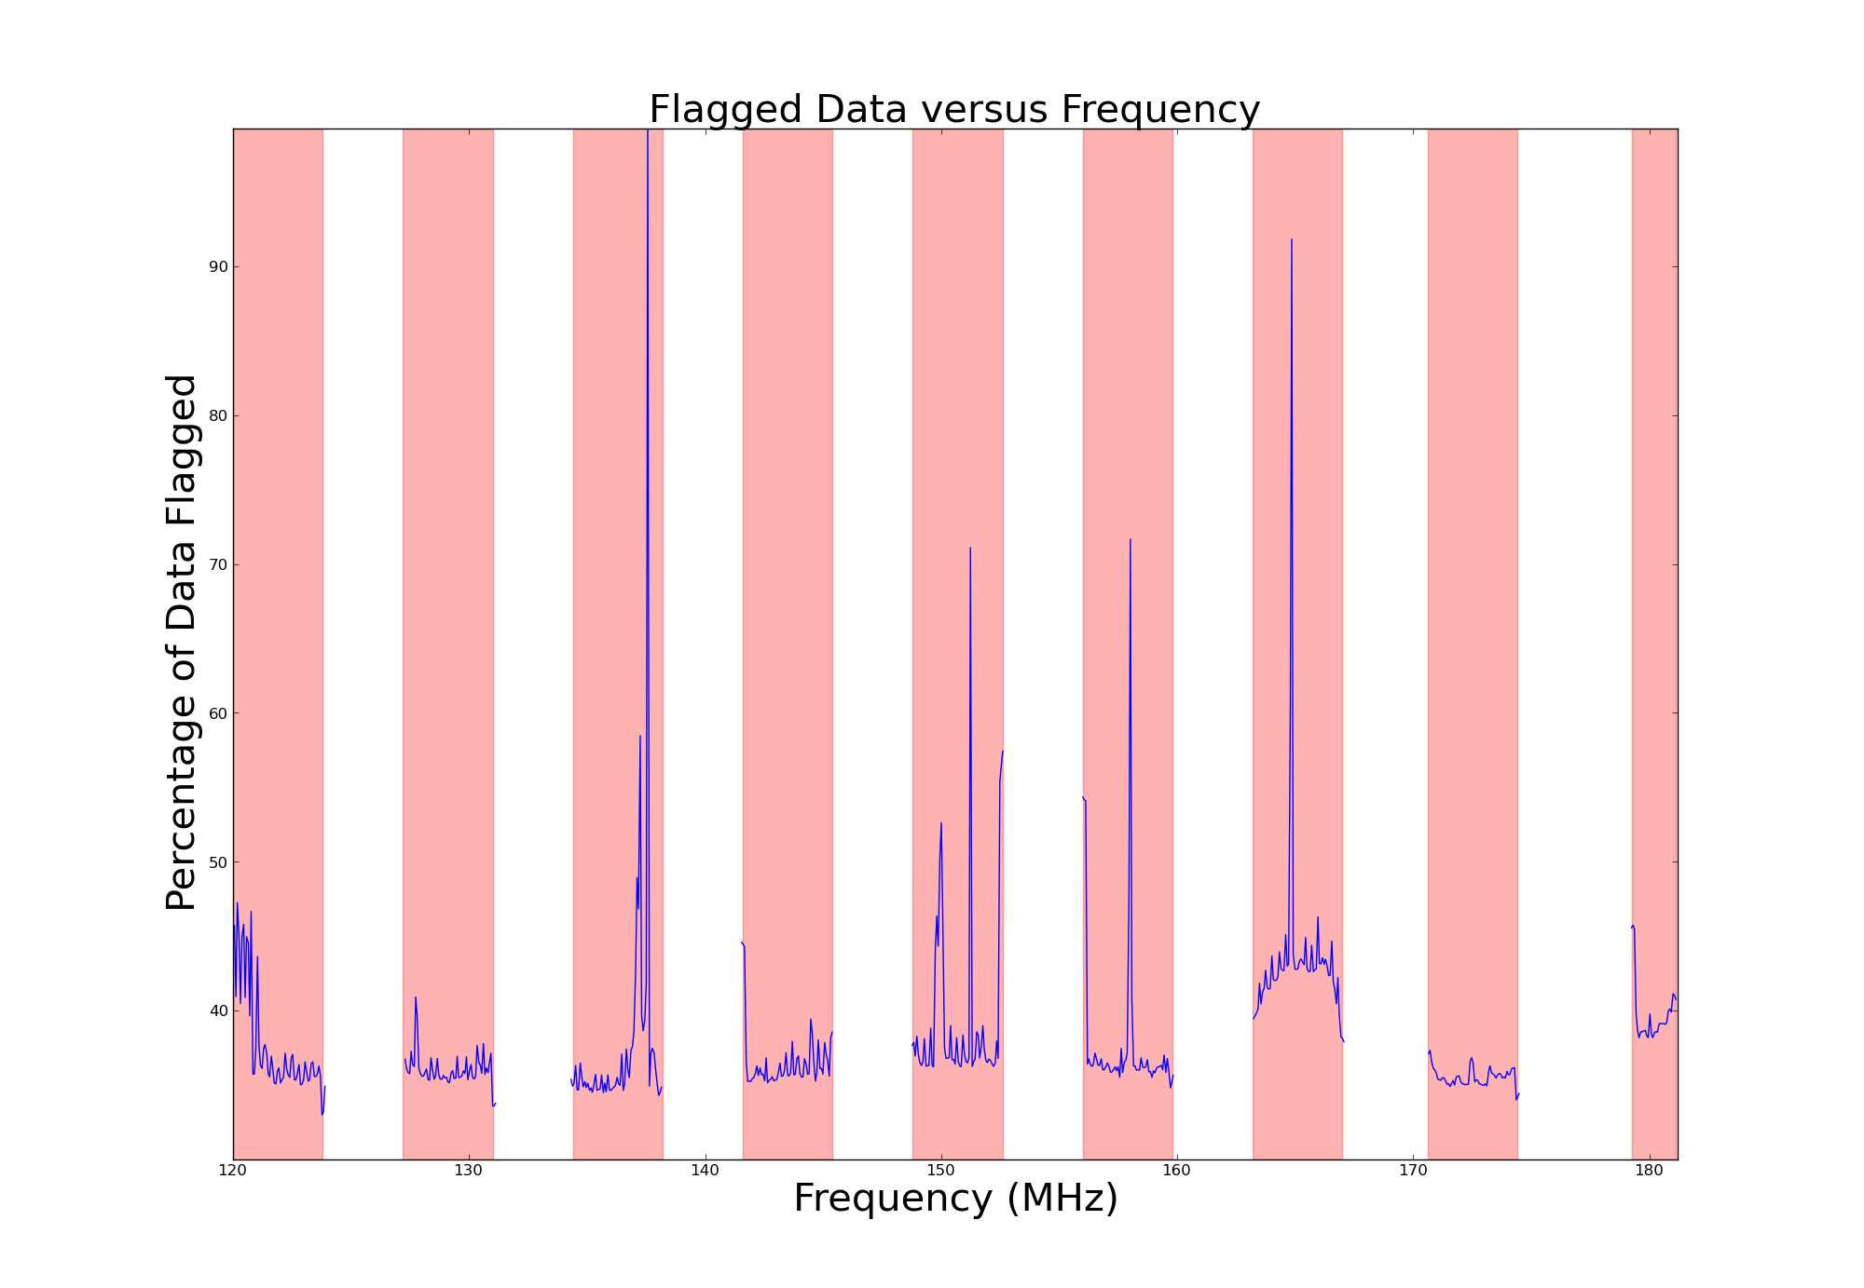
Total Data Flagged

Slide 8
Disadvantage of Direct Gain Transfer Motivation for Gain Interpolation
At present, an equal amount of subbands must be used on both the calibrator and the target source.
Therefore, observing bandwidth on the target source is halved.
Decreasing the number of subbands used for calibration is very desirable.
Calibrator
Target
SB1
SB2
SB3
Frequency
SB4

Slide 9
Disadvantage of Direct Gain Transfer Motivation for Gain Interpolation
At present, an equal amount of subbands must be used on both the calibrator and the target source.
Therefore, observing bandwidth on the target source is halved.
Decreasing the number of subbands used for calibration is very desirable.
Calibrator
Target
Frequency

Slide 11
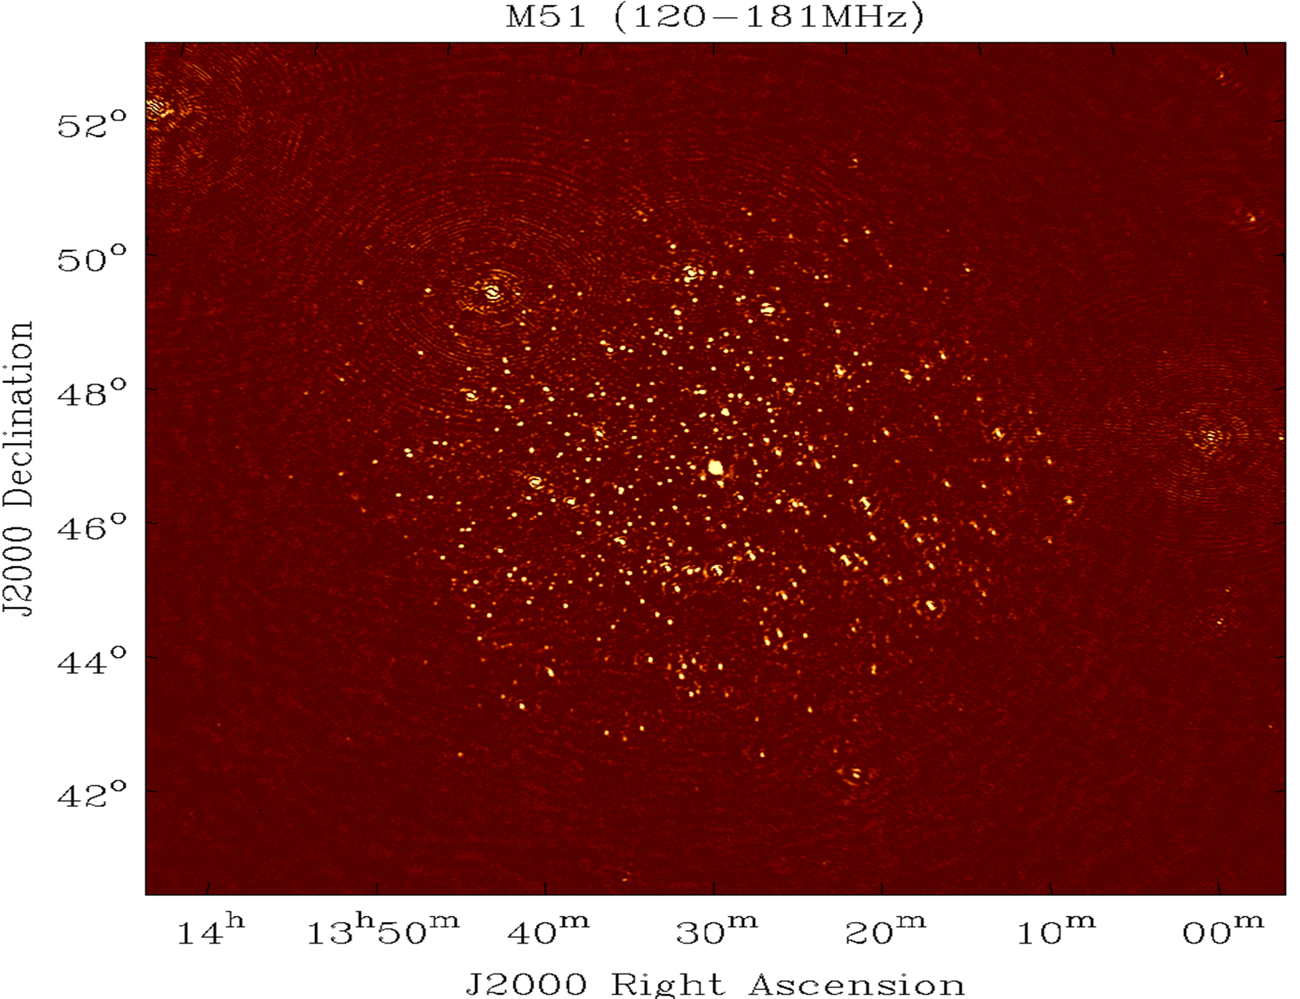
M51 Field –Full Bandwidth (36 MHz)

Slide 12
12 Degrees

Slide 13
Final Image: M51 @ 150MHz
20‘’ beam
Uniform weighting
σ=0.9-0.6 mJy

Slide 14
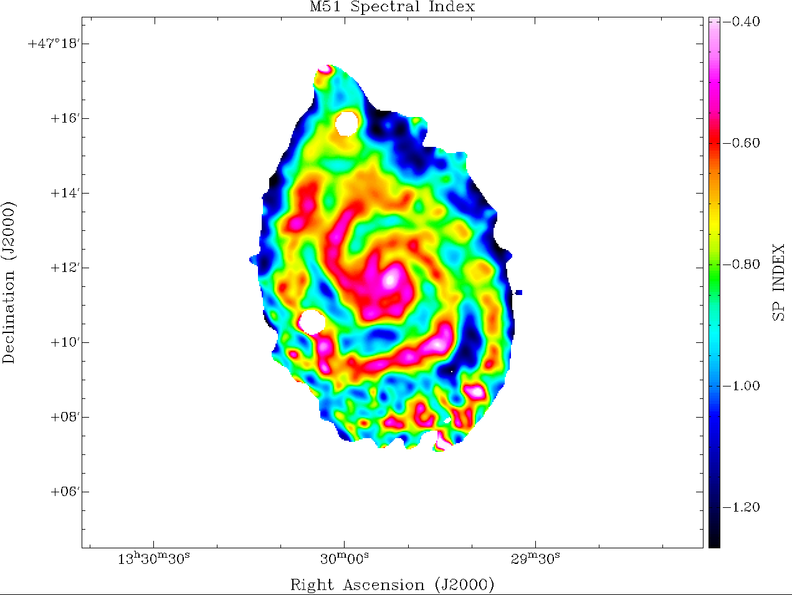
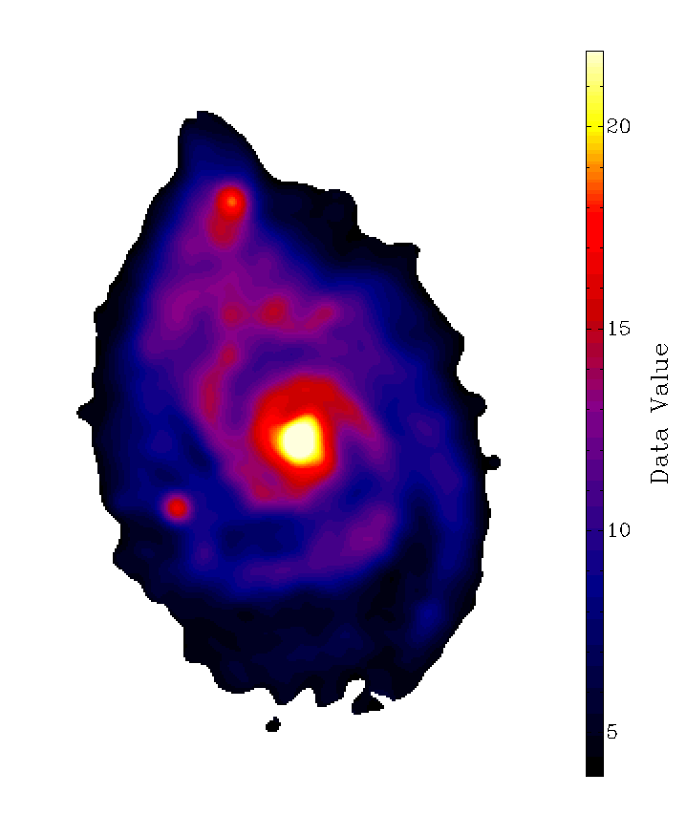
Spectral Index 1.4GHz-150MHz
B-Field Map

Slide 15
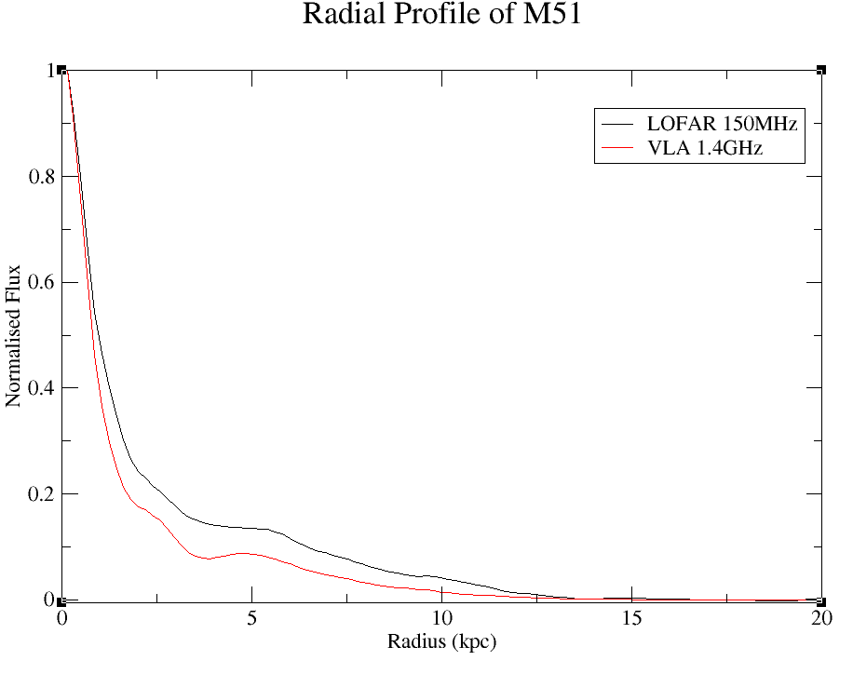

Slide 17
Performing RM Synthesis- Detecting Polarized Foreground
Faraday Depth Resolution with LOFAR is excellent.
Enables us to resolve
many different features.

Slide 18
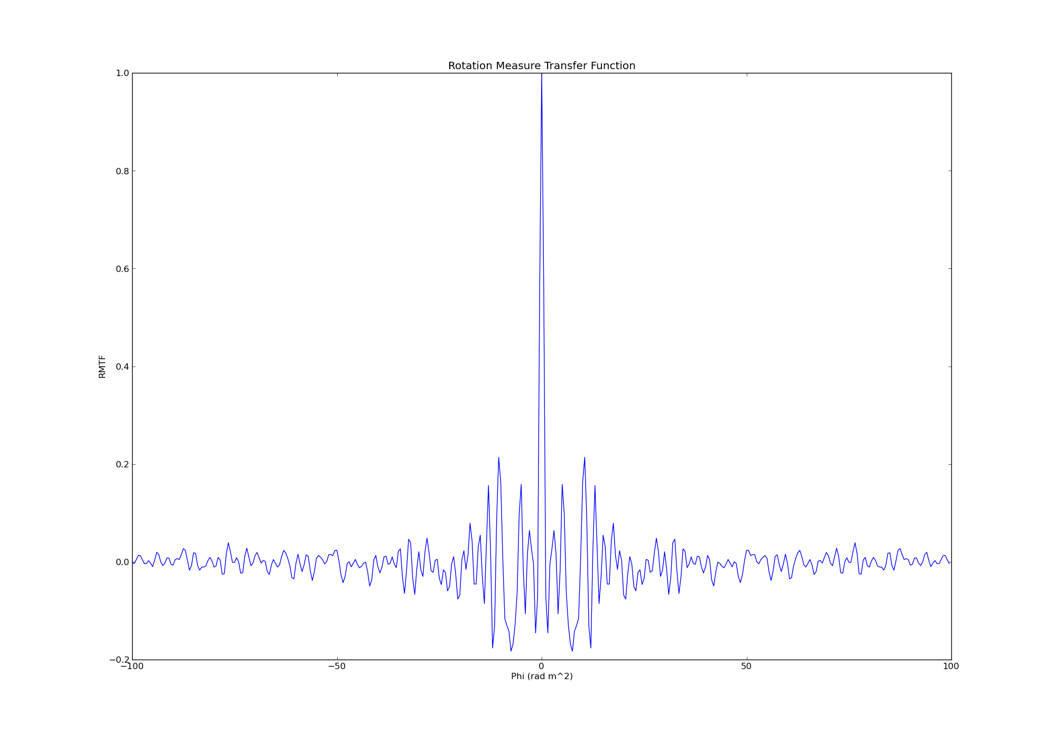
Performing RM Synthesis- Detecting Polarized Foreground
Faraday Depth Resolution with LOFAR is excellent.
Enables us to resolve
many different features.

Slide 19
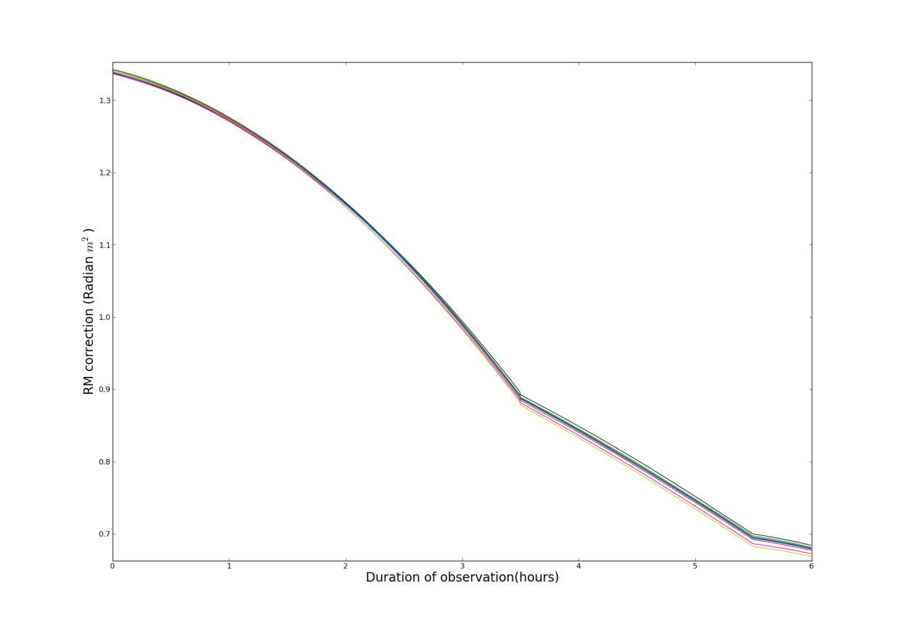
Performing RM Synthesis- Detecting Polarized Foreground
Ionospheric Faraday rotation correction was performed using CODE TEC data and RMwriter code.
RM correction for M51 observation

Slide 20
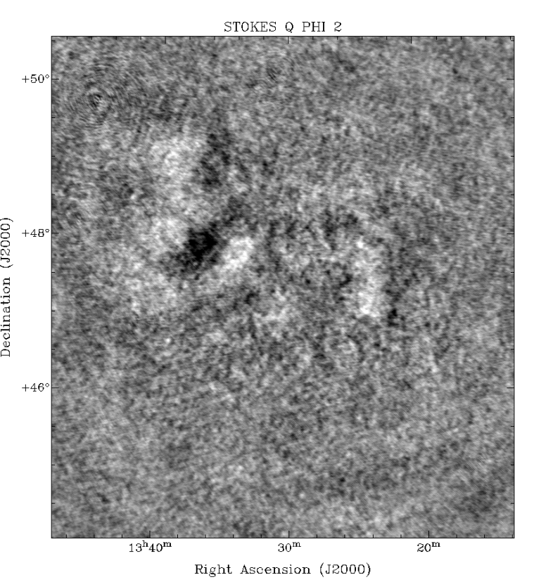
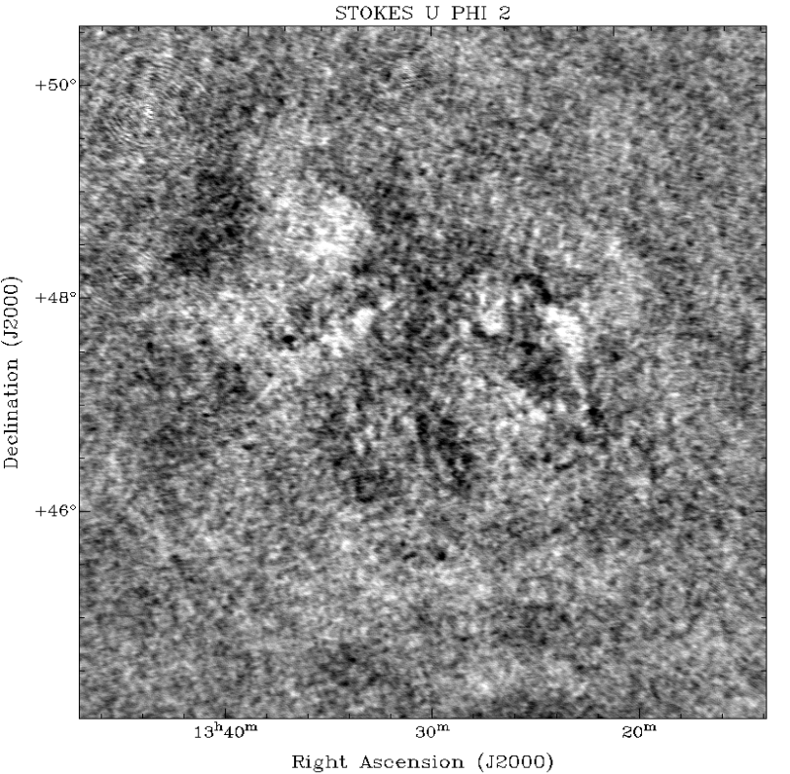
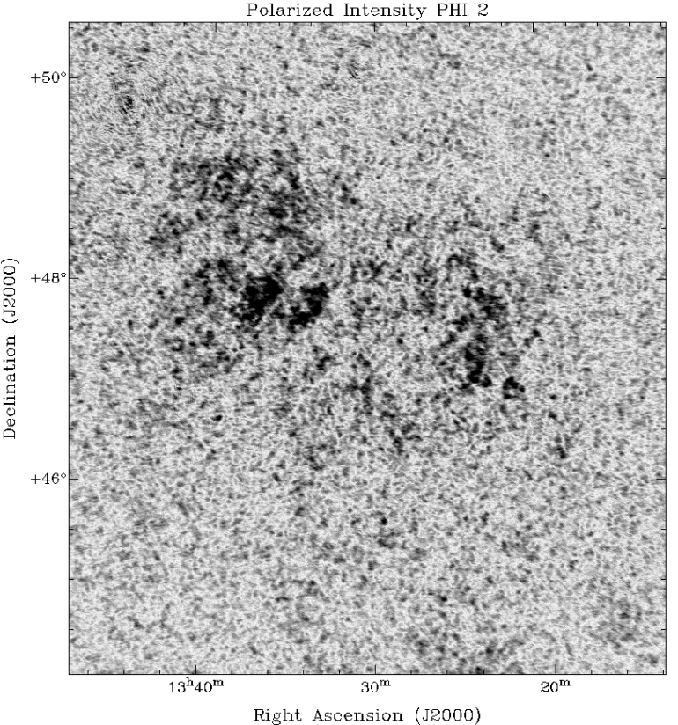
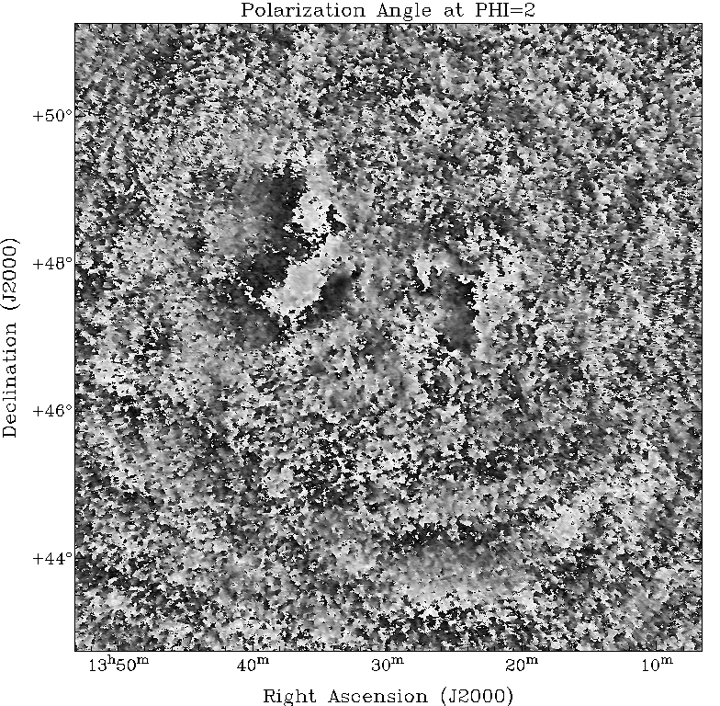

Slide 22
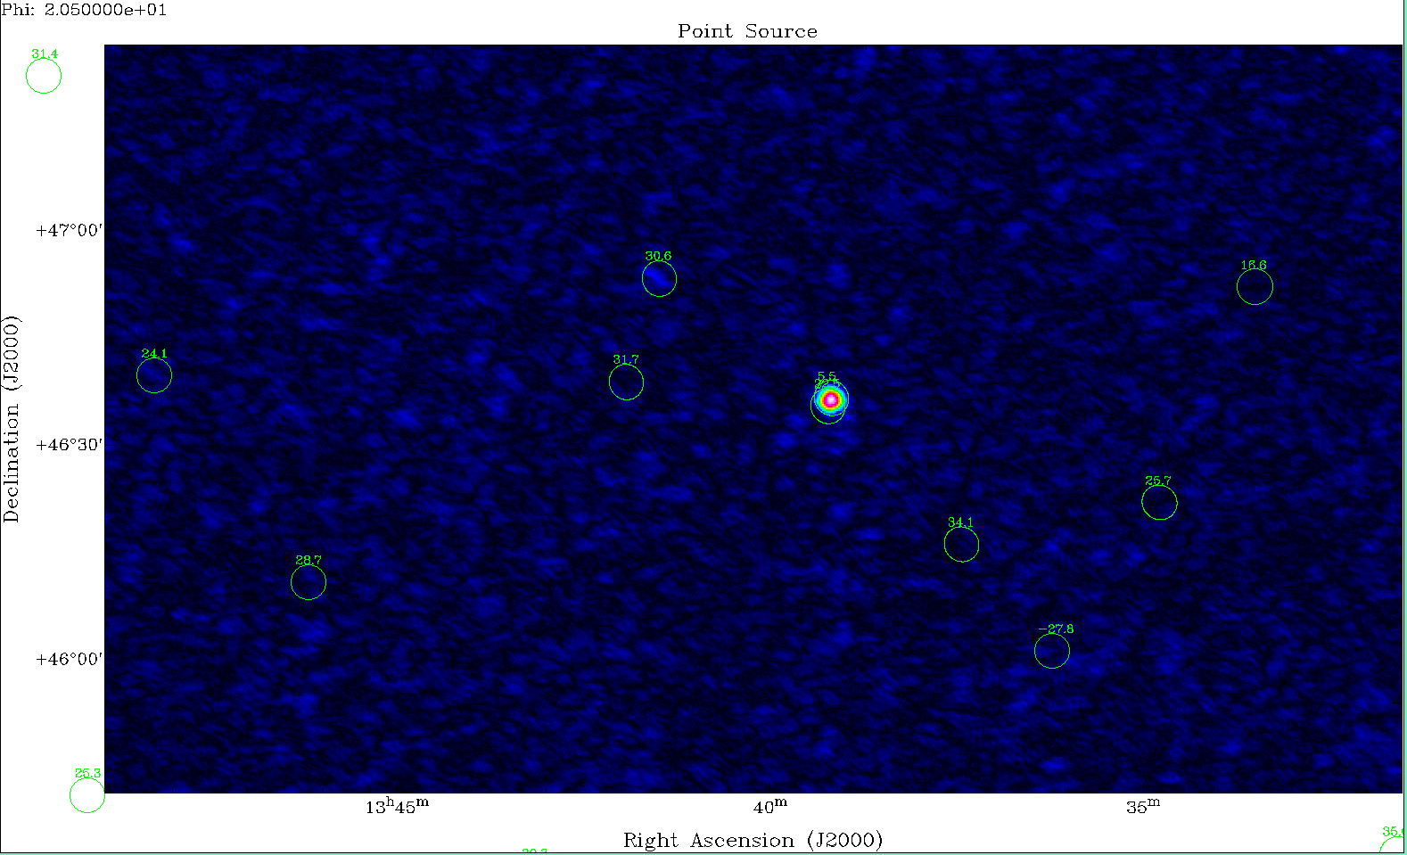

Slide 23
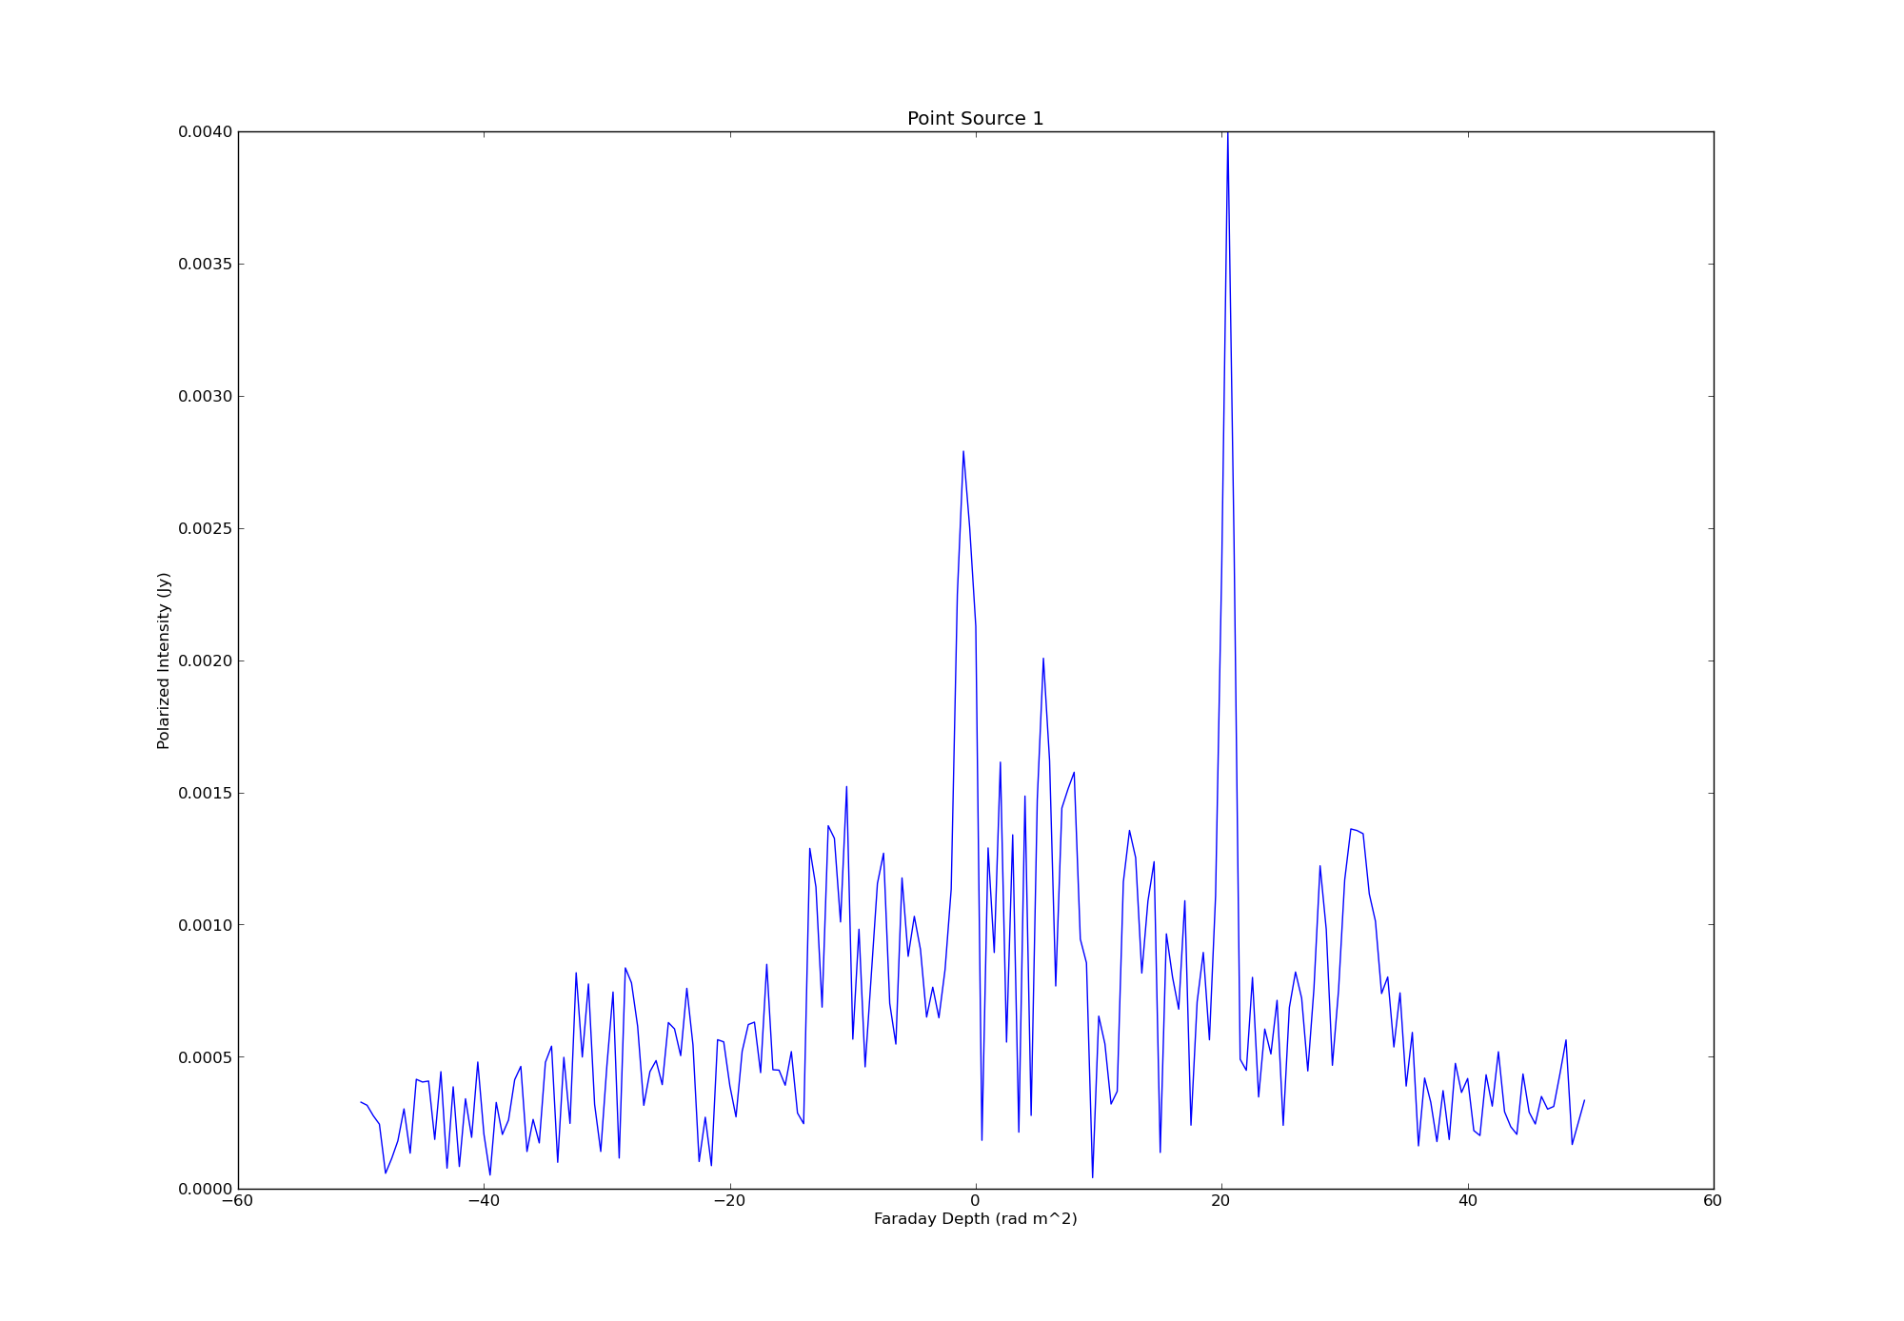
4mJy @
φ≈20.5 𝑟𝑎𝑑
P=1.5%

Slide 24
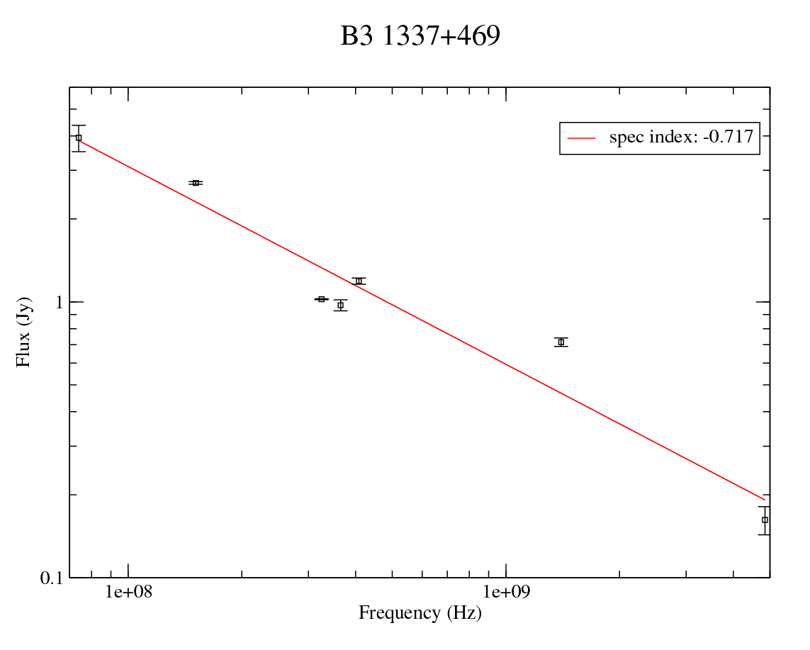
4mJy @
φ
P=1.5%

Slide 25
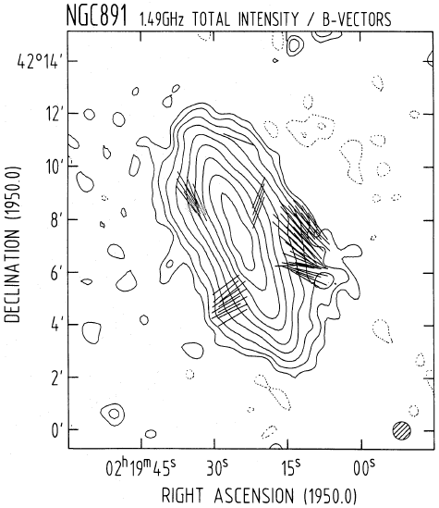
NGC891
NGC 891 was observed November 2012 for polarization calibration
commissioning reasons.
Was observed with the calibrator 3C48
NGC891 was observed in 10 min scans with 1 min scan on calibrator.
Gains were interpolated in time for amplitude calibration.
Hummel,Beck & Dahlem 1991

Slide 26
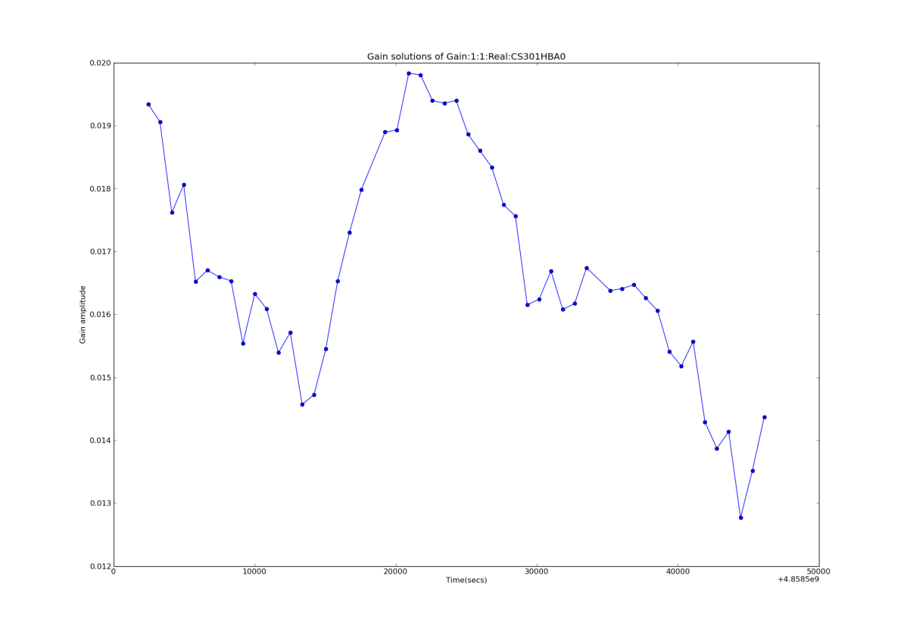
NGC891
NGC 891 was observed November 2012 for polarization calibration
commissioning reasons.
Was observed with the calibrator 3C48
NGC891 was observed in 10 min scans with 1 min scan on calibrator.
Gains were interpolated in time for amplitude calibration.

Slide 27
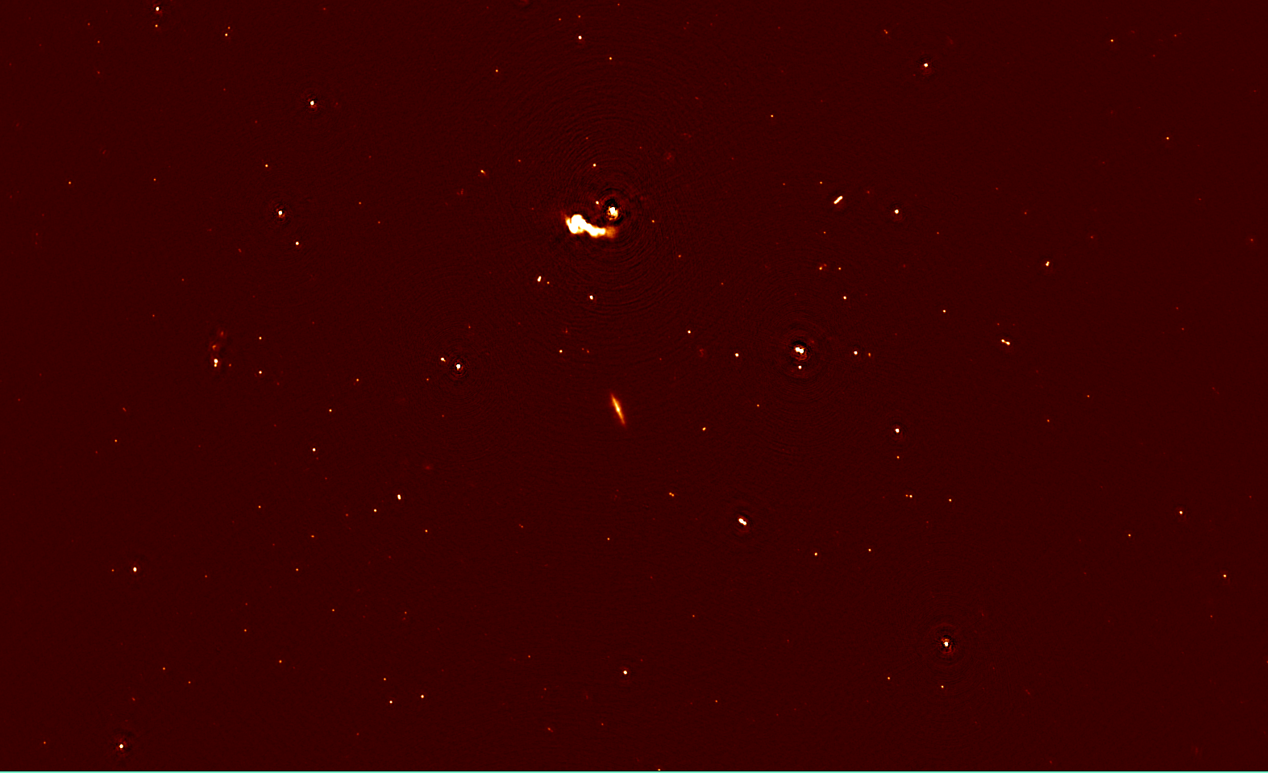
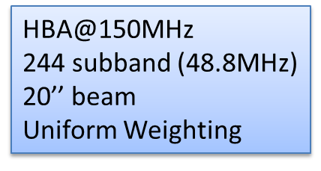

Slide 28
Noise in 1 Subband: 6mJy/Beam (156MHz)
Noise in 38 Subbands: 0.8 mJy/Beam
Noise for whole Bandwidth (244 SBs): 0.3 mJy/Beam

Slide 29
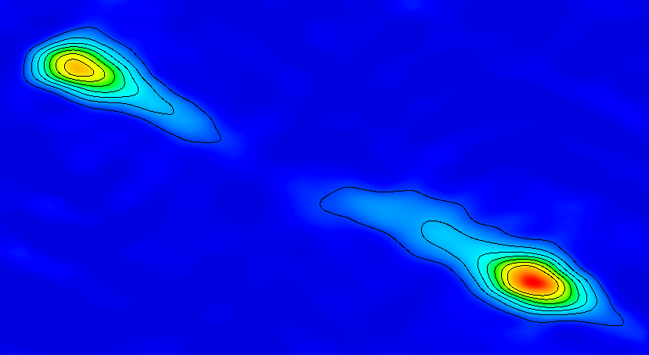
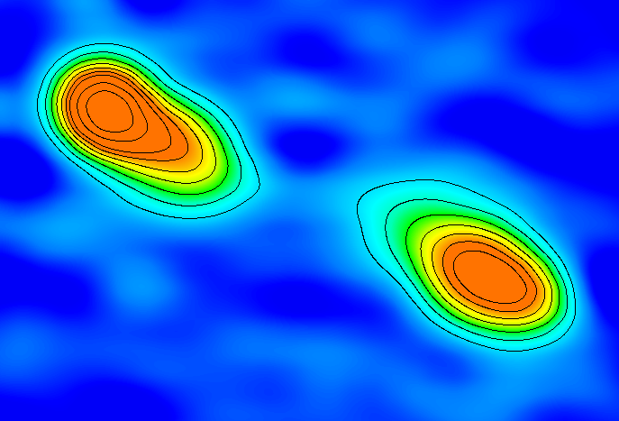
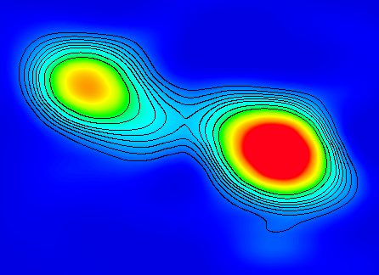
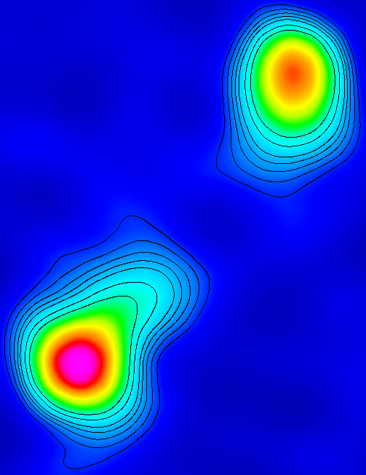
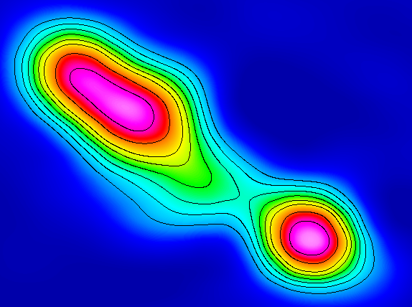
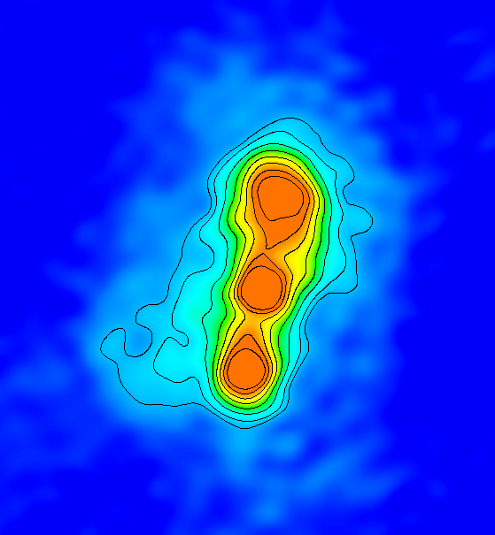
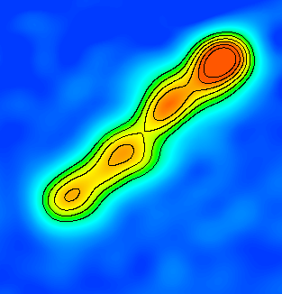
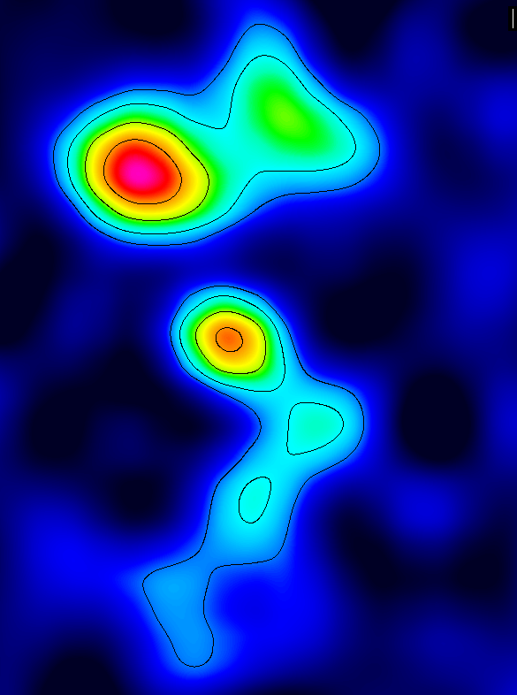
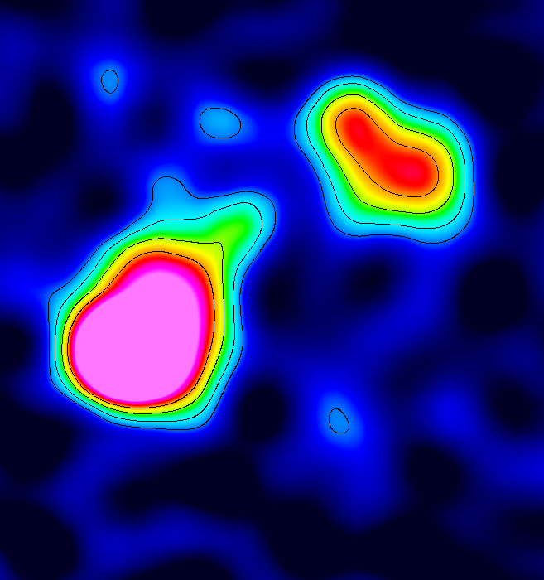
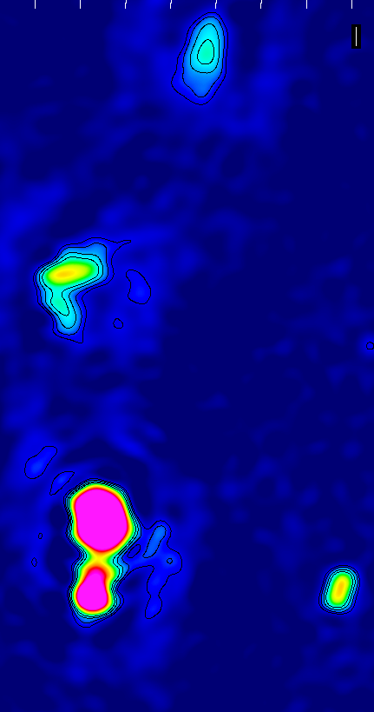

Slide 30
3C66 A/B

Slide 31
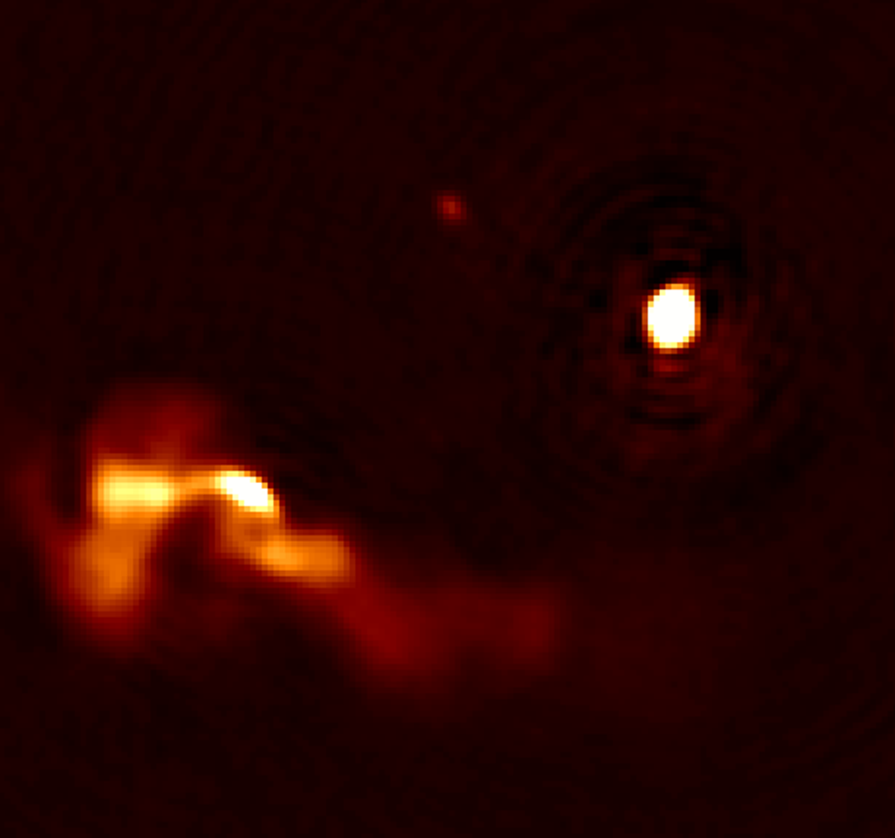
3C66 A/B

Slide 32
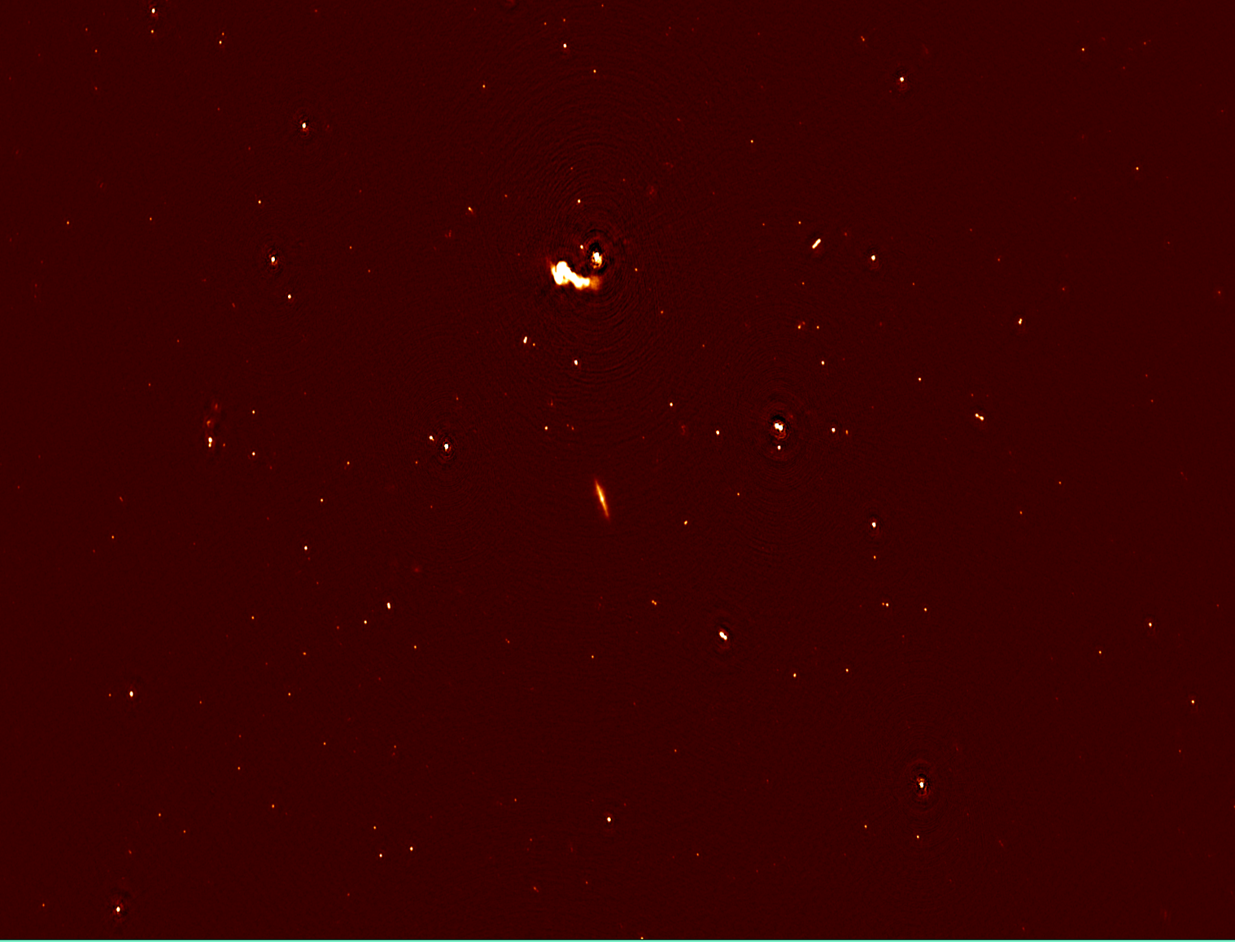
PSRJ 0218

Slide 33
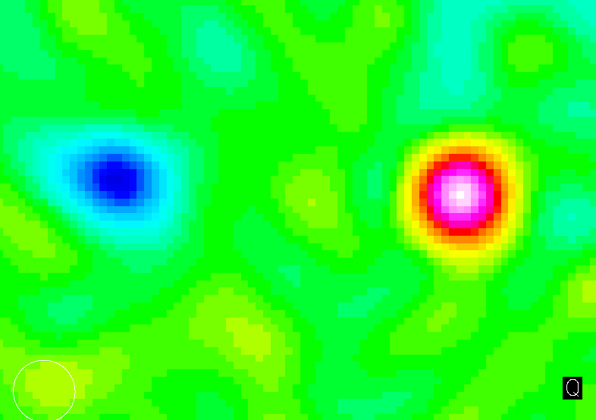
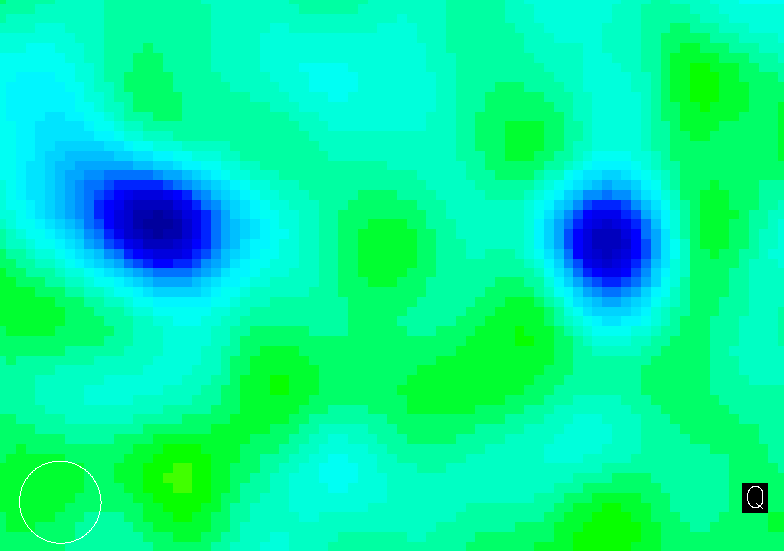
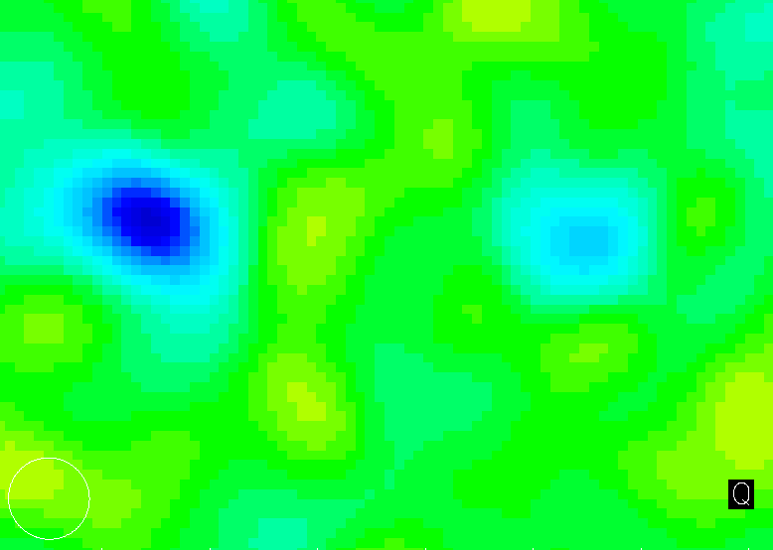
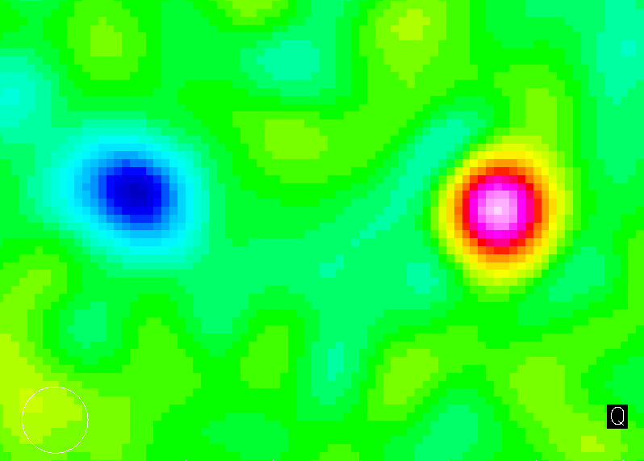
PSRJ 0218

Slide 34
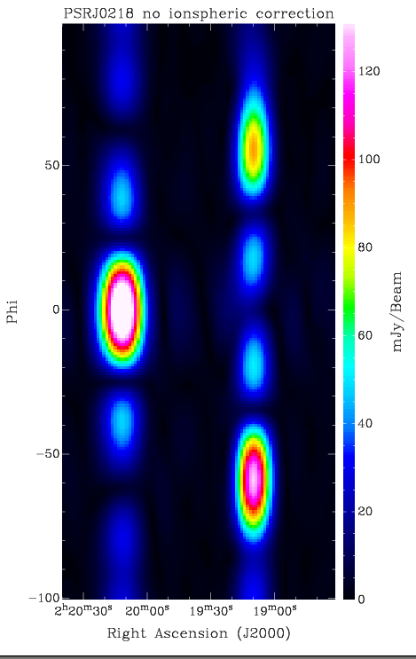
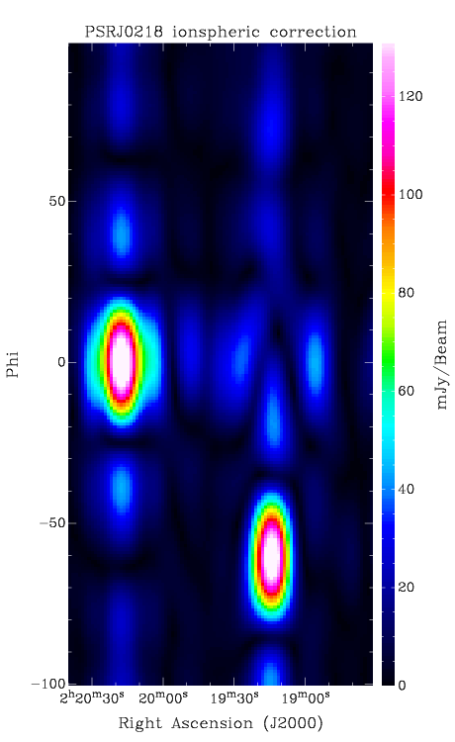
PSRJ0218

Slide 35
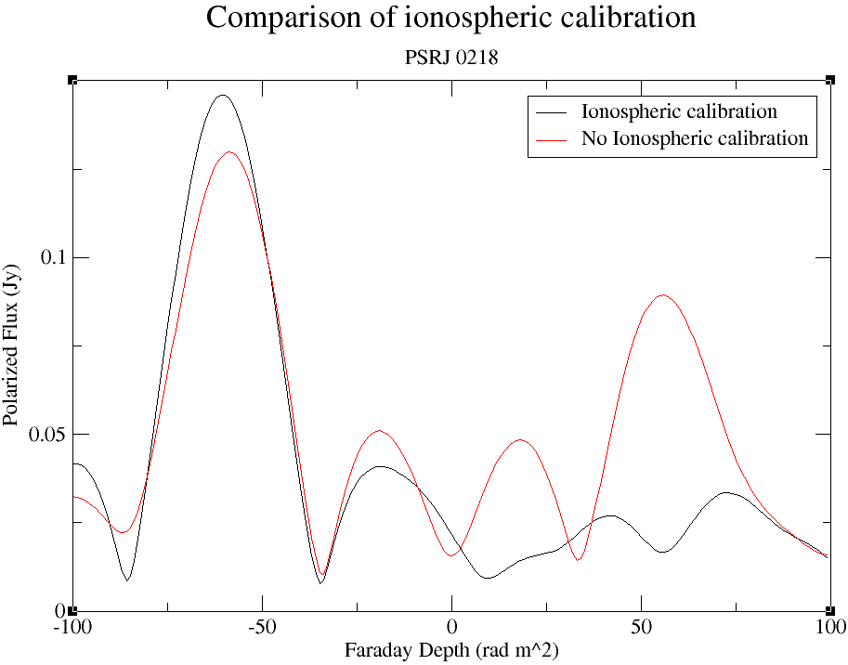

Slide 37
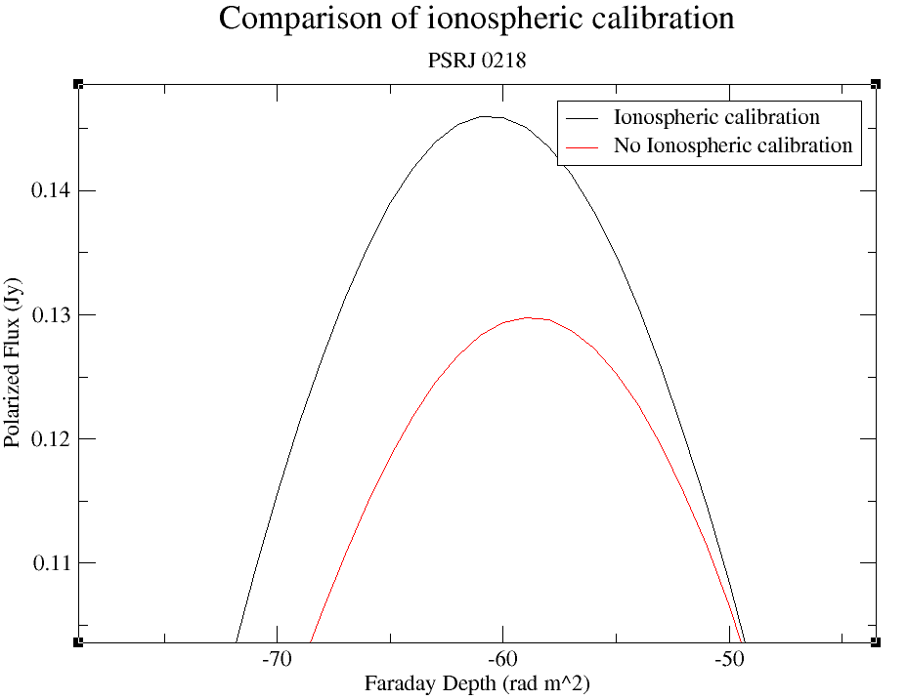

Slide 38
NGC891

Slide 39
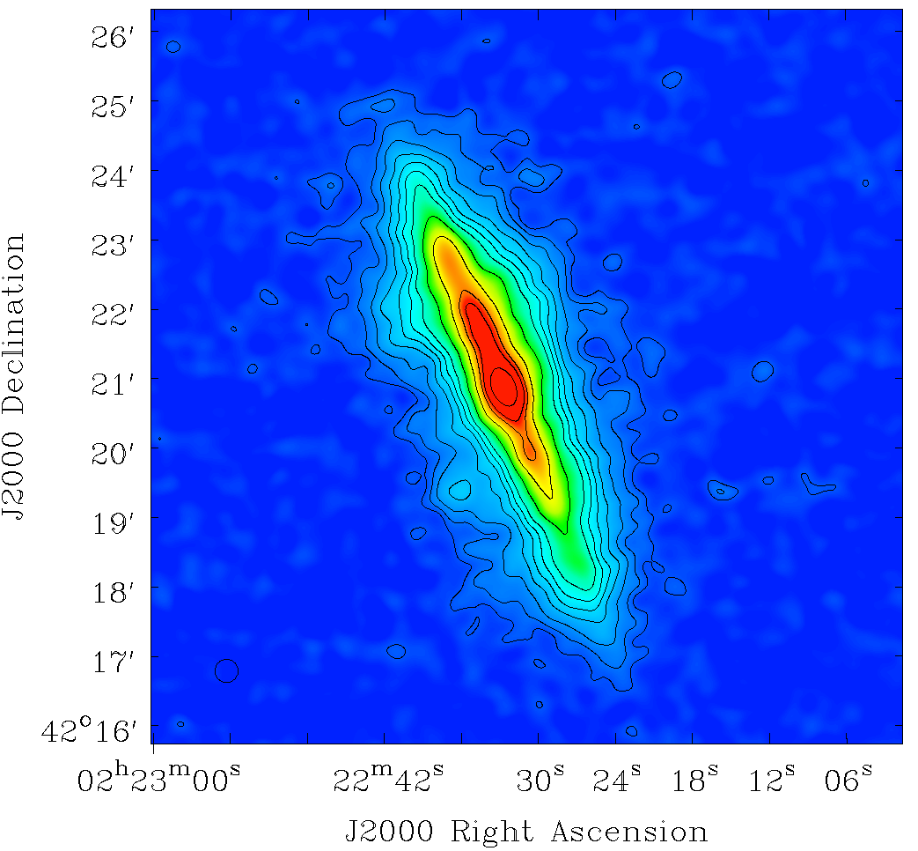
Noise:
0.8mJy/Beam

Slide 40
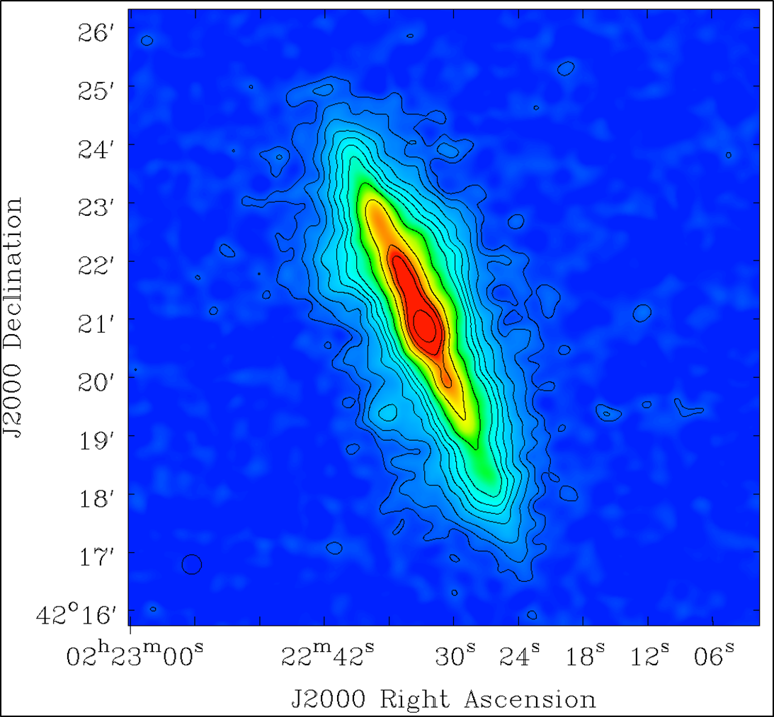
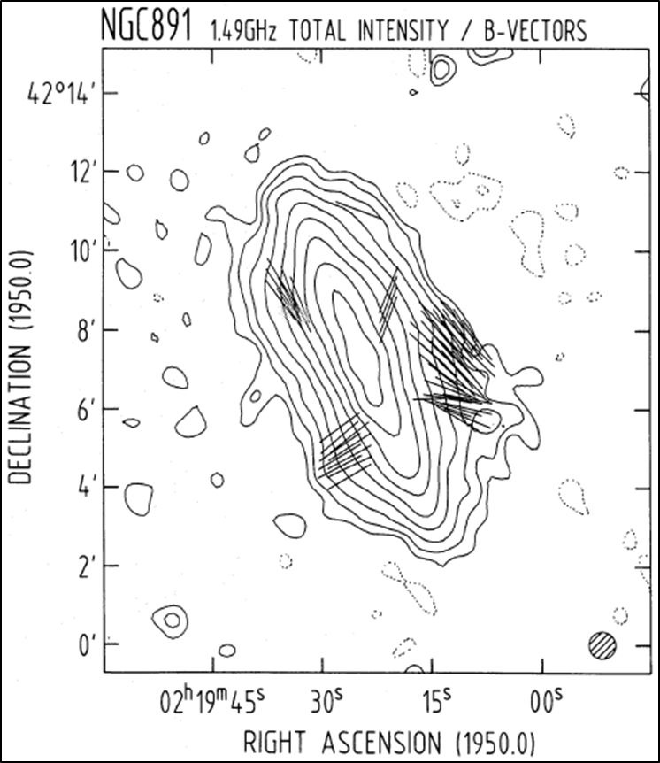

Slide 41
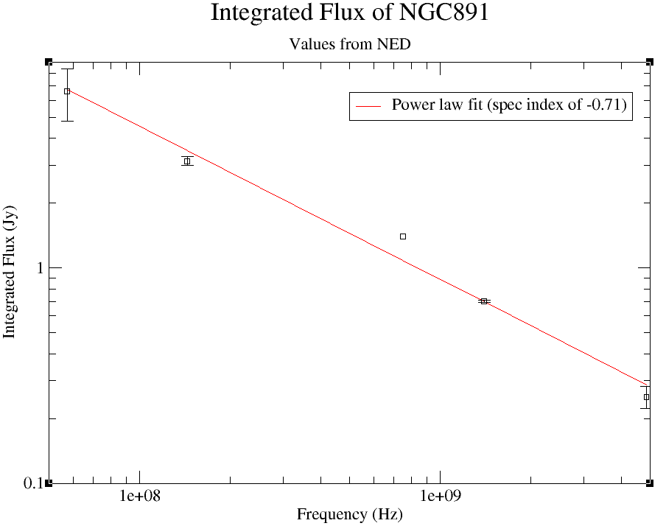

Slide 42
Summary
M51’s extended disk can be seen but doesn’t go as far out as we hoped.
We can observe that the arm and interarm contrasts are less visible at 150MHz than 1.4GHz.
No polarization has yet been seen in M51 but interesting foreground structures can been seen.
Important lessons learned from M51 dataset.
Initial direction independent calibration of NGC891 is complete with great results, 3C66 & 3C65 pushing up noise.
LOFAR has made a huge improvement in data quality within the last year.
Polarization calibration will be investigated further with PSRJ0218.

