Slide 1
Aperture Array Design & Construction Consortium
Low Frequency Aperture Array (LFAA)
AAVS1 Calibration
Prepared by: Randall Wayth

Slide 2
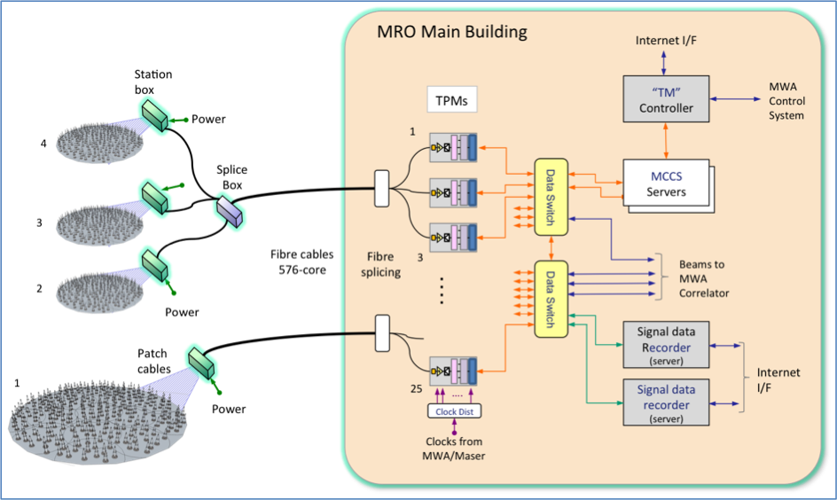
Background
For AAVS1, can we bootstrap a station calibration knowing only the sky and the locations of the antennas?
We require the “Array Covariance Matrix” generated inside the Monitor & Control & Calibration System (MCCS)

Slide 3
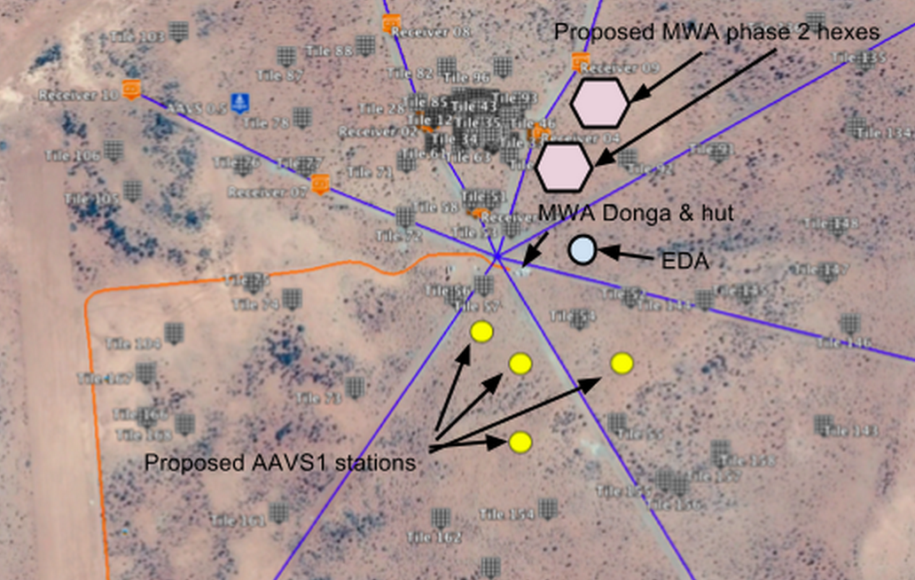
Location relative to MWA core

Slide 4
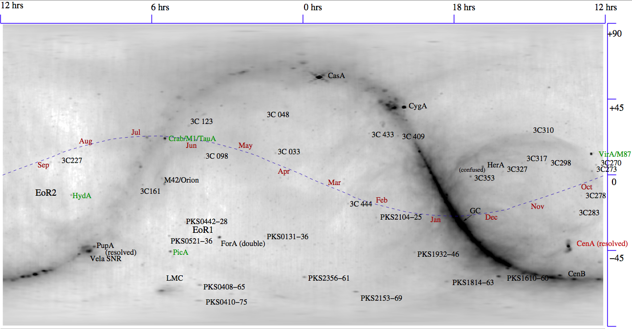
The radio sky @ 408 MHz

Slide 5
Stefan &Tim: Cal using compact sources
SKA-TEL-LFAA-0800003
Noted that sky power from diffuse emission >> from compact sources

Slide 6
Stefan &Tim: Cal using compact sources
Chunks of day when solutions do not converge

Slide 7
Goal: see if we can self-cal based on full sky model

Slide 8
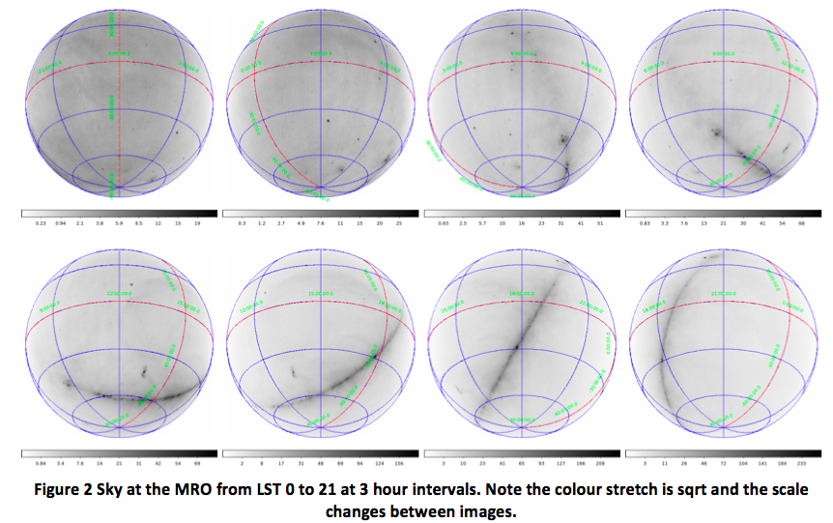
Document 0200006 (Cal Plan)
Full sky model based on Haslam used to calibrate simulated station visibilities.
Assumed identical antenna element pattern

Slide 9
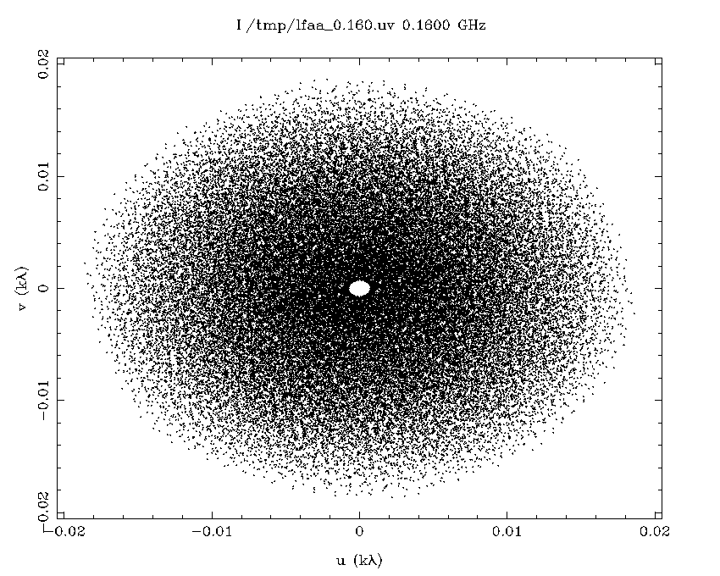
The u,v coverage of intra-station baselines within AAVS1

Slide 10
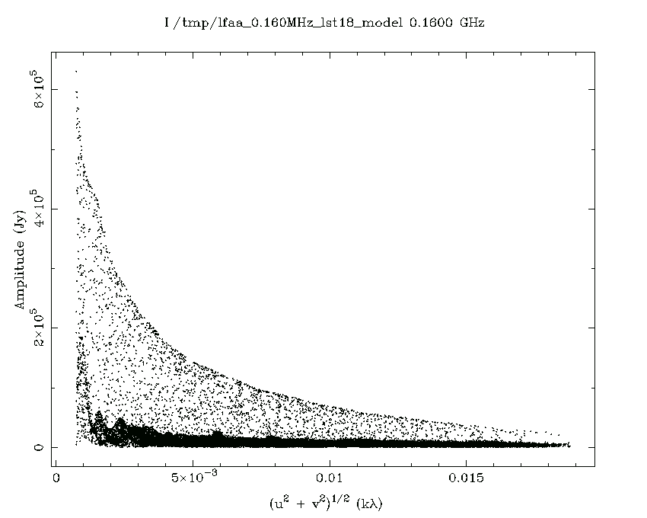
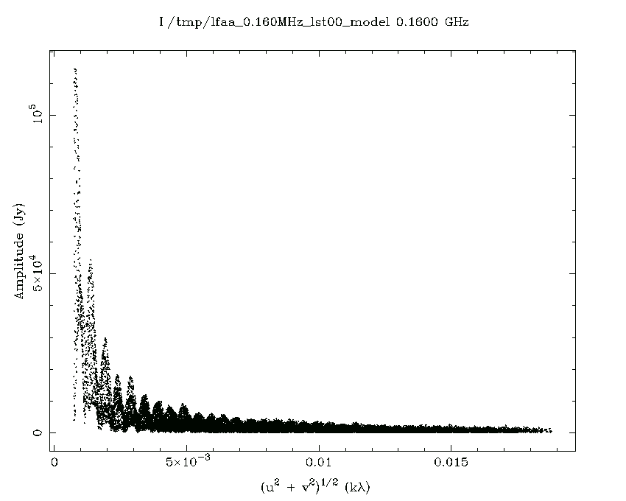
In simulation, it all looks good…
LST 18h
LST 0h

Slide 11
Zoom on LST 12 at 160 MHz
SEFD of antenna at 160 MHz
Is ~670000 Jy. Hence, noise on vis for 1s, 1 MHz integration is ~670 Jy.

Slide 12
Simulated calibration results

Slide 13
Tests with the MWA
Goal is to emulate single element calibration with MWA
Turn off all but 1 dipole off in MWA tile (i.e. single element tile)
Use only inner core tiles, specifically receivers 1,2,3,4,6 plus some core tiles on receivers 8 and 9
Diameter of tiles used approx 60m
The test uses 4 minute observation at LST 9.3
At this time, southern Gal plane is up (including PupA), as well as HydA, CenA and VirA
30 MHz bandwidth centred on 155 MHz, however each 1.28 MHz freq chunk is calibrated independently
Calibration assumes sky is constant over the entire freq range (not really correct, but close enough for this)

Slide 15
u,v coverage AAVS1 vs MWA core subset
Approx 1/6 the antennas, but more integration time.

Slide 16
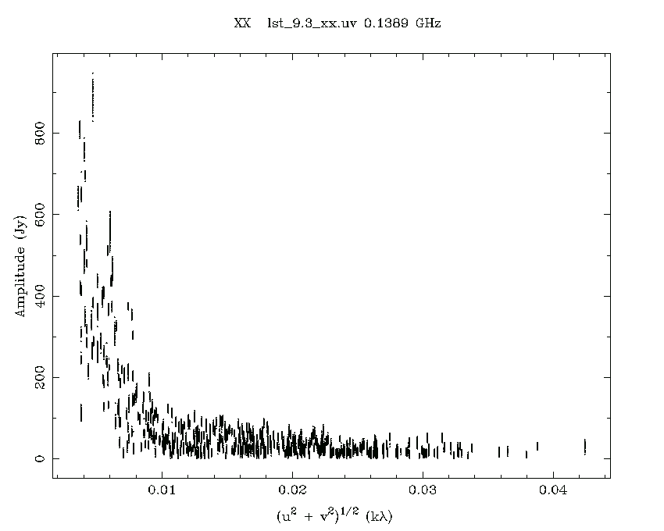
Comparison of uncalibrated vs calibrated visibilities
Uncalibrated
Calibrated

Slide 17
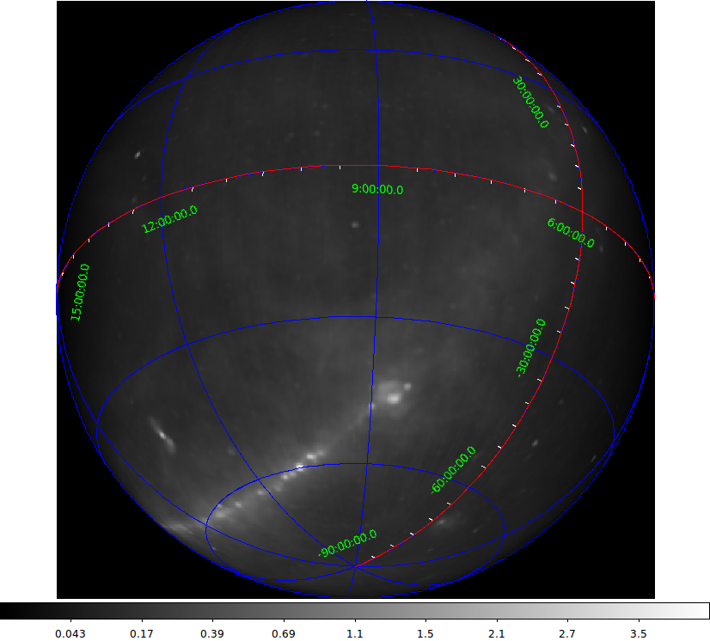
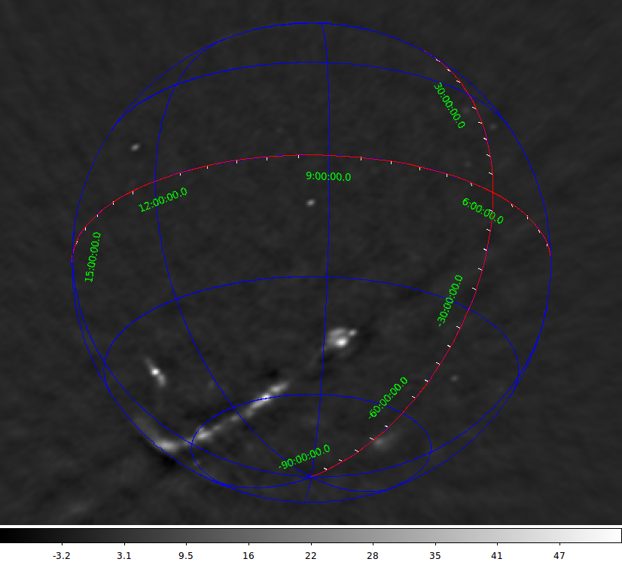
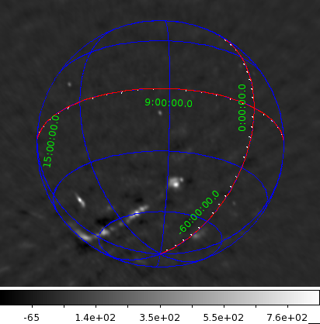
Sky model and image of sky from MWA
Sky model
Selfcal image
Phase transfer image
Notes:
Phase transfer image made using calibration solutions from a separate observation on HydA (with full MWA tiles) and transferred to these data.

Slide 18
Notes
Even with much fewer baselines than AAVS1 and a super simple sky model, it worked.
Element radiation pattern for single MWA dipole will be much more uniform between tiles than the AAVS1 dipole patterns (see next slide)

Slide 19
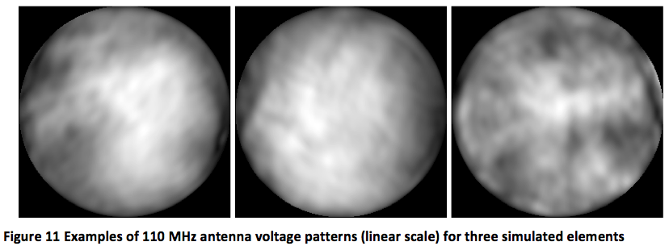
Effects of individual beams
Variations in simulated individual element patterns (courtesy Eloy) show ~10% variations in voltage pattern between different elements. Likely to be most unrealistic part of this simulation.
Real system should incorporate proper element patterns.

Slide 20
The path ahead
Need to generate intra station visibilities early and often. Priority should be given to MCCS correlation system
Max bandwidth for max integration time should be the goal
Tools to automate conversion of raw data to ms or uvfits will greatly speedup the commissioning process
Required: known positions of AAVS elements
Not required: accurate cable lengths/delays
We are likely to need simulations of the element patterns for each element for each coarse channel over freq range of interest
Can we use existing calibration tools (e.g. CASA) rather than writing our own code?

Slide 21
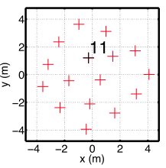
0800010 - CALIBRATION OF INDIVIDUAL AAVS1 ANTENNAS WITH THE MWA
Summary of document:
cross-correlation with MWA tiles can be used to solve for complex gains of individual AAVS1 antennas.
useful for diagnostics, including measuring complex gain in signal path and characterising embedded elements.
e.g. SKALA11 in AAVS0.5:
After correction for inner product between MWA tile beam and embedded SKALA11 pattern:
Freq (MHz)

