Slide 1







Recent Results with the UAV-based Array Verification and Calibration System
Giuseppe Virone
POLITECNICO DI TORINO
DIATI

Slide 2

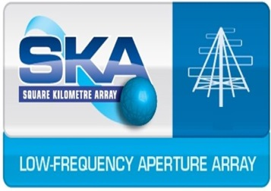
Framework
Research contract between INAF and CNR-IEIIT
Title: Power Pattern Measurements on the Modern Low-Frequency Arrays for Radioastronomy (AAVSx, LOFAR, SAD) and Feasibility of Phase Pattern Measurements
INAF PI: Jader Monari and Pietro Bolli
CNR PI: Giuseppe Virone
Partner : Politecnico di Torino- DIATI, Resp. Prof. Andrea M. Lingua
Official initial date: September 2015
TECNO INAF 2014
Title: Advanced calibration techniques for next generation low-frequency radio astronomical arrays
PI: Pietro Bolli (OAA) – co-PI: Giuseppe Pupillo (IRA-MED) and Tonino Pisanu (OAC)
Official initial date: April 2015
Research grant (18 months) to Salvo Pluchino (IRA-Noto)
External collaborators: Stefan Wijnholds, Andrea Lingua and Giuseppe Virone

Slide 3
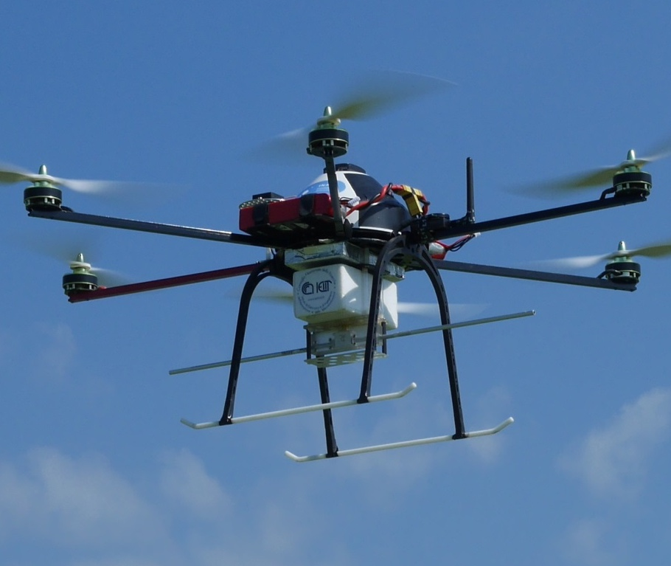
Flying Far-field Test Source
A micro hexacopter is used as far-field RF source
flying over the AUT
UAV equipped with a continuous-wave RF transmitter and a dipole antenna
The UAV autonomously performs quasi-rectilinear, constant height paths (GPS navigation) e.g. E-plane or H-plane cuts
Automatic take-off and landing
Differental GNSS system to track the position (accuracy few cm)
On-board IMU to measured attitude (pitch, roll, yaw)
RF transmitter
Dipole antenna

Slide 4
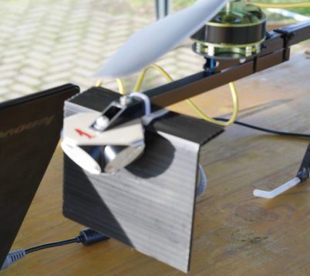
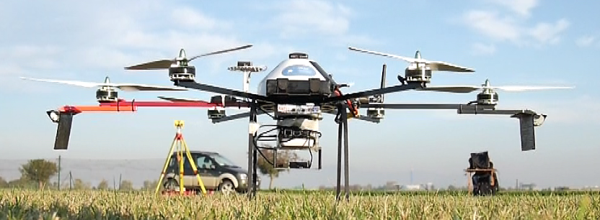
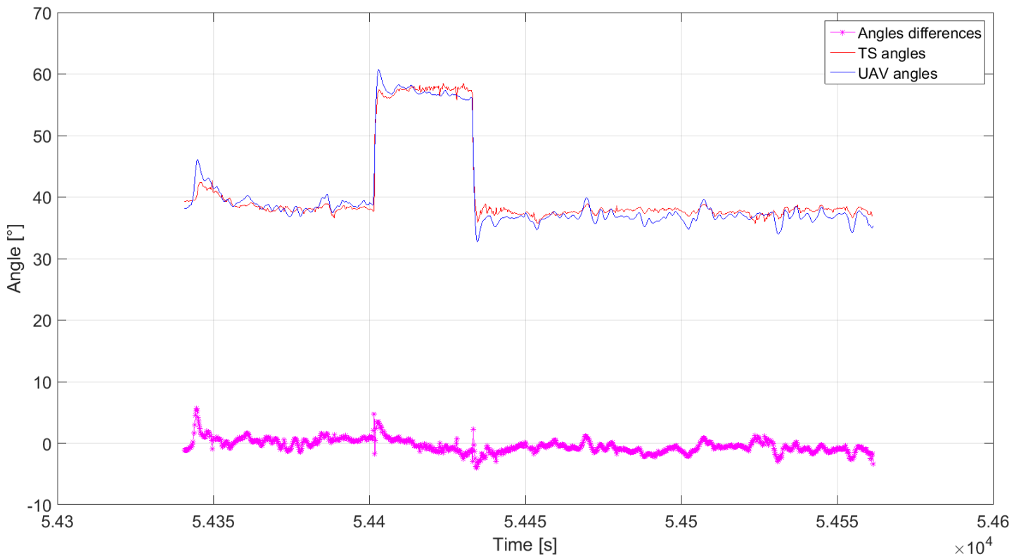
Compass Verification
DIATI
Two scatterers on the UAV
Two total station pointing the UAV (accuracy 1 cm)
The other angles could be verified as well
mean = - 0,547°, std = ±0,867°

Slide 5
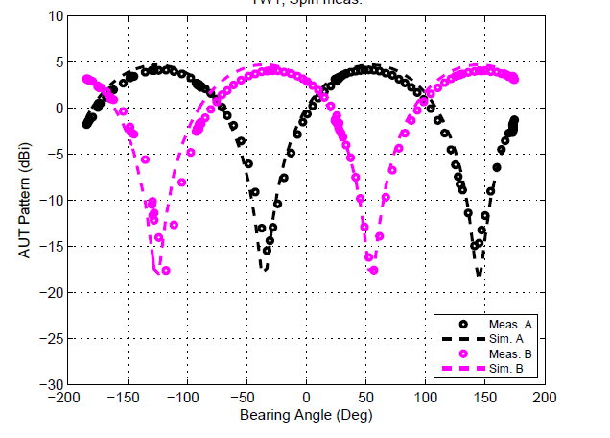
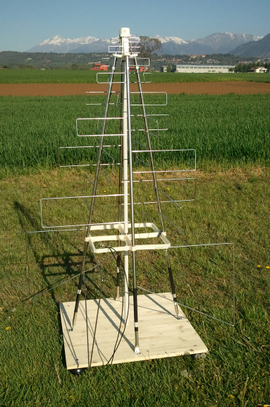
SKALA 2.0 Pattern from 50 to 650 MHz
Courtesy of
Spin Flight at 50 MHz
SKALA dual log-periodic antenna working from 50 to 650 MHz.
Height is about 1.8 m
E-plane at 650 MHz

Slide 6
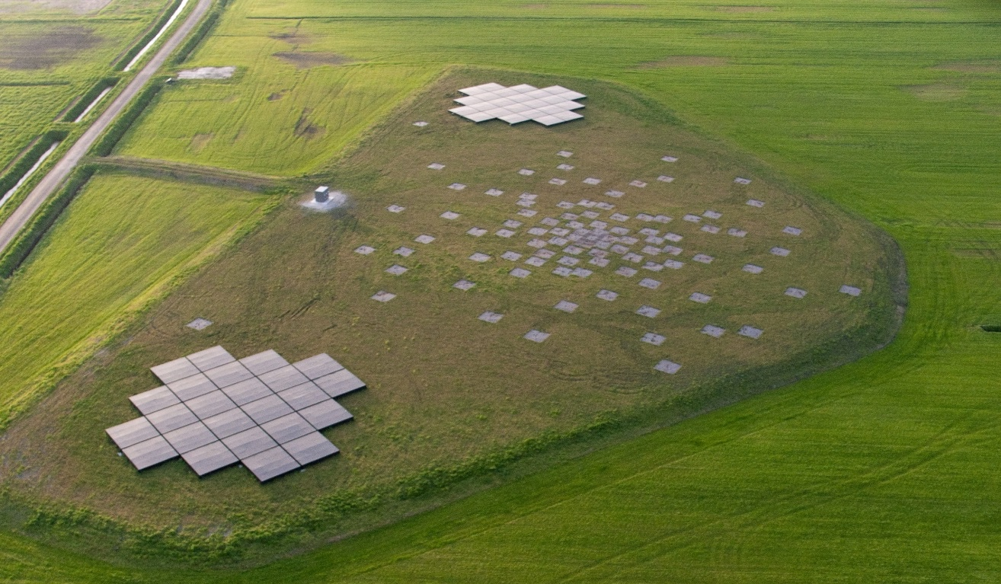
LOFAR campaign April 2016
in collaboration with Stefan Wijnholds and Menno Norden
Aerial View of a LOFAR station (The Netherlands)
UAV to perform an end-to-end system verification
LBA inner
Three Arrays in Three Days
with
Multi-frequency TX
(almost 300 Patterns/Flight)
Embedded Element Patterns
Array Calibration and Pattern
Antenna positions (SW’s talk)
HBA half
LBA outer
Courtesy of
LBAinner: 48 dual-pol elements (random quasi-dense) 10-80 MHz
LBAouter: 48 dual-pol elements (random sparse) 10-80 MHz
HBA: 48 tiles having 16 dual-pol bow-ties (dense) 120-240 MHz

Slide 7
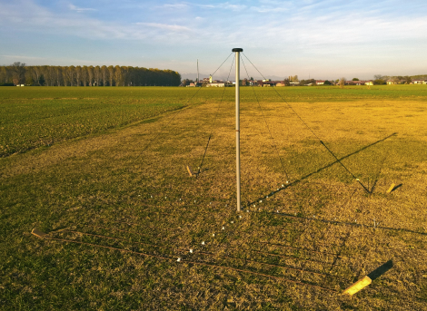
LOFAR LBA antenna in Turin
LOFAR Low-Band Antenna in Turin
Courtesy of:
LBA simulation by Michel Arts using WIPL-D
dB
LBA antenna consists of a pair of crossed inverted-V dipoles operating from 10 to 80 MHz.
Antenna height is 1.7 m, width is about 3 m

Slide 8
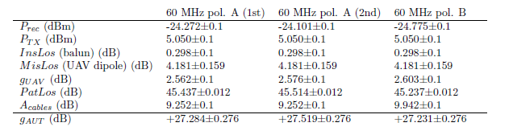
Gain Measurement

Slide 9
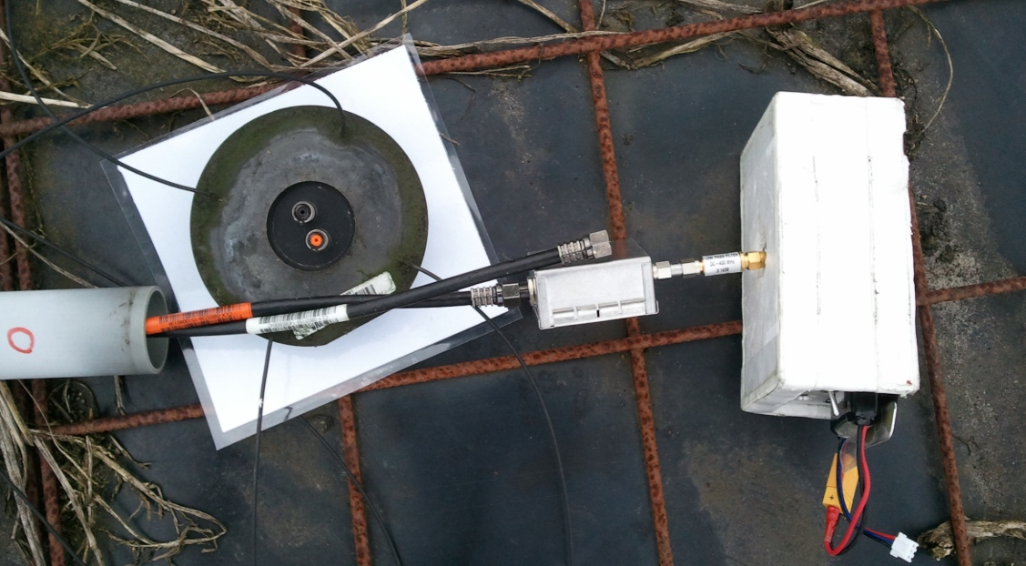

Gain Measurement

Slide 10
Embedded Element Pattern LBA inner
Element 0: E-plane
44.5 MHz
57 MHz

Slide 11
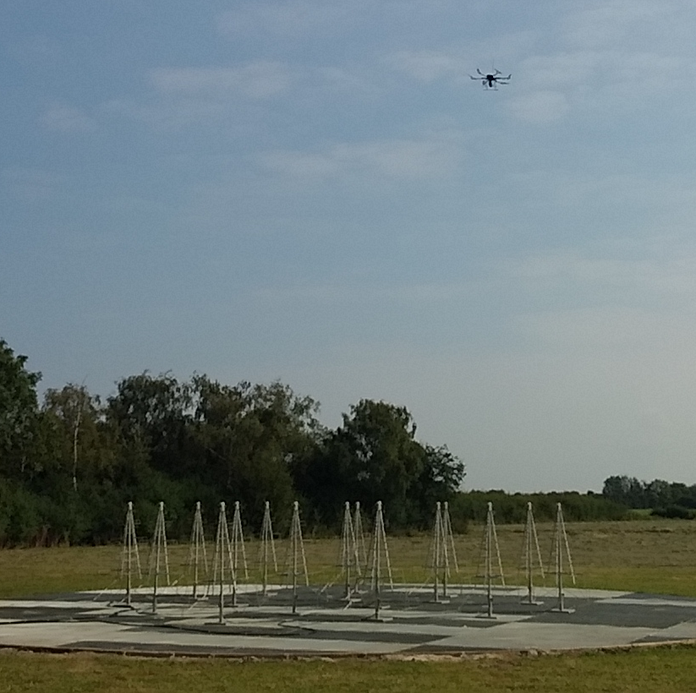
AAVS0.5 Embedded Element Patterns at 50 and 350 MHz
Phi=0° - 50 MHz
Mullard Radio Astronomy Observatory (UK)
Courtesy of
Phi=0° - 350 MHz

Slide 12

Phase of Cross Correlation Coefficient at 44.5 MHz
UAV at zenith above central element of the LBA inner
(length 13.7 m)
Measurement
$K(R^{0}$-$R^{40})$

Slide 13
Residual Phase Value
Measured RMS
RMS estimated from GNSS precision
For shorter baselines where the elements see the UAV at the same observation angle, this residual correspond to the calibration coefficient

Slide 14
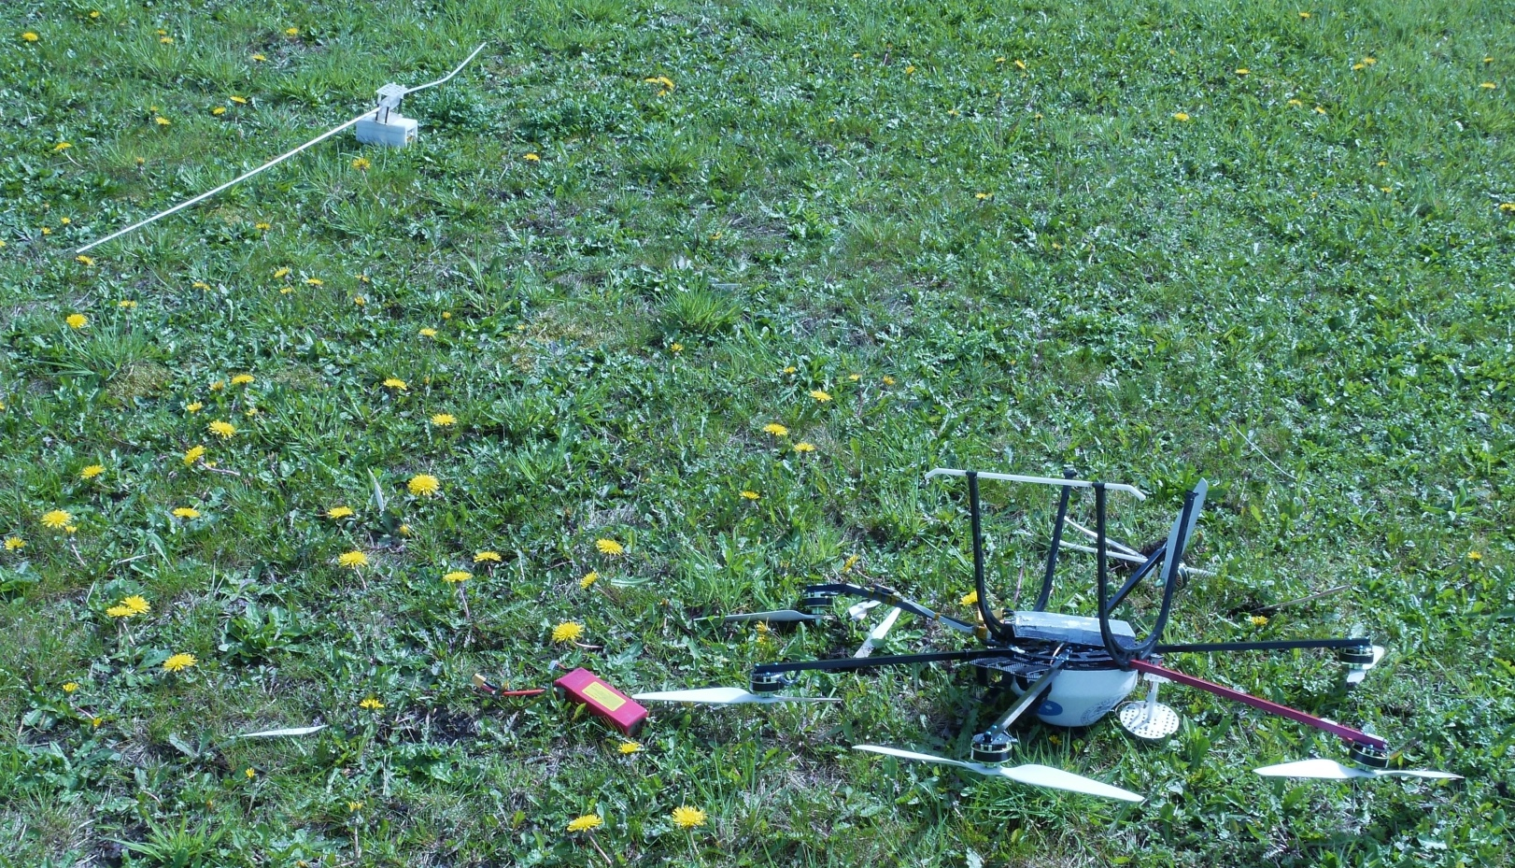
Second Day: Wind Speed 35 km/h
Cause not yet fully understood
The day before the wind was even faster. The UAV was not able to follow the preset path but was still able to land automatically
The values of attitude angles (pitch about 20 Deg) are less accurate
All the attitude traces are more noisy

Slide 15
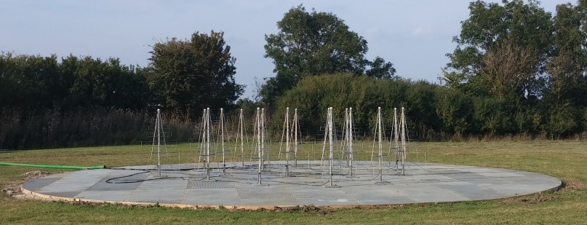

Near-field scan and Relative Phase Measurements
Ideas for the Upcoming Cambridge pre-AAVS1 Campaign
Phase Reference
Correlator
Measured Phase
$φ^{out}=φ^{array}−φ^{ref}−K(R^{array}$-$R^{ref})$

Slide 16

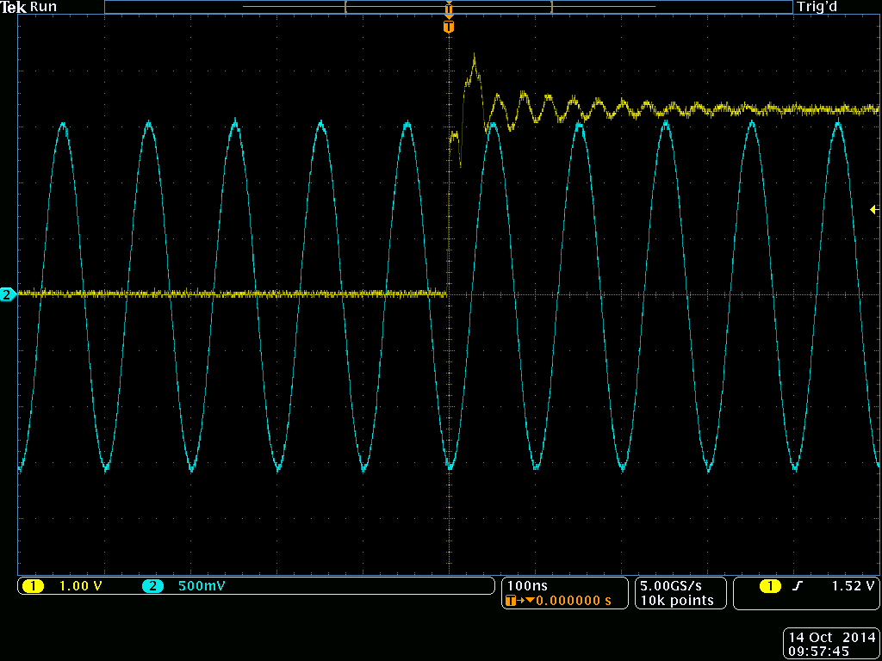
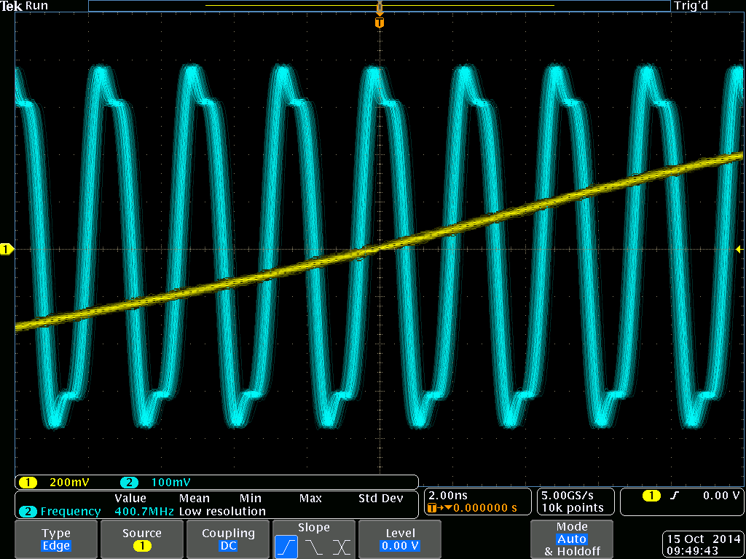
Ongoing: Phase-Locked UAV Transmitter
RF oscillator locked with the GNSS PPS signal
Independent of Reference Antennas
Copy of the transmitted signal
Correlator
Trimble: 10MHz + PPS
Valon: 10 MHz ref. + 400 MHz fout

Slide 17
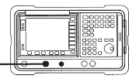
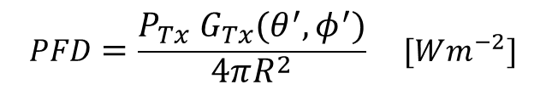

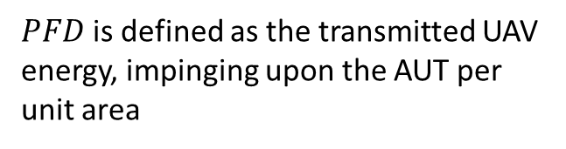


Ongoing: UAV-based Sensitivity Measurements
by G. Pupillo and S. Pluchino
The proposed method allows to measure the Sensitivity (${A_{eff}/ T}_{sys}$) of the system, including all its parts, in the operating environment.
The method estimates the Power Flux Density at AUT
UAV
$${ \text{G}}_{}^{Tx}\left(θ^{′},φ^{′}\right)$$
$$PFD=\frac{P_{Tx}{ G}_{Tx}\left(θ^{′},φ^{′}\right)}{4πR^{2}} [Wm^{−2}]$$
$$R$$
$PFD$is defined as the transmitted UAV energy, impinging upon the AUT per unit area
$$P_{meas}$$
AUT
Soil
Notes:
We know the distance R between AUT and UAV (from the UAV position GNSS measurements), the transmitted power and the gain of the transmitting system in the AUT direction.
Therefore the Power Flux Density of the transmitted UAV signal impinging upon the AUT per unit area can be calculated.

Slide 18


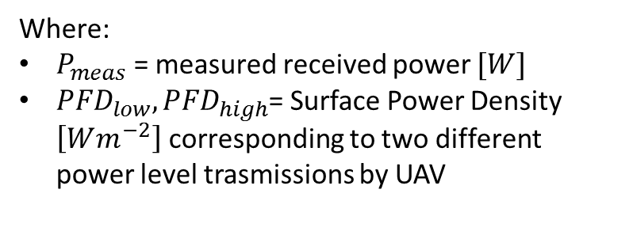
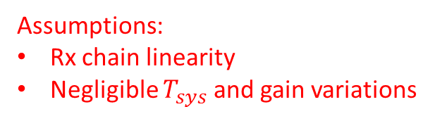
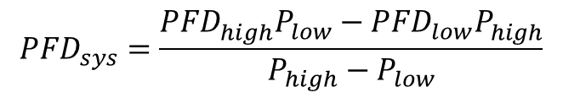
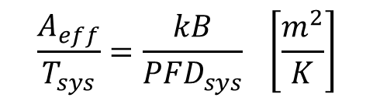







UAV-based Sensitivity measurements
by G. Pupillo and S. Pluchino
$$P_{meas}[W]$$
$${PFD}_{sys}=\frac{{PFD}_{high}^{}P_{low}^{}−{PFD}_{low}^{}P_{high}^{}}{P_{high}−P_{low}}$$
$$P_{high}^{}$$
$$P_{low}^{}$$
The sensitivity can be estimated by mean of ${PFD}_{sys}$ as follow:
$$O$$
$${PFD}_{low}$$
$${PFD}_{high}$$
$$\frac{A_{eff}}{T_{sys}}=\frac{kB}{{PFD}_{sys}} \left[\frac{m^{2}}{K}\right]$$
$${−PFD}_{sys}$$
$$PFD [Wm^{−2}]$$
Where:
$P_{meas}$ = measured received power $[W]$
${PFD}_{low},{PFD}_{high}$= Surface Power Density $\left[Wm^{−2}\right]$ corresponding to two different power level trasmissions by UAV
Tasks to be done:
Error budget investigation
Simulations
Test on the field
Assumptions:
Rx chain linearity
Negligible $T_{sys}$ and gain variations

Slide 19
Conclusion
Good results obtained on single element, embedded-element patterns from 50 to 650 MHz
UAV flying test source as an
end-to-end verification and calibration system
Advantages of UAV-based antenna measurements:
  Measurements in the real installation conditions
  Beam pattern measurements on arrays and instrument calibration are possible (see G. Pupillo, et al. “Medicina Array Demonstrator: calibration and radiation pattern characterization using a UAV-mounted radio-frequency source,” Experimental Astronomy, pp. 1-17, Apr. 2015
  Low cost, portability, no infrastructures

Slide 21
Phase measurements - CABLES
400 MHz
400 MHz

Slide 22


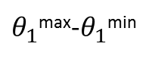

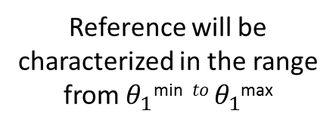
Relative Phase Measurements
Reference characterization
In a vertical Flight $φ^{array}$ is constant
$θ_{1}$^{max}-$θ_{1}$^{min}
$$θ_{1}$$
Reference will be characterized in the range from ${θ_{1}\text{min} to θ}_{1}$^{max}
Correlator
$φ^{out}=φ^{array}−φ^{ref}−K(R^{array}$-$R^{ref})$

