Slide 1







AADC: Aperture Array Design & Construction Consortium
LFAA: Low Frequency Aperture Array
Array Prototypes
Bologna, 11 May 2016, 9:30 AM
Adrian Sutinjo, Curtin University

Slide 2
Highlights
AAVS0.5 characterization:
A. Sutinjo, T. Colegate, R. Wayth, P. Hall, E. de Lera Acedo, T. Booler, A. Faulkner, L. Feng, N. Hurley-Walker, B. Juswardy, S. Padhi, N. Razavi-Ghods, M. Sokolowski, S. Tingay, and J. G. bij de Vaate, “Characterization of a low-frequency radio astronomy prototype array in Western Australia,” IEEE Trans. Antennas Propagat., vol. 63, no. 12, pp. 5433-5442, Dec. 2015.
Hybrid AAVS0.5/SKALA-MWA interferometry:
A. Sutinjo, D. Ung, T. Colegate, R. Wayth, P. Hall, E. de Lera Acedo, “Interferometry with hybrid low-frequency radio astronomy arrays,” submitted to IEEE Trans. Antennas Propagat., Mar. 2016.

Slide 3
Highlights
AAVS0.5 characterization:
A. Sutinjo, T. Colegate, R. Wayth, P. Hall, E. de Lera Acedo, T. Booler, A. Faulkner, L. Feng, N. Hurley-Walker, B. Juswardy, S. Padhi, N. Razavi-Ghods, M. Sokolowski, S. Tingay, and J. G. bij de Vaate, “Characterization of a low-frequency radio astronomy prototype array in Western Australia,” IEEE Trans. Antennas Propagat., vol. 63, no. 12, pp. 5433-5442, Dec. 2015.
Hybrid AAVS0.5/SKALA-MWA interferometry:
A. Sutinjo, D. Ung, T. Colegate, R. Wayth, P. Hall, E. de Lera Acedo, “Interferometry with hybrid low-frequency radio astronomy arrays,” submitted to IEEE Trans. Antennas Propagat., Mar. 2016.
We have significant experience measuring and characterizing low-frequency aperture arrays in the field
We understand the how to work with antennas of different designs and its implications on astronomical calibration

Slide 4
Highlights
RFoF & Fiber (Fibre, for those so inclined amongst us) Optics:
Stability of 2 km surface-laid fiber:
B. Juswardy, “Field test result at the MRO to assess gain & phase variation of fibre-optic cable, “SKA-TEL.LFAA.RE.AST-AADC-R-001, 2015-2-15
11 km buried fiber:
B. Juswardy, “Field test result of the 11-km buried fibre-optic cable at the MRO,” SKA-TEL-LFAA-0800005, 2015-9-17

Slide 5
Highlights
RFoF & Fiber (Fibre, for those so inclined amongst us) Optics:
Stability of 2 km surface-laid fiber:
B. Juswardy, “Field test result at the MRO to assess gain & phase variation of fibre-optic cable, “SKA-TEL.LFAA.RE.AST-AADC-R-001, 2015-2-15
11 km buried fiber:
B. Juswardy, “Field test result of the 11-km buried fibre-optic cable at the MRO,” SKA-TEL-LFAA-0800005, 2015-9-17
We understand factors that influence fiber stability and their impacts on array calibration

Slide 6
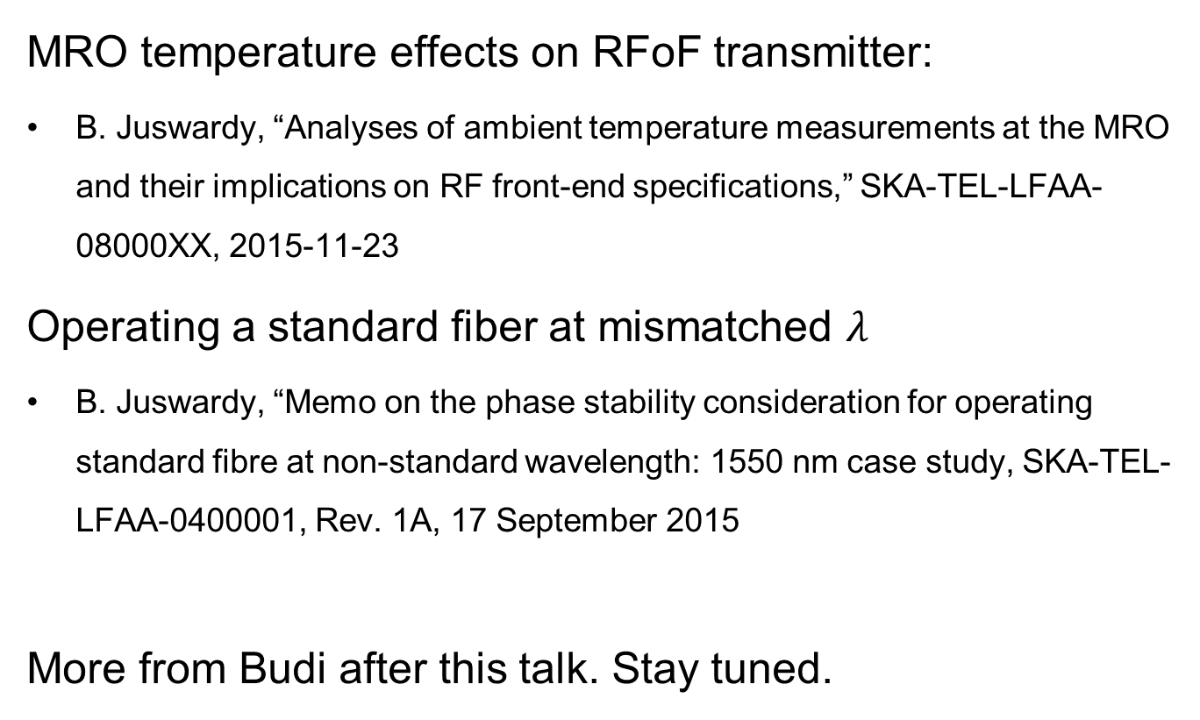
Highlights
MRO temperature effects on RFoF transmitter:
B. Juswardy, “Analyses of ambient temperature measurements at the MRO and their implications on RF front-end specifications,” SKA-TEL-LFAA-08000XX, 2015-11-23
Operating a standard fiber at mismatched $λ$
B. Juswardy, “Memo on the phase stability consideration for operating standard fibre at non-standard wavelength: 1550 nm case study, SKA-TEL-LFAA-0400001, Rev. 1A, 17 September 2015
More from Budi after this talk. Stay tuned.

Slide 7
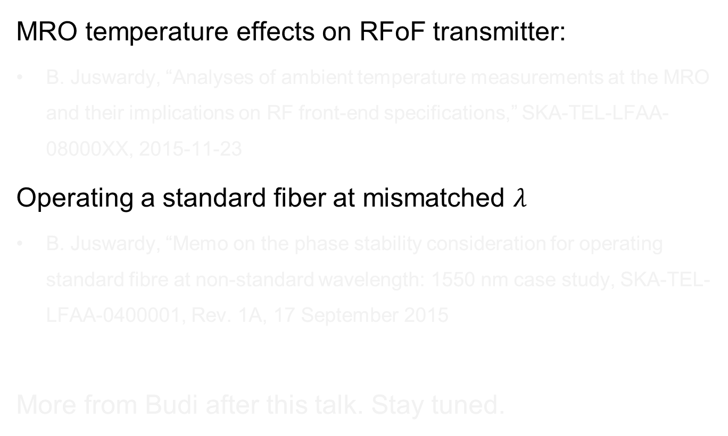
Highlights
MRO temperature effects on RFoF transmitter:
B. Juswardy, “Analyses of ambient temperature measurements at the MRO and their implications on RF front-end specifications,” SKA-TEL-LFAA-08000XX, 2015-11-23
Operating a standard fiber at mismatched $λ$
B. Juswardy, “Memo on the phase stability consideration for operating standard fibre at non-standard wavelength: 1550 nm case study, SKA-TEL-LFAA-0400001, Rev. 1A, 17 September 2015
More from Budi after this talk. Stay tuned.
We have developed expertise in practical considerations for operating an RFoF system at the MRO for low-frequency aperture arrays

Slide 8
Highlights
AAVS0.5 characterization:
A. Sutinjo, T. Colegate, R. Wayth, P. Hall, E. de Lera Acedo, T. Booler, A. Faulkner, L. Feng, N. Hurley-Walker, B. Juswardy, S. Padhi, N. Razavi-Ghods, M. Sokolowski, S. Tingay, and J. G. bij de Vaate, “Characterization of a low-frequency radio astronomy prototype array in Western Australia,” IEEE Trans. Antennas Propagat., vol. 63, no. 12, pp. 5433-5442, Dec. 2015.
Hybrid AAVS0.5/SKALA-MWA interferometry:
A. Sutinjo, D. Ung, T. Colegate, R. Wayth, P. Hall, E. de Lera Acedo, “Interferometry with hybrid low-frequency radio astronomy arrays,” submitted to IEEE Trans. Antennas Propagat., Mar. 2016.

Slide 9
AAVS0.5

Slide 10
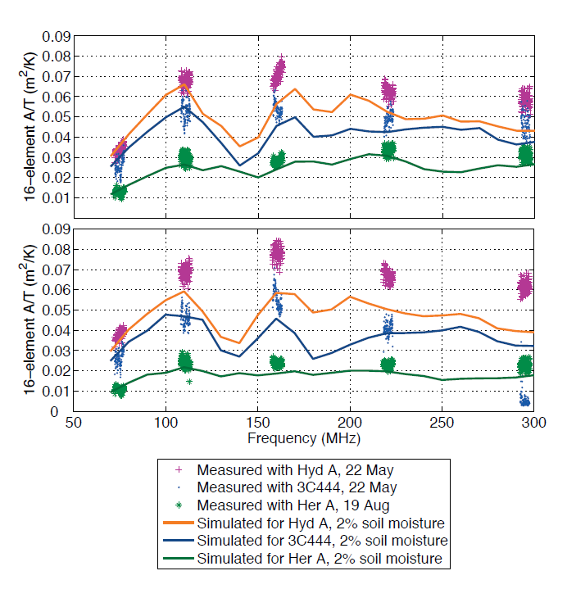
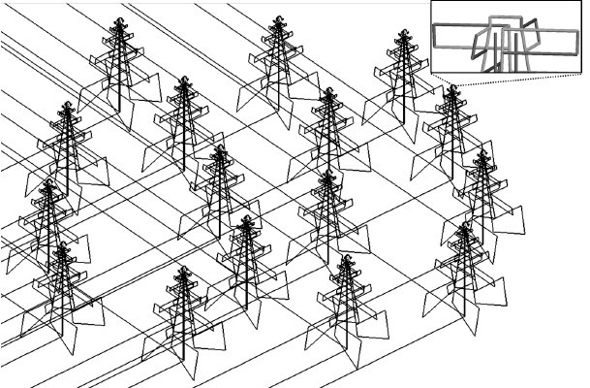
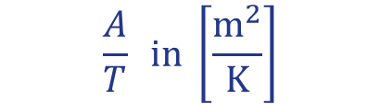
AAVS0.5: Sensitivity
E-W polarization (“X”)
Measured
Simulated
$$\frac{A}{T} in \left[\frac{m^{2}}{K}\right]$$
N-S (“Y”)
Simulation in FEKO

Slide 11
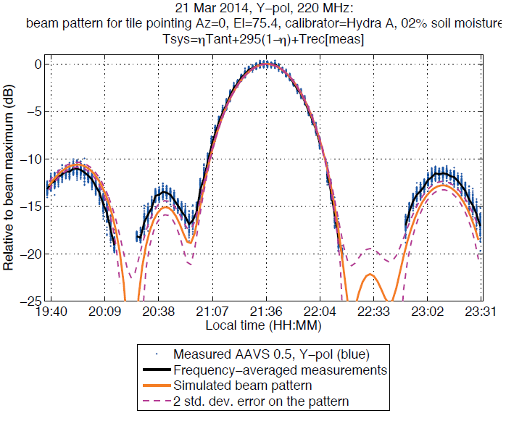

AAVS0.5: Beam Pattern
HydA & MWA
AAVS0.5

Slide 12
Highlights
AAVS0.5 characterization:
A. Sutinjo, T. Colegate, R. Wayth, P. Hall, E. de Lera Acedo, T. Booler, A. Faulkner, L. Feng, N. Hurley-Walker, B. Juswardy, S. Padhi, N. Razavi-Ghods, M. Sokolowski, S. Tingay, and J. G. bij de Vaate, “Characterization of a low-frequency radio astronomy prototype array in Western Australia,” IEEE Trans. Antennas Propagat., vol. 63, no. 12, pp. 5433-5442, Dec. 2015.
Hybrid AAVS0.5/SKALA-MWA interferometry:
A. Sutinjo, D. Ung, T. Colegate, R. Wayth, P. Hall, E. de Lera Acedo, “Interferometry with hybrid low-frequency radio astronomy arrays,” submitted to IEEE Trans. Antennas Propagat., Mar. 2016.

Slide 13

Identical vs. Hybrid Arrays
We initially treated as a non-issue the AAVS0.5 and MWA “hybrid” array combination
Radio astronomy software packages start with the assumption that the antennas/array are identical

Slide 14
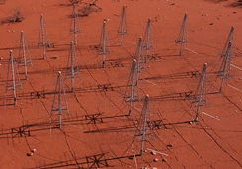
But……
AAVS0.5 and MWA are clearly not identical arrays: different antenna elements and spacing.
  Exact?
  Approximate? Under what conditions?
  How does it affect AAVS0.5/1 and SKA_LOW?

Slide 15
Summary of Findings
  If we have a bright compact source, hybrid array complex gain calibration (1 AUT + N-1 identical arrays) results in amplitude and phase direction-dependent error factors
    Amplitude factor is due to polarization mismatch of the hybrid array
    Phase factor is due to relative movement of antenna/array phase centers
  If we have a bright compact source, these effects can be well characterized and their impact assessed.

Slide 16
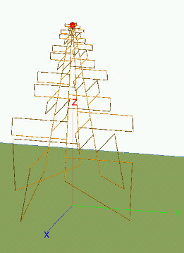
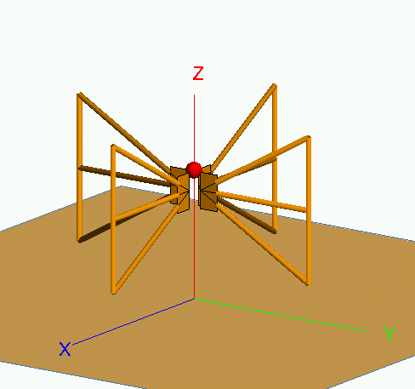
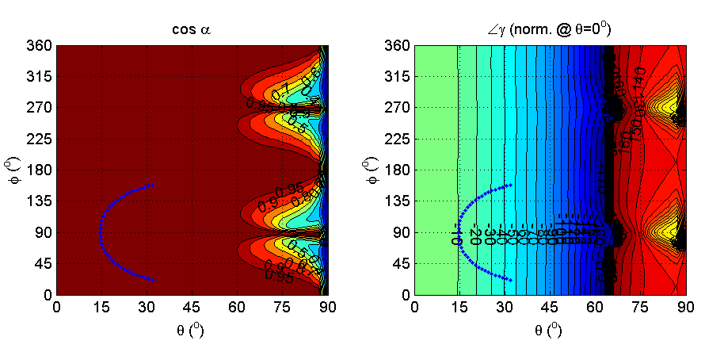

Example :
  A single log-periodic antenna and one MWA Bow-tie at 220 MHz
~-45
~0.99
~-10
Partial trajectory of HydA, a southern hemisphere calibrator
    Amplitude: $\cos{α} \sim 1$, polarization is well matched
    Phase: $γ$ varies by ~35°due to the phase center of LPDA located at ~100 cm above ground

Slide 17
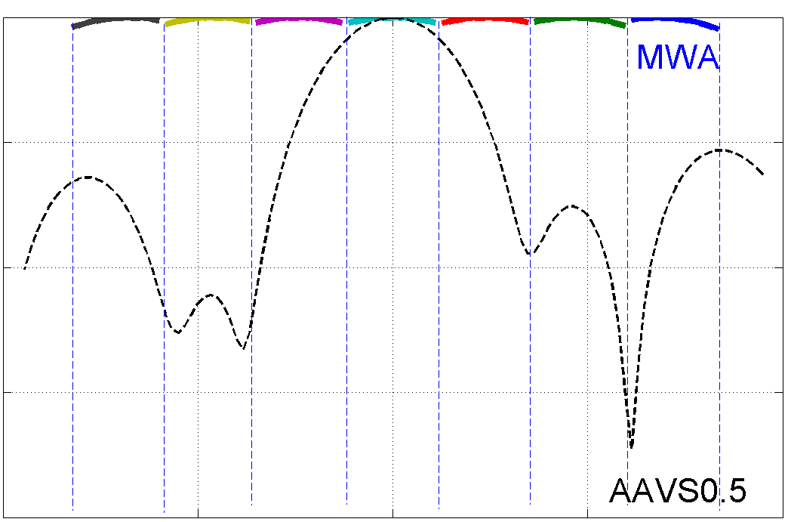
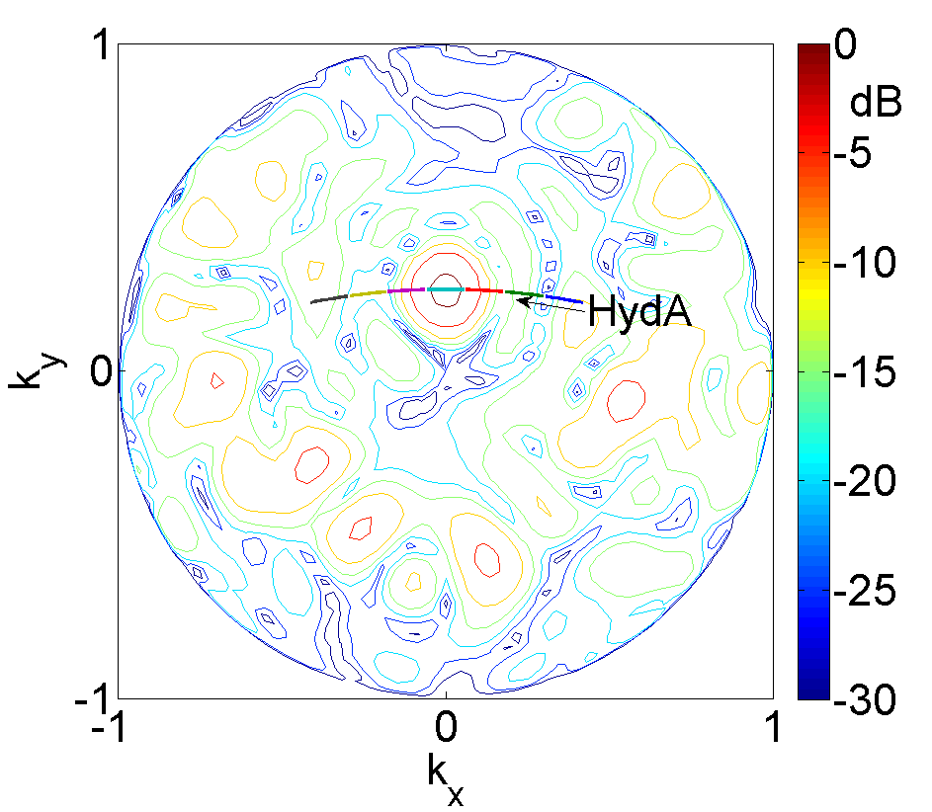
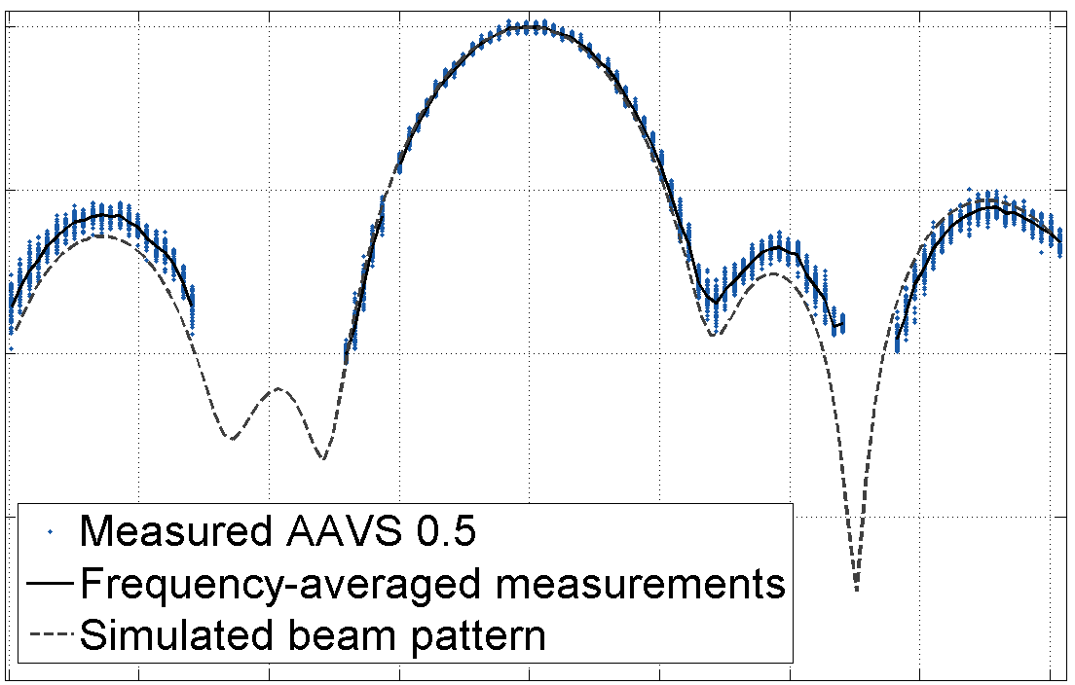

Amplitude:
  AAVS0.5 and MWA at 220 MHz
HydA
$\frac{A_{e}}{T_{sys}} \left[m^{2}/K\right]$
Notes:
This is an example of measuring beam pattern of an AUT through interferometry with the MWA (reference array ). How much hybrid array effect is at play here?
The way this works:
Point the beam such that a bright compact source such as HydA transits the main beam of the AUT
Track the source using the reference array
Perform complex gain calibration along the source’s trajectory
Use that information to extract sensitivity array A/T, see CAMA paper

Slide 18
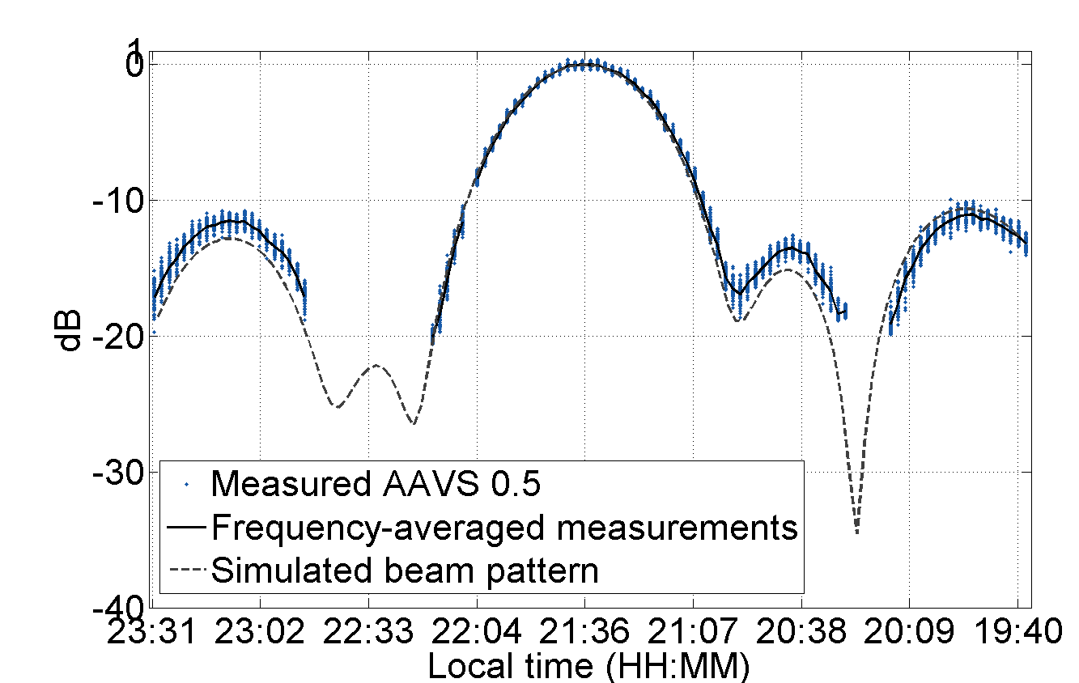
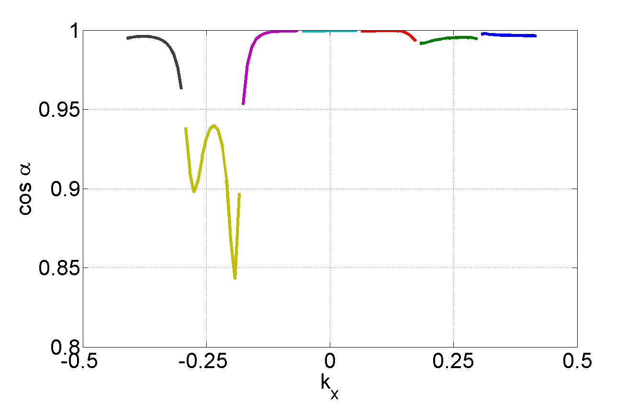
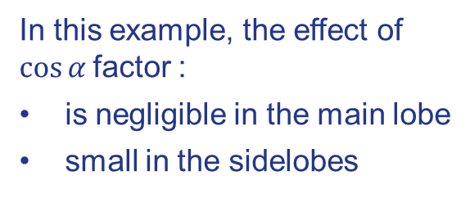
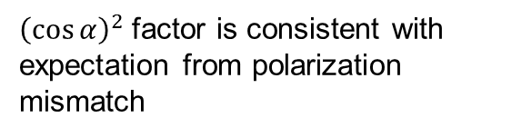

How much hybrid array effect is at play here?
It can be shown that we measure
$\frac{A_{e}}{T_{sys}} {\left(\cos{α}\right)}^{2}$
${\left(\cos{α}\right)}^{2}$factor is consistent with expectation from polarization mismatch
In this example, the effect of $\cos{α}$factor :
is negligible in the main lobe
small in the sidelobes

Slide 19





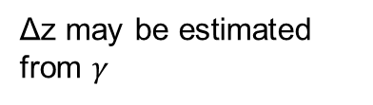
Phase:
Origin of SKALA radiation moves up relative to that of the MWA with increasing frequency.
$$λ/2$$
$$∆z$$
$$θ$$
$$k_{0}∆z\cos{θ}$$
Perfect conductor
Soil
Δz may be estimated from $γ$
Bow-tie image

Slide 20

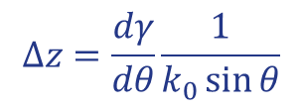

Estimating Δz
MHz | Physical measurement of height from base to ~λ/2 element (cm) | Mathematical estimation of Δz (cm) from $γ$
160 | ~85 | 85
220 | ~110 | 100
295 | ~135 | 120
$$λ/2$$
$$∆z=\frac{dγ}{dθ}\frac{1}{k_{0}\sin{θ}}$$

Slide 21
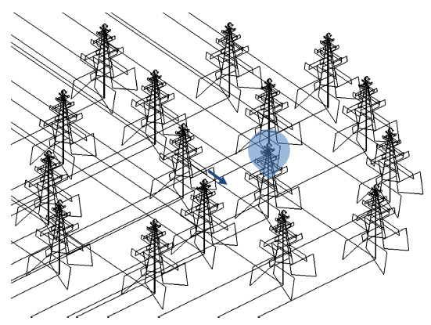
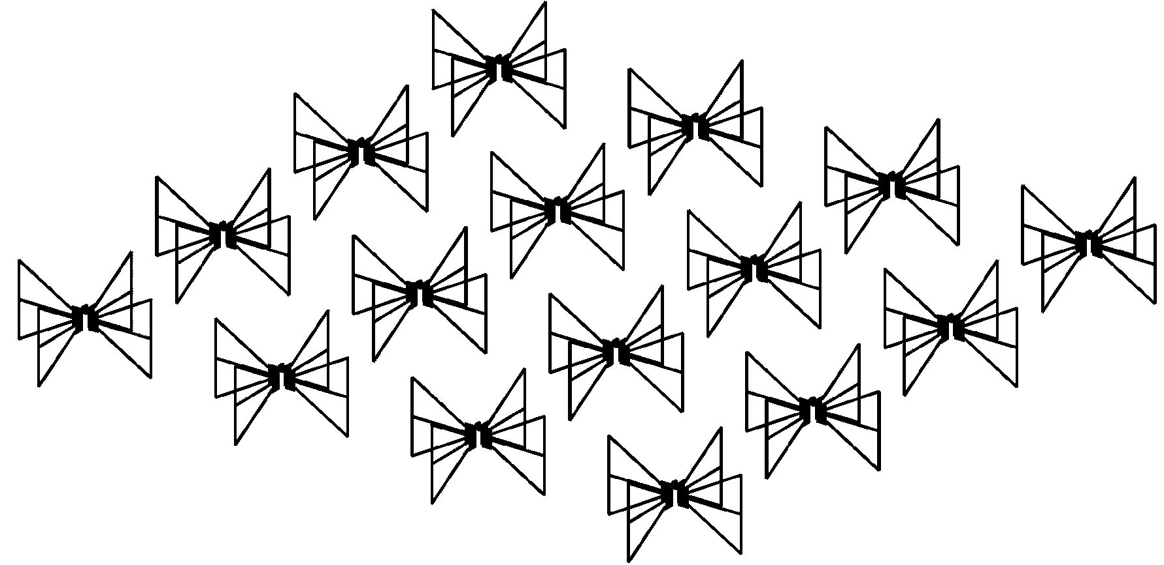
Useful for Calibration of a SKALA with MWA
In AAVS1, each SKALA is connected to RFoF and fiber optic cables. Fiber optic cables cannot practicably be phased-matched.
Prior to beamforming, we need to equalize these paths (“instrumental calibration”)

Slide 22
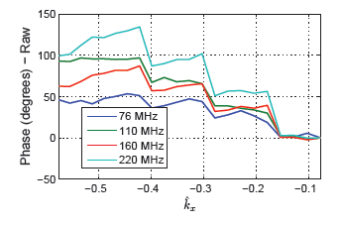
Calibration Solution
Calibrating an embedded SKALA using an MWA tile tracking HydA:
Steps are due to MWA analog beamformer (B/F)

Slide 23
A “simple” calibration involves correcting for the embedded SKALA’s position relative to the nominal center of the array

Slide 24
Phase correction is obtained by EM simulation of MWA tile and embedded SKALA over the trajectory of HydA
It corrects for phase center of SKALA relative to MWA and mutual coupling effects in the MWA tile (esp. at 220 MHz)

Slide 25
Note the improvement in the residual phase (std. dev.)
Not as much improvement at 160 MHz

Slide 26
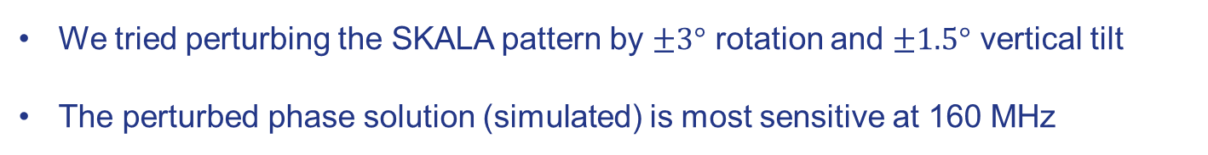


$20°$
$\sim 14°$
We tried perturbing the SKALA pattern by $±3°$ rotation and $±1.5°$ vertical tilt
The perturbed phase solution (simulated) is most sensitive at 160 MHz

Slide 27
Conclusion
We have a fall back calibration method using the MWA
Expect to expand this work to calibrate the disparate SKALA embedded element patterns in AAVS1 in intra-station calibration (with Randall)
Continue to add understanding of RFoF and fiber optics for AAVS1

Slide 28
Highlights
Low-frequency radio astronomy antenna polarization:
R. A. C. Baelemans, A. Sutinjo, P. J. Hall, A. B. Smolders, M. Arts, and E. de Lera Acedo, “Analysis of the polarization properties of dual polarized inverted vee dipole antennas over a ground plane,” submitted to IEEE Trans. Antennas Propagat., in revision, Mar. 2016.

