Slide 1
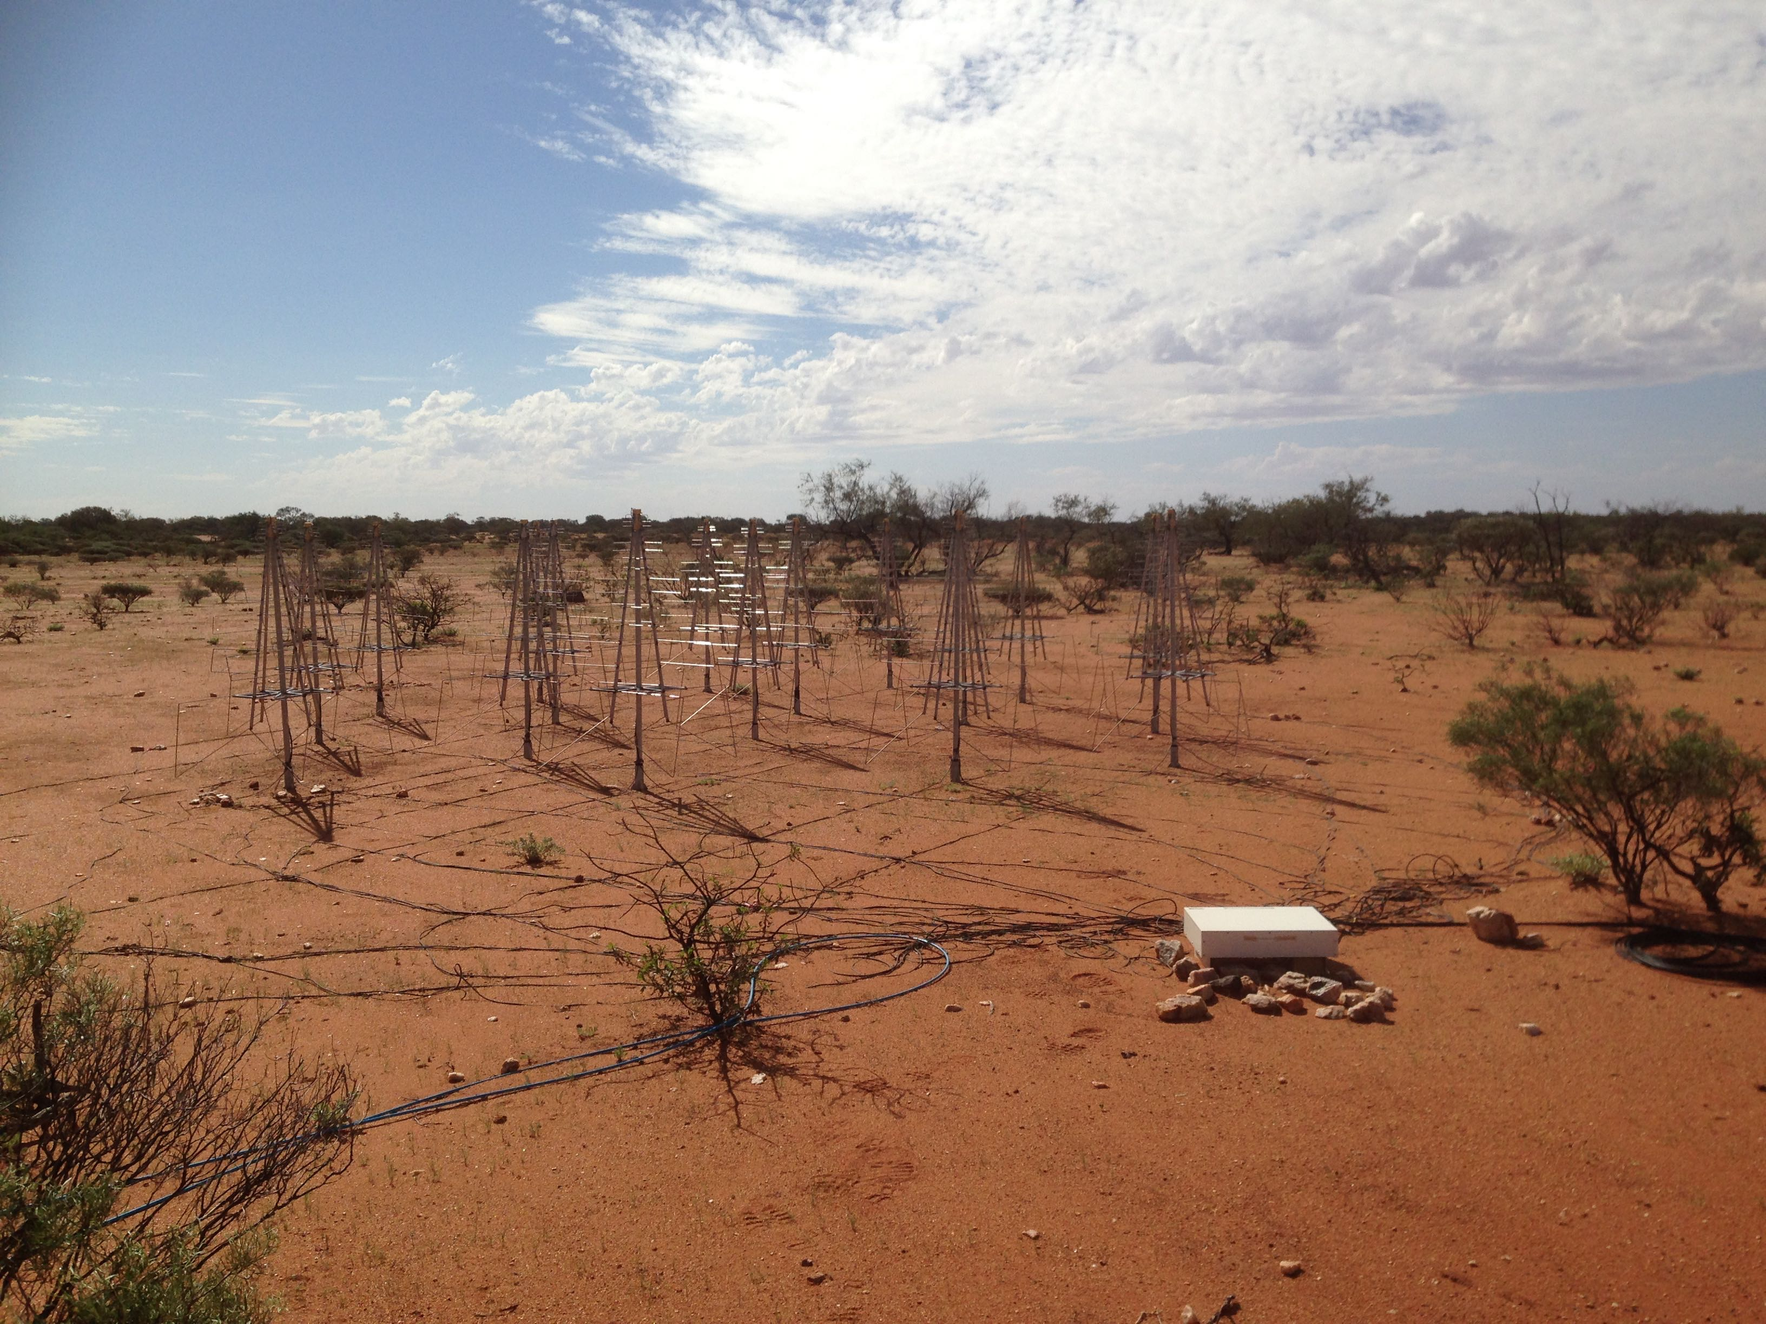
Location proposed
SKA-low and the Aperture Array Verification System
P. Benthem
AAVS1 workpackage lead
On behalf of the Aperture Array Design & Construction Consortium

Slide 2
Outline – AAVS1
What will it look like?
Why are we realizing this verification system?
What investment is needed?
How much power will be consumed?
How do we transfer from R&D towards deployment?
When will it be ready?
Pretty pictures

Slide 3
AAVS1 – Setup
Goal: Full-sized SKA station to properly test against requirements
  Will use all proposed LFAA technology from antennas through to digital beamformer, including RF over fibre
  Essential prototyping & development, but maximal re-use of MWA infrastructure & systems
  Successful test will mitigate large amount of risks
Instrument setup:
  1 x 256 antenna station; 3 x 48 antenna secondary arrays
  35 m diameter station
  Baseline lengths ∼85–240 m
Much of the testing of array performance can be done via cross-correlation with the MWA (75–300 MHz)

Slide 4
AAVS1 – Setup

Slide 5
AAVS1 – Why
The Panel (chair: Perley) regards the construction, deployment and verification of AAVS1 to be an essential developmental stage necessary for moving to CDR, including:
  informing the plan for full deployment of LFAA;
  validation of antenna and LNA performance;
  signal chain performance;
  station beamforming;
  station response characteristics compared to modelling;
  calibration strategy;
  demonstration of compliance with L1 requirements.

Slide 6
AAVS1 – Why
Is the proposed AAVS1 System Design able to adequately inform the LFAA CDR ?
In general, yes
  AAVS1 is a good platform to test maturity for CDR
  The Aperture Array Verification System 1 (AAVS1) proposed by the LFAA consortium is at an appropriate level of maturity for the stage of the project.
  Although the panel (chair: Schinckel) is acutely aware that the artificial schedule imposed by the SKA LFAA CDR is placing significant constraints on what AAVS1 can achieve, and impacts the decisions made.

Slide 7
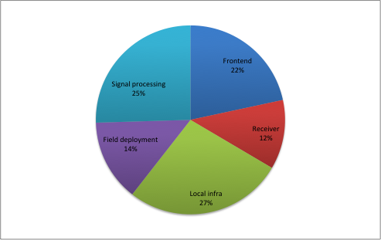
AAVS1 – Costing
Total: ~1.8 million euro
Including 20% contingency
Excluding VAT

Slide 8
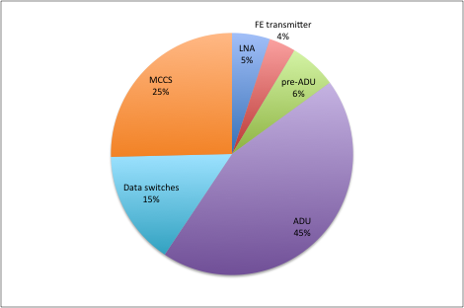
AAVS1 – Power consumption
Total: ~9 kW Field vs CPF: 10 – 90%
Including 86% power supply efficiency

Slide 9
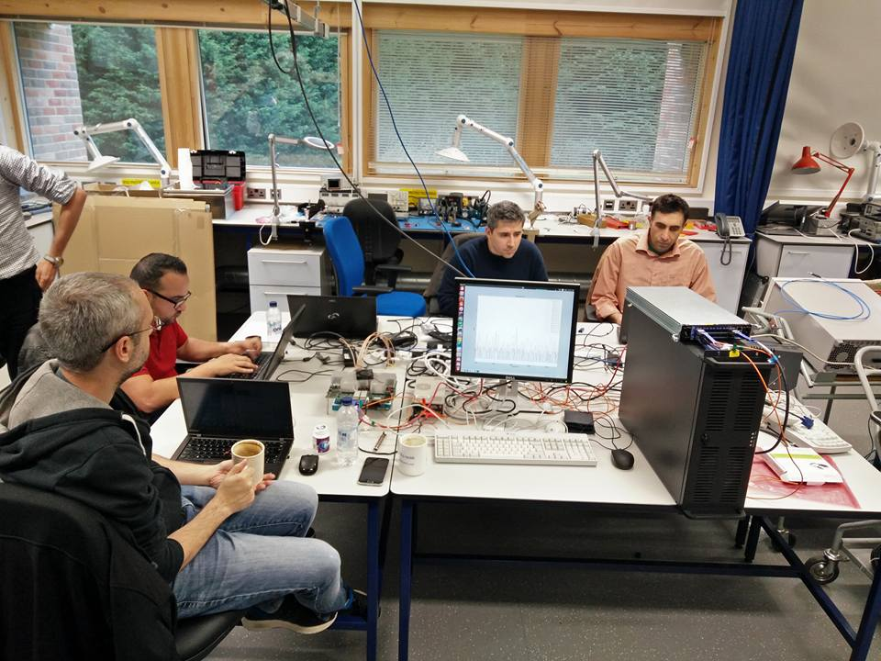
AAVS1 – Pre-AAVS1
Main goal:
  Prepare for AAVS1 installation
  Act as gateway
European:
  Test subsystems
  Integration
  Debugging
  Staff training
  Compliance test
  Support during AAVS1 installation
    Parallel site and staff
Australian:
  Duplicate system from European site
  Start ticking off requirements through first measurements as soon as possible….

Slide 10
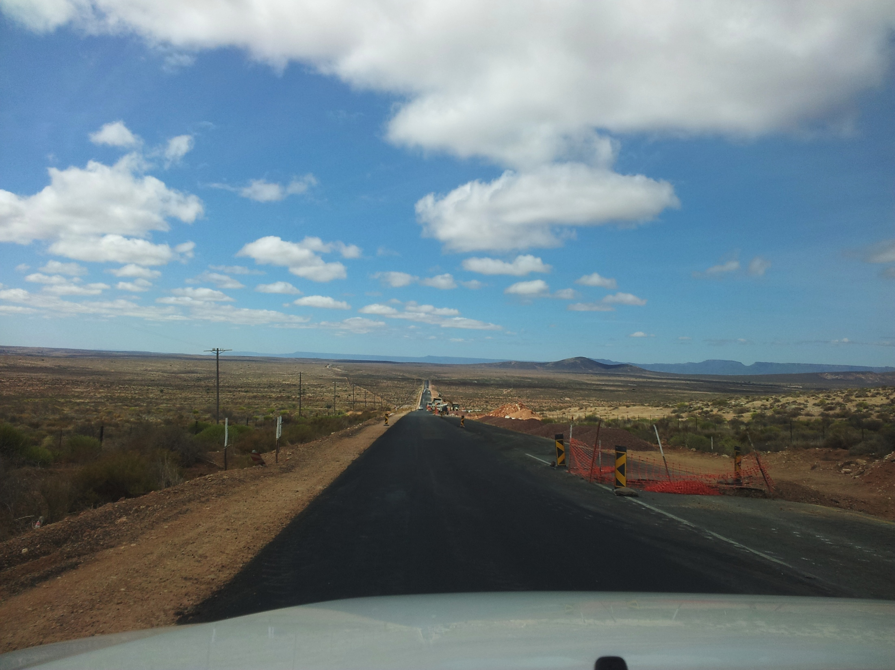
AAVS1 – Overall schedule
Pre-AAVS1 Europe
  Q2/3 2016
AAVS1 Compliance testing and MRO Deployment
  Q4 2016/ Q1 2017
AAVS1 MRO Initial commissioning
  Q1/2 2017
AAVS1 Verification
  Q3/4 2017
AAVS1 Operations
  Q1 2018 and beyond

Slide 11
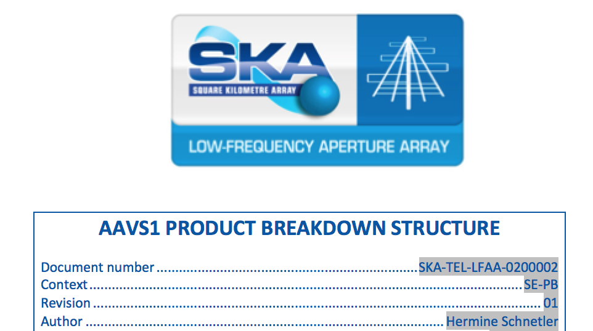
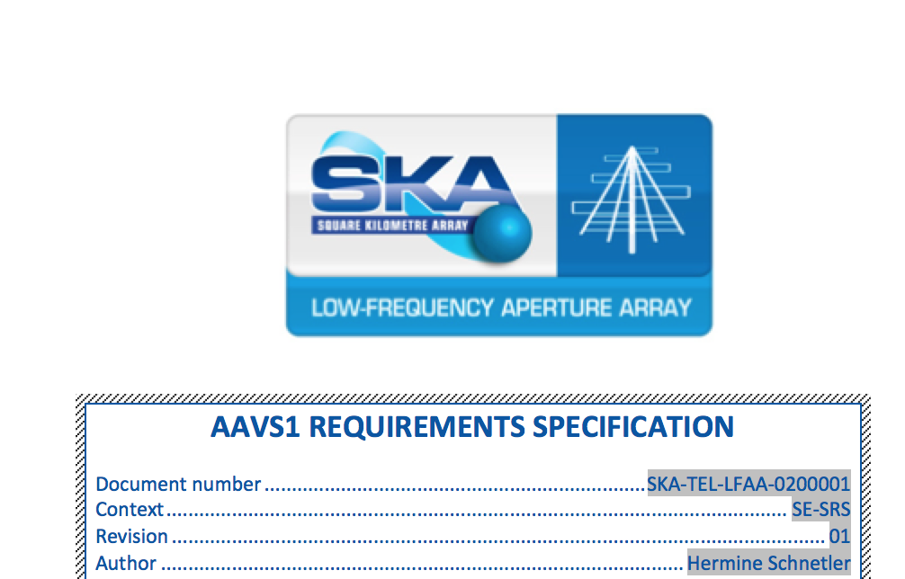
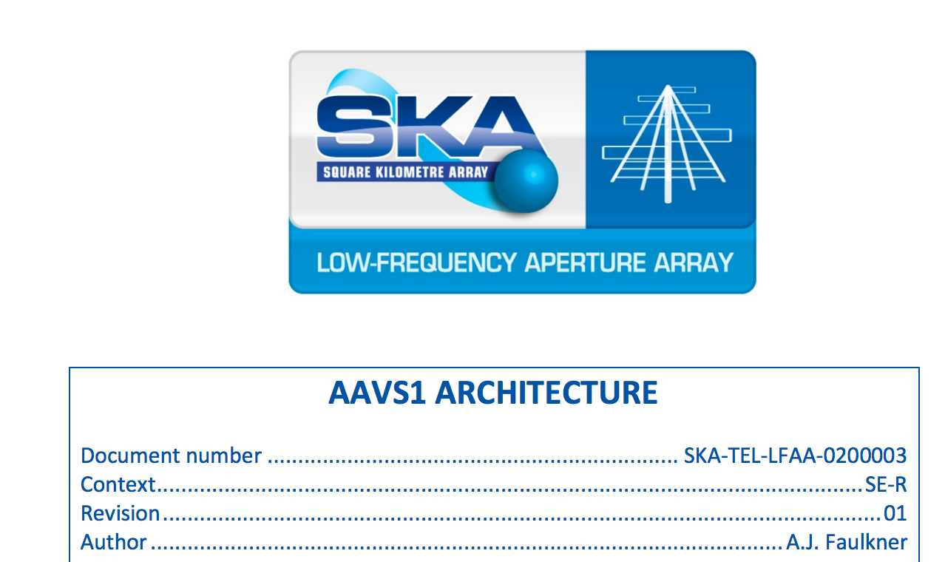
AAVS1 – Schedule - WPs
SE
Requirements
PBS
ICDs
Architecture

Slide 12
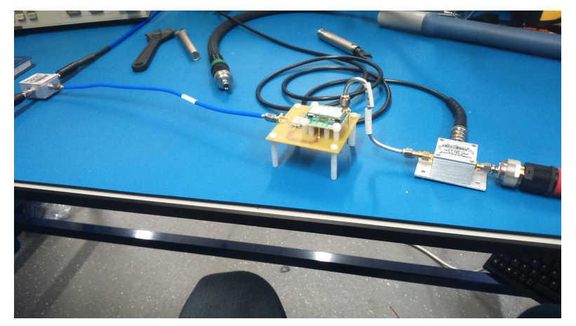
AAVS1 – Schedule - WPs
AL
Items ordered:
  Concrete bases
  Antenna arms
  Plastic parts
  LNA order to be finalized
LNA testing (Q2)
Trumpet integration (Q3)

Slide 13
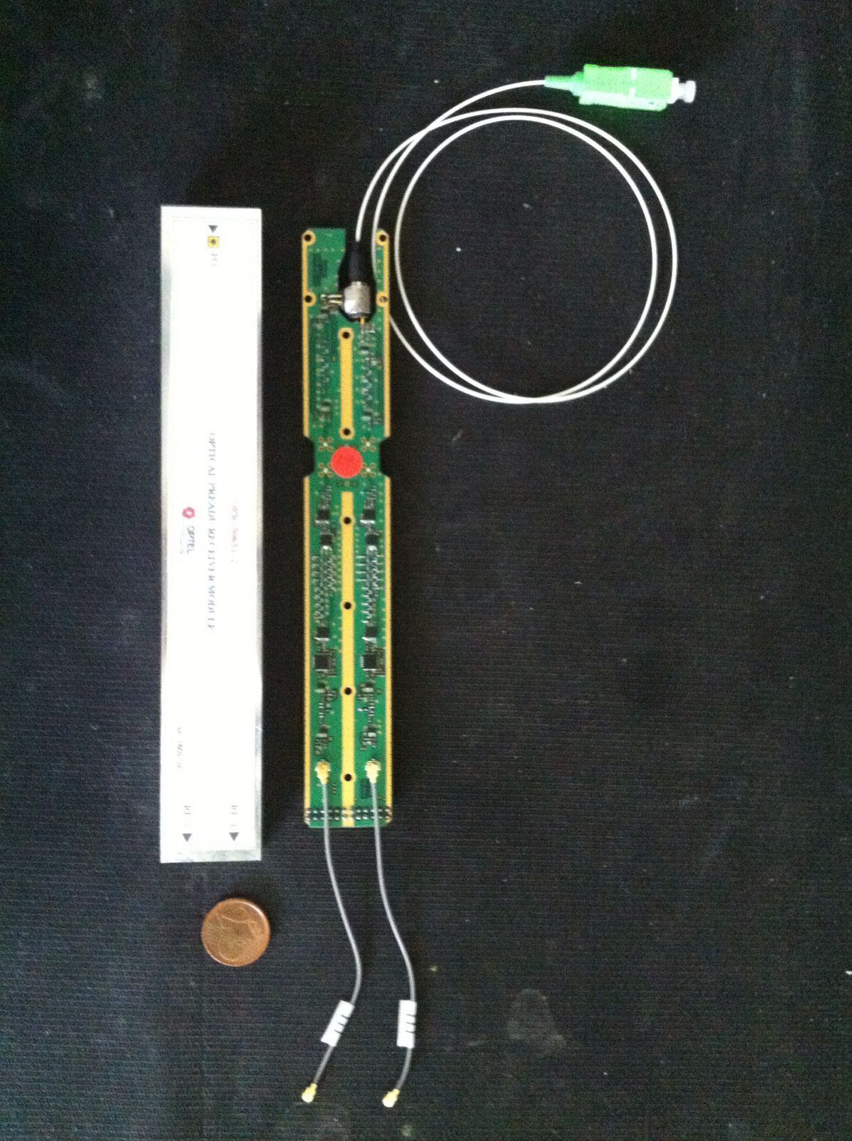
AAVS1 – Schedule - WPs
RX
Tender all WP items towards AAVS1
  FE module
  Pre-ADU
  Hybrid Cable
FE module testing (Q2)
Trumpet integration (Q3)
Pre-ADU testing (Q2/3)
TPM integration (Q4)

Slide 14
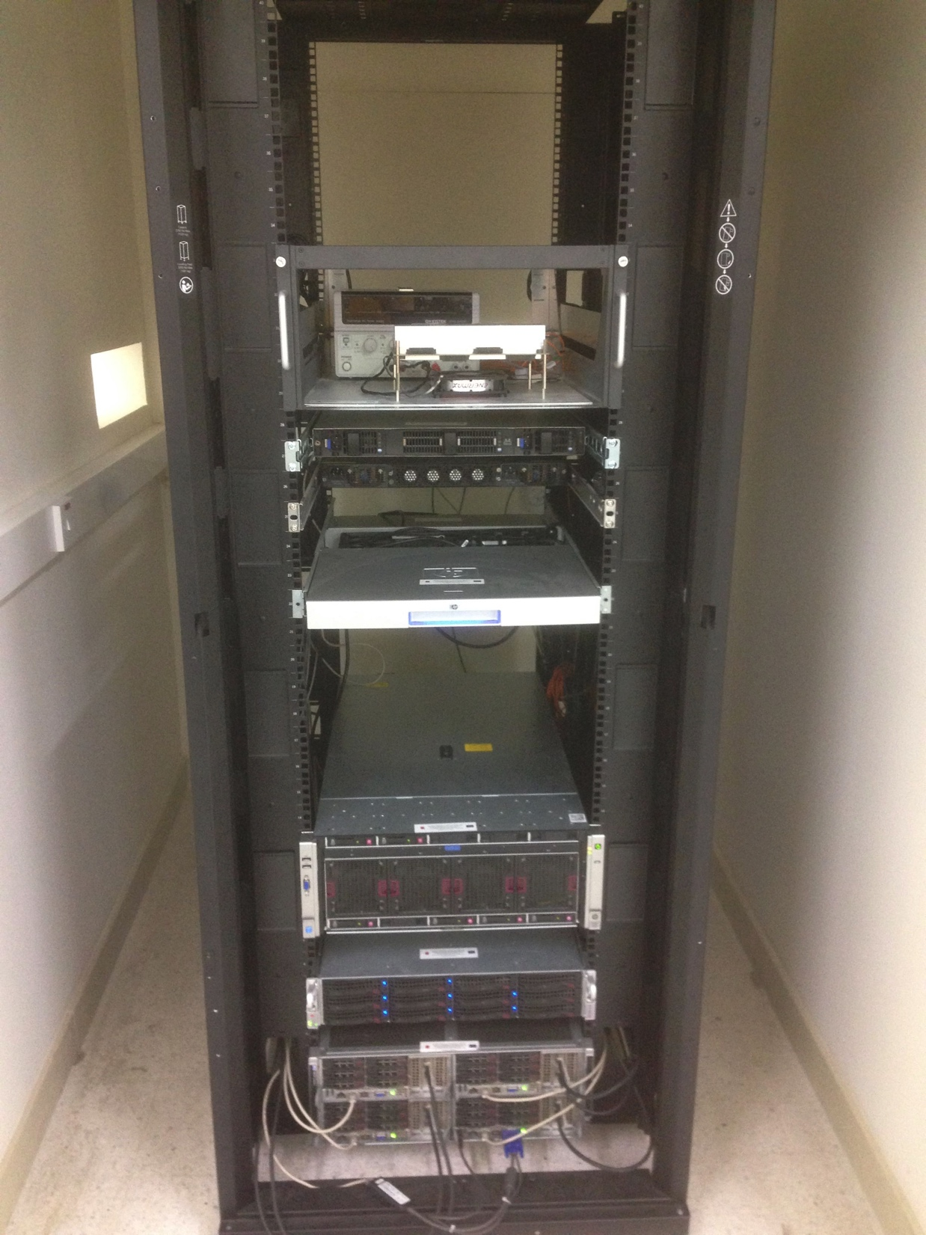
AAVS1 – Schedule - WPs
SP
Tender ADU
  Italy
  The Netherlands
ADU testing (Q3)
TPM testing (Q4)
Software development (Q2/3)
  LMC
  Data
  Firmware TPM

Slide 15
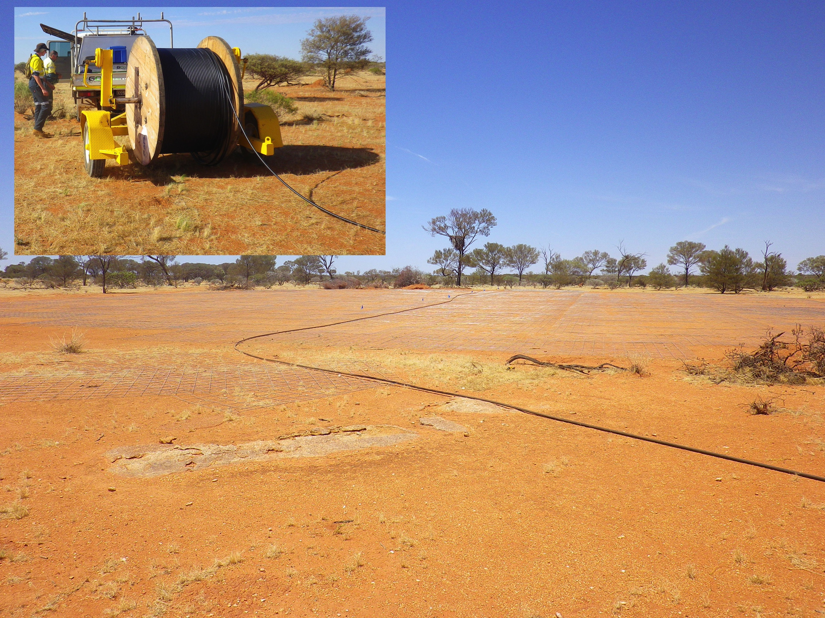
AAVS1 – Schedule - WPs
LINFRA
Station sites prepared
Fibre deployed and spliced
Power distribution
Ground plane deployed
Deploy concrete bases
Ready to deploy antennas!

Slide 16
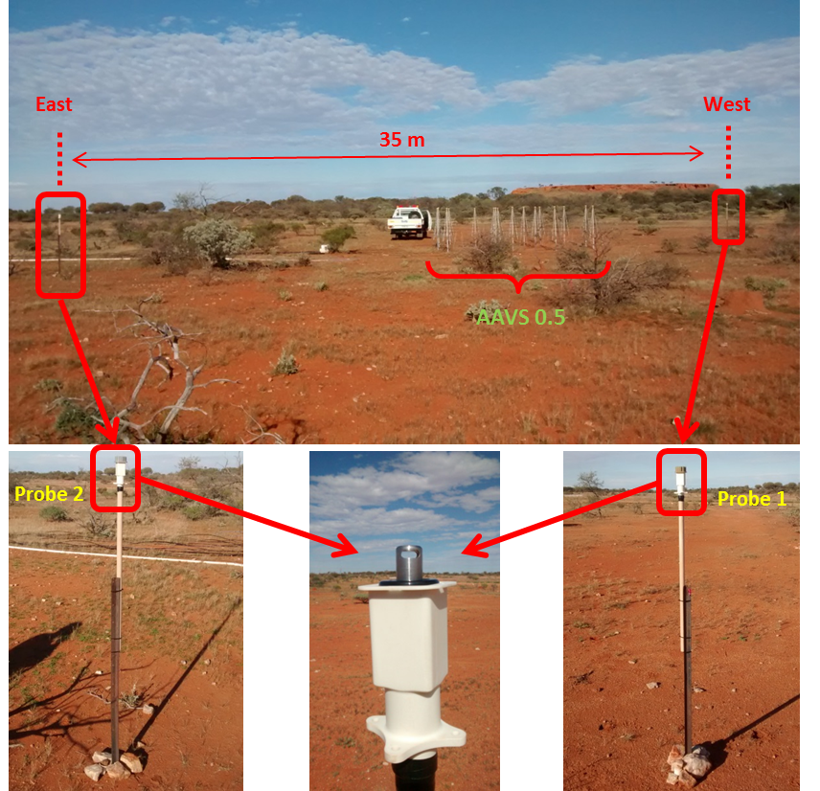
AAVS1 – Schedule - WPs
PROT
Frontend stability
Temperature fluctuation
FO cable evaluation
RFoF testing
Requirements - feedback

Slide 17
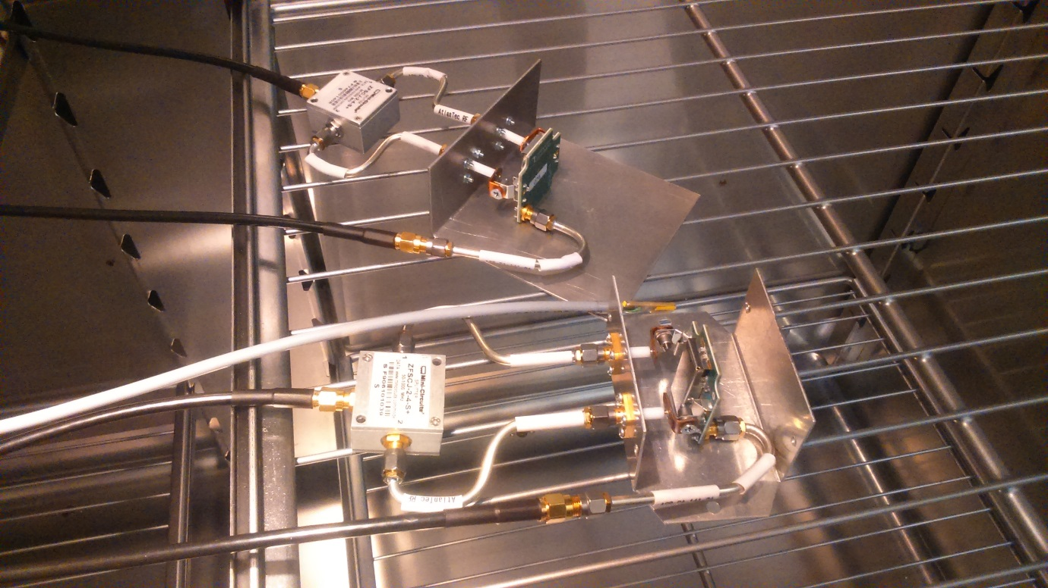
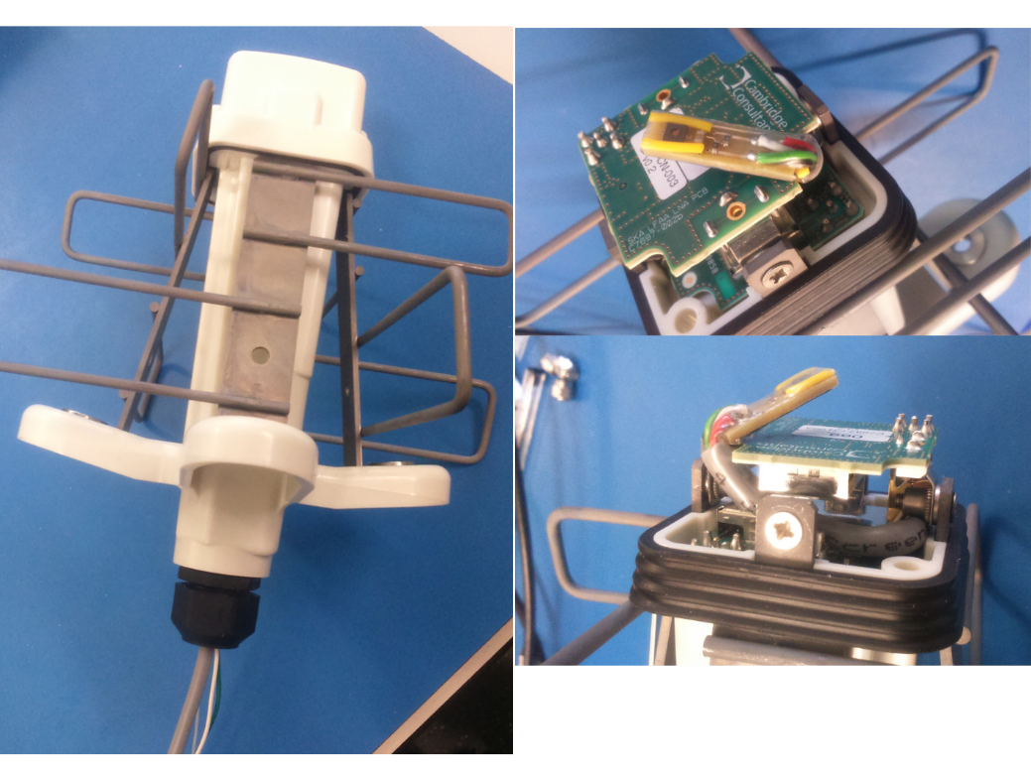
AAVS1 – LNA measurements

Slide 18
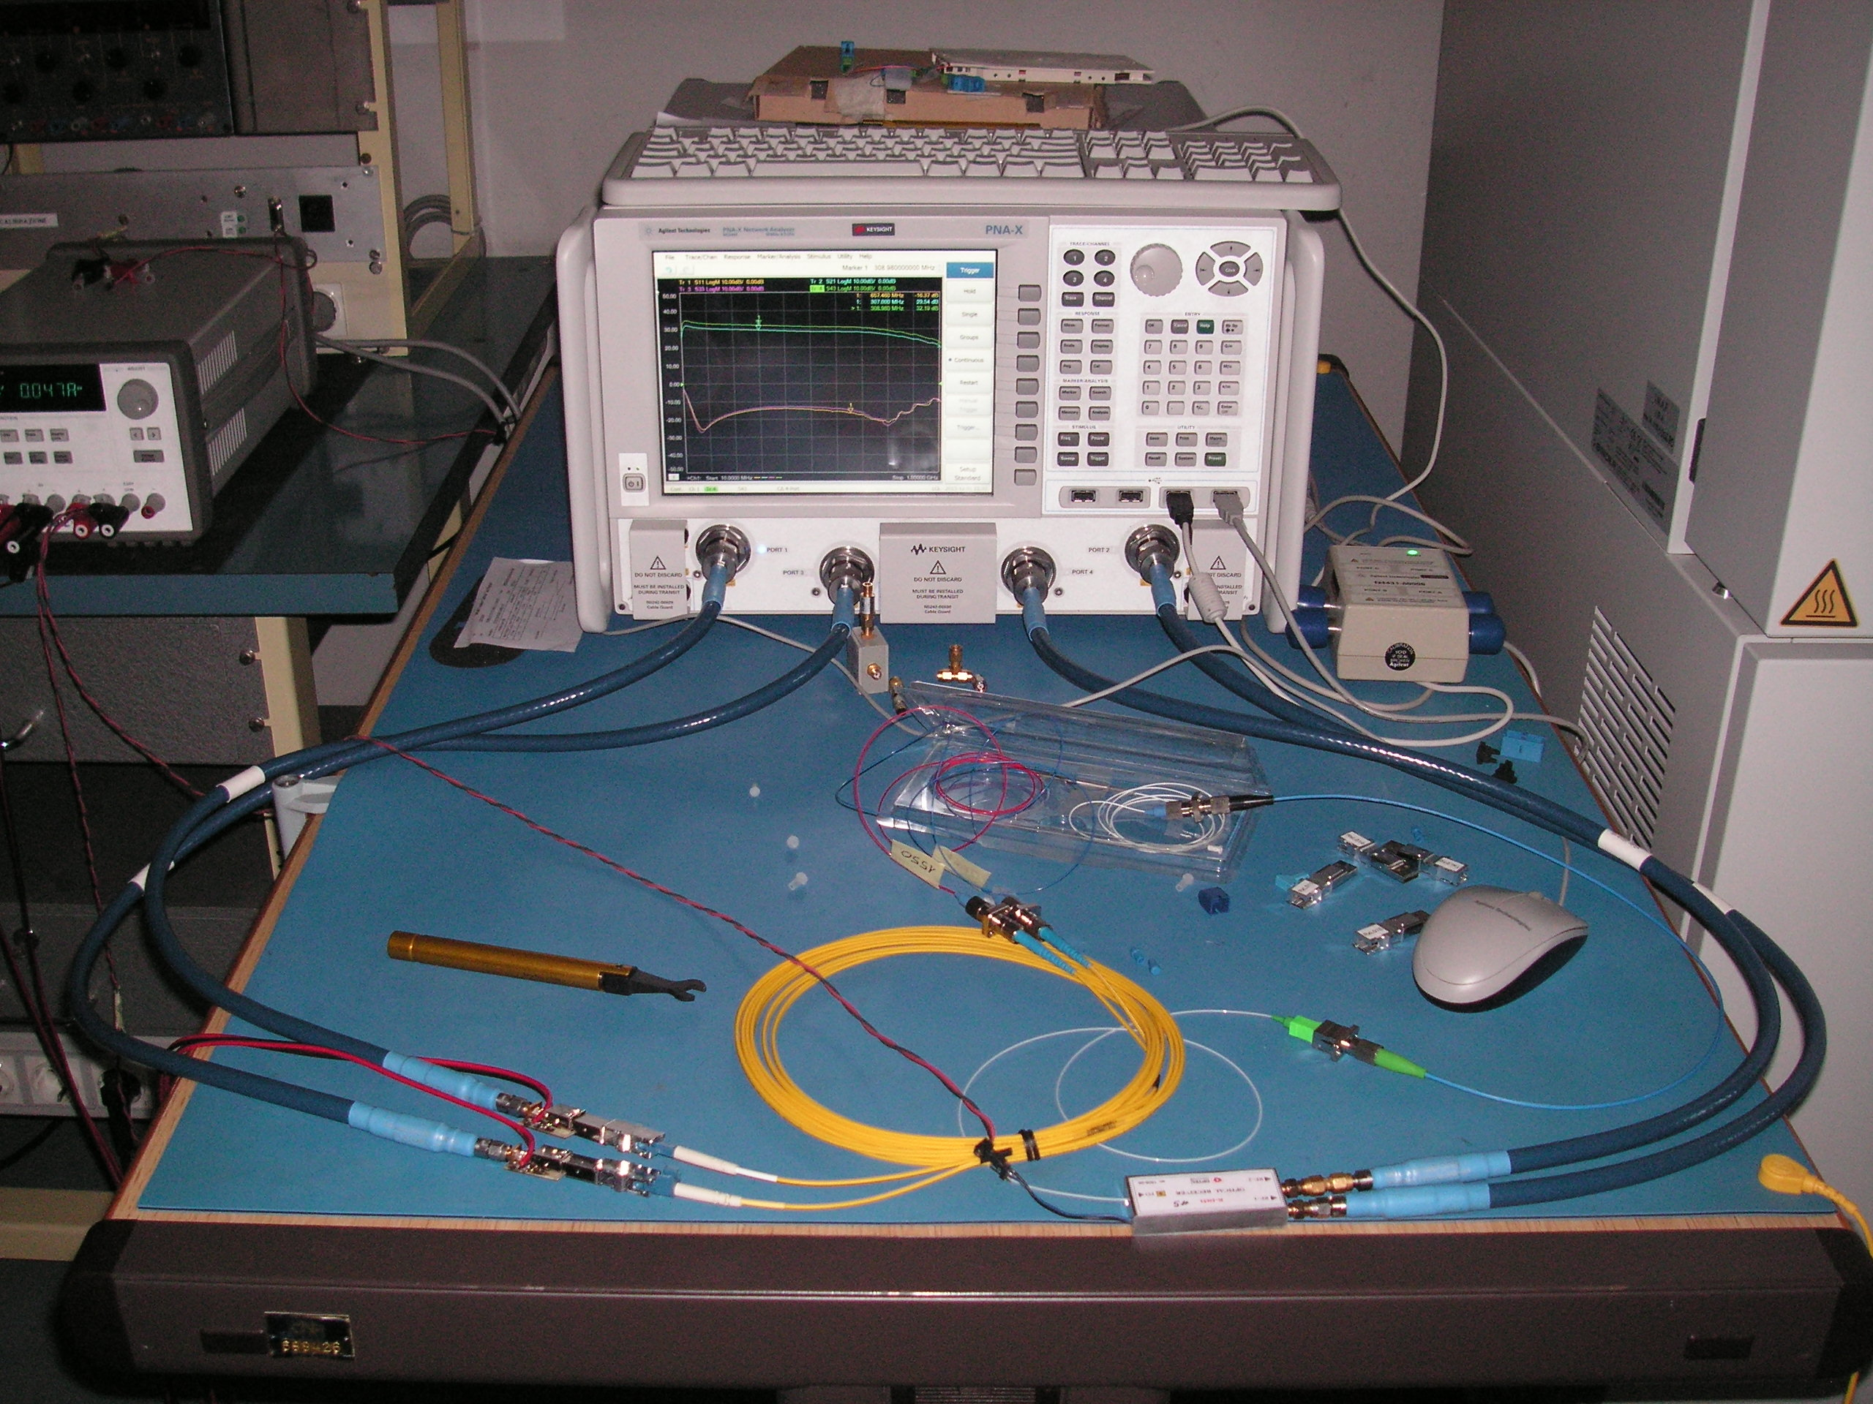
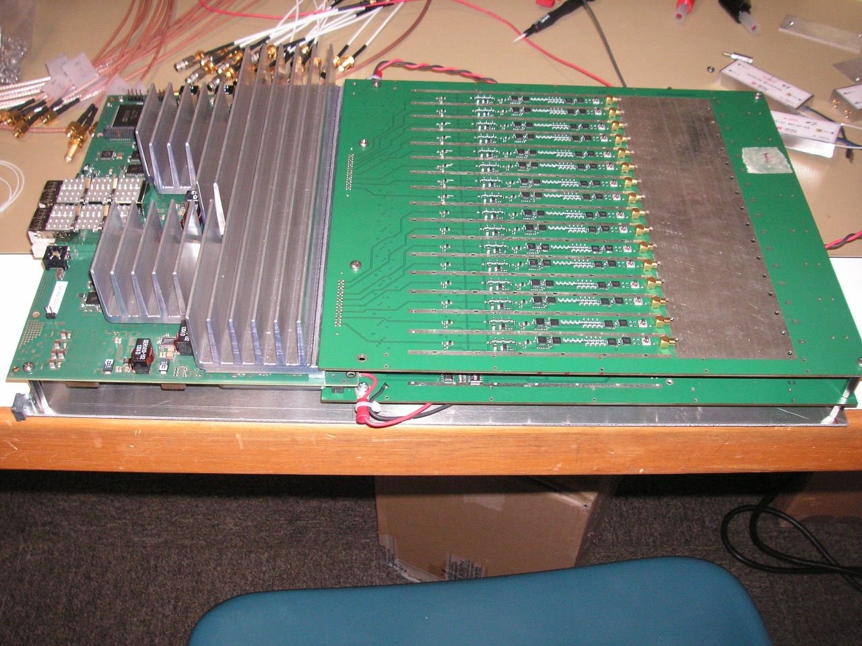
AAVS1 – RFoF and pre-ADU

Slide 19
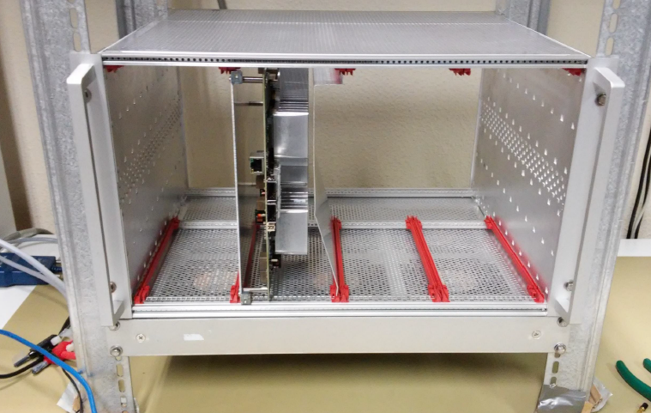
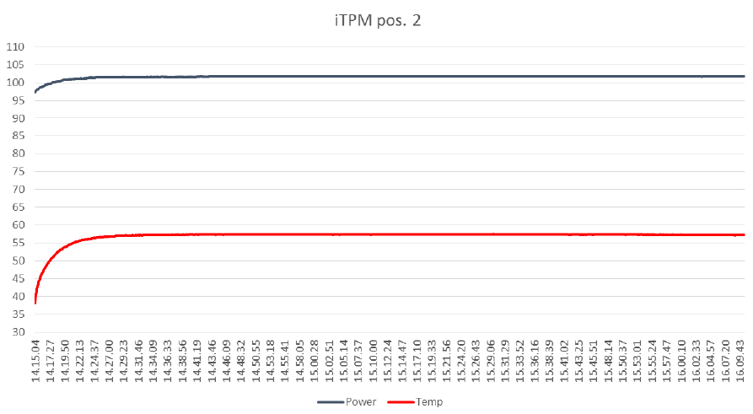
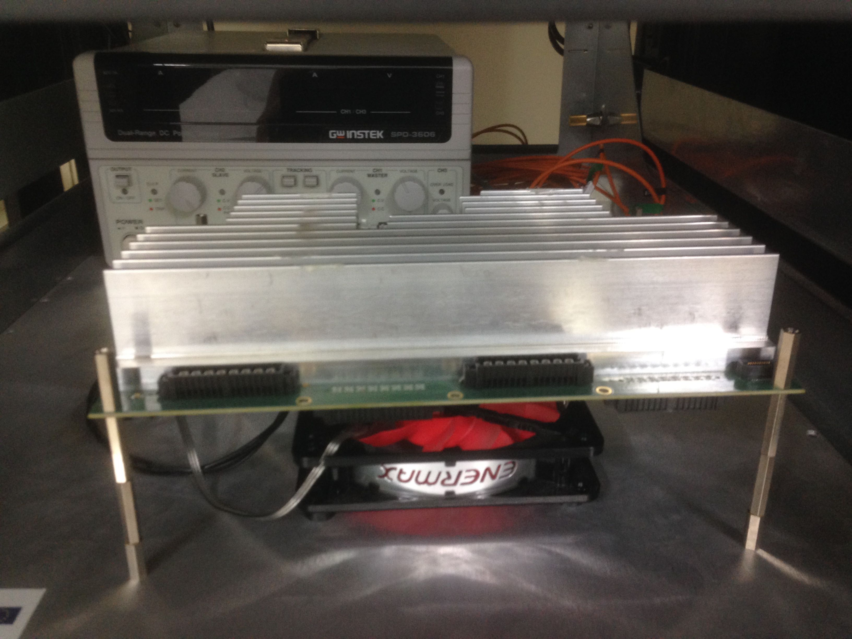
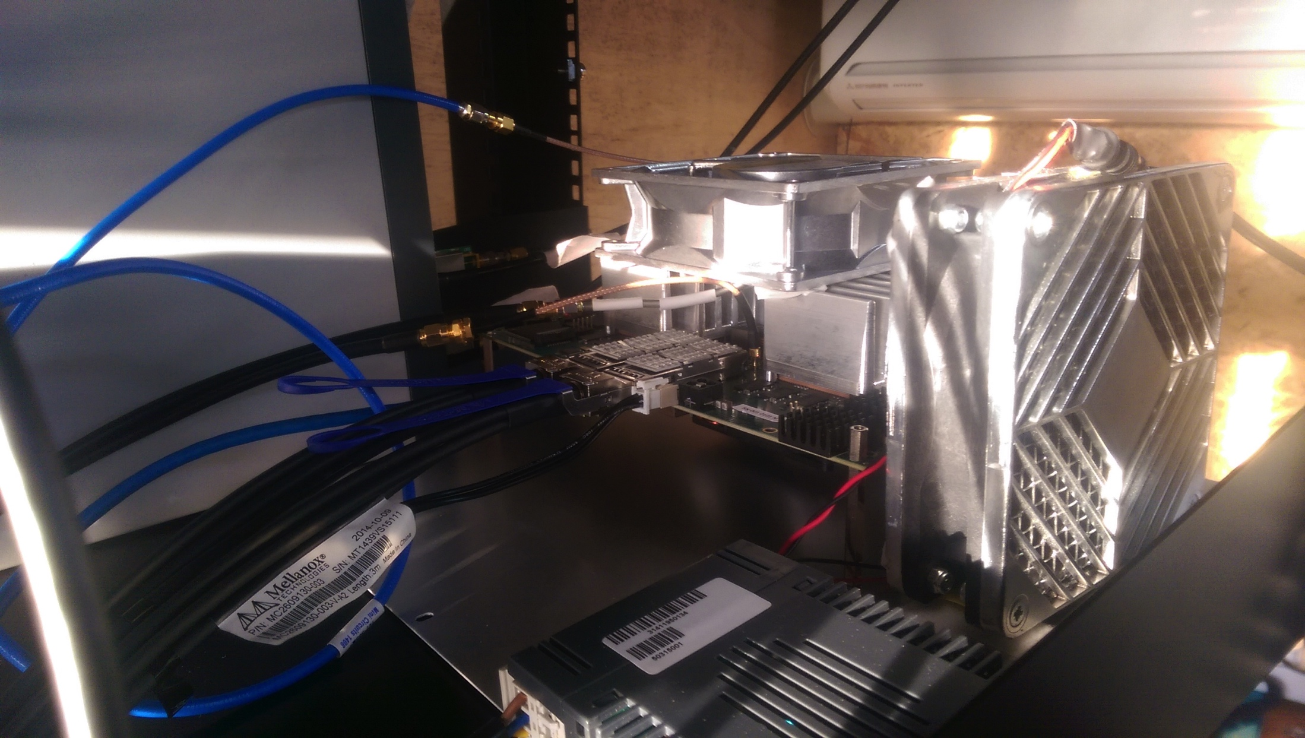
AAVS1 – ADU test and evaluation

Slide 20
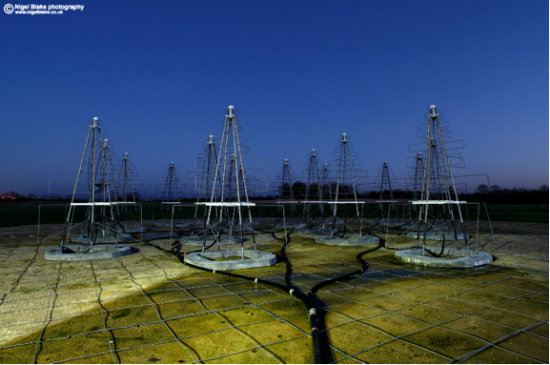
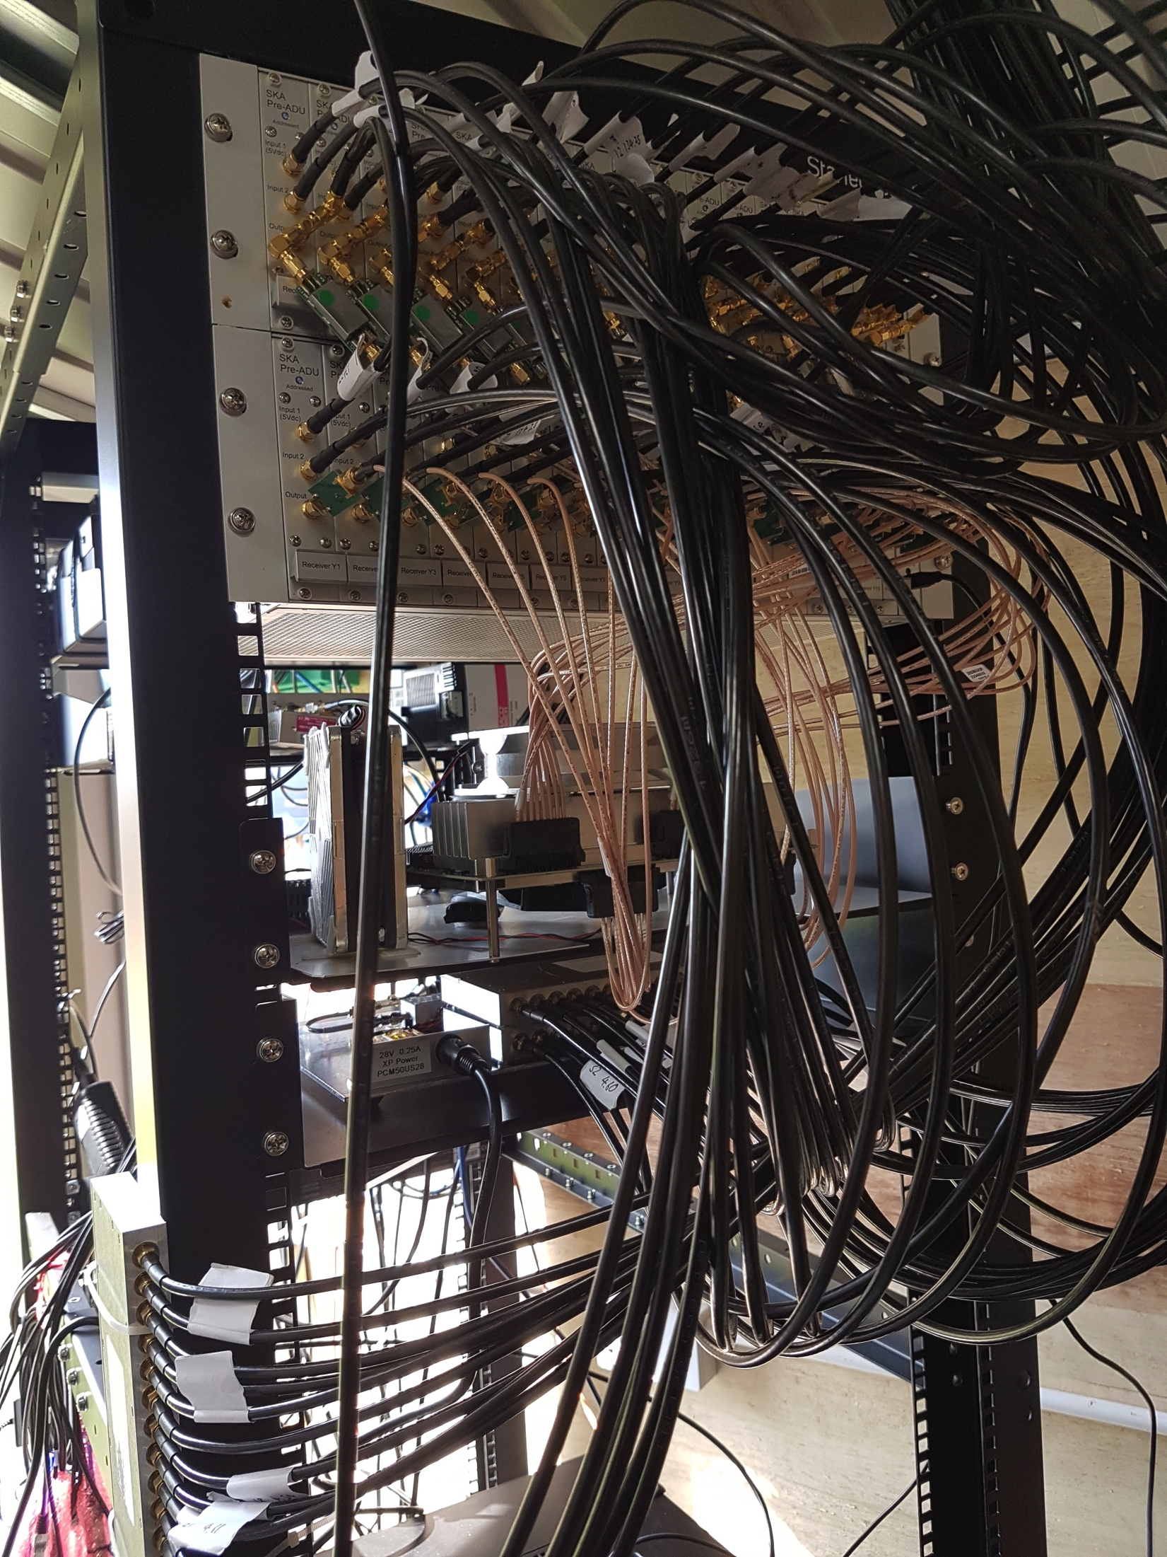
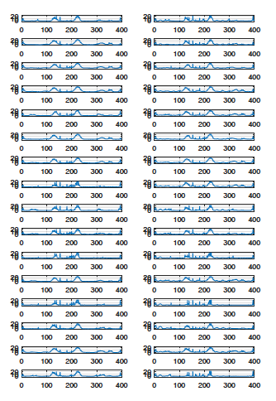
AAVS1 – Pre-AAVS1 Europe

Slide 21
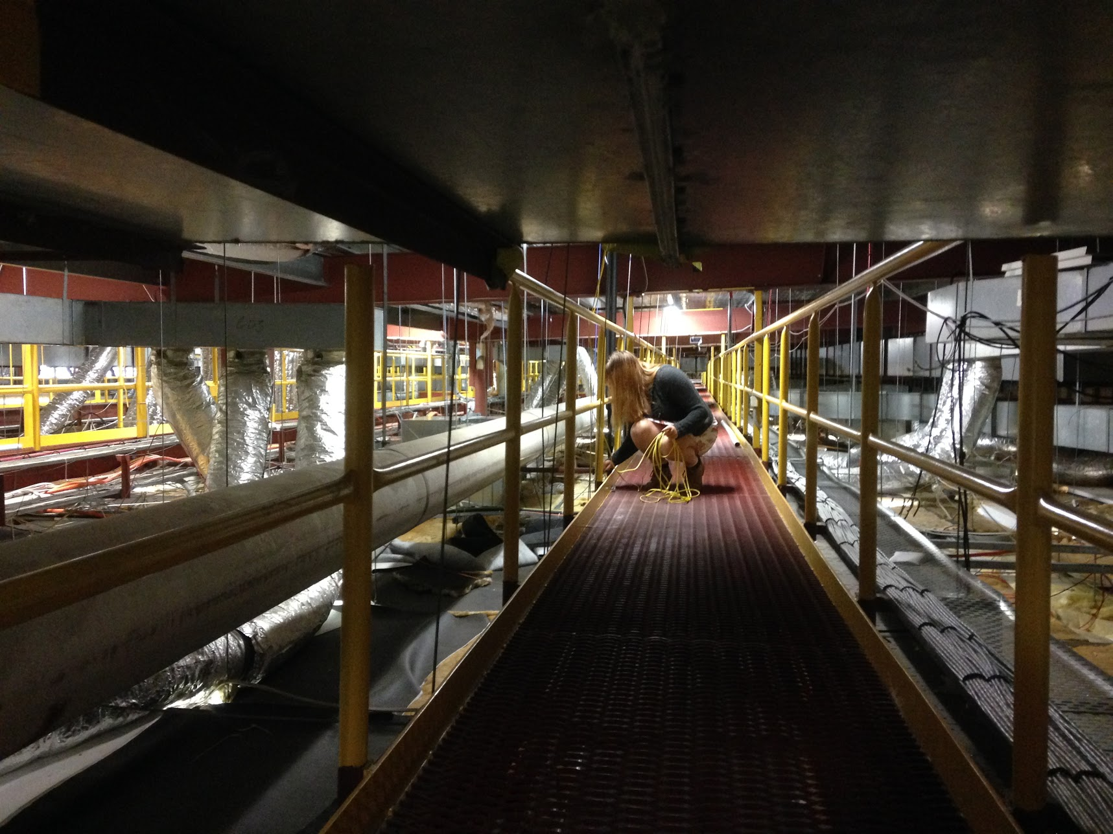
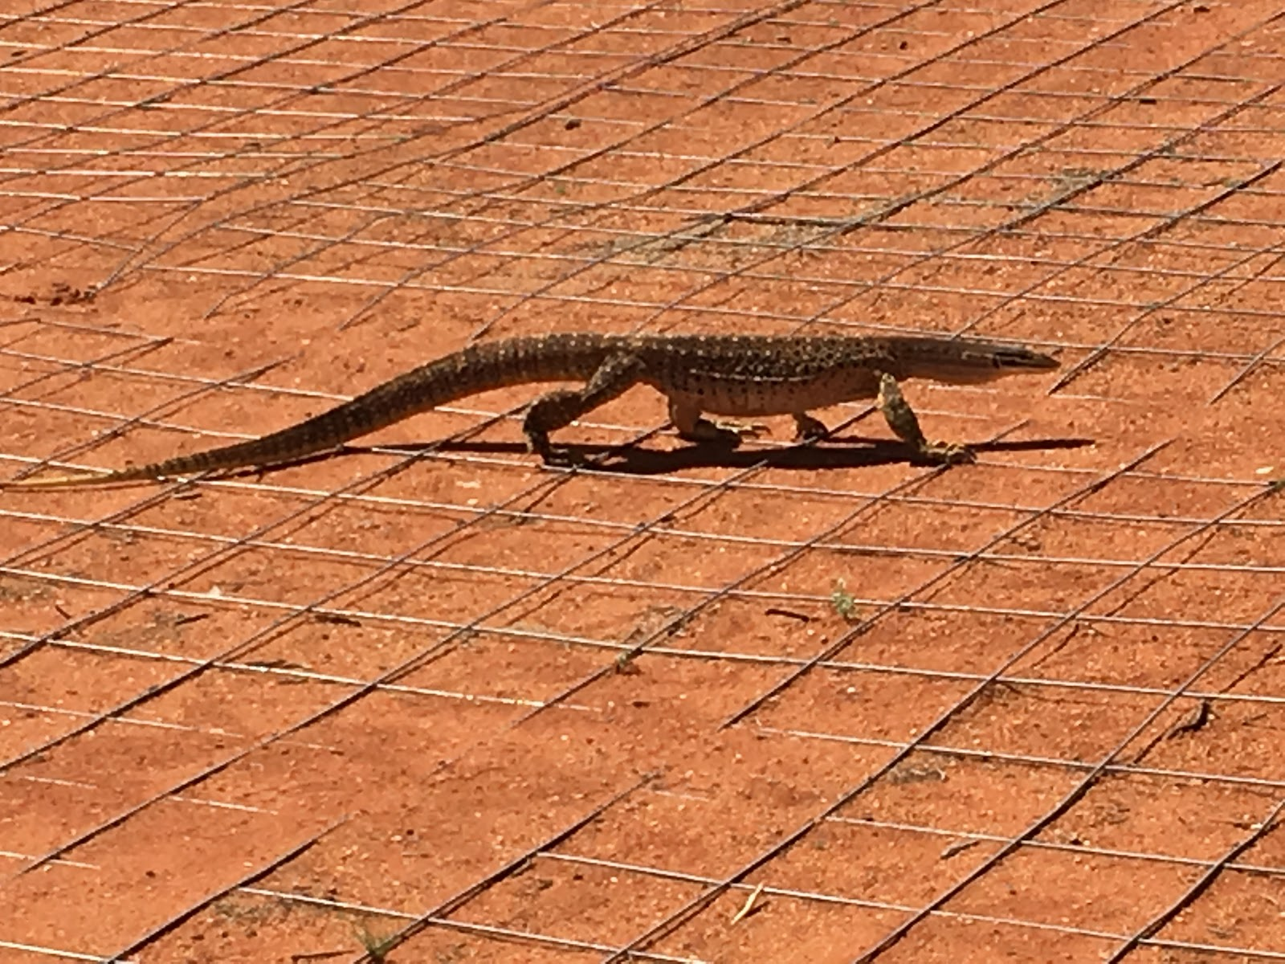
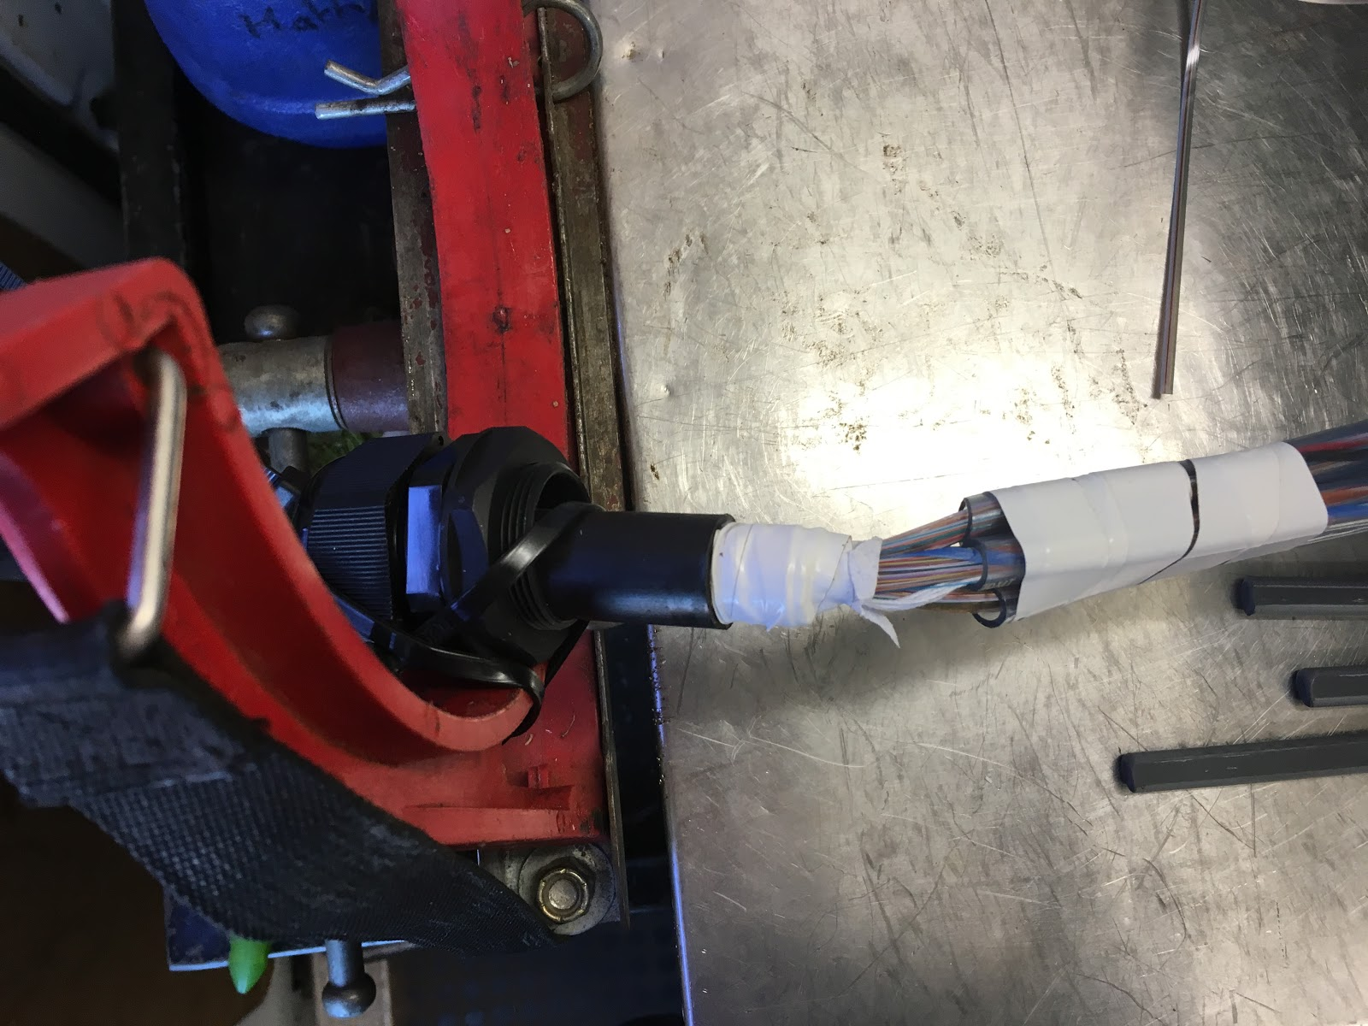
AAVS1 – Fibre splicing

Slide 22
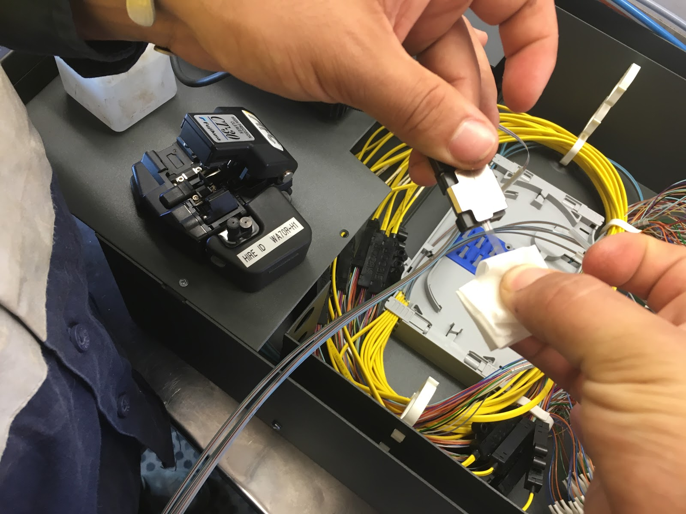
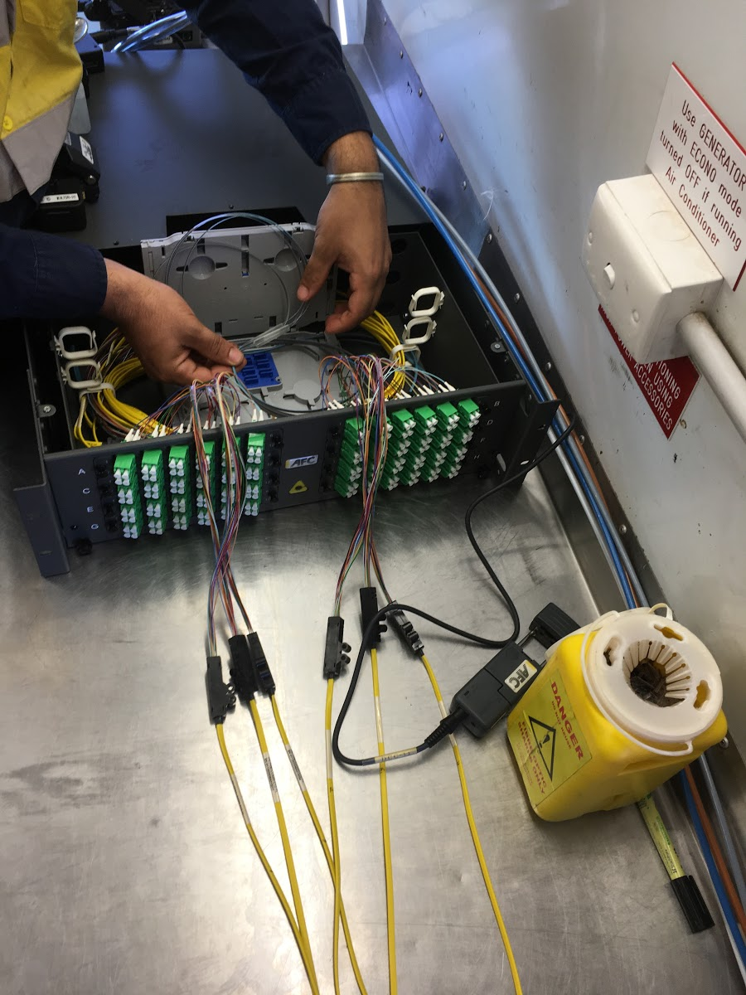
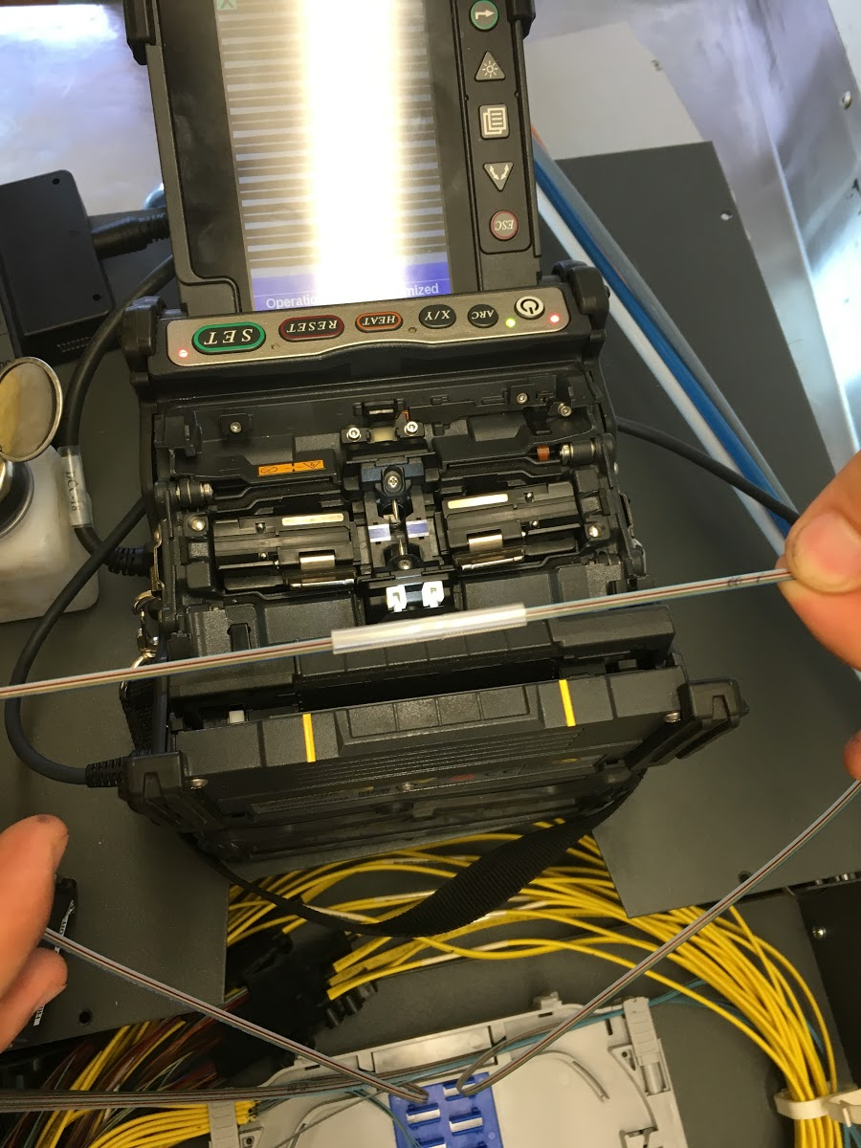
AAVS1 – Fibre splicing

Slide 23
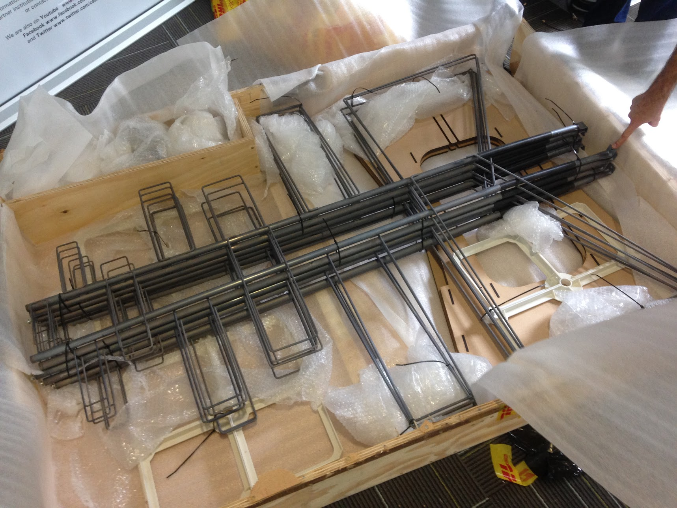
AAVS1 – Contractors

Slide 24
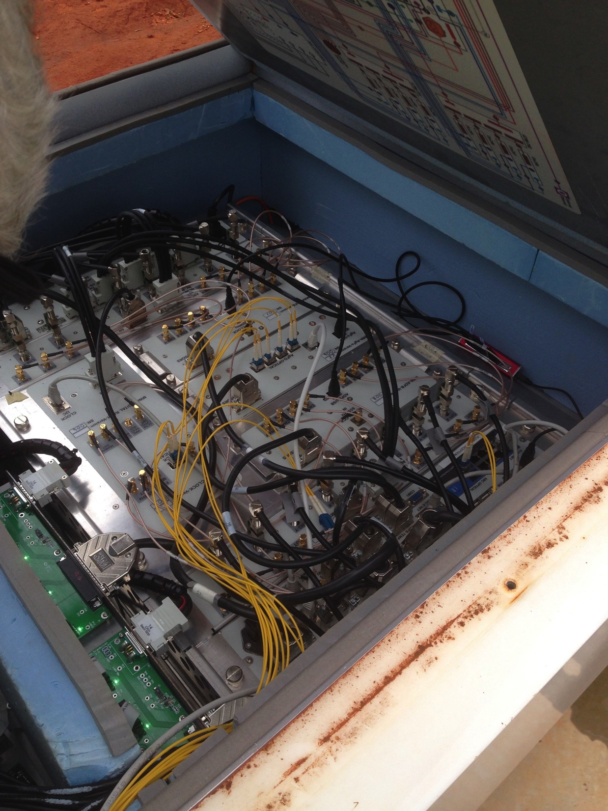
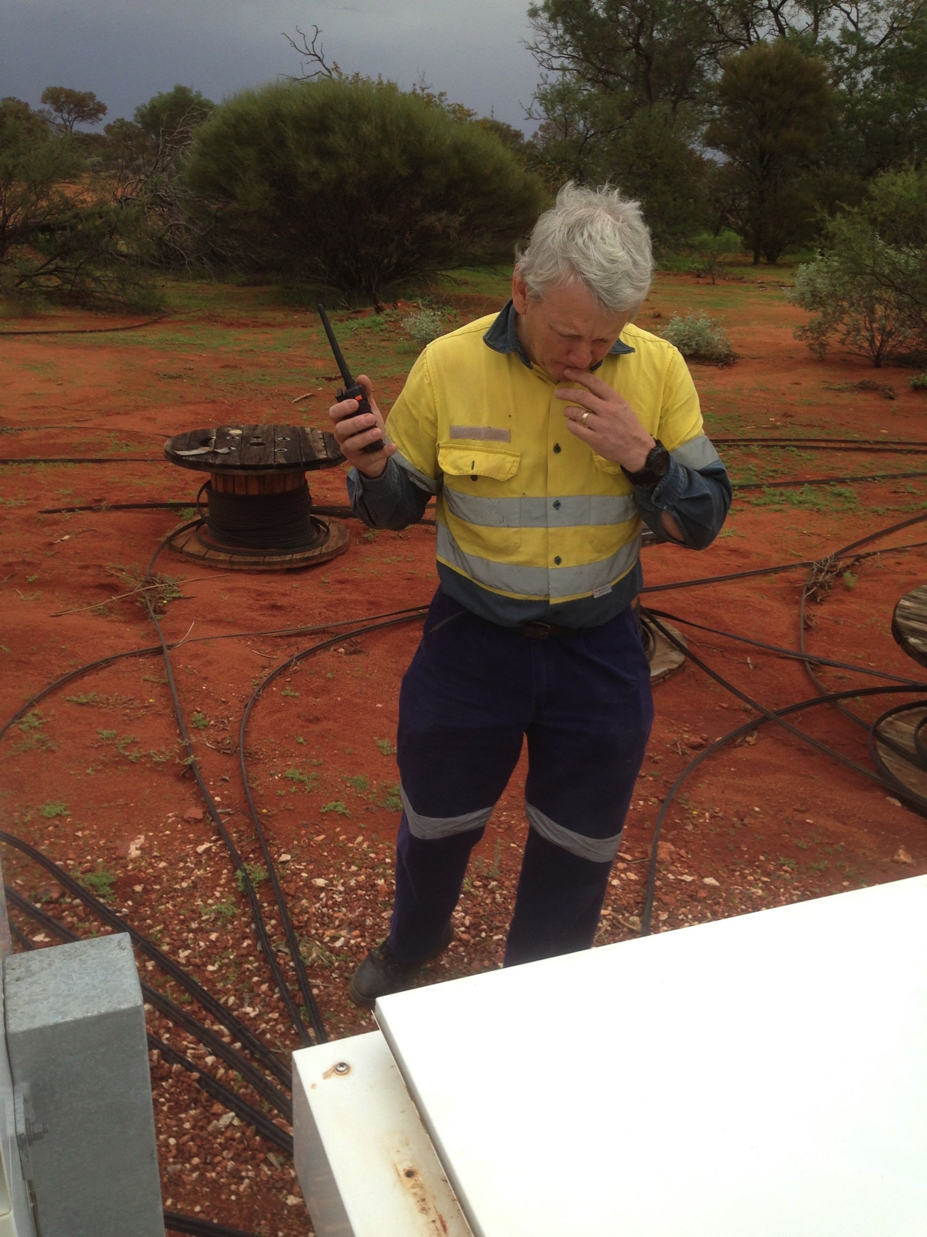
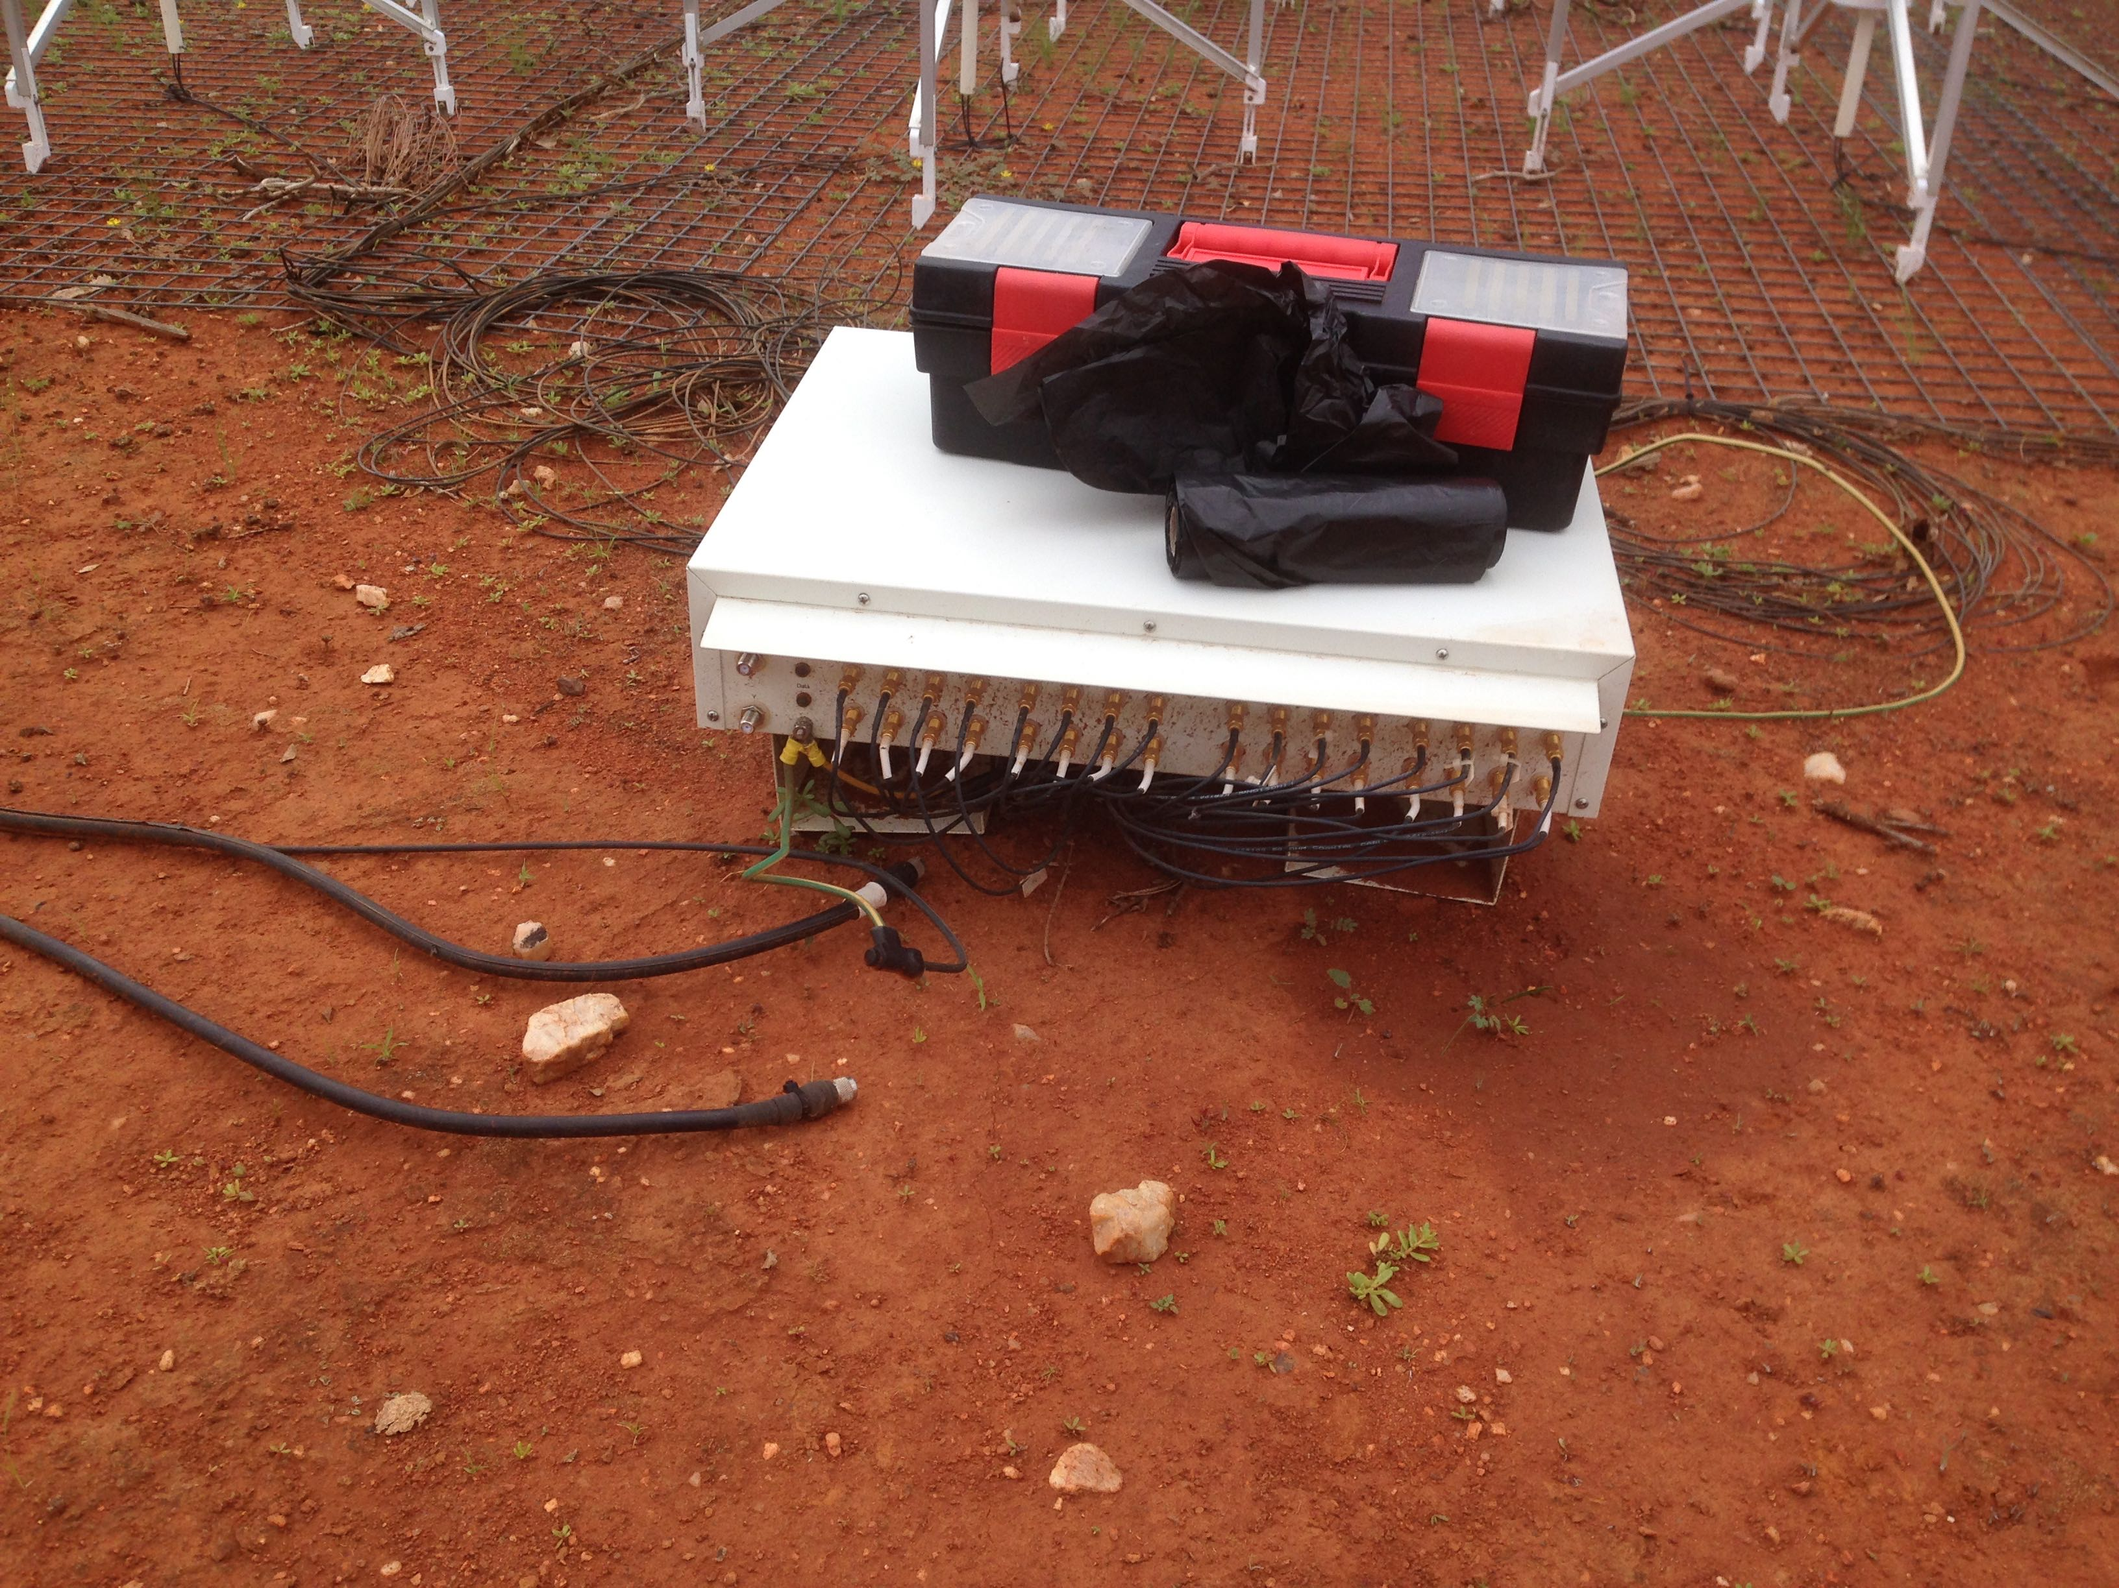
Human error

Slide 25
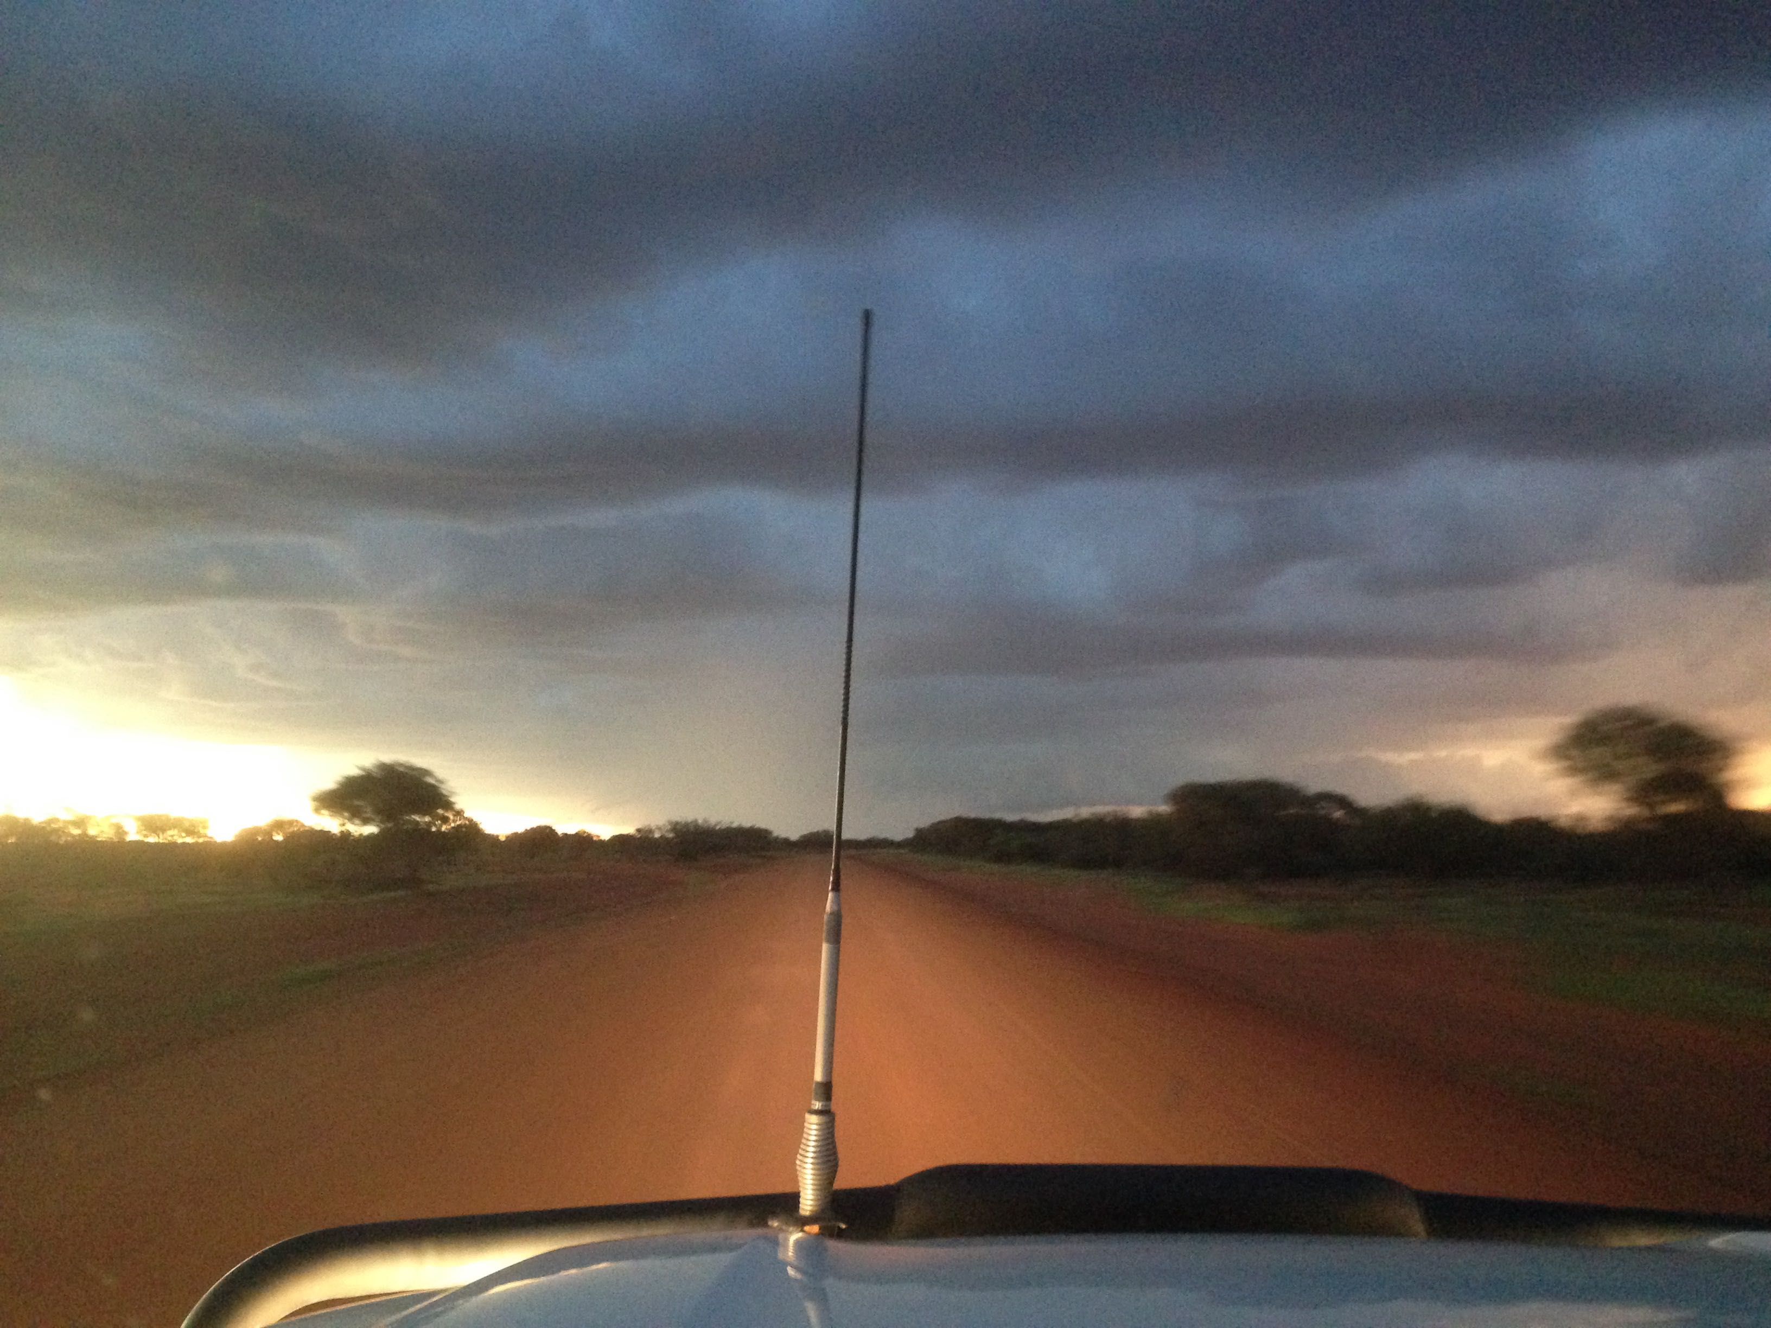
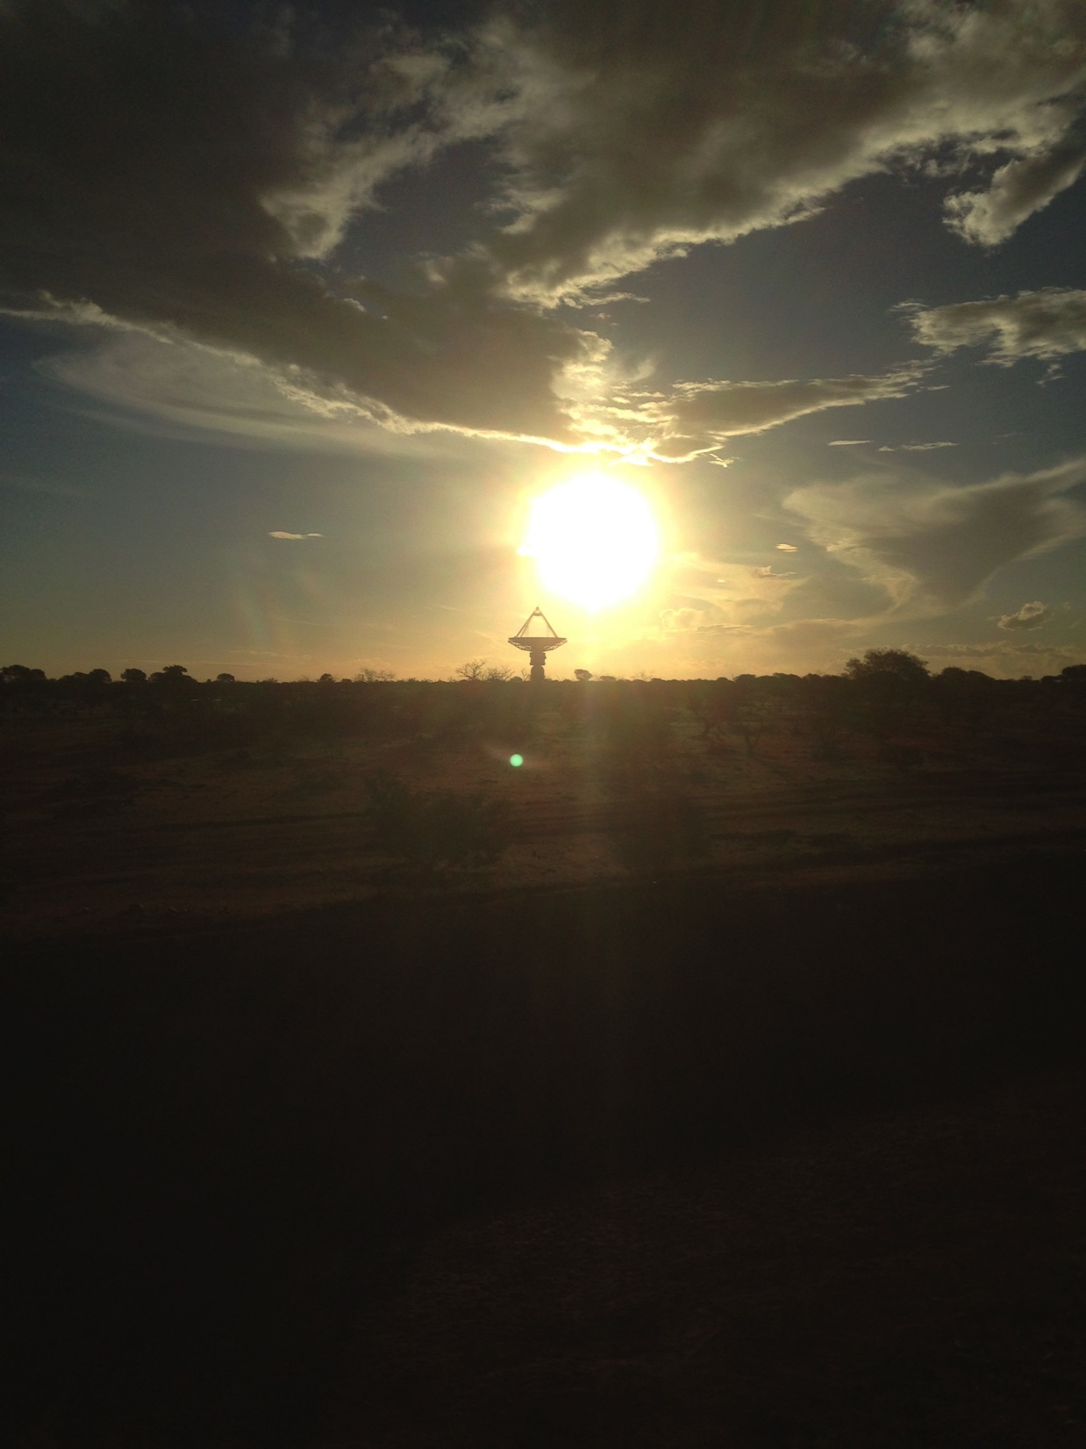
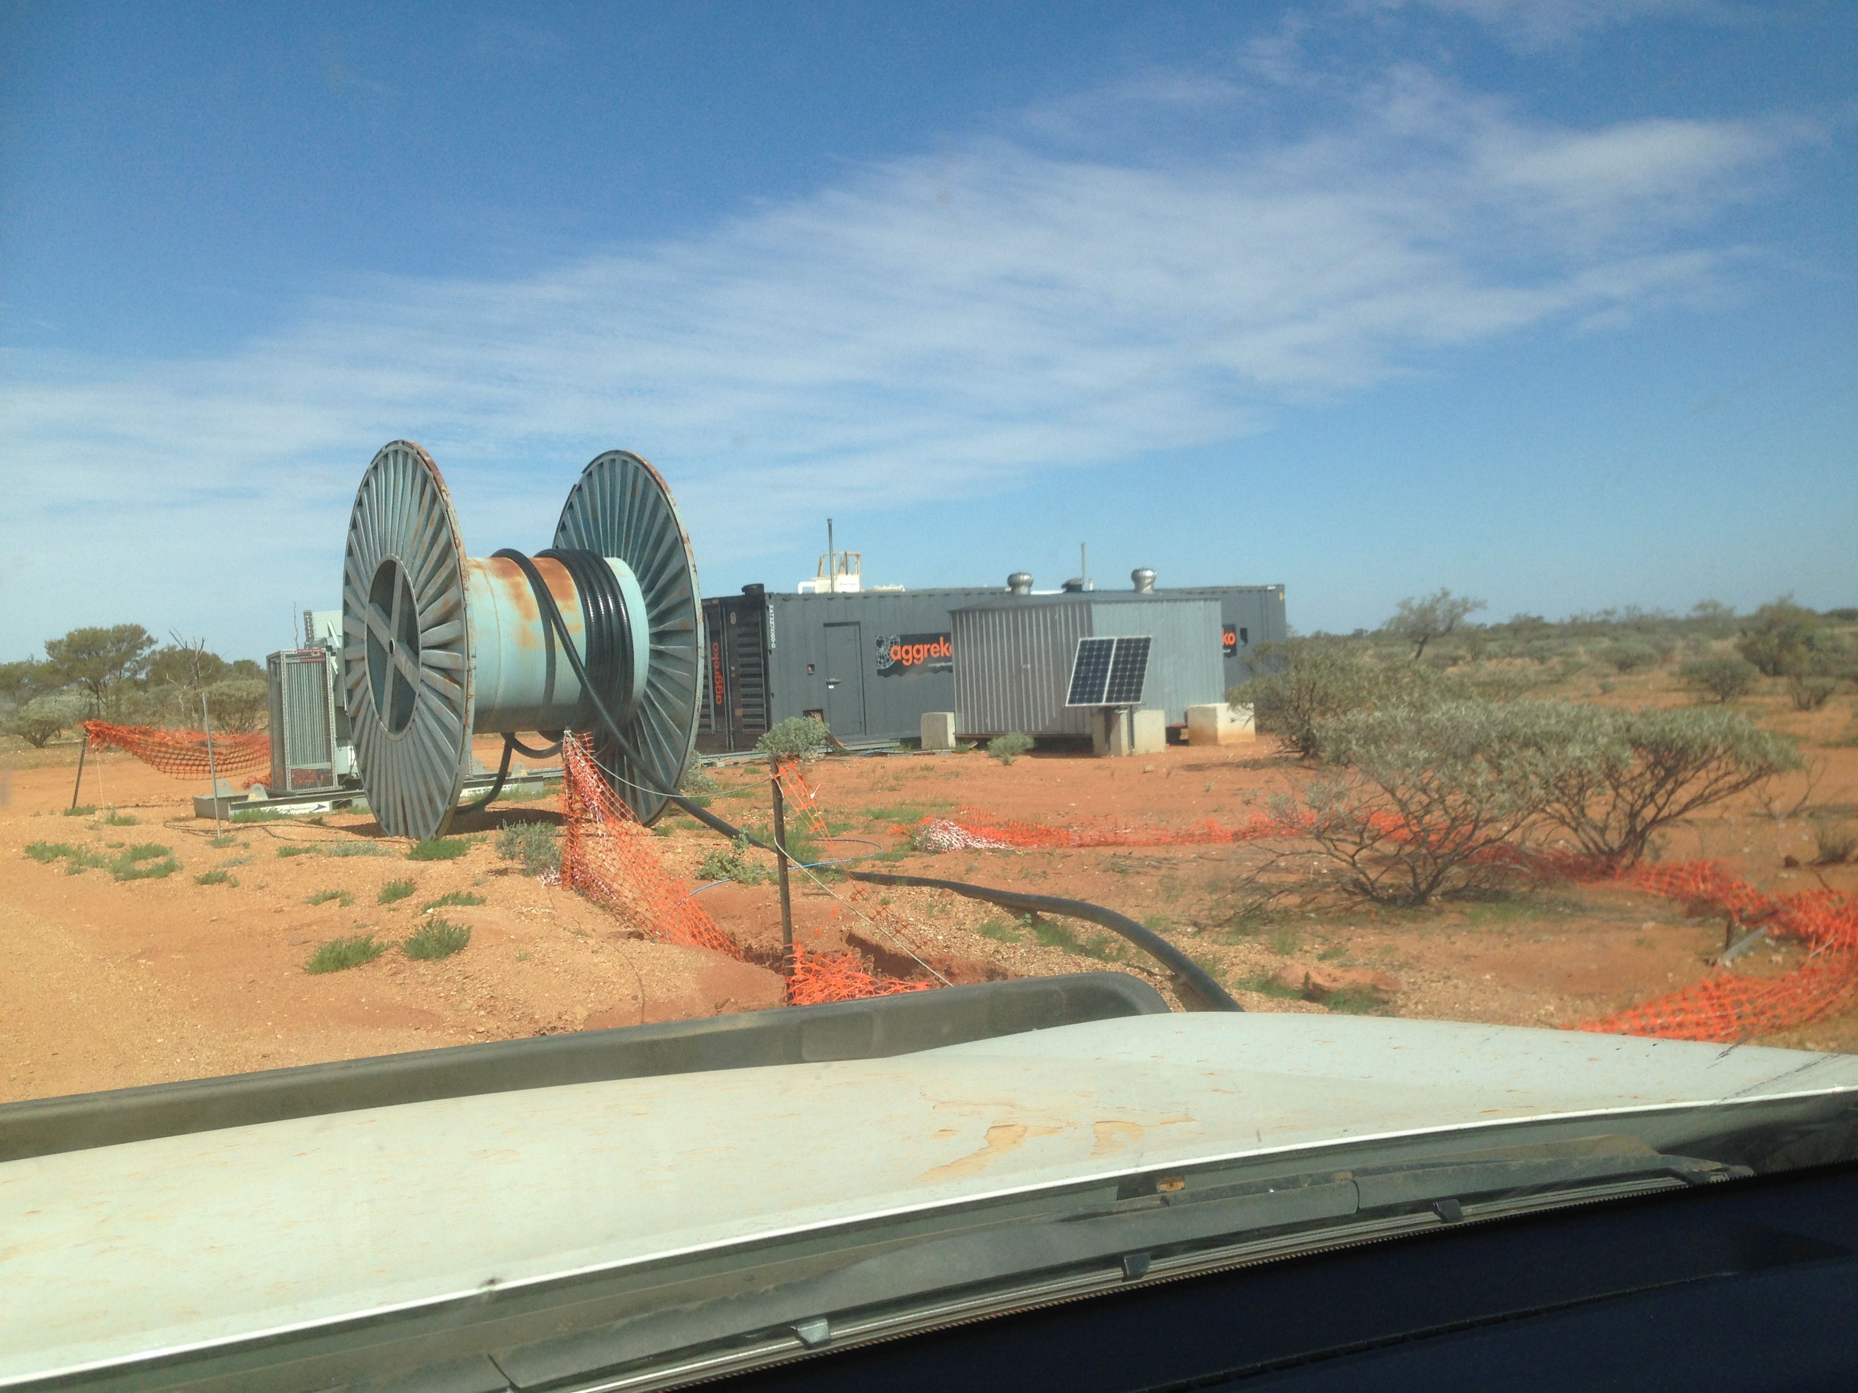
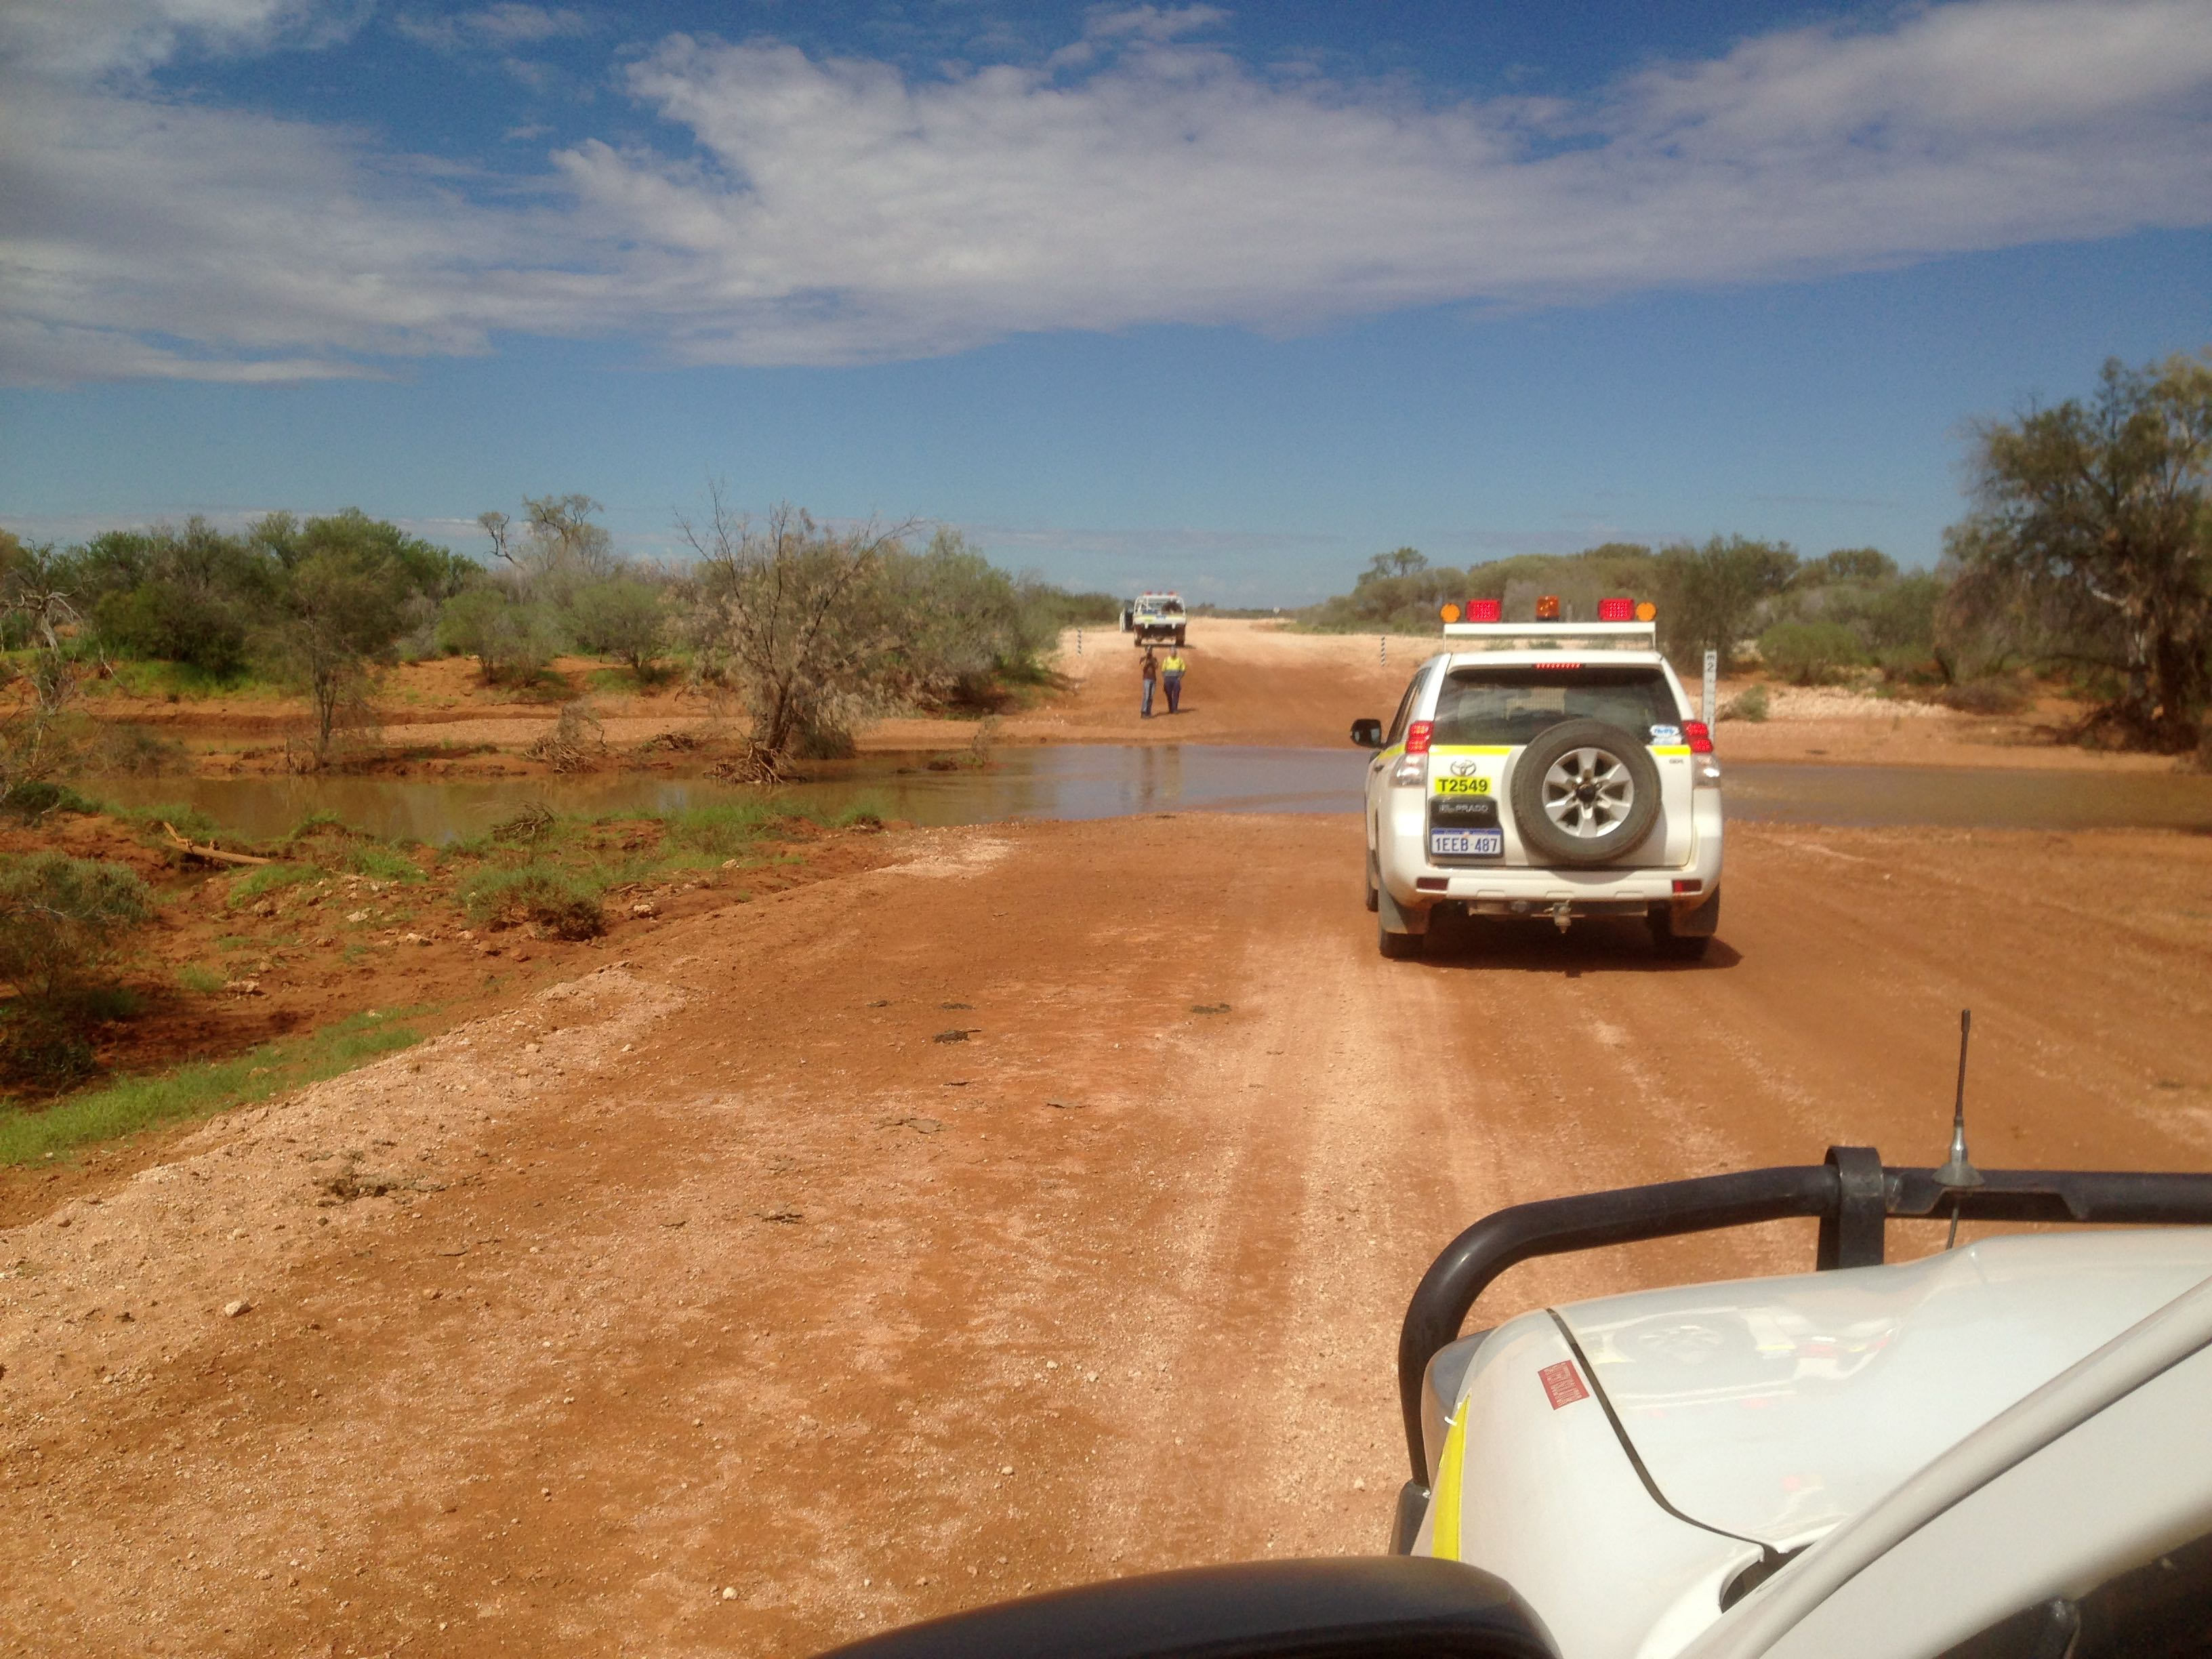
Remoteness

Slide 26
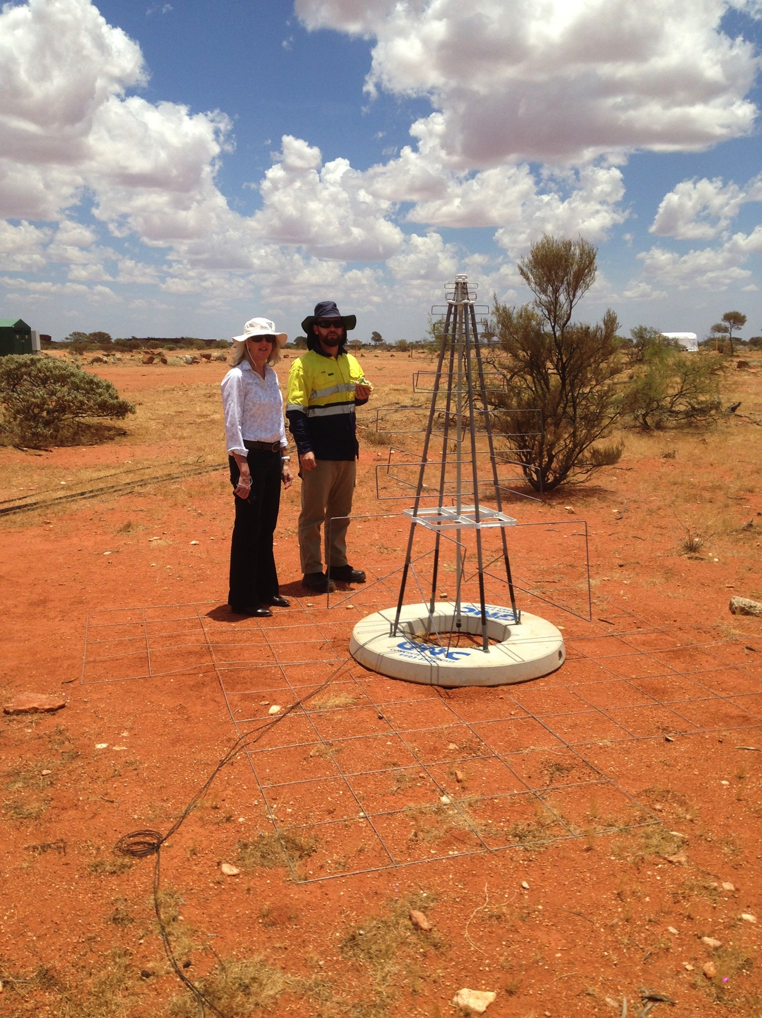
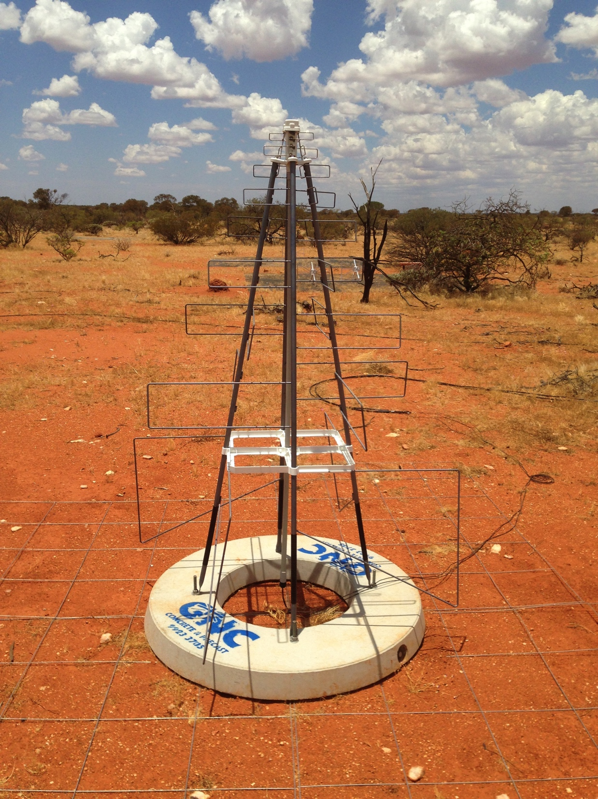
Towards SKA1_LOW
131071 to go….

