Slide 1







AADC: Aperture Array Design & Construction Consortium
LFAA: Low Frequency Aperture Array
Fibre Evaluation for MRO Conditions
Bologna, 11 May 2016, 10:00 am
Budi Juswardy, ICRAR/Curtin

Slide 2
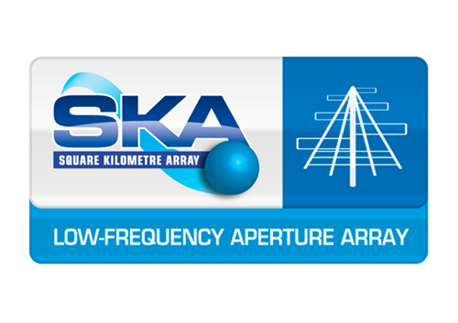
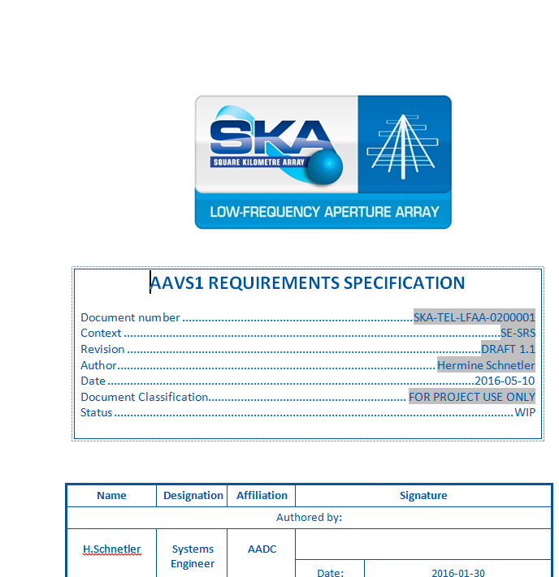
Context: LFAA System Req. Spec.
LFAA L3 requirements on the Relative Gain and Phase Stability of any two RF Signal Chains
Deploy in the field and fix the problem later ‘if we have problem’,
OR
Anticipate as much as possible real condition in the field, as we design and characterise, prior to deployment.

Slide 3
Results and Future Works
Progress to date:
    2-km (surface) & 11-km (buried) FO cable S₂₁(mag/phase) stability at MRO
    Relative temperature measurement (8 m & 35 m separations)
    Analysis on the impact of thermal variations (RF front-end components)
    Developed model to estimate the variations
    Lab evaluation to verify field measurements and understand underlying physical principle
Future activities:
    11-km (surface) FO cable at MRO for AAVS1!
    Verify LNA and RFoF links temperature evaluation.
    Documenting findings and communicating results to AADC Consortium
3 /19

Slide 4
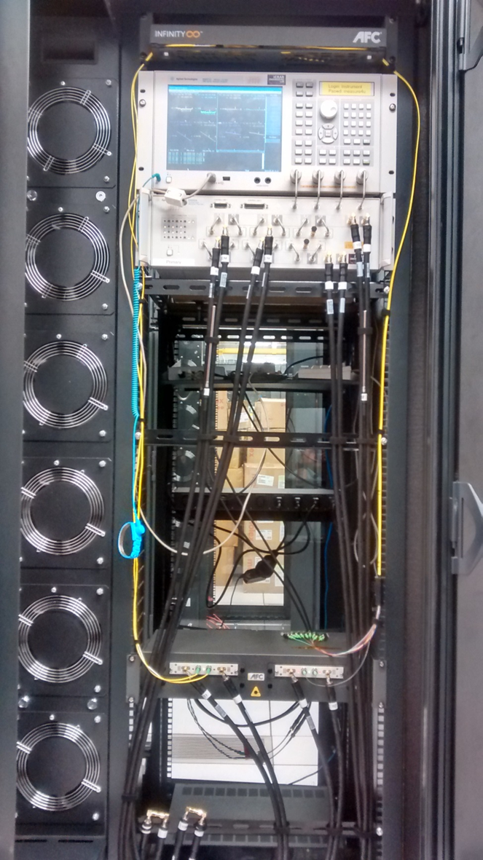
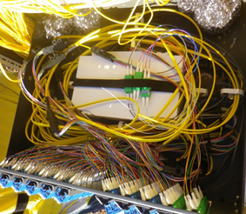
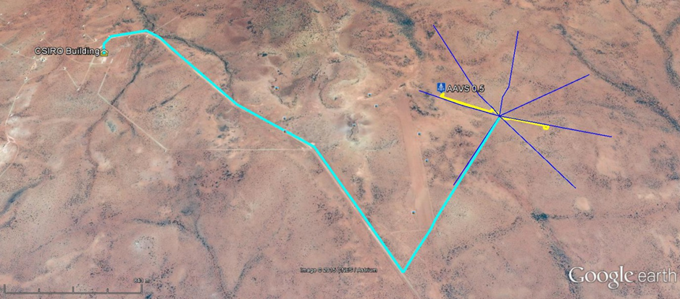
FO Cable Evaluations at the MRO
AAVS 0.5
Surface laid FO Cable
(~2 km)
Buried FO Cable
(~5.5 km)
4 /19

Slide 5
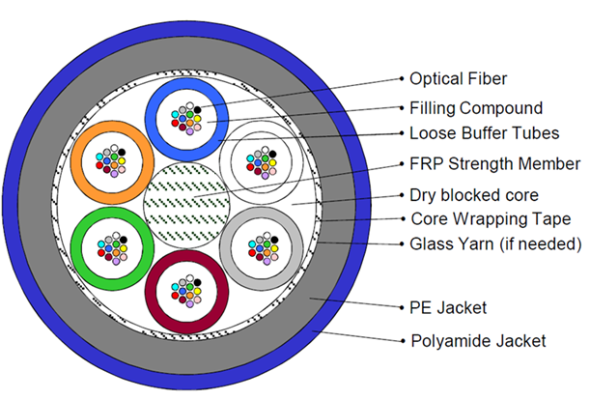
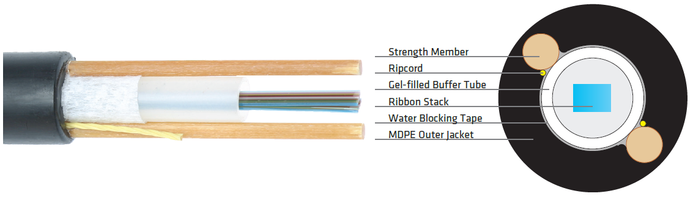
Different Cable Structures
2-km Fibre Cable
5.5-km Fibre Cable
Surface laid FO Cable
(~2 km)
Buried FO Cable
(~5.5 km)
Measure stability of RF signal over FO cable
Testing surface laid (2-km) & buried (5.5-km looped back to form 11-km loop)
Measuring a pair of fibre optic links “simultaneously”
Select the pair “near” and “far” to each other in the bundle.
5 /19

Slide 6
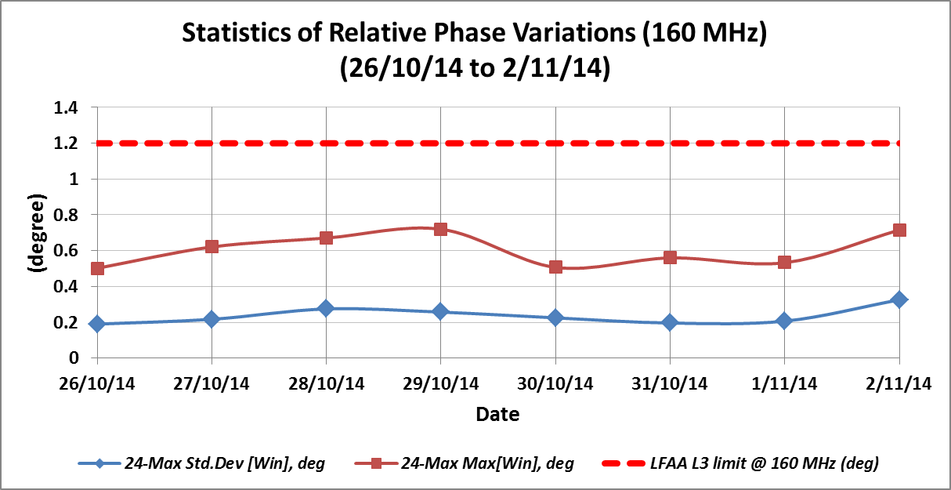
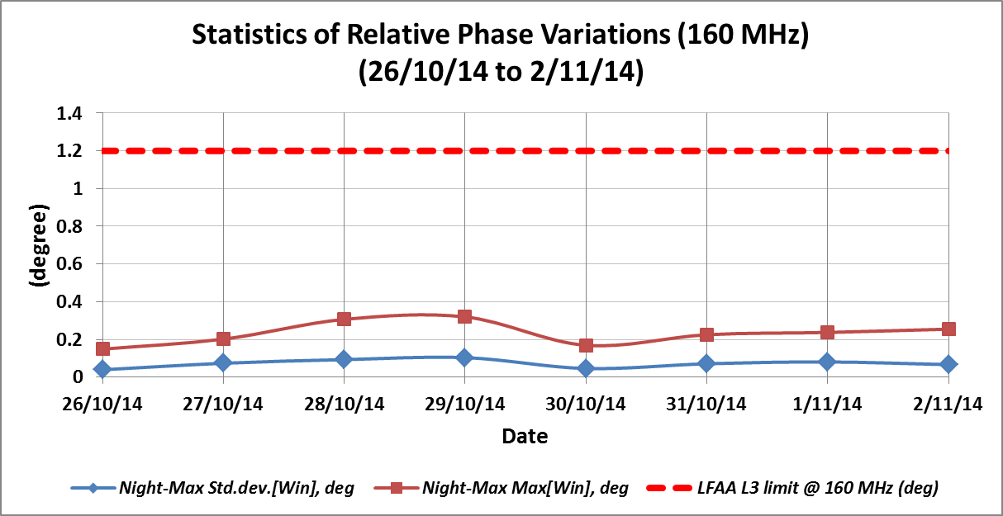
Results from Surface-laid FO Cable
2-km Fibre Cable
24-hour
Analyse statistics on 10-min Window
No significant relative gain variation
Mostly affect relative phase variations
  24-hr max: 0.7° (phase)
  Dark-hr max: 0.32°
Dark-hour
only
6 /19

Slide 7
Results from Buried FO Cable
5.5-km Fibre Cable
Relative Gain Variations
Analyse statistics on 10-min Window
No significant relative gain and phase variation, with respect to LFAA L3 (old) requirements.
Relative Phase Variations
7 /19

Slide 8
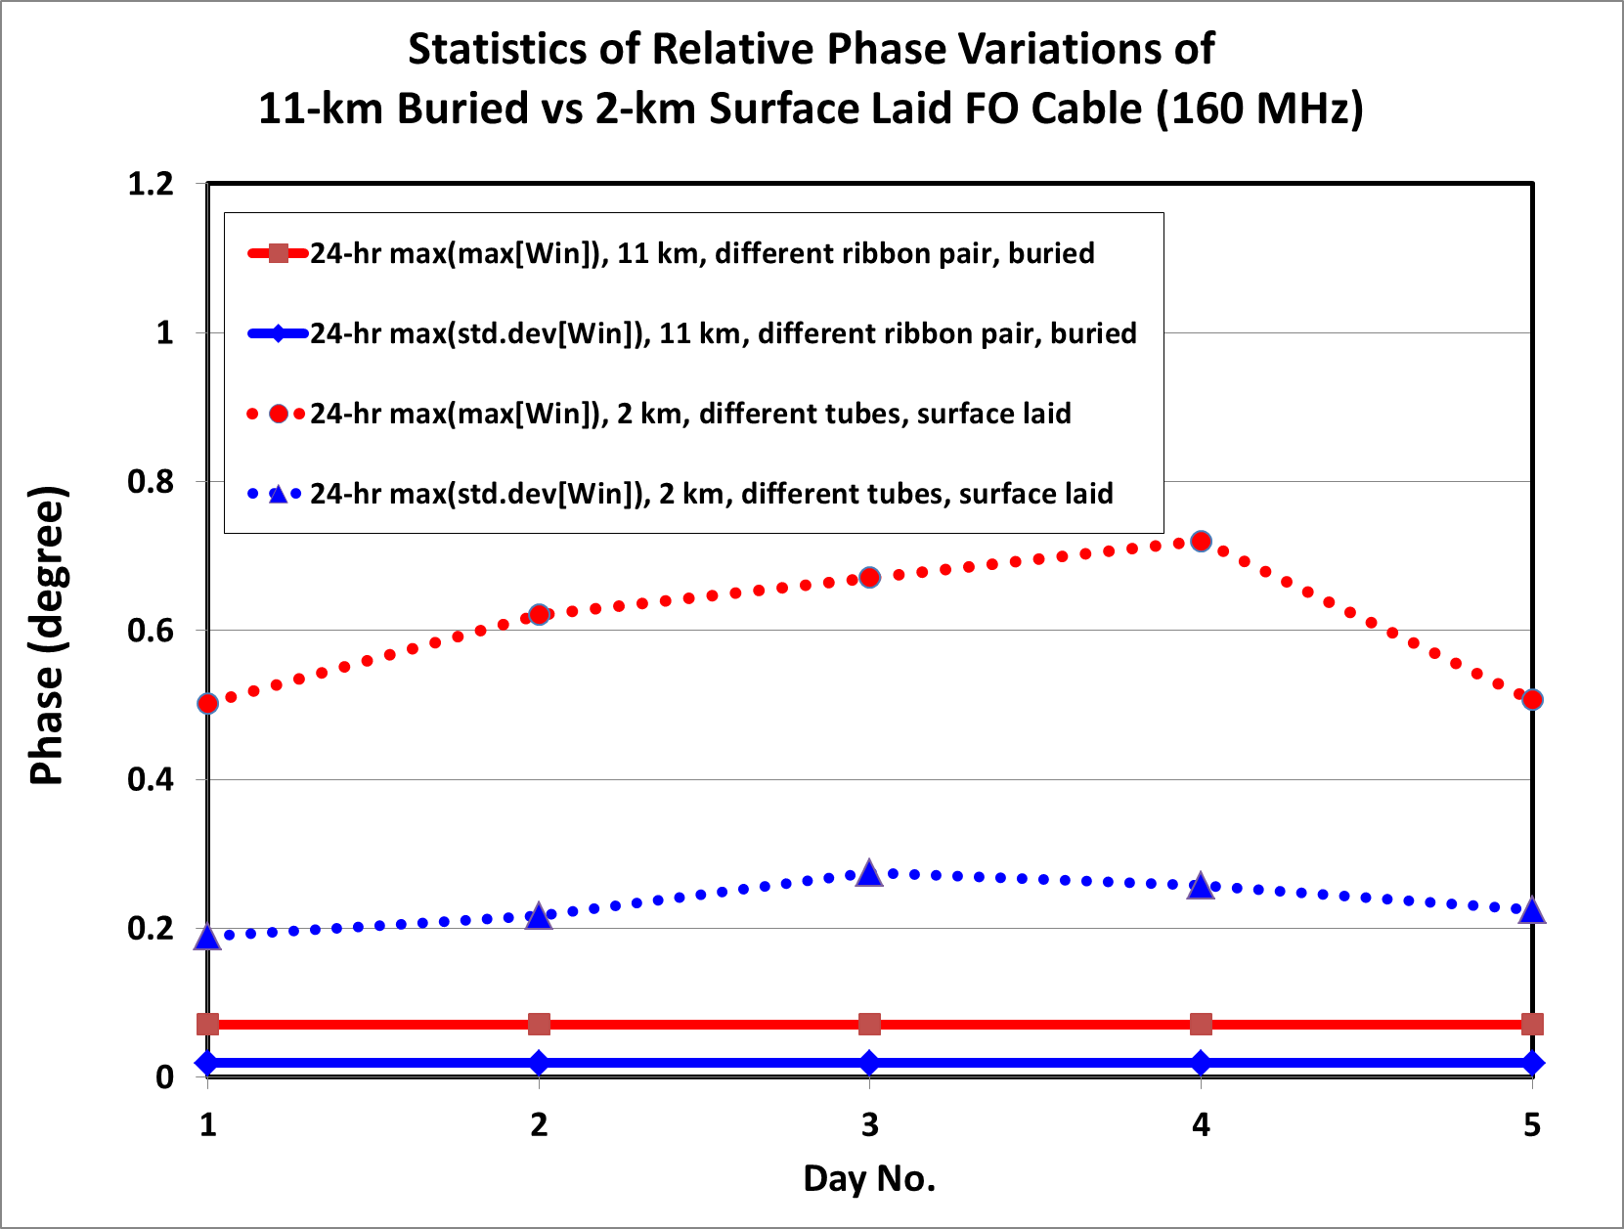

To bury, or not to bury….?
Can we afford not to bury the cable underground at the MRO?
Developed simplified model to estimate relative phase variation due to temperature difference between two RFoF chains:
$∆φ_{FO1−FO2}= {360}^{°}∙f∙\left|\left[\left(n∙α\right)+β\right]∙\left[\left(\frac{L_{0,FO1}∙∆T_{FO1}}{c}\right)−\left(\frac{L_{0,FO2}∙∆T_{FO2}}{c}\right)\right]\right|$
Refer to SKA-TEL-LFAA-0800005 → buried cable (available in Alfresco)
and to SKA-TEL-LFAA-0400017 → surface laid cable (available in Alfresco)
~ 0.68° (phase)
Difference!
8 /19

Slide 9
Contributions from RF Front-end Electronics
So far we just consider the gain/phase variation from the cable (FO).
Front-end electronics modules affected by temperature variation.
Motivate us to measure temp. simultaneously at 2 locations (MRO)
Used to extract statistics, and for simulating MRO condition in lab.
9 /19

Slide 10
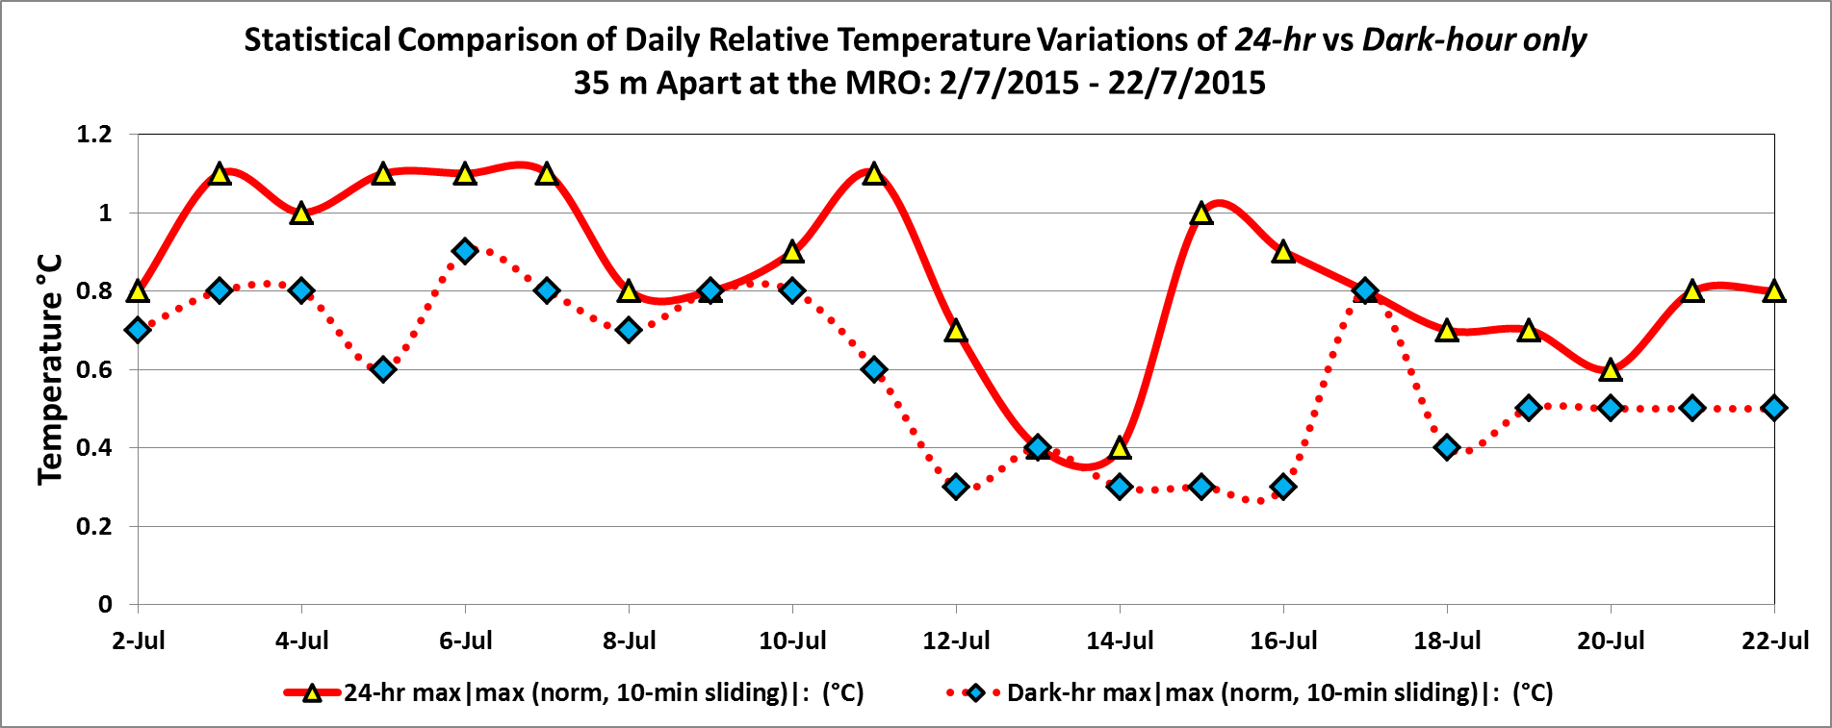
Result from Temperature Measurements
Max temperature difference occurred mostly during the day, 15% at night (dark hours).
1.1° C as max. relative temperature difference within 10-min window at MRO.
Max rate of change (relative temperature gradient (transient)) in the field is 0.2 °C/minute, with a 75th percentile rate of change of 0.1 °C/minute.
Refer to SKA-TEL-LFAA-08000xx_RFoF_Tx_temp_analysis_rev1 (available in Alfresco)
10 /19

Slide 11
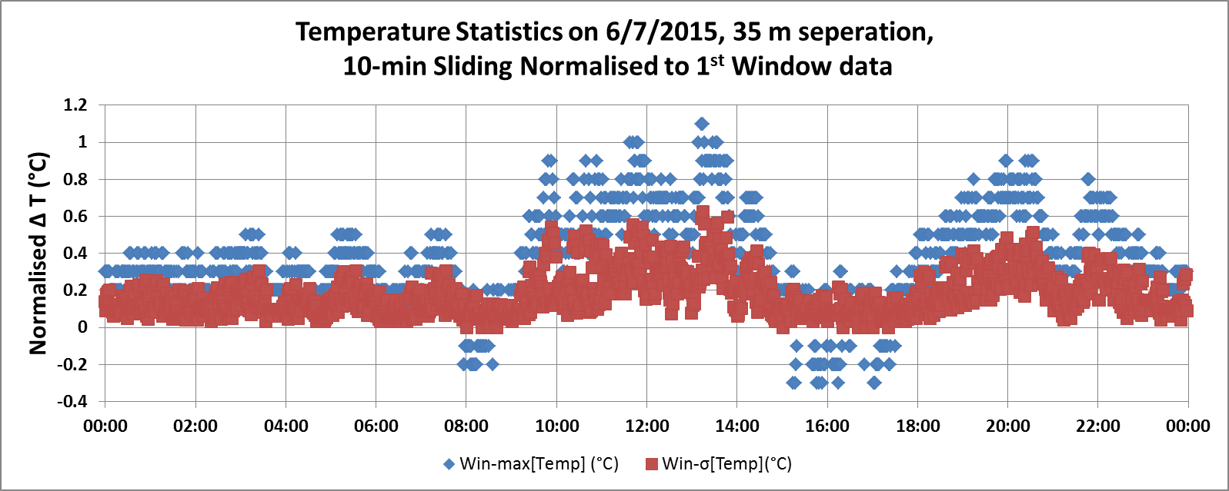
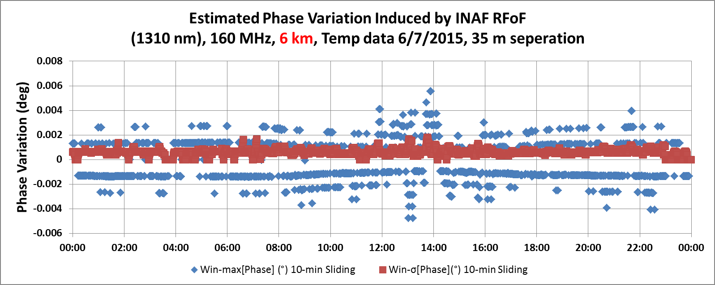
What we get from relative temperature data?
11 /19

Slide 12
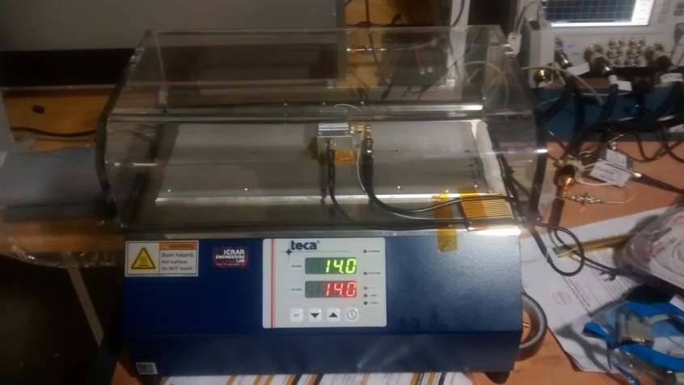
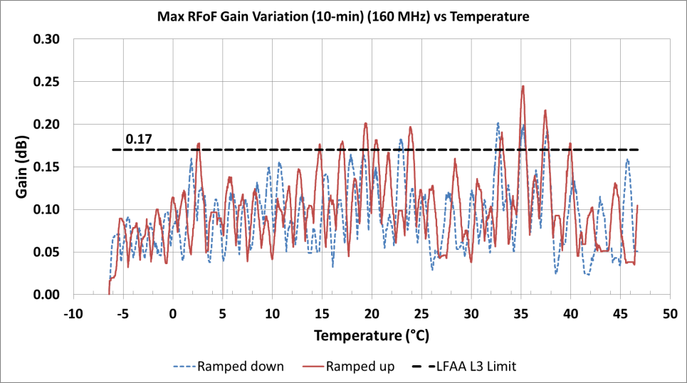
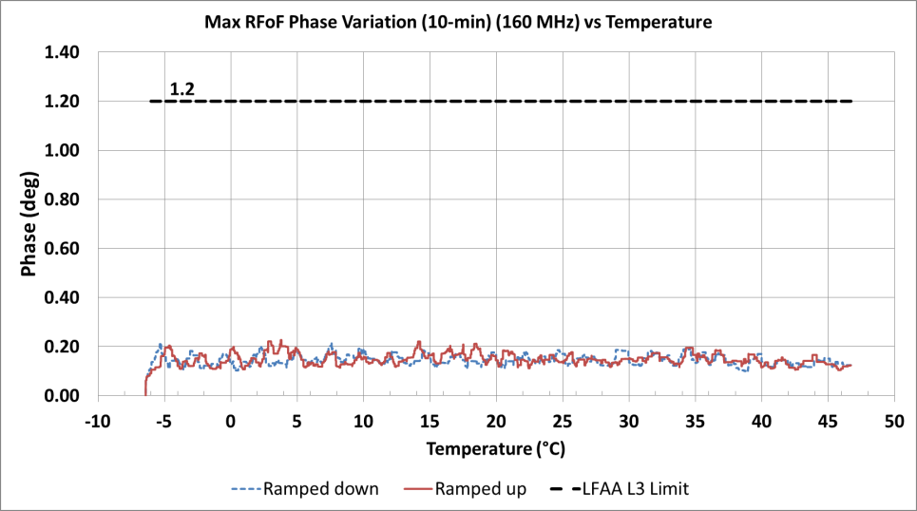
Simulate MRO Condition in the Lab
Subjecting front-end electronics (LNA and RFoF Tx) to thermal plate.
Max_var(gain/phase)_{peak-to-peak} = │max(gain/phase)_{win(τ)} − min(gain/phase)_{win(τ)}│
Gain
Phase
12 /19

Slide 13
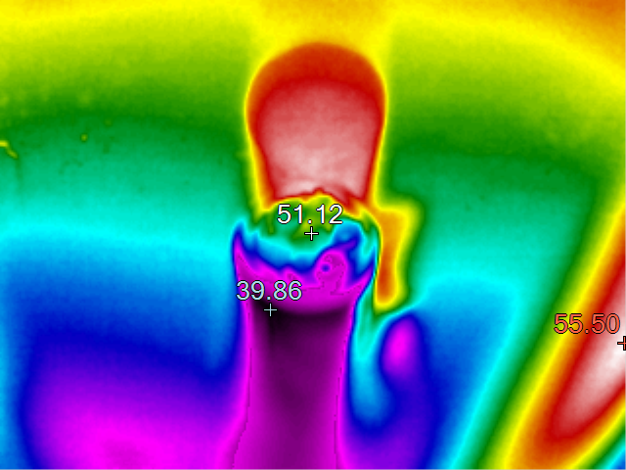
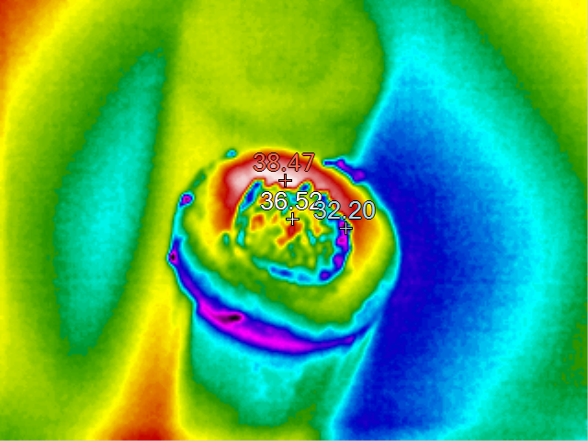
Thermal Loading due to Solar on Cable
2-km Fibre Cable
5.5-km Fibre Cable (SWR)
Tube #1
~50°C
Outer Core
~36°C
Tube #3
~40°C
Inner Core
~32°C
Plate temp: ~55°C
Plate temp: ~55°C
Smaller temp. difference for concentrated structure (e.g. SWR) compared to loose tubes type.
However, as cable diameter increases (for 576 cores), temperature difference between fibre at cable at inner core and outer core becomes higher → higher phase variations!
Also, non loose-tube cable means potential cable strain → refractive index change → phase and gain variations!
13 /19

Slide 14
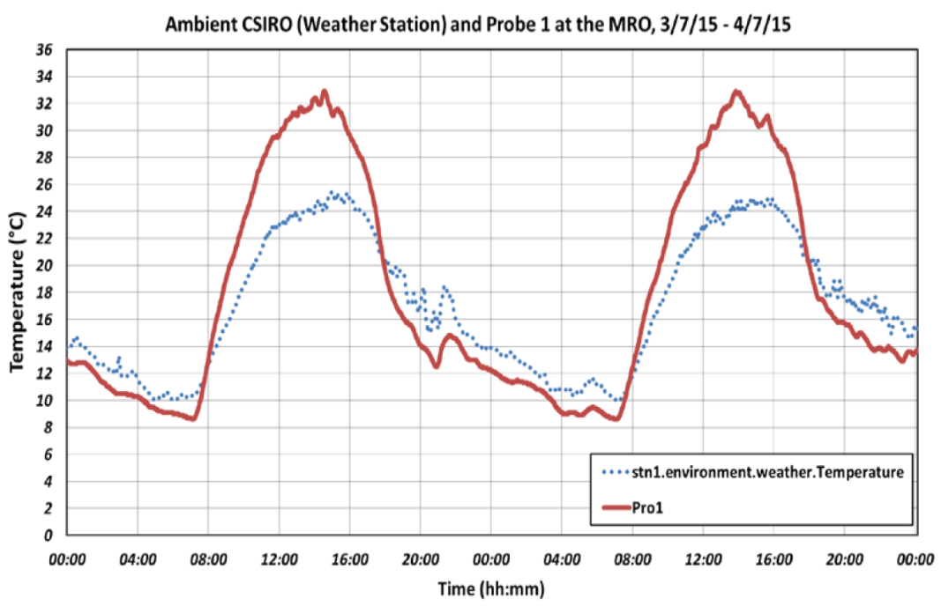
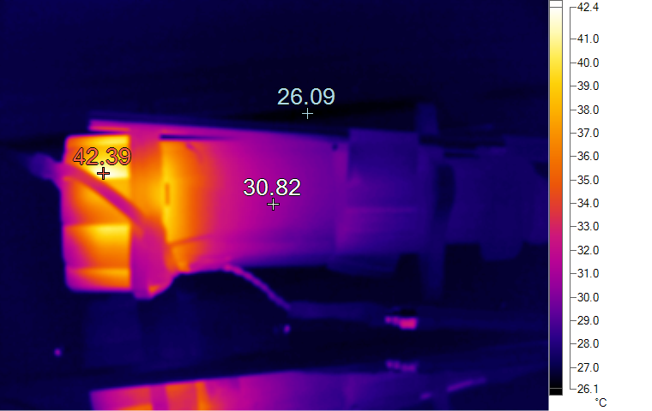
Thermal Loading due to Solar + Self Heating on SKALA trumpet
Measured up to 11°C difference between ambient + internal trumpet temp. due to solar heating only.
Up to 21°C difference between ambient (room) & internal due to self heating
1.5 hours required for trumpet internal temperature to reach equilibrium under room temperature.
Refer to Memo_Temp_Spec_Electronic_MRO_Rev1_2016_03_21 (Internal ICRAR document, distributed to AADCC)
14 /19

Slide 15
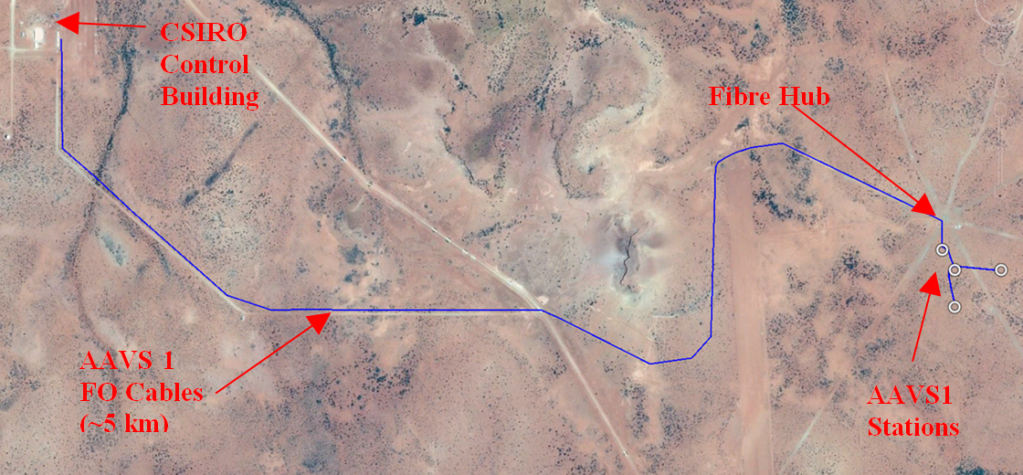
FO Cable Measurement for AAVS1
FO Cables for AAVS1 is routed April 2016, scheduled completion in early June 2016
Both cable surface laid, ~5 km in length.
Proposed to measure relative phase & gain variation end-July to end-Sept 2016
Looped-back to form ~10 km surface laid cable!
15 /19

Slide 16
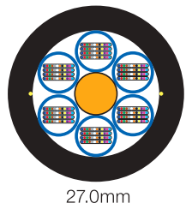
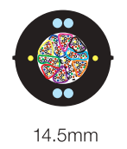
Plan for AAVS1 FO Cable Measurement
Fujikura Cable
Spider Web Ribbon (SWR)
SDGI Cable
Standard Loose-tube Fibre Ribbon
Two Types of AAVS 1 FO cable:
  Novel 576-core, Ф14.5 mm SWR cable from Fujikura (AFL) → CABLE 1
  Standard 576-core, Ф27 mm loose-tube ribbon cable from SDGI → CABLE 2
Measure 2 different cables “simultaneously” at the same time:
  Measure from a selected pair for each cable for one month
  Repeat the measurement from a different pair for another month.
  Measure a total of 4 RFoF chains from 2 cables relatively at the same time.
16 /19

Slide 17
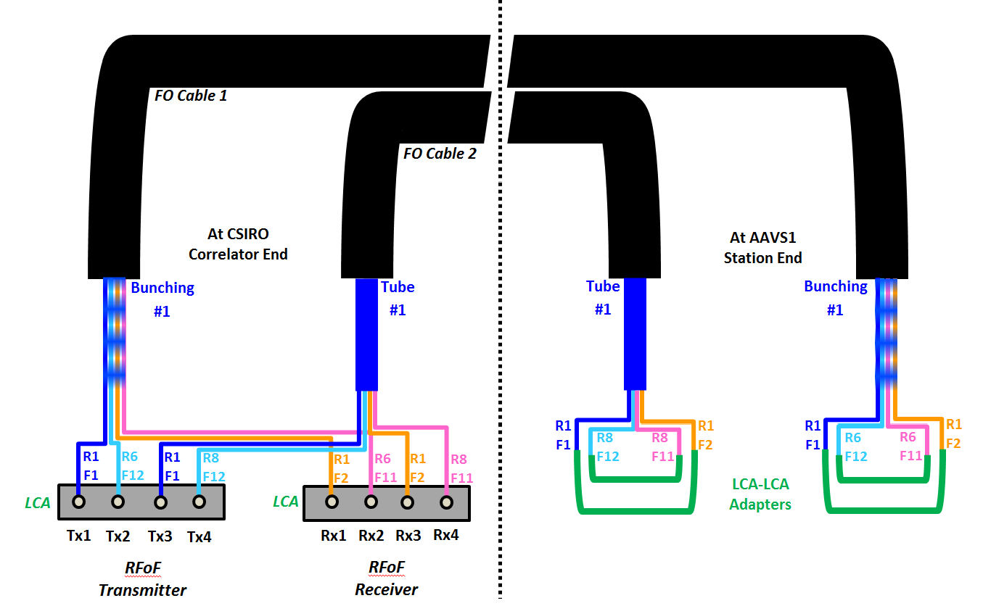
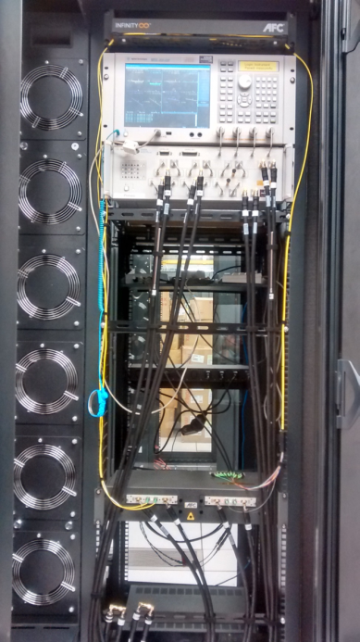
Plan for AAVS1 FO Cables Measurements
RFoF pair selection (scheduled July-August):
Cable 1: selected from different ribbons but the same fibre bunching,
Cable 2: selected from different ribbons but from the same loose tube
17 /19

Slide 18
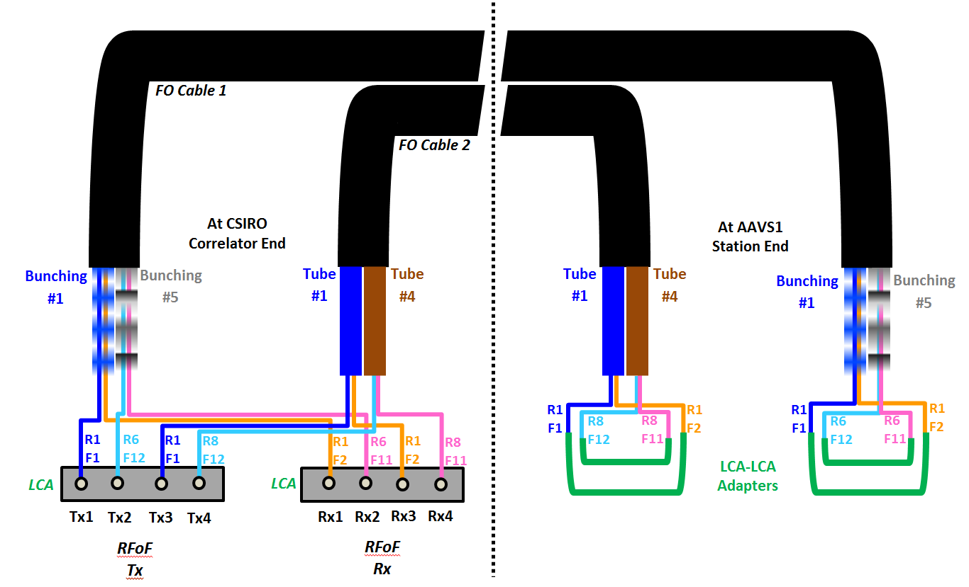
Plan for AAVS1 FO Cables Measurements
RFoF pair selection (scheduled August-September):
Cable 1: selected from different ribbons and different fibre bunching,
Cable 2: selected from different ribbons and different loose tube
18 /19

Slide 19
Closing
Demonstrate the feasibility of using RFoF links at the MRO:
  Gain/phase contribution from the FO cable has been, measured.
  Based on the result, different cable length can be estimated
  Need to characterise the RF front-end electronics (LNA and RFoF Tx).
Relative temperature information at the MRO available
  Simultaneous measurement at 8m and 35 m
  Use data to simulate the condition in the lab
Importance of proper design & screening prior to deployment to MRO
Future measurements:
  FO cables for AAVS 1
  2 months with different pair combinations
19 /19

