Slide 1
European Pre-AAVS1 Update
Nima Razavi-Ghods

Slide 2
Overview
Primary goals of Pre-AAVS1
Hardware integration and functional testing
Current system at Lord’s Bridge
TPM software modes and testing
Test plan and ongoing work

Slide 3
Primary goals of Pre-AAVS1
Develop a “modular” 16-element SKA-LOW prototype system at Lord’s Bridge, Cambridge
Integrate and tests system chain: mechanical assembly, RF performance, power and environmental testing
Evaluate and develop commissioning software
Develop understanding of the calibration process and carry out useful test such as beam-pattern and SEFD measurements
Sign off on initial hardware and software to be used at the MRO

Slide 4
A block diagram of our system

Slide 5
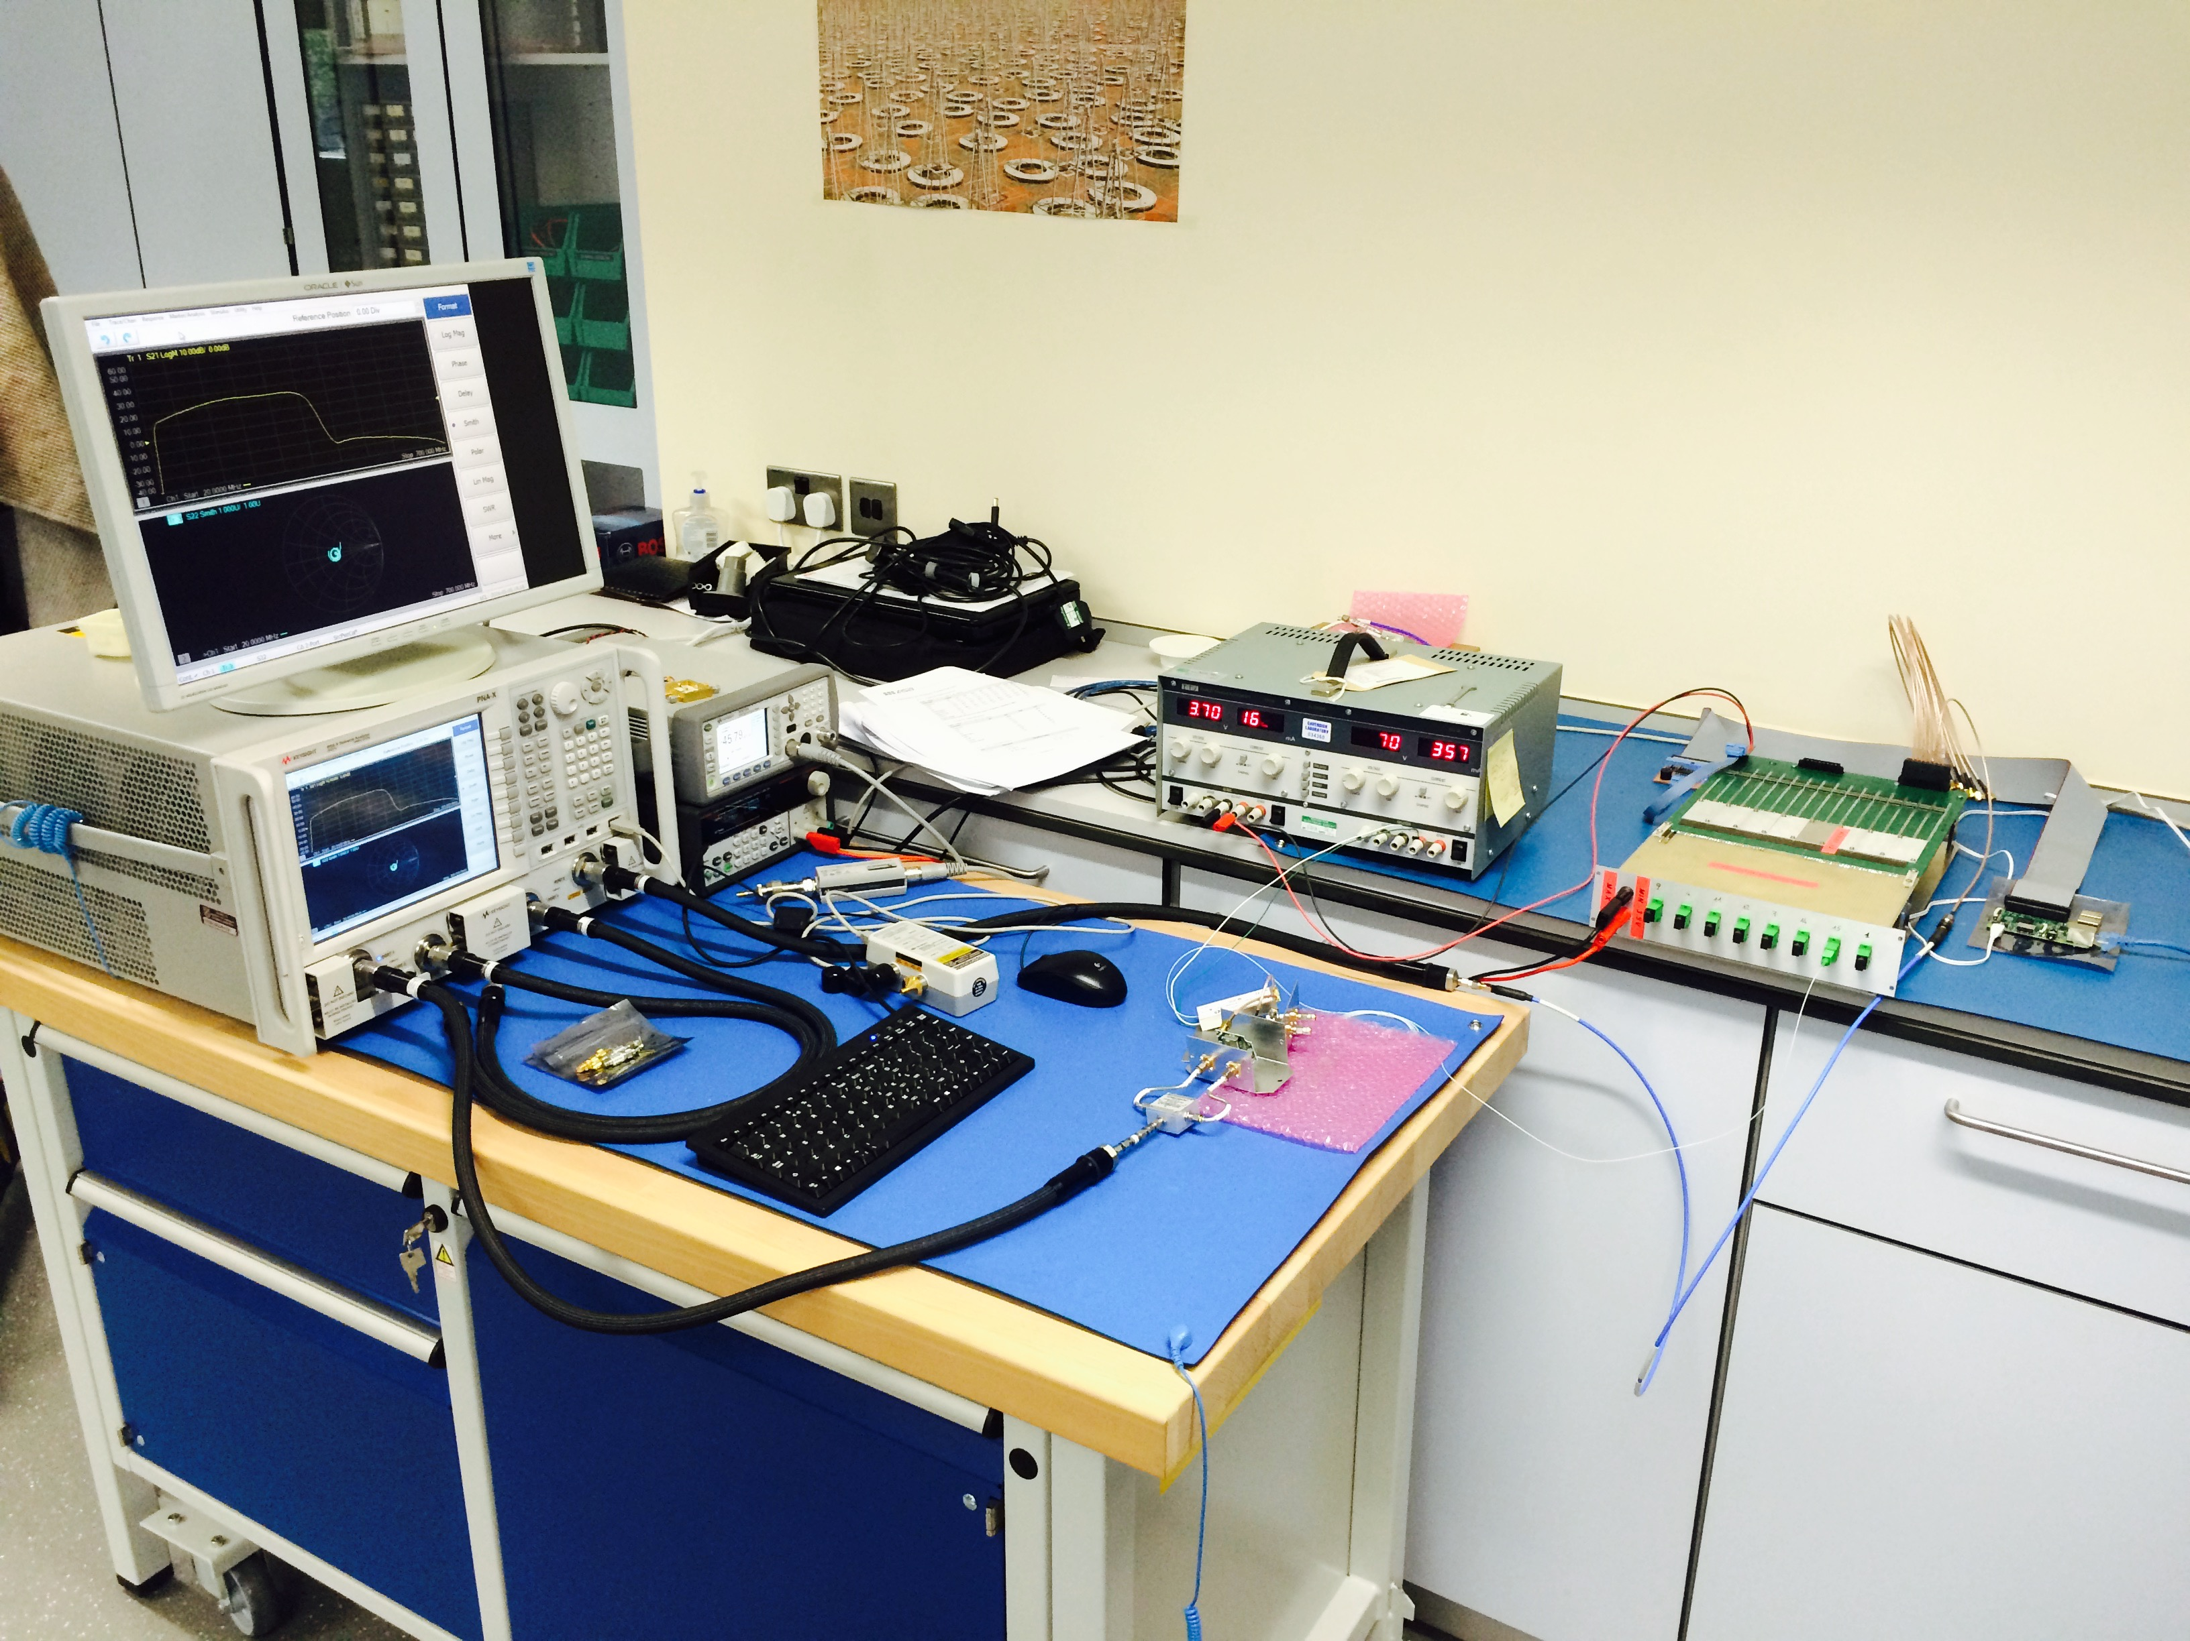
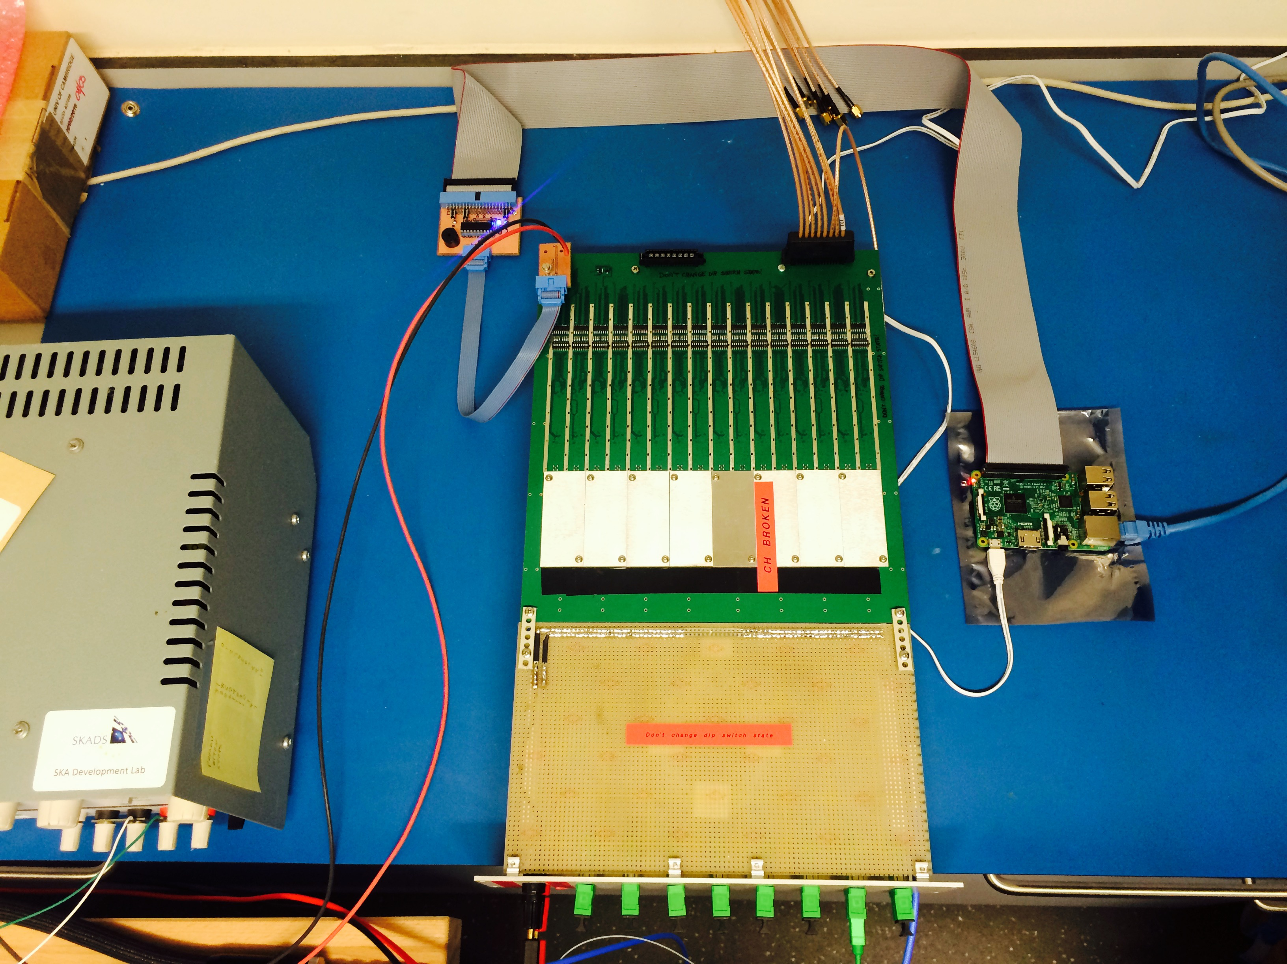
Hardware integration and testing (Laboratory)
A system has been setup to measure the end-to-end RF chain including the LNA, FE and PREADU and compare with simulations

Slide 6
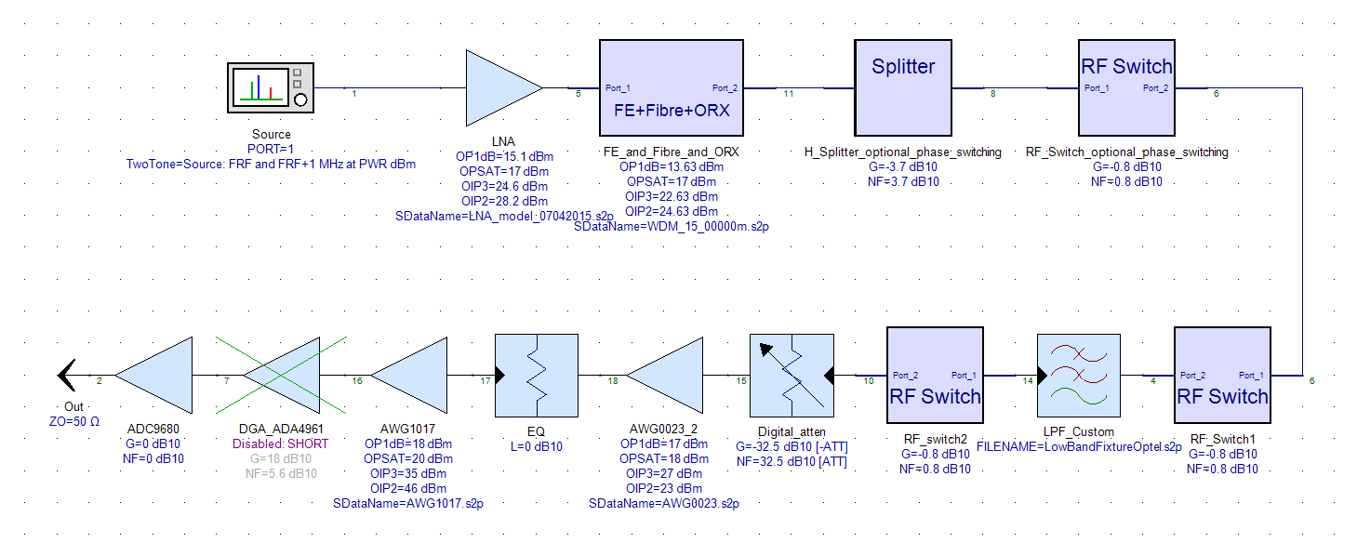
Bench setup and simulations

Slide 7
Results so far…

Slide 8
Laboratory measurements still to do…
Measurements of the trumpet including the LNA and FE inside an environmental chamber (stability and thermal drift)
Integration of a single antenna including the hybrid cable
Sending control signals via the ADU board
Installation of RX (FE & PREADU) at Lord’s Bridge

Slide 9
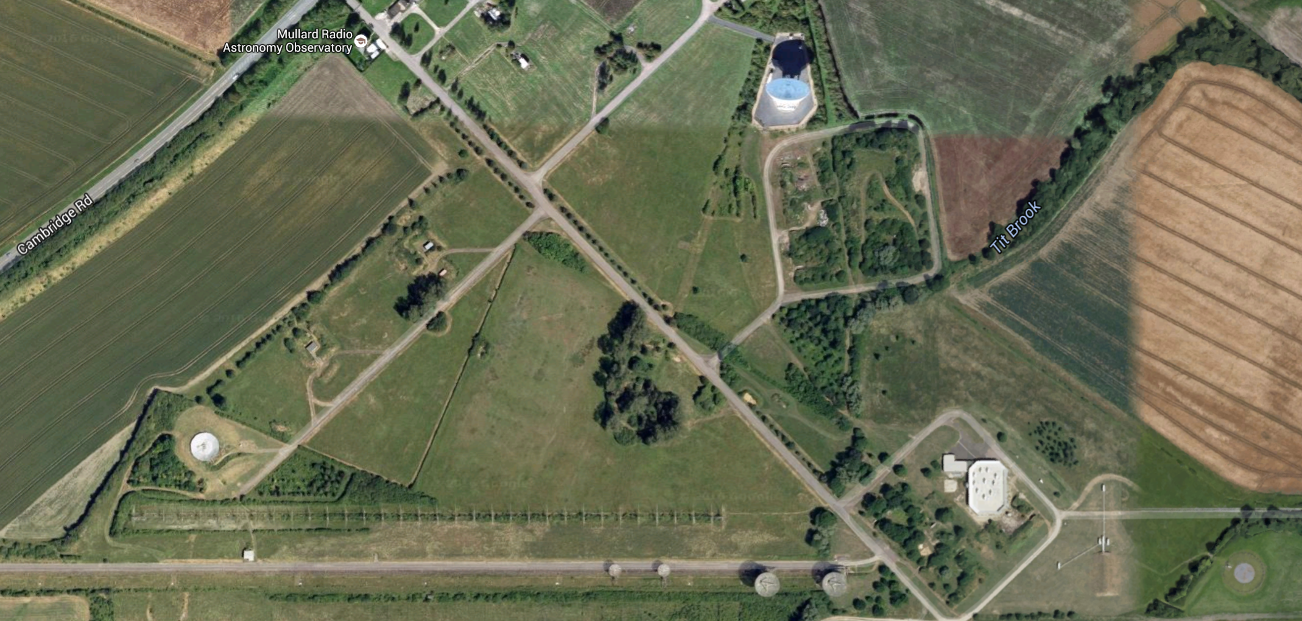
Pre-AAVS1 at Lord’s Bridge
MERLIN
AMI Large Array
CAT
AMI Small Array
4C Array
Half-Mile & One-Mile
Pre-AAVS1
IPS (Pulsar Array)
COAST

Slide 10
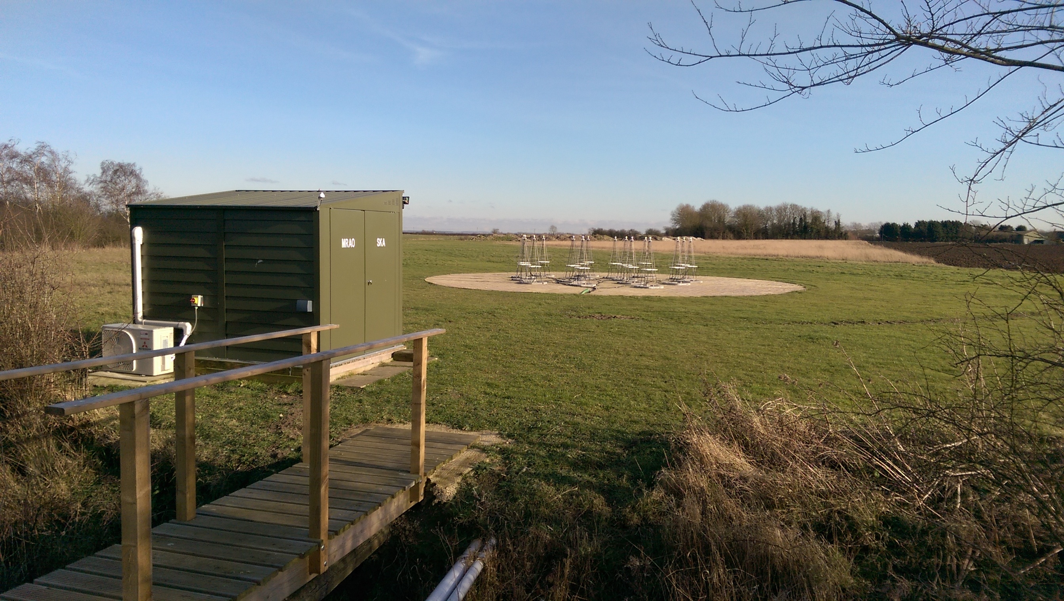
Pre-AAVS1 at Lord’s Bridge

Slide 11
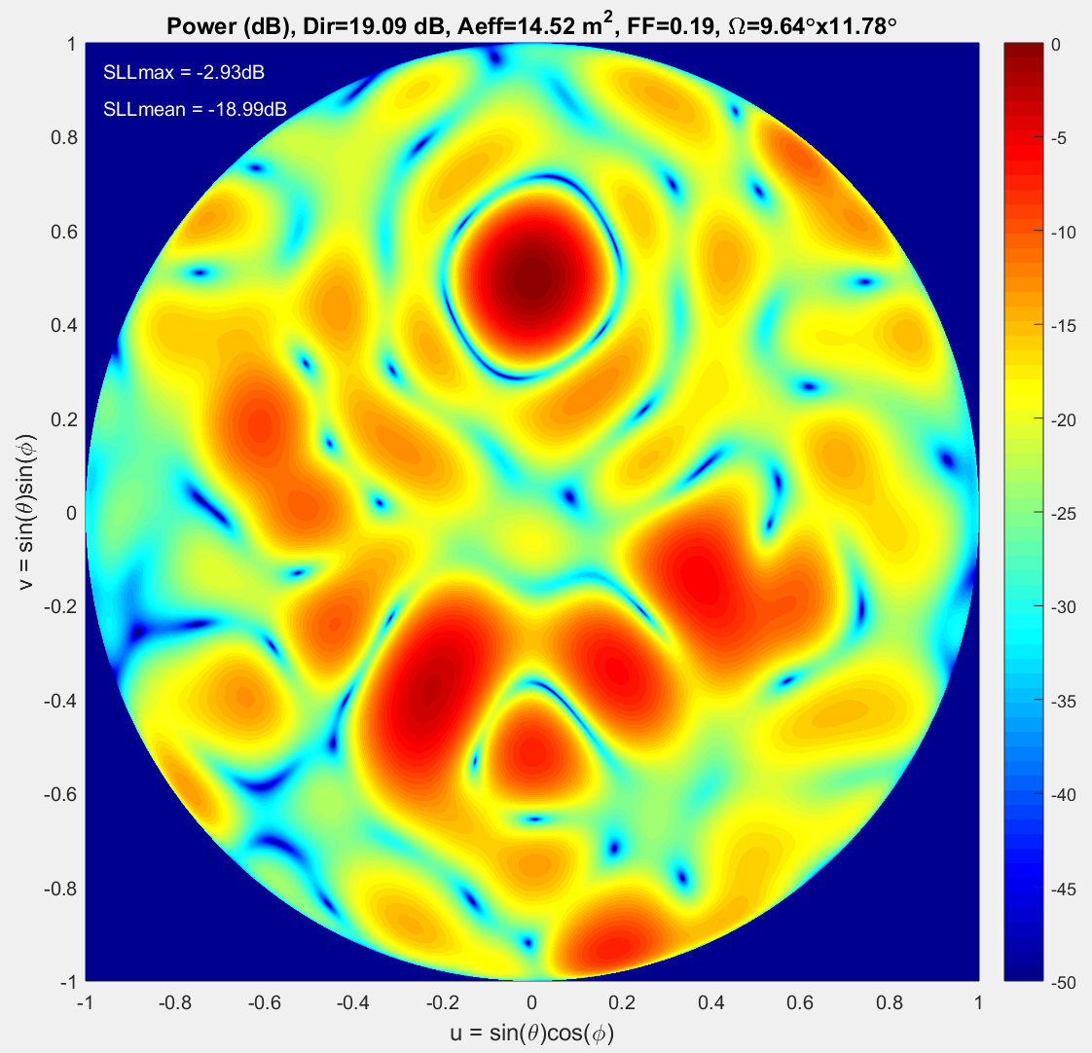
Pre-AAVs1 array
200 MHz
200 MHz

Slide 12
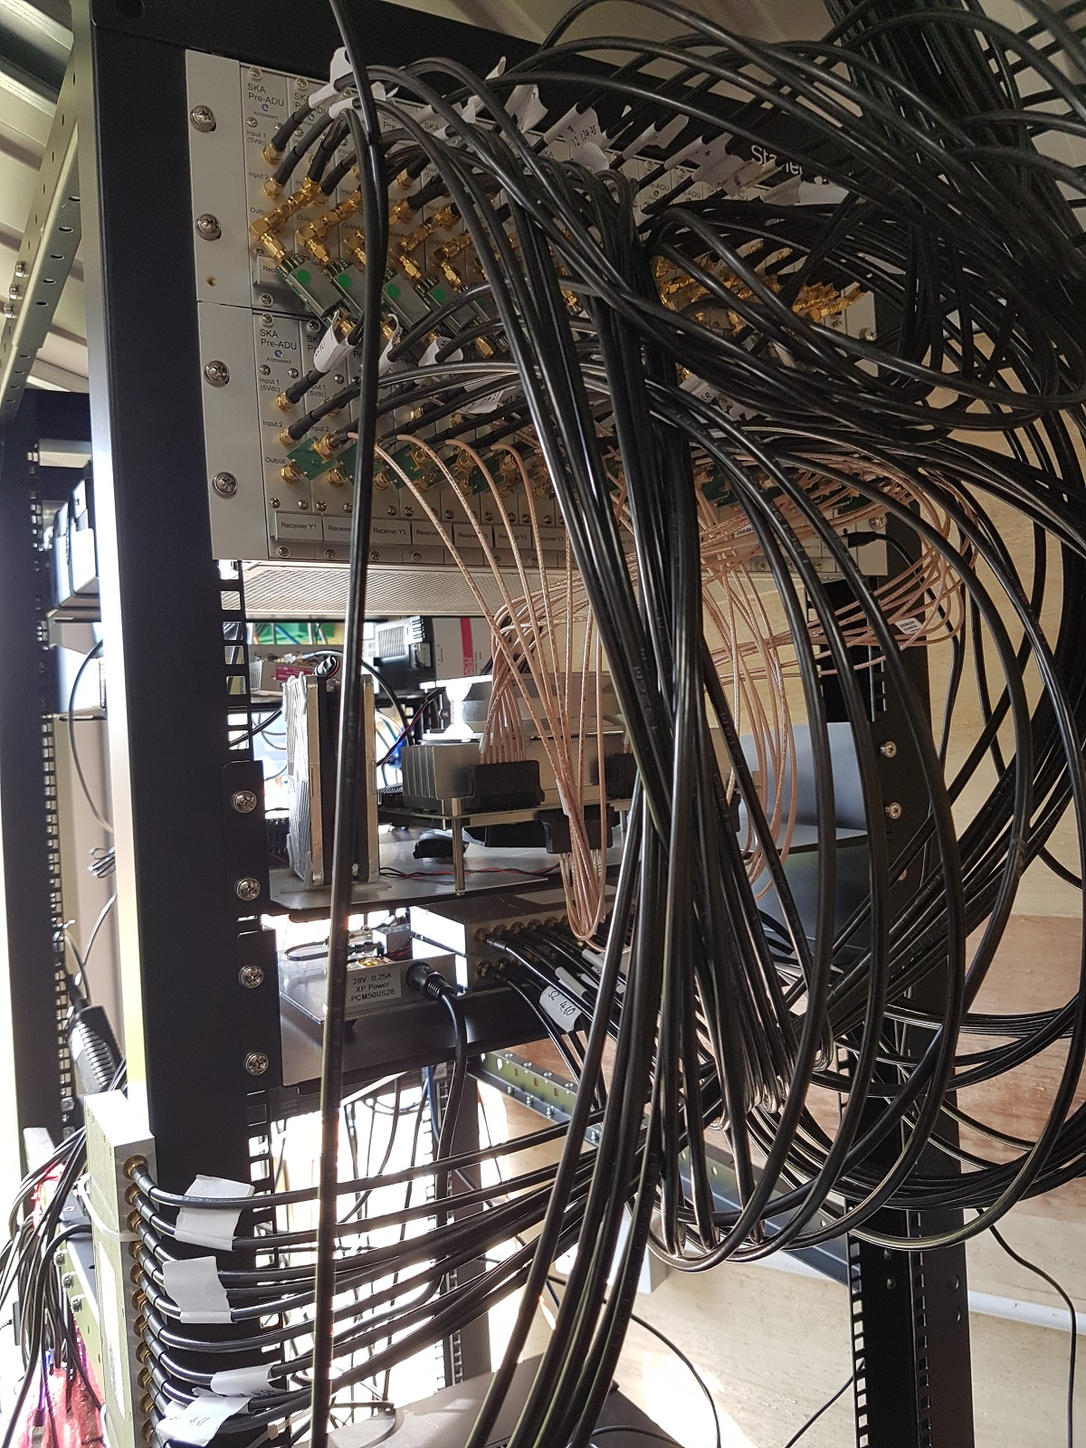
System Setup

Slide 13
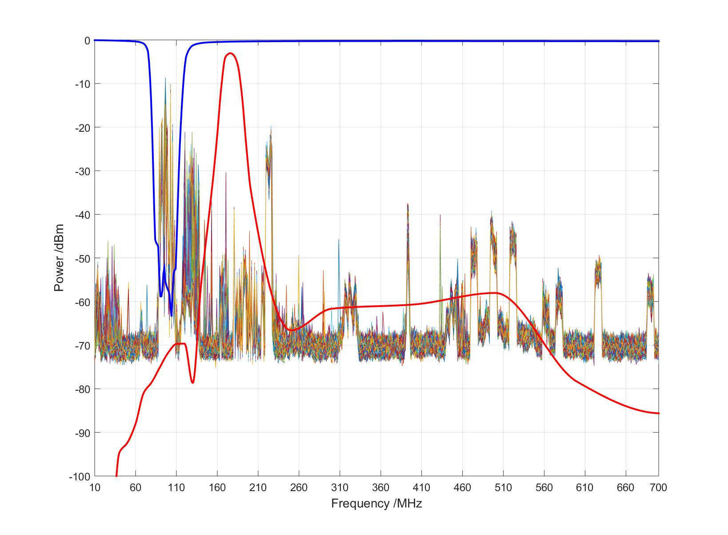
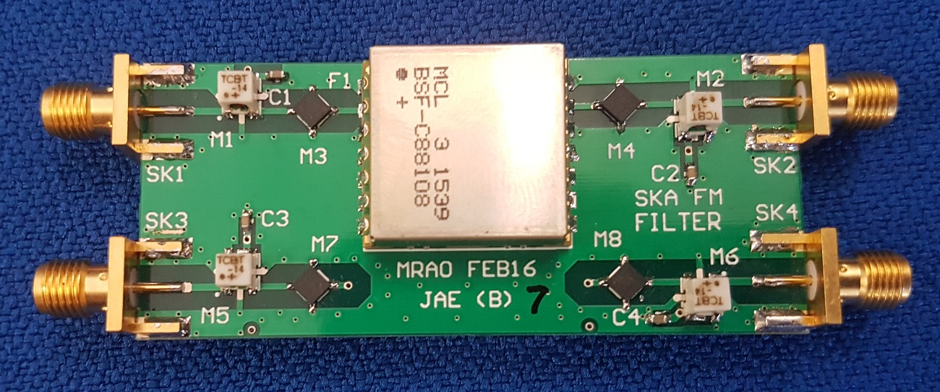
RFI and analogue filtering
FM notch 88-108 MHz
BPF @176MHz +/- 5 MHz

Slide 14
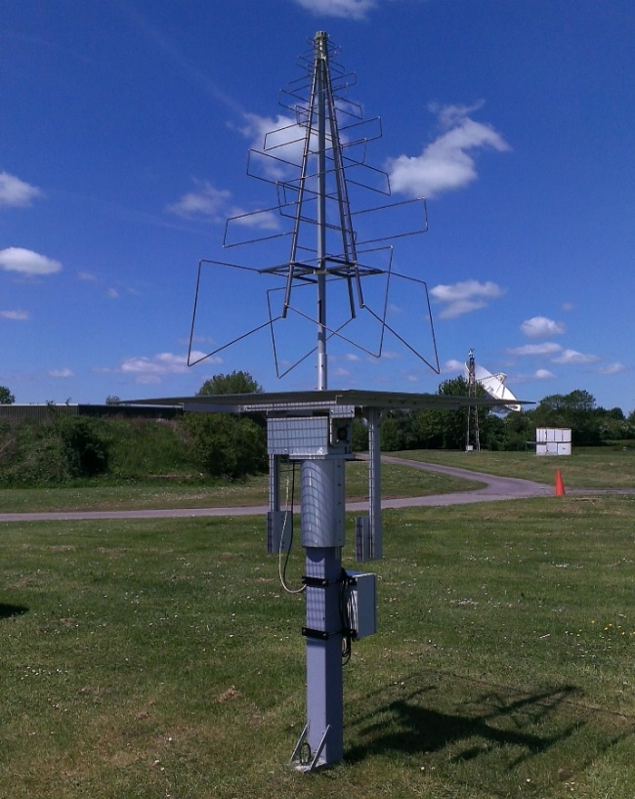
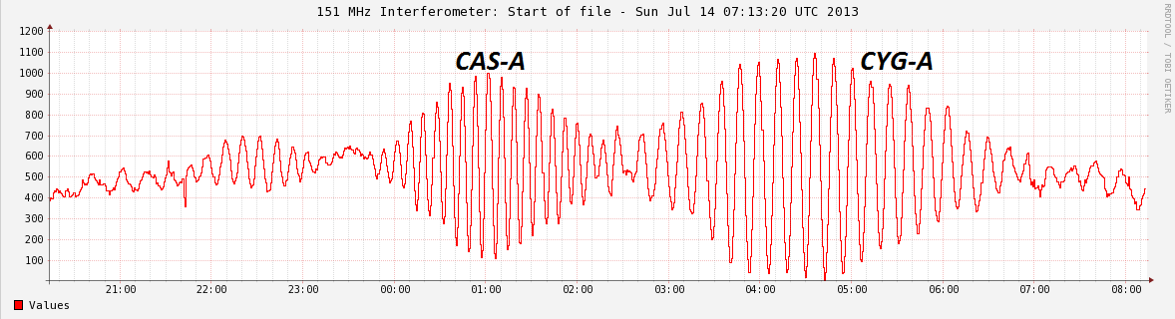
Single baseline platform

Slide 15
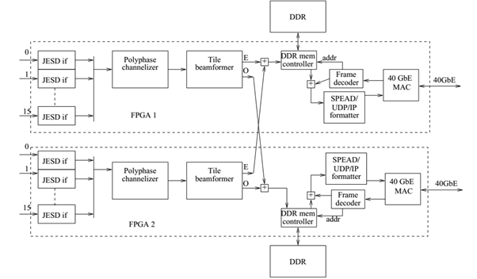
Pre-AAVS1 (&AAVS1) TPM test software modes
Channelised data
  burst mode (subset of samples (max 2048) for all polarisations (32) and subbands (512) - min period 1 second
  Integrated spectra of all antennas and all subbands – min period of 0.05 seconds
Beamformed data (burst mode or integrated)
Raw channelised data: Capture single channel raw data for testing and calibration (~2.8GB/minute)
ADC raw data (max 2^16 samples for all antennas)
Higher level observation script (coordinates in Spherical or Equatorial)
40 GbE data stream: Full data handling

Slide 16
Tests so far
Using CW or noise sources to carry out calibration of ADC offsets. Looking at “XF” or “FX” correlation of the signals. We can determine the ADC channels are aligned. Noise source method does not yield good results when looking at the channelized data (too little signal to noise)
Evaluating channelised data: raw single channel and burst mode (ongoing)
Testing beamformer weights and pointing (ongoing)

Slide 17
Antenna Spectra

Slide 18
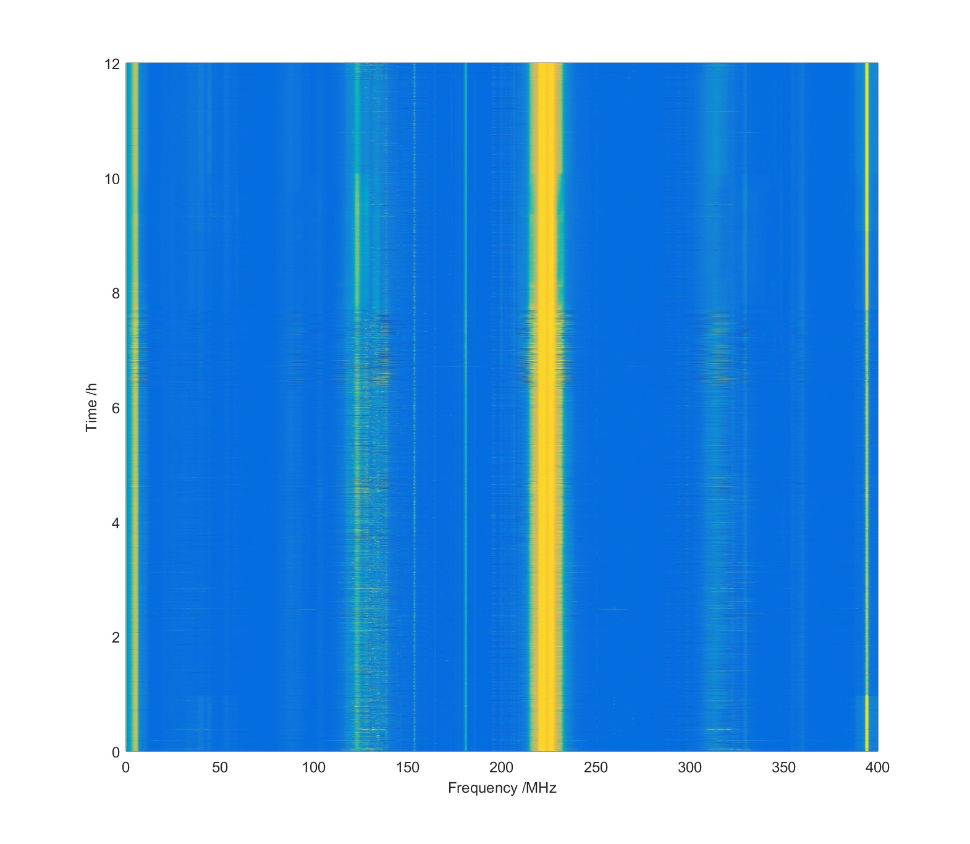
Beamformer
Testing data integrity
Testing pointing on CW source then RFI

Slide 19
Test Table (1)
Test ID | Test Type | Priority Level | Complexity Level | Required HW/SW | Description | Period of Test
PA1 | C | High (strong links with L2/L3) | Medium | HW: one full chain in the laboratory SW: quick spectra and integrated spectra | Integration of all hardware (not including the antenna) in the laboratory requiring testing of the chain (LNA, FE, 10km-Fibre, PREADU, ADU). Test for gain, NF (via noise injection), IMD, stability and thermal drift. Compare with simulations | ongoing
PA2 | C | High | High | HW: TPM (PREADU & ADU) SW: quick spectra, integrated and beamformed data, single channel raw data in continuous (append mode) | Fully test the performance of the ADU board to real world signals (CW tones and broadband noise). Measure and compare signal levels, especially for the channelised data stream. Test integrated spectra and raw channel output and write testing scripts. Calibrate ADC phase offsets and perform noise calibration. Test the general PREADU functionality using SPI generated on the ADU | ongoing
PA2A | C | High | Medium -High | HW: TPM (PREADU & ADU) SW: 10GbE data steam using existing server | Perform subsets of the PA2 test to evaluate reliability of 10/40GbE data stream. Evaluate channelised and beamformed data. | ongoing

Slide 20
Test Table (2)
Test ID | Test Type | Priority Level | Complexity Level | Required HW/SW | Description | Period of Test
PA3 | C | High | Medium | HW: Pre-AAVS1 system chain fully installed, outrigger SW: beamformer (integrated output – continuous), single channel raw data | Test beamformer by pointing to bright calibrators such as Cyg-A and Cas-A. Check discernible signal change in drift mode. Compare levels of Cas/Cyg | 1-2 weeks
PA4 | C | Medium | Low | HW: Pre-AAVS1 system chain fully installed SW: quick spectra and integrated spectra (continuous) | Monitor antenna spectral response over a period of one week. Analyse passband data and determine consistent levels of signal, test for oscillation/instability | 2-3 weeks
PA5 | V | Medium | Medium | HW: Pre-AAVS1 system chain fully installed, outrigger SW: single channel raw data (continuous) | Perform instrumental calibration. In the first instance using the fringes observing Cas-A or Cyg-A. Look at correlations in software (single channel) and correct for phase and amplitude offsets. Note there are brighter celestial calibration sources at LB compared to southern hemisphere. | 3-4 weeks

Slide 21
Test Table (3)
Test ID | Test Type | Priority Level | Complexity Level | Required HW/SW | Description | Period of Test
PA6 | V | Medium | High | HW: Pre-AAVS1 system chain fully installed, outrigger SW: single channel raw data (continuous), beamformer (integrated output – continuous) | Dynamic range performance testing (assuming PA3 & PA 5 completed): Perform on/off and drift scans of Cas-A and Cyg-A. Two identical modes: 1) beamform 15 antennas and correlate with outrigger, 2) correlate outrigger with each antenna in the array. Measure ratio of Cas/Cyg in both or either case. The former should yield more accurate results of system sensitivity | 4-5 weeks
PA7 | V | Low | High | HW: Pre-AAVS1 system chain fully installed SW: single channel raw data (continuous) | Dynamic range testing using broadband noise injection on sight into the terminals of the antenna. This testing has been done for LOFAR (refer to S. Wijnholds) | -
PA8 | V | Medium | Medium - High | HW: Pre-AAVS1 system chain fully installed, outrigger SW: single channel raw data (continuous) | Antenna/Array beam mapping or holography using strong celestial sources. The use of the existing alt-az mount (the outrigger) would be useful since for measuring cuts of the beam using astronomical sources, it is necessary to correlate the antenna/array beam with the outrigger (~200m EW baseline). Requires much of the same setup as PA6 | 4-5 weeks

Slide 22
Test Table (4)
Test ID | Test Type | Priority Level | Complexity Level | Required HW/SW | Description | Period of Test
PA9 | V | Medium | Low -Medium | HW: Pre-AAVS1 system chain fully installed, Filtering and attenuation required post LNA SW: single channel raw data (continuous) | Carry out antenna and array beam measurements similar to PA8 using hexicopter system. This type of measurement was carried out in 2014. Compare with simulations (AL to deliver) | 1-2 weeks
PA10 | V | Low | Medium -High | HW: Pre-AAVS1 system chain fully installed SW: single channel raw data (continuous) | Carry out antenna and array beam measurements at select frequencies similar to PA8/9 using satellites. | 3-4 weeks

Slide 23
Pre-AAVS1 proposed schedule back in January
15/02 – 02/05: New FE and PREADU will be used for integration and for high priority laboratory tests of the entire RF chain (e.g link budget).
02/05 – 06/05: At the end of this period the RX should be installed at LB along with FM filters and hybrid cables/fibres
15/02 – 02/05: Development of software scripts and test modes of operation and well as the verification of the full data output.
16/05 – 08/08: Carry out a subset of the medium level tests including RFI monitoring, instrumental calibration and the best achievable dynamic range measurements
27/06 – 01/07: Array beam measurements using hexacopter
08/08 onwards: Carry out beam measurements using a variety of sources

