Slide 1
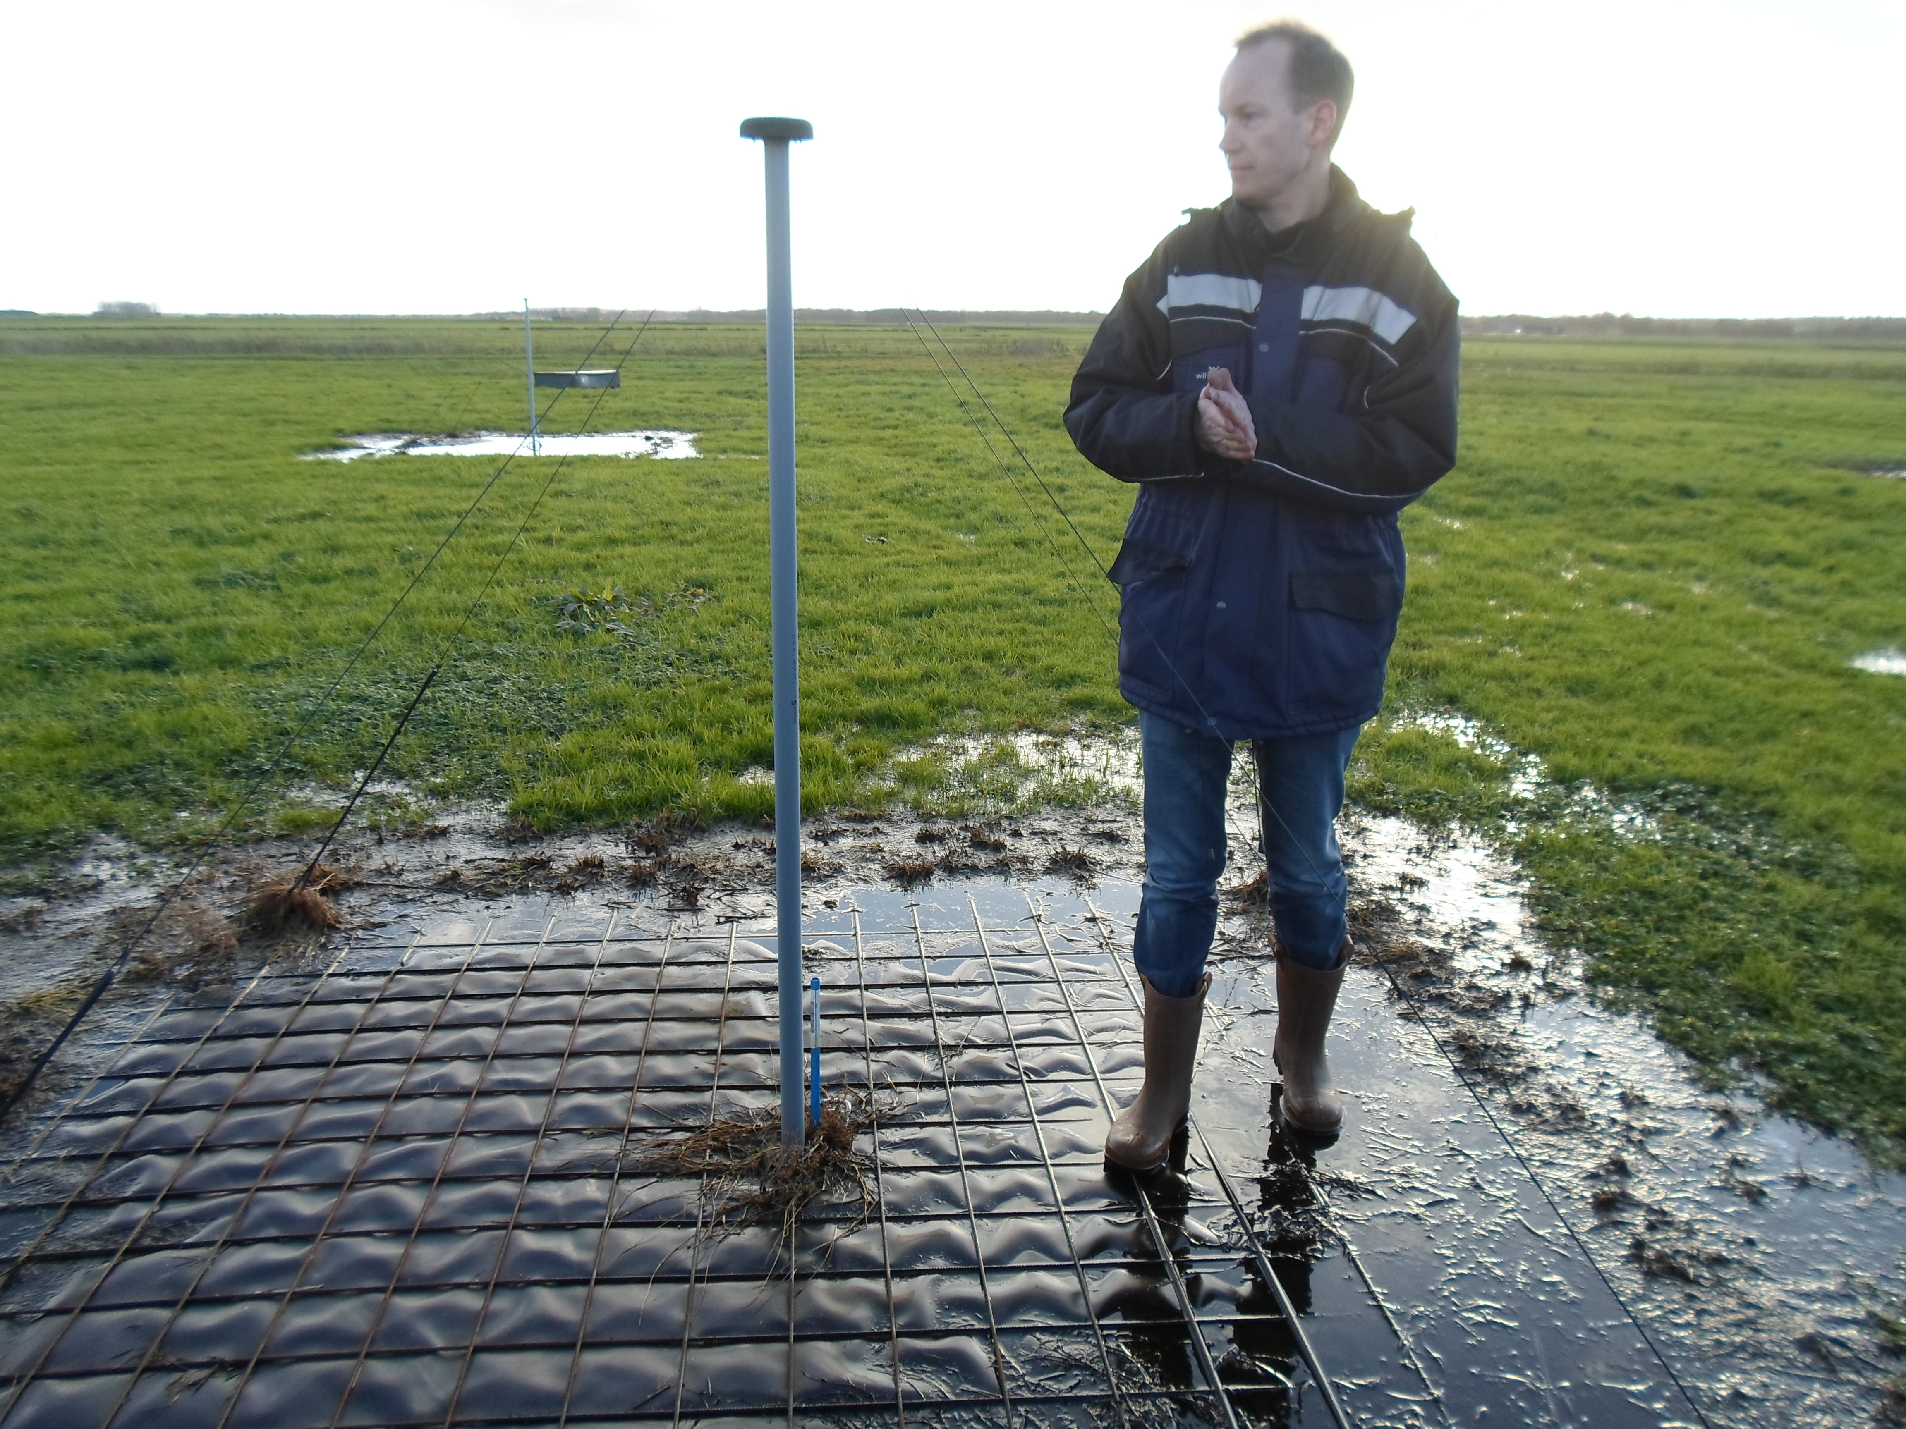







Aperture Array Design & Construction Consortium
Low Frequency Aperture Array (LFAA)
Reliability, Availability and Maintainability
Prepared by: Marchel Gerbers

Slide 2
Presentation
Availability Requirements
FMECA
Environmental Testing
Draft LFAA RAM analysis report
Maintenance Issues
SKAO HALT/HASS preparations
Questions

Slide 3
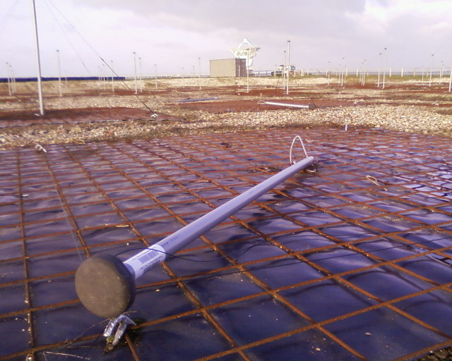
Availability
SKA1-SYS_REQ-2716 Telescope availability: Each SKA1 Telescope shall have an operational availability of 95%.
REQ-LOW-2: The LOW telescope shall have an Inherent Availability (Ai) of more than 99% (95% of the collecting area, correlating or processing capability must be available 99% of the time, in an ideal support environment)
SKA-TEL-0000102 SKA RAM allocation: Based on the down time allocation it is estimated that MID and LOW telescopes will have a Science Availability (As) of 69.5% and 81.5% respectively

Slide 4
LFAA 99% Available and 95% Signal chains
99.9% Local Infrastructure
99.8% Antenna and LNA
99.8% Receiver module (RFoF) and Pre-ADU
99.8% Signal processing
99.99% LFAA DATA Network
99.9% Local monitoring and control hardware
99.8% Local monitoring and control software
0.1% = 8.76 hours down time
5% of 256 = 12 antennas/signal chains down
5% of 512 = 25 Stations down

Slide 5
LFAA 99% Available and 95% Signal chains
100% Local Infrastructure
100% Antenna and LNA
99.8% Receiver Pre-ADU
99.7% Signal processing
99.99% LFAA Data Network
99.9% Local monitoring and control hardware
99.7% Local monitoring and control software
5% of 256 = 12 antennas/signal chains down
5% of 512 = 25 Stations down
5% of all = 6553 signal chains down

Slide 6

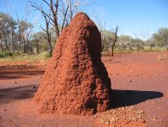
Failure Mode Effect Criticality Analysis:
Temperature stability of RFoF connection
High temperature in the Trumpet (Sun load + Dissipation)
Vibrations due to wind
Mounting of the Trumpet/Pyramid to the antenna arm
Heat dissipation/distribution in the Signal Processing Racks
Cooling fans
Damage from animals

Slide 7
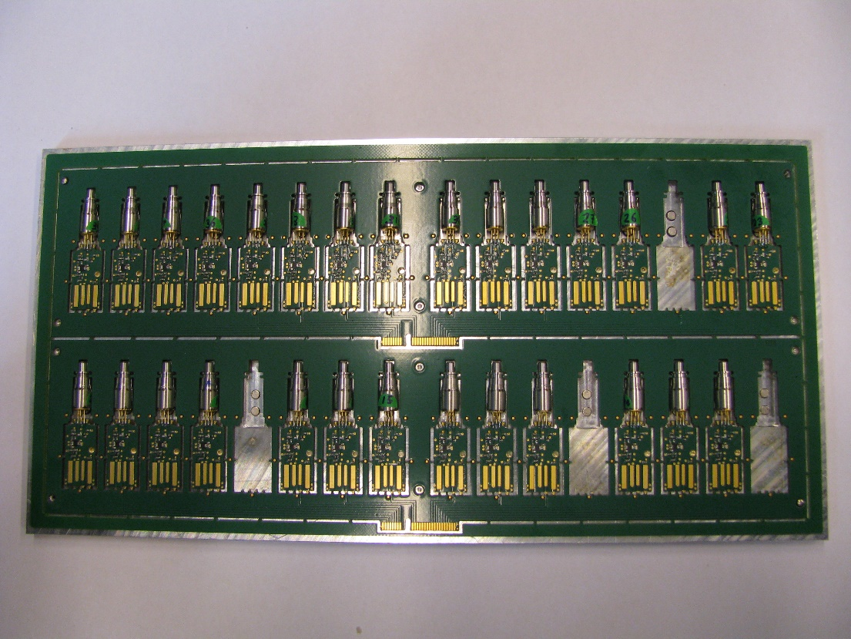
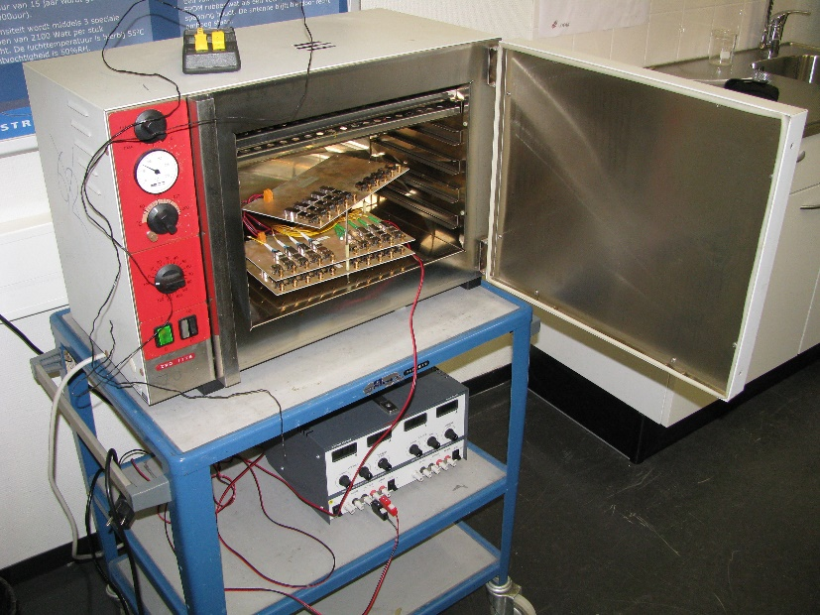
Environmental testing of RFoF
Testing at INAF in Rome
Testing at the MRO site in Australia
Testing at ASTRON in Dwingeloo
Okt 2015 – May 2016

Slide 8
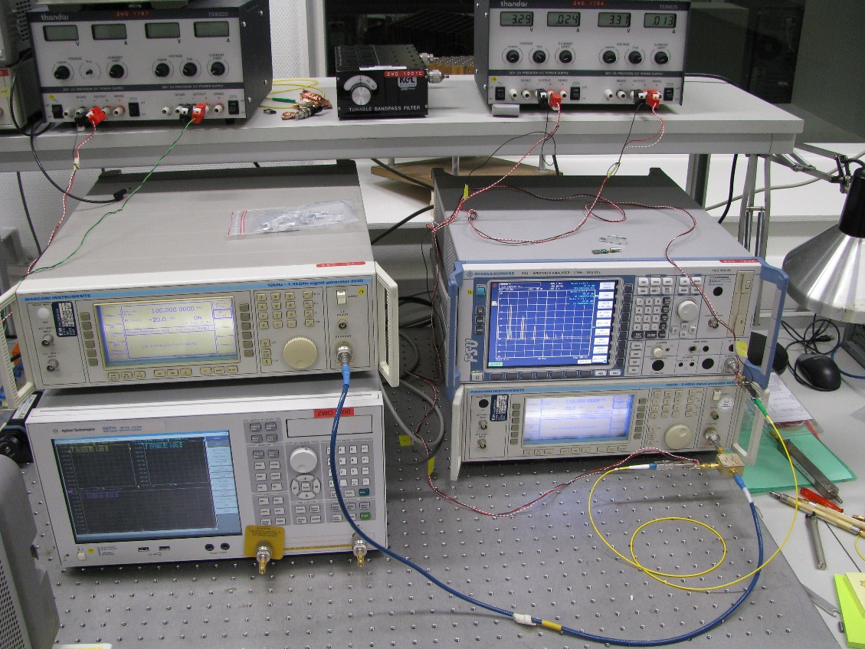
Noise / Gain / Phase measurement

Slide 9
Universita Degli Studi Firenze (Florence lab.)
Measurement, Reliability and Quality laboratory
Measurement methods and tolerance analysis
Reliability analysis of parts/boards for the Receiver work package
Environmental testing

Slide 10
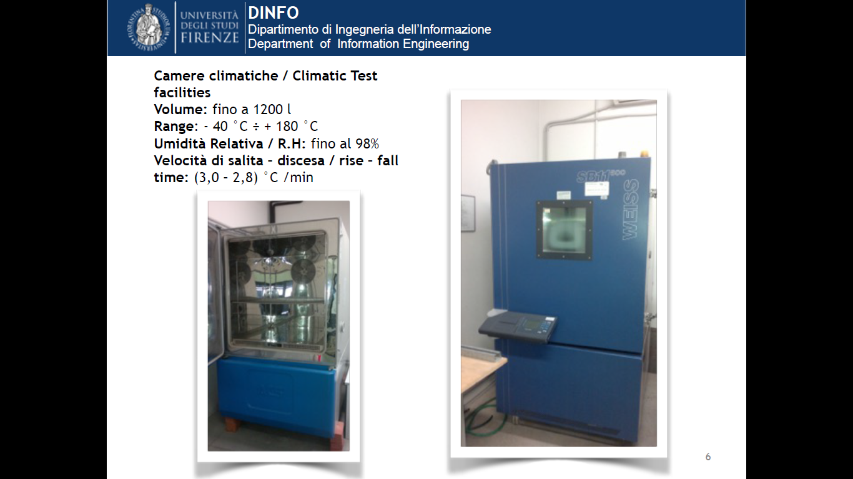
Temperature testing

Slide 11
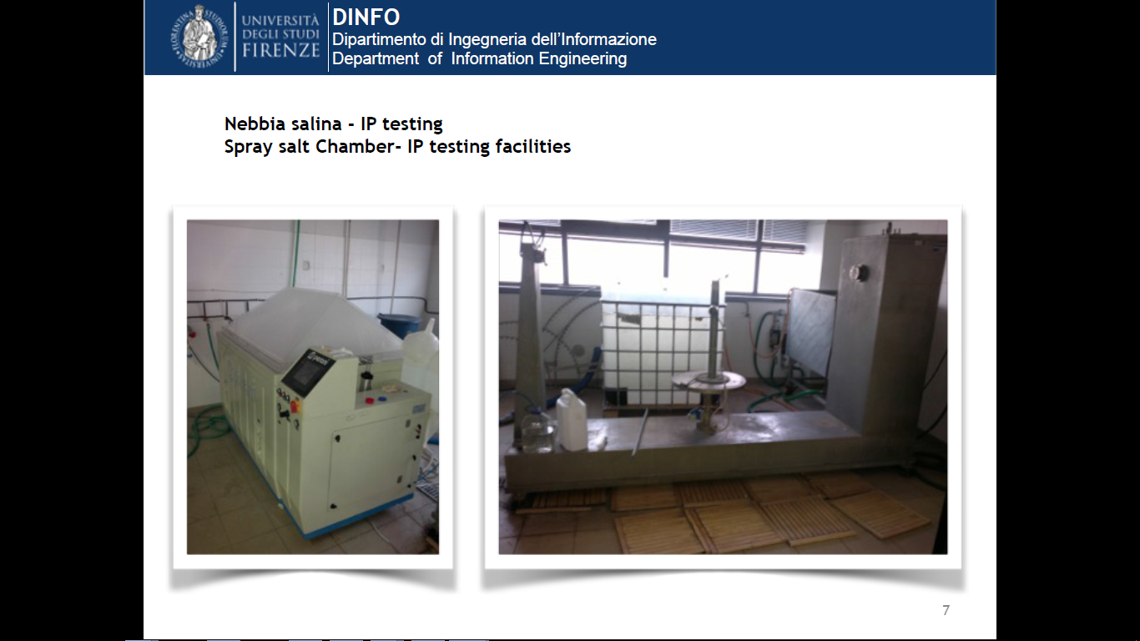
Ingress Protection and Corrosion testing

Slide 12
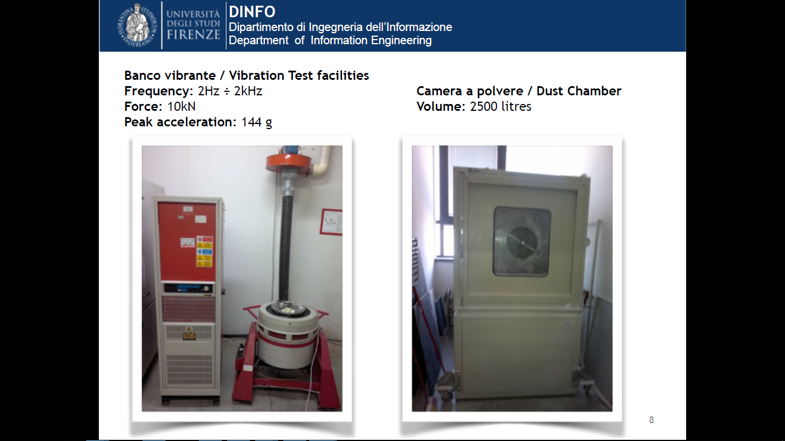
Vibration and Dust testing

Slide 13
Reliability (Life Time / MTTF ) Analysis

Slide 14
RAM analysis -> Draft Report Sept 2015
Overview with all parts / sub assemblies and assemblies
Compare part with known life time of comparable part
Input:
  Mean Time To Failure
  Response time
  Traveling time
  Replacement time
  Test Time
  Repair time / Repair costs / % which can be repaired
  Preventive maintenance
  Hourly rates
Use a normal distribution (MTTF, Sigma = 25% of MTTF)
Sum of all failures -> total amount of failures / year
Req: 95% of all signal chains should work (12 per station)
Early failures added (3% first year / 1% second year

Slide 15
RAM analysis -> Draft Report Sept 2015
Calculated:
  Failures / year
  Maintenance hours -> Amount of crews necessary for maintenance
  Availability hours / percentage
  Yearly replacement / repair and preventive maintenance costs

Slide 16
OPEN: RAM Issues
Science cases / Observation schedule / Time between observations?
Differences in impact of different failing signal chains / different stations on the system
Switching ON and OFF (xx? times/week?)
Inrush currents? -> Sequence for powering the stations on? (Is TM aware about this? Has INFRA-Aus implemented remote controlled switches?
Plan for structural replacement of parts at the end of life time.
Process for following “ Last time buy” of components
How will the LFAA / SKA-Low be used?
Can maintenance be executed during operations?

Slide 17
RAM Conclusion(s) (from Sept report)
Be aware about early failures
RAM of Software needs attention
Look to the science cases
Analyse impact of failing antennas and stations

Slide 18
Maintenance issues
Control desk, workshop, storage facility for spare parts at the MRO site
Glass fiber access points with power outlet on each station and near each RFoF connection panel.
Network maintenance connection near each Signal Processing Rack.

Slide 19
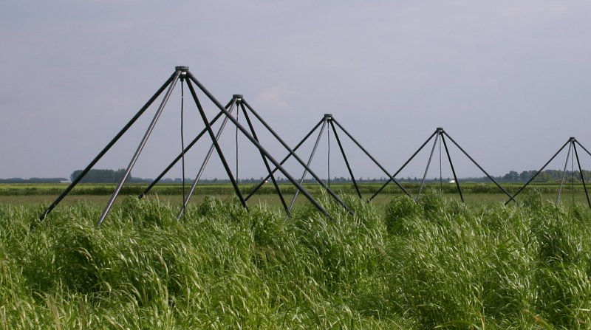
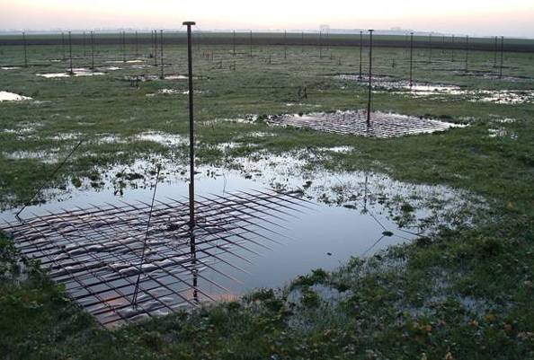
SKA-RAM Allocation document (Feb 2016)
Initial Maintenance Personnel Estimations:
The following factors are critical due to the large quantities and will have a direct impact on the number of people required:
LFAA design maturity and reliability;
elimination of software bugs;
cryogenic cooler servicing intervals.

Slide 20
Highly Accelerated Life Time /
Highly Accelerated Stress Screen
SKAO prepares a tender for HALT/HASS
Full SKALA Antenna test OR only the Trumpet?
How many samples?
Which environmental tests should be done before HASS?
How to transfer results to the real usage environment
HALT includes
  Fast (extreme) temperature changes
  Vibration
  Power cycling?
Which

Slide 21
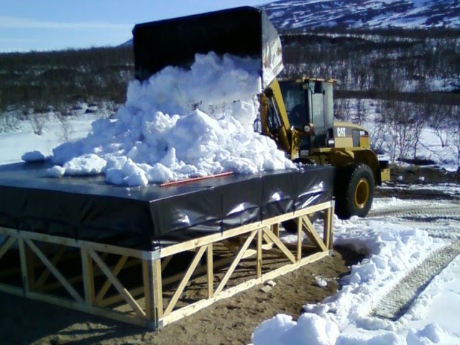
Conclusion
FMECA made
RAM analysis made
Testing started on several places regarding several risks
BUTT
Still a lot to do.
LFAA shall be cheap and simple
“The best parts for the lowest price”

Slide 22
Remarks:
Maintenance is the place where a high amount of money is spend
Maintenance starts when the first field node is constructed (OPEX costs start in 2018)
Maintenance (Non available) is counter part of Observations (Available) -> Management conflicts

Slide 23
Questions?

