Slide 1







Aperture Array Design & Construction Consortium
Low Frequency Aperture Array (LFAA)
LFAA System Requirements
STFC (UK ATC)
Prepared by: Hermine Schnetler

Slide 2
Documentation Information flow

Slide 3
Requirements Engineering – the process
Version 7
13th April 2016)
Which Version will be the CDR baseline? We need to define a cut-off date?
One day we might have an official version?

Slide 4
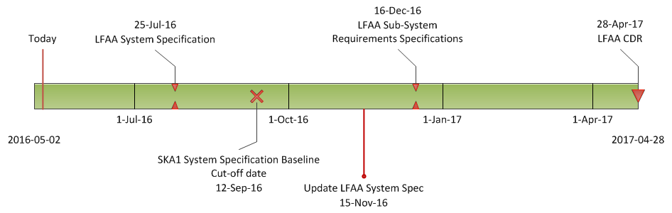
Requirements Engineering Time-Line

Slide 5
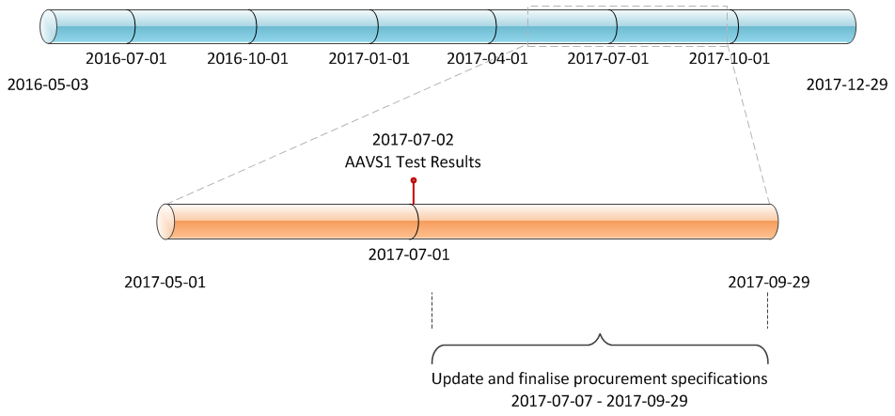
Requirements Engineering Time-Line (2)

Slide 6
Engineering budget process

Slide 7
Science to Engineering budgets map
Science Case & Performance Characteristic | Timing Budget [1] | Time-domain stability [2] | Noise/Tsys [3] | Linearity [4] | Dynamic Range [5] | Spectral Performance [6] | Polarization performance [7]
EoR/CD
Spatial/spectral frequency domains |  | x | x | x | x | x | x
Spectral cube image domain |  | x | x | x | x |  | x
Brightness temperature sensitivity
Pulsar Search
DM range |  | x |  |  |  | x
Search area |  | x | x
Pulsar Timing
Timing Accuracy | x | x | x
System clock and clock derivatives | x
Standard Imaging
Continuum | x | x | x | x | x | x | x
Spectral line cubes |  |  | x | x | x | x
Transients | x | x | x

Slide 8
House of Quality (part of QFD)
QFD = Quality Function Deployment

Slide 9
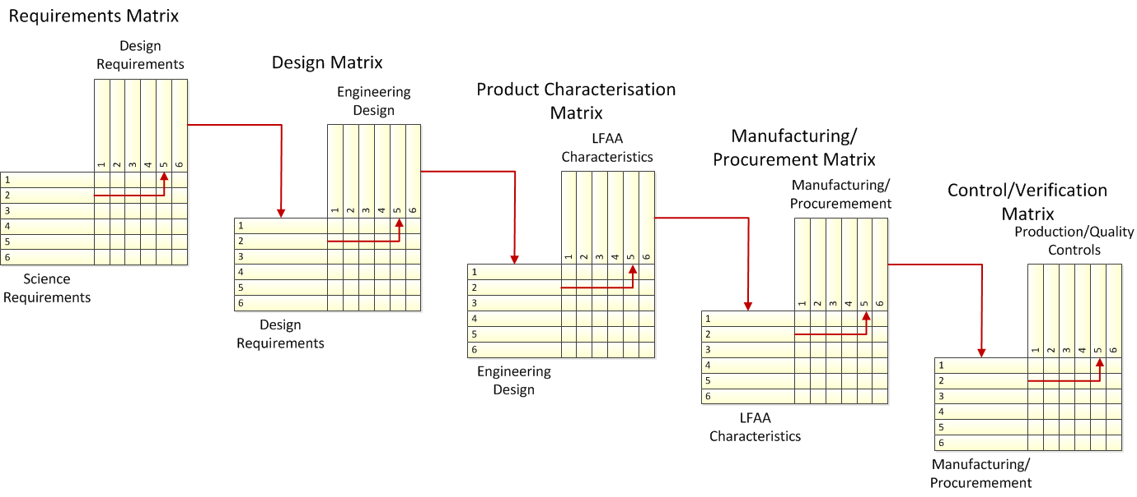
Waterfall Relationship of QFD matrices
AADC Task
AADC Task
Low Telescope Domain Specialist
AAVS1
Measured
Calculated

Slide 10
System Specification Model
Production Margin
Guard band
Production Test Data Distribution
Measurement Uncertainty
Delta Environmental Drift
Δ Guard band
Mean
Test Line Limit (TLL) = Which will provide and acceptable Turn-on Rate (TOR)
Production Specification
The purpose of the model is to separate the specification into quantifiable elements, that taken together, link a science specification to the production distribution while maintaining metrology goals, competitiveness of specifications, and producibility.

Slide 12
Engineering budgets

Slide 13
LFAA Specification Tree

Slide 14
THE END

Slide 15

Any Questions

Slide 16
Noise/Tsys
SKA1-SYS_REQ-2824 | Absolute flux scale : The absolute flux scale shall be accurate to 5%
SKA1-SYS_REQ-2135 | SKA1_Low array sensitivity at 50MHz . The SKA1_Low array shall have sensitivity per polarization at zenith greater than 72 m 2 K -1 at 50MHz when assuming a sky noise temperature following the law 60.lamda 2.55
SKA1-SYS_REQ-2136 | SKA1_Low array sensitivity at 110MHz . The SKA1_Low array shall have a sensitivity per polarization at zenith greater than 380 m 2 K -1 at 100 MHz when assuming a sky noise temperature following the law 60.lambda^2.55
SKA1-SYS_REQ-2137 | SKA1_Low array sensitivity at 160MHz . The SKA1_Low array shall have a sensitivity per polarization at zenith of greater than 535 m 2 K -1 at 160 MHz when assuming a sky noise temperature following the law 60.lambda^2.55
SKA1-SYS_REQ-2138 | SKA1_Low array sensitivity at 220MHz . The SKA1_Low array shall have a sensitivity per polarization at zenith of greater than 530 m 2 K -1 at 220 MHz when assuming a sky noise temperature following the law 60.lambda^2.55.
SKA1-SYS_REQ-2814 | SKA1_Low array sensitivity per polarization at 280 MHz. The SKA1_Low array shall have a sensitivity per polarization at zenith greater than 500 m^2/K at 280 MHz when assuming a sky noise temperature following the law 60.lambda^2.55
SKA1-SYS_REQ-2815 | SKA1_Low array sensitivity per polarization at 340 MHz. The SKA1_Low array shall have a sensitivity per polarization at zenith greater than 453 m^2/K at 340 MHz when assuming a sky noise temperature following the law 60.lambda^2.55

Slide 17
Linearity
SKA1-SYS_REQ-2653 | Linearity. At the finest frequency resolution in the processing chain, the level of spurious signals due to non-linearity shall be less than the noise level when no external input signal is present.

Slide 18
Dynamic range
SKA1-SYS_REQ-2676 | Dynamic range. The SKA1_Low beams shall have a dynamic range of better than 40 dB.
Spectral dynamic Range
For Spectrally-based science observations, the ability to resolve and detect individual weak spectral lines against the thermal continuum and in the presence of nearby strong lines is analysed.
Imaging dynamic Range
In imaging applications, the spatial behaviour of the station and array beams sets the noise limits of the observations.
Spectral performance
Spectral performance includes frequency-domain parameters including digital and analogue filter performance and stability, as well as calibration effects.

Slide 19
Polarization performance
Polarization is limited by the basic/intrinsic cross-polarization performance of the antenna pair (IxR) as well as the fidelity of beam models which predict the behaviour of the beam pointing. As the beam is pointed off-zenith, projection effects make the polarization response of the antenna pair more elliptical, and while a cross-polarization response term (Jones Matrix) is included in the station signal processing, fitting and estimation errors as well as effect of discrete pointing angles cause errors between the predicted and actual responses.
SKA1-SYS_REQ-2964 | SKA1_Low Cross Polarisation Purity, Pulsar timing. The SKA1_Low intrinsic cross polarisation ratio for Pulsar timing shall be at least 15 dB over the whole observing bandwidth within the half power beam width
SKA1-SYS_REQ-2966 | SKA1_Low Calibrated Polarisation Fidelity for Pulsars. The SKA1_Low telescope shall produce phase-resolved averages of the polarised flux from Pulsars with calibrated polarisation fidelity of at least 40 dB.

Slide 20
Other engineering budgets
Network capacity
Control latency
Power budget
Rack space
Rack cooling requirements

Slide 21
Noise/Tsys
SKA1-SYS_REQ-2824 | Absolute flux scale : The absolute flux scale shall be accurate to 5%
SKA1-SYS_REQ-2135 | SKA1_Low array sensitivity at 50MHz . The SKA1_Low array shall have sensitivity per polarization at zenith greater than 72 m 2 K -1 at 50MHz when assuming a sky noise temperature following the law 60.lamda 2.55
SKA1-SYS_REQ-2136 | SKA1_Low array sensitivity at 110MHz . The SKA1_Low array shall have a sensitivity per polarization at zenith greater than 380 m 2 K -1 at 100 MHz when assuming a sky noise temperature following the law 60.lambda^2.55
SKA1-SYS_REQ-2137 | SKA1_Low array sensitivity at 160MHz . The SKA1_Low array shall have a sensitivity per polarization at zenith of greater than 535 m 2 K -1 at 160 MHz when assuming a sky noise temperature following the law 60.lambda^2.55
SKA1-SYS_REQ-2138 | SKA1_Low array sensitivity at 220MHz . The SKA1_Low array shall have a sensitivity per polarization at zenith of greater than 530 m 2 K -1 at 220 MHz when assuming a sky noise temperature following the law 60.lambda^2.55.
SKA1-SYS_REQ-2814 | SKA1_Low array sensitivity per polarization at 280 MHz. The SKA1_Low array shall have a sensitivity per polarization at zenith greater than 500 m^2/K at 280 MHz when assuming a sky noise temperature following the law 60.lambda^2.55
SKA1-SYS_REQ-2815 | SKA1_Low array sensitivity per polarization at 340 MHz. The SKA1_Low array shall have a sensitivity per polarization at zenith greater than 453 m^2/K at 340 MHz when assuming a sky noise temperature following the law 60.lambda^2.55

Slide 22
Noise/Tsys
SKA1-SYS_REQ-2824 | Absolute flux scale : The absolute flux scale shall be accurate to 5%
SKA1-SYS_REQ-2135 | SKA1_Low array sensitivity at 50MHz . The SKA1_Low array shall have sensitivity per polarization at zenith greater than 72 m 2 K -1 at 50MHz when assuming a sky noise temperature following the law 60.lamda 2.55
SKA1-SYS_REQ-2136 | SKA1_Low array sensitivity at 110MHz . The SKA1_Low array shall have a sensitivity per polarization at zenith greater than 380 m 2 K -1 at 100 MHz when assuming a sky noise temperature following the law 60.lambda^2.55
SKA1-SYS_REQ-2137 | SKA1_Low array sensitivity at 160MHz . The SKA1_Low array shall have a sensitivity per polarization at zenith of greater than 535 m 2 K -1 at 160 MHz when assuming a sky noise temperature following the law 60.lambda^2.55
SKA1-SYS_REQ-2138 | SKA1_Low array sensitivity at 220MHz . The SKA1_Low array shall have a sensitivity per polarization at zenith of greater than 530 m 2 K -1 at 220 MHz when assuming a sky noise temperature following the law 60.lambda^2.55.
SKA1-SYS_REQ-2814 | SKA1_Low array sensitivity per polarization at 280 MHz. The SKA1_Low array shall have a sensitivity per polarization at zenith greater than 500 m^2/K at 280 MHz when assuming a sky noise temperature following the law 60.lambda^2.55
SKA1-SYS_REQ-2815 | SKA1_Low array sensitivity per polarization at 340 MHz. The SKA1_Low array shall have a sensitivity per polarization at zenith greater than 453 m^2/K at 340 MHz when assuming a sky noise temperature following the law 60.lambda^2.55

Slide 23
Pre-construction Stage 2 Objectives
Produce a fully qualified “system”
  Engineering Design Data Pack or a
  Fabrication Data Pack
Well define system ready to call for tenders we need a mix of various types of system and procurement specifications and
Well defined and costed roll-out plan.
All of this should be based on a well developed System Architecture and Product Breakdown Structure

Slide 24
What do we need?
Design and Analysis Document for each sub-system based on the actual planned implementation
Procurement Specifications (including interface definitions)
Agreed Product Breakdown Structure
A PBS driven WBS – lean and essential engineering artifacts
Construction cost will be driven by the quality of the CDR Data Pack – What will be in place?

Slide 25
Low Telescope Block Definition Diagram

Slide 26
100-000000 – SKA1 Low Telescope PBS
101-000000 – LFAA LOW
160-000000 – Field Node LOW
161-000000 – Tile Processing Module (TPM) LOW
162-000000 – Monitor Control and Calibration System (MCCS) LOW
163-000000 – Signal Processing System (SPS) LOW
164-000000 – Low Frequency Aperture Array Data Network (LFAA_DN) LOW
102-000000 – Central Signal Processing (CSP) LOW
111-000000 – CSP Correlator and Beamformer (CBF) LOW
113-000000 – CSP Pulsar Search Engine (PSS) LOW
114-000000 – CSP Pulsar Timing Engine (PST) LOW
110-000000 – CSP Local Monitor and Control (LMC) LOW
115-000000 – CSP Sub Element Integration Infrastructure LOW
103-000000 – Telescope Manager LOW
121-000000 – TM Telescope Management LOW
122-000000 – TM Observation Management LOW
123-000000 – TM Local Monitoring & Control (LMC) LOW
124-000000 – TM Local Infrastructure LOW
125-000000 – TM Graphical User Interface LOW

Slide 27
100-000000 - Low Telescope PBS
104-000000 – Science Data Processing (SDP) LOW
136-000000 – Data Processor LOW
134-000000 – Delivery System LOW
135-000000 – SDP Local Monitoring and Control (LMC) LOW
137-000000 – Long Term Archive LOW
105-000000 – Signal and Data Transport (SaDT) LOW
140-000000 – Trenching and Reticulation Network Infrastructure LOW
141-000000 – Synchronisation and Timing (SAT) LOW (SAT-LOW)
142-000000 – Non-Science Data Network (NSDN) LOW
143-000000 – Network Manager LOW
145-000000 – Digital Data Back Haul (DDBH) LOW
146-000000 – Central Signal Processor – Science Data Processor (CSP-SDP) LOW
144-000000 – To External LOW
500-000000 – INAU LOW
513-000000 – Access LOW
514-000000 – Access AUSI
515-000000 – Prepared Ground LOW
506-000000 – Communications AUSI
510-000000 – Camps AUSI
508-000000 – Buildings LOW
516-000000 – Buildings AUSI LOW

Slide 28
100-000000 - Low Telescope PBS
500-000000 – INAU LOW
513-000000 – Access LOW
  514-000000 – Access AUSI
  515-000000 – Prepared Ground LOW
506-000000 – Communications AUSI
510-000000 – Camps AUSI
508-000000 – Buildings LOW
  516-000000 – Buildings AUSI LOW
  517-000000 – Building Management System AUSI LOW
  518-000000 – Facility Power LOW
  519-000000 – Facility Cooling LOW
  510-000000 – Facility RFI Shielding LOW
  511-000000 – Facility Rack Space LOW
503-000000 – Power LOW
  512-000000 – Power AUSI
  512-000001 – Onsite Backup LOW
  512-000002 – Power Monitoring & Control System LOW
  512-000003 – Primary Distribution LOW
  513-000000 – Array Power Network LOW
  513-000001 – Array Power Network - Core LOW
  513-000002 – Array Power Network - Remote LOW
505-000000 – Site Monitoring LOW
  514-000000 – Weather Stations AUSI
  515-000000 – Tropospheric Monitor AUSI
  516-000000 – Radio Frequency Interference Monitor AUSI
  517-000000 – Visual Monitoring AUSI
509-000000 – Vehicles AUSI
511-000000 – Water and Waste AUSI

Slide 29
LFAA Block Diagram

Slide 31
SKA Product Breakdown Structure - LFAA
Telescope | Element | Sub-System | Assembly
Low
 | LFAA
 |  | Field Node | Antenna Assembly
 |  |  | Antenna Power Interface Unit
 |  |  | Mesh
 |  | Tile Processing Module
 |  | Monitor, Control and Calibration System
 |  | Signal Processing Sub-System
 |  | Low Frequency Aperture Array Data Network
Element Level Deliverables
LFAA Requirements Specification | LFAA Design and Analysis Report | Internal ICD
LFAA Compliance Matrix | LFAA RAM Analysis | Safety Report
LFAA Construction Plan | LFAA Detailed Cost Report | Risk Report
Telescope Level Deliverables (SKAO)
Telescope Requirements Element to Element ICDs Telescope AIV Plan Compliance Matrix Telescope Construction Plan and Telescope Cost Analysis
Sub-System Level Deliverables
Sub-System Development Specification
Software Requirements Specification (if required)
Design and Analysis Document
Assembly, Integration and Verification Plan
Final Acceptance Test Report
Compliance Matrix
Assembly Level Fabrication Data Pack consists of:
Bill Of Material Data Pack (see next slides)
Final Acceptance Test Specification
Final Acceptance Test Plan and Procedure
Final Acceptance Test Report

Slide 32
Document number | Document name
SKA-TEL-LFAA-01000XX | Detailed risk register
SKA-TEL-LFAA-01000XX | Procurement strategy and costing for LFAA procurement at SKA1 construction
SKA-TEL-LFAA-01000XX | LFAA ILS input to SKAO ILS report
SKA-TEL-LFAA-02000XX | LFAA RAM Analysis
SKA-TEL-LFAA-01000XX | Safety plan
SKA-TEL-LFAA-01000XX | Delivered Items and Documents List
SKA-TEL-LFAA-02000XX | LFAA Construction plan (can include verification plan, test plan, roll out, hand over, acceptance plan)
SKA-TEL-LFAA-02000XX | LFAA requirements specification
SKA-TEL-LFAA-02000XX | LFAA design and analysis report
SKA-TEL-LFAA-02000XX | External ICD LFAA-CSP
SKA-TEL-LFAA-02000XX | External ICD LFAA - INFRA.AUS
SKA-TEL-LFAA-02000XX | External ICD LFAA - TM
SKA-TEL-LFAA-02000XX | External ICD LFAA - SaDT
SKA-TEL-LFAA-02000XX | Internal ICD document, including all internals ICDs + system definition
SKA-TEL-LFAA-02000XX | LFAA Compliance matrix
SKA-TEL-LFAA-02000XX | Power report
SKA-TEL-LFAA-0000000 | AAVS 1 Test and Verification Plans (subsumed by a & b)
SKA-TEL-LFAA-0000001 | Top-level design and specification of AAVS 1 (subsumed by SKA-TEL-LFAA-0200001 SE-SRS REV 01 AAVS1 System Requirements Specification: HS)
SKA-TEL-LFAA-0000002 | Production and test of hardware and software modules for AAVS 1 (This is now split into the WPs with their L4 and tie back to 0200001)
SKA-TEL-LFAA-0000003 | Internal and external procurement for AAVS 1 (procurement is not managed by PROT, but AAVS1 management PB)
SKA-TEL-LFAA-0000004 | AAVS1 test and evaluation report (subsumed by b)
SKA-TEL-LFAA-0000005 | a) AAVS1 Commissioning Test Plan (SKA-TEL-0800002, updated)
SKA-TEL-LFAA-0000006 | b) AAVS1 Commissioning Test Report

Slide 33
Specification Types
Development
Technical
Critical Item
Procurement
Software Requirements
Which ones do we need – debatable and should be based on the final system architecture

Slide 34
THE END

Slide 35
Any Questions

Slide 36
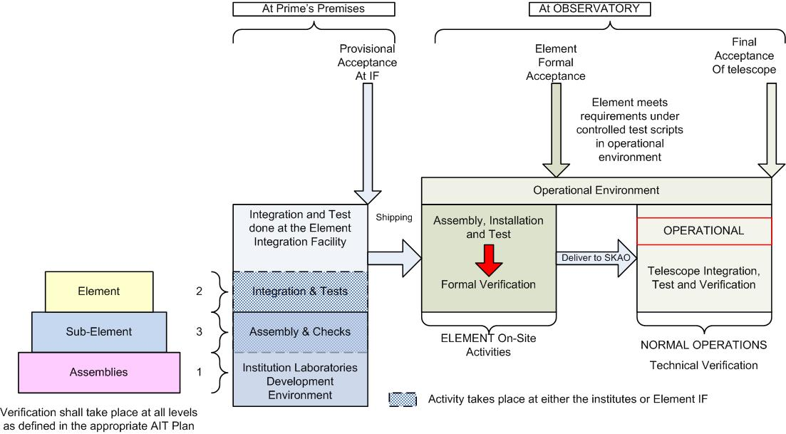
AIV Strategy

Slide 37
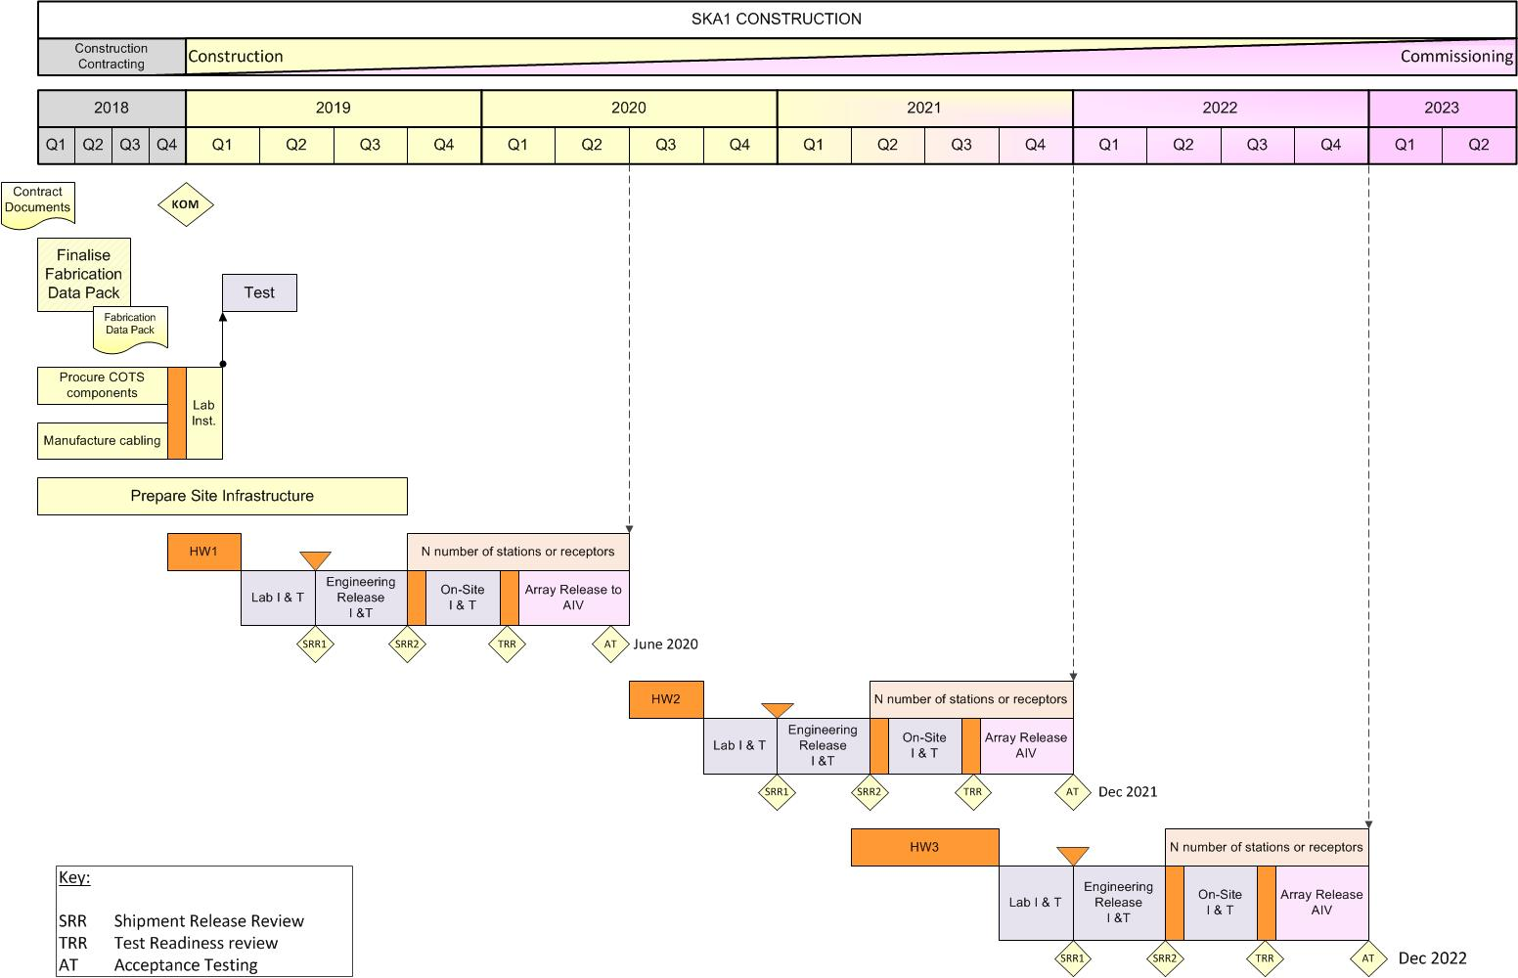
Example Construction Schedule

Slide 38













































































