Slide 1
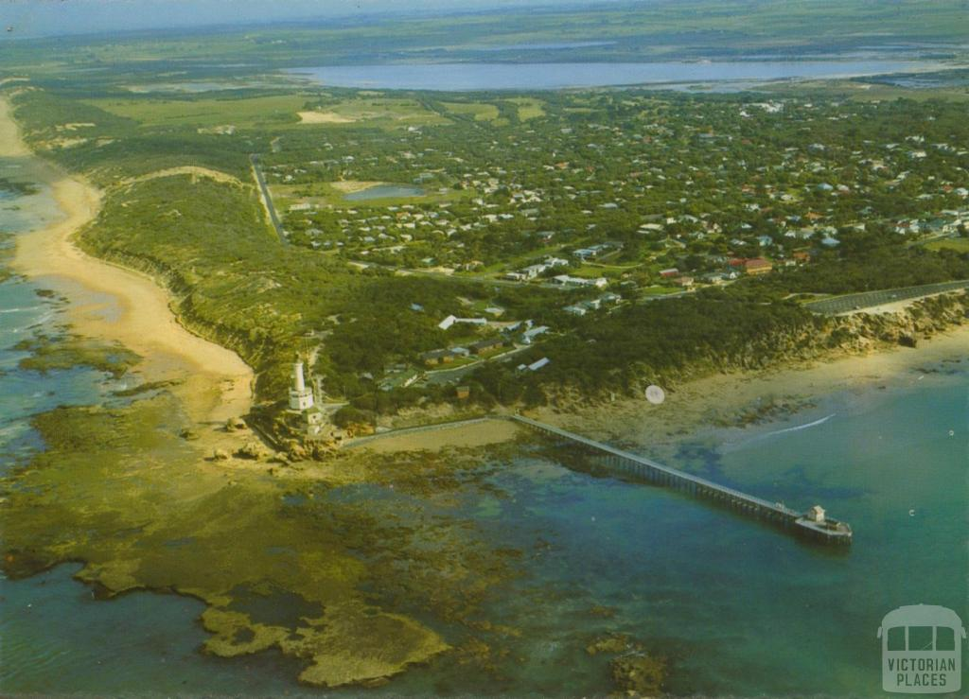
July 12, 1906 – First Australian “overseas” wireless transmission, from Point Lonsdale to Devonport, Tasmania (~350 km).
http://insidestory.org.au/when-marconis-magic-came-to-queenscliff
Point Lonsdale
Devonport

Slide 2
Contemplating future uses of the technology, the Victorian attorney-general favoured what he called pocket Marconi installations. These devices, he imagined, could be used to transmit photographs to the wives of politicians, letting them know where their husbands were.
Governor-General Northcote worried that wireless may make it harder for him to travel beyond the control of the prime minister.
Jock Given

Slide 3
Integration and Test Facilities (or is it National Development Centres?, or is it Regional Science and Engineering Centres?): musings, philosophy, and suggestions
Prof. Steven Tingay
INAF

Slide 4
Examples:
Large Hadron Collider CMS trigger system (“low level” sub-system)
PNNL US DoE National Lab (Highly industry connected)
European Spallation Source (Close to SKA consortium model)
JWST (Space Agency approach)
AAVS1 (You guys)

Slide 5
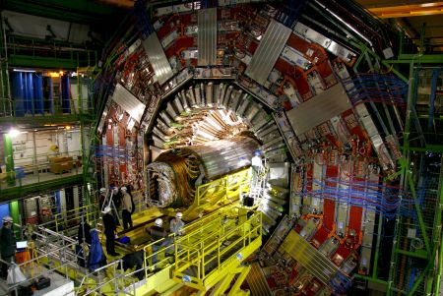
An Integrated Testing Facility for the Global Trigger of the CMS Experiment at CERN
Themel, T.: http://inspirehep.net/record/894139?ln=en
13 boards and 51 FPGAs checking for event triggers from 100 kHz event rate with 3.2 us decision timescales;
Separation between development and testing environment is important;
Software developed as part of test and verification program migrated to operational system.

Slide 6
PACIFIC NORTHWEST NATIONAL LABORATORY Systems Integration and Testing Facility (SITF) Test Bed for Threat Detection Systems
http://tour.pnnl.gov/testtrack.html
PNNL experts in fields such as nuclear physics, radiological engineering, test engineering, operations and field deployment, and statistics are available to assist project staff.

Slide 7
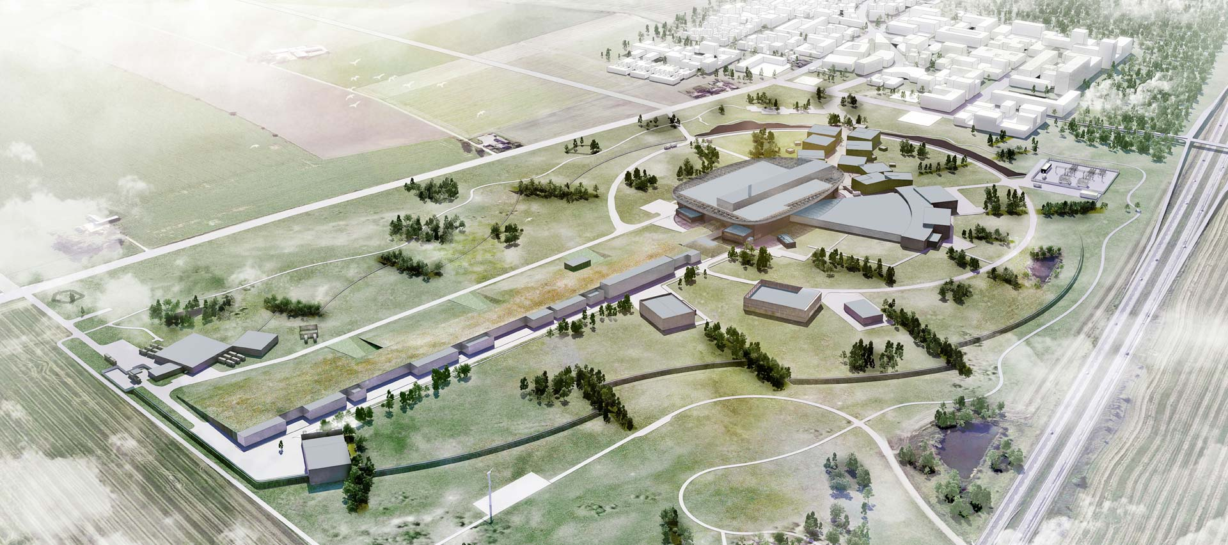
European Spallation Source
http://eval.esss.lu.se/DocDB/0002/000274/014/TDR_online_ver_ch8.pdf
Design integration -> installation

Slide 8
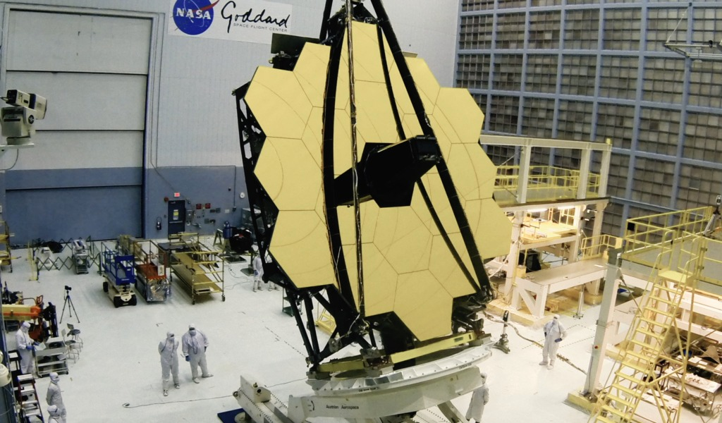
JWST Test and Integration
David Florida Lab in Canada, Astrium facility in Germany, Rutherford Appleton Laboratory in England, Lockheed Martin Facility in the US.
The instruments are then brought together in the Integrated Science Instrument Module (ISIM) at Goddard Space Flight Center (GSFC), US.
Once the ISIM and telescope optics are mated, there is an additional I&T program at Johnson Space Center (JSC), US.

Slide 9
Terrestrial Planet Finder (2011),
Space Interferometry Mission (2010),
Laser Interferometer Space Antenna (2011),
International X-ray Observatory (2011),
MAXIM (Microarcsecond X-ray Imaging Mission),
SAFIR (Single Aperture Far-Infrared Observatory),
SUVO (Space Ultraviolet-Visible Observatory),
SPECS (Submillimeter Probe of the Evolution of Cosmic Structure)
Didn’t make
it.
NASA Industry involvement
(JWST: Ball Aerospace, TRW)
NASA Industry involvement
(JWST: TRW, Lockheed Martin)
NASA Industry involvement
(JWST: TRW selected as prime)
Industry
involvement
Prime selected
I&T costed

Slide 10
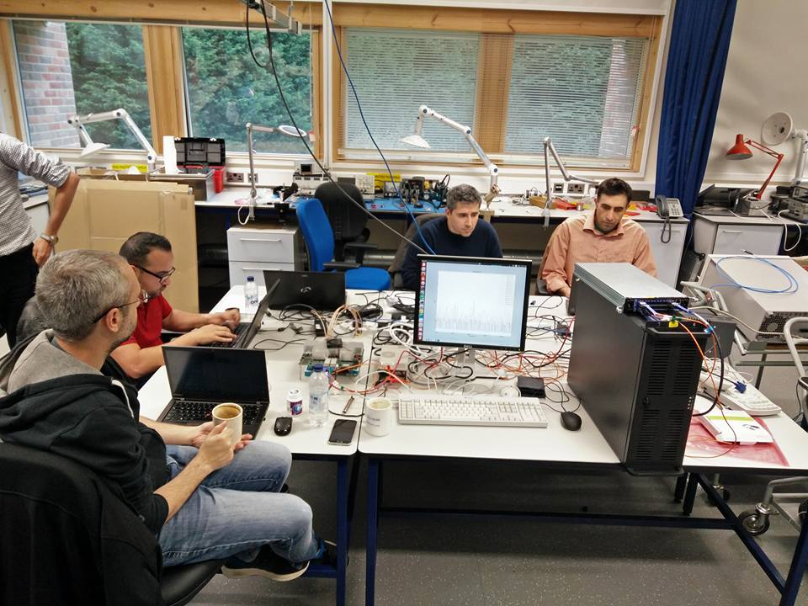
AAVS1 – Pre-AAVS1
Main goal:
Prepare for AAVS1 installation
Act as gateway
European:
Test subsystems
Integration
Debugging
Staff training
Compliance test
Support during AAVS1 installation
Parallel site and staff
Australian:
Duplicate system from European site
Start ticking off requirements through first measurements as soon as possible….
From Pieter Benthem (and see Nima’s presentation)

Slide 11
Common characteristics of Integration and Test Facilities
Gather and combine/mix expertise from:
Domain experts;
Management; and
Industry;
Can/should exist across the lifecycle of a project:
Design -> Construction -> Operations;
Often have role in early system design;
Test and integrate as the project proceeds (blurred with prototyping);
Used to progressively retire risks;
Separation (geographical and logical) between development and test activities are ok/advantageous;
Operational facilities often inherit from test and integration activities;
Are generally hierarchical, both in time and across the system;
Follow partner contributions (intellectual and financial);
Are budgeted for in the construction plan and planned for early;
Closely involve industry (early) – as prime in large/complicated/complex projects.

Slide 12
The SKA
Will likely be funded with cash and in-kind contributions (a la European Spallation Source). IGO negotiations will determine this;
Intellectual and financial contributions from around the world;
Consists of two complicated systems (telescopes), each consisting of complicated sub-systems. One set of policies to rule them all;
Unique distributed nature (instrument and management), mix of infrastructure, technology, logistics -> complex operational boundary conditions on instrument design;

Slide 13
Is the SKA on a path to delivery?
Approaching CDR with incomplete system, patchy consortium outputs, requirements, analysis at all levels of the project;
Approaching CDR without systematic industry guidance or input;
Cost-capped construction budget excises critical elements of the system (defined as the stuff needed to extract science from the SKA);
Boundary conditions from integration and test, deployment, engineering/science commissioning, and operations require substantial work to understand;
Telescope Teams are a good but limited step in the right direction.

Slide 14
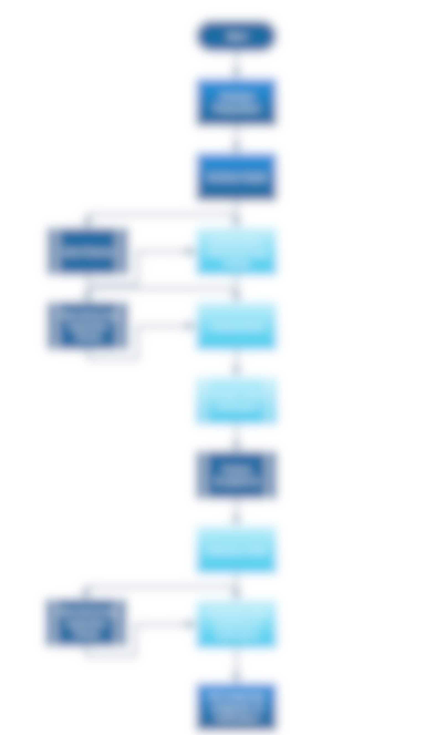
Who does this?
Where?
Who pays for it?
CDR
Contract award
……………………..
Pre-con
ITF/NDC/RSEC
Expose to industry
Review designs/plans
Design qualification for contract preparation
Full and standard document set (incl. drawings)
Testing with prototypes/emulators/simulators
Couples to:
Procurement strategy;
Construction plan/cost book (what is in, what is out);
IGO negotiations.
AIV

Slide 15
Conclusions/suggestions
I&T is a critical activity over the life of a project:
Starts from early design stage and is important in designing a system;
Should draw from domain experts, project management, and industry;
Should be some logical separation between I&T and development teams;
Should be fully budgeted in the construction cost (establishment and operational costs).
I&T should be undertaken as early and as often as possible and progressively encompassing the full system:
One of the primary risk reduction activities available to projects.
I&T should deeply involve industry (I think I&T should be industry-led as a precursor to contract preparation):

Slide 16
For SKA, I&T is likely to be hierarchical, sensibly aggregated, but distributed. I&T activities will likely follow financial and intellectual contributions to the technical program;
The conclusion of CDR is the perfect point at which to stand up a coordinated I&T program:
Problematic, because construction budget will not be available for years(?);
Problematic, because establishment of I&T is one of a number of costs excised from the cost cap
Who will spend money post-CDR but before construction start??
A project-wide I&T strategy is required, involving industry, as soon as possible:
But this touches the IGO negotiations (procurement, member contributions, in-kind vs cash, juste retour).
AADC leading the way in this respect – you have forced yourself into I&T because you have chosen a strong prototyping path during your pre-construction activities.

