Slide 1
Aperture Array Design & Construction Consortium
Low Frequency Aperture Array (LFAA)
Signal Processing and Commissioning Software
University of Oxford/Malta
Prepared by: Kristian Zarb Adami and Alessio Magro

Slide 2
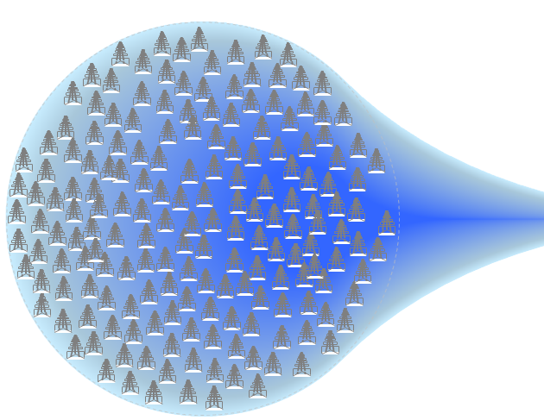
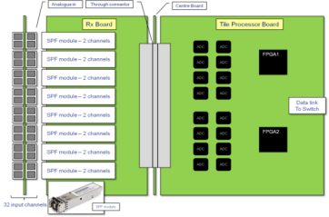
The LFAA system
Monitoring and Control System

Slide 3
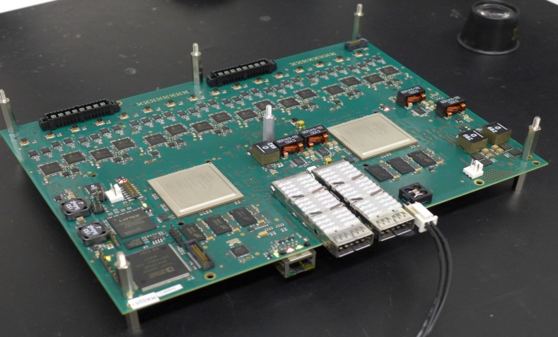
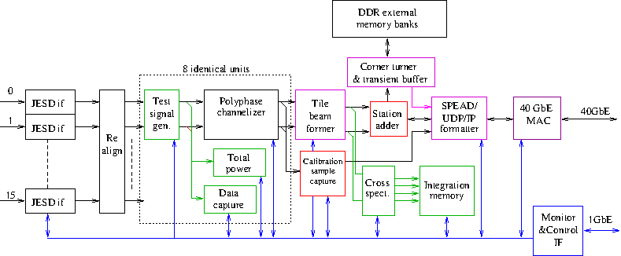
TPM firmware

Slide 4
AAVS0.5 DSP Firmware Architecture
AXI4 LITE
LMC SPEAD
FORMATTER
AXI4 STREAM C2C STREAM Bridge
AXI STREAM
CPLD
(LMC data)
POWER
INTEGRATOR
POWER
INTEGRATOR
JESD20B IF
CHANNELIZER
BEAMFORMER
CSP SPEAD
FORMATTER
4x10G ETHERNET
ADC
QSFP
C2C MM
AXI4LITE
Bridge
CPLD
(c&c)
AXI4 LITE BUS

Slide 5
AAVS0.5 DSP Firmware Modules
Data to LMC server through 1G Ethernet
Raw ADC data, 64 Kbytes snapshot from 1 antenna
Synchronized Raw ADC data, 64 Kbytes snapshot from 16 antenna
Continuous channel mode, 1 frequency channel of channelized data from 16 antenna
Burst channel mode, variable number of samples from 1 frequency channel rotating through all channels, 16 antenna
Beamformed data, 64 Kbytes snapshot
Integrated channel data, power spectrum, programmable integration time
Integrated beam data, power spectrum, programmable integration time
Data through 40G Ethernet
Beamformed data, 1 beam, ~7.5 Gbit/s

Slide 6
AAVS0.5 DSP Firmware Modules
JESD204B
16 serial lines per FPGA, 8 Gbit/s per line, ADCs operate at 800 MHz 8 bits per sample
Synchronized ADCs operation using JESD204B Subclass-1 between FPGAs in the TPM has been tested
Synchronization between different TPMs to be verified
Channelizer (undergoing field testing)
Provided by INAF
512 frequency channels
32/27 oversampling factor
Beamformer (undergoing field testing)
Provided by University of Malta
Single beam
Full BW, 400 MHz
Run-time configurable weights using shadow memory

Slide 7
AAVS0.5 DSP Firmware Modules
4x10G Ethernet / SPEAD formatters (LMC and CSP)
Provided by RAL
Tested in the lab, undergoing field testing
AXI4 LITE Infrastructure
XML2VHDL Python script used for generating VHDL code of AXI4 Lite slave interfaces from XML registers description
Adopted throughout the design
Tested on field
AXI4 STREAM Infrastructure
Streaming library including MUX, DEMUX, PIPELINE, FIFO,…
Tested on field

Slide 8
AAVS1 DSP Firmware Ongoing Development
Tile Beamformer supporting multi-beam
Station beamforming is performed by an Ethernet connected TPMs chain
Each TPM receives beamformed data from the previous TPM and combines the received data with the produced tile beam. Then it transmits the combined beam to the next TPM in the chain
DDR3 and FPGA2FPGA High-speed link are needed to address this architecture

Slide 9
Firmware Status
Requirement | Status
JES-D | I
Channelizer | I
Beamformer | P
CPLD | I
4 x 10Gb-E | I
1 x 40Gb-E | D
FPGA-FPGA | P
DRAM | P
ADC Synch | I
Board Synch | P
Legend:
D In Design
P In Progress
I Implemented
N Not started

Slide 10
AAVS1 Rack Status
PDU/PSU delivered
TPM(s) ordered
Clock distribution (delivered)
40-GbE switch delivered
1-GbE switch delivered
Fans (on order)
PSU
1Gb SWITCH
CABLE TRAY
OPTICAL FIBRE DIST.
TPM
CABLE TRAY
CLOCK DIST.
40Gb SWITCH
1Gb SWITCH
CABLE TRAY
OPTICAL FIBRE DIST.
TPM
CABLE TRAY
CLOCK DIST.

Slide 11
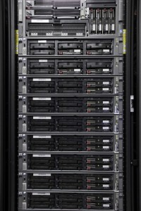
LFAA Software
O(10⁴) hardware devices to monitor and control
O(10²) GB/s processed for calibration
Raw antenna data is trickled through the same network to an HPC system
A software architecture using large scale control systems and cloud-based technologies is being developed in collaboration with industry

Slide 12
AAVS1 Overall Architecture

Slide 13
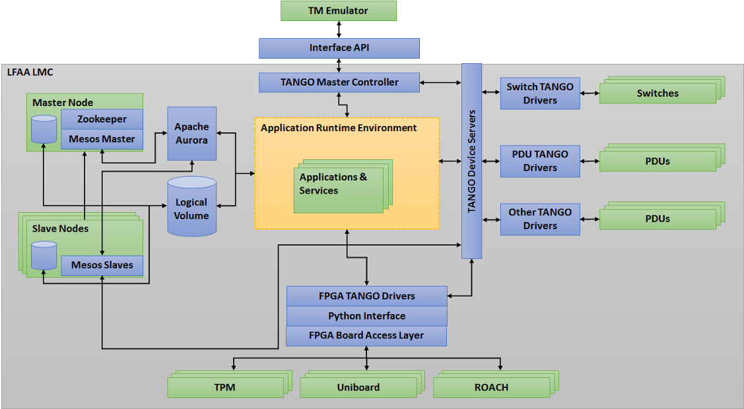
Software Architecture

Slide 14
AAVS0.5
TPM Control
Download firmware
Initialize and control all devices on TPM
Interact with loaded firmware
Data Acquisition
Receive LMC data from TPM (7 types)
Receive station beams (buffers)
Save to HDF5 files
Online plotting functionality for testing
Pointing (under test)
Point to arbitrary ALT/AZ and RA/DEC

Slide 15
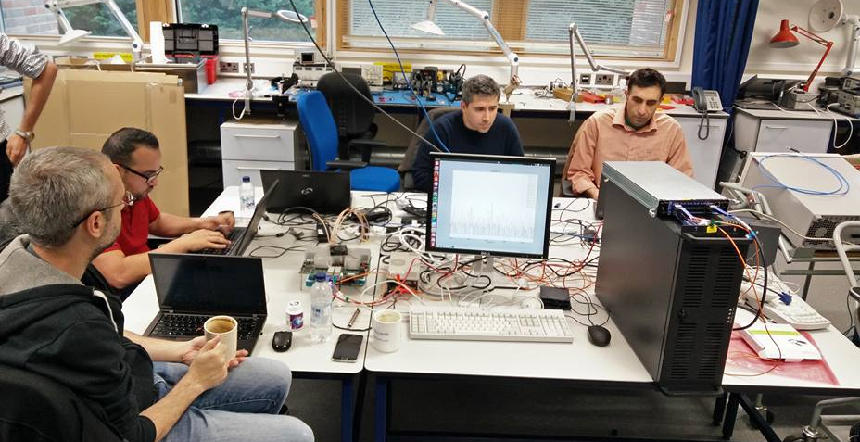
How many cables does it take…

Slide 16
Towards AAVS0.75
AAVS0.75 will include 4 TPMs, and this is where things start getting interesting:
Synchronization across TPMs
Data flow between Tiles
Synchronized software-level operations across Tiles (eg: application of pointing coefficients)
New devices introduced to the system:
40GbE switch
Clock distribution unit
PDU/PSU

Slide 17
AAVS0.75
TANGO deployed and tested (connected to a working system) in AAVS0.75
TANGO must be capable of synchronizing operations across Tiles when required (through access layer)
Clock synchronization procedure
New device drivers: switch, server, PDU, PSU
DAQ has to be updated to handle streams from multiple tiles (especially for calibration)
Correlator for calibration
Rolled integration with TM Emulator

Slide 18
Towards AAVS1
Requirement | Status
TPM driver | I
Switch driver | I
PDU/PSU driver | N
Server driver | P
Rack driver | N
Control System Bus | I
Logging | P
Alarms | P
Events | P
Archiving | N
Requirement | Status
Job System | P
Telescope Model | P
Sky Model | D
Observation modes | P
Cluster Management | N
API and LMC driver | P
DAQ | P
Correlation | D
Pointing | I
Calibration | D
D In Design
P In Progress
I Implemented
N Not started

Slide 19
Towards AAVS1
TPM driver periodically updated when new firmware functionality is available
Job system for initial AAVS1 deployment will simply use services (Aurora to be investigated after initial deployment)
Likewise, cluster management will initially be very simple
LMC driver acts as the top-level LMC manager, whilst the API is a wrapper to communicate with it
Significant effort will be required to integrate all requirements into a working, stable system (lots of testing)

Slide 20
TM Emulator
A web-based front end for telescope operators and observers, emulating the role of Telescope Manager
Allows operators to monitor and control telescope hardware through appropriate views of the telescope setup
Allows observers to configure and monitor observations
The emulator is under development (with industry) and an end-to-end test from emulator to TPM has been successfully performed
Python, Django, Nginx, bootstrap, MySQL

Slide 21
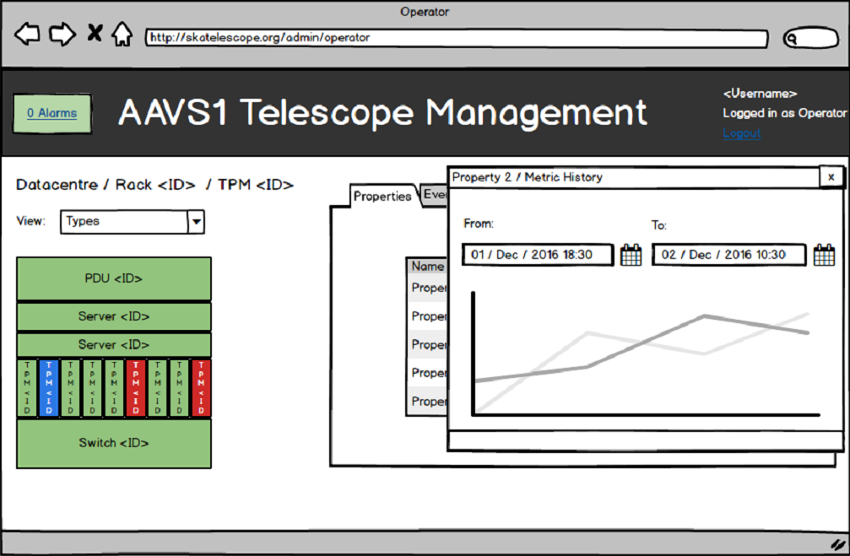
TM Emulator

Slide 22
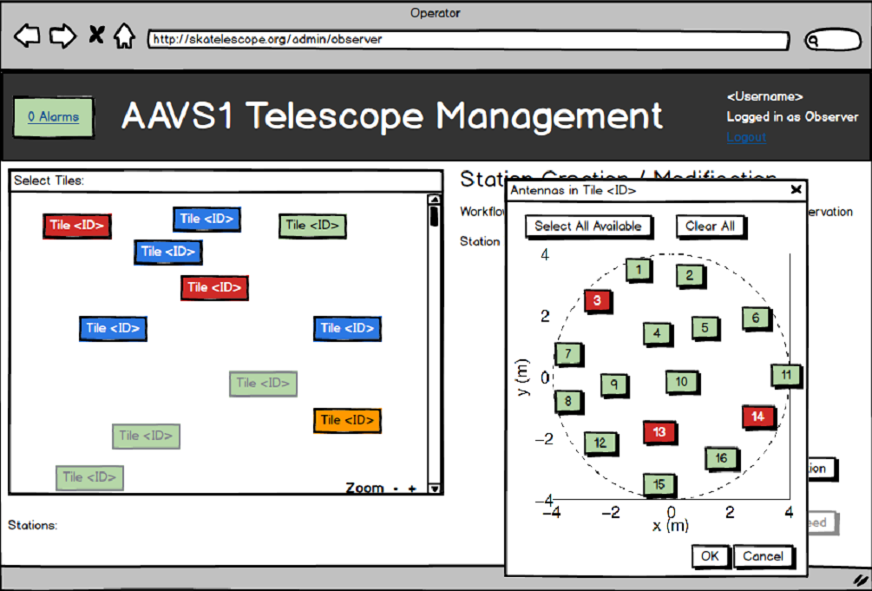
TM Emulator

Slide 23
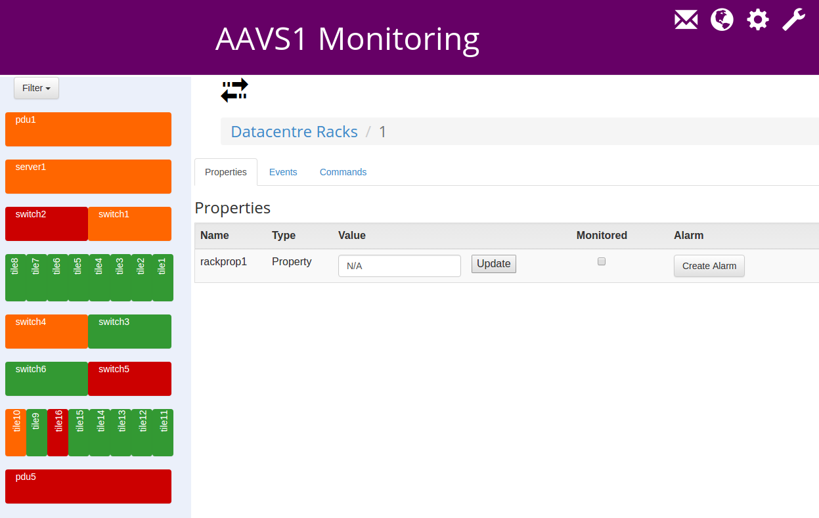
TM Emulator
Insert screenshot

Slide 24
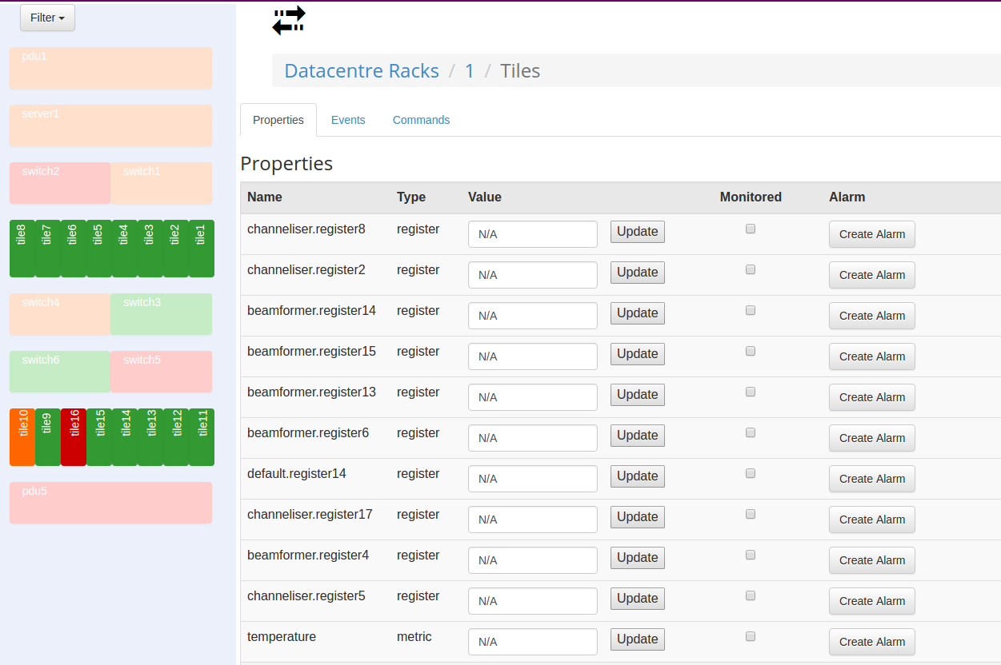
TM Emulator
Insert screenshot

Slide 25
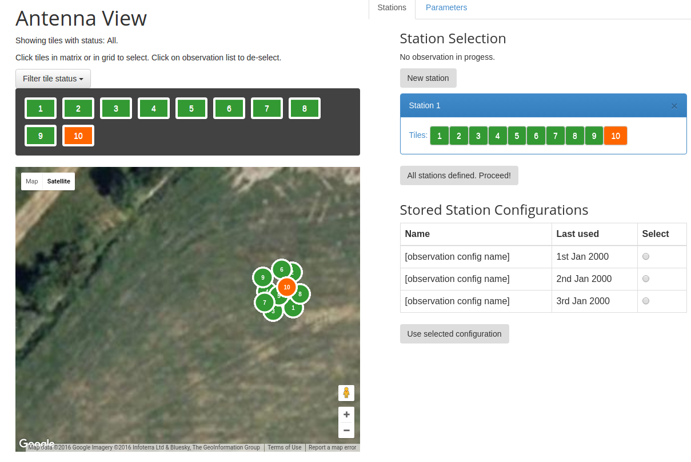
TM Emulator
Insert screenshot

Slide 26
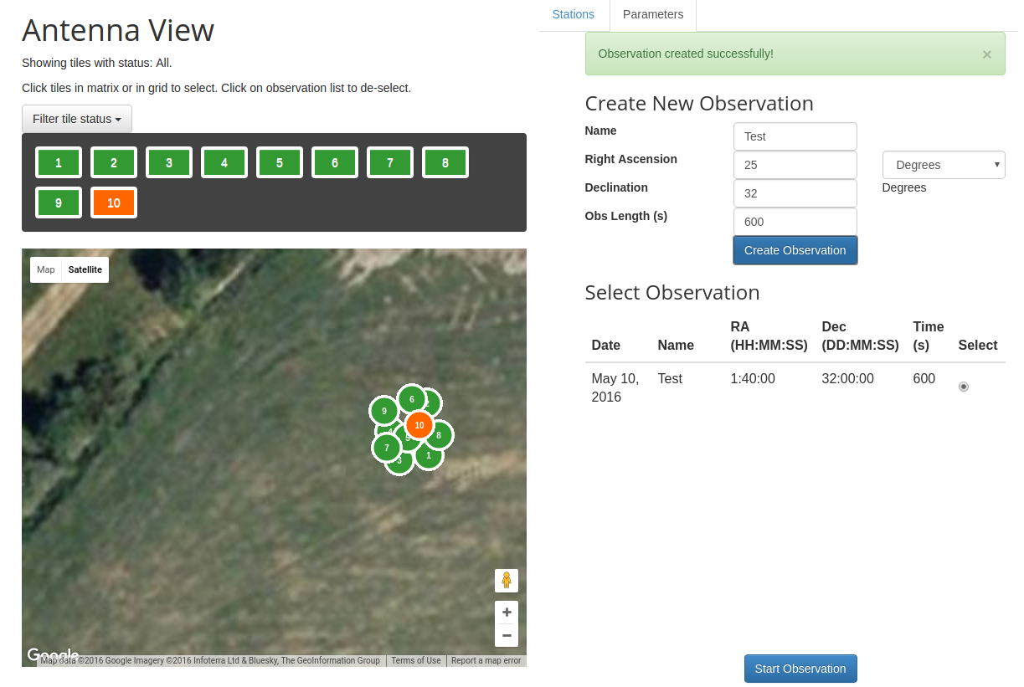
TM Emulator
Insert screenshot

Slide 27
Interface with MWA
MWA will have two interfaces with AAVS1:
AAVS-MWA interface for beamformed data (data path)
MWA-AAVS control interface (control path)
MWA must be capable to taking over control of AAVS1, that this, create and launch observations
This will happen through the same REST interface which the Telescope Emulator uses
Three primitives: define, start and stop observation
No async control feedback is required

Slide 28
AAVS1+
Once the system for AAVS1 is deployed and substantially tested, additional low-priority requirements may be implemented:
Cluster management with Mesos (and maybe DC/OS)
Job management with Aurora
Distributed File system with GlusterFS
Design to handle multiple concurrent observations
Design to handle more than one beam per station
Re-direction of station beams to LMC cluster for science pipelines

Slide 29
SKA LMC Harmonization ANT TEAM
One member on the LMC Harmonization ANT Team
Writing SKA Control System Guidelines document (replacing LIG, TIG, LSR)
Managing sub-teams for:
Element Alarms and Central Alarms Handling
Element Archiving and Central Archiving
Time stamped commands
Participating in sub-teams for:
Element configuration and sequencing
Multi-parameter setting and LMC role in configuration
Development of SKA base-devices

