Slide 1


WP-RX Status May 2016
          Monari Jader – Perini Federico
          INAF-IRA
          Radiotelescopio Croce del Nord
          Sasso Marconi of 9th-13th of May 2016

Slide 2
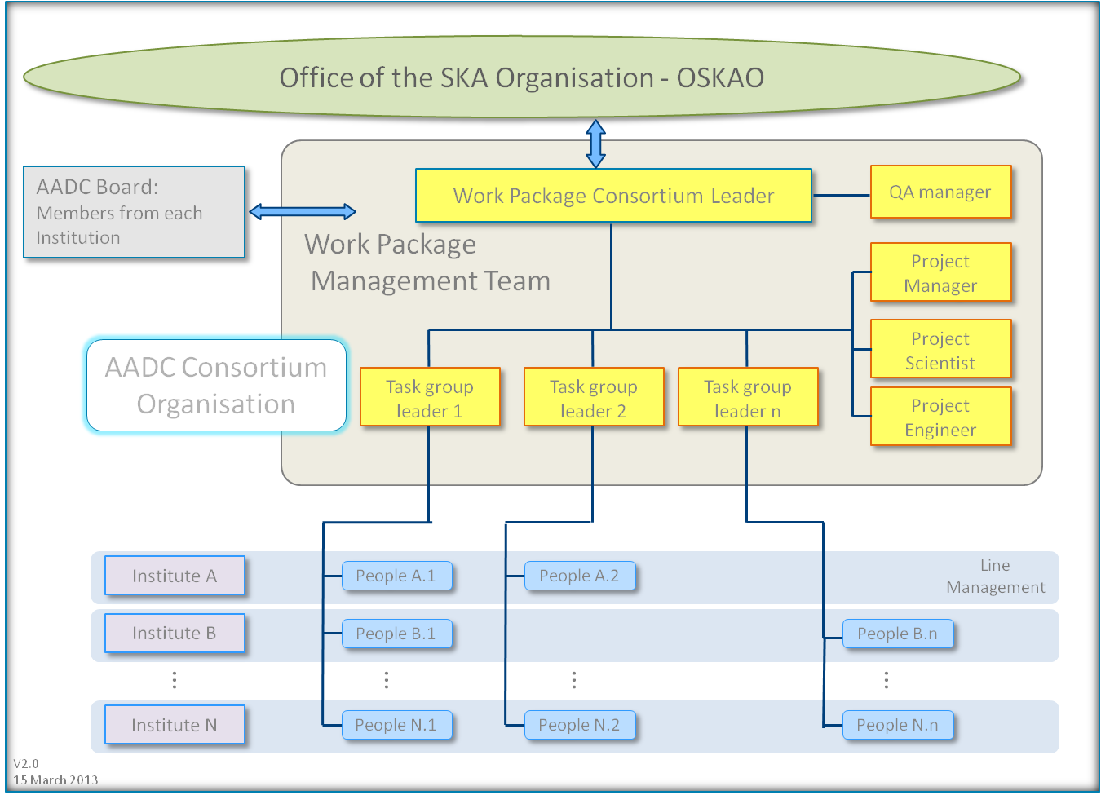
AADC participation
Davide Fierro
Giuseppe Virone
Jader Monari

Slide 3

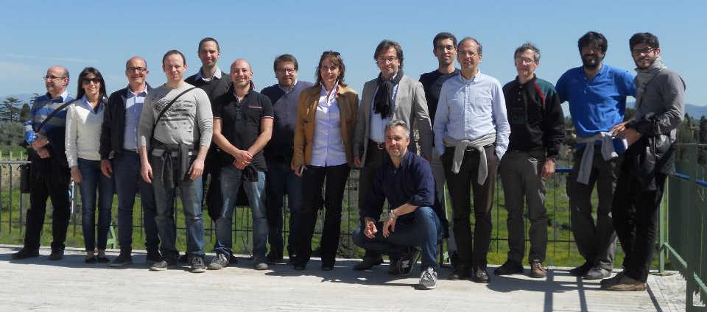
Italian SKA-low – Dream Team
Davide Fierro
PM SKA Italia
Roma Headquarter
Jader Monari
Technical LFAA coordinator
IRA
Pietro Bolli
Antenna & Calibration
Federico Perini
Receiver
Marco Schiaffino
Mechanics
Francesco Schillirò
Acquisition System
Gianni Comoretto
Firware
OAA
IRA
IRA
OACT
OAA
SKA Italian Manager& LFAA board member: Davide Fierro
Coordination & RX WP leader : Jader Monari
Antenna & Calibration: Pietro Bolli, Giuseppe Pupillo Receiver Chain: Federico Perini, Simone Rusticelli, Marco Poloni
Mechanics: Marco Schiaffino
Signal Processing: Francesco Schillirò, Monica Alderighi Giovanni Naldi, Andrea Mattan
Firmware: Gianni Comoretto, Carolina Belli, Simone Chiarucci
Admistration: Alice Tabellini
SAD : Matteo Murgia, Federica Govoni, Tonino Pisanu, Giampaolo Serra, Francesco Gaudiomonte, Ignazio Porceddu, Lino Morongiu

Slide 4







Research & Industrial Contracts
(2015-2016)
UniBO
Analogue Optical fibre
Giovanni Tartarini,
Antenna & Calibration
CNR-IEIIT
Giuseppe Virone, Augusto Olivieri, Fabio Paonessa
CNR-IEIIT & POLITO (WP-AL)
UNIBO (WP-RX)
UNIFI (WP-RX)
Flying measure facility
POLITO
Andrea Lingua, Marco Piras,
Paolo Maschio,
UniFi
Reliability
Marcantonio Catelani
Lightech & OPTEL (WP-RX)
Sanitas EG (WP-SP)
Finmeccanica (WP-RX)
Campera ES (WP-SP)

Slide 5
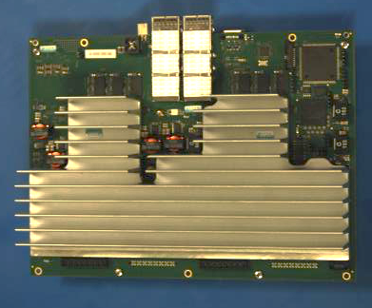
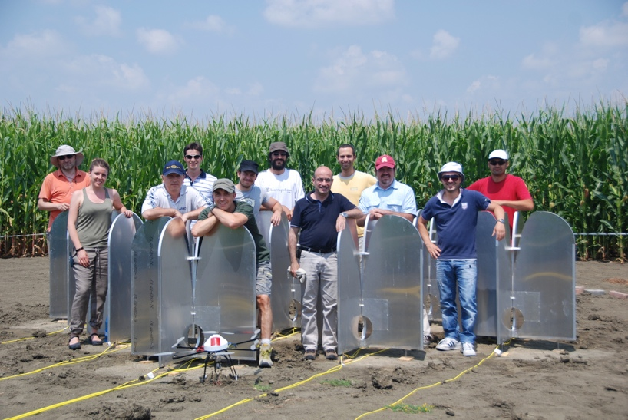
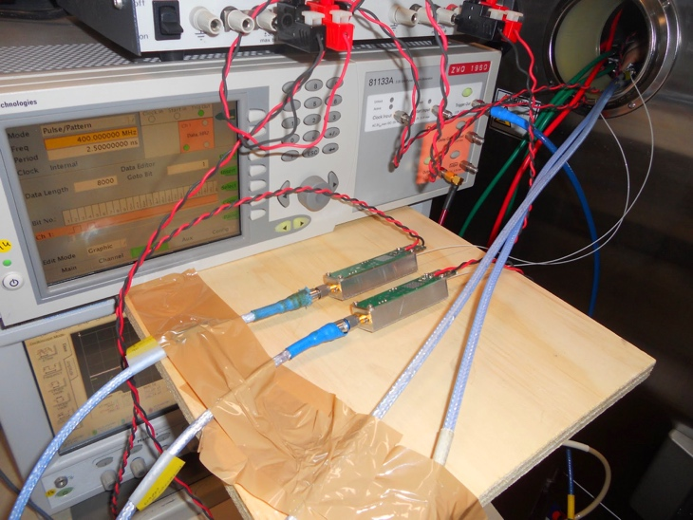
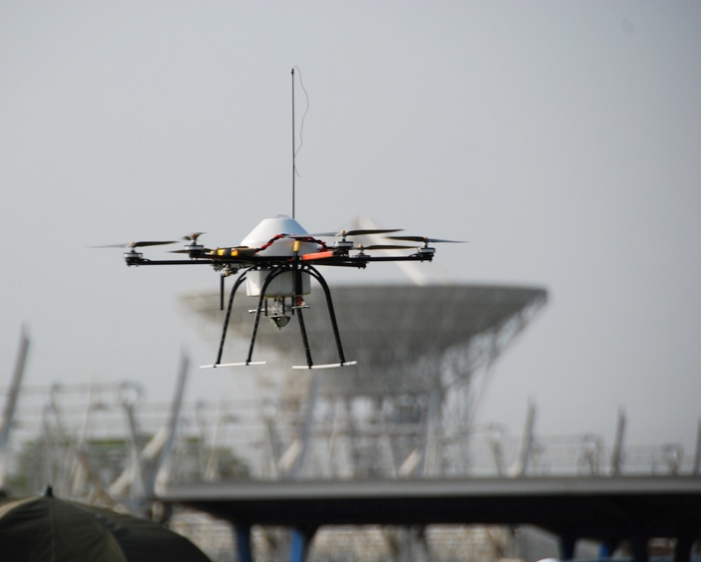
Main Past Activities
Vivaldi design
Hexacopter test bench
RFoF technology (standard, WDM, VCSEL, POF)
Pattern measurement/Calibration for Vivaldi/SKALA, Mini MAD, MAD-1,2,3
iTPM

Slide 6
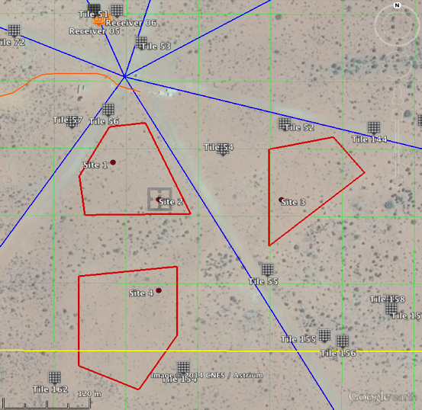
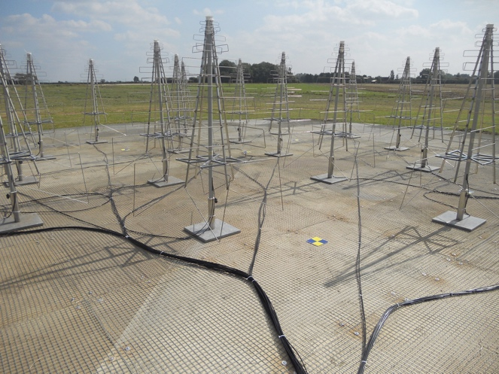
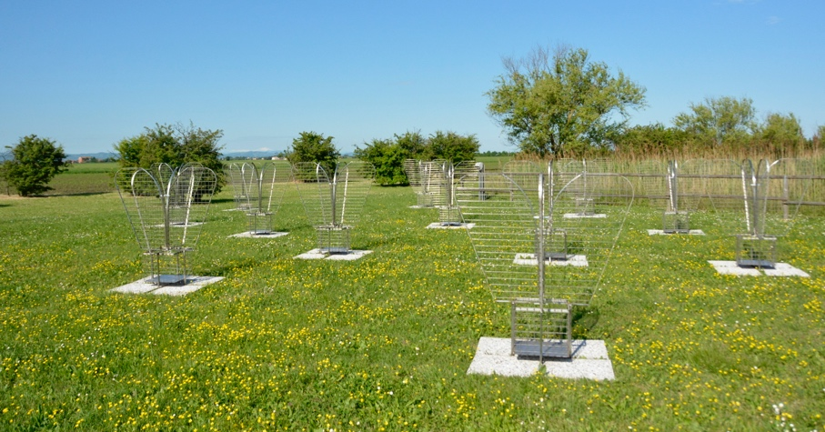
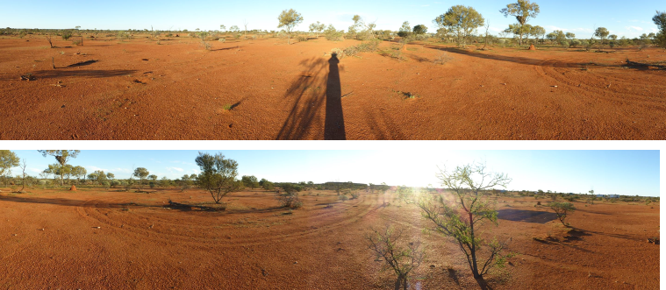
Verification systems (2015-2016)
Pre-AAVS1 (16 SKALA Lord Bridge) – 2015
BAD (16 Vivaldi Medicina)
SAD (128 Vivaldi SRT) –2016
Pre-AAVS1 (16 SKALA MRO) - 2016
AAVS1 (384 SKALA MRO) -2016 (December)

Slide 7
INAF AADC participation
Costs (2012-2016)
Year | FTE (1=66K€) | Cash | Industry Contract | Travel
2012-2013 | 10.39 | 185K | 0 | 20K
2013-2014 | 9.6 | 256K | 100K | 20K
2014-2015 | 9.84 | 214K | 0 | 49.8K
2015-2016 | 8.69 | 152.2K | 589.3K | 41K
4.17M€
Maybe more:
Administration tenders
Comoretto 2012 to 2015

Slide 8



WP-RX
LNA
RF Circuitry
TX
RX
RF Circuitry
Link RFoF
FEM
PREADU
WP Receiver

Slide 9
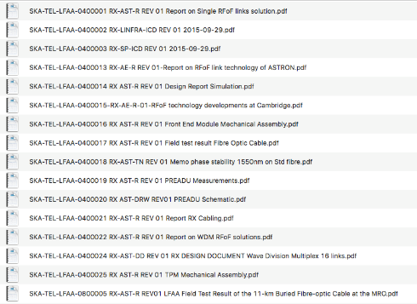
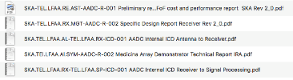
Documents delivered (PDR, DDR)

Slide 10
Documents delivered (SKAO)
Nominal date | Deliverable | Earned Value
15st April 2015 | Kick-off Stage 2 | €1M
12th Oct 2015 | AA Verification System 1 (AAVS1) Detailed Design Review | €2M
15th March 2016 | Preliminary installation plan of a LFAA station | €0,5M
1st July 2016 | Installation plan of a LFAA station | €0.5M
1st May 2016 | Report on RFoF performance over the max. length expected for both surface laid and trenched cable to demonstrate achieving the stability requirements. | €1M
1st Aug 2016 | Installation and functional test report of AAVS1 | €1.5M
1st Feb 2017 | Validation and evaluation report of AAVS1 | €2M
1st April 2017 | CDR SKA1 | €3M
30th July 2017 | Closure of Stage 2 | €1,7M
31st Dec 2015 | LFAA station design report and Technical compliance update | €1.0M
10th July 2 2015 | PMP and SEMP review | €0.5M
15th Sept 2015 | Inputs to SKAO System Review Updated costs External ICDs Risk review Draft RAM and ILS report | €1.0M
Total |  | €15.7M
Date | Nominal date | Deliverable | Earned Value
T0 | 1st Nov 2013 | Bid preparation and SKAO delivery of Level 1 requirements | €0,5M
T0+12 weeks | 1st Feb 2014 | TBD and TBC agreed and closed for Level 1 requirements | €1M
T0+25 weeks | 1st May 2014 | Preliminary report on RFoF cost and performance | €1M
T0+34 weeks | 1st July 2014 | Preliminary installation plan (including demonstration plan) | €0,5M
T0+38 weeks | 1st August 2014 | Preliminary power design report | €1M
T0+46 weeks | Mid Sept 2014 | System Requirements Review and associated documents (see SEP) | €2M
T0+50 weeks | End of Oct 2014 | Preliminary Design Review and associated documents (see SEP) | €1M
T0+68 weeks | 1st March 2015 | Closure of Stage 1 | €0,6M
 | Total |  | €7,6M

Slide 11



Tenders for AAVS1

Slide 12
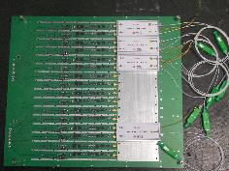
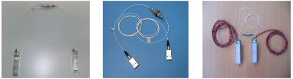
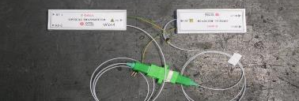
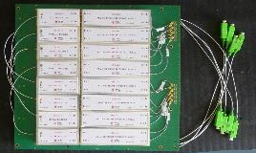
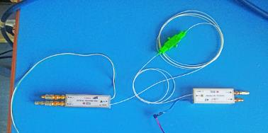
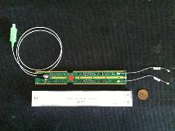
Prototypes developed
RFoF links
PREADU 1.0
PREADU 2.0
PREADU 2.0
With integrated ORX

Slide 13
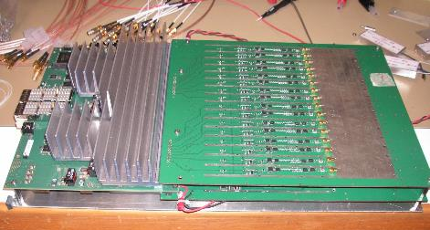
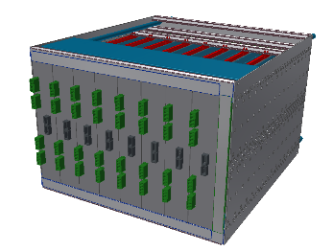
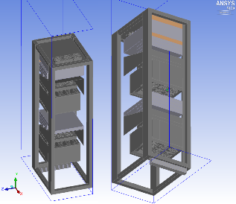
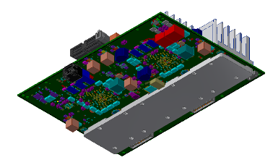
Mechanics works

Slide 14
Main on going activities
Production for AAVS1
Benches and and JIG preparation
Reliability
Long links up to 70 Km

Slide 15
1. AAVS1 Production
320 Hybrid Cables (440 necessary)
49K€
400 + 40 RFoF FE/WDM OTX
50 + 5 Complete PREADU 2.1 boards
20 ADU (iTPM)
244K€
244K€
6 Subrack + metal works for iTPM
10K€
+ preAAVS1 Cambridge and preAAVS1 Australia
30K€

Slide 16
1. Production and Testing (RX)
Production (1)
First tranche (40 FE modules / 5 preADU)
Production (2)
Second tranche (380 FE / 50 preADU)
time
T₀
August
Dec

Slide 17
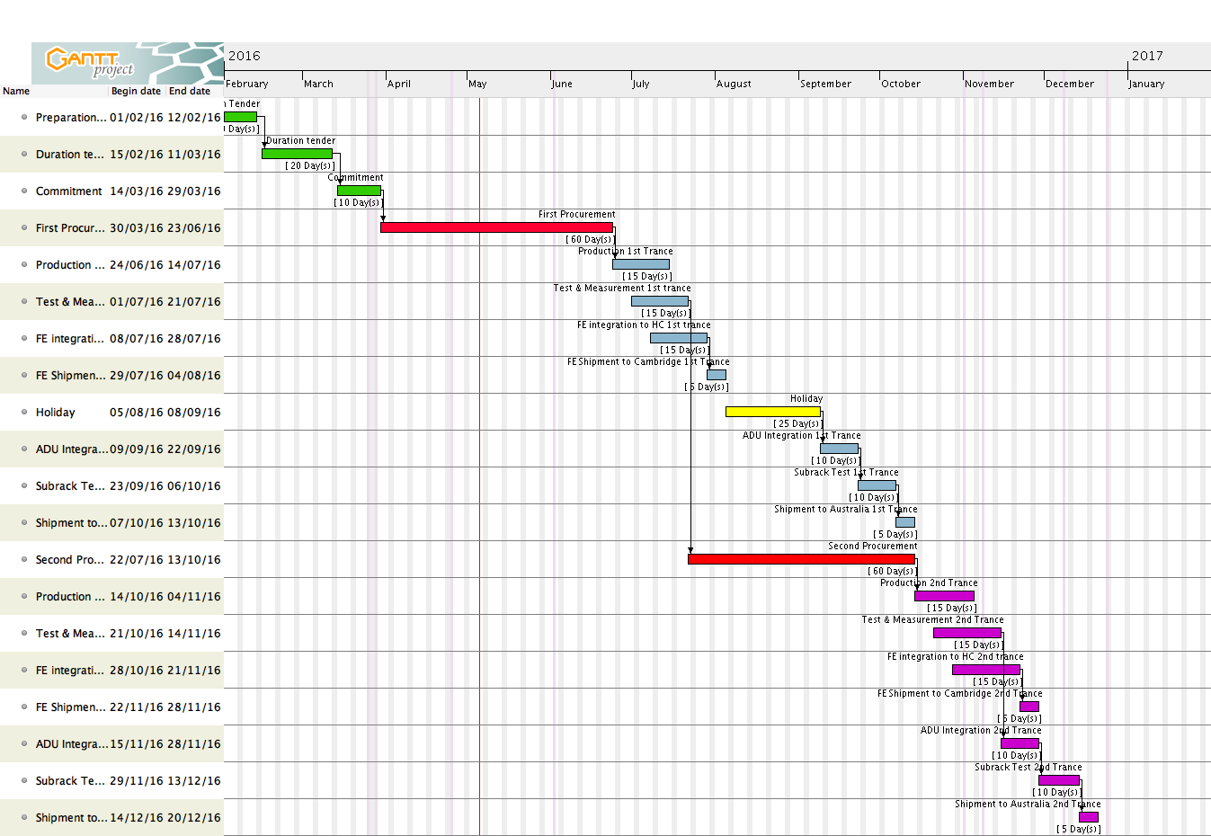
1. Gantt Chart
No EMC pre-compliance test considered

Slide 18
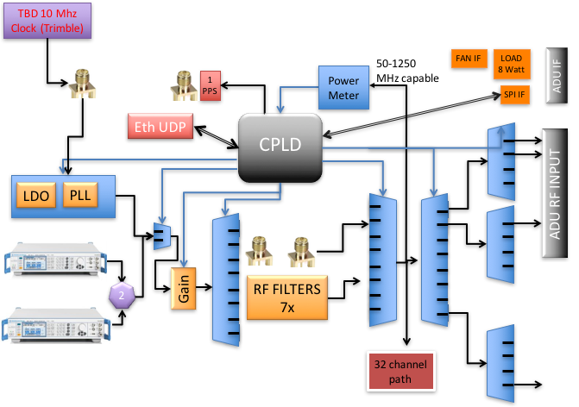
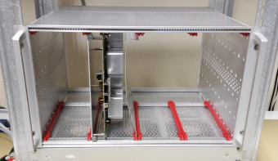
2. Benches and JIG preparation

Slide 19
3. Reliability preliminary results
Notes:
The reliability prediction may be used as a guide to improvement by showing the highest contribution to failure
The predicted will also help evaluate the significance of reported failure to determine whether the number of failures Is commensurate with the number of components used in the system

Slide 20
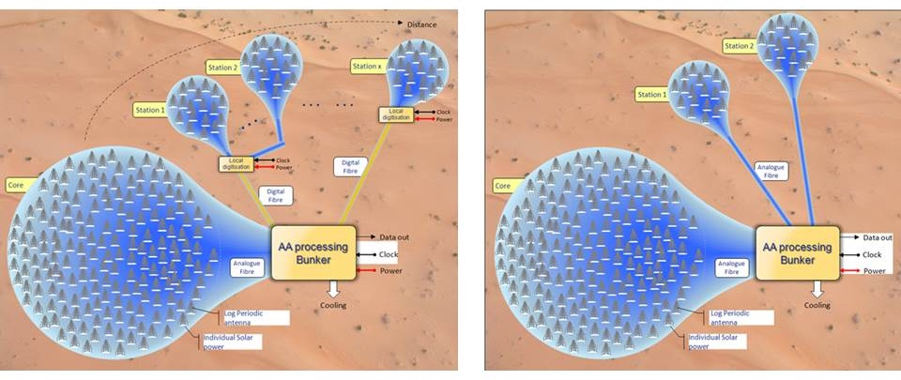
4. Long Links main results
Main topics related to the fibre length:
Attenuation
Relative phase variation due to temperature changes and nonlinearity → due to chromatic dispersion.
Notes:
This study has led us to conclude that there are no obstacles that make unfeasible an analogue link length up to 70Km in particular studying the main topics, which are related to the fibre length, of attenuation, relative phase variation due to temperature changes and nonlinearity both due to chromatic dispersion.
The analysis has been applied to the standard SMF (G.652D), due to its wide spread diffusion, and extended to other fibre types like ITU G.653 and ITU G.655, in order to exploit the coincidence of the minimum of the dispersion with the minimum of the optical attenuation.

Slide 21
News from the Lab
Update of the most recent results towards AAVS1

Slide 22
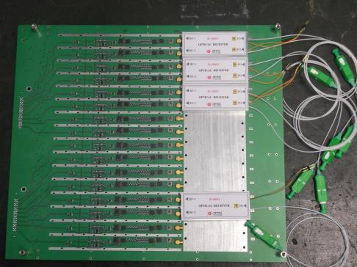
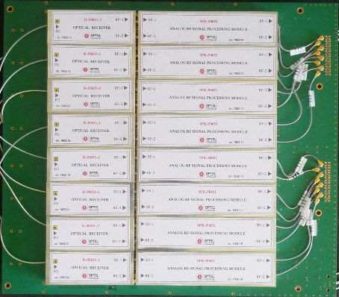
From PREADU1.0 to 2.0 (February 2016)
Demonstration of integration of 16RF chains
ORX detachable
RF receivers mounted on the carrier PCB
SPI or Dip Switches RX control
Designed to meet RF PDR specifications
Same size of 1.0
Both ORX and RF modules are detachable
Easier replacement
SPI and Dip Switches RX control
Improved RF specifications to meet DDR specifications (also in the FE/OTX)

Slide 23
RX WP Specifications
FE/OTX
Up to 10Km SMF G652D
ORX
RF
RX(RFoF)
RX(RF)
RX
SubAssembly
Needed also for national tender specs definition
SubElement

Slide 24
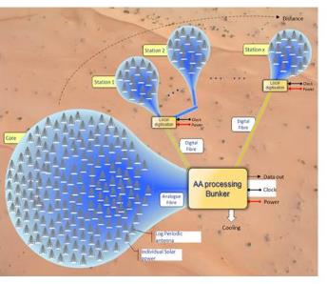
RFoF Links specifications
RF specifications | Values | Notes
RF band | 50-650MHz
Gain | Min:20dB Typ:25dB Max:30dB | Freq=100MHz and with 10Km of G652D SMF between OTX and ORX
Flatness | +/-0.5dB | Measured in two separate sub-bands: 50-375MHz and 375-650MHz
IRL | >15dB (>10dB) | 50-350MHz (350-650MHz)
ORL | >15dB (>10dB) | 50-350MHz (350-650MHz)
NF | <18dB | Over full 50-650MHz band and with 10Km of G652D SMF between OTX and ORX
RF channels isolation | >30dB | Measured as difference of the gains at the two outputs with the same input.
Out of band rejection | ≥50dB | Freq ≤20MHz
OP1dB | >+8dBm | Over full 50-650MHz band and with 10Km of G652D SMF between OTX and ORX
OIP3 | >+21dBm | Over full 50-650MHz band and with 10Km of G652D SMF between OTX and ORX
OIP2 | >+30dBm for G<28dB >+33dBm for G>28dB | Freq>100MHz and with 10Km of G652D SMF between OTX and ORX
10Km links

Slide 25
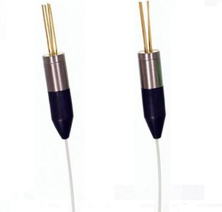
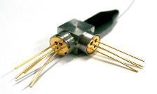
WDM – Wavelength Division Multiplex
2 separate FO
Same λ (1310 OR 1550nm)
2 Laser in 2
separate packages
2 PD in 2
separate packages
Pol 1
Pol 1
Pol 2
Pol 2
Pol 1
Pol 1
2 PD with a WDM splitter integrated in a single package
2 Laser with a WDM combiner integrated in a single package
Same FO, different λ
1310 AND 1550nm
(1270 AND 1330nm)
Pol 2
Pol 2

Slide 26
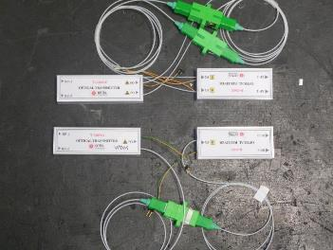
WDM – Wavelength Division Multiplex
The RF circuits remain the same as for the standard (two separate LASER and PD in separate packages).
Half FO, connectors, fusion splices, fibre joints.
Optical isolation doesn’t limit the RF isolation.
WDM LASER and PD costs are similar to 2 LASER and 2 PD
  → main cost saving is on FO, connectors, joints,…
Different dispersion for G652D SMF at 1310 and 1550 nm
  → but with closer wavelengths selection the problem can be fixed (i.e. 1270 and 1330 nm)

Slide 27
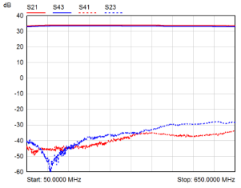
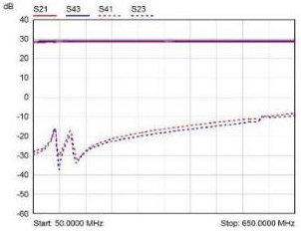
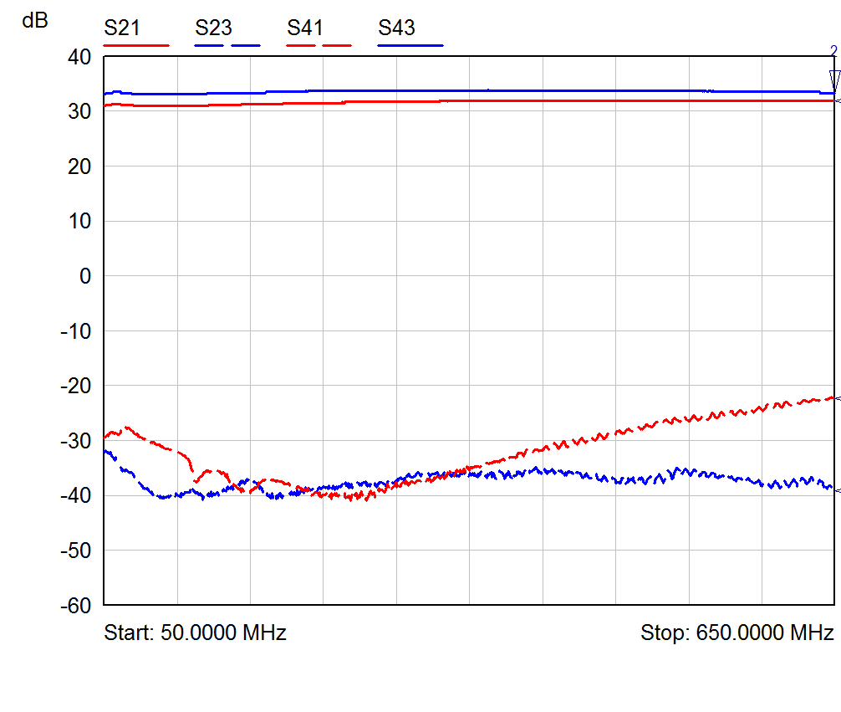
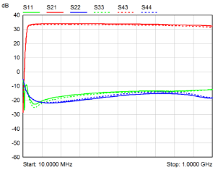
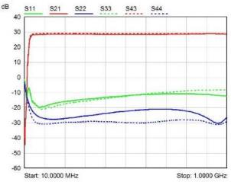
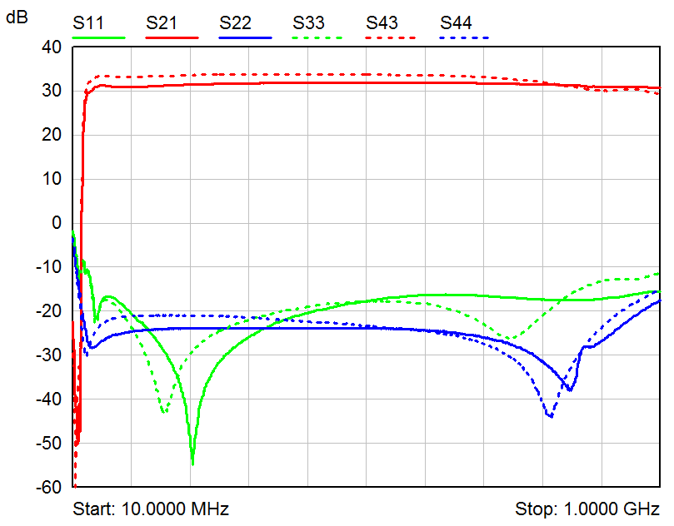
RFoF evolution (options)
60dB
40dB
50dB!
February 2016
Dotted = CH1/1310nm
Solid = CH2/1310nm
Dotted = 1310nm
Solid = 1550nm
Dotted = 1330nm
Solid = 1270nm
Standard
WDM 1310/1550
WDM 1290/1330

Slide 28
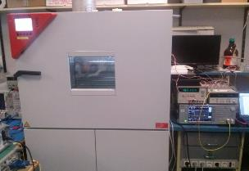
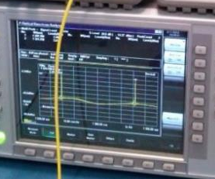
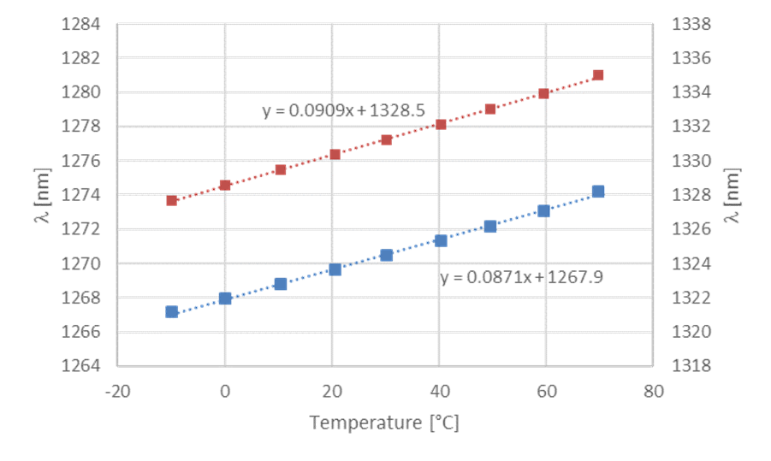
WDM 1270/1330 pre-production meas.
A full RF characterization (as performed for 1310/1550 version) is still undergoing
Completed over full temperature range -10 to +70°C for Δλ/ΔT coefficients
Link# | Δλ/ΔT (1270nm) [nm/°C] | Δλ/ΔT (1330nm) [nm/°C]
1 | 0.0871 | 0.0909
2 | 0.0866 | 0.0910
3 | 0.0863 | 0.0906
4 | 0.0874 | 0.0911
5 | 0.0879 | 0.0913
6 | 0.0877 | 0.0920
7 | 0.0858 | 0.0901
8 | 0.0862 | 0.0900

Slide 29
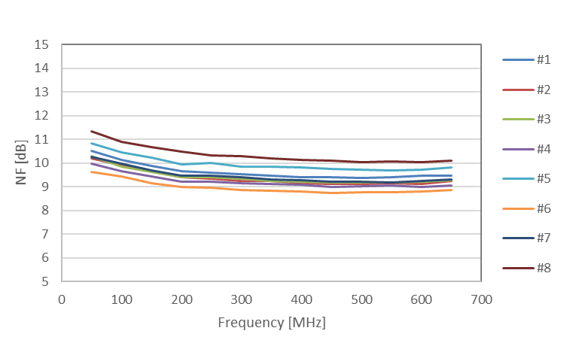
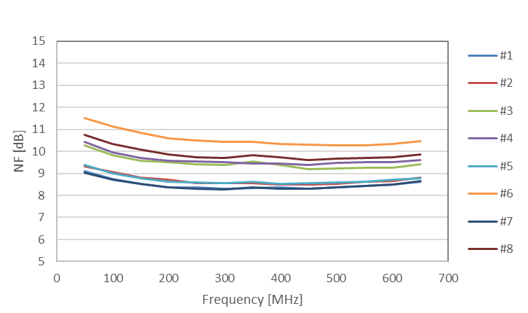
WDM 1270/1330 pre-production meas.
OP1dB
Completed at +25°C for RF
(S-parameters, NF, P1dB and IP2/IP3) with and without 10Km of G652D SMF optical fibre between TX and RX
→ needs to be performed at least at -10°C and +70°C
 | 0m |  |  |  | 10km
 | 1270nm |  | 1330nm |  | 1270nm |  | 1330nm
Link # | 100MHz | 450MHz | 100MHz | 450MHz | 100MHz | 450MHz | 100MHz | 450MHz
1 | 14.9 | 14.2 | 17.2 | 16.1 | 14.0 | 13.2 | 14.8 | 13.7
2 | 15.7 | 15.4 | 14.9 | 14.3 | 13.9 | 13.5 | 13.3 | 13.1
3 | 15.4 | 14.8 | 15.1 | 14.5 | 14.7 | 14.4 | 12.5 | 13.1
4 | 14.9 | 14.3 | 14.2 | 13.7 | 14.0 | 13.7 | 12.7 | 12.3
5 | 13.2 | 12.3 | 15.1 | 14.6 | 13.6 | 13.3 | 14.3 | 14.1
6 | 15.1 | 14.6 | 15.3 | 14.5 | 14.2 | 13.8 | 12.3 | 14.0
7 | 14.4 | 13.8 | 14.7 | 14.1 | 13.5 | 13.1 | 13.5 | 12.9
8 | 13.9 | 12.9 | 14.3 | 13.9 | 12.3 | 12.2 | 13.6 | 13.3

Slide 30
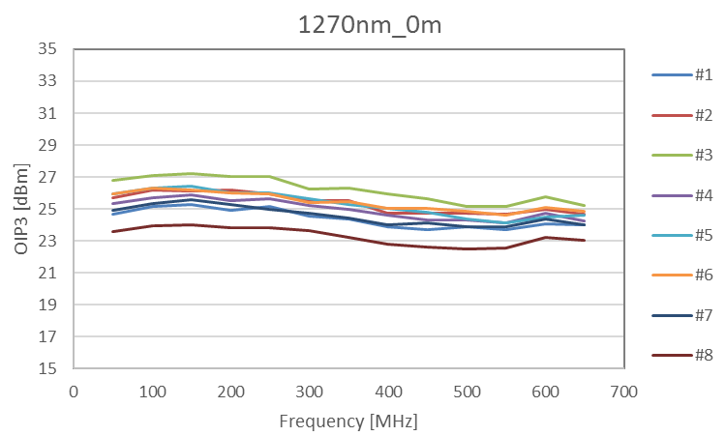
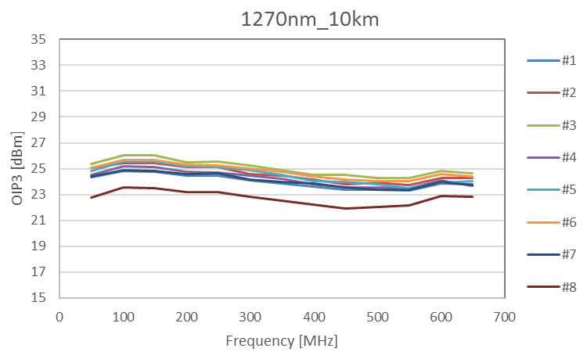
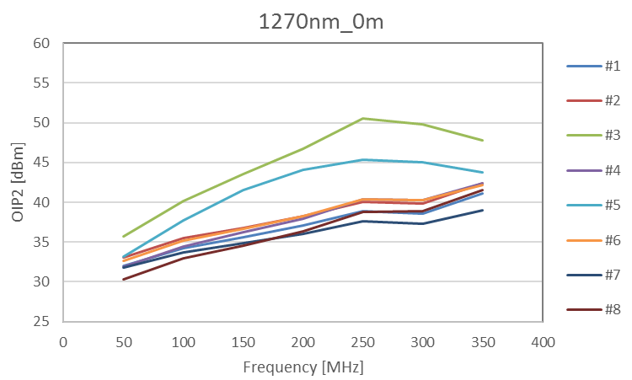
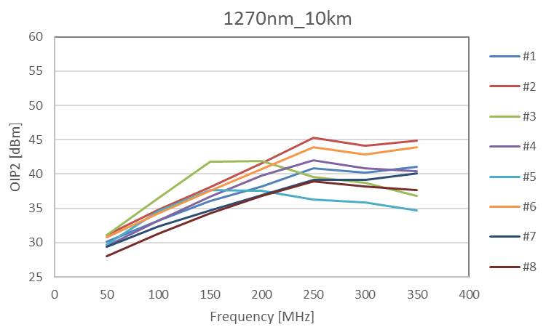
WDM 1270/1330 pre-production meas.

Slide 31
RF receiver specifications
RF Specifications | Values | Notes
Overall RF Band | 50-650MHz | Split in two sub-bands: LB 0-375MHz and HB 375-650MHz
LB Filter | 0-350MHz (50-375MHz) | 1dB band (3dB band)
LB Filter Rejection | 50dB | Freq ≥ 450MHz
HB Filter | 375-650MHz | 1dB band
HB Filter Rejection | 50dB | Freq ≤ 325MHz & Freq ≥ 750MHz
Gain | Min:26dB Typ:27dB Max:28dB | The receiver chain shall include a 5 bit (0-31dBa) digital step attenuator (DSA). Freq=100MHz with DSA at minimum level of attenuation (0dB).
Flatness | +/-0.5dB | Measured in the two separate sub-bands: 50-375MHz and 375-650MHz
IRL | >15dB (>10dB) | 50-375MHz (375-650MHz)
ORL | >15dB (>10dB) | 50-375MHz (375-650MHz)
NF | <10dB | Freq=350MHz with DSA at minimum level of attenuation (0dBa)
RF channels isolation | >50dB | Measured as difference of the gains of two adjacent outputs with the same input and with all DSA at minimum level of attenuation over 50-350MHz band
OP1dB | >+17.5dBm | Over 50-350MHz band and with DSA at minimum level of attenuation
OIP3 | >+31dBm | Over 50-350MHz band and with DSA at minimum level of attenuation
OIP2 | >+41dBm | Over 50-350MHz band and with DSA at minimum level of attenuation

Slide 32
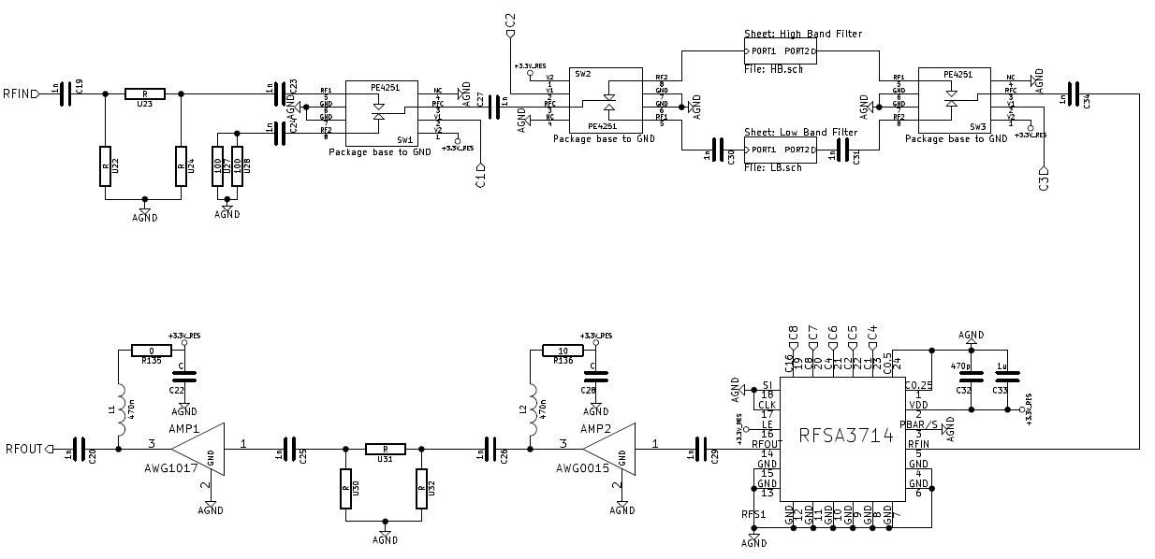
RF receiver 2.0 schematic
SKY/50Ohm Switch
Filters Bank
Equalization/PAD
1st Gain
Block
2nd Gain
Block
31dB/1dB
Step Attenuator
New RF switches from Peregrine (PE4251) and new DSA from RFMD (RFSA3714): cheaper and easier to procure than Hittite and Minicircuits ones

Slide 33
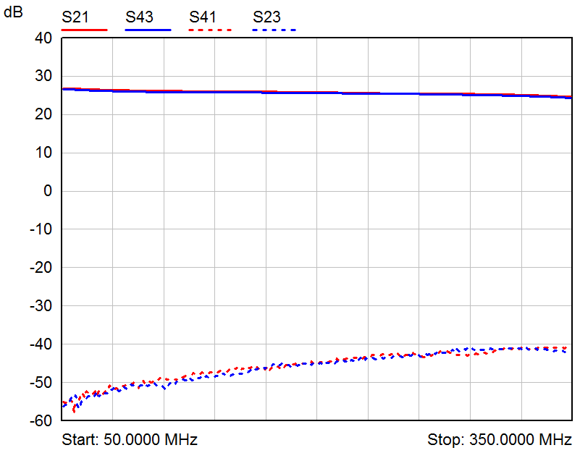
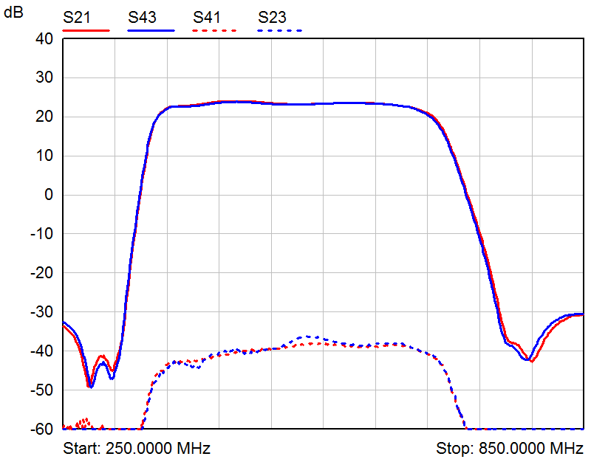


RF receiver 2.0 measurements
CH ISOLATION
LOW Band
HIGH Band
S-parameters

Slide 34




RF receiver 2.0 measurements

Slide 35

RX2.0 Power Consumption
FE/OTX
First RX Specification (@+50°C):
0.5W (FE) + 0.5W (PREADU) = 1W
Total (FE+PREADU) consumption for each single polarisation/RX chain:
0.35W+0.6W = 0.95W @+50°C
0.42W+0.6W = 1.02W @ +70°C
 |  | Phase Switch | Filter Bank
 | ORX | RF Switch PE4251 | RF Switch PE4251 | RF Switch PE4251 | Dig. Att RFSA3714 | Gain Block AWG-0015 | Gain Block AWG-1017 | PREADU2.0
Idc (mA) | 66 | 0.055 | 0.055 | 0.055 | 0.18 | 34 | 70 | 168.35
 |  | Vdc (V) | 3.5 | Pdc (W) | 0.59
 |  | Vldo (V) | 3.3 | Pldo (W) | 0.54
PREADU2.0@25°C

Slide 36
Why PREADU2.1 for AAVS1?
ORX
RF
MMCX
coaxial connector broken

Slide 37

PREADU2.1 for AAVS1
One single PCB and shielding enclosure for both ORX and RF
No more coax connectors between ORX and RF receiver
Same size, controls and performance than ORX+RF

Slide 38
Final RX specs for national tender
Parameter | Value | Notes
RF band | 50-650MHz | Overall frequency band
Low Band (LB) | 50-375MHz | 3dB cut frequency
High Band (HB) | 375-650MHz | 3dB cut frequency
Flatness | +/-1.5dB | Measured in the two separate sub-bands LB and HB
HP filter rejection | ≥45dB | Freq≤20MHz, HP filter integrated in the FE PCA
LB filter rejection | ≥45dB | Freq≥450MHz, LB filter integrated in the PREADU PCA
HB filter rejection | ≥45dB | Freq≤325MHz & Freq≥750MHz, HB filter integrated in the PREADU PCA
Gain | Min 54dB Typ 60dB Max 66dB | Freq=100MHz FE and ORX connected directly DSA set at minimum attenuation level
IRL | >12dB | Measured at both FE inputs on the overall RF band 50-650MHz.
ORL | >12dB | Measured at both ORX+RF outputs on the two sub-bands LB and HB.
NF | <16dB | Measured in the two sub-bands LB e HB FE and ORX connected directly DSA set at minimum attenuation level
RF channels isolation | >30dB | Defined as the difference of the gains measured at the two PREADU PCA outputs with the same FE PCA input on both LB and HB bands. DSA set at minimum attenuation level
OP1dB | >+17dBm | Freq=100MHz FE and ORX connected directly DSA set at minimum attenuation level
OIP3 | >+18dBm | Freq=100MHz FE and ORX connected directly DSA set at minimum attenuation level
OIP2 | >+38dBm | Freq=100MHz FE and ORX connected directly DSA set at minimum attenuation level

Slide 39
Critical issues
Requirements and Analysis not completed yet
No reliability studies considered so far
(maintenance may suffers)
Costing
International Scientific groups not involved so far (AAVS1)
IP and its protection not clear
Notes:
Italy not a direct participant in SKA precursor/pathfinder projects.

Slide 40
Technology Maturity
Rack design
Cooling system, Clocks Distribution,
main PSU, Routing & Cabling
Software/Firmware design
Connection antenna end not optimized
Monitoring at APIU level (maintenance)
PREADU & ADU assembly
Self RFI, RFI acceptable for Australian regulations

Slide 41
Conclusions
Much has been done since the beginning of the project up to now and the results achieved are remarkable.
But we are aware of the fact that, time and expertise are needed to reach the technological maturity that this extraordinary project requires.
In particular is unavoidable and needed an end to end homogenization of all parts and development towards engineering for SKAlow (ITF).

