Slide 1
iTPM
Monica Alderighi, monica@iasf-milano.inaf.it
Sandro Pastore, sandro.pastore@sanitaseg.it
SKA AADC All Hands Meeting, May 9th - 13th, 2016

Slide 2
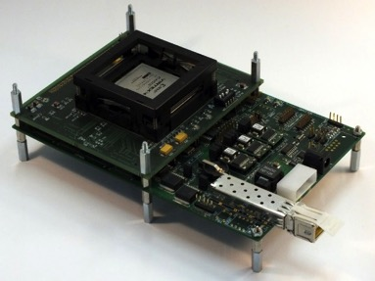
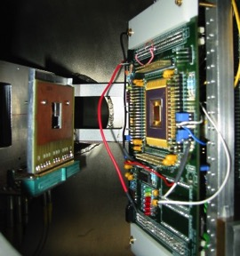
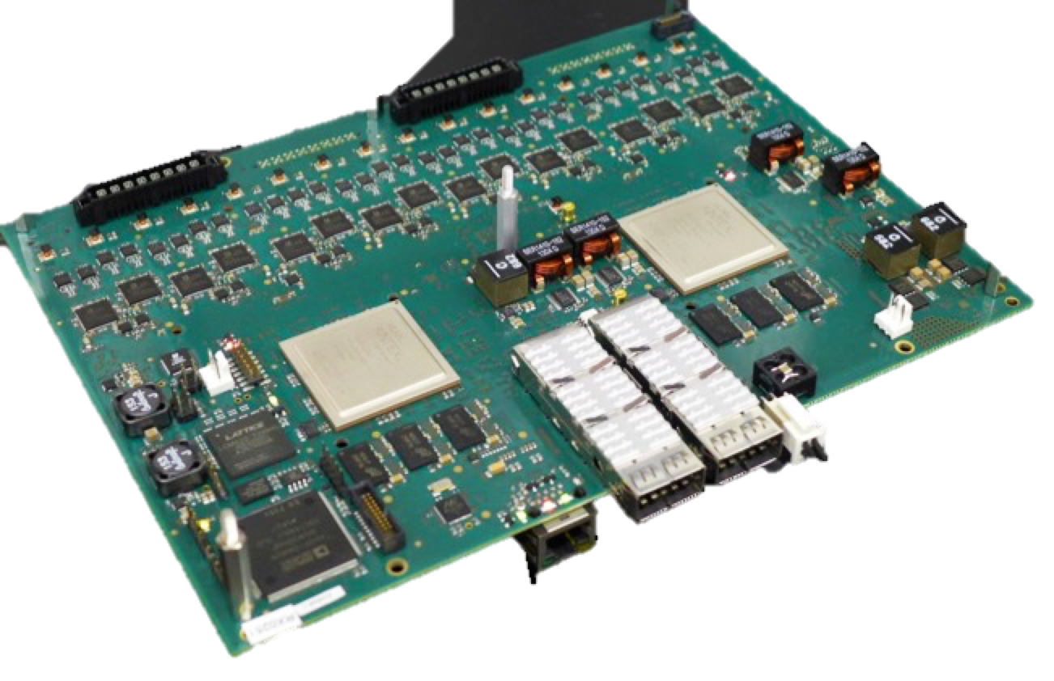
Who we are
Team @INAF-IASF Milano
  2 Staff, 5 Research Associates, 4 Collaborators, Bachelor/Master students
  High reliability computing systems for Astrophysical apps
Sanitas EG s.r.l.
  Founded by former students
  Historical partner of IASF Milano
    Scientific collaboration
    Prototypes
  Industrial products
    Single board computers
    Cameras
    FPGA & SW IP CORE

Slide 3

Beginning…
INAF IASF
Milano
INAF project approved for funding, May 2013
“Digital Platform development for back end design of new generation SKA Aperture Arrays”
  2 year program
  P.I. Francesco Schillirò (OACT)
  5 INAF Institutes involved
Accepted within LFAA AADC, December 2013 (Signal Processing WP)
INAF IRA
Medicina
INAF- Arcetri
INAF- OA
Cagliari
INAF –OA
Catania

Slide 4








AADC Participants and Partners

Slide 5
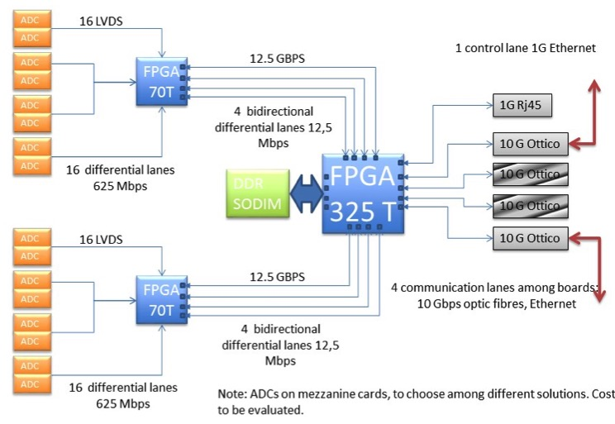
Initial board proposal
MODULAR
&
SCALABLE
Handling of 8-12-16 antennas
Analogue signal acquisition through 8 bit ADC @700 MHz
Two polarization signals
In calibration it must be possible to transfer the whole acq BW
Input signals must be filtered to extract 1Mhz frequency bands
  1 Mbit for each channels
Giga Ethernet protocol for the output communication (likely 40G via QSFP or similar)

Slide 6
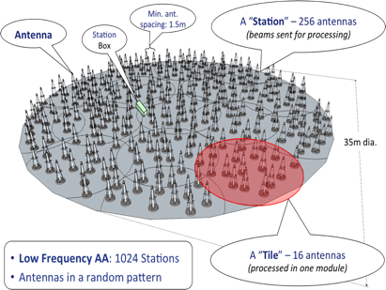
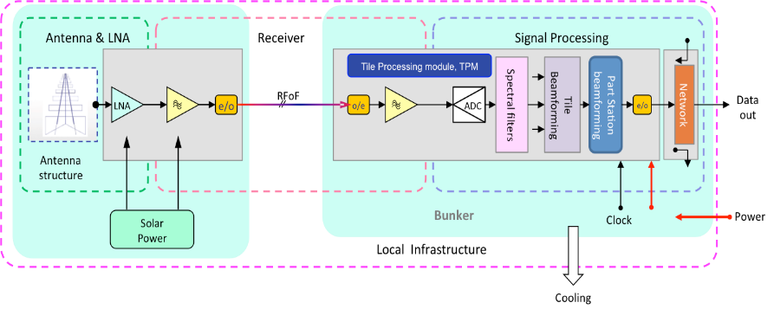
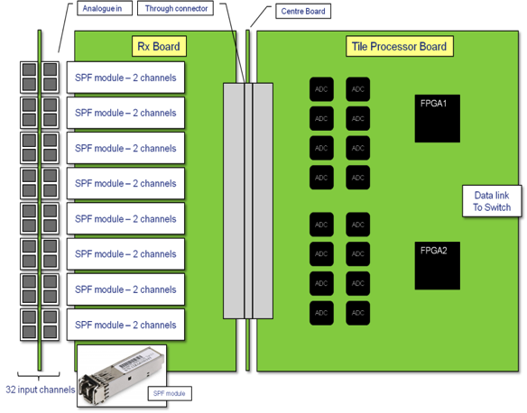
iTPM in LFAA
Tile: 16 Antennas, 2 Pol, 32 Channels
Tile processor implementation
AADC-TEL.LFAA.SE.MGT-AADC-PL-002
Low Frequency Aperture Array Technical Description, Issue 1, 2013

Slide 7
iTPM-ADU first concept, Jan 2014
Main function co-existence:
  Online digital data processing: 2 large FPGAs
  Analog to digital low noise conversion
    32 analog input
    Up to 1 Giga sample at 8 bit
  Board management
Mechanical specs: max 4U
Total power < 90 Watt
Cost, testability & manufacturability
Feasibility study

Slide 8
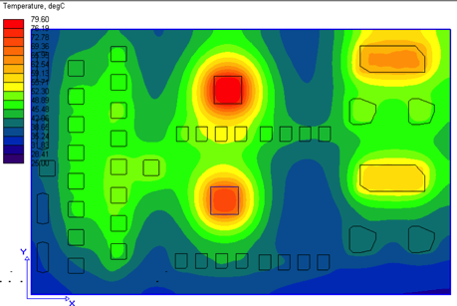
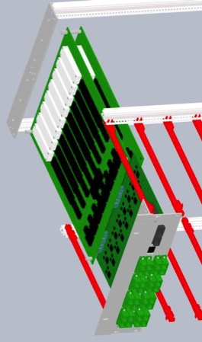
Feasibility study topics
Main device: FPGA & AD
Rack assembly
Board size & Power dissipation
Board technology
  PCB build-up
  Isolation criteria
  Sampling clock architecture

Slide 9
Feasibility output: main devices
Direct support from market leader suppliers
  Xilinx: state of the art 20nm Ultrascale FPGA, and early access program
  Analog Device: last devices close to release
    JESDB 14 bit 1 GHz dual channel AD
    JESDB PLL
    Ultra High PSRR linear regulator for AD
    SKA DEMO FMC board to performance evaluation
Notes:
Power Supply Rejection Ratio

Slide 10
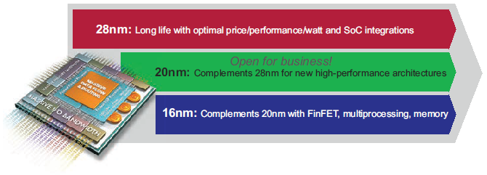
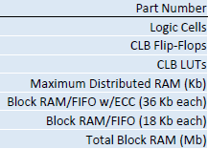
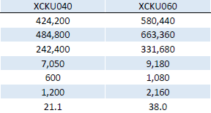
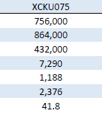
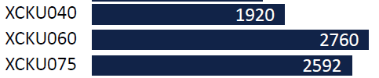
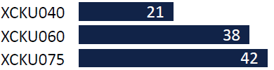
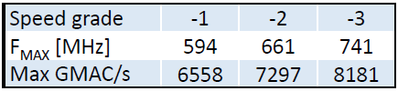
FPGA Xilinx Ultrascale: 20 nm device
Serial Transceivers:
Production 1q 2015
DSP Slice Count
Block RAM Capacity (Mb):

Slide 11

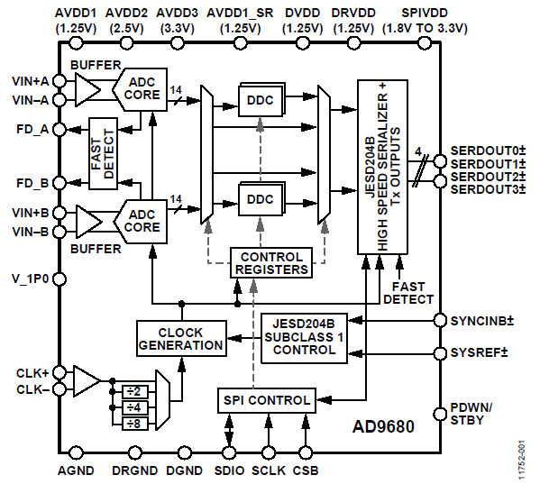
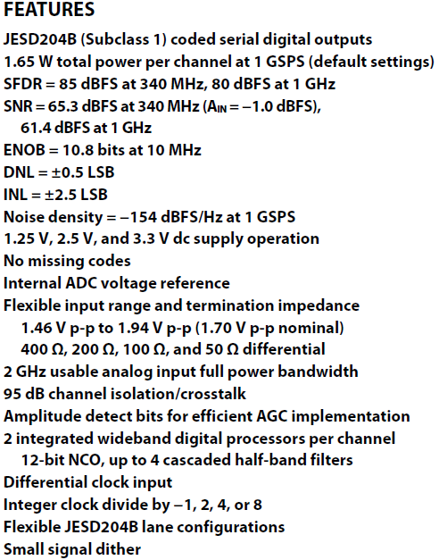
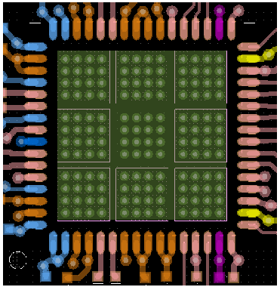

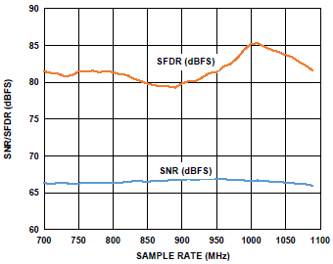
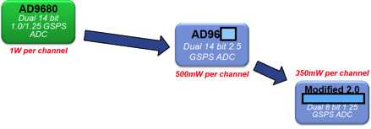
AD9680 Datasheet
Input 0
JESD IF
Clock
Input 1
??? mW
per channel
1.6 W
per channel
700 mW
per channel
1q 2016

Slide 12
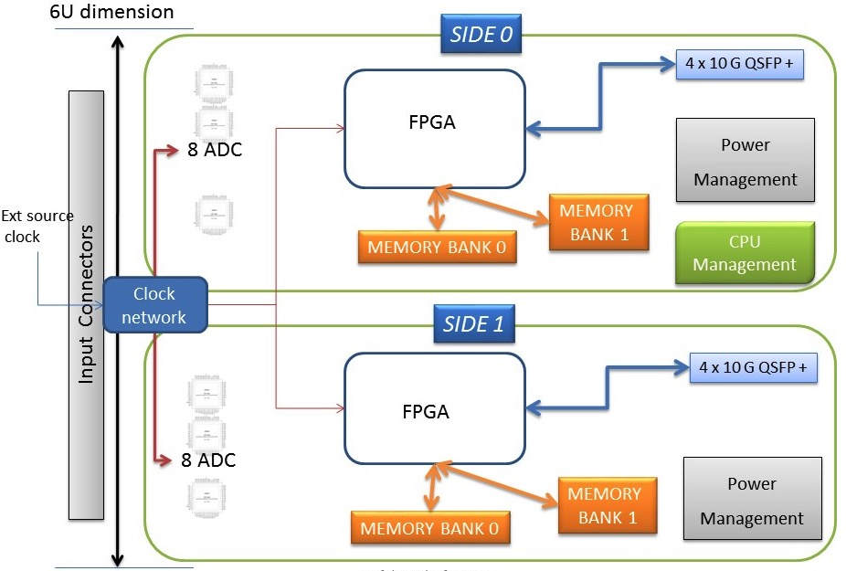
Feasibility output: preliminary board design
  Board architecture
  Expected performances
  Expected power consumption
  Costs & production proc
  Production time line

Slide 13
Performed activities
Feasibility Study: January 2014
Prototype production
  R 1.0 (#2): January 2015
  R 1.1 (#4): October 2015
Performance Tests
  Data acquisition, configurations: Spring 2015
  Power consumption and temperature in rack: December 2015

Slide 14
Current & future activities
iTPM-ADU Public Tender for AAVS1
  Published April 18, 2016
  Closure May 18, 2016
Testing & AAVS1 production support
  Test Specification
  Test Firmware
  Procedures for functional verification of the iTPM ADU board
  Test JIG development
iTPM-ADU development
  R 2.0 prototype featuring low power ADCs
  High density rack capability

Slide 15
Activity Breakdown
iTPM Board Development
Management
HW + Basic Firmware
Performance Test
Operation Firmware
Test Bench
Mechanical Design
Software
OACT/IASF
Arcetri/Sanitas EG/ Oxford/RAL
IASF/Sanitas EG
Malta Univ/Oxford
IASF/Sanitas EG
IRA
IRA/Sanitas EG
15

Slide 16
iTPM key

Slide 17
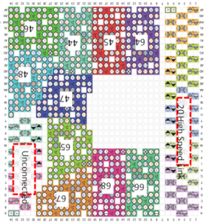
Board
Placement issues
CPU
XO2
ADA
DC-DC 14-17
AD
ADA
AD
ADA
IJ5
ADA
ADD
AD
ADA
ADA
DDR
AD
SYSB
CLKB
DDR
AD
RJ45
AD
IJ5
QSFP+
AD
LAY 2-11
100 Ω
AD
ADA
ADA
QSFP+
DC-DC 4-13
INT BUS
PLL
ADD
ADA
AD
DDR
ADA
AD
ADA
IJ5
DDR
ADA
AD
Input DC-DC
AD
SYSB
CLKB
AD
DC-DC 1-3
AD
IJ5
AD
DIGITAL SIDE
AD
ADA
ADA

Slide 18
ADC related issues (partial)
Input RF
AD9680
Output JESD
8 GND & Supply
Syncro signals
Power and
decoupling
AD9680
Device specific positioning and layout issues:
  HS signal routing (16 device in 233 mm board height)
  Staggered placement
  Clock and Sync routing
AD9680
Analog Inputs
12.5 Gbps
digital out
AD9680
Clock & syncro

Slide 19
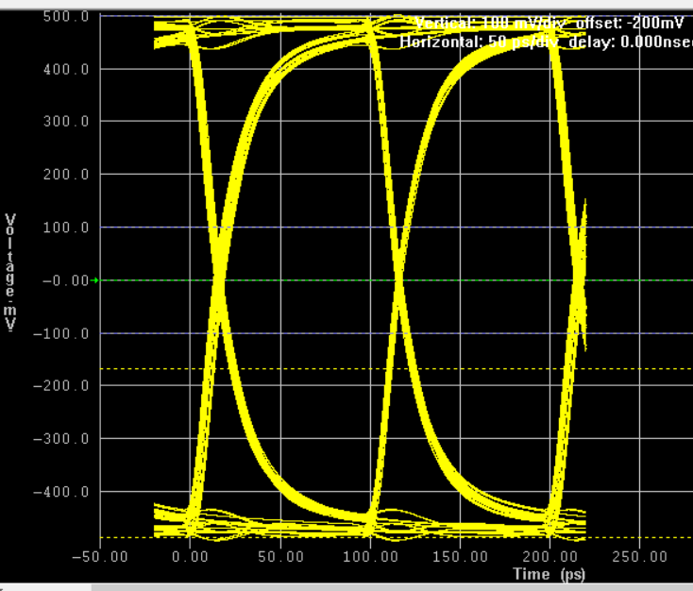
Stripline technology, 10 G JESDB, 10Geth, Analog Signal, Analog clocks
Stripline on Layer 2, 13
  External shield, layer 1, 14
  Reference GND plane, layer 3, 12
Signal
path
Reference Ground

Slide 20
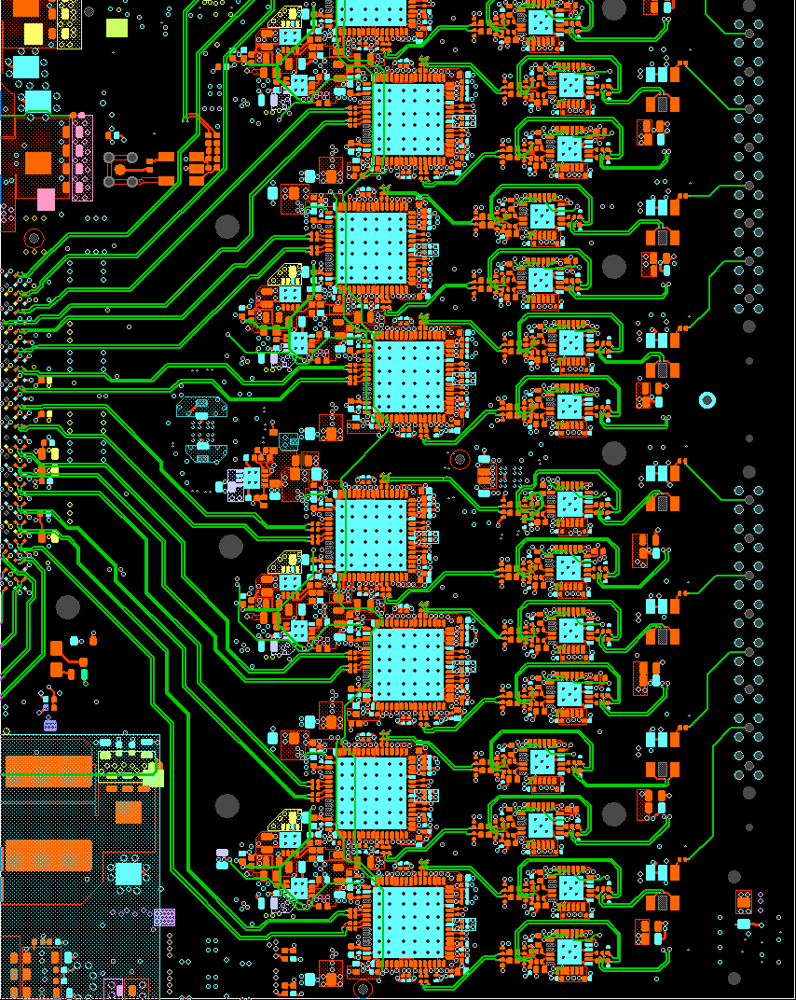
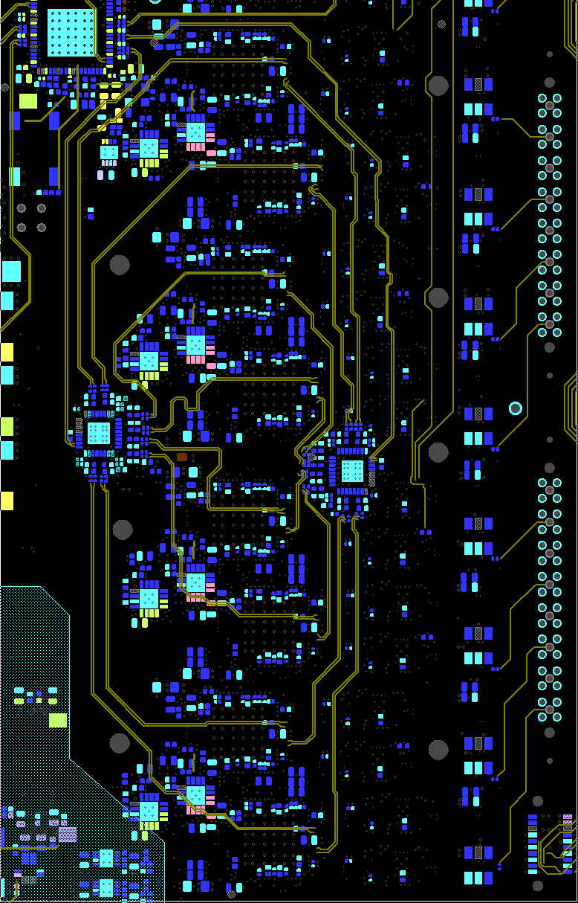
Analogue input & JESD clock layout

Slide 21
iTPM features

Slide 22
iTPM board
Compact size, 6U format compatible
32 analog input capability with high quality and high isolation connectors
32 analog programmable driver (amplifier/attenuator)
16 dual channel 14 bit 1Ghz AD converter
High quality clock distribution system JESD204B Subclass 1 with deterministic latency
Two Xilinx Ultrascale XCU40 20 nm FPGAs dedicated to data processing
Two DDR3, 96 bit memory banks, 6+6 Gbit total size, 1800 Mhz speed
Two 40G Ethernet interface (QSFP)
FPGAs high speed internal connection bus, 25 Gbit + 25 Gbit bidirectional
Ethernet gigabit management with instant ON flash based CPLD
Complete system monitor interface with power, voltages and temperatures monitoring
On board user flash for multiple FPGA configurations options
Management microprocessor (ARM Cortex A8, 32 bit, 240 Mhz)
High efficient multistage configurable Power Distribution system

Slide 23
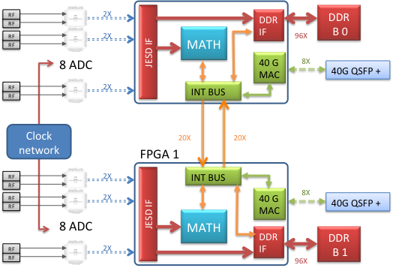
Acquisition and processing architecture
FPGA USAGE: | JESD RX | INT BUS | DDR | 40G Eth
 | 16 GByte/s | 5.0 GByte/s | 16 GByte/s | 5.0 GByte/s

Slide 24
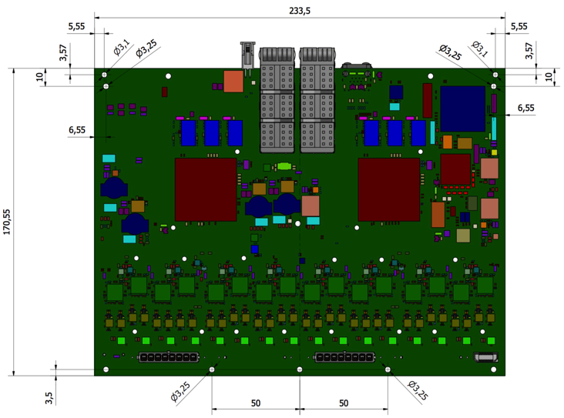
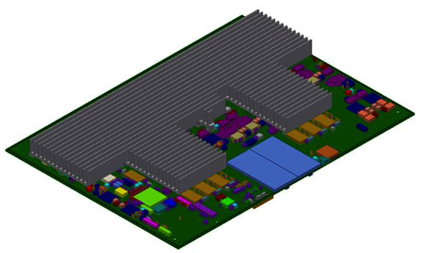
Mechanical specification
6U high and 170 mm depth
standard rack mount format
Top mount heat sink

Slide 25
Management
  Supply control
  Voltage, current and temperature monitoring
  Ethernet GIGA management interface
  Board configuration
    Configuration signals and device register
    FLASH Memory read/write
    FPGA configuration
    Firmware Update (multiple bitstream)
    FPGA scrubbing (SEE monitoring)
  CPU complex procedure execution
    TCP protocol, 100 Mbit
    Complex management procedure
DEBUG & TEST
INTEGRATION

Slide 26
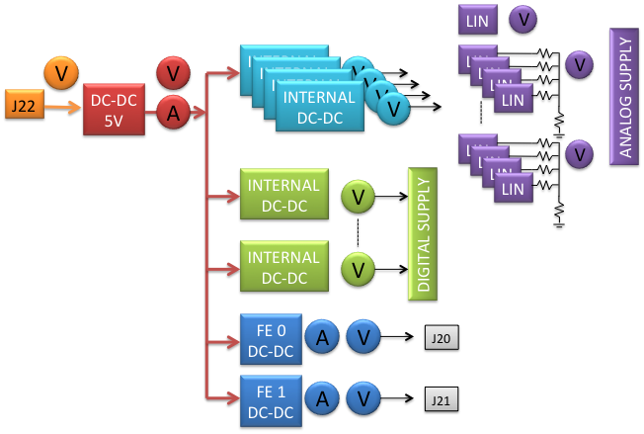
Monitoring
Voltages: 40 point of measure:
  Input
  All DC-DC
  AD linear filtered group
Current: 3 point of measure:
  Input
  FE output
Temperature: 4 point of measure:
  Board management
  Board analog area
  FPGAs core

Slide 27
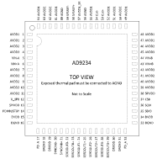


Data synchronization JESD204B, sub1
SIDE 0
SYSREF Gen
FPGA 0
RX JesdB
AD side 0
RX JesdB
Internal
PLL
Dev clock side 0
SYSREF side 0
RX JesdB
Ext source
clock
Clock network
Dev clock
PPS
SIDE 1
On board
Oscillator
FPGA 1
Notes:
SYSREF must be source synchronous with the device clock

Slide 28
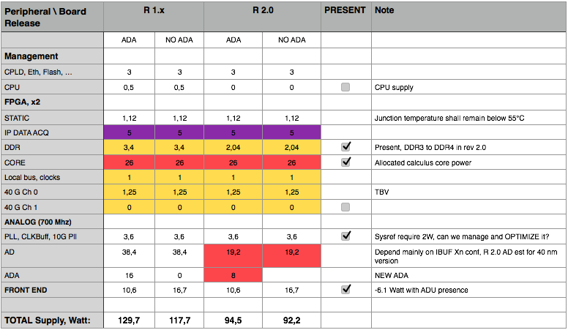
Power consumption

Slide 29
iTPM Numbers
Placement Areas: Available: 123,45 Sq. (in)
  Required: 37,99 Sq. (in)
  Required/Available: 30.78 %
Connections ...................... 13.312
Differential Pairs ............ 413
Total Trace Length ............ 233 meter
Vias ............................... 10.800
Parts Placed ..................... 4.214
  Parts Mounted on Top … 2.159
  Parts Mounted on Bottom … 2.055

Slide 30
RF qualification
TPM TEST procedure

Slide 31
RF qualification
Test objective: verify iTPM RF signal acquisition capability and quality.
Band selection, iTPM-ADU sampling clock:
  50-375, sampling clock 800 MHz
  375-650, sampling clock 700 MHz
  TBD 1000 MHz
Single channel RAW acquisition for selected input frequencies (50-60 frequency point)
Multiple channel RAW acquisition for cross talk measurement (TBD frequency point)
S11 measure ??? - OFFLINE -

Slide 32
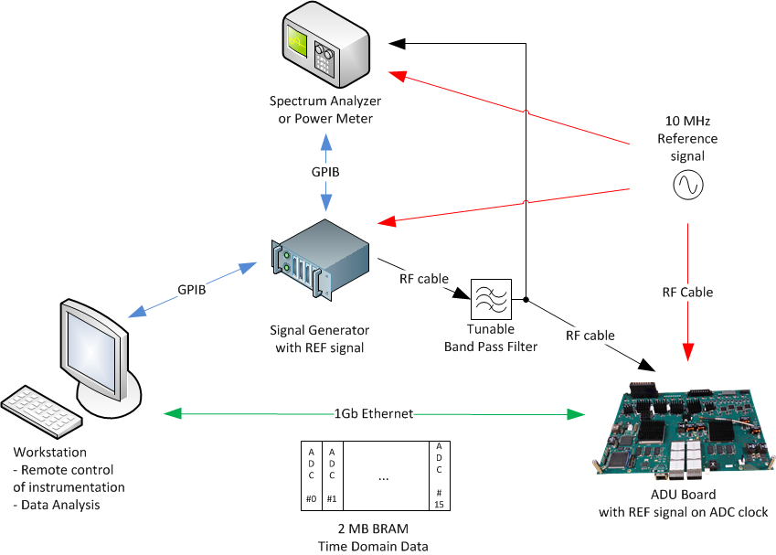


ADU Board Test Setup
ADU Board Test Setup
Notes:
In the picture there are the elements of the system:
A Signal Generator, with low harmonics, good spectral purity, low phase noise
Filters to suppress harmonics and spurious signals
Power meter to measure the RF output power of Signal Generator and for its control
Source and Sinks must be locked to the same stable Reference
A workstation that controls the instruments over a GPIB bus, controls also the ADU board, receives and processes measurements data

Slide 33
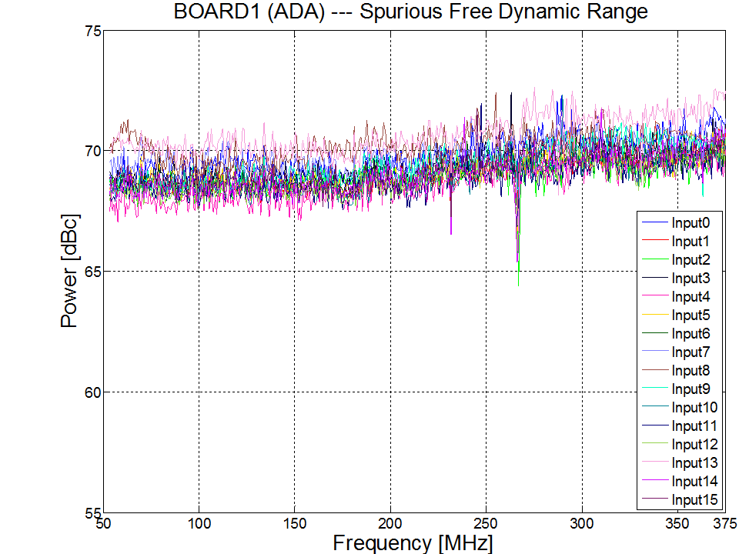
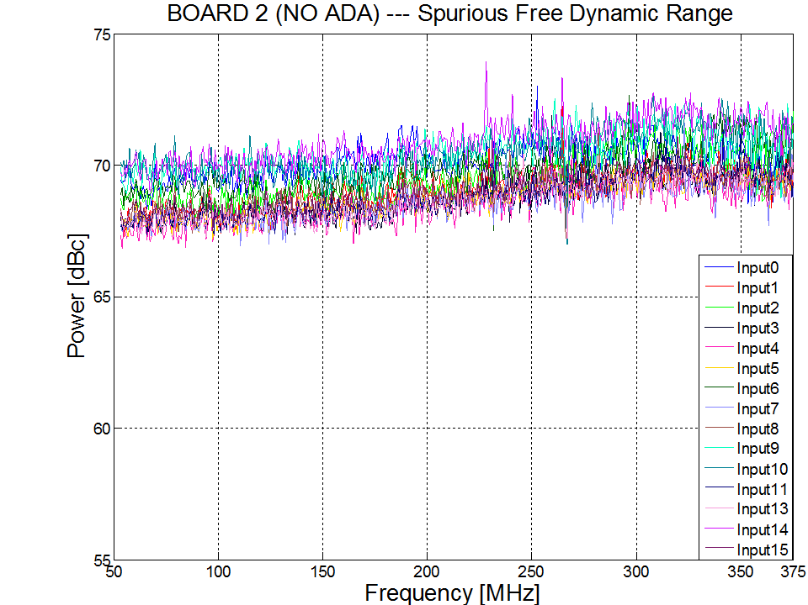
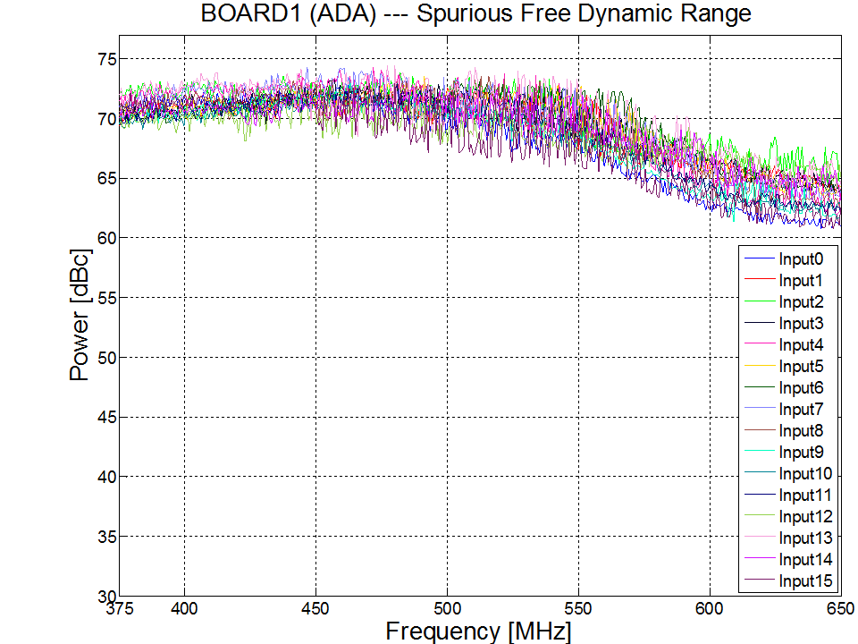
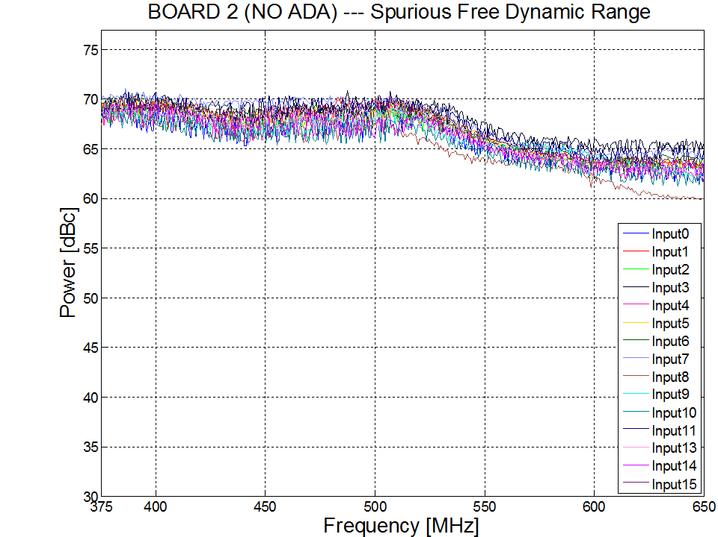
Spurious Free Dynamic Range
50-375 MHz
375-650 MHz
Notes:
I show you some results from the measurement on the BOARD with ADA.
The dispersion of all the input trends is within 0.6 dB. Also the gain flatness is within 0.6 dB

Slide 34
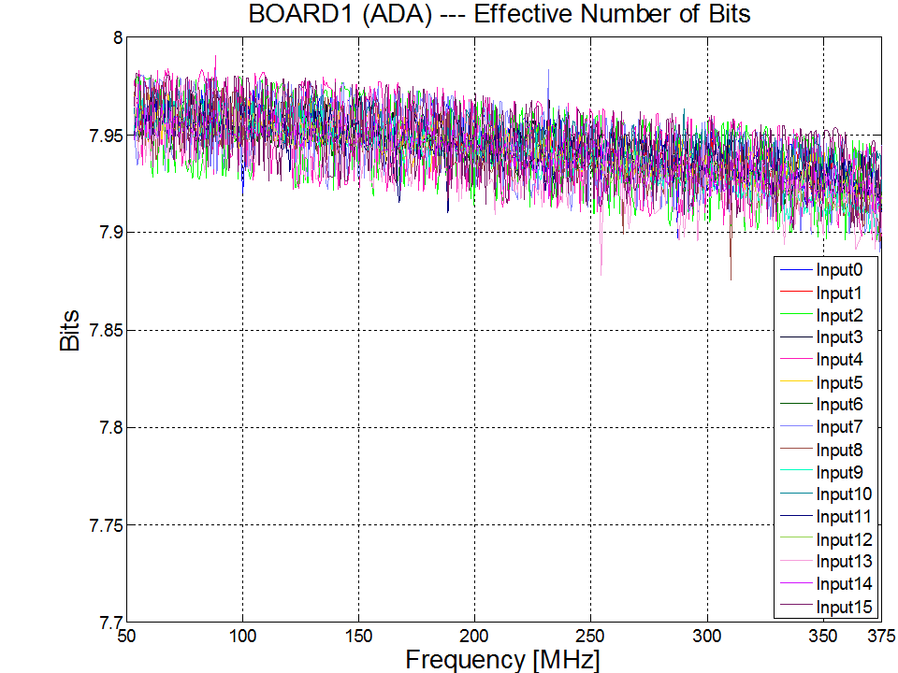
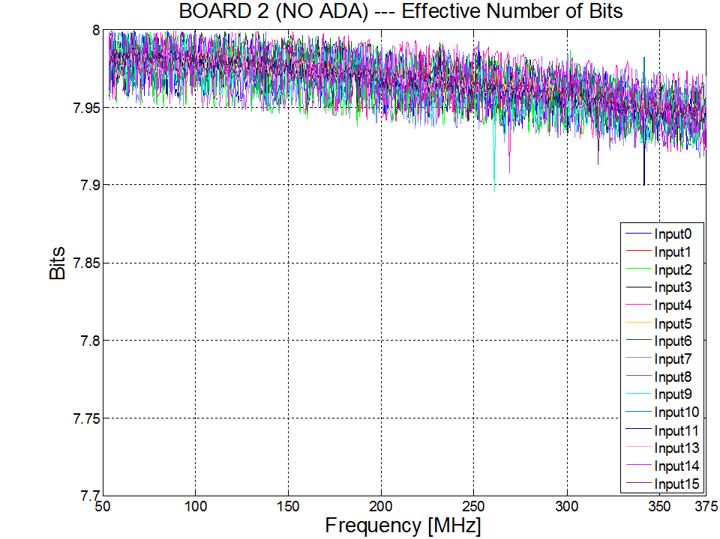
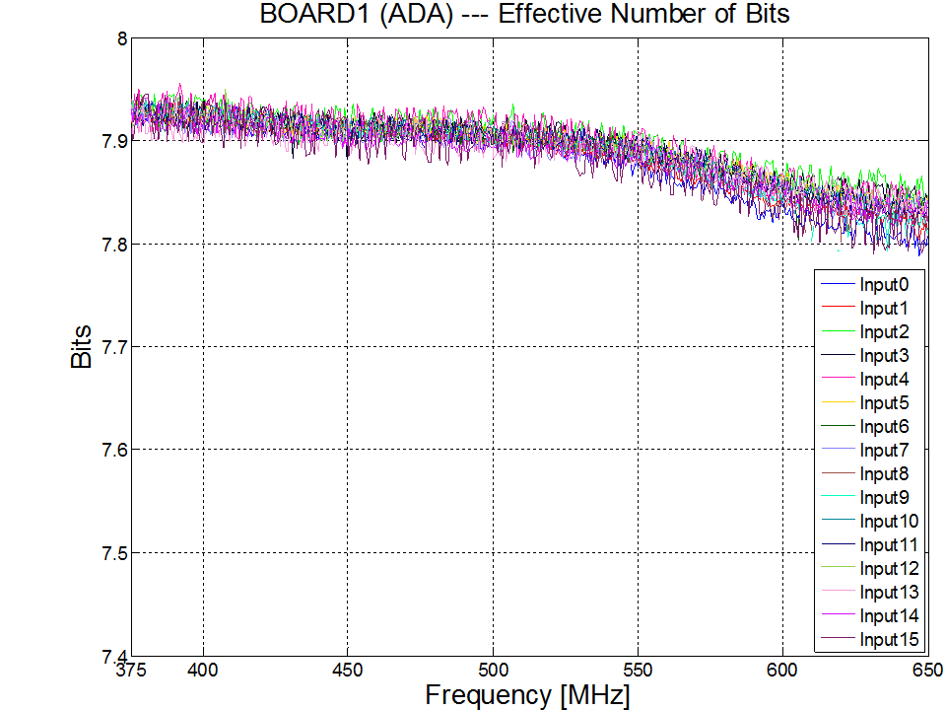
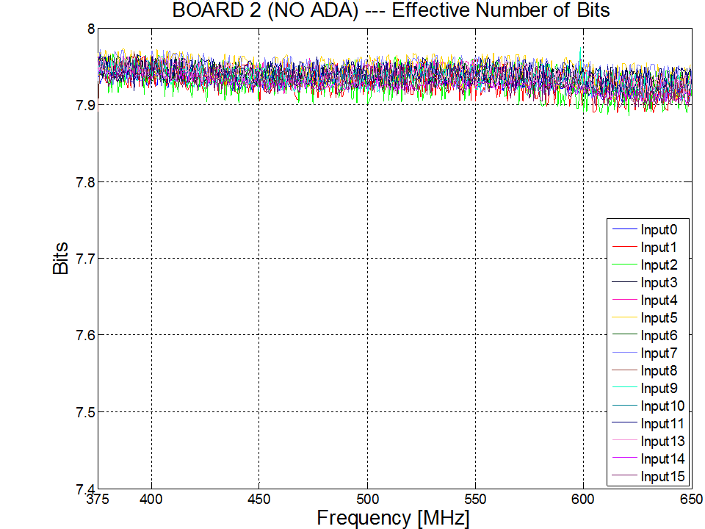
Effective Number of Bit
50-375 MHz
375-650 MHz
Notes:
I show you some results from the measurement on the BOARD with ADA.
The dispersion of all the input trends is within 0.6 dB. Also the gain flatness is within 0.6 dB

Slide 35
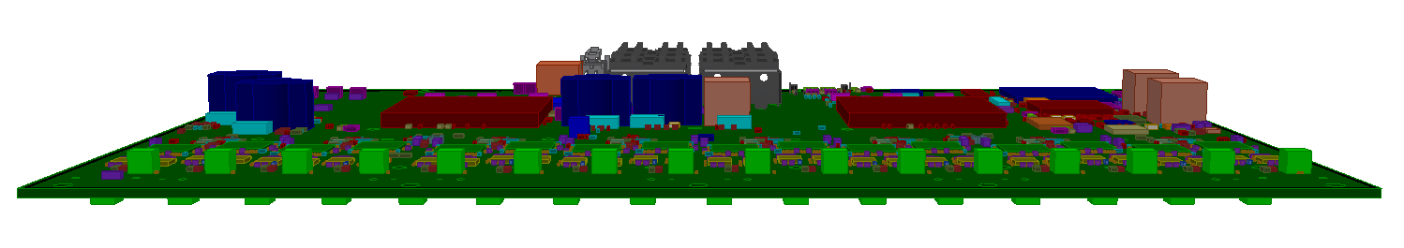
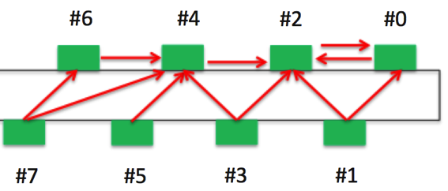
Cross-Talk Measurement
#14
#12
#10
#8
#6
#4
#2
#0
Input numbering
#15
#13
#11
#9
#7
#5
#3
#1

Slide 36
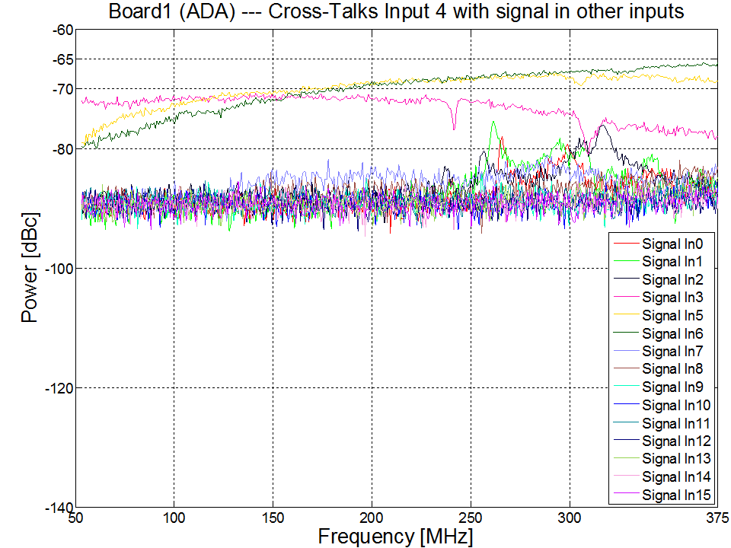
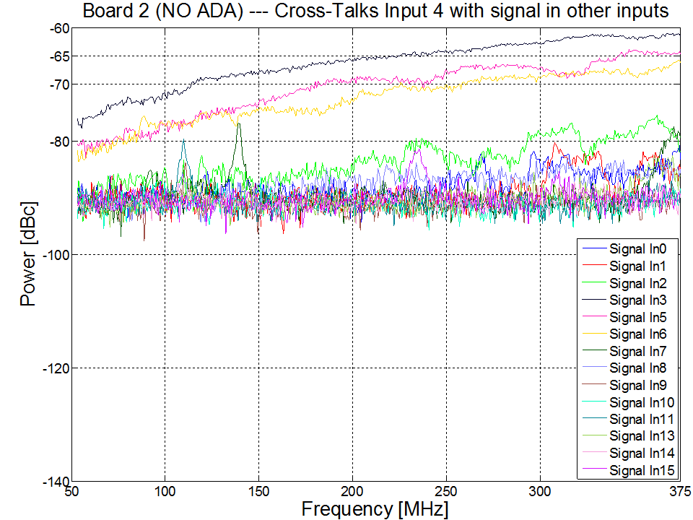
Cross-Talk Measurement
BANDWIDTH: 50-375 MHz, signal injected in Input 4, no heat sink shielding
WORST CASE

Slide 37
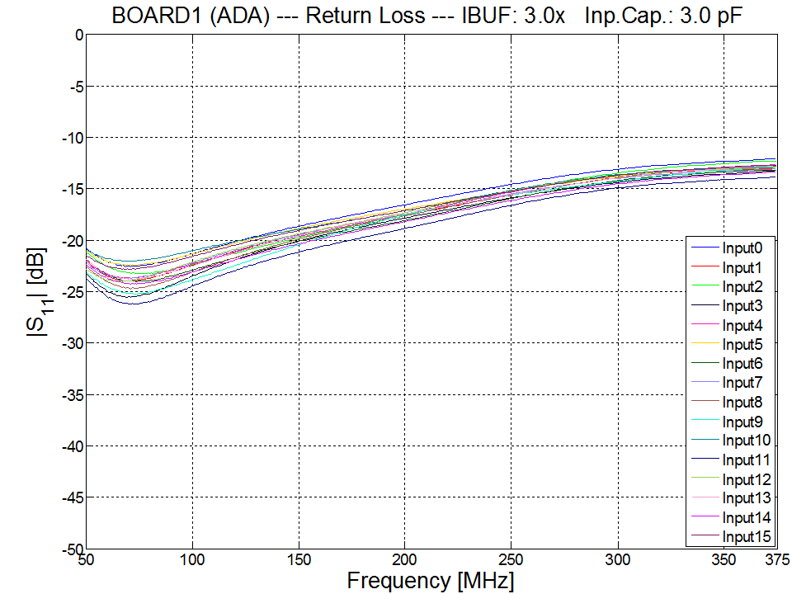
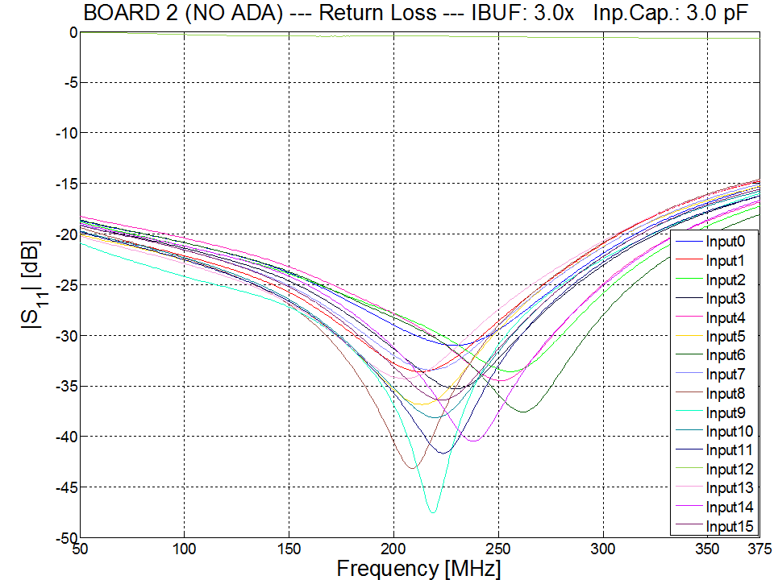
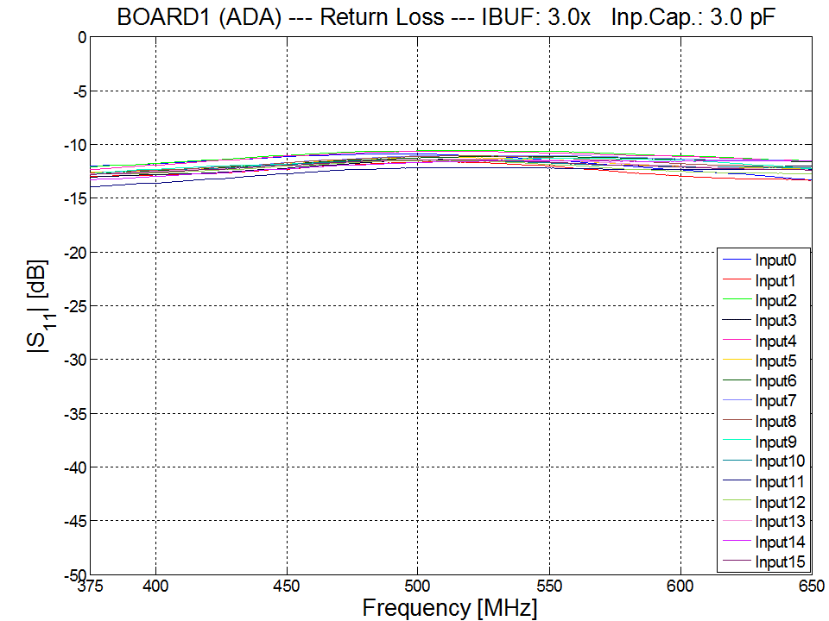
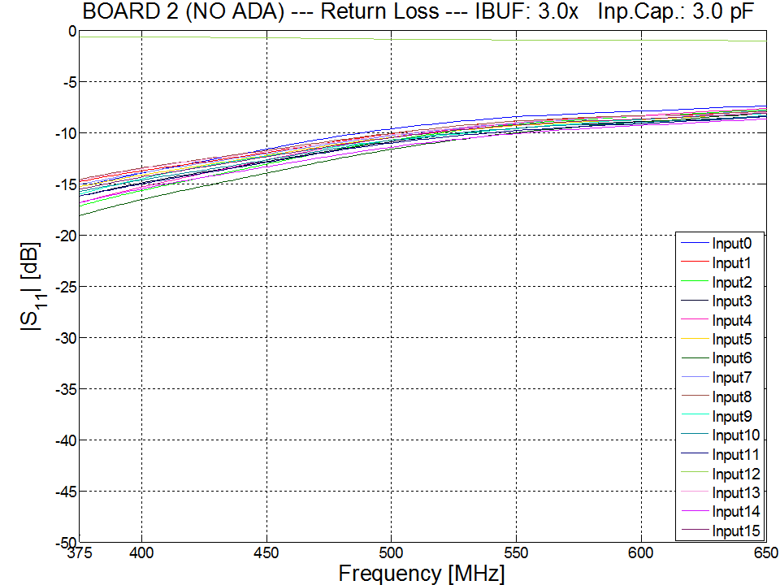
Return Loss
50-375 MHz
375-650 MHz

Slide 38
Measurement Summary
Fs: 800 MSPS --- BW: 50 – 375 MHz
ADC Performance Parameters | ADU Board#1 (with ADA) | ADU Board#2 (without ADA)
Signal to Noise Ratio referenced to Full Scale [dBFS] | ≥ 49.19 | ≥ 49.33
Gain Flatness [dBFS] | ≤ ±0.3573 | ≤ ±0.343
2nd-order Harmonic Distortion [dBc] | ≤ -67.24 | ≤ -67.74
3rd-order Harmonic Distortion [dBc] | ≤ -66.53 | ≤ -68.56
Worst Other Spur [dBc] | ≤ -67.03 | ≤ -66.83
Spurious Free Dynamic Range [dBc] | ≥ 66.53 | ≥ 66.83
ENOB [bits] | ≥ 7.876 | ≥ 7.896
Cross-Talk [dBc] | ≤ -65.69 | ≤ -61
IP3 [dB] (F1=184.7 MHz; F2=187.5 MHz) | 29.55 | 32.2
IP2 [dB] (F1=184.7 MHz; F2=187.5 MHz) | 66.3 | 77.5
Fs: 700 MSPS --- BW: 375 – 650 MHz
ADC Performance Parameters | ADU Board#1 (with ADA) | ADU Board#2 (without ADA)
Signal to Noise Ratio referenced to Full Scale [dBFS] | ≥ 48.88 | ≥ 49.32
Gain Flatness [dBFS] | ≤ ±0.6252 | ≤ ±1.356
2nd-order Harmonic Distortion [dBc] | ≤ -65.77 | ≤ -59.9
3rd-order Harmonic Distortion [dBc] | ≤ -60.78 | ≤ -65.64
Worst Other Spur [dBc] | ≤ -64.16 | ≤ -63.23
Spurious Free Dynamic Range [dBc] | ≥ 60.78 | ≥ 59.9
ENOB [bits] | ≥ 7.788 | ≥ 7.886
Cross-Talk [dBc] | ≤ -70.58 | ≤ -70.39
IP3 [dB] (F1=500.1 MHz; F2=503.2 MHz) | 26 | 24.4
IP2 [dB] (F1=500.1 MHz; F2=503.2 MHz) | 64 | 58.3
NOTE: all values are based on WORST CASE

Slide 39
iTPM qualification & testing

Slide 40
Test Objectives
Production test
  Fast and simple
  Identify main electrical production defects
Functional test
  Single wire oriented to guide defect identification
  Board delivery
    Complete functional verification
    High speed qualification
    Acceptance procedure report generation
Qualification test
  SKA installation
    RF test
    Integration test

Slide 41
iTPM Test strategy
Different place, skills & instrument needed
Three level testing
  ON line production testing
  Complete functional test
    Management test
    Digital Test
    Functional analog test
  Quality analog test
    RF full qualification
Production delivery
SKA delivery

Slide 42
iTPM Test Implementation
HW
FW & SW
Production test plant
iTPM TEST JIG control SW & CPLD-CPU FW
iTPM FPGA TEST FW
iTPM TEST JIG
iTPM Production SW
FUNCTIONAL TEST PLANT
“Medium quality” RF signal generators
iTPM RF JIG
QUALIFICATION TEST PLANT
“SKA quality” RF signal generators
SERVER data analysis
TPM Qualif. SW
iTPM FPGA SKA FW

Slide 43
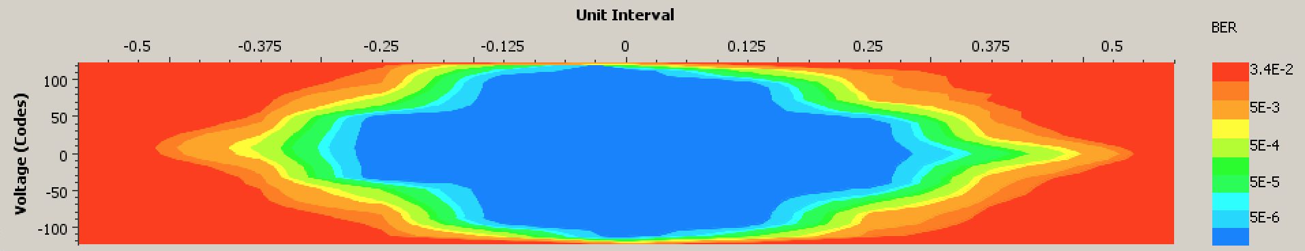

Test requirement
Complete functional check, digital devices
  Power check
Multi gigabit data lines check
  Electrical margins
  BER check
Full load board
  Power Noise impact on board function
  Noise vs. board temperature
Analog interface
  Functional & RF qualification

Slide 44
Functional & Qualification set up
SERVER
iTPM
JIG
DISC
RAM
40 G
40 G
16
32
Signal
generator
RF
JIG
HW
X 4
CPU
40 G
40 G
16
1 G
1 G
1 G
POWER
SUPPLY
USER INTERFACE (TBC)
MEASURE SET UP
QUALIFICATION
FW FUNCTION
SW - FW
QUALIFICATION MANAGER
RAW DATA RAM BUFFERING
DATA ANALISYS

Slide 45



RF JIG Architecture
FAN IF
LOAD
8 Watt
1
PPS
Power Meter
ADU IF
10 Mhz
SPI IF
Eth UDP
CPLD
LDO
PLL
ADU RF INPUT
2
Gain
RF FILTERS
7x
ADU RF INPUT
32 channel path

Slide 46
Single signal path iTPM RF generator:
-1 dB FS
Fast switching time
High power
iP3
iTPM RF INPUT
PLL
RF FILTERS
7x
Coupler
Att
Gain
2
iTPM RF INPUT
Power Meter
+15.6 .. +18.1dB
+11.8dB
-6,0dB (worst)
-3.5 dB
-2.0 dB
-1.5 dB

Slide 47
Filter selection
All COTS filters (except KR228975S)
Parameters considered :
Freq Band: 50÷1250 MHz
Rejection at 2f ≥ 40dB
Rejection at f/2 ≥ 20dB
In band IL ≤ 2.5dB
In band Return Loss ≥ 15dB

Slide 48
RF performances
Isolation between channels > 80dB
IRL&ORL for active channel better than 10dB
ORL for non-active channels ≥ 20dB

Slide 49
iTPM Next release: 2.0
New AD
  Pin compatible, same performance
  Sample rate up to 1.250 Msample/sec
  Less power, more than 50%
New Amplifier, half power
New PLL, Jitter reduction
DDR4 Memory
  Power reduction, 40% expected
  Double capacity, Speed increase
Backplane interface ?

Slide 50
Thanks !!!

Slide 51
RF Qualification FW function
All single channel measures:
  RAW data capture, selectable depth single channel, 8 bit mode
    1 MB (Required)
    2 MB (TBC)
    More MB ? (TBD)
  RAW data capture, 12/14 bit mode (TBD)
Multichannel measures:
  RAW data capture, 2 MB total buffer for 16 input, selectable n° of adjacent input
    16 input (ALL), 128 KB RAW each
    8 input, 512 KB RAW each
Depth: | Frequency resolution
RAW KB | Low BW, 50-375 Mhz | High BW, 375-650 Mhz
128 | 6.10 KHz | 5.34 Khz
512 | 1.56 KHz | 1.33 Khz
1024 | 762.9 Hz | 667.6 Hz
2048 | 381.5 Hz | 333.8 Hz
16384 | 47,6 Hz | 41,7 Hz
Current spectra resolution of the CSP: 1 KHz

Slide 52
RF qualification: measures calculation
RAW buffering
10 x 1 Mega samples
1M samples
FFT
Data analysis
Measure
SET UP
And
X10
acquisition
1M samples
FFT
Preliminary evaluation
MEDIA
Matlab Operators
Measures
1M samples
FFT
Compliance check

Slide 53
ITPM Test Implementation
Hardware
  Test JIG (Production and Functional)
  Ad hoc JIG (Qualification)
    RF signal generator
  Server for data analysis
Firmware
  FPGA test firmware (Production, Functional, Qualification)
Software
  Production, Functional, Qualification

Slide 54
Xilinx test FW option 2: SDK integration
Management
BUS
Data
buffer
JESD IF
Link 0-7
Master
FFT
DRP
Microblaze
32 Bit
200 Mhz
BRam
Data
buffer
JESD IF
Link 8-15
Slave
Slave
FFT
AXI BUS OXFORD
AXI DMA
AXI BUS TEST
DRP
DDR IF
XSDB
Master
Slave
4x10G Eth
Link 16-19
DRP
System monitor
Select I/O
16 + HSQ
Select I/O
16 + HSQ

