Slide 1
AAVS1/LFAA RACK INTEGRATION
Marco Schiaffino - Design INAF-ORA Radiotelescopio Croce del Nord
Email : m.schiaffino@ira.inaf.it
Richard Bennett - Thermal Analysis
UK Astronomy Technology Centre Science and Technology Facilities Council
Email : richard.bennett@stfc.ac.uk

Slide 2
RACK – AAVS1 Vs LFAA AAVS1 and LFAA rack comparison
 | AAVS1 | LFAA
N° OF SIDES WITH COMPONENTS | 1 | 2
N° OF SUBRACK/RACK | 2 | 8
N° OF TPM BOARDS/SUBRACK | 4 | 8
N° OF TPM BOARDS/RACK | 8 | 64
COOLING SYSTEM | AIR | HYBRID
N° OF POLARIZATIONS | 256 | 2048

Slide 3
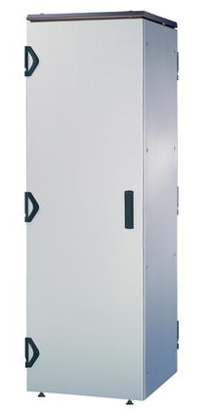
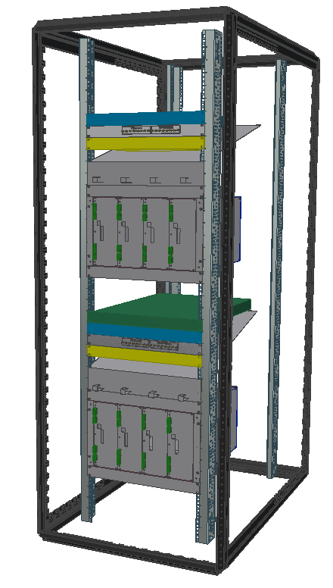
AAVS1 rack
Allocation of space:
6U - power supply (not included in the drawing)
1U - optical box
1U - supplier 10MHz / pps
1U - 1Gb switch
3U - deflector
1U - drawer 6 ventilation fans
6U - subrack TPM
1U - drawer 6 ventilation fans
3U - empty
1U - 40Gb switch
1U - optical box
1U - supplier 10MHz / pps
1U - 1Gb switch
3U - deflector
1U - drawer 6 ventilation fans
6U - subrack TPM
1U - drawer 6 ventilation fans
4U - empty
Total Height: 42U

Slide 4
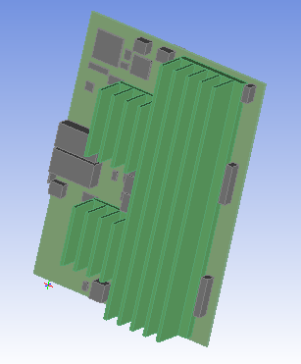
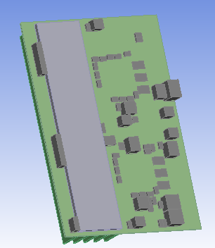
TPM ADU board hardware and thermal model
In the thermal model 90% of components are filtered out by size – can compensate by assigning surface roughness to the pcb

Slide 5
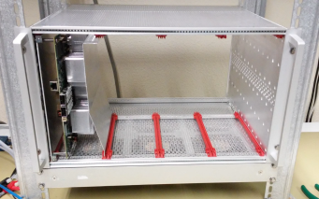
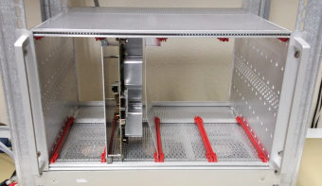
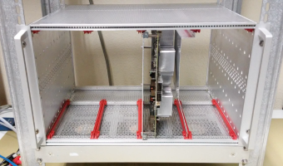
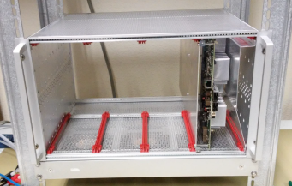
AAVS1 sub-rack heat-sink preliminary test
T MAX (1): 57,3° C
T MAX (2): 56,9° C
T MAX (3): 58,5° C
T MAX (4): 58,4° C

Slide 6
AAVS1 TPM sub-rack thermal model

Slide 7
AAVS1 simulation – air velocity (on plane through front row of fans)

Slide 8
AAVS1 simulation temperatures on ADU

Slide 9
AAVS1 simulation heat source temperatures

Slide 10
AAVS1 simulation ADU board temperatures
Agreement between simulation and measurement appears to be good….
but could be serendipity…
Quickly converges for values of temperature, velocity and pressure at monitoring points but solution residuals are higher than one would like.
Ideally one would:
Re-mesh the model with coarser and finer mesh to check that the results are independent of the mesh
Re-run with different turbulence models
Board temperatures
analysis (4 TPM present):
56.4°C, 56.4°C, 56.4°C, 56.4°C
measured (one by one):
57.3°C, 56.9°C, 58.5°C, 58.4°C

Slide 11
AAVS1 rack thermal model

Slide 12
AAVS1 rack thermal model mesh work in progress

Slide 13
LFAA sub-rack concept heat pipes + water cooling
Custom 7U height, depth 475 + manifolds
(8U would be better, to have an easier integration and larger contact surfaces)
Management
board
TPM boards

Slide 14
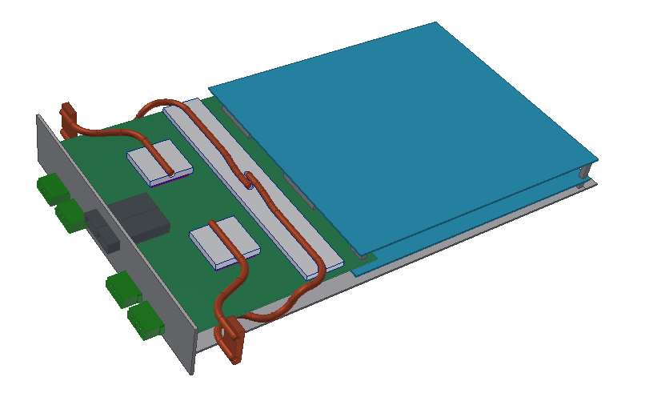
LFAA TPM concept heat pipes + water cooling
Existing TPM geometry with heat pipes to cool ADC and FPGA
The heat pipes are screwed directly to a water cooled block at the top or the bottom, the contact resistance and the film temperature difference must be determined. For 25W, 40mm of φ6mm tube and 0.025kg/sec water flow ΔT_{film} = 7K.

Slide 15
LFAA TPM sub-rack concept water cooling connections
Cold water input
Hot water output
Hot water output
Cold water input

Slide 16
LFAA TPM sub-rack Concept connection of management and backplane
Backplane Board
Management Board
TPM Board (only one is visible)

Slide 17
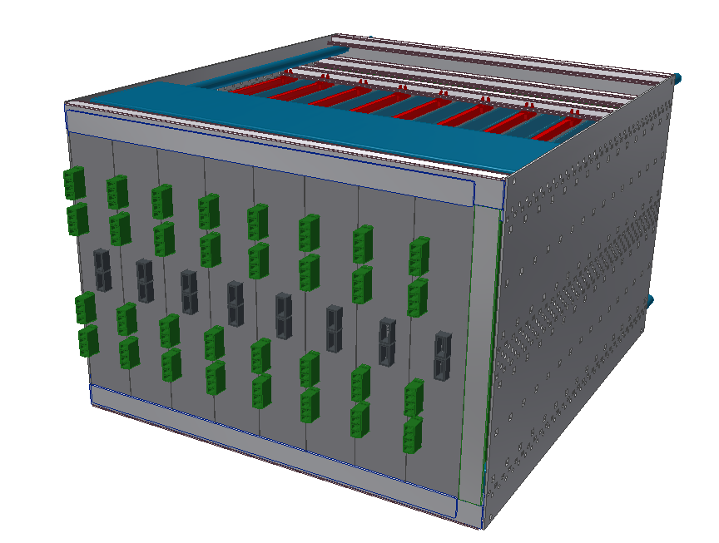
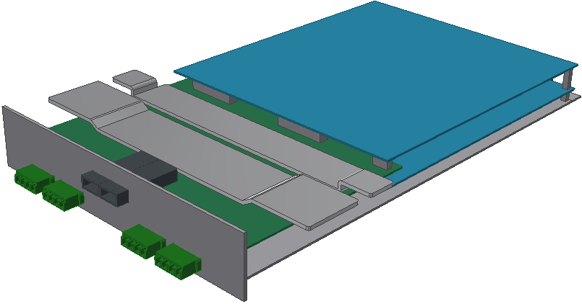
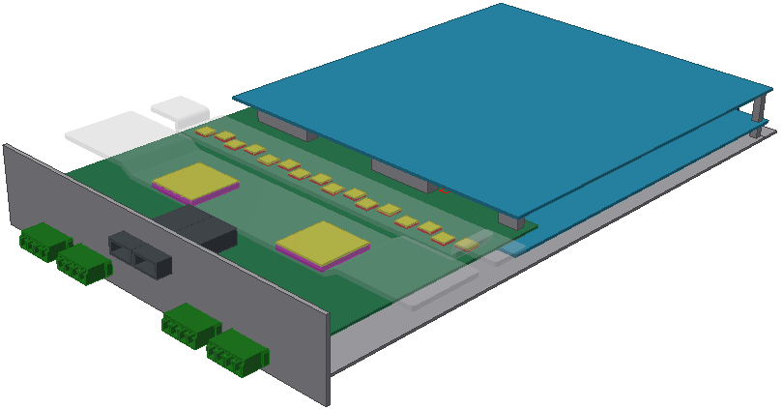
LFAA TPM sub-rack concept metal plate + water cooling
Custom 7U height, depth 475 + manifolds
Custom metal plate (aluminium or copper)
For 5mm thick copper ΔT along plate = 31K
TPM module
TPM boards
Management
board

Slide 18
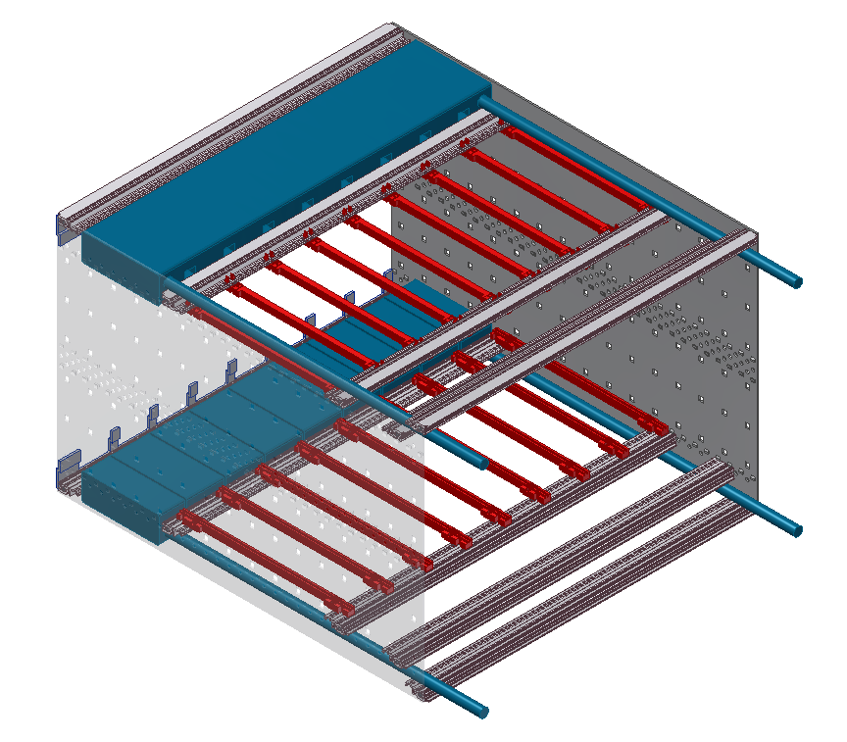
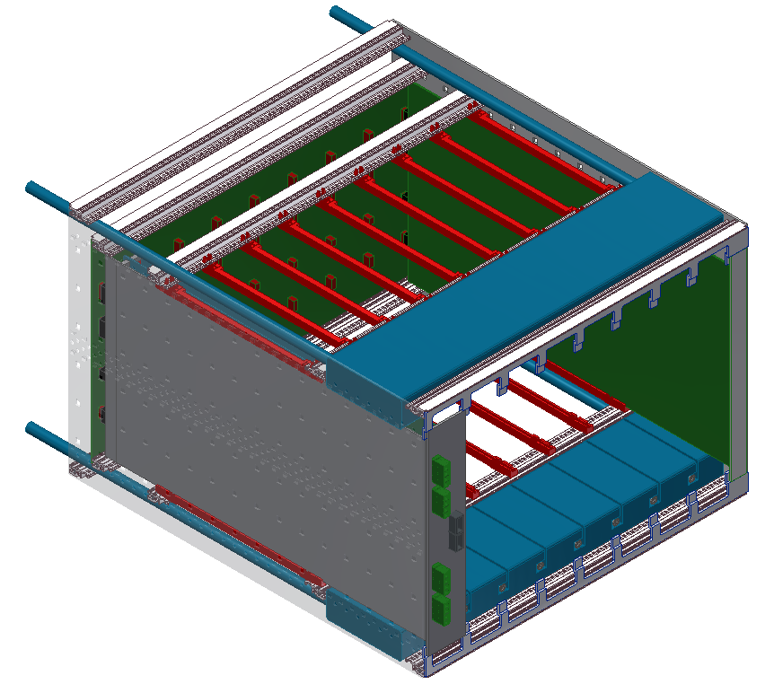
LFAA TPM sub-rack concept metal plate + water cooling
Backplane Board
Management Board
Cold water
input
Hot water output
Hot water
output
Cold water
input
TPM Board (only one is visible)

Slide 19
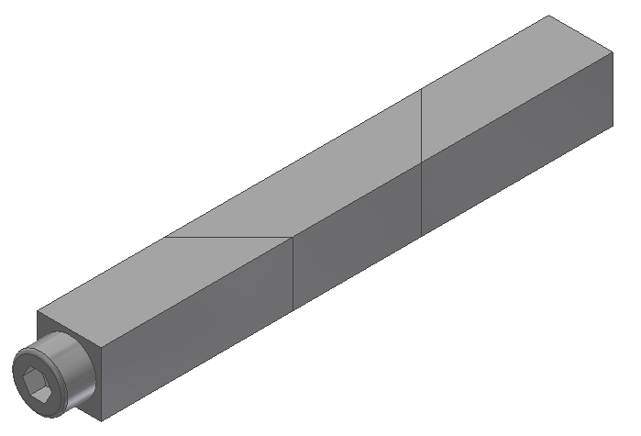
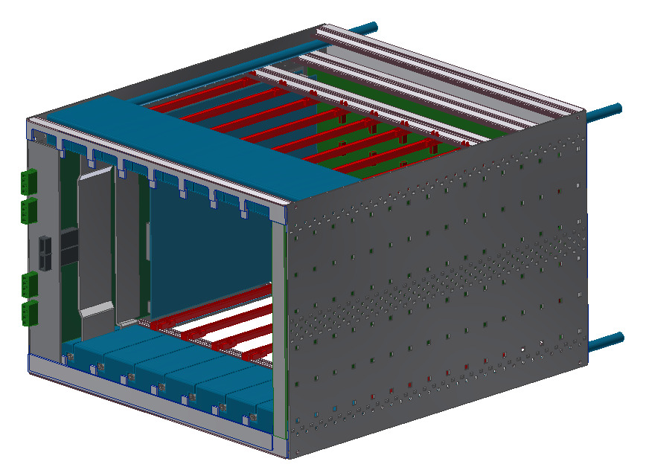
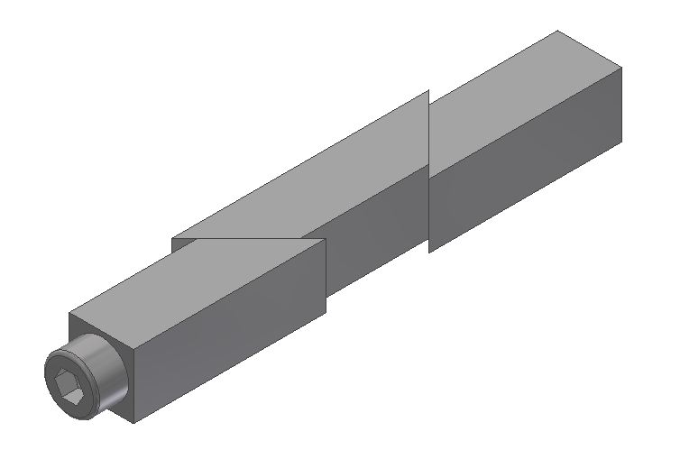
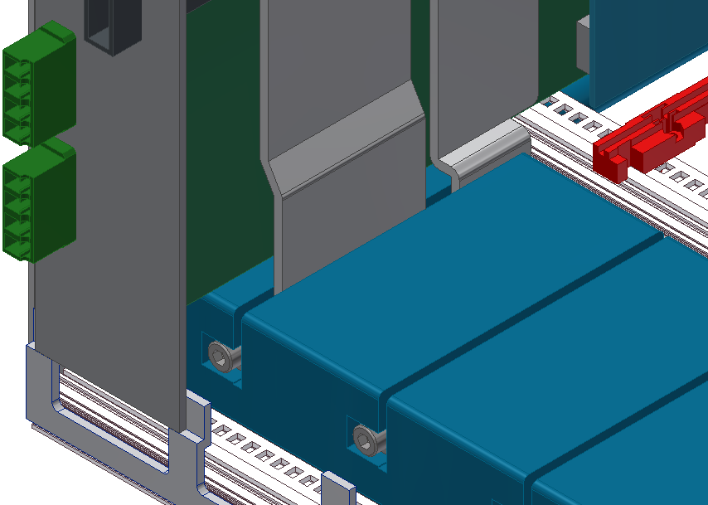
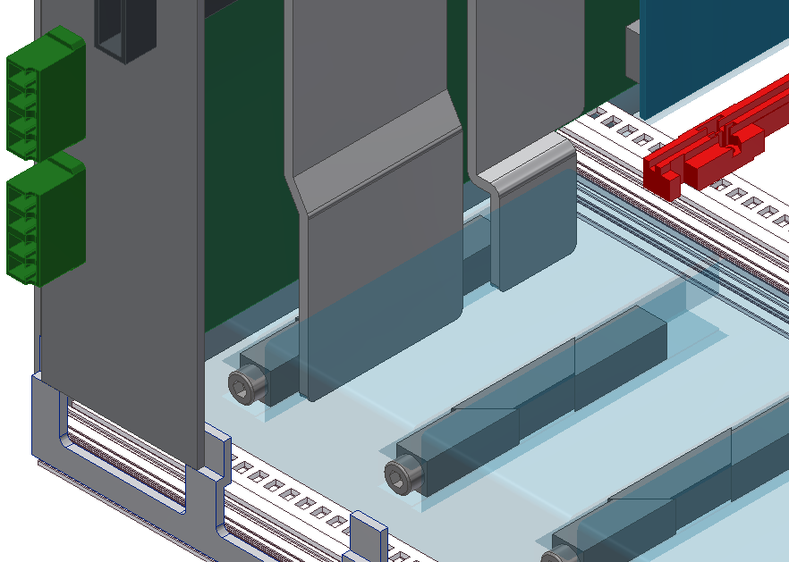
LFAA TPM sub-rack concept metal plate + water cooling
Compression blocks (for the «metal plate» - «cold plate» contact)
Custom cold plates

Slide 20
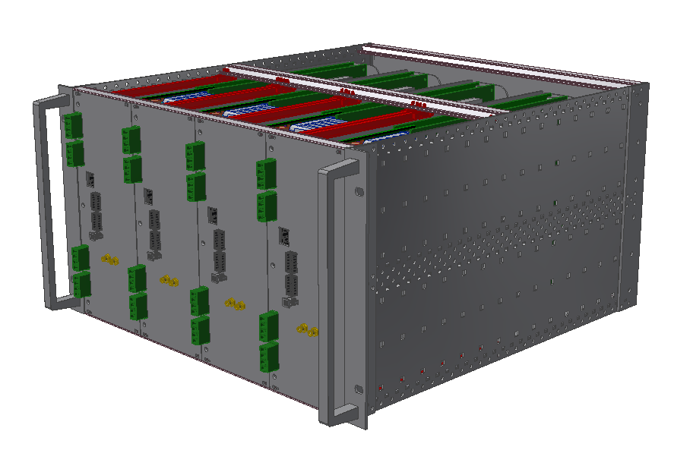
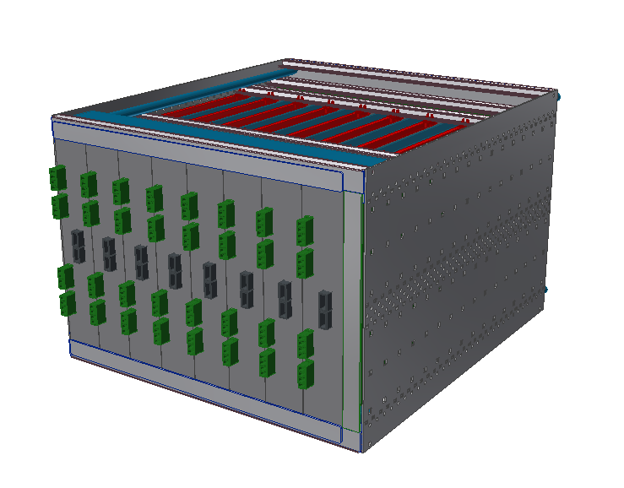
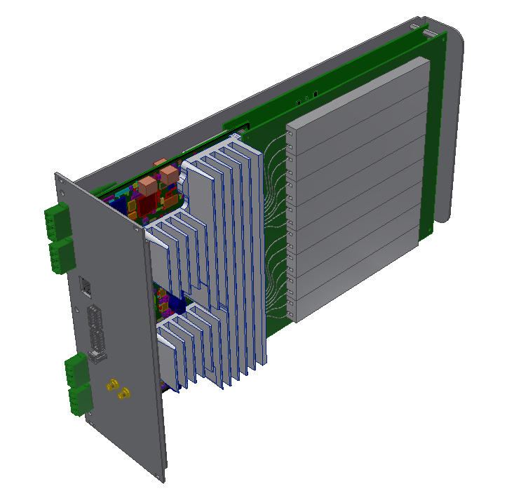
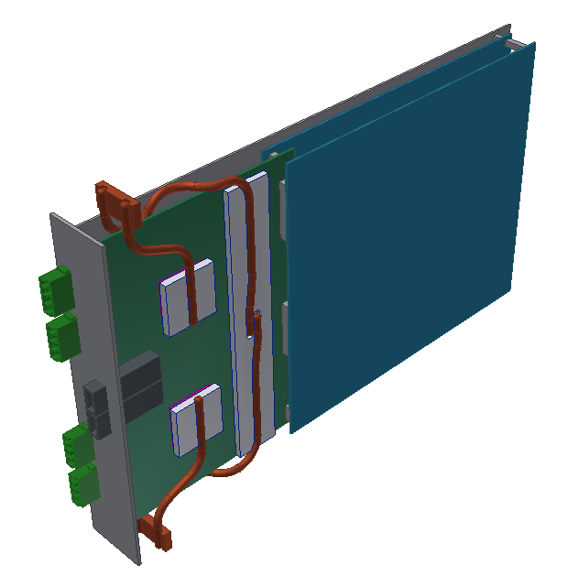
LFAA TPM sub-rack Concept Potential increase in the number of TPM boards
Using the same concept of boards assembly – sandwich mode
AAVS1 TPM module (21 hp)
Example of LFAA TPM module (10 hp)
8 TPM modules + 1 management board
In each Sub-rack
256 RF Chains in each Sub-rack
4 TPM modules in each Sub-racks
128 RF Chains in each Sub-racks

Slide 21
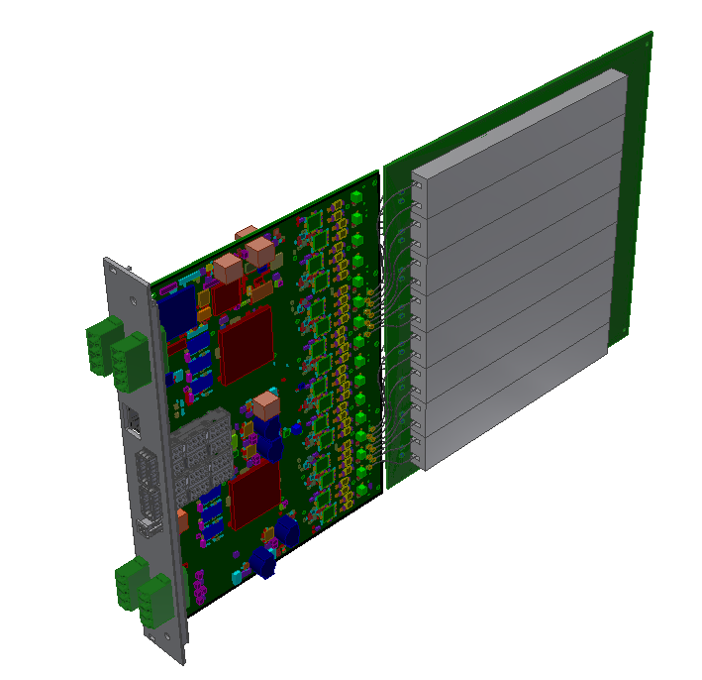
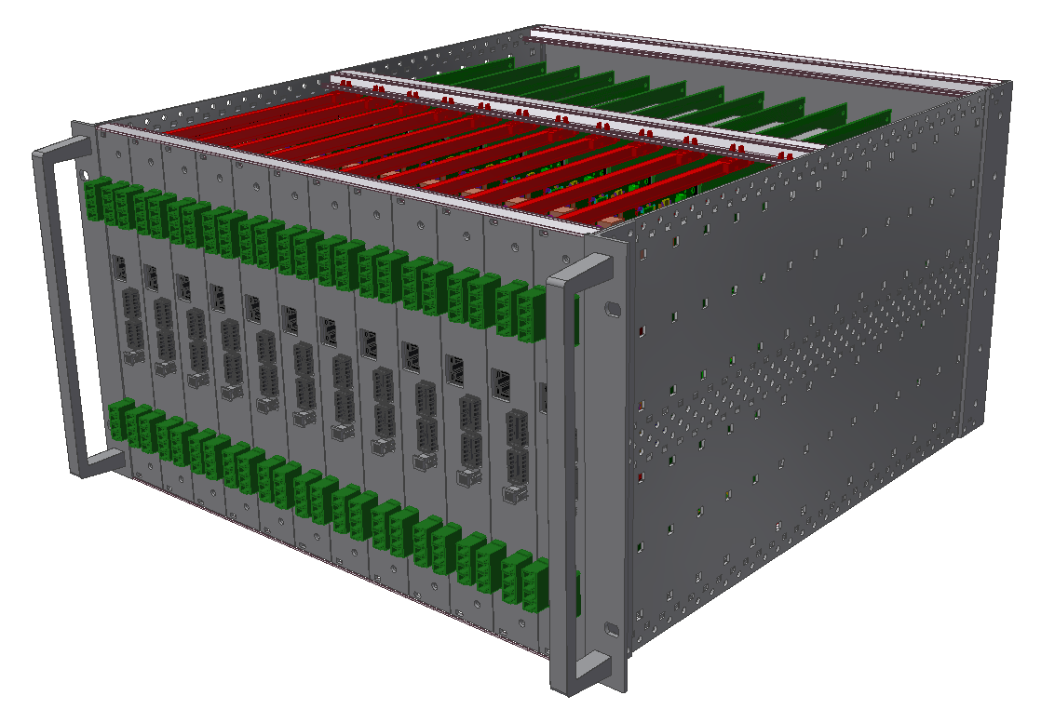
LFAA TPM sub-rack Concept Potential increase in the number of TPM boards
Putting 32 RF chains in a single preADU board
AAVS1 TPM module (21 hp)
Example of LFAA TPM module (7 hp)
4 TPM modules in each Sub-rack
128 RF Chains in each Sub-rack
12 TPM modules (or 11 + 1 management board) in each Sub-rack
384 (352) RF Chains in each Sub-rack

