Slide 1
Murchison Widefield Array
Randall Wayth
ICRAR – Curtin University

Slide 2
MWA: The SKA Low precursor
Notes:
Better way to describe the MWA

Slide 3
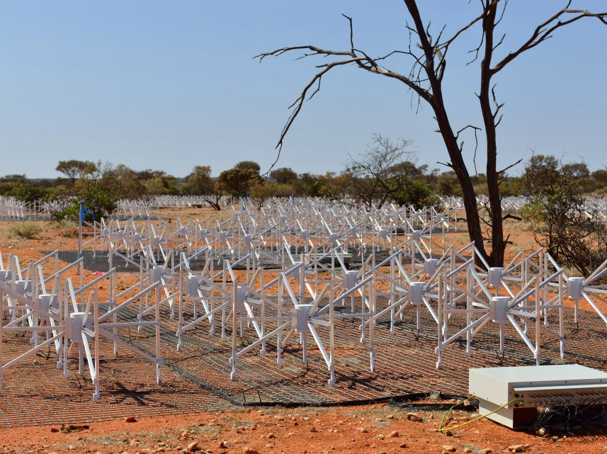
Current MWA: 128 tile system
Antenna tiles: 128
Operating frequency: 70-300 MHz
Array diameter: 3 km
Processed bandwidth: 30.72 MHz / 10 kHz
Field of view: 30 degs @ 150 MHz
Many small antennas -> huge field-of-view and excellent image fidelity
2016-2018: MWA phase 2 upgrade. Doubles number of antennas and array diameter

Slide 4
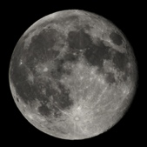
Full moon
20 degs
Offringa et al., 2016.
Notes:
This is the deepest image yet made with the MWA of one of the EoR program’s observation fields . In this image, virtually every dot is an extragalactic radio source at cosmological distance. The field is centred on RA=0, DEC=-27.

Slide 5
MWA -> SKA Low
Key science
Location
Signal processing, calibration & imaging challenge
Hosting and integrating SKA Low prototypes
Training the next generation of radio astronomers
Local Industry
MWA phase 3

Slide 6
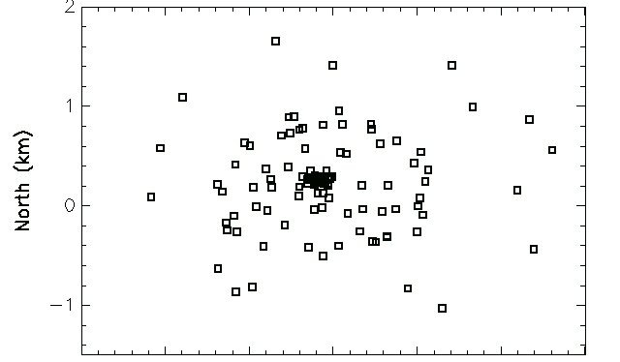
MWA: The SKA-Low precursor
Total tiles: 128
Mid/outer regions
Approx 60% tiles
MWA operating frequency & location same as SKA-Low
Density distribution of antennas (core vs long baseline) very similar
Scale of calibration/imaging problem (determined by station diameter / array diameter) is similar
All MWA knowledge and experience is relevant to SKA-Low
Compact core
Approx 40% tiles
Total super-stations: 94
Mid/outer regions
Approx 55% stations
SKA-Low V4a config
Compact core
Approx 45% stations

Slide 7
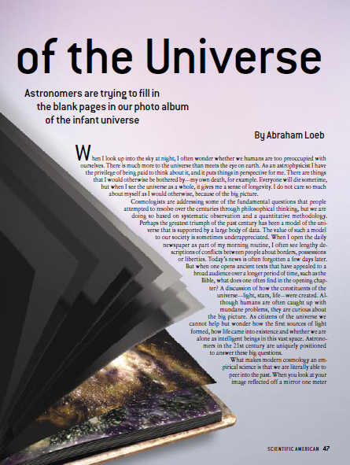
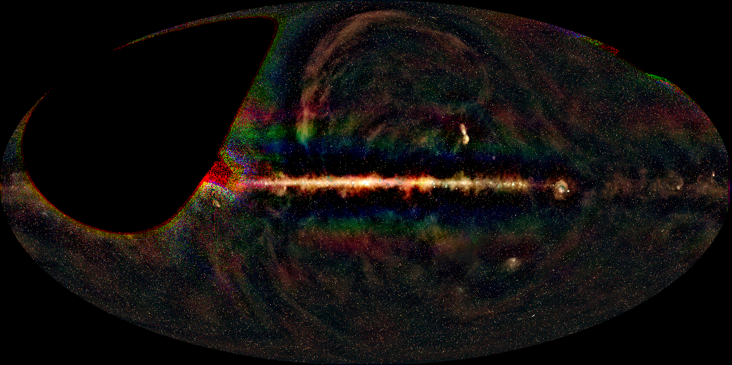
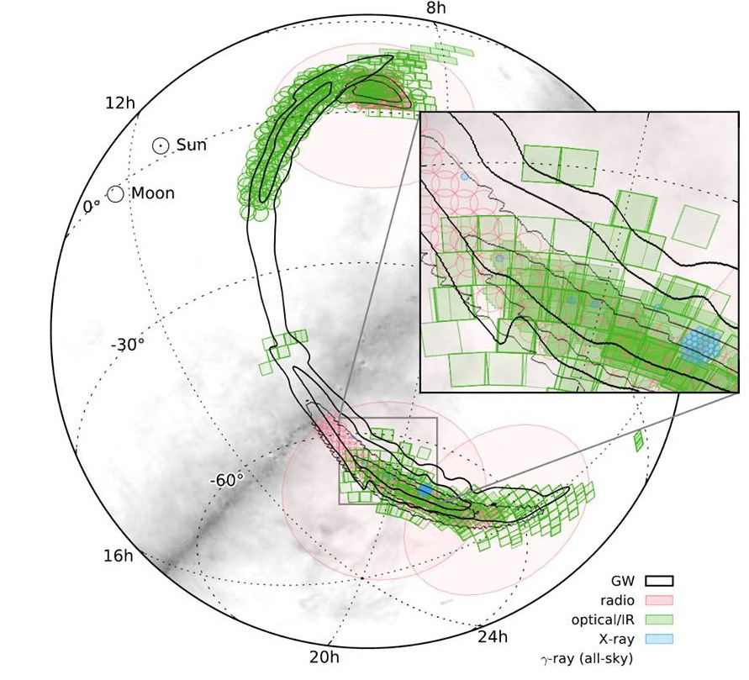
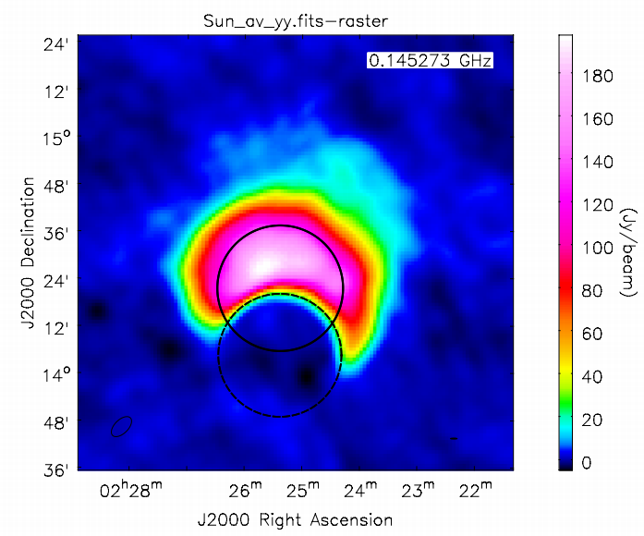
MWA Key science
Bowman et al, 2013.
The Epoch of Reionisation
Galactic & extragalactic astrophysics
Transient & variable universe
Solar & heliospheric science

Slide 8
Key Science – Epoch of Reionisation
Scientific American. November 2006.

Slide 9
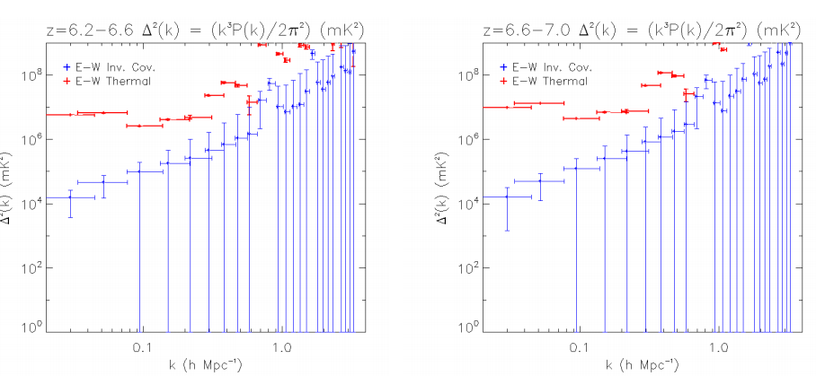
MWA EoR: current status
Trott et al. 2016: CHIPS (one of two pipelines)

Slide 10
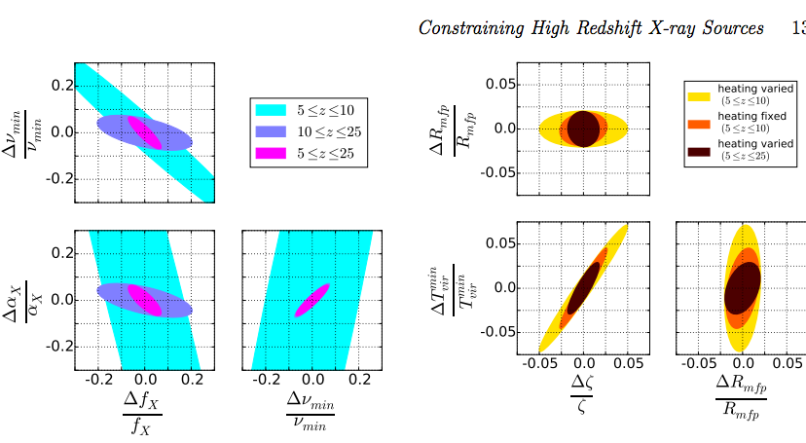
MWA EoR: current status
Trott et al. 2016: CHIPS (one of two pipelines)
Ewall-wice et al 2016: first x-ray heating epoch results from low freq (70-100 MHz) data

Slide 11
MWA EoR: current status
Trott et al. 2016: CHIPS (one of two pipelines)
Ewall-wice et al 2016: first x-ray heating epoch results
Also:
Jacobs et al.: (submitted) (full MWA dual-pipeline overview paper)
Beardsley et al (in prep): 100 night results

Slide 12
MWA EoR: spinoffs
Trott & Wayth 2016: Spectral smoothness
Loi et al. 2015,2016: monitoring the ionosphere, discovery of plasma tubes
Offringa et al. 2015, Franzen 2016: deep images and radio source counts
Tingay et al. 2016, Rowlinson et al. 2016: limits on FRBs in EoR field(s)

Slide 13
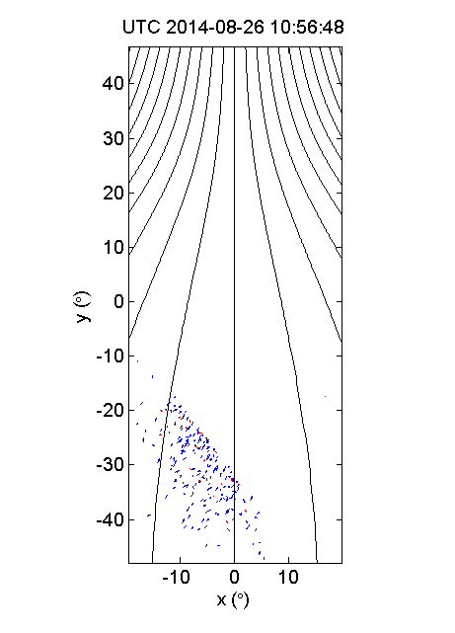
Unexpected discoveries
MWA confirms existence of ionsopheric plasma ducts Loi et al 2015.
The movie shows formation of ducts aligned with B fields (lines) after passage of travelling ionospheric disturbance.
Small vectors indicate direction of local gradients in ionospheric density (blue=left, red=right)
Notes:
This movie shows the formation of ducts in the ionosphere aligned with the Earth’s magnetic field after the passage of a travelling ionospheric disturbance (TID). The small vectors show the offset of the apparent position of extragalactic radio sources compared to their known position. The small offset is due to density gradients in the ionosphere. Because the MWA has such a huge field of view and can see thousands of radio sources in a 2 minute snapshot, it is able to directly measure the local density gradients in the ionosphere via the measured shifts of sources. The TID passes through around 16:00 hours, then the tubes follow. Prior to that only small random offsets are seen.

Slide 14
MWA EoR: spinoffs
Courtesy Chris Jordan (Curtin)

Slide 15
MWA: A sky monitoring machine
Bulk of GW error region covered in 3 MWA pointings
MWA was the first radio telescope to follow-up the GW event
Sky coverage of MWA dwarfs others
Frequently re-visiting sky: detailed time domain data
Serendipitous observations of ANTARES neutrino events (Croft et al 2016)
Follow-up fields for the first GW event http://arxiv.org/abs/1602.08492

Slide 16
GLEAM – a legacy dataset of the MWA
Wayth et al. 2015, PASA
300,000+ sources
72-230 MHz, 19 freq sub-bands
δ<+25, |b| > 10
Extragalactic catalogue: mid 2016 Hurley-Walker et al. 2016, in prep
Image: Natasha Hurley-Walker

Slide 17
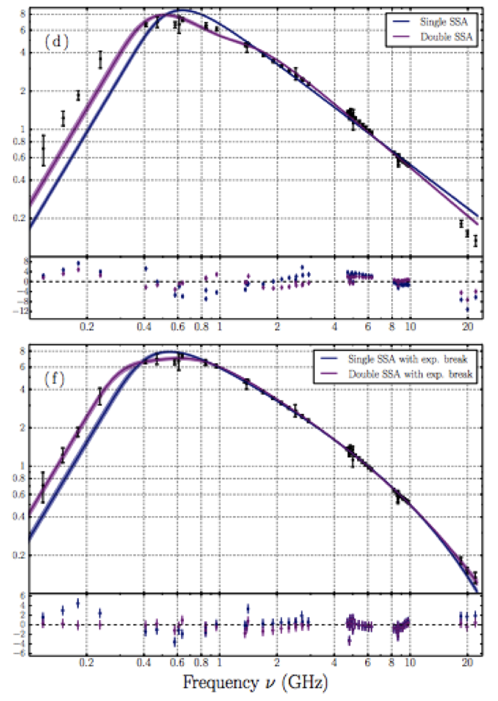
THE EXTREME GIGAHERTZ-PEAKED SPECTRUM
RADIO SOURCE PKS B0008-421: Callingham et al. 2015 ApJ 809 168C
Halo and relic radio emission from
Abell 3376: George et al. 2015

Slide 18
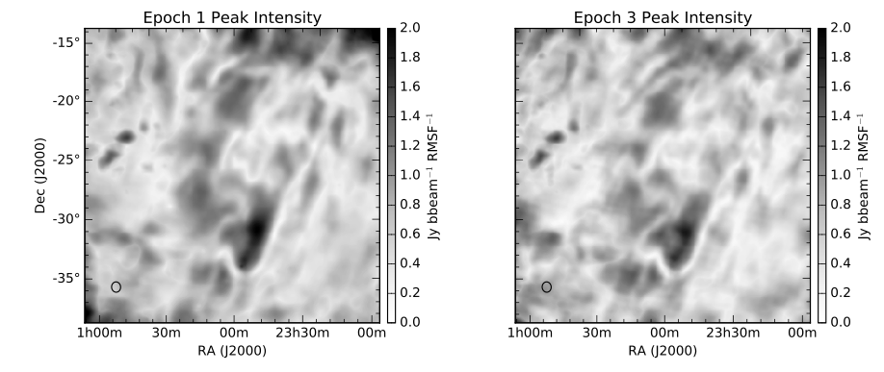
GLEAM: Polarised diffuse emission
From Lenc et al 2016 (in prep)

Slide 19
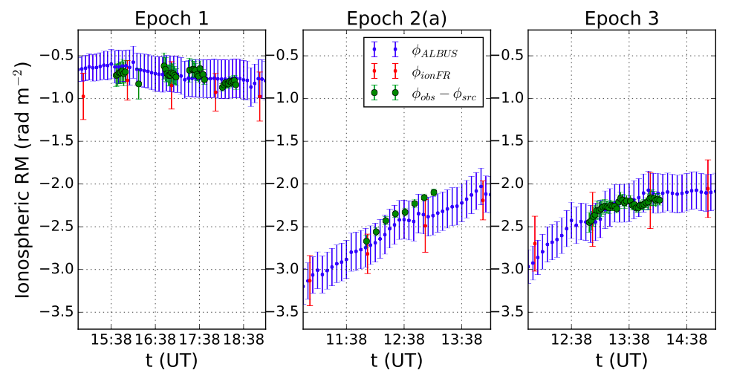
GLEAM: Polarised diffuse emission
From Lenc et al 2016 (in prep)

Slide 20
Past, present, future
Phase 1: 2013-2016
128 antennas, 2.5 km max baseline
Phase 2: 2016-2018
Expand with additional 128 antennas, comprised of
72 closely spaced in 2x hexagonal grids approx 100m size
56 new long baseline antennas to double max baseline to 5km
Only 128 antennas used at any time: reconfigure for
‘EoR array’ (existing core tiles plus new hexes)
‘Long baseline array’ (existing non-core tiles + new long baseline tiles)
Same correlator, receivers: reconfigure by manual re-plugging of tiles into receivers
Phase 3: 2018+(?)
All 256 tiles correlated
Increased frequency range and instantaneous bandwidth, resolution
Requires replacement of post-beamformer analogue and digital hardware

Slide 21
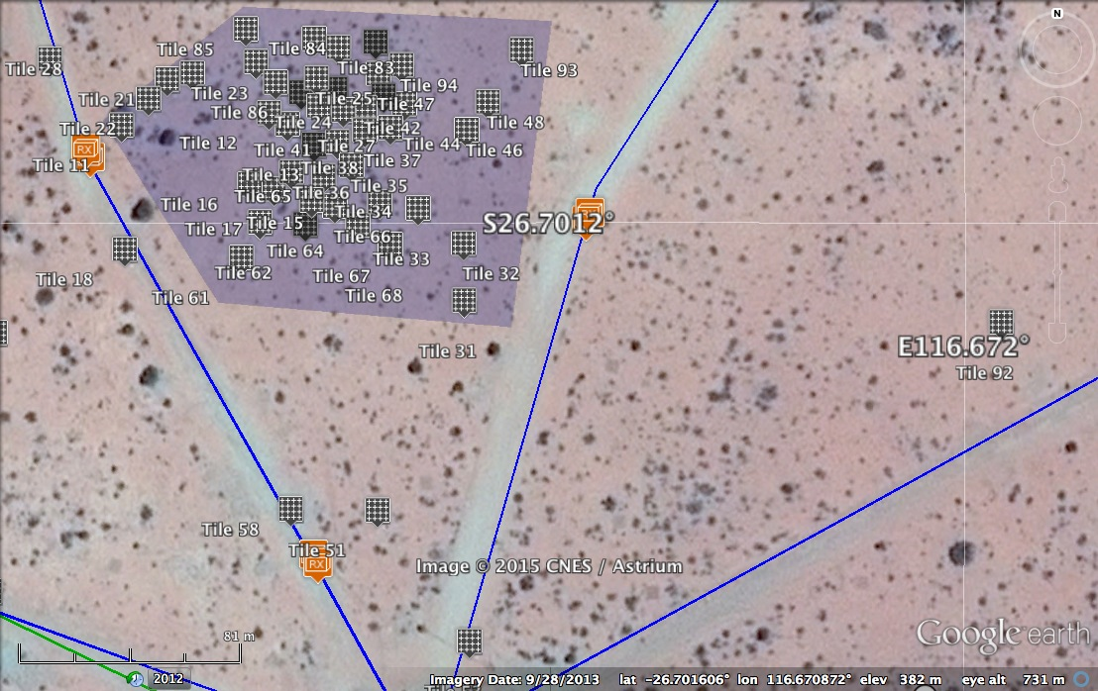
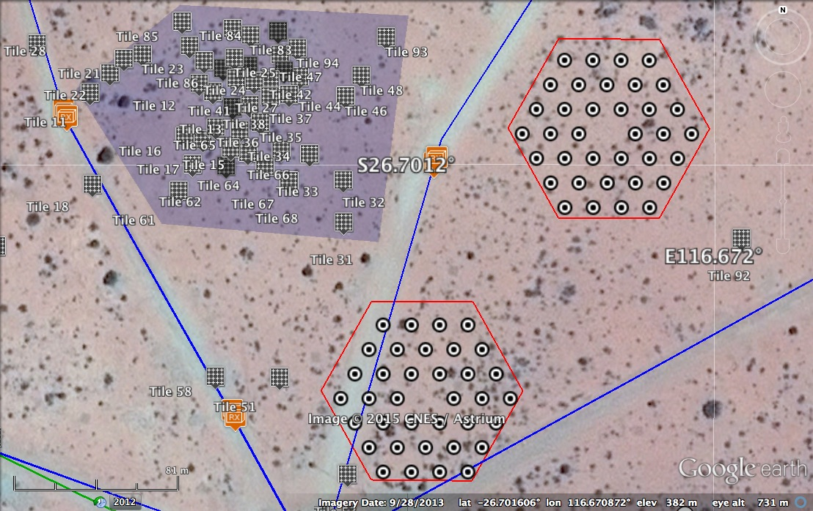
MWA phase 2: core region

Slide 22
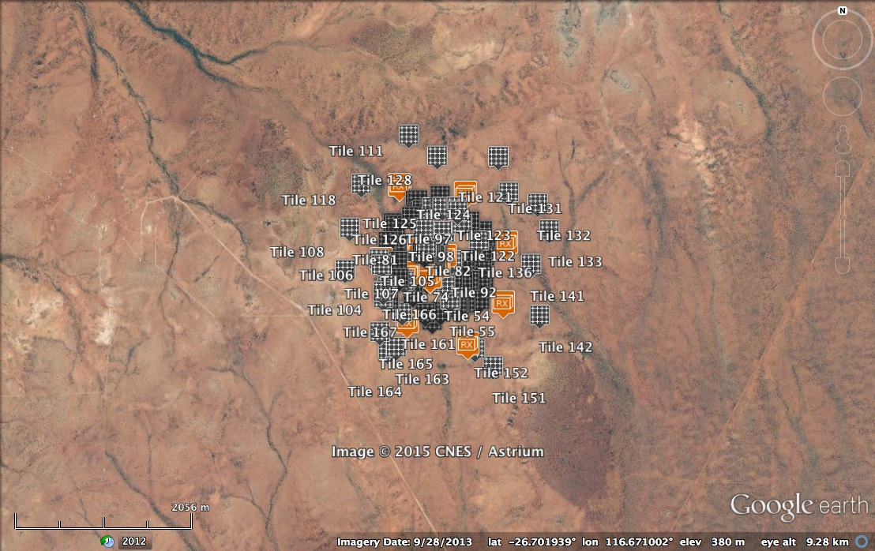
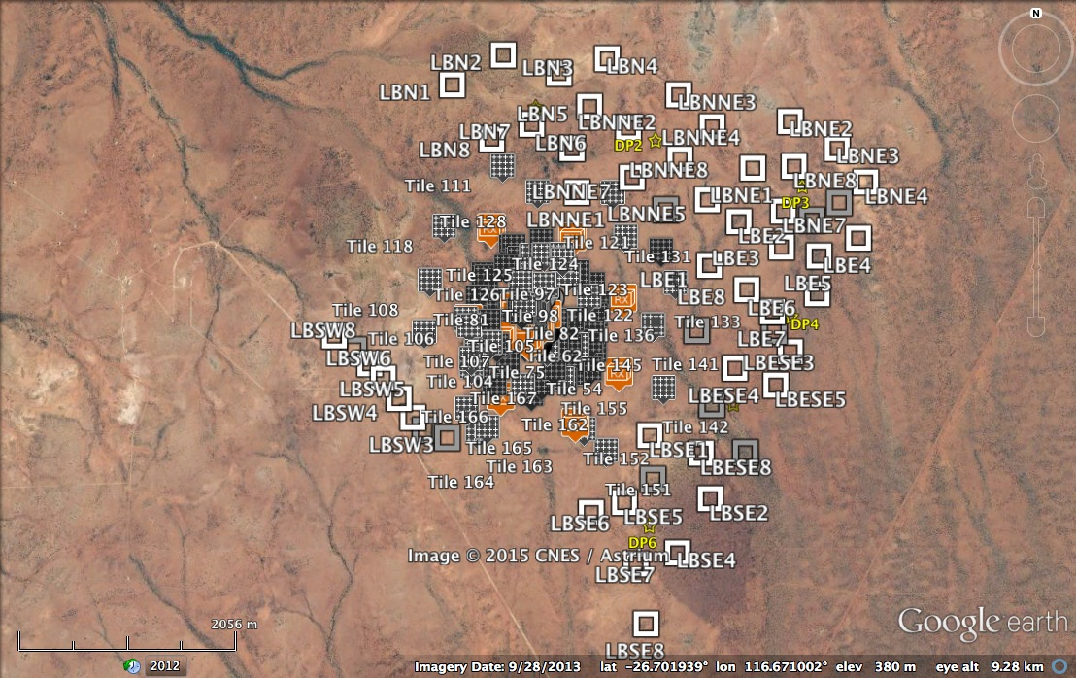
MWA phase2 – long baselines
128 new tiles
72 in two compact hexagons in core for an enhanced EoR capability
56 on baselines up to 5 km, enhanced survey & imaging capability

Slide 23
MWA phase 3
Vision
All 256 tiles correlated simultaneously
Increased instantaneous bandwidth to ~100 MHz
Coarse channel aliasing fixed
Improved dynamic range
More flexible correlation options:
Spectral resolution, time averaging etc
Requires:
Replacement of existing digital hardware: receivers, PFBs, correlator

Slide 24
MWA Phase 3
Phase 2: 2016-2018 Phase 3: 2018 +
MWA phase 3 is only a factor of 2 in stations and a factor of 3 in bandwidth from SKA Low

Slide 25
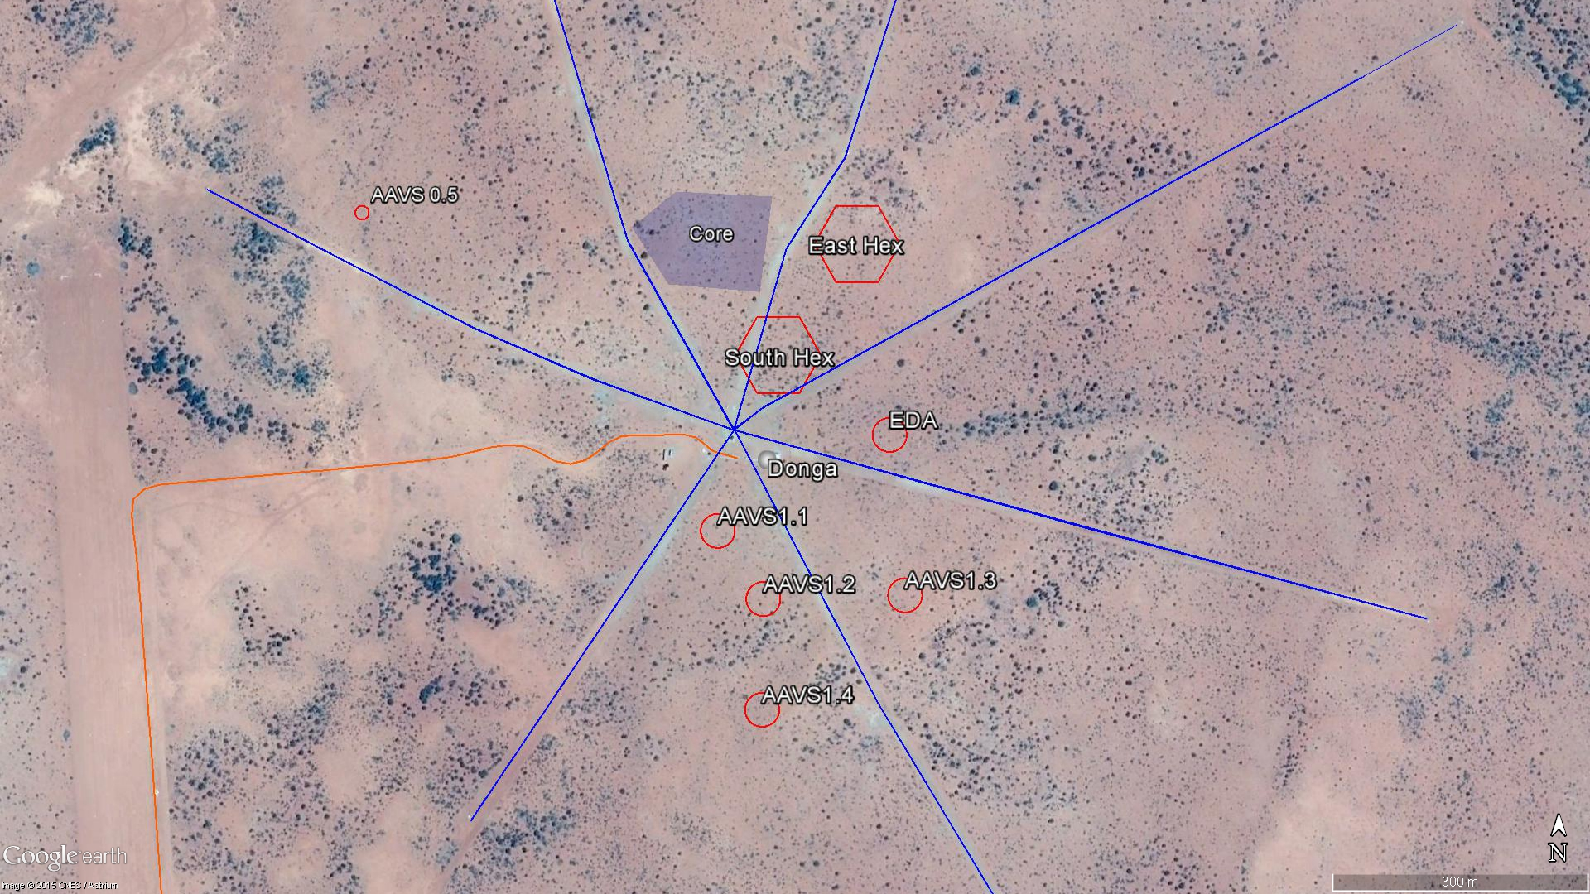
What else does MWA support?
Existing MWA core
New hexes
ICRAR Engineering Development Array (EDA)
Aperture Array Verification System 1 stations

Slide 26
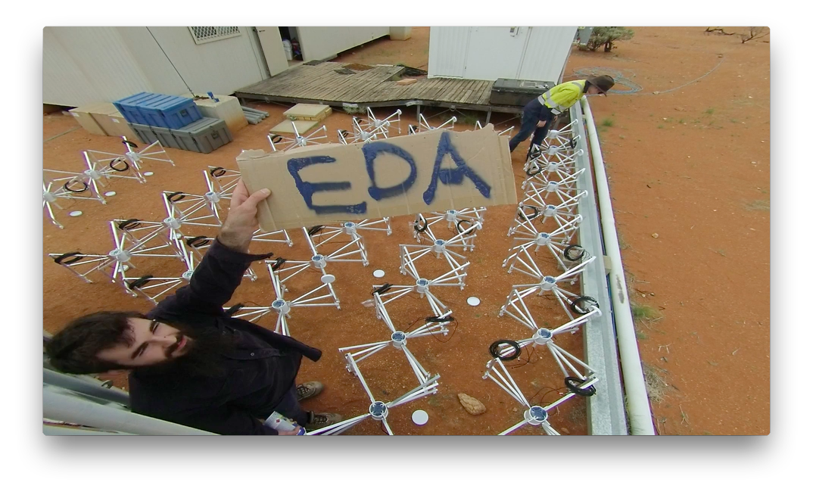
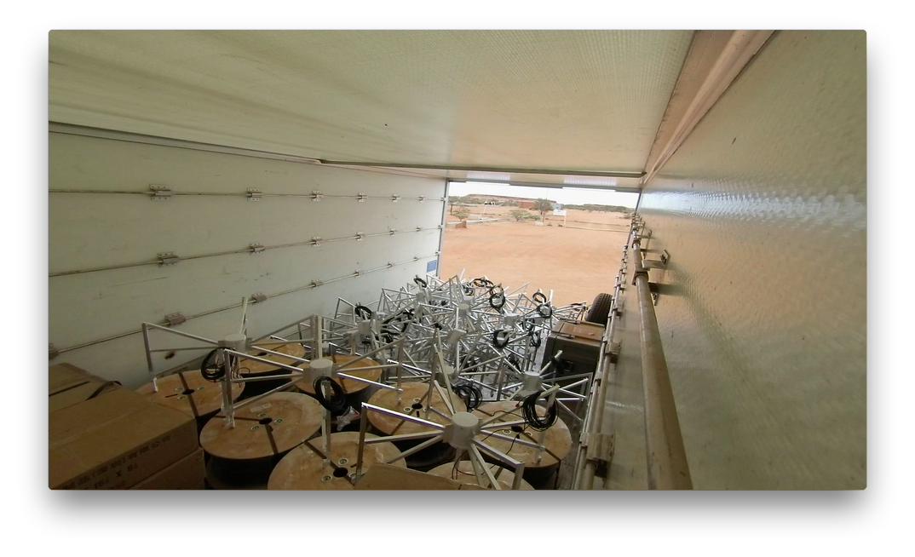
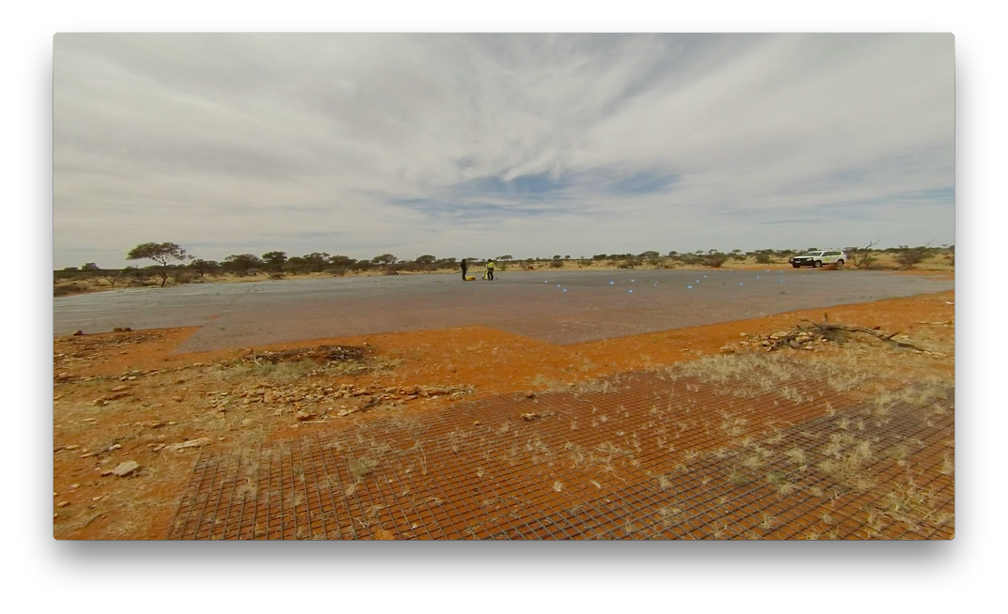
ICRAR Engineering Development Array (EDA)
SKA-low sized station of MWA dipoles
Prototype and test MWA and SKA equipment
Integration of external instrument with MWA
Risk mitigation for SKA-Low

Slide 27
Thanks!

Slide 28
Beamformer interface (BFIF) units
Long baselines supported by RF-over-fibre (RFoF) links from remote tiles to MWA hub region.
Tile
Power, RF, comms on coax (max ~400m)
Receiver
BF
Standard network over fibre
Tile
Network, power
~1m
BF
BFIF
BFIF out
RF over fibre (several kms)
RF on coax
Power

Slide 29
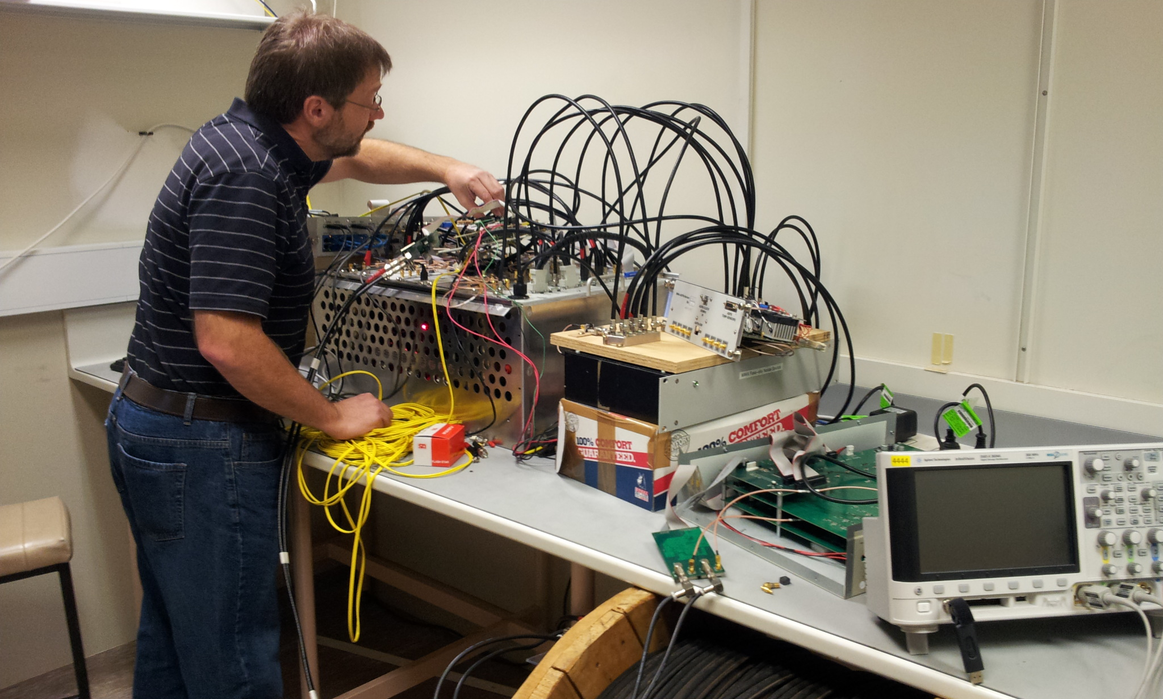
Beamformer interface (BFIF) units
Long baselines supported by RF-over-fibre (RFoF) links from remote tiles to MWA hub region.
Prototype beamformer control unit working in ICRAR/Curtin lab
Lab receiver
BFIF prototype units
beamformer

Slide 30
EDA beamformer controllers
8x DoC units to
beamformers
2x raspberry pis to control beamformers and power
PSU
Output RF

Slide 31
RF-over-fibre units

Slide 32
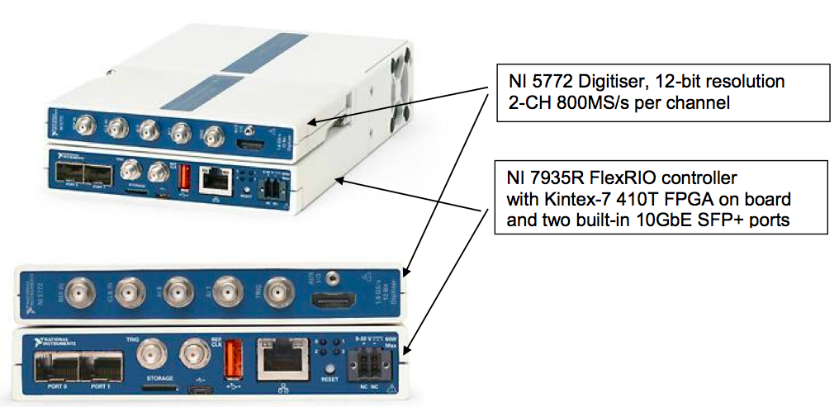
Potential digital receivers
NI FlexRIO sampler/controller
Standard network, clock, RF interfaces
Built-in linux control computer
Extremely capable FPGA (no FPGA programming required!)

Slide 33
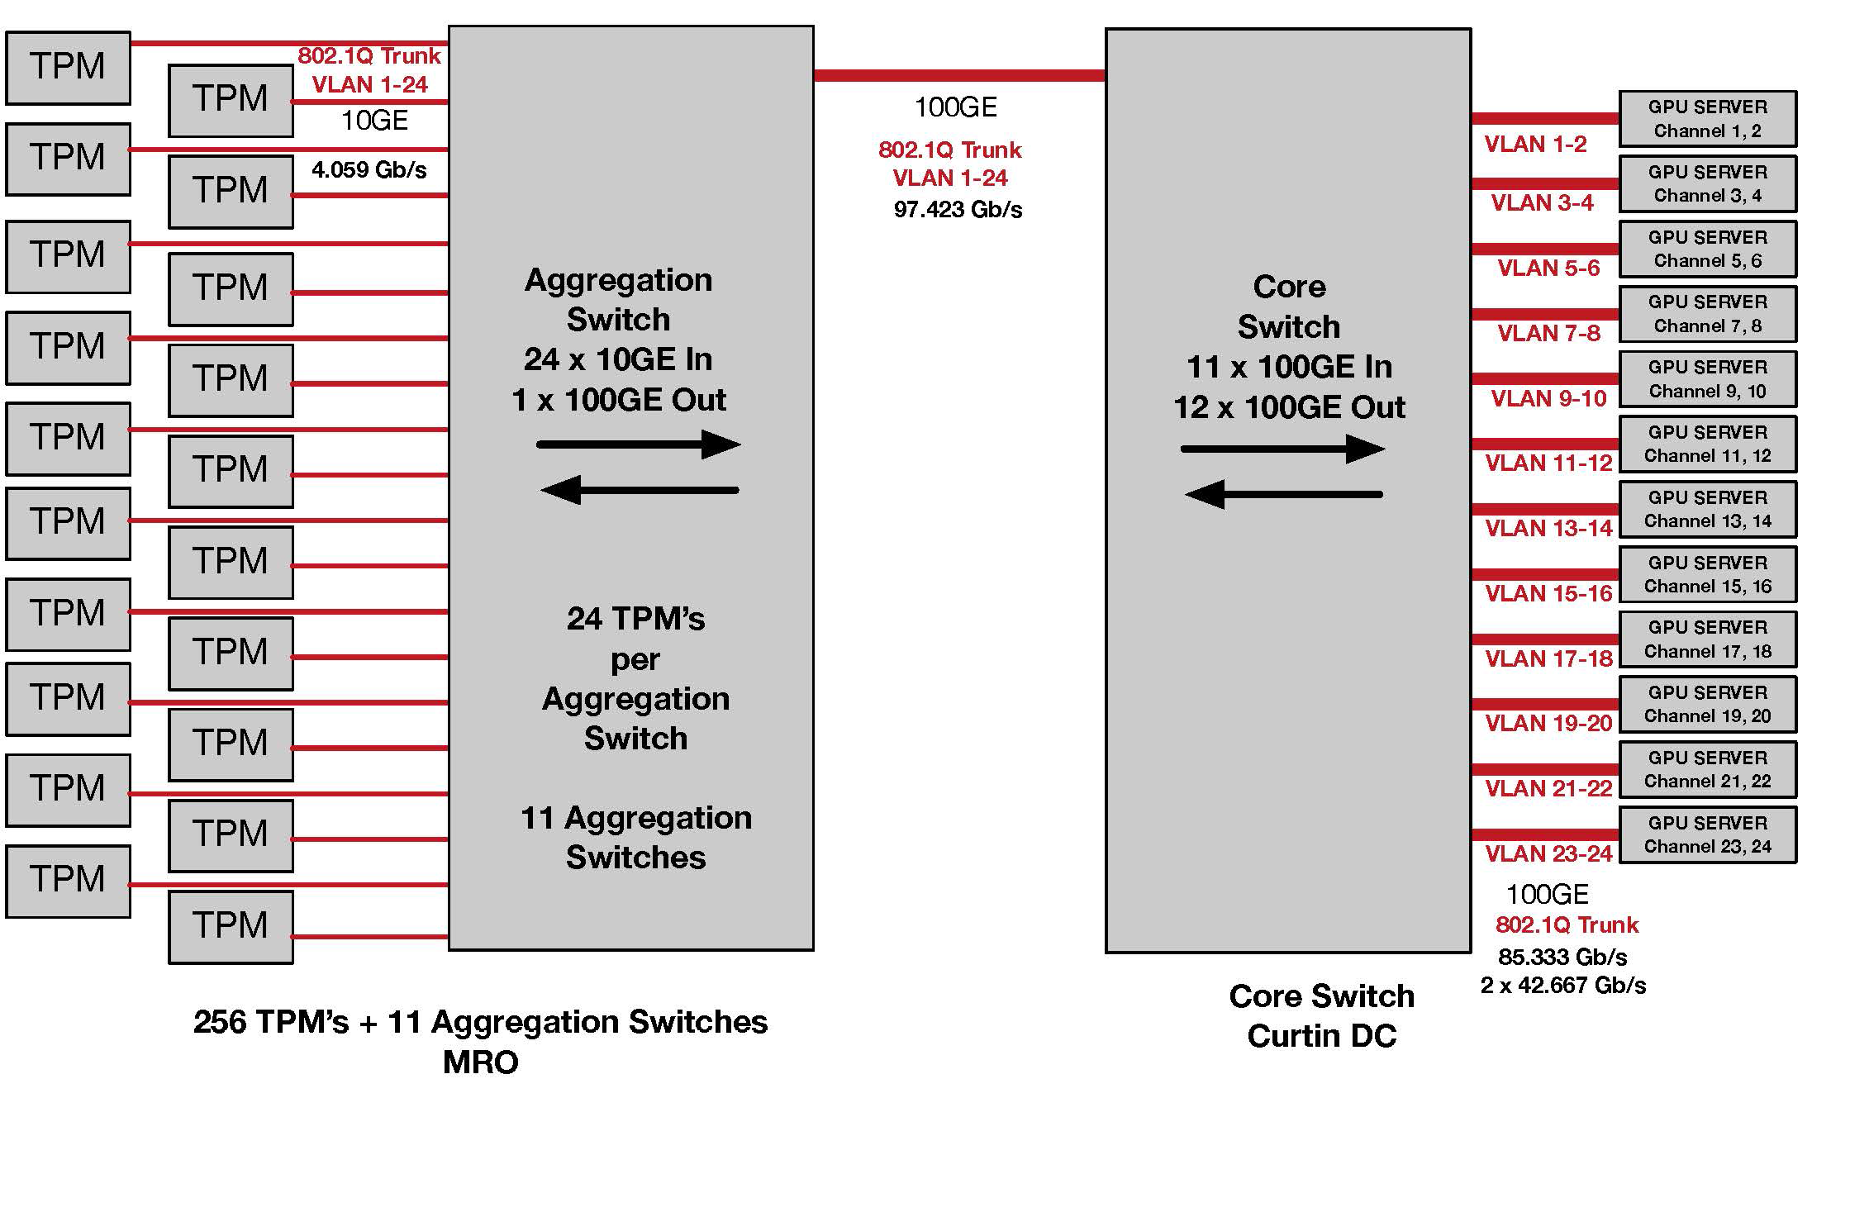
MWA Phase 3 Network Topology
“TPM”=tile

Slide 34
Array performance considerations
Current performance > 250 MHz reduced by cable attenuation
Signal > 300 MHz further attenuated by anti-aliasing filter
RFoF link will preserve higher freq signals
800 MHz sampler means sky signals up to ~350 MHz are available (caveat dipole response)
Coax cable reflections eliminated

Slide 35
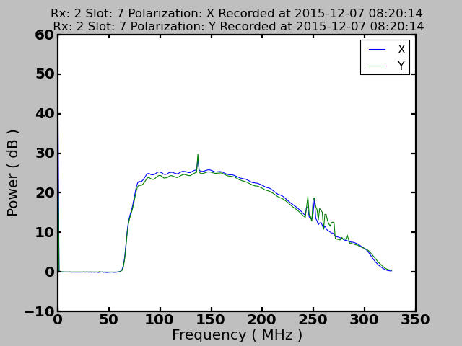
Down to 50 MHz?
Data from standalone MWA dipole with modified LNA. High freqs have been attenuated by lowpass filter. EDA LNAs are modified to 50 MHz.

Slide 36
Potential Pulsar/VCS mode
Pulsar astronomers want a large bandwidth unchannelised baseband voltage stream
NI units offer “digital down conversion” (DDC) mode which selects one or more contiguous (large bandwidth) chunks of frequency as a baseband data stream

Slide 37
4 DDC channels Different central freq, different BW, overlapping freq ranges
680 MB/s output over 10G

Slide 38
Expanded signal processing options
Goals at Curtin are for core radio astronomy functionality: e.g. correlation with fixed spectral resolution
Flexibility of receiver and software correlator offer potential for partner institutions to develop specialised modes, e.g:
Zoom modes
Pulsar binning mode
Sub-arrays, etc…
Hardware and development environment is off-the-shelf. LabVIEW environment very popular in industry.

Slide 39
Phase 3 correlator: Number of server boxes
Numbers for 100 MHz bandwidth
Courtesy Charles Smith - Curtin
24 Channels @ 4.167MHz is the “sweet spot”
Allows 2 Channels @ 42.667 Gb/s to map onto a single 100GE Interface (this is reassuringly similar to the Swinburne UTMOST system)
Each of the 256 TPMs generates @ 0.167 Gb/s for each channel.
8 coarse channels cannot fit onto a single 100GE.
16 or 20 coarse channels require a 100GE per channel
If processing is insufficient the number of coarse channels can be increased with the number of GPU Servers.

Slide 40
Scientific productivity
Professor Frank Briggs,
Dr Randall Wayth,
Professor Steven Tingay,
Professor Rachel Webster,
and Ms Kate Gunn
MWA instrument and scientists were recently recognised in the 2015 Thompson Reuters Citation and Innovation awards
Notes:
MWA’s productivity, in terms of science output in the form of publications, has accelerated significantly through the reporting period, as evidenced by the recognition of eight MWA researchers at the 2015 Thompson Reuters Citation and Innovation awards.
In further recognition of the growing body of work produced by MWA researchers, the journal Publications of the Astronomical Society of Australia (PASA), produced a special library and glossy digest of MWA papers they have published.

